Slide 1
Multiple Ways to Communicate With OpenAI

Slide 2
Multiple ways to Communiate to OpenAI with C#
Direct HTTP Call
Chat Client -> ChatCompletionAPI
ReponseCleint -> ReponseAPI
OpenAIClient -> Parent Client

Slide 3
Direct HTTP Call
Complexity - High
a. Need to manage URL’s
b. Need to create and pass Http parameters carefully.
c. need to take care of reponse JSON in raw format
d. Better for Internal working knowledge.
e. No need to worry about SDK versions.
e . Full control on
Headers
Timeout
CancellationRetries

Slide 4
Chat Completions
specifically communicates with Chat Completions API
Classes ->
ChatClient for Client
ChatCompletion for reponse
Open AI URL -> Chat | OpenAI API Reference
Simple Chat Bot Text based
Code
ChatClient client = new(
model: "gpt-4o-mini",
apiKey: apiKey);
4. Reponse
ChatCompletion completion =
await client.CompleteChatAsync(messages);

Slide 5
ResponsesClient
Specifically communicates with Responses API
Classes ->
ResponsesClient for Client
ResponseResult for reponse
Open AI URL -> Chat | OpenAI API Reference
Code
ResponsesClient client = new( apiKey: apiKey);
Response
string result = response.GetOutputText();

Slide 6
OpenAIClient
Entry point/factory for OpenAI services
Classes ->
OpenAIClient for Client
ResponseResult for reponse
Open AI URL -> Responses Overview | OpenAI API Reference
Use OpenAIClient when application need all these object then we can use this as DI and can use in entire applicaiton
Benefits - We can access multiple objects like AudioClient and GetEmbeddings client
client.GetChatClient(...)
client.GetResponsesClient(...)
client.GetAudioClient(...)
client.GetEmbeddingClient(...)

Slide 7
OpenAIClient
Entry point/factory for OpenAI services
OpenAIClient
Images
Embeddings
Audio
Responses
Vector DB
LLM Calls
Image Analysis
AudioBot

Slide 8
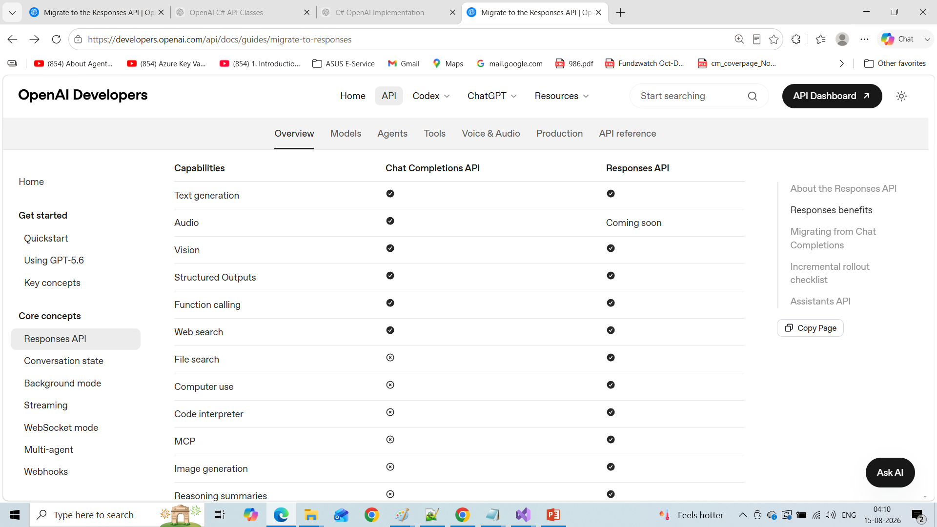
Migration ChatCompletation to ReponseAPI
Migrate to the Responses API | OpenAI API

Slide 9
ChatMessage Class
ChatMessage is an OpenAI SDK class that represents one message in a chat conversation
System → You are a helpful assistant.
User → What is C#?
Assistant → C# is a programming language...
User → What is LINQ?
Assistant → LINQ is...
System – we pass to LLM for Role – Who you are
User- Question
Assiatance -> LLM response.

Slide 10
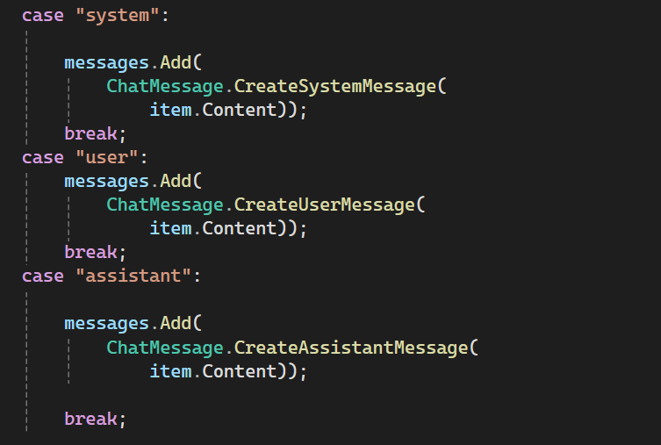
ChatMessage Class
var messages = new List<ChatMessage>();

Slide 11
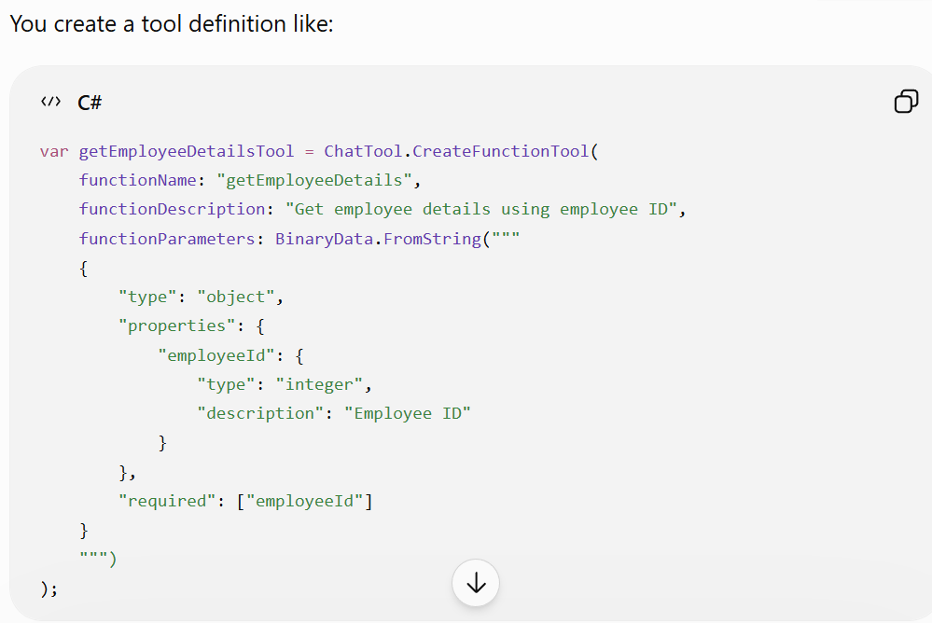
Chat Tool
WHAT tools the AI is allowed to use
ChatTool represents a tool/function
that you expose to the model.

Slide 12
Chat Tool
ChatTool
│
├── Function Name
│ getEmployeeDetails
│
├── Description
│ Get employee details using employee ID
│
└── Parameters Schema
employeeId
integer
required

Slide 13
ChatCompletionOptions
ChatCompletionOptions contains the settings for the chat completion request.
ChatCompletionOptions
│
├── Temperature
├── Tools
├── Max output settings
├── Tool choice
├── Other request options
│
└── ...
var options = new
ChatCompletionOptions { Temperature = 0.2f };

