Slide 1
Generative AI
AI Agents

Slide 2
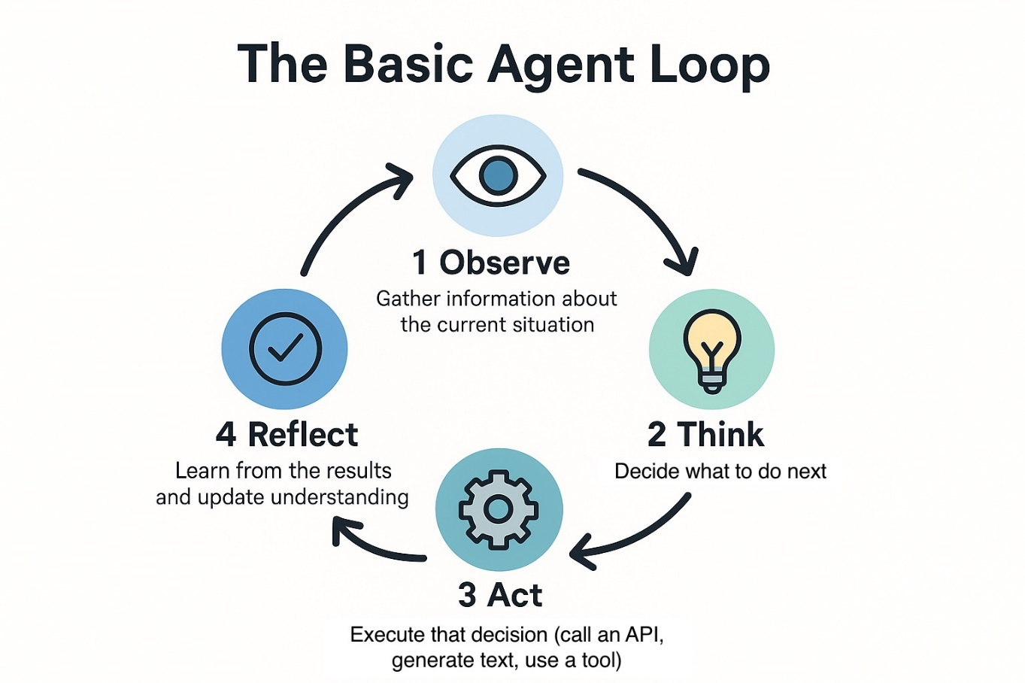
Agent Loop
When LLM need complex task and it need multiple steps to finish then it keep calling LLM until it get final result.

Slide 3
Example Scenarios
Please apply leave for me from april 4 to april 11.
Here below will be tasks
Task 1 -> Getleavebalance
Task 2 -> Check Rule if balance > number of days required
Task 3-> Apply Leave
Task 4 -> Send Email
Task 4 dependent of Task 3,Task 2 and Task 1
Task 3 Dependent on task 1
1. Here Agent will First Go to DB and Take LeaveBalance
2. Code will check Sufficient leave
3. Result of Task 1 Send to LLM and Then Task 3 will Execute
4. Result of Task 1 and Task 3 send to LLM and then Task 4 will execute.

Slide 4
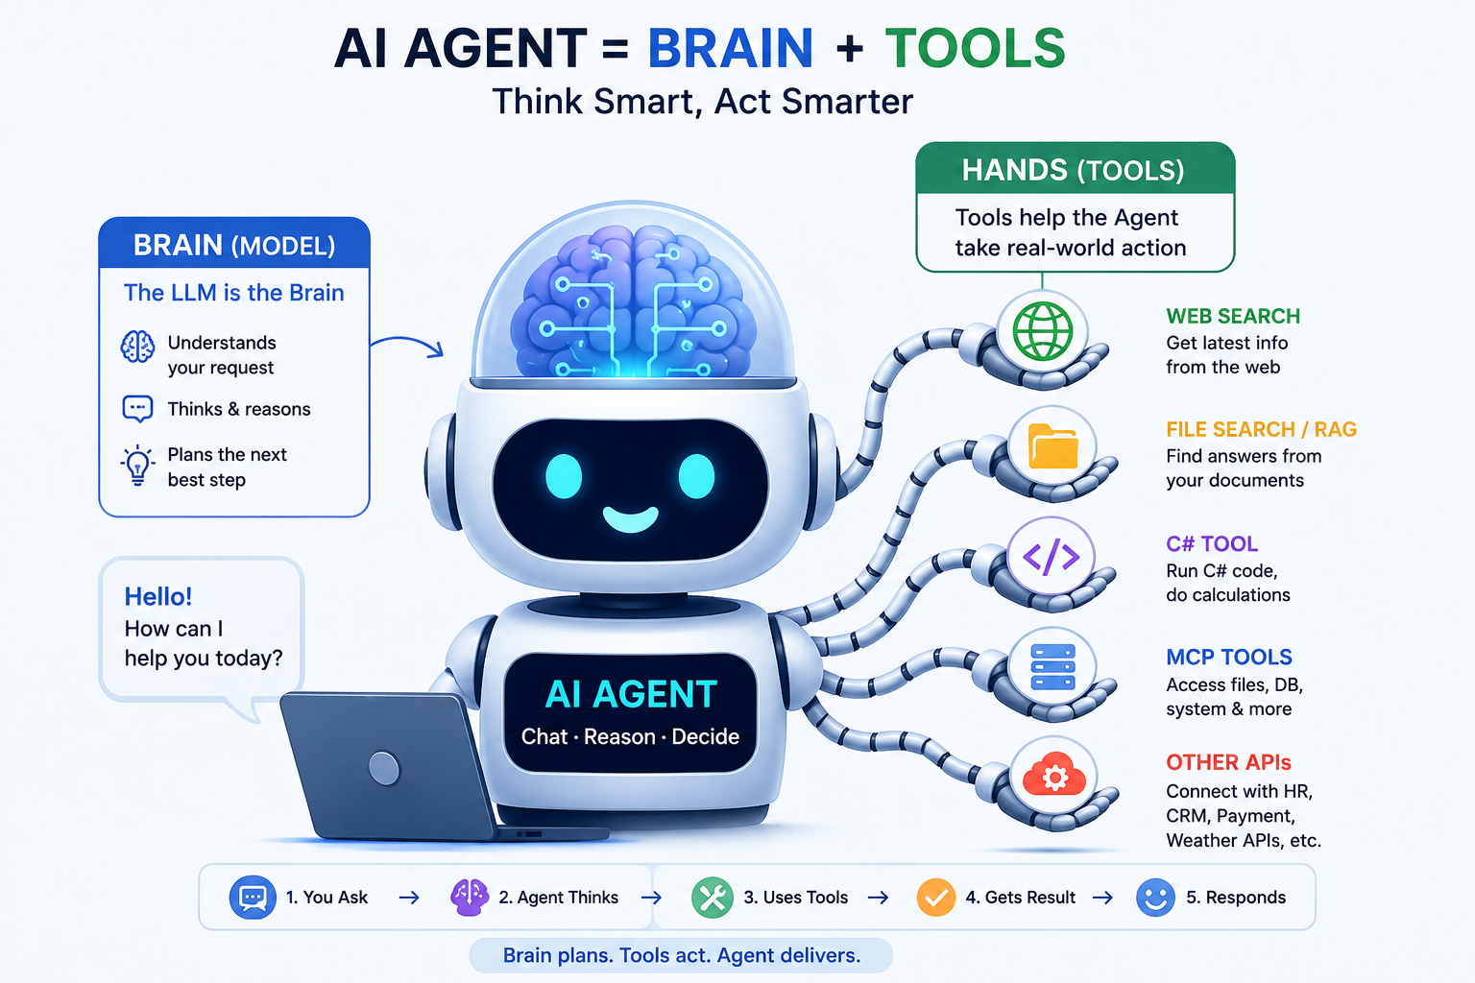
Agent -> Digital Human

Slide 5
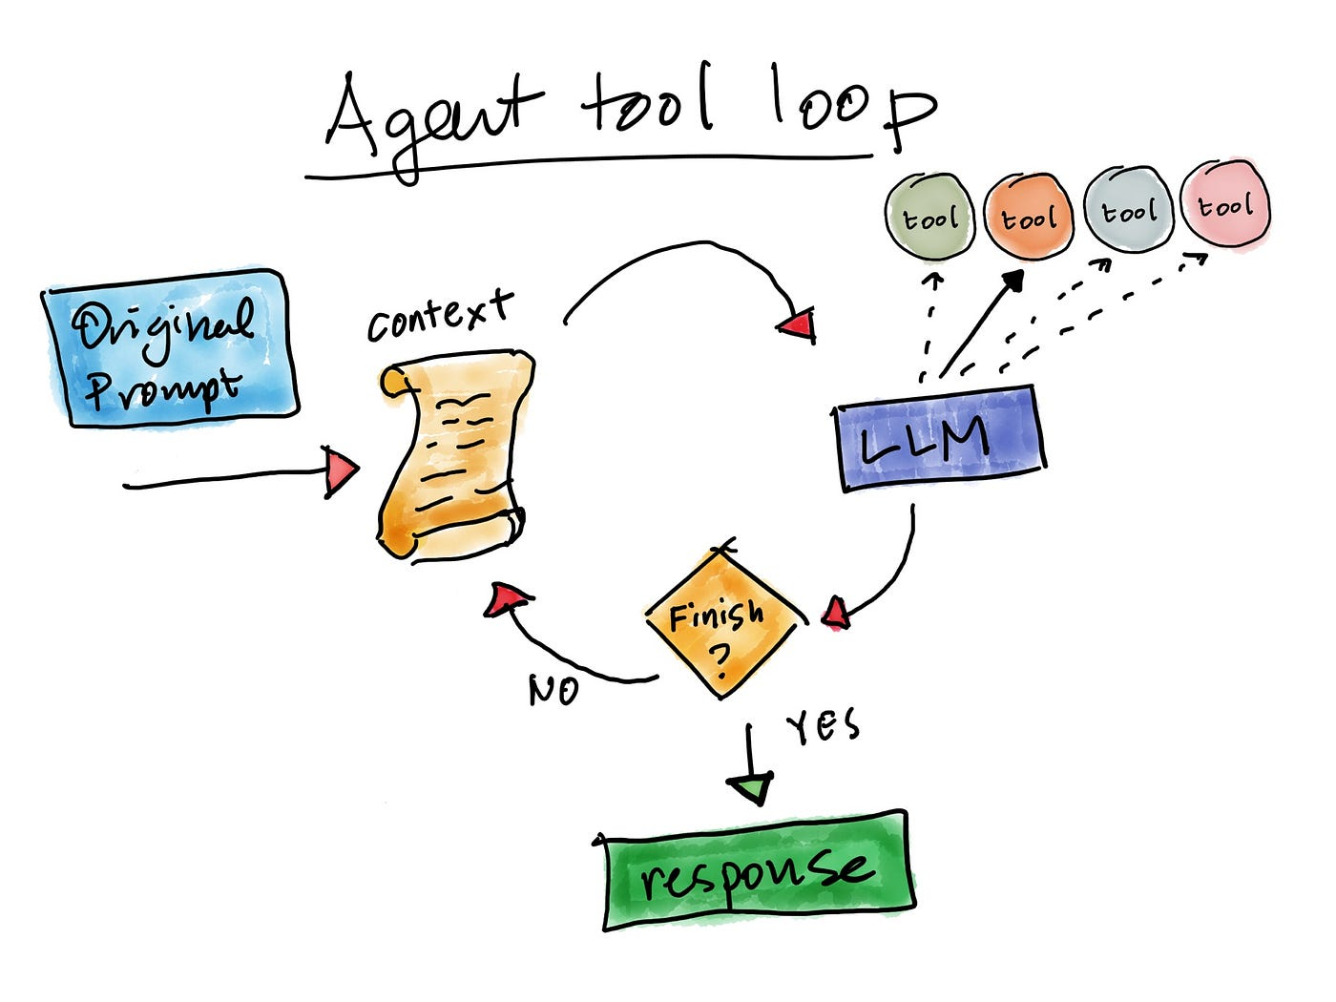
Agent Tool Loop

Slide 6
Agent Loop
Example->
Leave balance for employee 2344 and email to devesh.omar@gmail.com
Task 1 -> Get Leave Balance
Task 2 -> Send Email
Here in this case LLM will see that email need to send or need data from first or before steps.
First LLM Call -> get_leave_balance(2344)
Second LLM call-> send_email (devesh.omar@gmail.com)

Slide 7
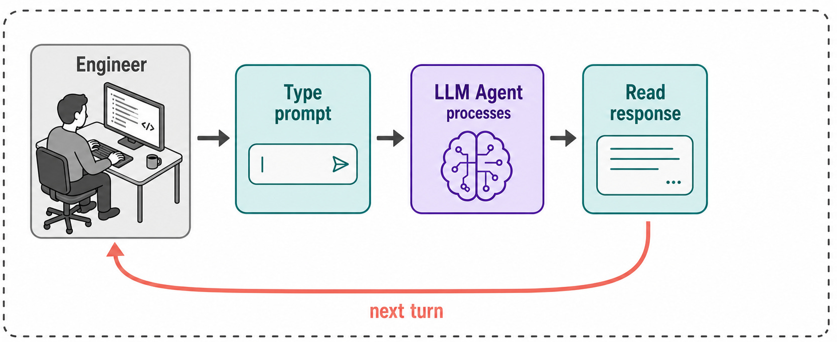
Agent Loop
While true
Response = CallLLM()
If response.tool >0
Execute tool
Add Tool result
Continue
If response.tool==0
No further processing need
exit

Slide 8
How LLM Decide need to call Again.
ChatCompletion completion =
_chatClient.CompleteChat(messages, options);
messages.Add(new AssistantChatMessage(completion));
if (completion.FinishReason != ChatFinishReason.ToolCalls)
{
return completion.Content[0].Text;
}
completion.FinishReason != ChatFinishReason.ToolCalls (need Second LLM CALL)
completion.FinishReason ==STOP -Means no second call needed

