Slide 1
Generative AI
AI Agents

Slide 2
Testing Agent Tools
We need to ensure what ever tool returns by LLM is correct and valid as per user request.

Slide 3
LLM As Judge
We can use LLM As Judge
Here we can pass results from LLM to another LLM and ask for validation.
Example
LLM 1 Call - GPT
User Query: You are EMP assistance please return right tool present.
Can you give me leave balance
Below are tools , getempleave, getsalary,gettax etc
LLM : getempLeave
LLM 2 Call -Claude
You tool validator please validate tool received
User Query : Can you give me leave balance
Tool return : getempLeave
Avialable Tools : getempleave, getsalary,gettax etc
Return data in JSON { result: Pass/fail , Confidence: .9}

Slide 4
LLM as Judge
User query + Tools (Can you tell me leave balance)
LLM 1 - OpenAI
LLM 1 Result
Response: getsalary
LLM 2
Claude
Validate Confidence
Score .7 to .99 – Good
Score .4 to .69 Average

Slide 5
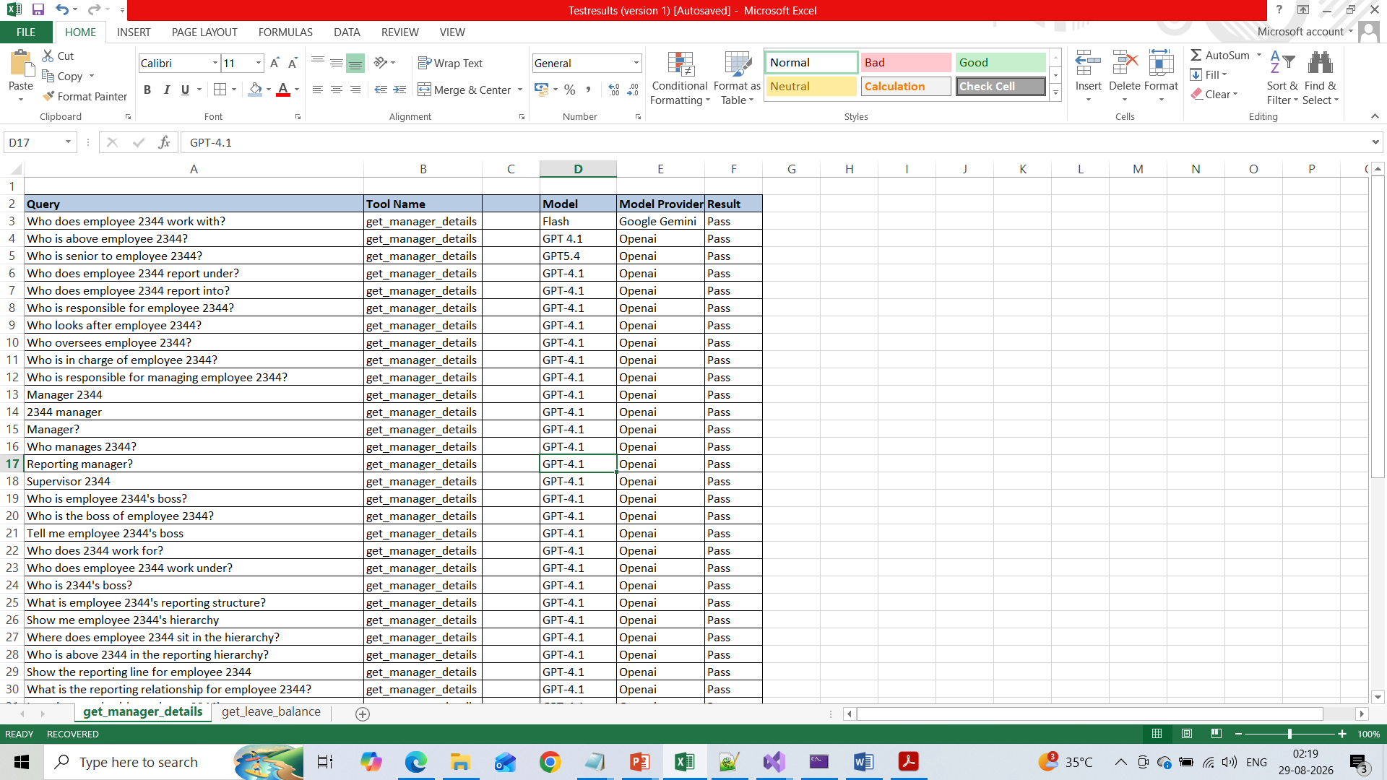
Test cases
Create test cases and add excepted result
Execute each test case or user query and pass to LLM and check if it is matching .

Slide 6
Log Analysis - PROD
We need to keep logging each result of LLM
We need to Log user query, Tool result, Tool Parameters etc
Send All Logs to LLM for further analysis.

