Slide 1
Generative AI
AI Agents

Slide 2
Agent Framework
YOUR CUSTOM CODE without framework
│
┌─────────────┼─────────────┐
▼ ▼ ▼
Prompt Mgmt Tool Calling Agent Loop
│ │ │
▼ ▼ ▼
Memory Validation Logging
│ │ │
└─────────────┼─────────────┘
▼
LLM
“We need an AI framework because building an enterprise AI application is much more than calling an LLM—it requires orchestration, tools, data, memory, security, validation and agent workflows
Without agent framework
Manage Tool calling manually
Manage business logic manually
Need to handle json from LLM manually
Difficult to switch between providers beucase each LLM have different sdk.

Slide 3
With Agent framework
YOUR .NET APP
│
▼
┌─────────────────┐
│ Semantic Kernel │
└────────┬────────┘
│
┌────────────┼────────────┐
▼ ▼ ▼
LLM Plugins RAG
│ │ │
▼ ▼ ▼
Reasoning Tools Data
YOUR .NET APPLICATION
│
▼
┌─────────────────────┐
│ AI FRAMEWORK │
│ Semantic Kernel │
└──────────┬──────────┘
│
┌──────────────────┼──────────────────┐
▼ ▼ ▼
OpenAI Azure OpenAI Gemini
│ │ │
└──────────────────┼──────────────────┘
▼
LLM / AI

Slide 4
Agent Framework - Semantic Kernel
“We need an AI framework because building an enterprise AI application is much more than calling an LLM—it requires orchestration, tools, data, memory, security, validation and agent workflows
Semantic Kernel (SK) is an open-source, lightweight SDK developed by Microsoft that acts as a powerful orchestration layer to build, deploy and manage intelligent AI applications and agents by integrating large language models (LLMs) with external code, memory, planning and plugins. It supports multiple programming languages, including C#, Python and Java, making it a versatile choice for enterprise-grade AI development.
The Semantic Kernel SDK comes with some predefined connectors that can be grouped into two areas:
Integration with AI models:
HuggingFace Microsoft.SemanticKernel.Connectors.AI.HuggingFace
Oobabooga Microsoft.SemanticKernel.Connectors.AI.Oobabooga
OpenAI Microsoft.SemanticKernel.Connectors.AO.OpenAI
Code easy to manintain

Slide 5
Sementic Kernal
What it is?
The Kernel is the central orchestrator in Semantic Kernel. Think of it as the IServiceProvider of the AI world — it holds references to AI service connectors, plugins, and configuration.

Slide 6
Sementic Kernal – AI service Layer
AI Services Layer — connectors to Azure OpenAI, OpenAI, local models
var builder = Kernel.CreateBuilder(); builder.AddAzureOpenAIChatCompletion( deploymentName: Environment.GetEnvironmentVariable("AZURE_OPENAI_DEPLOYMENT")!, endpoint: Environment.GetEnvironmentVariable("AZURE_OPENAI_ENDPOINT")!, apiKey: Environment.GetEnvironmentVariable("AZURE_OPENAI_KEY")! ); // Kernel is immutable after this call Kernel kernel = builder.Build();
Integration with AI models:
HuggingFace Microsoft.SemanticKernel.Connectors.AI.HuggingFace
Oobabooga Microsoft.SemanticKernel.Connectors.AI.Oobabooga
OpenAI Microsoft.SemanticKernel.Connectors.AO.OpenAI

Slide 7
Sementic Kernal – Plugin Layer (Kernal Functions)
Your business logic exposed as tools
[KernelFunction]
[Description("Get manager information for an employee")]
public string GetManagerDetails( [Description("Employee ID")] int employeeId)
{
Console.WriteLine($"TOOL: GetManagerDetails({employeeId})");
}
}

Slide 8
Automatic Function Call
Using Sementic Kernal , we do not need to worry about calling Tools.
Framework take care all those things via auto function settings
var settings = new OpenAIPromptExecutionSettings
{
FunctionChoiceBehavior = FunctionChoiceBehavior.Auto()
};

Slide 9
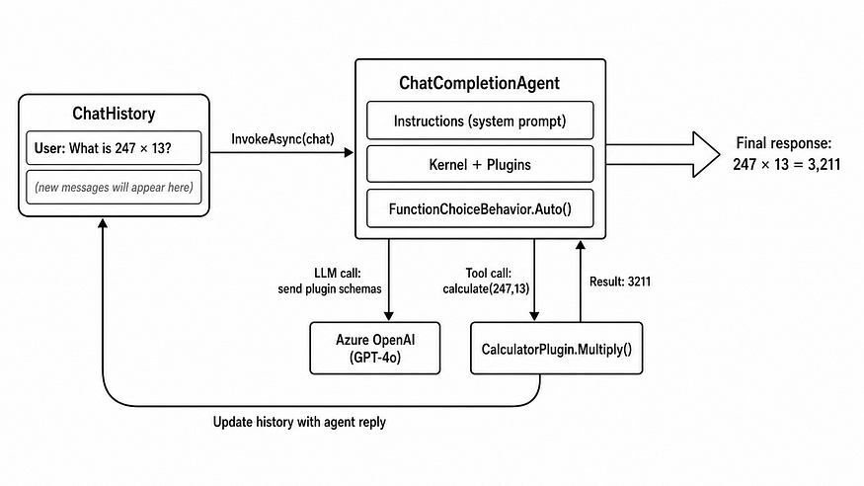
Invoke Function – Chatcompletion
var result = await _kernel.InvokePromptAsync(prompt);
Internally, ChatCompletionAgent.InvokeAsync(chatHistory) calls the registered IChatCompletionService, attaches the agent's instructions as a system message, sends the available plugin schemas to the LLM, and handles the reasoning loop:

Slide 10
Best Practice
Keep Very detailed description
Keep plugins single-responsibility.
Separate read and write plugins.
Always add agent responses back to ChatHistory.
Use FunctionChoiceBehavior.None() for debugging.

