Slide 1
Generative AI
AI Agents

Slide 2
Tool Accuracy- Most Imp
It is very important to ensure that our agent must able to fulfill user requirements
Example:
Can you please apply leave for me from 12 june to 23 june
Our Tool must perform : GetleaveBalance() and then Apply rules () then Apply()
Tool Must go with human Defined workflow

Slide 3
Tool Accuracy
We should not trust LLM based Plans for Crictical Write operations.
Read Operations are fine we can trust LLM
Critical Write operations like
ApplyLeave
Refund my amout
Cancel my tickets etc
UpdateTaxDetails

Slide 4
Tool Accuracy
Solution for Write Operations - Validation Layer
We Should Create robust Validation Layer
We need to validate each Parameters like for query -Can you please apply leave for me from 12 june to 23 june
Validate Dates
i) must have start and end dates
ii) Must validate enddate> startdate
b. Validate leave balance
c. Validate Leave policy may be emp is contractor or number of leave he is asking is not eligible.
d. Take Approval from human
e. Send notifications
g. Logging each steps.

Slide 5
Tool Calling - Best Practice
While defining Tools do below
Keep Very detailed description
Keep plugins single-responsibility.
Avoid Overload Tools like defining 50 Tools, do divide further.
Higher the Tool –higher the context window-> Higher token – Higher hallunications
Separate read and write plugins.
Do not expose write tools to LLM

Slide 6
Tool Calling - Best Practice
Add Paramaters and use business specifc Domain names
GetLeaveBalance(int eid) use GetLeaveBalance(int employeeId)
Always add agent responses back to ChatHistory.
Use FunctionChoiceBehavior.None() for debugging.
Control maximum tool-call iterations
We should limit Auto function call else it will keep in loop and impact Agent performance
Apply roles based rules
User may ask like can you please share salary slips for emp id 3456
Only manager or HR must have access on such cases.
Adding Tools | Microsoft Learn

Slide 7
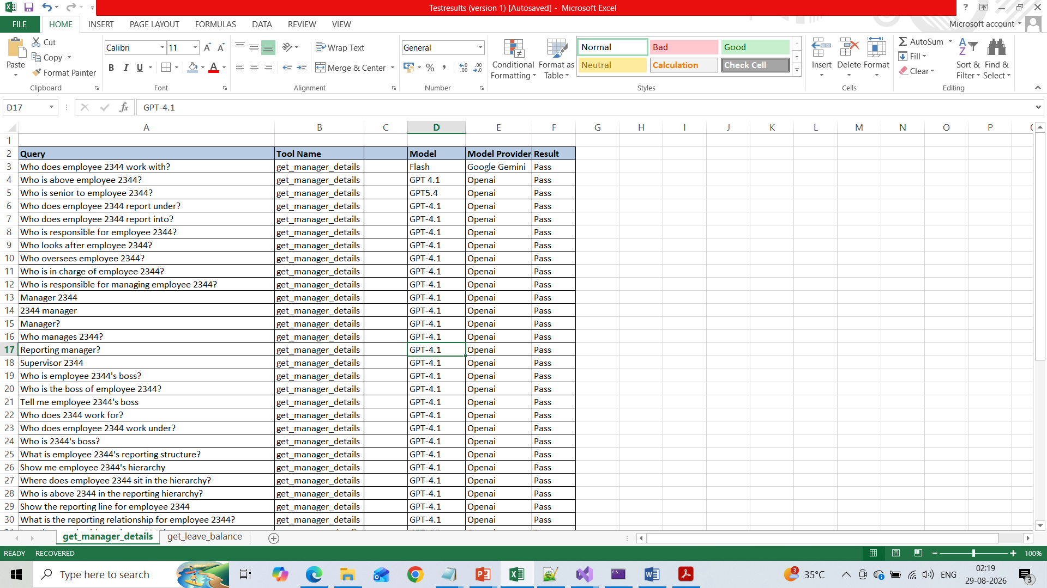
Tool Accuracy
Execute unit test cases defined by Developer
Create test cases and add excepted result
Execute each test case or user
query and pass to LLM and check if it is matching .

Slide 8
Tool Accuracy ->Agentic Evaluation
Critic → evaluates whether the tool choice / reasoning / output is correct.
Reflection → evaluates whether the agent needs correction or another tool call.
LLM-as-Judge → evaluates the final result and gives a score/pass-fail.

