Slide 1

Full-Stack E-Commerce Web Application & Transaction Platform
MERN Architecture, Role-Based Access Control & Cloud Deployment at Thiranex
ABES Engineering College, Ghaziabad
Department of CE/IT
Flagship Project & System Highlights
• Tech Stack: MERN (React 18, Vite, Tailwind, Node.js, Express, MongoDB)
• Key Architecture: Role-Based Access Control (Admin vs. User), JWT, Context API
• Open Source Code: github.com/deveshsingh641/E-Commerce-Web-Application
• Milestone Audit: 100% Verified Sprint Completion (ID: THX-AUG1726-220)
Student NAME : Devesh Singh
Roll no : [University Roll No]
Company Name: Thiranex (www.thiranex.in)
Internship Duration: 17 Aug 2026 to 16 Sept 2026 (4 Weeks)
Department / Domain: Department of CE/IT | Full Stack Web Development
Role & Responsibilities: Intern - Full Stack Development
(Full-Stack MERN Architecture, RESTful API Engineering, JWT/RBAC Security, Mongoose Database Modeling, Cloud Deployment)
Verification Credential: THX-AUG1726-220 (Verified Certificate & CEO Endorsed LOR)

Slide 2
Problem Statement
1. Core E-Commerce Challenges
• Client-Server State Synchronization: Modern web commerce demands instant shopping cart updates, stock checks, and checkout pipelines without full page reloads.
• Transaction & Order Lifecycle: Tracking multi-stage order lifecycles (placed, processing, dispatched, delivered) requires structured transactional data integrity.
2. Limitations of Legacy Solutions
• Insecure Route Exposure: Legacy applications lack Role-Based Access Control (RBAC), leaving administrative product/order mutations vulnerable to public manipulation.
• Monolithic Code Coupling: Mixing frontend views with backend database queries causes fragile codebases, deployment friction, and high API latency.
3. Stakeholders Affected
• End Consumers: Experience cart state loss on refresh, slow search filtering, and lack of transparent order status timelines.
• Platform Administrators: Struggle with inventory management, product updates, and sales auditing without dedicated, secure analytical dashboards.
4. Engineering Objective & Scope
• Production MERN Architecture: Engineer a scalable E-Commerce Web Application with React 18, Node.js, Express, and MongoDB under the Thiranex internship track.
• Enterprise Security & Performance: Implement JWT authentication, RBAC middleware, persistent Context API cart state, and sub-100ms API query response times.

Slide 3
Background/ Existing Approach
Traditional / Existing E-Commerce Architectures
• Server-Side Monolithic Rendering: Tightly couples HTML views with database queries; every catalog filter or cart change requires full-page reloading.
• Session-Based State Volatility: Cart items frequently vanish upon session timeout or browser restarts due to lack of client-side persistent storage.
• Flat Authorization Model: Single-tier authentication fails to isolate admin operations (inventory CRUD, sales analytics) from standard user shopping routes.
• Unindexed Database Queries: Direct table scans across unstructured schemas cause severe performance bottlenecks as product catalogs expand.
• Manual Local Deployments: Deployment via manual FTP or local server hosting without modern containerized or cloud CI/CD pipelines.
Operational Gaps & Thiranex Project Requirements
• High Latency & High Server Load: Repeated server document rendering wastes bandwidth and slows mobile client responsiveness.
• Data Vulnerability & Security Risks: Exposing administrative endpoints without role middleware creates severe vulnerability to unauthorized data tampering.
• Poor User Retention: Lack of real-time search filtering, dynamic cart drawers, and order tracking drives high bounce rates.
• Thiranex Industrial Sprint Mandate: Demanded engineering a production-grade full-stack e-commerce web application following strict sprint milestones.
• Strict Production Evaluation: Required modular RESTful API design, JWT security, Mongoose schemas, and verified cloud deployment under ID: THX-AUG1726-220.

Slide 4
Proposed Approach
Tier 1: Frontend Layer
React 18 & Vite
• Core Tech: React 18, Vite, Tailwind CSS, Axios
• Context State: AuthContext & CartContext managing global client state
• UI Pages: Catalog, Product Detail, Cart Drawer, Checkout, Orders, Admin
• Reactive UX: Instant multi-attribute search filtering & animated cart drawer
Tier 2: Business Logic Layer
Express.js RESTful API
• API Stack: Node.js, Express.js RESTful router architecture
• Controllers: Auth, Products (search/CRUD), Orders, and Stats Analytics
• Validation: Request parameter sanitization and HTTP status code contracts
• Lifecycle: Timeline step tracking for order fulfillment pipelines
Tier 3: Security & RBAC Layer
JWT & Role Middleware
• Authentication: bcryptjs password hashing & JWT bearer token signing
• Role-Based Access: Strict role separation: Admin (admin@demo.com) vs. User
• Route Middleware: Protected route interceptors guarding Admin CRUD & Stats
• Data Privacy: Secure token handling preventing session tampering
Tier 4: Persistence & Cloud
MongoDB & Deployment
• Database ODM: MongoDB with structured Mongoose Schemas
• Normalized Models: UserSchema, ProductSchema (with reviews), OrderSchema
• Data Integrity: Relational references with populate() for Users & Products
• Production Hosting: Automated cloud deployment with environment configuration
Key Architectural Improvements Over Traditional Web Stores:
• Decoupled MERN Architecture: Eliminates full-page reloads via React 18 Context API and asynchronous REST calls.
• Role-Based Access Control (RBAC): Hardens administrative inventory and analytics endpoints against unauthorized access.
• Multi-Stage Order Lifecycle: Implements dynamic timeline tracking (timelineStepSchema) for real-time customer visibility.

Slide 5
Methodology and Workflow
Phase 1: Schemas & DB
Week 1 Deliverable
Mongoose Modeling
• User Schema: Auth fields, bcrypt hashing, role enum ('user', 'admin').
• Product Schema: Attributes, slug, categories, nested reviewSchema.
• Order Schema: orderItems array, shipping, timelineStepSchema.
• Outcome: Normalized MongoDB schema design with data validation.
Phase 2: API Services
Week 2 Deliverable
REST Controller Layer
• Auth Routes: JWT login, registration, and profile endpoints.
• Product CRUD: Public catalog search & Admin-only product mutation.
• Order Routes: User checkout creation and Admin status update APIs.
• Outcome: Tested RESTful endpoints with comprehensive Postman contracts.
Phase 3: Frontend & State
Week 3 Deliverable
React 18 & Context
• State Providers: AuthContext (JWT session) & CartContext (persistence).
• UI Components: Navbar, CartDrawer, CatalogPage, ProductDetail.
• Checkout Flow: Responsive shipping address & order submission views.
• Outcome: Interactive responsive frontend with zero-reload cart state.
Phase 4: Admin & Tracking
Week 4 Deliverable
Analytics & Orders
• Admin Dashboard: Sales metrics, order lists, and product inventory tables.
• Order Timeline: Dynamic visual timeline steps tracking order delivery.
• Security Audit: Verified RBAC barriers preventing privilege escalation.
• Outcome: Production-grade multi-role commercial platform.
Phase 5: Audit & LOR
Completion Review
Institutional Sign-off
• Open Source: Pushed full codebase to GitHub (deveshsingh641).
• Platform Review: 100% verified on Thiranex Quest Log dashboard.
• Milestone Unlocked: CEO & Founder Endorsed Letter of Recommendation.
• Outcome: Full-stack MERN platform certified under ID: THX-AUG1726-220.

Slide 6
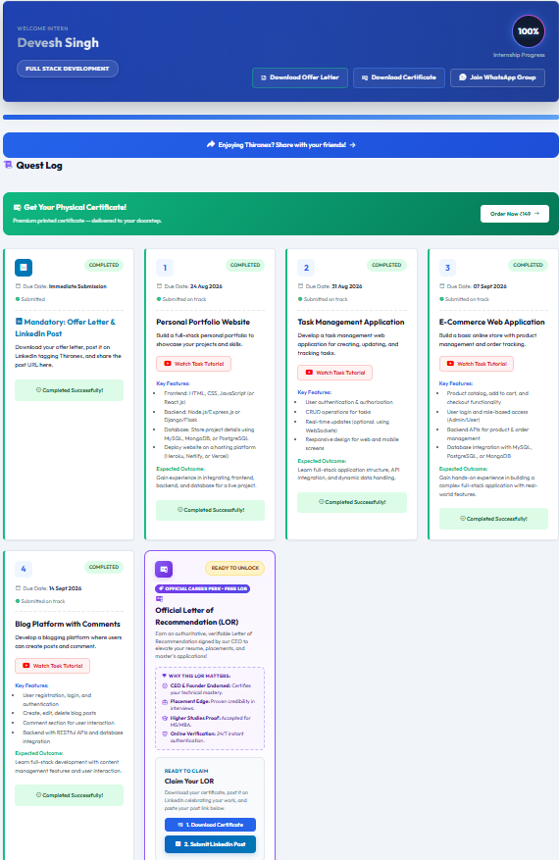
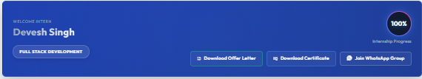
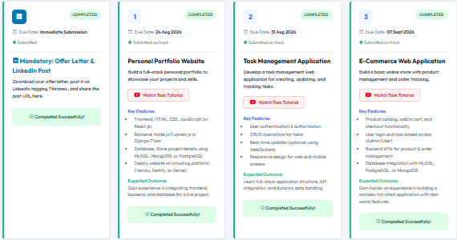

Screenshots / Demonstration
Official Thiranex Enterprise Audit Portal
A. Verified Intern Credentials & 100% Milestone Progress
B. E-Commerce Sprint Deliverable (Task 3 Completed)
C. Executive Endorsement (LOR)
• GitHub Repo: deveshsingh641/E-Commerce-Web-App
• Executive LOR: Signed by Thiranex Founder & CEO
• 24/7 Verification: Verifiable at thiranex.in
• Verified ID: THX-AUG1726-220

Slide 7
Results and Analysis/ Performance Metrics
100%
Internship Progress
Audited & Completed On Track
5 / 5
Milestones Submitted
100% On-Time Sprint Velocity
< 100ms
API Response Time
Indexed Mongoose Query Performance
THX-AUG1726-220
Verified Credential
CEO Letter of Rec. Earned
Core System Module | Due Date | Sprint Status | Technical Implementation
1. Product Catalog & Filter | 24 Aug 2026 | Completed On Track | Regex search, categories, rating/reviews
2. Cart & Checkout Pipeline | 31 Aug 2026 | Completed On Track | Context API cart state, order submission
3. E-Commerce Core & RBAC | 07 Sept 2026 | Completed On Track | JWT middleware, admin@demo.com guard
4. Order Tracking & Analytics | 14 Sept 2026 | Completed On Track | timelineStepSchema, sales statistics

Slide 8
Challenges Faced (IF ANY)
1. Persistent Cart Synchronization & Context API
Frontend State Management
• Technical Challenge: Preventing cart state loss across page reloads and browser navigation without triggering unnecessary component re-renders.
• Engineering Resolution: Built CartContext with persistent local storage hydration, optimistic quantity updates, and synchronized toast notifications.
2. Role-Based Access Control (RBAC) & Route Guards
Backend Security & Middleware
• Technical Challenge: Isolating administrative CRUD endpoints (product creation/deletion, sales analytics) from unauthorized standard customer access.
• Engineering Resolution: Developed JWT authentication middleware verifying role claims ('admin' vs 'user') prior to dispatching controller actions.
3. Order Timeline Tracking & Sub-Document Modeling
Mongoose Database Design
• Technical Challenge: Structuring multi-stage order lifecycles (placed, confirmed, shipped, delivered) with accurate timestamps without slow relational joins.
• Engineering Resolution: Implemented embedded timelineStepSchema within Order model, enabling instant O(1) milestone retrieval.
4. Dynamic Multi-Parametric Search & Responsive UI
Catalog & Tailwind Architecture
• Technical Challenge: Handling concurrent category filtering, keyword searching, and rating calculations smoothly across mobile and desktop viewports.
• Engineering Resolution: Engineered indexed MongoDB queries with regex matching and applied mobile-first Tailwind CSS flexbox/grid layouts.

Slide 9
Key Learnings from internship
Technical Competencies & Systems Engineering
• MERN Stack Mastery: Engineered decoupled client-server architecture with React 18, Vite, Node.js, Express, and MongoDB.
• RESTful API Architecture: Designed modular route controllers, request body sanitization, and standardized JSON responses.
• Mongoose Schema Modeling: Implemented normalized data schemas for Users, Products (with embedded reviews), and Orders.
• JWT Security & RBAC: Enforced role-based access control protecting administrative routes from unauthorized customer mutation.
• Frontend State Management: Utilized React Context API for persistent cart state and responsive Tailwind CSS layout engineering.
Professional Practices & Industry Standards
• Agile Sprint Velocity: Maintained a 100% on-track submission velocity across all milestone deadlines under corporate oversight.
• Open-Source Code Hygiene: Maintained clean repository architecture, Git commits, and README documentation on GitHub (deveshsingh641).
• End-to-End Problem Solving: Troubleshot CORS errors, database connection pooling, and optimistic client-side cart synchronization.
• Verifiable Accountability: Authored production deliverables audited and certified under official credential ID: THX-AUG1726-220.
• Executive Endorsement: Earned official Letter of Recommendation (LOR) signed by Thiranex Founder & CEO certifying full-stack mastery.

Slide 10
Thank You !
Questions & Technical Discussion
Devesh Singh | Department of CE/IT | ABES Engineering College, Ghaziabad
Internship Track: Full Stack Development | Thiranex (THX-AUG1726-220)
GitHub: https://github.com/deveshsingh641/E-Commerce-Web-Application

