Slide 1

Full Stack Web Development & Application Engineering
Industry Internship Project Portfolio at Thiranex
ABES Engineering College, Ghaziabad
Department of CE/IT
Internship Summary & Highlights
• Domain: Full Stack Web & Cloud Application Development
• Milestones: 100% Progress (5 of 5 Sprints Completed on Track)
• Deliverables: Portfolio, Task Manager, E-Commerce, Blog CMS
• Verification: Certified under THX-AUG1726-220 | CEO LOR
Student NAME : Devesh Singh
Roll no : [University Roll No]
Company Name: Thiranex (www.thiranex.in)
Internship Duration: 17 Aug 2026 to 16 Sept 2026 (4 Weeks)
Department / Domain: Department of CE/IT | Full Stack Development
Role and Responsibilities: Intern - Full Stack Development
(Web App Development, REST APIs, DB Schemas, Cloud Hosting)
Verification ID: THX-AUG1726-220 (Verified Certificate & CEO LOR)

Slide 2
Problem Statement
1. Core Problem & Industry Need
• Dynamic Digital Services: Modern businesses require agile, interactive web applications rather than slow, static web pages.
• Disjointed Full-Stack Flow: Engineering production software demands unified integration across frontend UI, backend APIs, and databases.
2. Limitations of Existing Situations
• Fragile Monolithic Code: Legacy apps tightly couple UI and backend logic, creating maintainability bottlenecks and regressions.
• Missing Authorization (RBAC): Unprotected routes allow unauthorized data access and lack separation between Admin and User workflows.
3. Affected Stakeholders
• End Users: Face jarring full-page reloads, sluggish interface latency, and broken layouts across mobile viewports.
• Platform Administrators: Lack dedicated tools and secure dashboards to manage user catalogs, orders, and content securely.
4. Objective & Engineering Solution
• Modular Tiered Architecture: Engineer 4 production applications (Portfolio, Task Manager, E-Commerce, Blog) with RESTful APIs.
• Scalable Cloud Delivery: Deploy fully responsive web applications on Vercel, Netlify, and Heroku with structured database schemas.

Slide 3
Background/ Existing Approach
Traditional / Existing System Architecture
• Static Web Architectures: Built primarily with static HTML/CSS files with hardcoded content; zero dynamic database persistence.
• Manual State Synchronization: User actions require full-page browser reloads, degrading performance and increasing client latency.
• Unstructured Endpoint Design: Direct script queries or non-standardized endpoints without parameter sanitization or validation.
• Absence of User Privileges: Flat access models without Role-Based Access Control (RBAC), leaving administrative routes open.
• Manual Deployment Workflows: Manual FTP file transfers or local script hosting without automated CI/CD and cloud hosting.
Operational Deficiencies & Thiranex Context
• High Server Overhead & Latency: Repeated full-page cycles waste client bandwidth and create server computation bottlenecks.
• Data Inconsistency & Corruption: Unnormalized schemas cause orphan records during concurrent multi-user transactions (e-commerce/blogging).
• Non-Responsive Device Layouts: Desktop-only styling results in broken components and poor usability on mobile screens.
• Thiranex Industrial Standards: Required adopting modular, component-driven full-stack development with strict sprint milestones.
• Deliverable Verification: Required engineering 4 distinct production applications (Portfolio, Task Manager, E-Commerce, Blog Platform).

Slide 4
Proposed Approach
Tier 1: Presentation Layer
Frontend UI / UX
• Tech Stack: HTML5, CSS3, JavaScript, React.js
• Responsive Layouts: Mobile-first design adaptable to web and mobile devices
• Dynamic UI State: Component-based DOM rendering without page refresh
• Interactive Elements: Real-time task boards, dynamic forms, cart state
Tier 2: Business Logic Layer
RESTful API Engine
• Tech Stack: Node.js / Express.js or Python (Flask/Django)
• Modular API Services: RESTful controllers for tasks, catalog, cart, and blog
• Validation Layer: Sanitizes request bodies and manages error responses
• Real-Time Events: Event-driven updates and optional WebSocket sync
Tier 3: Security & Auth Layer
Access & Identity
• Authentication: User registration, secure login, and session tokens
• Role-Based Access: Strict separation of Admin and Customer/User privileges
• Route Protection: Protected endpoints preventing unauthorized data access
• Data Confidentiality: Encrypted password hashing and credential validation
Tier 4: Data & Cloud Layer
Persistence & Hosting
• Database Systems: MySQL, PostgreSQL (Relational) & MongoDB (NoSQL)
• CRUD Workflows: Normalized schemas for articles, comments, orders, tasks
• Data Integrity: Foreign key constraints & ACID transaction compliance
• Cloud Hosting: Automated continuous deployments on Vercel, Netlify, Heroku
Key Improvements Achieved Over Traditional Systems:
• Decoupled client-server architecture eliminates full page reloads • Strict Role-Based Access Control secures admin functions
• Normalized relational and NoSQL schemas guarantee ACID compliance • Cloud-native CI/CD deployment ensures global 24/7 accessibility

Slide 5
Methodology and Workflow
Step 1: Onboarding
Immediate Submission
Environment & Setup
• Offer Letter: Formal acceptance and verification at Thiranex.
• GitHub Setup: Repository initialization and git branch strategies.
• LinkedIn Post: Professional announcement tagging Thiranex.
• Outcome: Approved onboarding and Quest Log activation.
Step 2: Sprint 1
Due: 24 Aug 2026
Personal Portfolio
• Frontend UI: HTML, CSS, JavaScript (or React.js) responsive layout.
• Backend & DB: Node.js / Express or Django; project data storage.
• Hosting: Production deployment on Vercel / Netlify / Heroku.
• Outcome: Live portfolio showcasing full-stack capabilities.
Step 3: Sprint 2
Due: 31 Aug 2026
Task Management App
• Auth Engine: User authentication & session authorization.
• CRUD Engine: Full Create, Read, Update, Delete task pipeline.
• Dynamic UI: Real-time updates with dynamic data handling.
• Outcome: Interactive task management tool with dynamic APIs.
Step 4: Sprint 3
Due: 07 Sept 2026
E-Commerce Web App
• Catalog & Cart: Product browsing, cart state, and order checkout.
• Role Access: Admin management vs. Customer storefront.
• Database: MySQL / PostgreSQL / MongoDB order persistence.
• Outcome: Production-grade multi-role commercial platform.
Step 5: Sprint 4
Due: 14 Sept 2026
Blog Platform & LOR
• Content CRUD: Blog post publishing, editing, and moderation.
• Interactions: Relational comment threads and user discussion.
• Final Audit: 100% progress sign-off; unlocked CEO LOR.
• Outcome: Full-stack CMS + Verified Certificate THX-AUG1726-220.

Slide 6
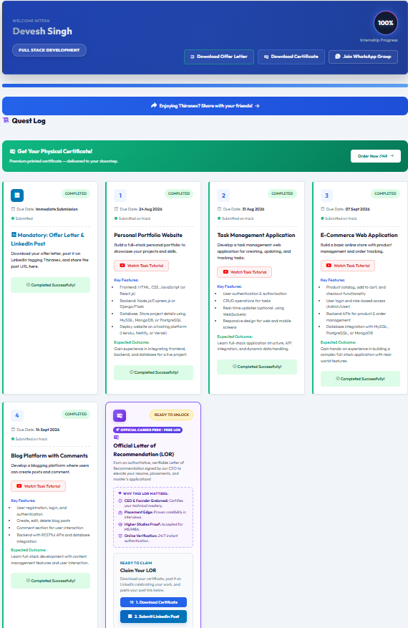
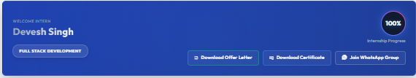
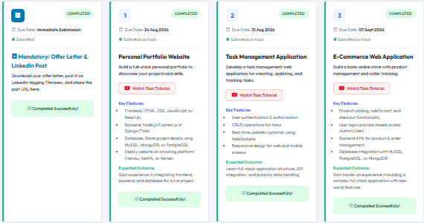

Screenshots / Demonstration
Official Thiranex Dashboard
A. Intern Profile & 100% Progress Verification
B. 4 Completed Project Sprints
C. Letter of Recommendation
• Endorsed: Signed by CEO & Founder
• Verification: 24/7 instant online authentication
• Placement Edge: Proves full-stack technical mastery
• Certificate: ID: THX-AUG1726-220

Slide 7
Results and Analysis/ Performance Metrics
100%
Overall Progress
Internship Completed On Track
5 / 5
Milestones Submitted
100% Timely Submissions
4
Web Applications Built
Production Full-Stack Projects
THX-AUG1726-220
Verified Credential
CEO Letter of Rec. Unlocked
Milestone / Project | Due Date | Status | Technical Outcome
1. Personal Portfolio | 24 Aug 2026 | Completed On Track | Full-stack portfolio; cloud hosted
2. Task Management App | 31 Aug 2026 | Completed On Track | Auth, full CRUD, dynamic API data
3. E-Commerce Web App | 07 Sept 2026 | Completed On Track | Product catalog, cart, RBAC
4. Blog Platform (CMS) | 14 Sept 2026 | Completed On Track | Article CRUD, comment threads

Slide 8
Challenges Faced (IF ANY)
1. Real-Time Dynamic State Synchronization
Task 2: Task Management Application
• Technical Challenge: Synchronizing client UI task changes with backend REST endpoints without causing unnecessary component re-renders or stale DOM state.
• Engineering Resolution: Implemented modular state controllers and optimized asynchronous API requests to ensure seamless, real-time UI updates.
2. Role-Based Access Control (RBAC) & Security
Task 3: E-Commerce Web Application
• Technical Challenge: Safeguarding administrative routes (inventory management, order tracking) while preserving frictionless access for shoppers.
• Engineering Resolution: Developed token-based authentication middleware verifying user privileges (Admin vs. User) prior to executing backend endpoints.
3. Relational Schema Design & Comment Threading
Task 4: Blog Platform with Comments
• Technical Challenge: Structuring relational foreign-key mappings between blog posts, user profiles, and nested comments without query slowdowns.
• Engineering Resolution: Designed normalized database schemas with indexed queries in PostgreSQL/MySQL, ensuring rapid relational data retrieval.
4. Cross-Platform Responsiveness & Cloud Deployments
Task 1: Portfolio & Full-Stack Projects
• Technical Challenge: Eliminating layout breakage across diverse mobile viewports and configuring cloud environment variables on hosting platforms.
• Engineering Resolution: Applied mobile-first CSS flexbox/grid media queries and standardized CI/CD configuration files on Vercel, Netlify, and Heroku.

Slide 9
Key Learnings from internship
Technical Competencies & Skills Acquired
• Frontend Engineering: Mastered responsive UI development using HTML5, CSS3, JavaScript, and React.js with dynamic component binding.
• Backend & REST APIs: Engineered scalable RESTful API services in Node.js/Express.js and Python (Flask/Django) with rigorous parameter validation.
• Database Architecture: Designed normalized relational database models (PostgreSQL, MySQL) and flexible NoSQL document schemas (MongoDB).
• Security & Auth Systems: Implemented secure session authentication, token handling, and Role-Based Access Control (Admin/User privileges).
• DevOps & Cloud Hosting: Gained hands-on deployment experience using Heroku, Netlify, and Vercel for live continuous deployment.
Professional Practices & Project Management
• Sprint-Based Execution: Maintained a 100% on-track submission record across 4 intensive weekly milestones under industry supervision.
• Modular Code Quality: Structured clean, maintainable code following industry conventions, separation of concerns, and documentation standards.
• Analytical Problem Solving: Troubleshot complex integration bugs between client requests, backend middlewares, and database transactions.
• Verification & Accountability: Delivered verifiable software artifacts meeting rigorous industry standards under Verified ID: THX-AUG1726-220.
• Career Milestone: Awarded official Letter of Recommendation (LOR) endorsed by Thiranex CEO & Founder for technical mastery.

Slide 10
Thank You !
Questions & Discussion
Devesh Singh | Department of CE/IT | ABES Engineering College, Ghaziabad
Internship Track: Full Stack Development | Thiranex (THX-AUG1726-220)

