Slide 1
AI-driven End-to-End BDD Automation Platform
From Natural Language Requirements to Executable Test Automation
Tech Stack: Spring Boot, Java 21, Cypress (TypeScript), Jenkins, LLMs

Slide 2
Problem Statement
• Manual translation of requirements to feature files is time-consuming
• Misalignment between analysts, developers, and testers
• Step definitions written manually
• Lack of traceability between JIRA and automation
• Fragmented CI/CD integration

Slide 3
Solution Overview
BDDForgeAI automatically converts Natural Language Requirements (from JIRA) into:
- Gherkin Feature Files
- Automated Test Cases (Cypress + TypeScript)
- UI Wireframes
- Jenkins CI/CD Pipelines
Powered by LLMs + Custom AI Agents

Slide 4
High-Level Architecture
Core Components:
1. JIRA Connector – fetches requirements
2. AI Translation Engine – converts user stories to Gherkin, wireframes
3. Test Generator Module – Cypress + TS code
4. CI/CD Module – Jenkins integration
5. Artifact Repository – Git storage
6. Web Dashboard – visualization and editing

Slide 5
Data Flow Diagram
Flow:
JIRA → BDDForgeAI → LLM Translation → Feature + Test + Wireframe Generation → Git Repo → Jenkins CI/CD
Inputs:
- JIRA Ticket Data
- Historical Tests
Outputs:
- Feature Files (.feature)
- Step Definitions (.ts)
- Wireframes (.png/.json)
- Jenkinsfile (.yml)

Slide 6
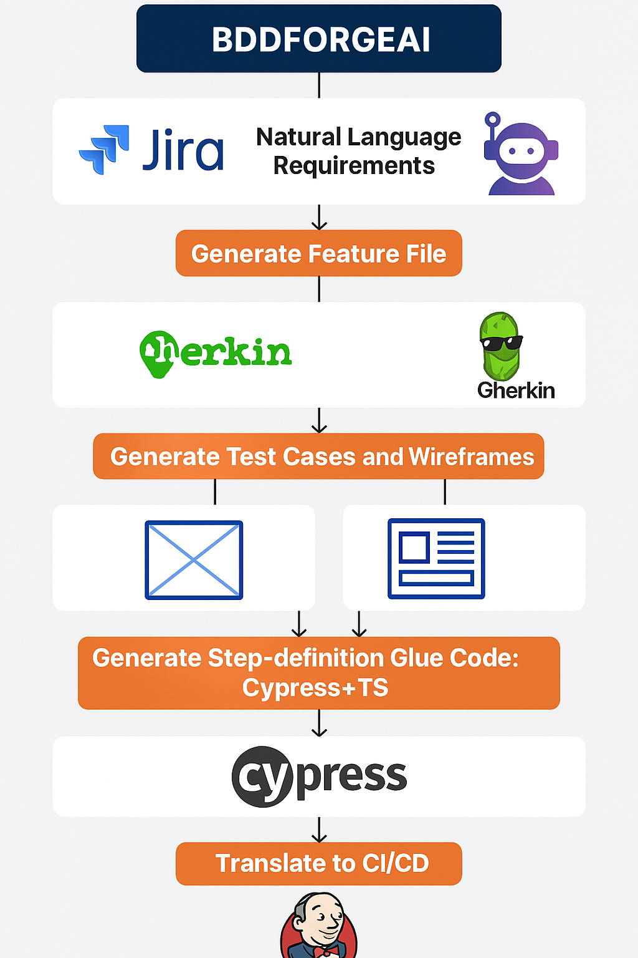
Data Flow Diagram

Slide 7
Value Proposition (AI Contribution)
• Natural Language Understanding for business stories
• Automated BDD generation reduces manual effort by 80–90%
• Ensures consistency and alignment
• Continuous learning through feedback
• Faster CI/CD integration and release cycles

Slide 8
Target Users
Business Analyst – Auto-generates Gherkin files
QA Engineer – Ready-made test steps and Cypress code
Developer – AI-generated glue code
Product Manager – End-to-end traceability
DevOps Engineer – Automated Jenkins setup

Slide 9
Data Requirements
Required Data:
- JIRA Metadata: Summary, Description, Acceptance Criteria
- Test Repositories: existing Gherkin/test files
- UI Templates: for wireframes
- CI/CD Configs: Jenkins templates
Data Handling:
- Secure Git + DB storage
- Anonymized data processing

Slide 10
AI Act Compliance
• Transparency: Traceable, editable AI outputs
• Human Oversight: Approval before execution
• Data Privacy: Secure internal environment
• Explainability: Rule-based validation layers
• Risk Category: Low-risk developer assistive AI

Slide 11
Future Roadmap
Phase 1: MVP with JIRA, Gherkin, Cypress generation
Phase 2: Add wireframes, Jenkins integration
Phase 3: AI feedback loop for self-learning
Phase 4: Multi-framework support (Playwright, Selenium)

Slide 12
Summary
BDDForgeAI transforms plain JIRA stories into executable test automation pipelines – powered by AI.
Benefits:
✔ Unified BDD automation lifecycle
✔ Reduced manual effort
✔ Faster release cycles
✔ Compliant and scalable AI-driven approach

