Slide 1
Portals, time away and meeting rooms
Five narrated walkthroughs of the running product — employee, manager, HR, admin, and what happens between check-in and check-out — with the plan in detail and its status.
Demo organisation: Al Bahja Trading (Oman) · recorded 15 October 2026

Slide 2






Agenda
One short video per audience, each followed by the plan in detail
Employee portal
Manager portal
HR portal
Attendance, bar graph, step out, leave, swap
Team today, approvals, hierarchy
Organisation, holidays, leave, reports
Admin console
Between check-in and check-out
Plan, status and rollout
Settings, roles, terminals, audit
Time away, terminals, meeting rooms
What is delivered, what is next

Slide 3






What was built and is live in the product
Everything in the videos is the real application on real data — no mock-ups
Time away during working hours
Step out / I’m back
Terminal punch roles
Engine 1.5.0 classifies every gap between the first IN and the last OUT: official duty, permission, break, unapproved.
For sites with an entry terminal only: the portal records the step-out, the terminal (or “I’m back”) the return.
Entry-only, exit-only, two-way IN/OUT, and ACCESS readers that never touch attendance.
Meeting rooms & access
Managers of managers
Reports and approvals
Rooms on the location tree, meetings with invitees, attendance from readers, unauthorised entries.
Team scope “whole hierarchy”: up to five levels, enforced in the database (RLS) and the API alike.
HR time-away report, the activity bar graph, TIME_AWAY approvals, and the managers’ daily morning roll call.

Slide 4
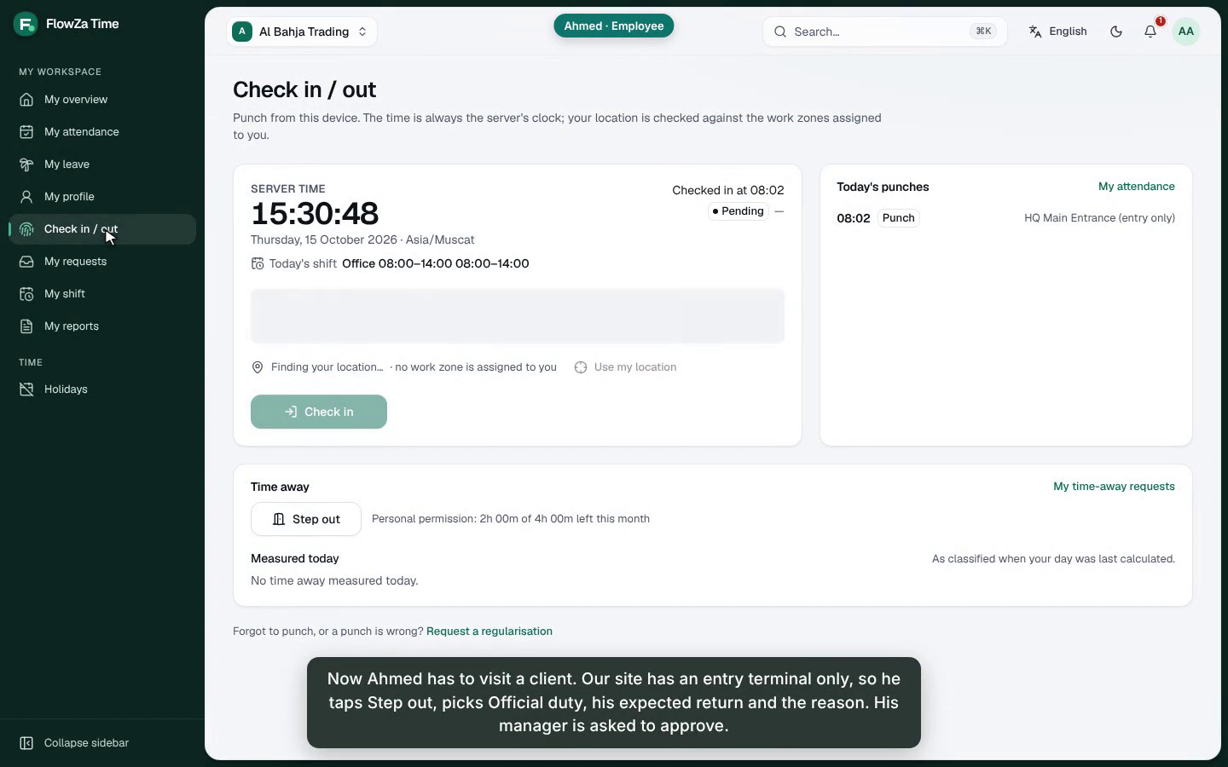
Employee portal — video
Ahmed, Technician · Quality Assurance · Office 08:00–14:00
What it shows
My overview: today’s shift, check-in on the entrance terminal, the month at a glance
My attendance: month calendar, open a day for punches and the calculation
Activity bar graph: on site vs time away (official, permission, unapproved)
Step out (official / personal, expected return) and I’m back
Plan time away; the monthly permission allowance
Leave balances and Apply for leave
Shift swap request with a colleague
Audience: every employee · web and phone
▶ 2:25 · narrated, captions burned in · FlowZa-Time-1-Employee-Portal.mp4

Slide 5
Employee portal — plan in detail
What the employee can do, how it works, and the rule behind it
Feature | How it works | Rule / control
See attendance | Calendar, daily log, statistics; open a day for punches and the calculation trace | Own records only (RLS self predicate)
Bar graph (in site / out site) | Activity tab: per day on site, official duty, permission, break, unapproved | Engine figures, same as payroll
Step out / I’m back | Break-out punch now + a request for the expected window; return on the terminal or “I’m back” | Policy: step-out allowed, return by terminal only or also portal
Plan time away | Official duty or personal permission, a window on one day | Personal: 4 h a month, 2 h at a time; no overlaps
Apply for leave | Type, dates, half day; balance shown before sending | Allowance, notice and approval workflow per type
Shift swap | Pick a day and an eligible colleague | Line manager approves; both schedules change that day only

Slide 6
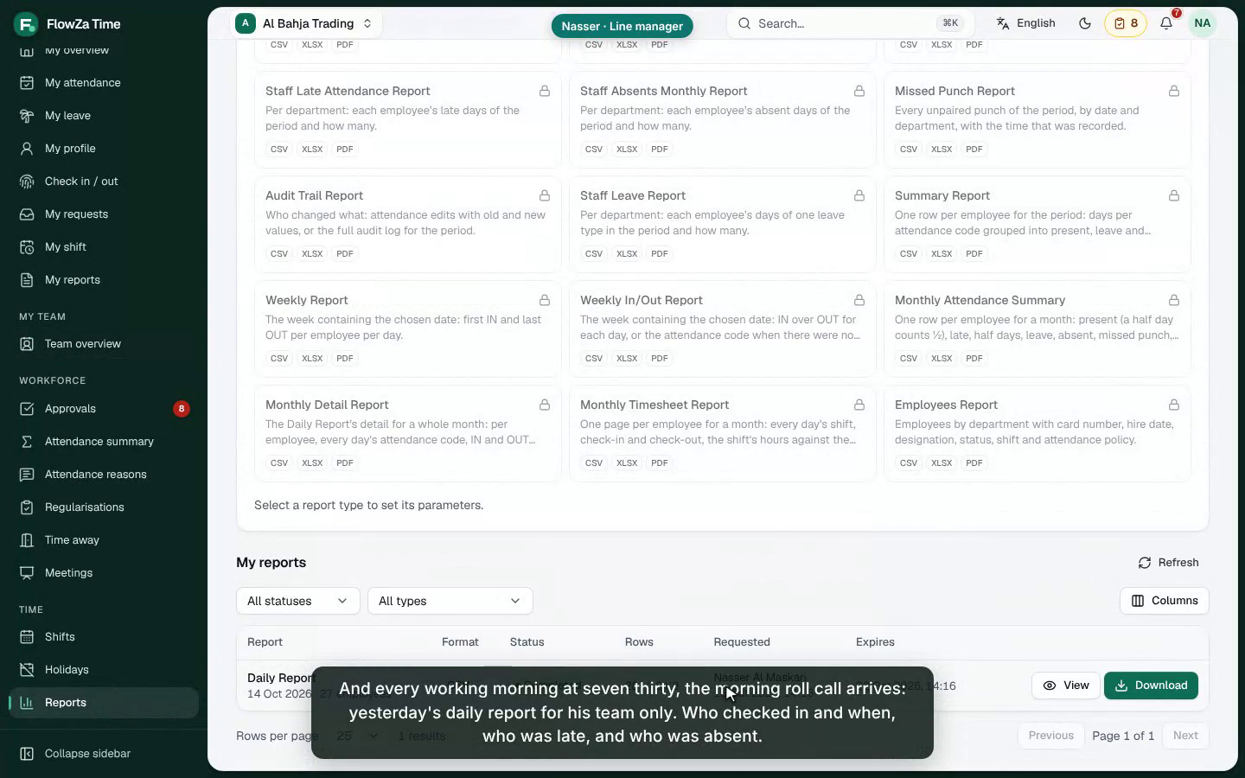
Manager portal — video
Nasser, IT & QA team lead — and Hamed, Head of Technology, above him
What it shows
Team › Today: who checked in, late, absent, on leave, in now
Morning roll call: yesterday’s Daily Report every working morning
Approvals inbox: time away, leave and shift swaps in one place
Time-away context: window, kind, destination, monthly allowance
Approve → the day is recalculated immediately
Team › Attendance: the month grid for the whole team
Managers of managers: indirect reports “via” their manager
Audience: line managers, heads of department
▶ 2:02 · narrated, captions burned in · FlowZa-Time-2-Manager-Portal.mp4

Slide 7
Manager portal — plan in detail
The daily roll call, one inbox, and the reporting hierarchy
Need | Where | How it works
Who logged in, who is absent — daily | Team › Today (refreshes every minute) and Dashboard | Live from punches and the engine: present, late, absent, on leave, missing punch, in now
Approve time away | Approvals | Line manager (secondary stands in) or an HR workflow up to 5 levels; approval recalculates the day
Approve leave and shift swaps | Approvals | Balance shown; one by one, in bulk, or from the e-mail
The month for the team | Team › Attendance | Month grid per report; open any day
Managers of managers | Settings › Attendance › Manager team scope | “Whole reporting hierarchy”: depth 5, enforced by RLS and the API alike; indirect reports labelled
Who logged in, who is absent — every morning by e-mail | Reports › Schedules (HR sets it up) | “Morning roll call”: the Daily Report every working morning (Sun–Thu 07:30) for yesterday — each manager receives their own team only

Slide 8
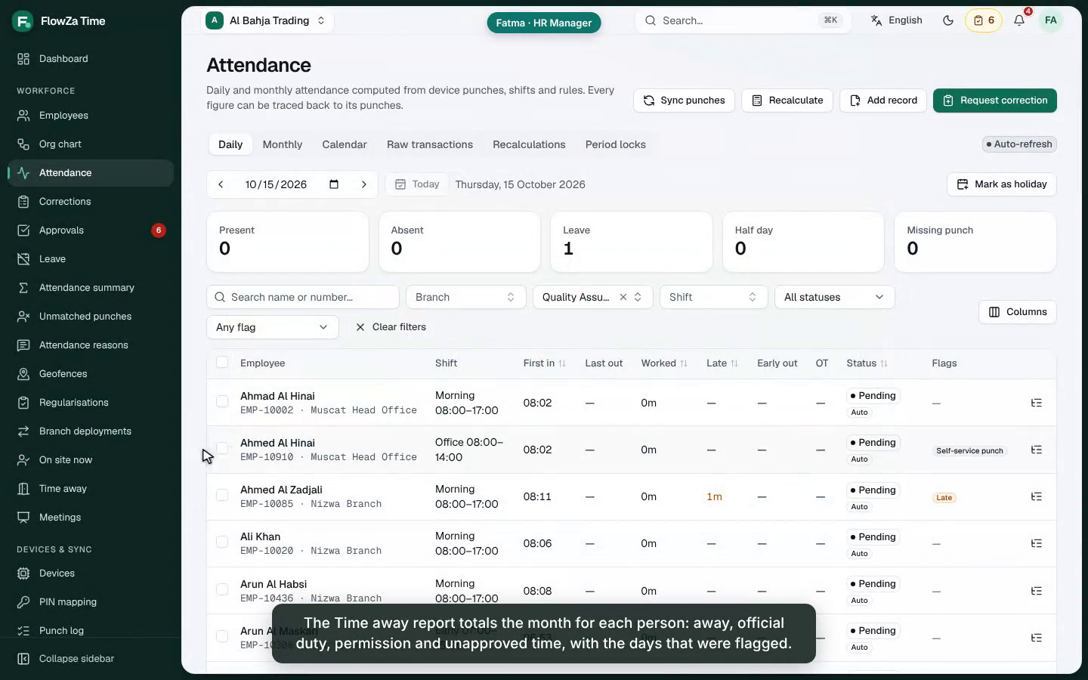
HR portal — video
Fatma, HR Manager — the whole organisation
What it shows
Dashboard: today across branches, trend, late, on leave
Attendance › Daily by department; open a day
Time away report: month totals per person, flagged days
Schedules the managers’ morning roll call (daily, Sun–Thu)
Organisation: branches, departments, org chart
Holidays: add and remove; days are recalculated
Leave records and balances
Meeting attendance from the room readers
Audience: HR and attendance administrators
▶ 1:56 · narrated, captions burned in · FlowZa-Time-3-HR.mp4

Slide 9
HR portal — plan in detail
Overall view, departments, holidays, leave and time away
Area | What HR does | Effect
Overview | Dashboard by branch; Overview / Operations / Executive layouts | One look at the day and the trend
Departments & hierarchy | Organisation › departments (parent, manager); org chart with drag-and-drop | Reporting lines drive approvals and the team scope
Holidays | Calendars per branch; add, edit, remove holidays (half days, company days) | Affected days recalculated; never counted absent
Leave | Types, allowances, accrual, approvals, team calendar, balances | Leave days never marked absent
Time away | Monthly report per person; policy per group / department / shift | Unapproved time deducted and flagged; official duty paid
Meetings | Rooms, meetings, attendance, access log | Who attended, late, absent, unauthorised walk-ins
Morning roll call | Reports › Schedules: the Daily Report, daily Sun–Thu 07:30, to the managers | Each manager receives their own team; a Sunday run covers Thu–Sat

Slide 10
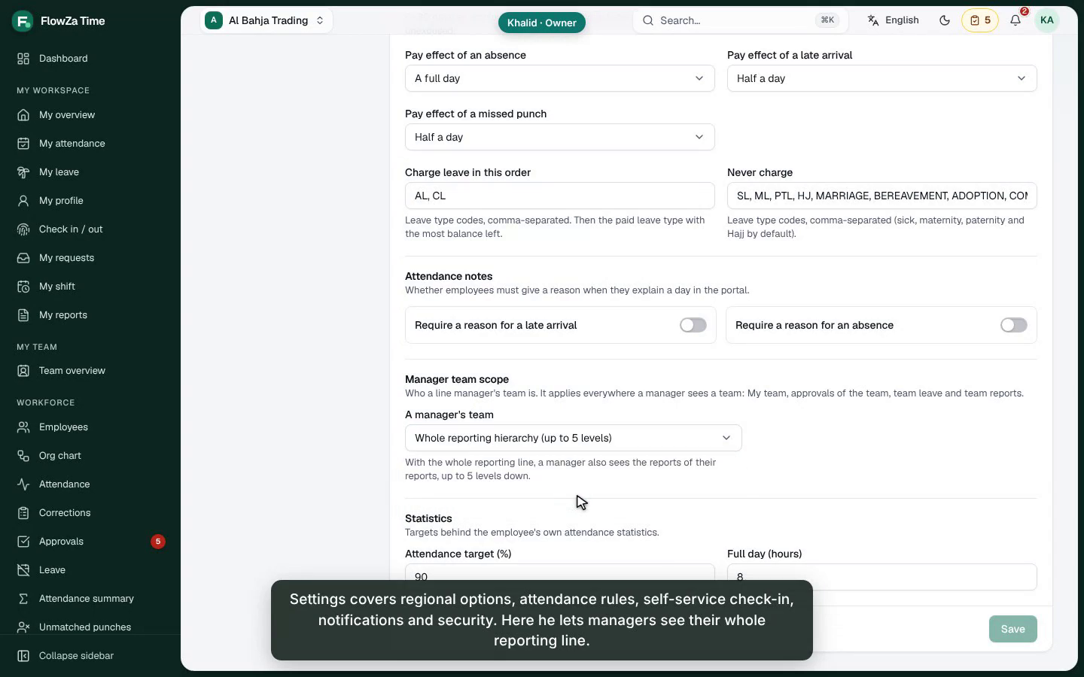
Admin console — video
Khalid, General Manager — owner of the account
What it shows
Settings: regional, attendance, self-service, notifications, security
Manager team scope: direct reports or the whole hierarchy
Users & roles: permissions, branch scope
Devices: entry-only, exit-only, IN/OUT and meeting-room readers
Register a terminal with its punch role
Locations: branches › floors › rooms
Audit log of every change and request
Audience: owners, administrators, IT
▶ 1:22 · narrated, captions burned in · FlowZa-Time-4-Admin.mp4

Slide 11
Admin console — plan in detail
Configuration that the other three portals depend on
Setting | Where | Recommended for this rollout
Attendance policy with time away | Attendance › Policies (or Shifts › Rules) | Directional punches; official counts as worked; permission 240 min/month, 120 at a time; flag after 15 min
Self-service | Settings › Attendance | Web and mobile check-in on; step-out from the portal on; return by terminal or portal
Terminal punch roles | Devices › device › Settings | Entrance = entry only; exit gate = exit only; lobby = IN/OUT; rooms = ACCESS
Meeting rooms | Organisation › Locations, then Meetings › Rooms | Room = a place with its reader; restrict boardrooms to departments
Manager team scope | Settings › Attendance | “Whole reporting hierarchy” for heads of department
Roles | Users & roles | meeting.view / .manage / .rooms as needed; managers who receive the roll call need report.export (e.g. a “Line manager” role = Manager + report.export)

Slide 12
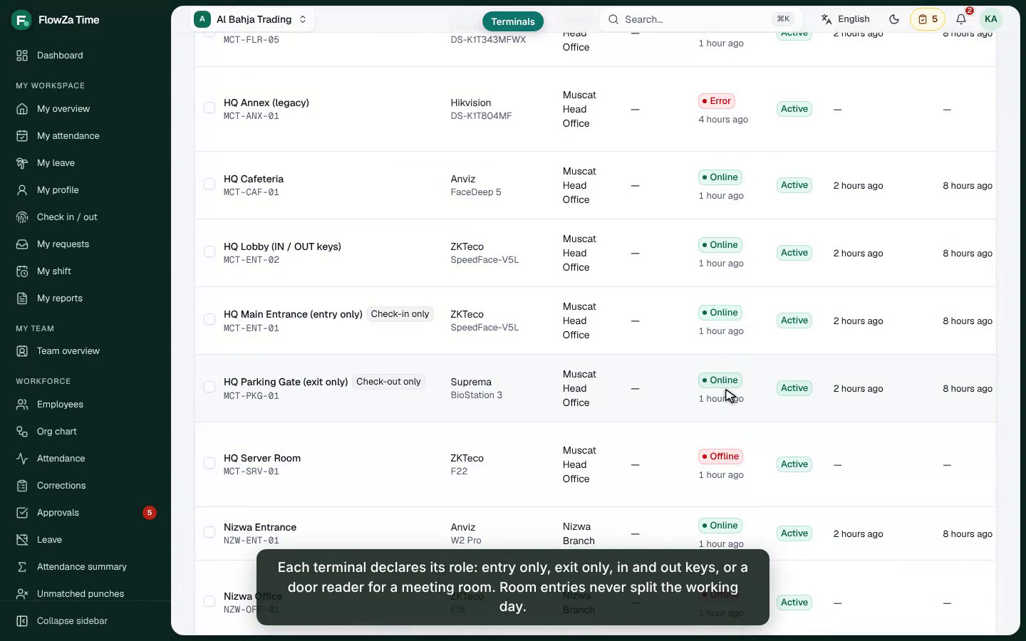
Between check-in and check-out — video
The main concern: time away from the site during working hours
What it shows
Two site layouts: two-way terminals, or entry terminal + portal
Terminal roles; room readers never split the day
The policy: official, permission quota, unapproved flag
Classification of every gap, shown in the day’s calculation
The bar graph for employee and manager
Meeting attendance and unauthorised entries
HR month totals
Audience: everyone — the rules in two minutes
▶ 1:49 · narrated, captions burned in · FlowZa-Time-5-Between-Check-In-And-Out.mp4

Slide 13
How every gap between check-in and check-out is classified
Example: office 08:00–14:00 — IN 08:00, OUT 10:00, IN 12:05, OUT 14:00
Kind | When | Pay / status | Example result
Official duty | Inside an approved OFFICIAL window (+10 min grace) | Worked (configurable) | Approved 10:00–12:00 → 125 min official; worked 6 h; PRESENT
Permission | Inside an approved PERSONAL window (+ grace) | Unpaid, excused; 4 h a month | Approved 10:00–12:00 → 2 h permission; worked 4 h; not short
Break | The rest, up to the shift’s break allowance | As the shift’s break | 30-min lunch allowance used first
Unapproved | Whatever is left | Deducted; UNAPPROVED_AWAY after 15 min | No approval → 125 min unapproved; worked 3 h 55; flagged
Short gap | Under 5 minutes | Worked | 3-minute step outside the reader
Two layouts, same answer
Two-way terminals: OUT when leaving, IN when returning (IN/OUT keys, or exit + entry gates)
Entry terminal only: Step out in the portal; the return is the next check-in, or “I’m back” if the policy allows
Requires paired or directional punch interpretation (first/last ignores the middle — refused by the API)

Slide 14
What comparable products do — and what FlowZa took
Researched practice for attendance terminals and GCC HR suites
Product family | Mechanism | Taken over in FlowZa
ZKTeco (push / BioTime), Hikvision | Punch states: check-in/out, break-out/in, OT-in/out | Break-out / break-in punches; portal step-out writes a break-out
Matrix COSEC | “Official work” and “Short leave” in/out functions | Two kinds: OFFICIAL (worked) and PERSONAL (limited)
GCC HR suites (Bayzat, Jisr, ZenHR, Menaitech) | Permission (استئذان) requests in hours, manager approval, monthly quota | Time-away requests via approvals; quota and longest window
greytHR, Keka, Zoho People | “On duty” requests for work outside the office | Official duty counts as worked time
Suprema, Hikvision, Gallagher access control | Door readers by zone; attendance from designated readers only | Terminal punch roles; ACCESS readers → room entries, meeting attendance

Slide 15
Meeting rooms and access control
If the meeting rooms have readers: how many attended, when, and who should not have entered
A meeting room is a place in the location tree (HQ › Floor 3 › Boardroom) with a capacity; its readers are ACCESS terminals
Book a meeting: room, time, invitees (required / optional); one meeting per room at a time; capacity checked
Attendance from the room entries: on time, late (minutes after the start), absent; repeat entries counted
Restricted rooms: allowed departments / employees; anyone else entering — or an unknown card — is reported as unauthorised
Room entries never touch attendance: a meeting never splits the working day
Access log for the room administrators (permission meeting.rooms); employees see their own invitations
Next: pushing access groups to the controllers (vendor-specific), so the door itself enforces the restriction

Slide 16
Plan and status
Delivered in this change, and the next steps
Work item | Status | Evidence
Engine 1.5.0: time-away classification; nothing changes with the policy off | Delivered | 18 new engine tests; all 446 existing pass
Policy section “time away” (core, every plan); FIRST_LAST refused | Delivered | API tests; policy editor
Requests, step-out / I’m back, approvals (TIME_AWAY), HR list & monthly summary | Delivered | 11 API tests; real-data run
Terminal punch roles; ACCESS readers → access_events | Delivered | Worker tests (normaliser, end-to-end day)
Meeting rooms, meetings, attendance, access log (Enterprise module) | Delivered | 6 API tests + domain tests
Manager team scope: whole hierarchy (RLS + API) | Delivered | API + SQL RLS suites, cross-tenant probes
Daily scheduled roll call to managers (daily cadence, previous day, team-scoped) | Delivered | Domain, contract and web tests; real run
Push room access groups to controllers | Next | Per vendor (ZKTeco, Hikvision, Suprema)
Payroll export columns for permission / unapproved minutes | Next | Figures already on every daily record

Slide 17
Rollout for a customer
Six steps, about two weeks including a pilot
# | Step | Owner | When
1 | Mark each terminal: entry only, exit only, IN/OUT, or meeting-room reader | IT / admin | Day 1
2 | Create the time-away policy for the pilot group (directional punches, quotas, flags) | HR | Day 1
3 | Set reporting lines; choose the manager team scope | HR / admin | Day 2
4 | Places and meeting rooms; restrict boardrooms | Facilities | Day 2–3
5 | Pilot one department for a week; review the time-away report | HR + managers | Week 1
6 | Train with these videos; roll out to all departments | HR | Week 2

Slide 18
Every minute between check-in and check-out, accounted for.
FlowZa Time — people on time, business on track.

