Slide 1
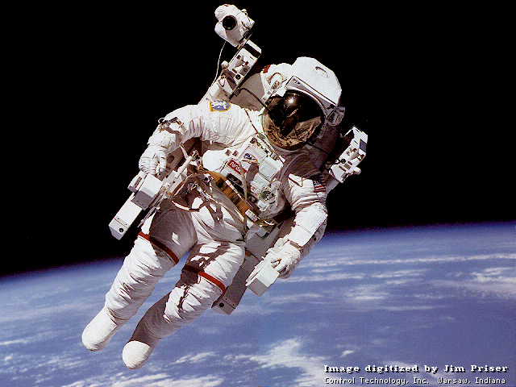

Slide 4
テキスト 表示いろいろ
Python
font.size = 24 pt
font.name = Meiryo UI
font.italic = True
font.underline = True
level = 0
level = 1
level = 2
alignment = center
alignment = left
alignment = right

Slide 5
テーブルの作成
 | 1st Column | 2nd Column | 3rd Column
1st Row | cell(1, 1) | cell(1, 2) | cell(1, 3)
2nd Row | cell(2, 1) cell(2, 2) |  | cell(2, 3)
3rd Row | cell(3, 1) | cell(3, 2) | cell(3, 3)

Slide 6
いろいろ

