Slide 1
PythonでPowerpointを作成しよう
TeamXeppet Channel

Slide 2
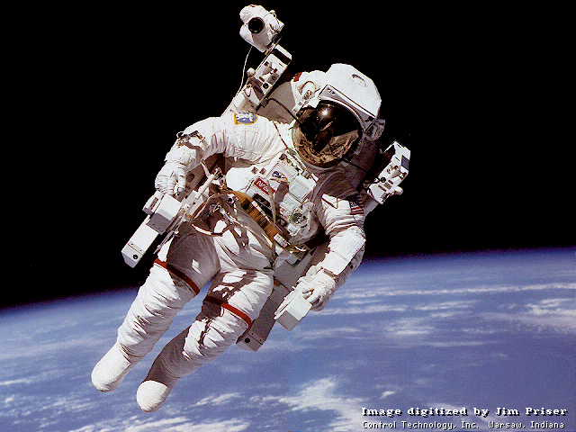
PythonでPowerpointを扱うには？
pip install python-pptx
をまずは実行しよう

Slide 3
テーブルの作成
No. | qualification | type
1 | ORACLE MASTER | Vendor
2 | Fundamental Information Technology Engineer Examination | Nation
3 | Linux Professional Institute Certification | Private

