Slide 1
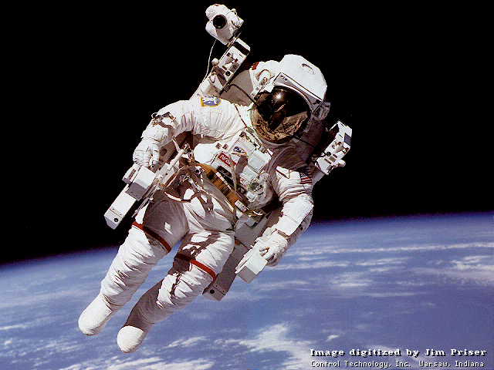
ok2
RONDED
いろいろ
cube
arc
OK
DONUT
oval

Slide 2
TEXT1
あいうえお
TEXTbox
OKOKOKK
TEXT2

Slide 3
 | 1st Column | 2nd Column | 3rd Column
1st Row | cell(1, 1) | cell(1, 2) | cell(1, 3)
2nd Row | cell(2, 1) cell(2, 2) |  | cell(2, 3)
3rd Row | cell(3, 1) | cell(3, 2) | cell(3, 3)

