Slide 1
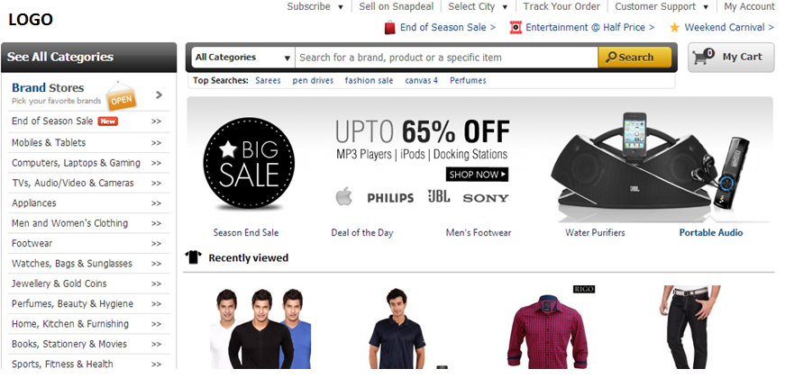
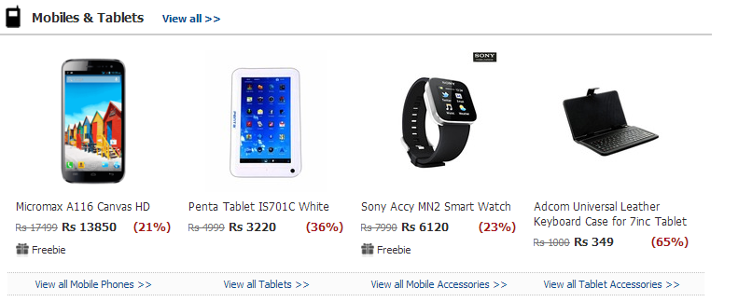
Popular Categories
Here we will display top 5 categories with 4 products each. At top there will be a link to open that category pages and at bottom of each product there will be a link to display that respective product.
This module will be showing the products explored by the customers. This module will disappear if there is noting to display.

Slide 2
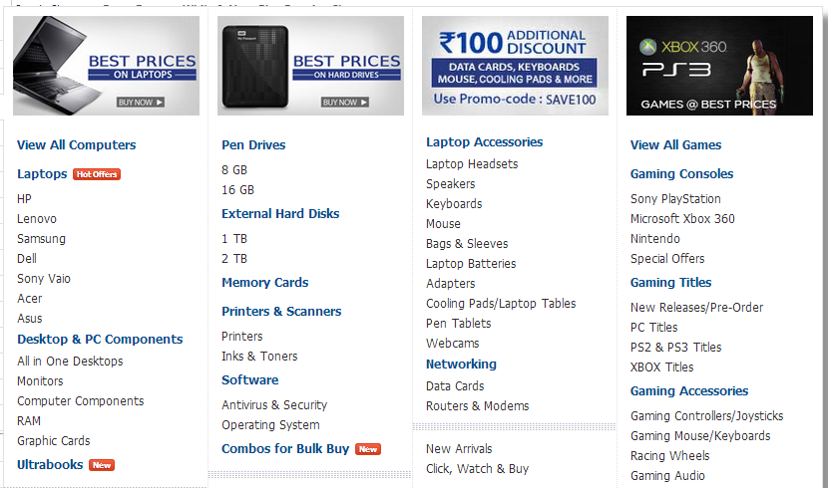

Slide 3
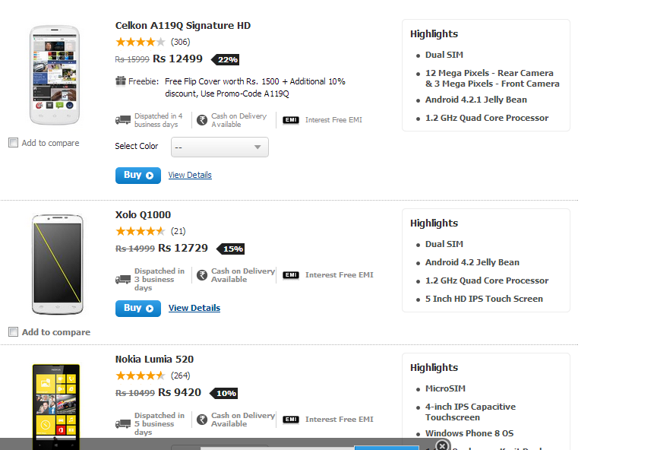

Popular Categories
One the user will start the scrolling nest set of products will be loaded. Buy default there needs to some products only.

Slide 4
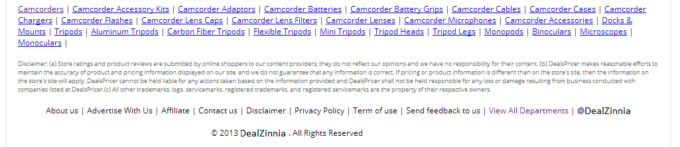
Footer
Top 20 Category List

