Slide 1
Project Summary & Objectives
Project Title:
Optimizing Air Travel — A Data-Driven Approach to Delay Analysis & Prediction
Business Context:
Flight delays cause major operational inefficiencies and customer dissatisfaction in the aviation industry.
This project leverages data science to uncover patterns and predict delay behavior to support better decisions.
Project Objectives:
1. Perform Exploratory Data Analysis (EDA) to identify key patterns and root causes of delays.
2. Build predictive models (classification & regression) to forecast delay severity and duration.
3. Apply SHAP and Operational Adjustability Index (OAI) to generate interpretable, actionable insights.
Dataset:
Monthly aggregated U.S. domestic flight data across all major airlines and airports.
by- Devendra Garwa
(21410010)
GT(5y)
.

Slide 2
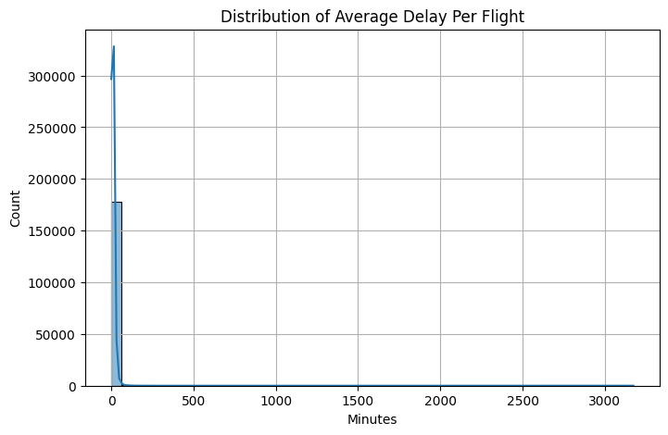
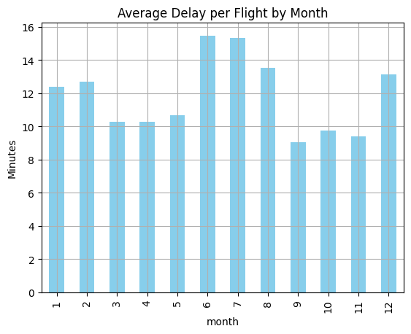
EDA Highlights — Delay Distribution & Trends
• Delays are right-skewed; most flights have low delays, few extreme outliers.
• The distribution is heavily right-skewed, with most delays under 20 minutes and a few extreme cases causing significant disruption.
• Outliers in delay duration, though rare, contribute disproportionately to total delay minutes—warranting special operational attention.
• Delay peaks in June and July coincide with summer travel, indicating seasonal strain on the system.
• Low delays in the fall suggest operational efficiency or reduced load; airlines can benchmark against this period.
• Airlines can proactively prepare for peak months (June–July) through staffing buffers and resource planning.
• Fall performance may serve as a baseline for assessing operational improvements.

Slide 3
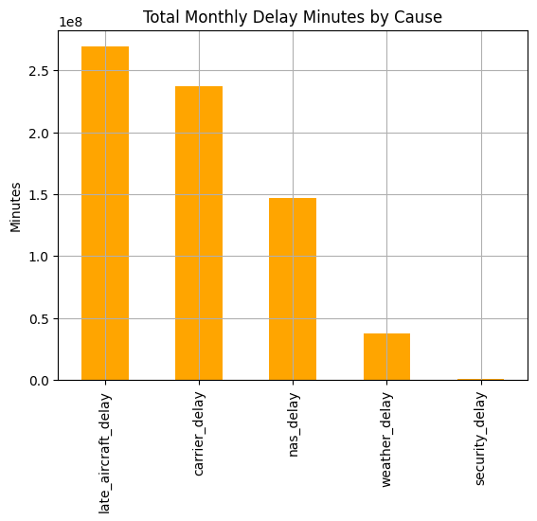
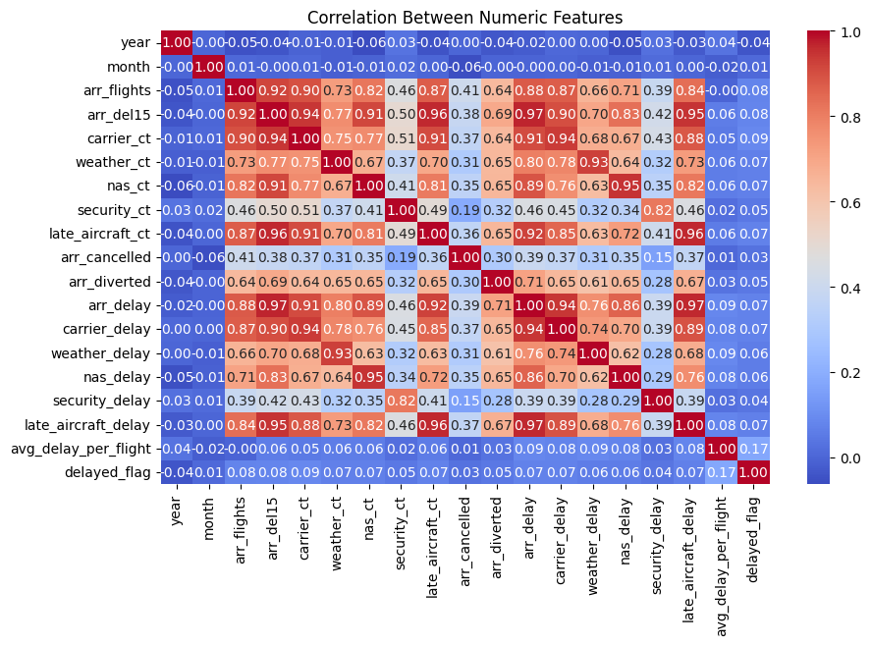
Root Causes & Operational Impact
Late aircraft delay is the single largest contributor to overall delay minutes, often a knock-on effect from previous delayed flights.
Carrier delays are operational delays (e.g., crew readiness, baggage loading), making them highly actionable.
NAS (National Aviation System) delays, while significant, are usually harder to control.
Weather and security delays are minimal but can still cause cascading effects in severe events.
Strategic Focus: Airlines should prioritize reducing late aircraft and carrier delays to maximize impact.
Strong correlation between:
carrier_delay and late_aircraft_delay (suggests propagation of delays across flights).
arr_delay and both carrier_delay and late_aircraft_delay (makes these primary targets for mitigation).
Weak correlations between external causes like weather_delay and the rest confirm their randomness.
High arr_del15 correlation with total delays reinforces it as a useful derived feature.

Slide 4
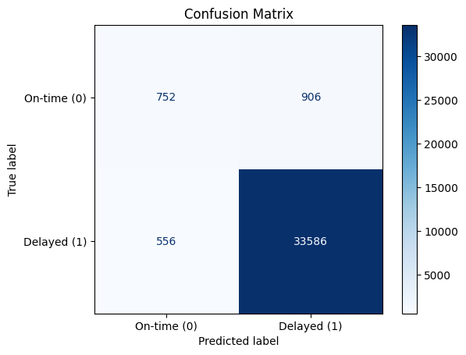
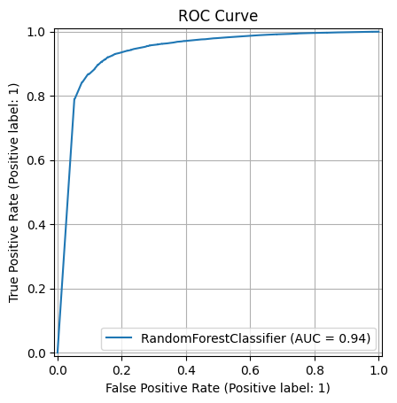
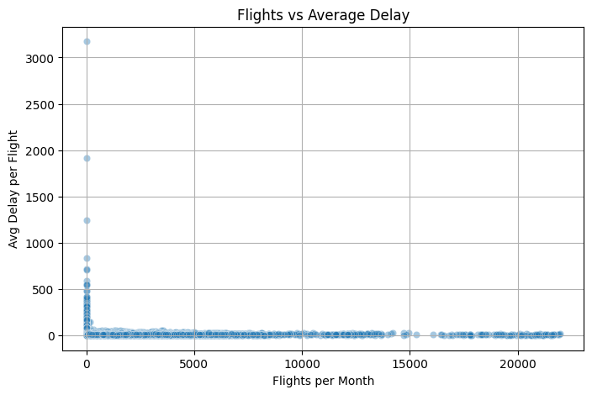
Predictive Modeling: Delay Classification & Regression
• Random Forest Classifier achieves strong performance: AUC = 0.94 and high recall for delay months.
• Confusion matrix shows most severe delay periods are correctly flagged with minimal false negatives.
• ROC curve confirms excellent model discrimination between delayed and normal classes.
• Regression plot shows low-traffic airports may face disproportionately high delays — ideal intervention targets.

Slide 5
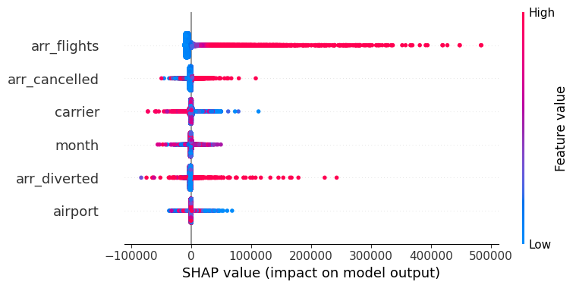
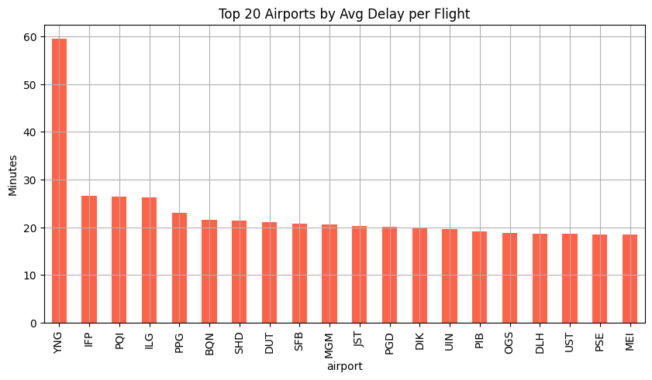
Model Interpretability & Operational Prioritization
• SHAP shows cancellations, flight volume, and carrier identity significantly influence delay predictions—these are operationally controllable.
• Lower flight volume (blue) correlates with higher SHAP impact → small airports are delay-prone.
• Top 20 airport delay chart confirms SHAP: smaller airports like YNG, IFP experience high average delay per flight.
• Interventions (resource reallocation, extra buffers) should prioritize these high-impact features and locations.

Slide 6
Actionable Recommendations
Improve Turnaround Operations:
• Prioritize reduction of carrier and late aircraft delays — the largest controllable causes.
• Tactics: Enhance gate readiness, minimize crew switch delays, automate aircraft positioning.
Target High-Delay Airports:
• Focus interventions at top-delay airports like YNG, IFP, PIE where avg delays exceed 30+ mins.
• Even low-volume airports have outsized impact on delay averages and passenger satisfaction.
Leverage Explainable AI (SHAP + OAI):
• Use SHAP to identify delay-driving features (e.g., cancellations, flight volume).
• OAI helps prioritize controllable issues — shifting focus from weather to operational bottlenecks.
Align Resources with Temporal Patterns:
• Peak delays in June–July suggest seasonal staffing/scheduling buffers are essential.
• Match crew and gate logistics with historical monthly demand and delay trends.

