Slide 1
Development Gateway
Solutions that empower

Slide 2
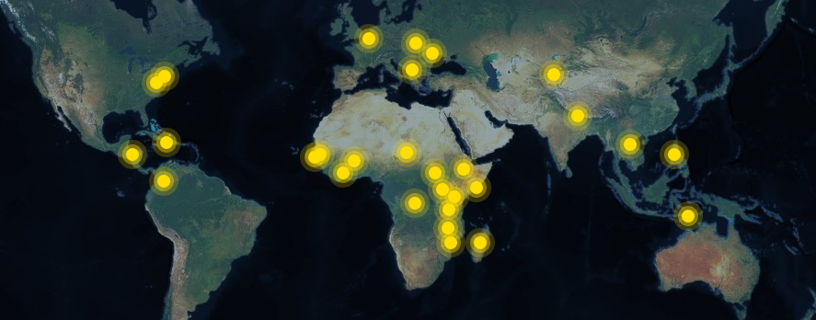

Slide 3
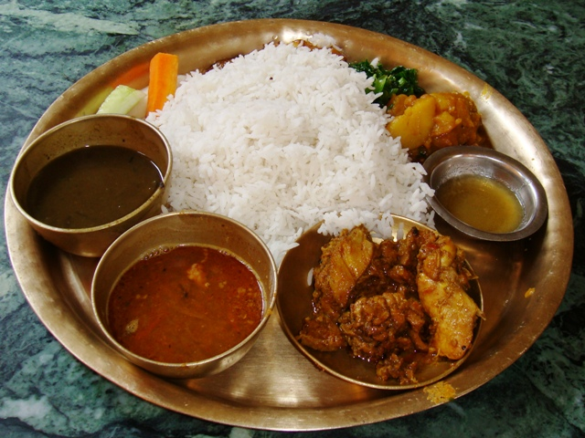

Slide 4
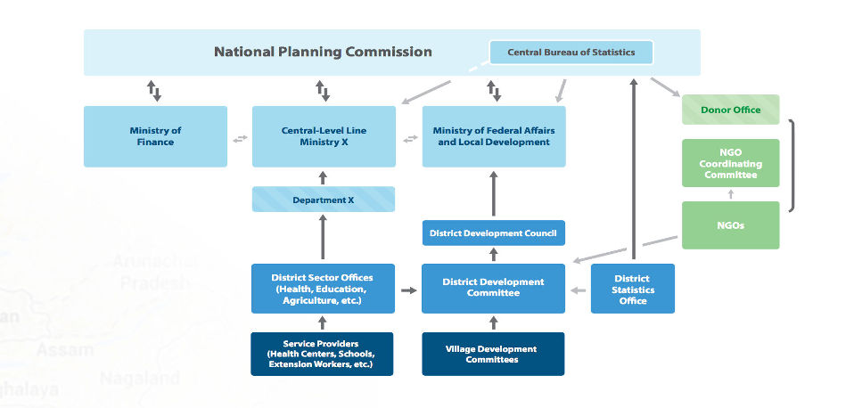
Government of Nepal

Slide 5
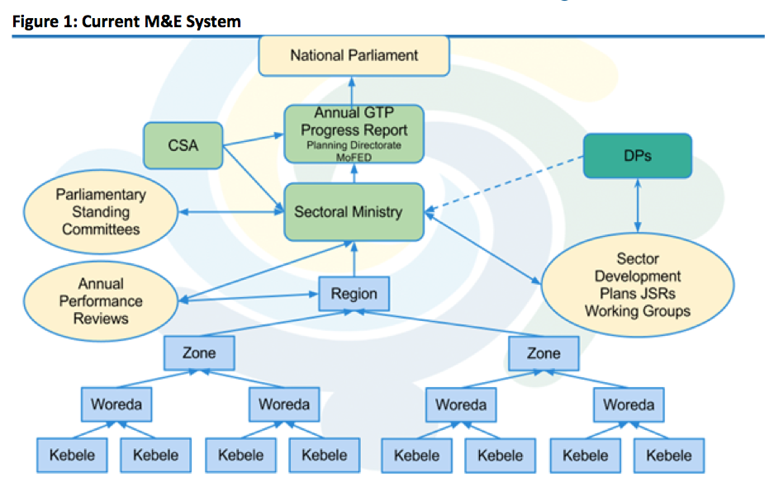
Government of Ethiopia

Slide 6
The Issue
Is results data good enough -- and is it used well enough -- to increase the impact of development activities?
Quality
Sharing
Use

Slide 7
Results Data Initiative
Question
What will it take to improve results data quality and make it more useful for government and donors?
Method
Document the way donors, governments, and implementers collect, manage, disseminate, and use results data.
Product
Produce a synopses of the results management “ecosystem” via 3 country case studies

Slide 8
Results Data Initiative
Question
How can existing results data be compared, shared, and used effectively?
Method
Conduct a careful “crosswalk” of donor results data from the health and agriculture sectors
Product
Demonstrate how results reports can be “joined up” to facilitate cross-donor and cross-country comparison, data visualization, and analysis

Slide 9
Country Case Studies
Countries
Ghana
Tanzania
Sri Lanka
Sectors
Health
Agriculture
Data Collection
Semi-structured interviews
Government, donors, implementers

Slide 10
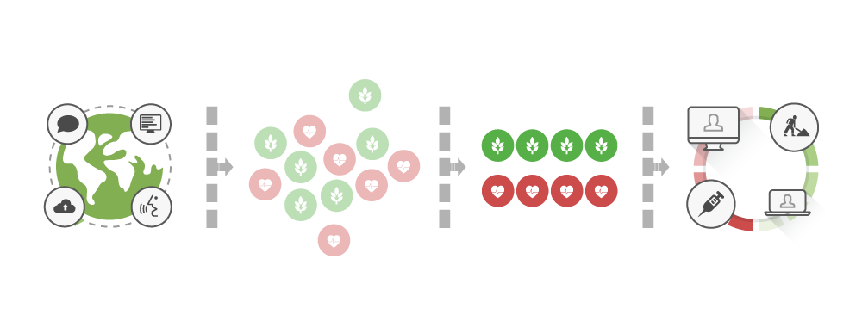
Data Crosswalk

Slide 11
Timeline
 | Sept '15 | Oct '15 | Nov '15 | Dec '15 | Jan '16 | Feb '16 | Mar '16 | Apr '16 | May '16 | Jun '16
Consultation Meeting
Country Research
Data Exercise
Review Period
Final Meeting & Outputs

Slide 12
Where you come in:
Asking the right questions
Producing useful outputs
What evidence do you need to push the results agenda forward?

