Slide 1
Development Gateway
Unleashing Results: Motivating Observations
Susan Stout
September 22, 2015

Slide 2
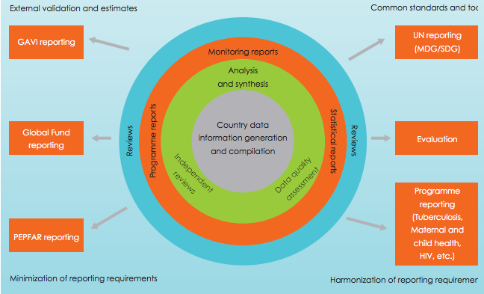
Country use is the heart of the problem
Source: The Roadmap for Health Measurement and Accountability

Slide 3
But measurement efforts concentrate at the top of the pyramid
Utility for Service Provision
Clients / Consumers
‘on the ground’
Level of Investment in Information
Local
Government
Civil Society &
Private Sector
State/Provincial Government
Central Government
Donor Agency
Donor Authorizing Environment

Slide 4
What is the results ecosystem?
Depends on Context
Authorizing Environment
Public Value
Implementing Organization
Notes:
Something flying in over graphic: depends on context

Slide 5
What is the results ecosystem?
District Council
Farmers
District Department of Agriculture
Notes:
Something flying in over graphic: depends on context

Slide 6
What is the results ecosystem?
National Plan and Budget
Households and Families
Ministry of Health
Notes:
Something flying in over graphic: depends on context

Slide 7
The tyranny of good intentions – multiple donors, multiple systems
Donor Project 1
Donor Project 2
Donor Project 3
Director
National level and sectoral leadership typically not well-informed by ad hoc, project-specific M&E.
Notes:
Something flying in over graphic: depends on context

Slide 8
The “Results Chain”
Input
Process
Output
Outcome
Impact!
Supply
Demand

Slide 9
Beware two diseases!
Indicatoritis
Resultsophobia

