Slide 1
INVESTMENT ASSIGNMENT SUBMISSION
Name: Dev Kumar Singh

Slide 2
Spark Funds Investment Case Study
Spark Funds wants to make investments in a few companies.
Spark Funds wants to understand the global trends in investments so that she can take the investment decisions effectively.
Spark Funds has two minor constraints for investments:
It wants to invest between 5 to 15 million USD per round of investment
It wants to invest only in English-speaking countries because of the ease of communication with the companies it would invest in

Slide 3
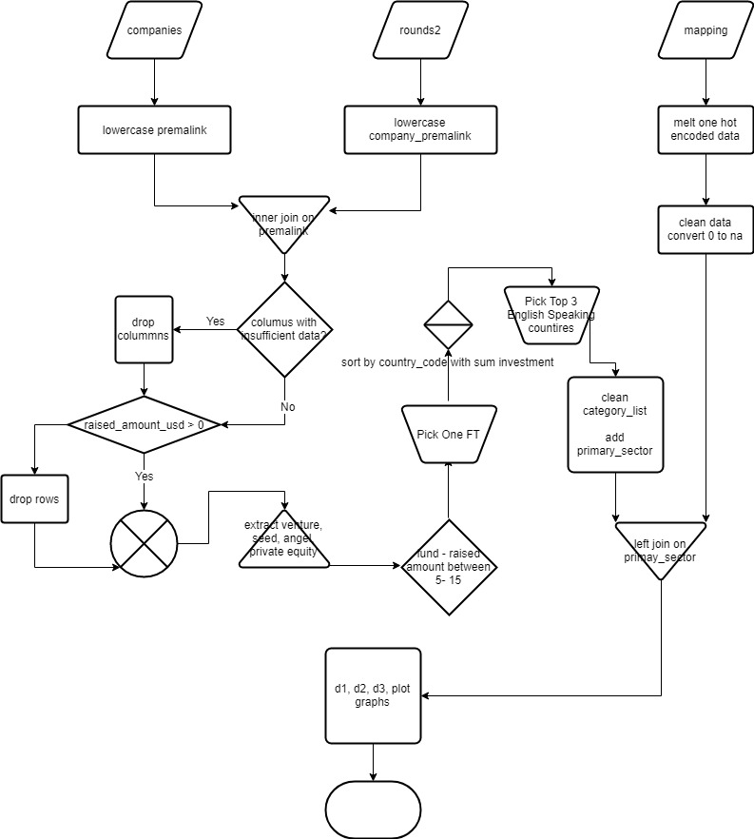
Problem Solving Methodology

Slide 4
Analysis
Data For Analysis Source of Data for analysis is real investment data from crunchbase.com.
Company Data, A file with basic data of companies
2. Investment Rounds Data, companies past investment round details
3. Mapping File, category to main sector mapping
4. English-speaking countries reference document.
Assumptions:
• All the information provided within the 3 files is a trusted source for analysis. Data cleaning performed:
• Removing columns having null values which are not required for the current analysis.
• Removing rows having null value in the required analysis fields.
• Correcting incorrect or missing data wherever required to make data clean for analysis.

Slide 5
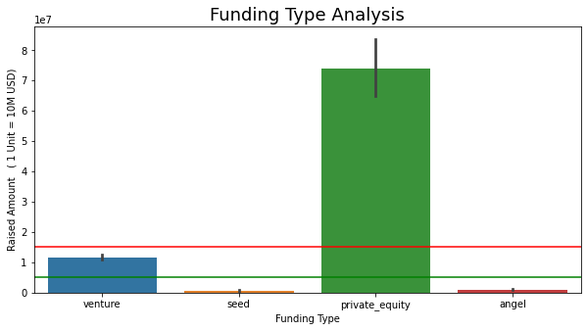
Funding Type Analysis

Slide 6
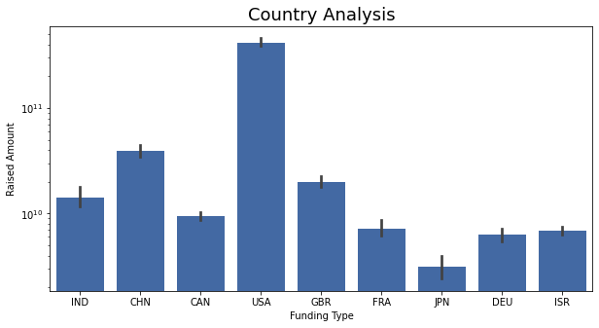
Country Analysis

Slide 7
<Results>
Plot 1

Slide 8
<Results>
Plot 2

Slide 9
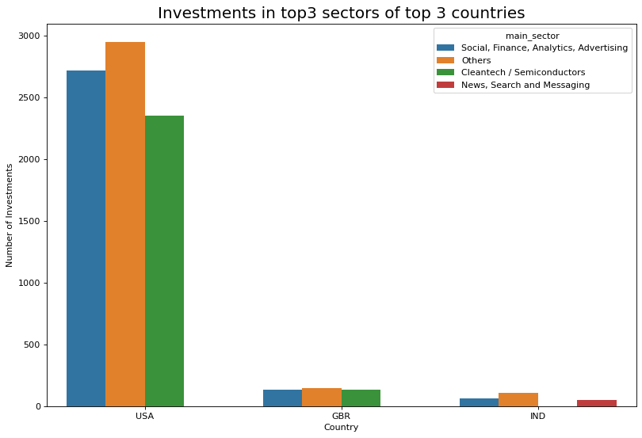
<Results>
Plot 3

Slide 10
<Conclusions>
Based on the data it is clear that USA is the prime place to make investment, going by the number and volume of investments, 50% of the amount can be invested in the top 2 companies on the top 2 sectors shared equally among all 4 companies
Virtustream
Capella
Shotspotter
Demandbase
Next set of investment 25% each can be made at the top company of the top 2 sector in GBR and India respectively
electric-cloud
celltick-technologies
manthan-systems
firstcry-com
Which makes an even share of 12.5% across all the identified 8 companies.
Average total investment across the 8 identified companies as per the data is around 40 million with median between 5-15 million

