Slide 1
Show me all of your artifact!
Using SQLite JSON objects to store all of the artifact

Slide 2

Artifact
Artifact
Artifact

Slide 3
Why have different types of Output?
Output for Analysis
Output for People
Sometimes the output for people takes valuable information away from the analyst

Slide 4
Correlation Points
Can’t correlate artifacts if the correlation point is not present
Example
IDLists in linkfiles can correlate to Shellbags for external device access.

Slide 5
THAT’S A LOT OF ARTIFACTS!
LogFile
Shell Bag
MFT
Prefetch
USN
Link File
Jump List
Shim Cache
Event Logs

Slide 6
THAT’S A LOT OF CORRELATION!
LogFile
Parent Reference Numbers
Shell Bag
MFT
Prefetch
Update Sequence Number
File Names
USN
Timestamps
Entry Reference Numbers
Link File
Jump List
Shim Cache
Object IDs
Event Logs

Slide 7
Stolen Data?
Device Serial Info
System
Device
MFT
Parent Reference Numbers
MFT
FAT Entries
Jumplists
File Reference Numbers
USN
Link Files
Shell Items
Name
Shell Bags
Size
USB Info
Timestamps

Slide 8
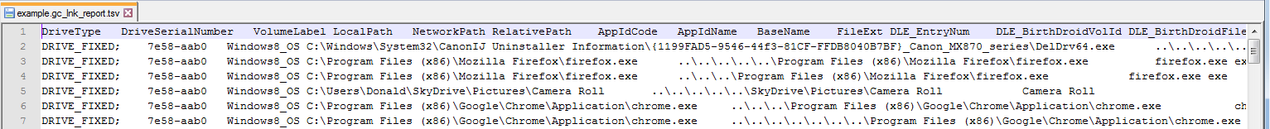
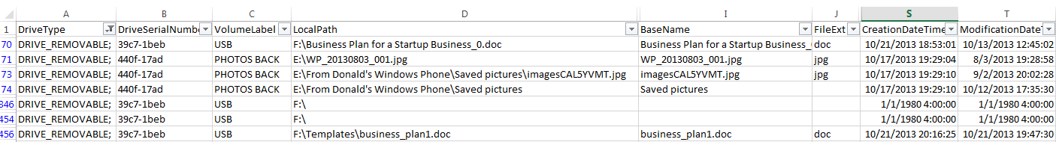
Flat Output
Easy for review
Easy to stick into excel, make pretty, and send off to client
Easy to sort and filter

Slide 9
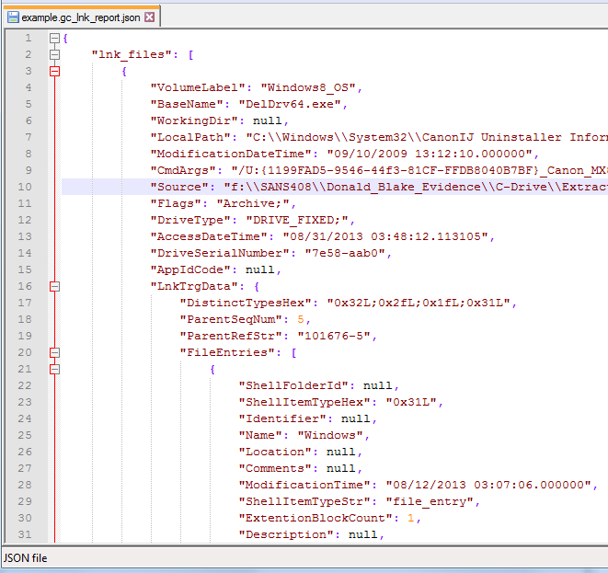
Nested Output
Contains data that does not have room in flat output
Can lead to more correlation points
Can show the proper structure of an artifact
Can contain unstructured data
Common formats – JSON, XML, YAML

Slide 10
JSON objects in SQLite
You get all the artifact
You can do better filtering
You decide how you output it

Slide 11
Windows Event Structure - XML
<Event xmlns="http://schemas.microsoft.com/win/2004/08/events/event">
<System>
<Provider Name="Microsoft-Windows-Security-Auditing" Guid="{54849625-5478-4994-A5BA-3E3B0328C30D}"/>
<EventID>4648</EventID>
<Version>0</Version>
<Level>0</Level>
<Task>12544</Task>
<Opcode>0</Opcode>
<Keywords>0x8020000000000000</Keywords>
<TimeCreated SystemTime="2013-09-20T20:32:40.903544000Z"/>
<EventRecordID>1206752</EventRecordID>
<Correlation/>
<Execution ProcessID="732" ThreadID="9668"/>
<Channel>Security</Channel>
<Computer>Bifrost</Computer>
<Security/>
</System>
<EventData>
<Data Name="SubjectUserSid">S-1-5-18</Data>
<Data Name="SubjectUserName">BIFROST$</Data>
<Data Name="SubjectDomainName">ASGARD</Data>
<Data Name="SubjectLogonId">0x00000000000003e7</Data>
<Data Name="LogonGuid">{00000000-0000-0000-0000-000000000000}</Data>
<Data Name="TargetUserName">dblake@asgard-venture-capital.com</Data>
<Data Name="TargetDomainName">MicrosoftAccount</Data>
<Data Name="TargetLogonGuid">{00000000-0000-0000-0000-000000000000}</Data>
<Data Name="TargetServerName">localhost</Data>
<Data Name="TargetInfo">localhost</Data>
<Data Name="ProcessId">0x00000000000002a8</Data>
<Data Name="ProcessName">C:\Windows\System32\winlogon.exe</Data>
<Data Name="IpAddress">127.0.0.1</Data>
<Data Name="IpPort">0</Data>
</EventData>
</Event>
*The problem is this data is dynamic and can contain anything.

Slide 12
Dynamic Examples
<EventData>
<Data/>
<Binary>00000800010000000000000012000540000000000000000000000000000000000000000000000000E000000000000000</Binary>
</EventData>
<EventData>
<Data>msiexec</Data>
<Data>3636</Data>
<Data>Instance: </Data>
<Data>0</Data>
<Data>6</Data>
<Data>02</Data>
<Data>9200</Data>
<Data>0000</Data>
</EventData>
<UserData>
<AddServiceID xmlns="http://manifests.microsoft.com/win/2004/08/windows/userpnp">
<ServiceName>WUDFWpdFs</ServiceName>
<DriverFileName>\SystemRoot\system32\DRIVERS\WUDFRd.sys</DriverFileName>
<DeviceInstanceID>SWD\WPDBUSENUM\{ABCD082A-3B8E-11E3-BE8D-24FD52566EDE}#0000000000007E00</DeviceInstanceID>
<PrimaryService>true</PrimaryService>
<UpdateService>true</UpdateService>
<AddServiceStatus>0</AddServiceStatus>
</AddServiceID>
</UserData>
<EventData>
<Data>Service started successfully.</Data>
</EventData>

Slide 13
Windows Event Structure - JSON
{ | { | "TimeCreated": { | "Channel": {
"EventData": { | "#text": "localhost", | "SystemTime": "2013-09-20T20:32:40.903544000Z" | "#text": "Security"
"Data": [{ | "Name": "TargetServerName" | }, | }
"#text": "S-1-5-18", | }, | "Level": { | }
"Name": "SubjectUserSid" | { | "#text": "0" | }
}, | "#text": "localhost", | },
{ | "Name": "TargetInfo" | "Correlation": {
"#text": "BIFROST$", | },
"Name": "SubjectUserName" | { | },
}, | "#text": "0x00000000000002a8", | "Version": {
{ | "Name": "ProcessId" | "#text": "0"
"#text": "ASGARD", | }, | },
"Name": "SubjectDomainName" | { | "Opcode": {
}, | "#text": "C:\\Windows\\System32\\winlogon.exe", | "#text": "0"
{ | "Name": "ProcessName" | },
"#text": "0x00000000000003e7", | }, | "EventRecordID": {
"Name": "SubjectLogonId" | { | "#text": "1206752"
}, | "#text": "127.0.0.1", | },
{ | "Name": "IpAddress" | "Provider": {
"#text": "{00000000-0000-0000-0000-000000000000}", | }, | "Guid": "{54849625-5478-4994-A5BA-3E3B0328C30D}",
"Name": "LogonGuid" | { | "Name": "Microsoft-Windows-Security-Auditing"
}, | "#text": "0", | },
{ | "Name": "IpPort" | "Keywords": {
"#text": "dblake@asgard-venture-capital.com", | }] | "#text": "0x8020000000000000"
"Name": "TargetUserName" | }, | },
}, | "xmlns": "http://schemas.microsoft.com/win/2004/08/events/event", | "Security": {
{ | "System": {
"#text": "MicrosoftAccount", | "EventID": { | },
"Name": "TargetDomainName" | "#text": "4648" | "Execution": {
}, | }, | "ProcessID": "732",
{ | "Task": { | "ThreadID": "9668"
"#text": "{00000000-0000-0000-0000-000000000000}", | "#text": "12544" | },
"Name": "TargetLogonGuid" | }, | "Computer": {
}, |  | "#text": "Bifrost"
 |  | },

Slide 14
Logon Activity in Windows Events
SELECT
winevent.written_time AS "Time",
winevent.event_identifier AS "EventID",
winevent.we_description AS "Description",
CASE
WHEN event_identifier == 4624
THEN json_extract(we_jrec,'$.EventData.Data[5].#text')
WHEN event_identifier == 4634
THEN json_extract(we_jrec,'$.EventData.Data[1].#text')
WHEN event_identifier == 4648
THEN json_extract(we_jrec,'$.EventData.Data[5].#text') || ' -> ' ||
json_extract(we_jrec,'$.EventData.Data[1].#text')
ELSE '<Not Handled>'
END AS "LogonID",
winevent.computer_name AS "Computer",
winevent.source_name AS "Channel",
winevent.we_source AS "Source"
FROM "winevent"
WHERE
Channel == 'Microsoft-Windows-Security-Auditing' AND
event_identifier IN (4624,4625,4634,4648)
ORDER BY written_time

Slide 15
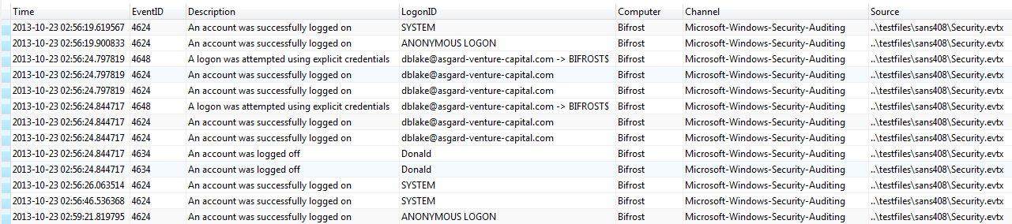
Result

Slide 16
Demo
SQLite Templates for Windows Events with EventMonkey
Templates and the tool can be found here: https://github.com/devgc/EventMonkey

Slide 17
Lnk File Structure - Json
{ | "FileSize": 0, | "LongName": "business_plan1.doc", | "ParentLongName": "Templates",
"VolumeLabel": "USB", | "ExtentionBlocks": [ | "ExtentionBlockSize": 86, | "ParentEntryNum": 253312,
"BaseName": "business_plan1.doc", | { | "LocalizedName": null, | "DistinctTypesStr": "volume;root_folder;file_entry",
"WorkingDir": null, | "LongName": "Templates", | "SeqNum": 0, | "ExtentionListing": "0xbeef0004L;0xbeef0004L",
"LocalPath": "F:\\Templates\\business_plan1.doc", | "ExtentionBlockSize": 68, | "EntryNum": 2494848, | "ItemCount": 5,
"ModificationDateTime": "10/21/2013 19:47:30.000000", | "LocalizedName": null, | "FileReferenceInt": 2494848, | "RootFolder": [
"CmdArgs": null, | "SeqNum": 0, | "AccessTime": "10/21/2013 04:00:00.000000", | {
"Source": "f:\\SANS408\\Donald_Blake_Evidence\\C-Drive\\Extracts\\SANS408\\p1-sys\\link-files\\48409.Donald.business_plan1.LNK", | "EntryNum": 253312, | "CreationTime": "10/21/2013 20:16:26.000000", | "ShellFolderId": "20d04fe0-3aea-1069-a2d8-08002b30309d",
"Flags": "Archive;", | "FileReferenceInt": 253312, | "Signature": "0xbeef0004L", | "ShellItemTypeHex": "0x1fL",
"DriveType": "DRIVE_REMOVABLE;", | "AccessTime": "10/21/2013 04:00:00.000000", | "RefNum": "2494848-0" | "Identifier": null,
"AccessDateTime": "10/21/2013 04:00:00.000000", | "CreationTime": "10/21/2013 20:16:24.000000", | } | "Name": null,
"DriveSerialNumber": "39c7-1beb", | "Signature": "0xbeef0004L", | ] | "Location": null,
"AppIdCode": null, | "RefNum": "253312-0" | } | "Comments": null,
"LnkTrgData": { | } | ], | "ModificationTime": null,
"DistinctTypesHex": "0x32L;0x2fL;0x1fL;0x31L", | ] | "Volume": [ | "ShellItemTypeStr": "root_folder",
"ParentSeqNum": 0, | }, | { | "ExtentionBlockCount": 0,
"ParentRefStr": "253312-0", | { | "ShellFolderId": "00000000-0000-0000-0000-000000000000", | "Description": null,
"FileEntries": [ | "ShellFolderId": null, | "ShellItemTypeHex": "0x2fL", | "FileSize": null,
{ | "ShellItemTypeHex": "0x32L", | "Identifier": "00000000-0000-0000-0000-000000000000", | "ExtentionBlocks": []
"ShellFolderId": null, | "Identifier": null, | "Name": "F:\\", | }
"ShellItemTypeHex": "0x31L", | "Name": "BUSINE~3.DOC", | "Location": null, | ]
"Identifier": null, | "Location": null, | "Comments": null, | },
"Name": "TEMPLA~1", | "Comments": null, | "ModificationTime": null, | "Description": null,
"Location": null, | "ModificationTime": "10/21/2013 19:47:30.000000", | "ShellItemTypeStr": "volume", | "RelativePath": null,
"Comments": null, | "ShellItemTypeStr": "file_entry", | "ExtentionBlockCount": 0, | "Codepage": "cp1252",
"ModificationTime": "10/21/2013 20:04:18.000000", | "ExtentionBlockCount": 1, | "Description": null, | "IconLoc": null,
"ShellItemTypeStr": "file_entry", | "Description": null, | "FileSize": null, | "AppIdName": null,
"ExtentionBlockCount": 1, | "FileSize": 153600, | "ExtentionBlocks": [] | "FileExt": "doc",
"Description": null, | "ExtentionBlocks": [ | } | "NetworkPath": null,
"FileSize": 0, A52A30:A63 | { | ], | "FileSize": 153600,
 |  |  | "CreationDateTime": "10/21/2013 20:16:24.870000",
 |  |  | "EnvVarLoc": null
 |  |  | }

Slide 18
Link File Example
SELECT
linkfiles.DriveType,
linkfiles.VolumeLabel,
linkfiles.DriveSerialNumber,
json_extract(entry_item.value,'$.ExtentionBlocks[0].LongName') AS LongName,
json_extract(entry_item.value,'$.ExtentionBlocks[0].EntryNum') AS EntryNum,
json_extract(entry_item.value,'$.ExtentionBlocks[0].SeqNum') AS SeqNum,
linkfiles.LocalPath,
json_extract(entry_item.value,'$.ExtentionBlocks[0].CreationTime') AS CreationTime,
json_extract(entry_item.value,'$.ExtentionBlocks[0].AccessTime') AS AccessTime,
linkfiles.FileSize,
linkfiles.Source,
json_extract(LnkTrgData,'$.FileEntries') AS LnkTrgData
FROM
"linkfiles",
json_each(
json_extract(LnkTrgData,'$.FileEntries')
) AS entry_item
WHERE
DriveType == 'DRIVE_REMOVABLE;'

Slide 19
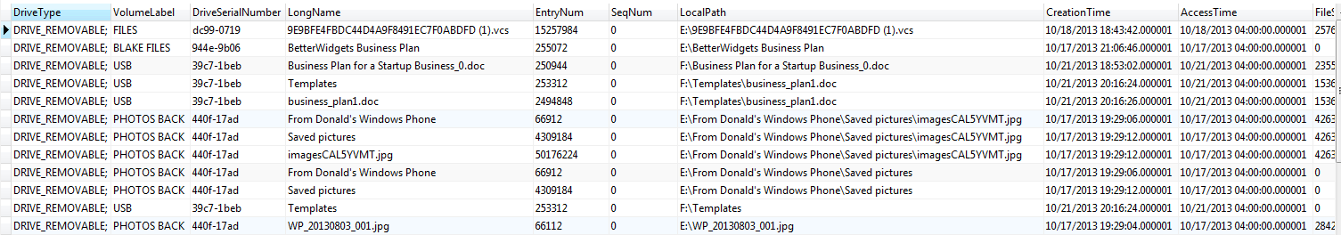
Result

Slide 20
Demo
Correlation of Links and Shellbags
Get GcLinkParser at https://github.com/devgc/GcLinkParser
It will output into SQLite for you!

Slide 21
MFT Example – JSON Columns
mfth_magic | mfth_lsn | mfth_seq | mfth_flags_str | mfth_allocation | mfth_entry | mfth_entry_ref | mft_headers | attr_standardinformation | attr_filename | attr_data
FILE | 24578749660 | 3 | Folder | Allocated | 200 | 200-3 | [{"mfth_alloc_size": 1024, "mfth_allocation": "Allocated", "mfth_attr_ofs": 56, "mfth_base_rec": 0, "mfth_base_ref": "0-0", "mfth_base_seq": 0, "mfth_entry": 200, "mfth_entry_ref": "200-3", "mfth_flags": 3, "mfth_flags_str": "Folder", "mfth_link_cnt": 2, "mfth_lsn": 24578749660, "mfth_magic": "FILE", "mfth_next_attrid": 4, "mfth_padding1": "0000", "mfth_seq": 3, "mfth_update_cnt": 3, "mfth_update_ofs": 48, "mfth_us_array": ["0300", "0000", "0000"], "mfth_us_val": "0900", "mfth_used_size": 776}] | [{"contents": {"siattr_atime": "2013-09-26T18:26:42.956691", "siattr_attr_num": null, "siattr_class_id": 0, "siattr_ctime": "2013-09-26T18:26:42.956691", "siattr_dos": "", "siattr_maxver": 0, "siattr_mftmtime": "2013-09-26T18:26:42.956691", "siattr_mtime": "2013-09-26T18:26:42.956691", "siattr_own_id": 0, "siattr_quota": 0, "siattr_sec_id": 269, "siattr_usn": 9172738280, "siattr_ver": 0}, "header": {"attr_alloc_size": null, "attr_compress_size": null, "attr_content_ofs": 24, "attr_content_size": 72, "attr_flags": "", "attr_id": 0, "attr_index_flag": 0, "attr_init_size": null, "attr_last_vcn": null, "attr_len": 96, "attr_name_len": 0, "attr_name_ofs": 0, "attr_padding1": 0, "attr_padding2": null, "attr_real_size": null, "attr_res": 0, "attr_run_ofs": null, "attr_start_vcn": null, "attr_type": 16}}] | [{"contents": {"fnattr_alloc_fsize": 0, "fnattr_atime": "2013-09-26T18:26:42.956691", "fnattr_ctime": "2013-09-26T18:26:42.956691", "fnattr_flags": "Directory;", "fnattr_fullname": "000C0C~1", "fnattr_len_name": 8, "fnattr_mftmtime": "2013-09-26T18:26:42.956691", "fnattr_mtime": "2013-09-26T18:26:42.956691", "fnattr_name": "000C0C~1", "fnattr_namespace": 2, "fnattr_parent_rec": 192, "fnattr_parent_ref": "192-4", "fnattr_parent_seq": 4, "fnattr_real_fsize": 0}, "fullname": "\\Windows\\assembly\\NativeImages_v2.0.50727_32\\System.Configuratio#\\", "header": {"attr_alloc_size": null, "attr_compress_size": null, "attr_content_ofs": 24, "attr_content_size": 82, "attr_flags": "", "attr_id": 3, "attr_index_flag": 1, "attr_init_size": null, "attr_last_vcn": null, "attr_len": 112, "attr_name_len": 0, "attr_name_ofs": 0, "attr_padding1": 0, "attr_padding2": null, "attr_real_size": null, "attr_res": 0, "attr_run_ofs": null, "attr_start_vcn": null, "attr_type": 48}}, {"contents": {"fnattr_alloc_fsize": 0, "fnattr_atime": "2013-09-26T18:26:42.956691", "fnattr_ctime": "2013-09-26T18:26:42.956691", "fnattr_flags": "Directory;", "fnattr_fullname": "000c0cc1624e7bef48ab396be286c2bf", "fnattr_len_name": 32, "fnattr_mftmtime": "2013-09-26T18:26:42.956691", "fnattr_mtime": "2013-09-26T18:26:42.956691", "fnattr_name": "000c0cc1624e7bef48ab396be286c2bf", "fnattr_namespace": 1, "fnattr_parent_rec": 192, "fnattr_parent_ref": "192-4", "fnattr_parent_seq": 4, "fnattr_real_fsize": 0}, "fullname": "\\Windows\\assembly\\NativeImages_v2.0.50727_32\\System.Configuratio#\\", "header": {"attr_alloc_size": null, "attr_compress_size": null, "attr_content_ofs": 24, "attr_content_size": 130, "attr_flags": "", "attr_id": 2, "attr_index_flag": 1, "attr_init_size": null, "attr_last_vcn": null, "attr_len": 160, "attr_name_len": 0, "attr_name_ofs": 0, "attr_padding1": 0, "attr_padding2": null, "attr_real_size": null, "attr_res": 0, "attr_run_ofs": null, "attr_start_vcn": null, "attr_type": 48}}]

Slide 22
MFT Filelist Example
SELECT DISTINCT
coalesce(json_extract(fnattr.value,'$.fullname'),'') ||
json_extract(fnattr.value,'$.contents.fnattr_name') ||
coalesce(':' || json_extract(dtattr.value,'$.contents.daattr_stream_name'),'')
AS filename,
mft_records.mfth_entry,
mft_records.mfth_seq,
mft_records.mfth_allocation,
CASE
WHEN (json_extract(dtattr.value,'$.contents.daattr_resident') IS 0)
THEN json_extract(dtattr.value,'$.header.attr_content_size')
ELSE
json_extract(dtattr.value,'$.contents.daattr_real_size')
END AS daattr_real_size,
json_extract(dtattr.value,'$.contents.daattr_stream_name') AS daattr_stream_name,
json_extract(dtattr.value,'$.contents.daattr_resident') AS daattr_resident,
json_extract(siattr.value,'$.contents.siattr_ctime') AS siattr_ctime,
json_extract(siattr.value,'$.contents.siattr_mtime') AS siattr_mtime,
json_extract(siattr.value,'$.contents.siattr_mftmtime') AS siattr_mftmtime,
json_extract(siattr.value,'$.contents.siattr_atime') AS siattr_atime,
json_extract(fnattr.value,'$.contents.fnattr_ctime') AS fnattr_ctime,
json_extract(fnattr.value,'$.contents.fnattr_mtime') AS fnattr_mtime,
json_extract(fnattr.value,'$.contents.fnattr_mftmtime') AS fnattr_mftmtime,
json_extract(fnattr.value,'$.contents.fnattr_atime') AS fnattr_atime,
json_extract(fnattr.value,'$.contents.fnattr_flags') AS fnattr_flags,
json_extract(fnattr.value,'$.contents.fnattr_name') AS fnattr_name,
json_extract(fnattr.value,'$.contents.fnattr_namespace') AS fnattr_namespace,
json_extract(fnattr.value,'$.contents.fnattr_parent_rec') AS fnattr_parent_rec,
json_extract(fnattr.value,'$.contents.fnattr_parent_seq') AS fnattr_parent_seq,
json_extract(dtattr.value,'$.contents.daattr_name') AS daattr_name,
json_extract(dtattr.value,'$.contents.daattr_real_size') AS daattr_real_size,
mft_records.info_source_file
FROM
"mft_records",
json_each(mft_records.attr_filename) as fnattr,
json_each(mft_records.attr_standardinformation) as siattr,
json_each(mft_records.attr_data) as dtattr;

Slide 23
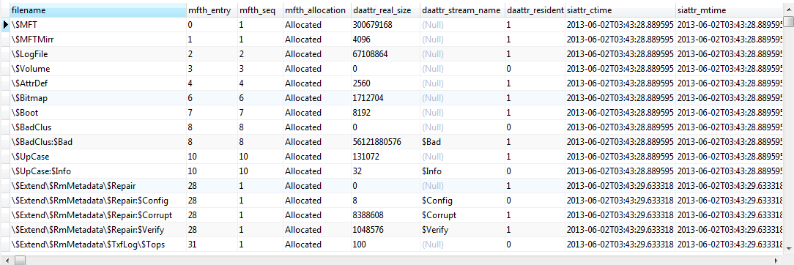
Result

Slide 24
More Thoughts
SQLite works, but is probably not the best solution
Need something like an embeddable MongoDB
Technologies to look into
RocksDB (key value store database) [http://rocksdb.org/]
ObjectPath (query language for semi-structured data) [http://objectpath.org/]
Zorba (Zorba is a query processor designed for flexible data: from the simplicity of JSON to the completeness of XML.) [http://www.zorba.io/home]

Slide 25
Questions?
Email us:
Matt: mseyer@g-cpartners.com
Dave: dcowen@g-cpartners.com
Tweet us:
@forensic_matt
@hecfblog
Get the code!
https://github.com/devgc

