Slide 1
A Database for Forensics
Artifact Correlation with ArangoDB
David Cowen & Matthew Seyer
G-C Partners, LLC

Slide 2
Lots of Artifacts
LogFile
Shell Bag
MFT
Prefetch
USN
Link File
Jump List
Shim Cache
Event Logs

Slide 3
Lots of Correlation
LogFile
Parent Reference Numbers
Shell Bag
MFT
Prefetch
Update Sequence Number
File Names
USN
Timestamps
Entry Reference Numbers
Link File
Jump List
Shim Cache
Object IDs
Event Logs

Slide 4
The Process
Tool
Output
Ingestion
Analysis
Report
The better the tool output, the better the analysis
The better the analysis, the better the report

Slide 5
Tool and Output Challenge
The Forensic tool has to give us all the artifact!
Output for People
Linear
Easy to read
Output for Analysis
Nested
Difficult to read with the human eye
More data for analysis

Slide 6
Output for Human

Slide 7
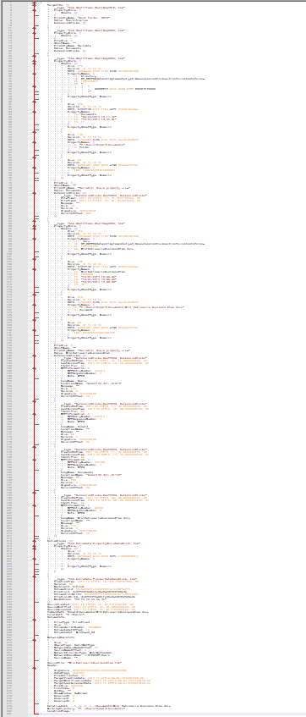
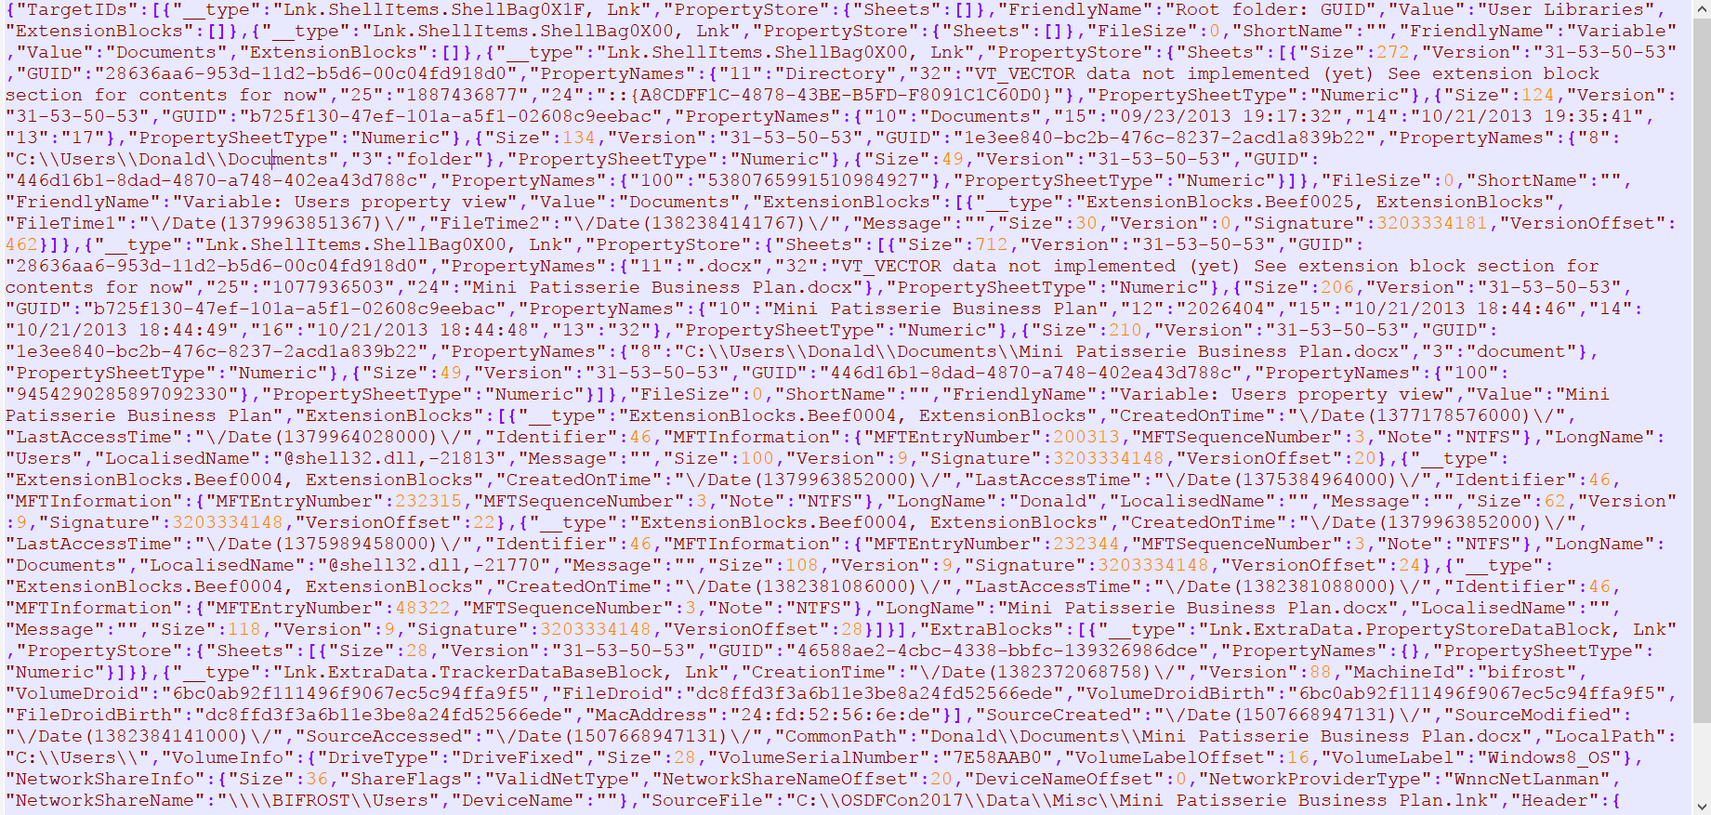
Output for Analysis
281 lines

Slide 8
Analysis Challenges
Navigating the data
Searching the data
Correlating the data
Formatting the data
Automation of it all

Slide 9
Some History
SQLite [SQL] – OSDFCON 2016
Advantages
Fast and local
Disadvantages
Not built for nested data (but possible to store)
Not efficient for joining on nested data (correlation)
Does not scale
MongoDB [NoSQL]
Advantages
Built for nested data (JSON Documents)
Disadvantages
Server needed
Not relational

Slide 10
Some History
Elasticsearch [Search Engine] - OSDFCON 2015
Advantages
Built for nested data (JSON Documents)
Super fast querying
Disadvantages
Not a database
Not relational
Server needed

Slide 11
ArangoDB to the Rescue!
Multi-Model Database
Document Store (JSON)
Graph Database
Key-Value store
A great query language [AQL]
Efficient relational queries on nested documents
Written in C! AKA NO JAVA!
Maintains a scalable environment
JavaScript microservices
Ships with a great interface

Slide 12
2015 Rewind Example Device History in Elasticsearch
156 lines of python script to stich things together.
To much code to display. See it here: https://github.com/devgc/ElasticHandler/blob/master/scripts/ExternalDeviceExample.py

Slide 13
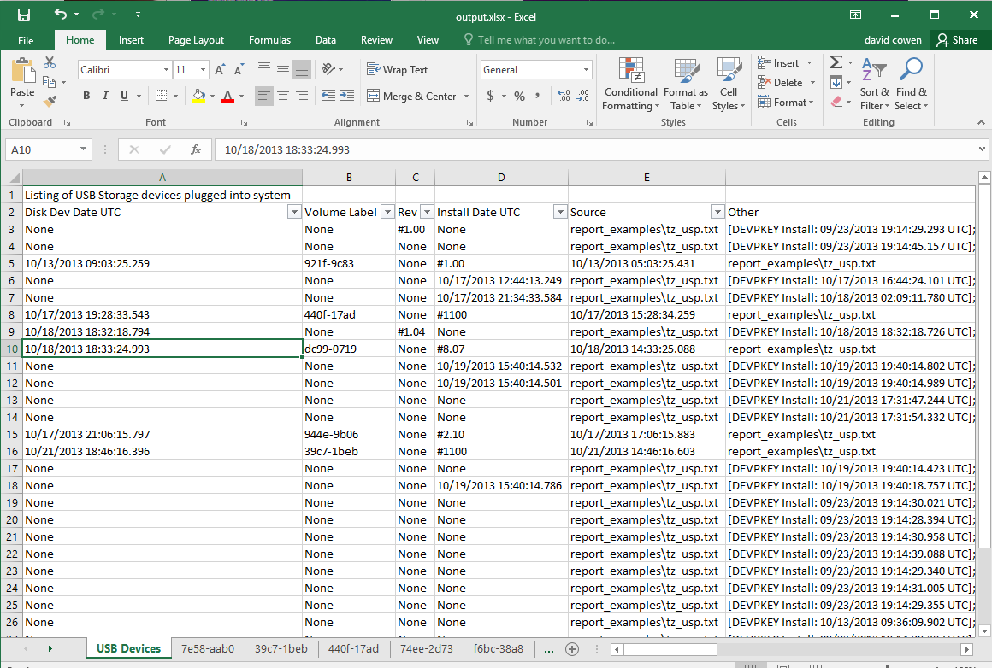
Device History in Elasticsearch Result

Slide 14
2016 Rewind Example SBAGS and LNKS in SQLite
CREATE TEMP TABLE linkpaths AS
SELECT DISTINCT
linkfiles.DriveType,
linkfiles.VolumeLabel,
linkfiles.DriveSerialNumber,
json_extract(entry_item.value,'$.ExtentionBlocks[0].LongName') AS LongName,
json_extract(entry_item.value,'$.ExtentionBlocks[0].EntryNum') AS EntryNum,
json_extract(entry_item.value,'$.ExtentionBlocks[0].SeqNum') AS SeqNum,
linkfiles.LocalPath,
json_extract(entry_item.value,'$.ExtentionBlocks[0].CreationTime') AS CreationTime,
json_extract(entry_item.value,'$.ExtentionBlocks[0].AccessTime') AS AccessTime,
linkfiles.FileSize,
linkfiles.Source,
json_extract(LnkTrgData,'$.FileEntries') AS LnkTrgData
FROM
"linkfiles",
json_each(
json_extract(LnkTrgData,'$.FileEntries')
) AS entry_item
WHERE
DriveType == 'DRIVE_REMOVABLE;';
SELECT DISTINCT
sbags.AbsolutePath,
linkpaths.LocalPath AS "Lnk Local Path",
linkpaths.DriveType,
linkpaths.DriveSerialNumber,
linkpaths.VolumeLabel,
sbags.MFTEntry,
CASE
WHEN (sbags.MFTSequenceNumber IS NULL)
THEN 0
ELSE
sbags.MFTSequenceNumber
END AS MFTSeqNumber,
sbags.MFTSequenceNumber,
linkpaths.EntryNum,
linkpaths.SeqNum,
RTRIM(sbags.Value) AS SbagDirName,
linkpaths.LongName AS LnkDirName,
linkpaths.LnkTrgData,
linkpaths.Source
FROM
sbags
LEFT JOIN linkpaths ON (
(sbags.MFTEntry = linkpaths.EntryNum) AND
(MFTSeqNumber = linkpaths.SeqNum) AND
(SbagDirName = linkpaths.LongName)
)
WHERE AbsolutePath NOT LIKE '%C:%'
ORDER BY "Lnk Local Path"

Slide 15
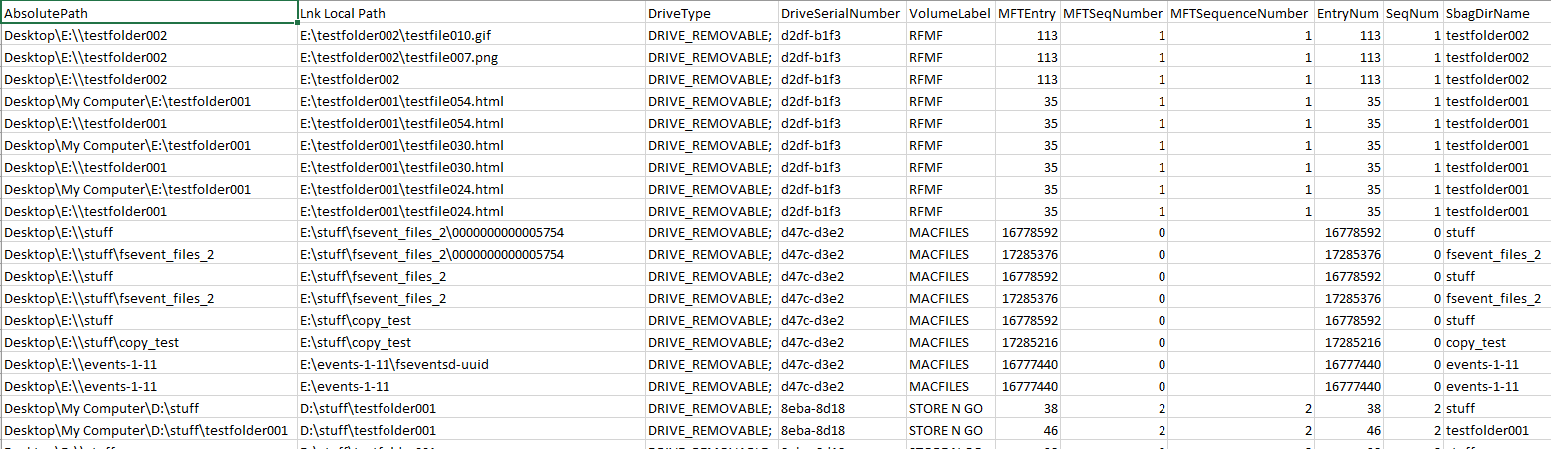
SBAGS and LNKS in SQLite Result

Slide 16
2017 Example SBAGS and LNKS in ArangoDB
FOR lnk IN lnks
FILTER lnk.LnkTrgData.FileEntries != null
FILTER lnk.DriveType == "DRIVE_REMOVABLE;"
FOR entry IN lnk.LnkTrgData.FileEntries
FOR extention IN entry.ExtentionBlocks
FILTER extention.LongName != null
FOR shellbag IN sbags
FILTER (shellbag.Value == extention.LongName &&
TO_NUMBER(shellbag.MFTEntry) == extention.EntryNum &&
TO_NUMBER(shellbag.MFTSequenceNumber) == extention.SeqNum)
RETURN DISTINCT {
"lnk.VolumeLabel": lnk.VolumeLabel,
"lnk.DriveSerialNumber": lnk.DriveSerialNumber,
"shellbag.AbsolutePath": shellbag.AbsolutePath,
"extention.LongName": extention.LongName,
"extention.RefNum": extention.RefNum
}

Slide 17
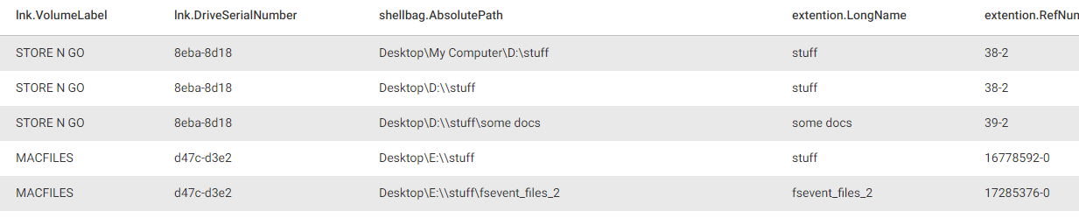
SBAGS and LNKS in ArangoDB Result
*Shows us that Shell Bags “D:\stuff” is a different volume than “E:\stuff”

Slide 18
ArangoDB Query Example #2 Device History
FOR device IN usp
FILTER device.`instance id/serial #` != "00000000"
FOR event IN events
// We need to make both the same CASE to insure contains match
FILTER CONTAINS(UPPER(event.UserData),UPPER(device.`instance id/serial #`))
// Sort by event time
SORT event.System.TimeCreated.SystemTime
RETURN {
"time":DATE_FORMAT(event.System.TimeCreated.SystemTime,'%mm/%dd/%yyyy %hh:%ii:%ss.%fff'),
"device":device.`device name`,
"serial":device.`instance id/serial #`,
"vid":device.vid,
"pid":device.pid,
"provider":event.System.Provider.Name,
"event_id": event.System.EventID,
"record_id": event.System.EventRecordID,
"event":event
}

Slide 19
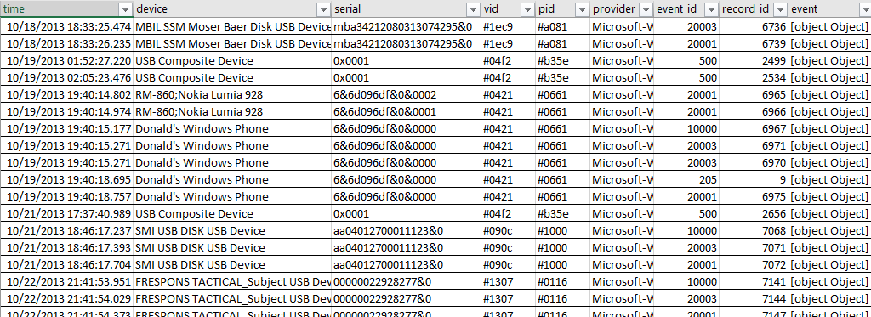
Device History Result

Slide 20
DEMOS!

Slide 21
Questions
Twitter
@hecfblog
@forensic_matt
Blog
http://www.hecfblog.com/
Code
https://github.com/devgc
https://github.com/forensicmatt

