Slide 1
MCQ Quiz App: Testing Knowledge in a Fun Way
PRESENTED BY:
DEV GUPTA
2110992538
BCA-5A

Slide 2
MCQ QUIZ APP
Interactive Learning Platform:
The MCQ Quiz App offers an interactive platform for users to engage in knowledge-testing quizzes using multiple-choice questions.
Accessible and User-Friendly Design:
Its user-friendly interface ensures easy navigation, making it accessible for users of all ages and tech proficiencies.
Engaging Learning Experience:
Aimed at providing an engaging learning experience, the app encourages users to enhance their knowledge in a fun and entertaining way.
Continuous Growth and Improvement:
Focused on continual development, the app plans to introduce new features and expand its question database to enrich the user experience over time.

Slide 3
FUTURE SCOPE
Personalized Quizzes:
Implementing personalized quiz functionalities based on user preferences, allowing users to select specific categories or difficulty levels.
Timed Quizzes and Leaderboards:
Introducing timed quizzes to add a competitive edge, along with leaderboards to showcase top scorers and foster healthy competition among users.
Social Sharing and Challenges:
Integration of social sharing features, enabling users to share their quiz scores or challenge friends, thereby enhancing engagement and user interaction.
Gamification Elements and Rewards:
Incorporating gamification elements like badges, achievements, or rewards to incentivize participation and encourage users to explore more quiz content.

Slide 4
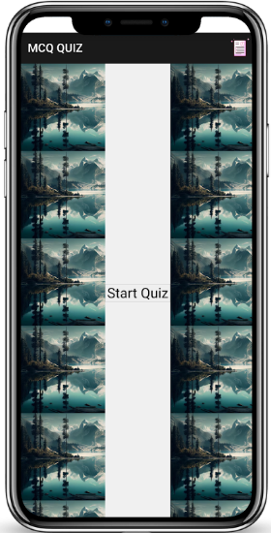
Start-up interface

Slide 5
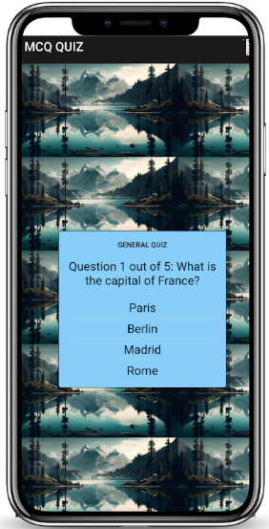
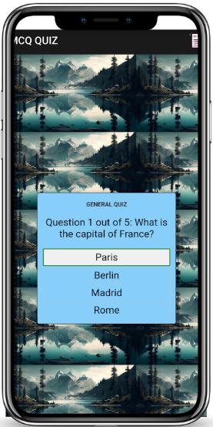
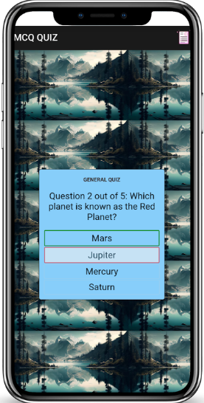
Middle interfaces

Slide 6
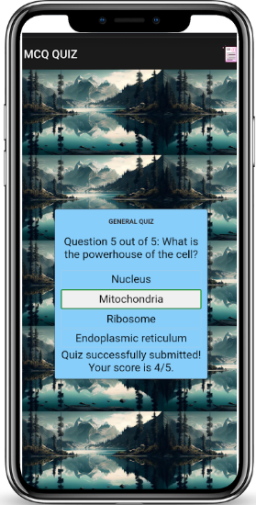
Final interface

Slide 7
advantages
Engaging Learning Experience:
Provides an interactive and engaging platform for learning through quizzes, making education enjoyable and immersive.
Diverse Knowledge Testing:
Offers a wide range of question categories across various subjects, allowing users to test their knowledge in different areas of interest.
Accessible Anytime, Anywhere:
Accessible on mobile devices, enabling users to engage in quizzes conveniently at their preferred time and location.
User-Friendly Interface:
Boasts a user-friendly interface, ensuring easy navigation and usability for users of all ages and technical backgrounds.

Slide 8
disadvantages
Limited Question Bank:
May have a finite set of questions available, potentially leading to repetition for frequent users.
Dependency on Internet Connectivity:
Requires a stable internet connection to access the app and participate in quizzes, limiting usage in areas with poor connectivity.
Lack of Real-Time Interaction:
Does not provide real-time interaction or live competitive elements with other users during quiz sessions, potentially reducing the competitive edge for some users.

Slide 9
Thank you

