Slide 1
BUILD CROSS-PLATFORM DESKTOP APPS WITH ELECTRON
G. Andrew Duthie – http://devhammer.net/

Slide 2







Northern VA CodeCamp Fall 2016
is sponsored by

Slide 3

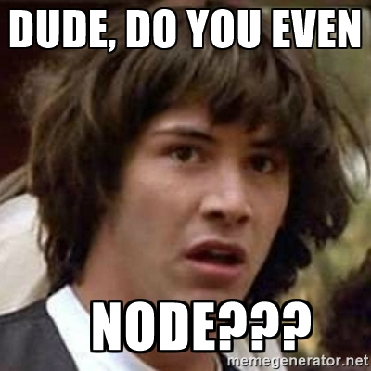
Disclaimer
I am NOT an Electron Expert
I cannot be held responsible for any problems you run into as a result of my bad advice
Do not try this at home. You will Die.

Slide 4
Agenda
Background
Demos

Slide 5
Background
What is this Electron Thing, Anyway?

Slide 6
What Is ELECTRON?
Originally Created as Part of Github’s Atom Editor
Spun off as its own open-source project
Hosts HTML/JS/CSS as a Desktop App (Windows/Mac/Linux)
Based on NodeJS, Chromium, and V8.
http://electron.atom.io/docs/tutorial/about/

Slide 7
Why Use Electron?
Cross-platform
Open Source
Easy to Get Started

Slide 8
Why NOT Use Electron?
Packaging and Deploying Can Get…Complicated
Potentially Large Dependency Tree
Large (100MB+) Executable size
Notes:
Multiple options for packaging and deployment, mostly third-party NPM packages
Output directory can have multiple thousands of files, and it’s not immediately obvious which are needed to run
To be fair, this is an NPM issue, not an Electron issue
The easy path for packaging results in large exe. It’s definitely possible to reduce this, as evidenced by VS Code, etc.

Slide 9
WHO Uses Electron?
Visual Studio Code
ATOM (of course)
Slack
Kitematic (for you Docker Fans)
Postman
Many More – List AT:
http://electron.atom.io/apps/

Slide 10
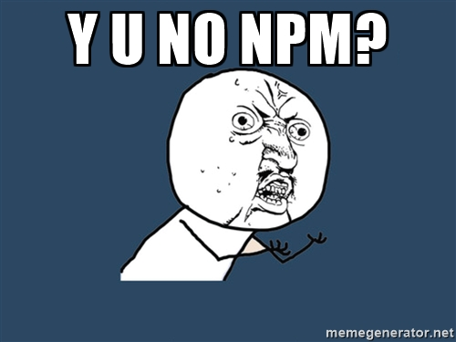
Getting Started – You Need:
NodeJS and NPM installed
Install Electron Prebuilt:
npm install electron-prebuilt -g
Point To Starting .JS file:
electron . (defaults to index.js)
Electron myJsFile.js

Slide 11
Getting Started – Code
const electron = require('electron');
const {app} = electron;
const {BrowserWindow} = electron;
let mainWindow;
app.on('ready', () => {
mainWindow = new BrowserWindow({
width: 1280,
height: 720
});
mainWindow.loadURL(`file://${__dirname}/index.html`);
});
Create a New Folder for your App
Add Index.js to your Folder
Add the boilerplate Code
${__DIRNAME} points to local folder
Add Your Index.HTML
Run Command:
electron index.js

Slide 12
WHAT CAN I DO?
Create New Windows and Respond to Window Events
Add Menus and Menu Items
Use System Dialogs
Launch from a Protocol Handler
Take a Screenshot
More – See the Electron API Demos App for Examples

Slide 13

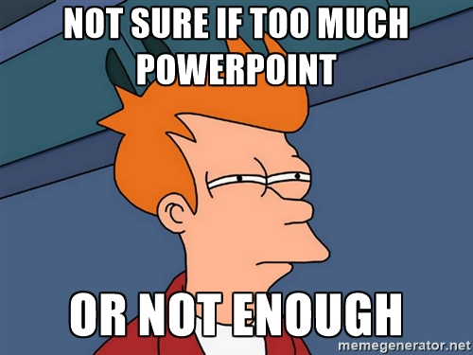
DEMOS!!!

Slide 14
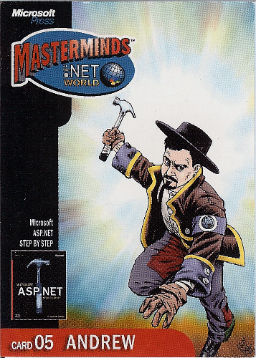
About Me
Independent Consultant (yes, you Can Hire Me)
ASP.NET, Azure, Etc.
Consulting & Training
Blog: Http://devhammer.net
Twitter: @devhammer
Email: g.andrew@devhammer.net

