Slide 1
Zero to Web In One Meeting – ASP.NET From Scratch
G. Andrew Duthie – Chief Consultant
Devhammer Enterprises LLC
http://devhammer.net/Contact devhammer@live.com

Slide 2
about.me
{
"name": "G. Andrew Duthie",
"title": "Chief Consultant",
"company": "Devhammer Enterprises LLC",
"workingWith": “Linchpin People",
"blog": "http://devhammer.net",
"training": "http://WintellectNOW.com",
}

Slide 3
Agenda
What Do We Mean by “from Scratch”?
Why Start from Scratch?
Building a Web API from Scratch
Building an MVC app from Scratch
References

Slide 4
What Isn’t Covered
Data Tier Interactions (i.e. – Entity Framework, Linq, etc.)
Client (i.e. SPAs)
Security – Authorization and Authentication (there’s a link in the references so you can learn more)
Deployment

Slide 5
What Do We Mean by “from Scratch”?
Starting from the simplest possible template, references, etc.
Tear down anything we don’t need and build it back up
We do need some infrastructure that the templates provide

Slide 6
Why Start from Scratch?
Many of the built-in templates throw in everything but the kitchen sink
Your project may not need some of these features (i.e. – API help pages)
If you’re still learning, the full-fat templates may be too complex
Avoid loading assemblies that you’re not actually using
If I put it in my project, I know why it’s there
Goals:
Demystify how Web API and MVC work
Discover the minimum code and configuration needed for a working Web API and MVC app

Slide 7
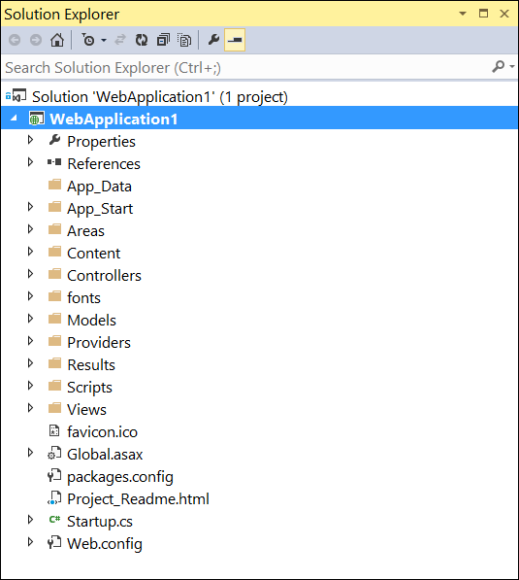
The Full-Fat Template Experience
Many times, it’s tempting to start with the fully-templated experience in Visual Studio
While this does a great job of wiring up a lot of the necessary stuff, it can also be overwhelming
The Web API template includes:
Web API
MVC
Areas
Authentication
Etc.
Makes for a pretty high concept count when getting started

Slide 8
DEMO
The Full-Fat Template Experience
Notes:
Start with presenter mode off and then turn it on and explain.
Show the modules debug window and the number of modules being loaded.

Slide 9
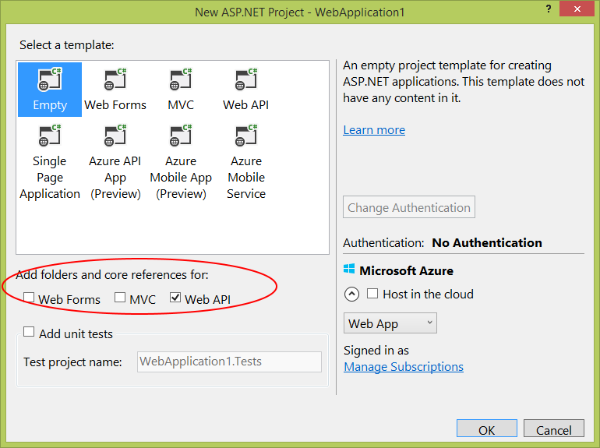
Add Folders and Core References
Another option is to use the Empty template, and use the Add folders and core references option
This option adds more to the project, but not nearly as much as the full Web API template
Still adds some things that may not be needed, though it’s not immediately obvious what can be removed and what needs to stay

Slide 10
DEMO
Add Folders and Core References

Slide 11
The Empty template
The Empty template is as barebones as you can get with Visual Studio
Still adds Web.config, and a few references
We can start with this, tear it down a bit, and start building back up
Nuget is a big help here
Visual Studio will warn us if we’re missing references or namespaces

Slide 12
Web API from Scratch
Building a Web API from Scratch…we need:
Nuget package(s) for Web API
Reference to System.Web.dll
API Route configuration class (including folder, if desired)
Global.asax to invoke the configuration
Folders for Controllers and Models (these specific names aren’t required)
At least one ApiController class, with at least one method that maps to an HTTP verb

Slide 13
DEMO
Building a Web API from Scratch
Notes:
Build an API from scratch using the Empty template, and show Fiddler and Postman accessing the API.

Slide 14
MVC from Scratch
Building an MVC app from Scratch is similar to Web API…we need:
Nuget packages for MVC
Reference to System.Web.dll
Route configuration class (including folder, if desired)
Global.asax to invoke the configuration
Folders for Controllers, Models, and Views (these specific names aren’t required)
At least one Controller class, with at least one Action method
At least one View (to work with models, you’ll need a web.config in the Views folder with the appropriate configuration elements)

Slide 15
DEMO
Building an MVC App from Scratch
Notes:
Build an MVC app from scratch against a local static list of HaloGames, and then modify the app to use the api to get the data.
Cover some basics on Web Essentials, specifically Browser Link.

Slide 16
What about ASP.NET vNext?
Things to be aware of:
In ASP.NET 5, MVC and Web API are combined (Web Pages, too, in a future release)
Both MVC and API controllers inherit from the same Controller class
Default for APIs is to use Attribute Routing:
[Route("api/[controller]")]
Significant differences in startup configuration
See http://j.mp/WebAPI6 for more details
All dependencies come from Nuget by default
Project structure is different
Host on full .NET 4.6, or the leaner cross-platform .NET Core

Slide 17
Summary
Starting from Scratch gives you flexibility and greater control
Learn how the platform works by tearing it down first
ASP.NET vNext (ASP.NET 5) merges MVC and Web API functionality

Slide 18
Resources
http://www.asp.net/web-api
http://www.asp.net/web-api/overview/security/individual-accounts-in-web-api
http://www.asp.net/web-api/overview/odata-support-in-aspnet-web-api/odata-v4/create-an-odata-v4-endpoint
http://www.asp.net/web-api/overview/getting-started-with-aspnet-web-api/creating-api-help-pages
http://www.asp.net/vnext/overview/aspnet-vnext/aspnet-5-overview
http://www.telerik.com/fiddler
https://www.getpostman.com/

