Slide 1
MediCrawl
A web search engine for medical diagnosis
Devharsh & Vaishnavi
Department of Computer Science
May 4th 2020

Slide 2
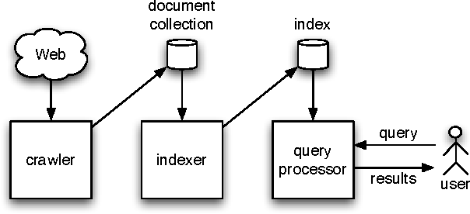
Introduction
Web Search Engine
Components of a web search engine: 1. Crawling 2. Indexing 3. Ranking 4. Searching
Web search engine for diseases: — Mayo Clinic — FindZebra

Slide 3
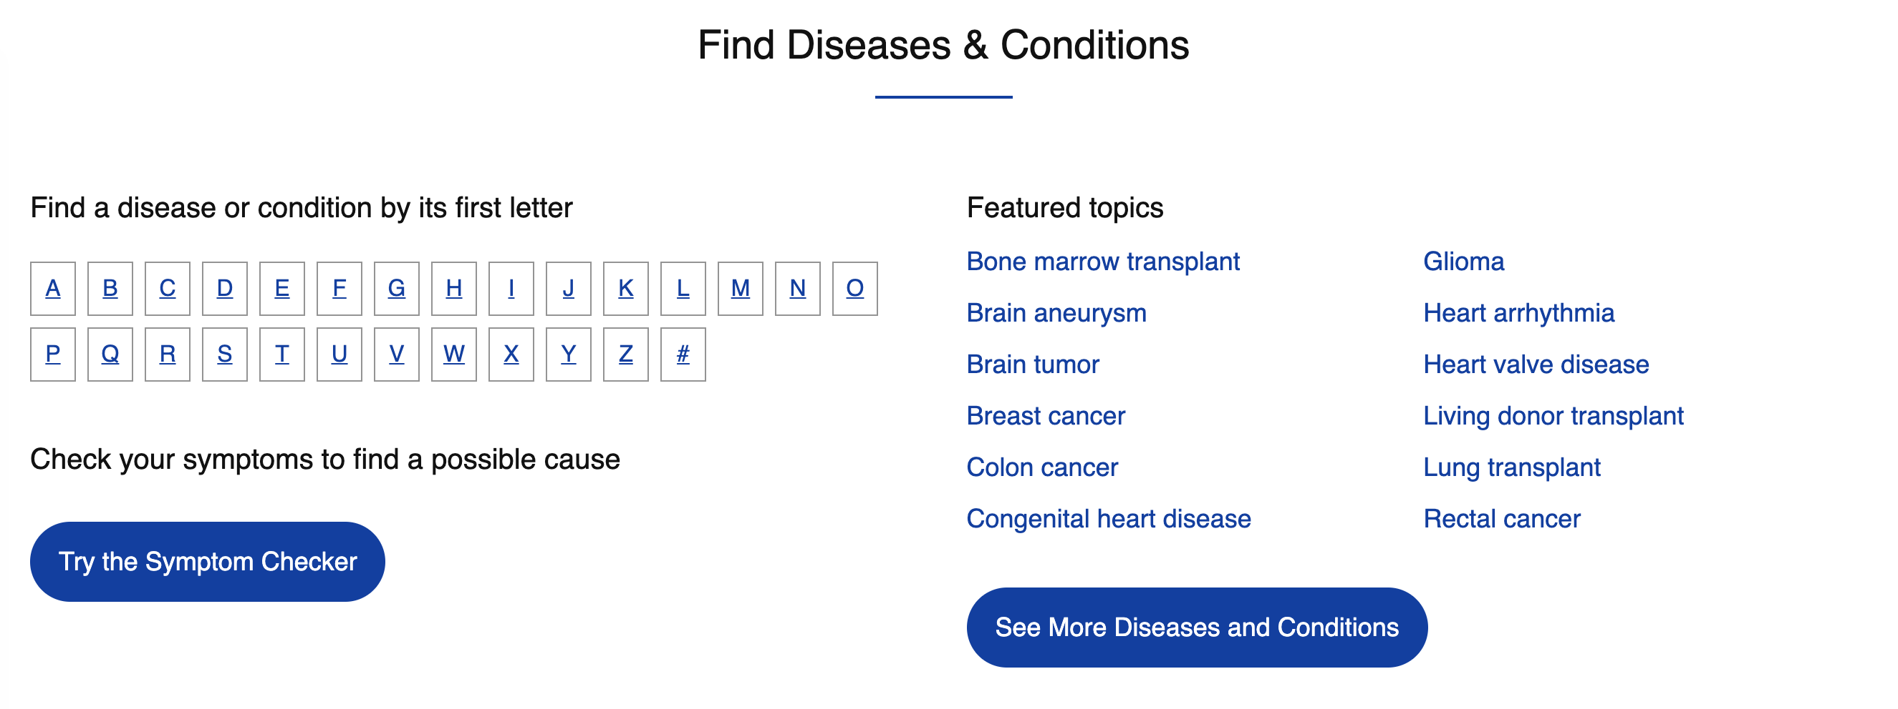
Introduction
Mayo Clinic

Slide 4
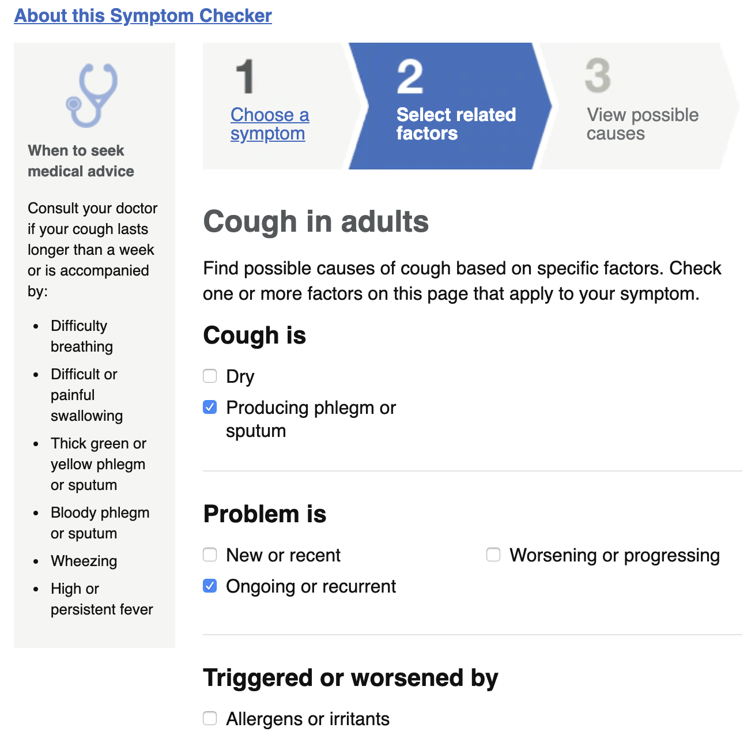
Introduction
Mayo Clinic

Slide 5
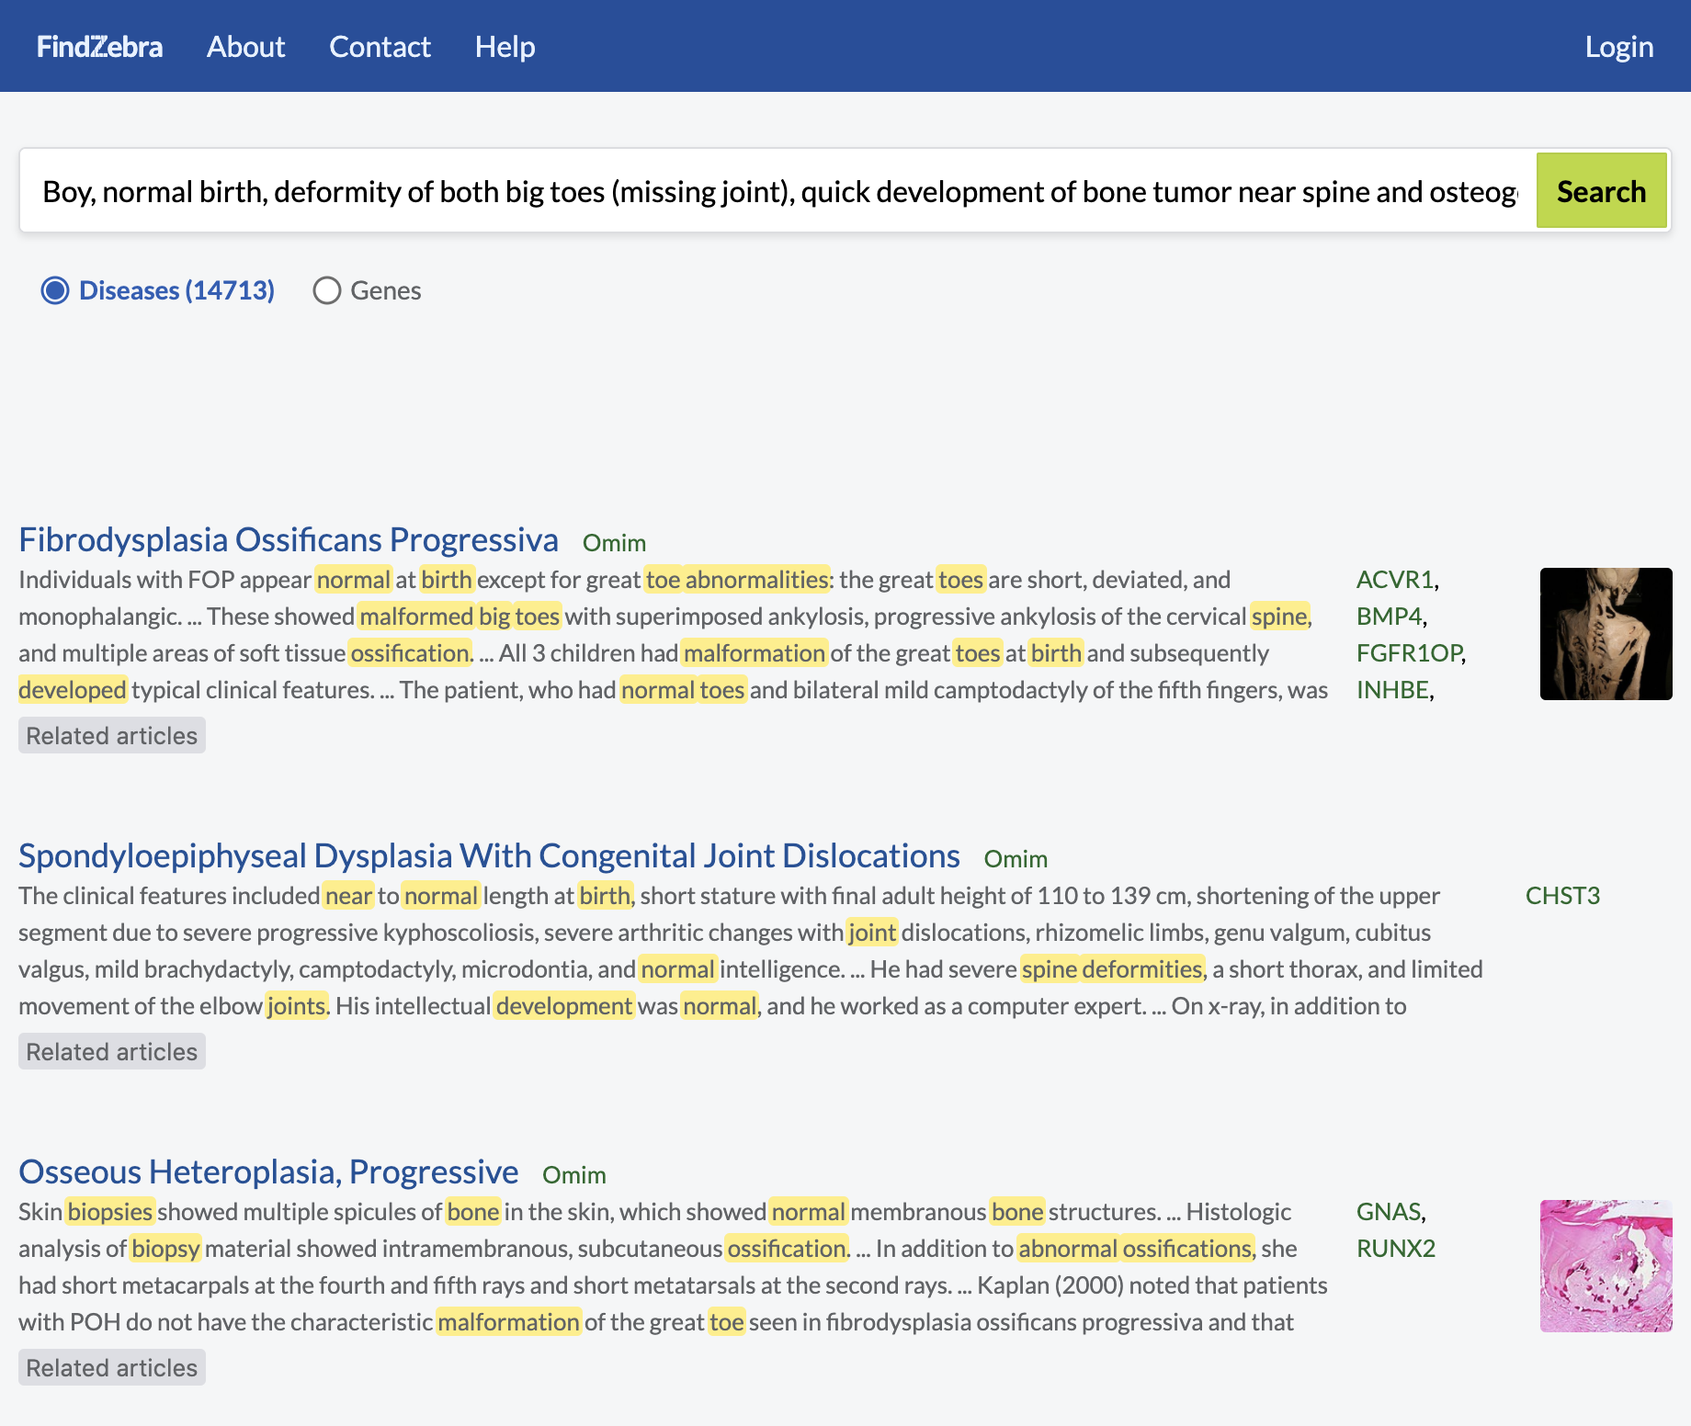
Introduction
FindZebra

Slide 6
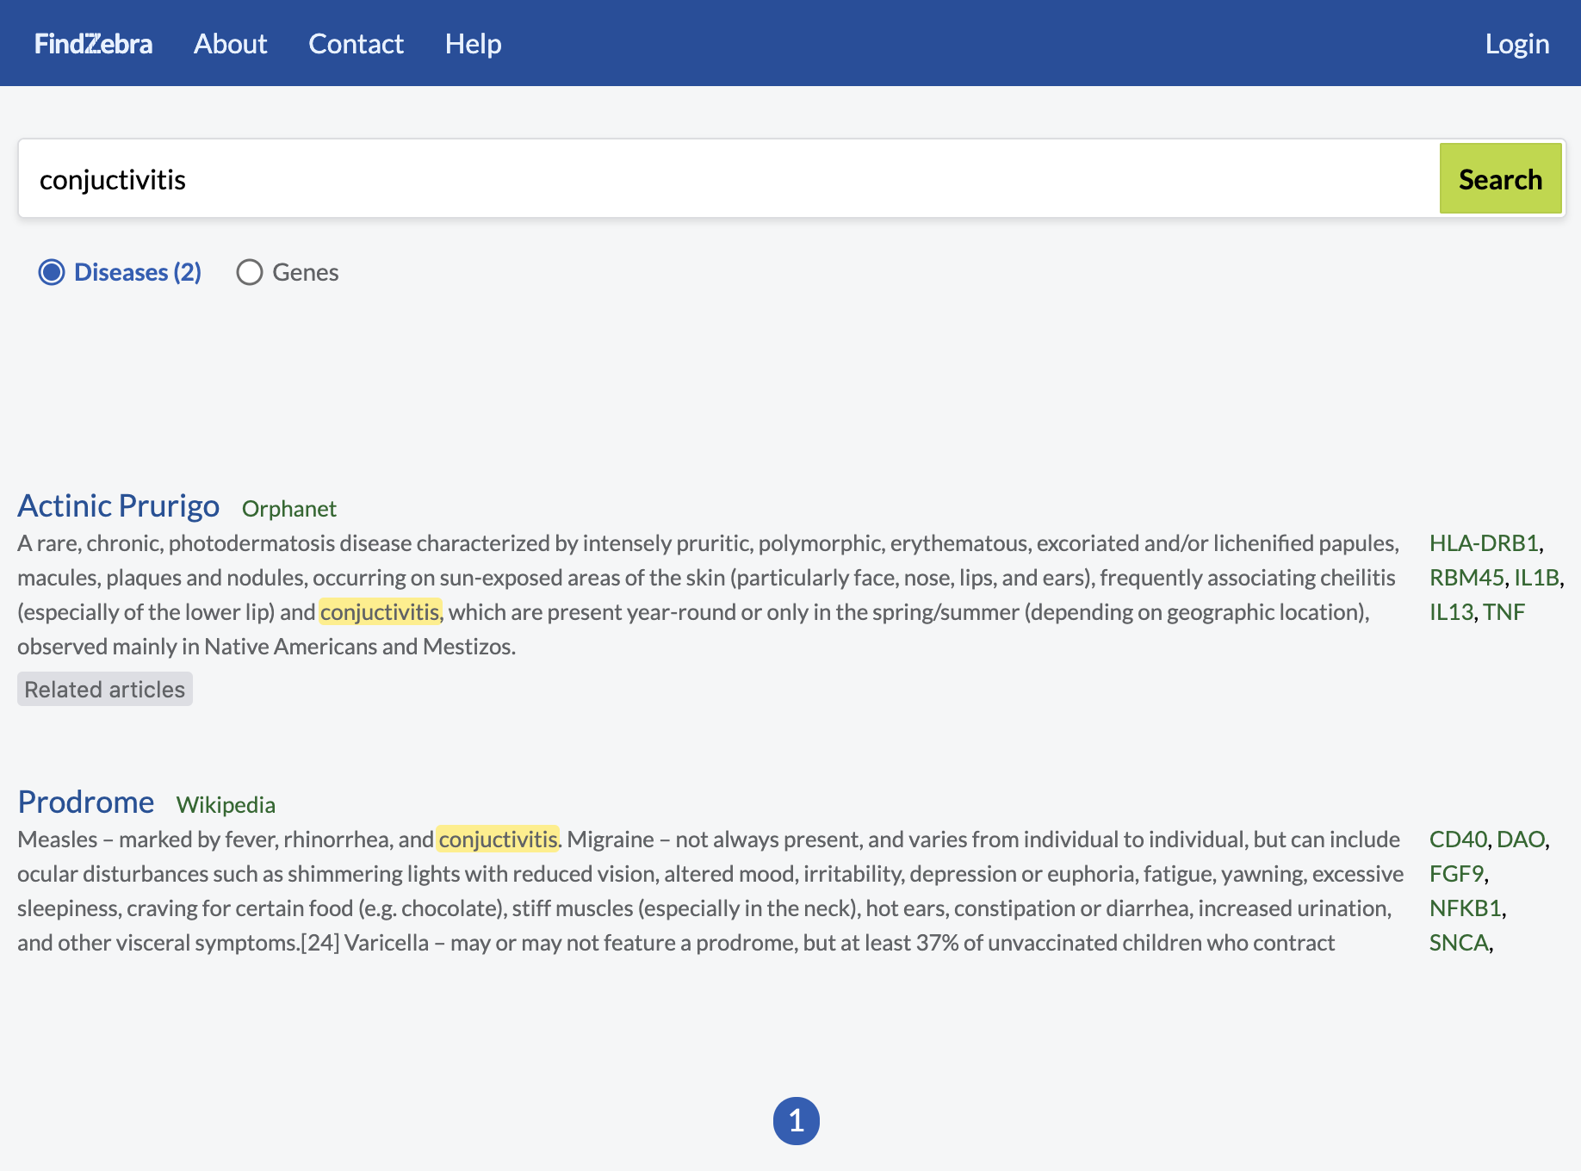
Introduction
FindZebra

Slide 7
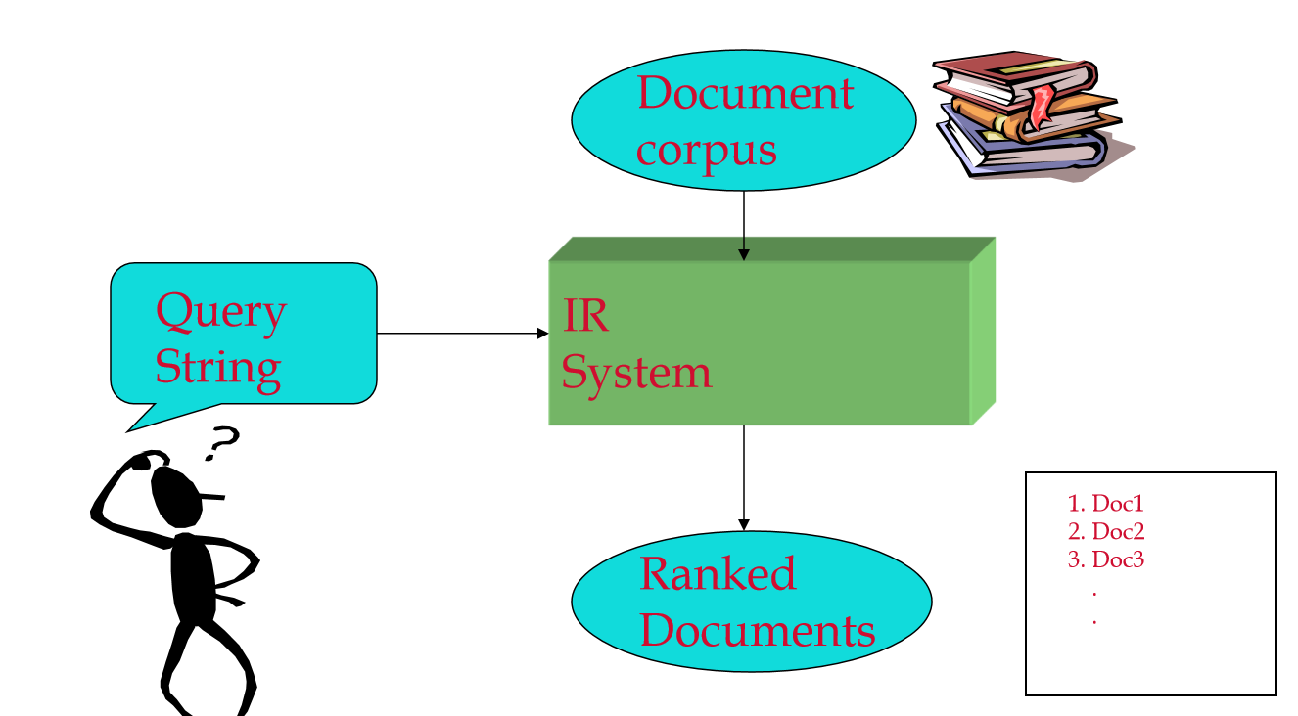
Motivation – Information Retrieval
Goals: To find relevant documents to the user query from large set of unstructured data over the web.
How do we represent text?
Bag of words
Represented as vectors
How to get terms?
Stop words
Normalization
Case folding
Stemming
Thesauri
Human factor
Other languages
Information retrieval process
Notes:
Main motive of our project is Information retrieval
Goal is to find…..
What is the Process of information retrieval – Query string by user -> IR system -> IR looks for the query in the document collection and provide the list of documents after ranking
How do we represent text?
Bag of words – Treat all words as index terms and assign weight
Vectors – They are sorted in alphabetical order and given the no. of occurrences
How do we process the terms?
Stop words – Little semantic content and are common words
Normalization – Eg: convert U.S.A to USA
Case folding – Reduce all to lower case
Stemming – Cars, car to car, be verbs
Thesauri – Synonyms and homonyms handling
Human factor – How the user queries?
Other languages – Date format & Accents

Slide 8
Motivation
How to organize terms in index structure?
Inverted Index
How to support phrase queries?
Positional index
How to reduce search time?
Binary tree
How to retrieve relevant answers?
Types of retrieval model
Boolean model – Too rigid & Too few or too many results
Vector space model – TF & IDF
Led to BM25
Notes:
Terms & Documents matrix – very sparse and hence very large
Solution is inverted index – Stores a list of documents containing term T
Issues – False positives & Index blow up
Solution – Positional Index - Store position of the terms in each postings
Issue – Takes a long time to seek
Solution – Binary tree – Quick to search & economic storage
Issues - Sometimes tree become unbalanced
Solution - Vocabulary tree
Boolean model – Use AND OR NOT to check the occurrence in the document – EXACT Match
Vector space model – Close match
BM refers to Best match
TF (How frequent the term is)
IDF (How important the term is)

Slide 9
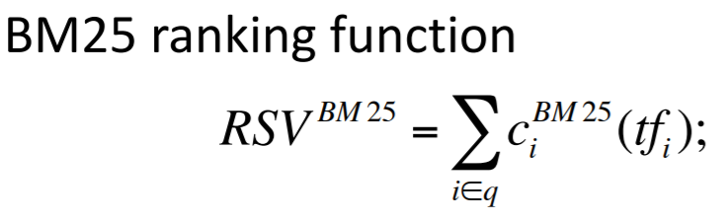
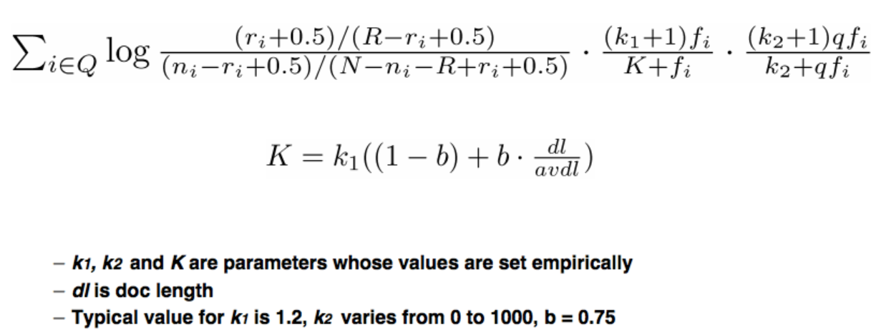
BM25
Ranking algorithm
BM for Best Match
Probabilistic term weighting model
Larger documents – larger term frequency values
BM25 – Normalizes the document length using the formula K
Notes:
BM25 is one of the most established models.
The 2-Poisson model designed by Robertson, Van and Porter has motivated the birth of term-weighting forms called BMs.
BM uses logarithmic and normalized tf.
RSV is the ranking function used. It is the summation of iDF and TF for each term.
K is the formula used to normalize the document length.

Slide 10
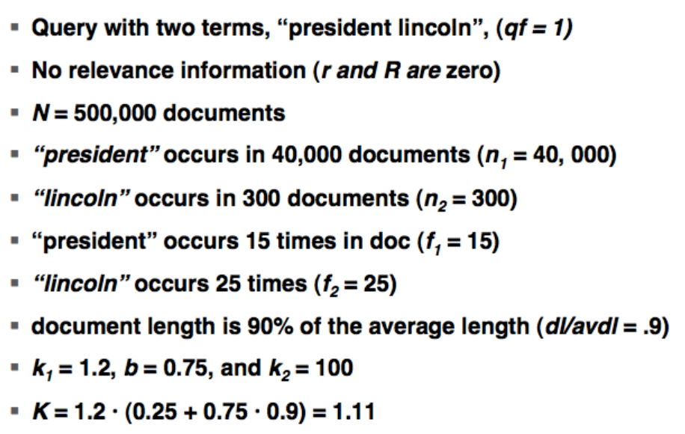
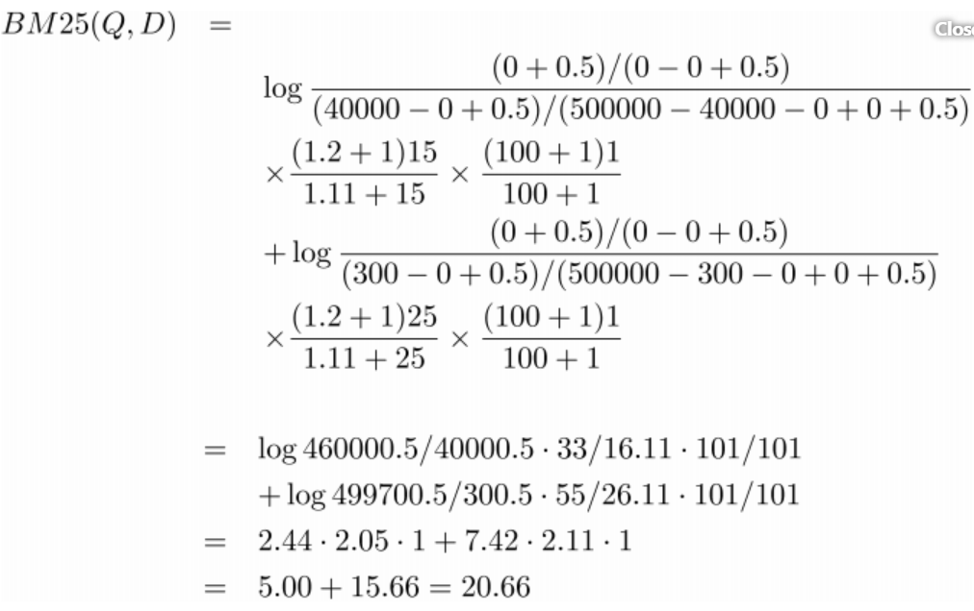
Explanation of BM25
Notes:
Lets see the explanation of BM25 formula using an example.
Formula explanation….
The output is called the OriginalScore in Linear model.

Slide 11
Implementation
Tools & Technologies
Java (Runtime Environment)
Web browser (HTML / CSS / JS)
Git
Nutch
Solr
Node.js
ALL ARE FOSS!! (Free or Open Source Software)

Slide 12
Implementation
Nutch
Open source Web Crawler
Written in Java
Implements “Map-Reduce” distributing processing model
Built on top of Apache Lucene
Fetches pages and turn them into inverted index
Configuration: — nutch/conf/nutch-site.xml — nutch/conf/schema.xml — nutch/urls/seed.txt
Crawl and Index simultaneously: nutch/bin/crawl -i -Dsolr.server.url=http://localhost:8983/solr/nutch -s nutch/urls/ Crawl 3

Slide 13
Implementation
nutch/url/seed.txt
https://www.everydayhealth.com/infectious-diseases/
https://www.healthed.govt.nz/resource-table/table-infectious-diseases
https://www.livescience.com/36519-diseases-conditions-symptoms-treatments.html
https://www.healthline.com/health/infections#types
https://www.nhsinform.scot/illnesses-and-conditions/a-to-z
https://www.socialstyrelsen.se/rarediseases
https://www.hon.ch/en/
https://www.verywellhealth.com/rare-diseases-4014657
https://ghr.nlm.nih.gov/
https://rarediseases.org/
https://www.orpha.net/consor/cgi-bin/index.php
https://rarediseases.info.nih.gov/
https://www.ncbi.nlm.nih.gov/omim
https://www.mayoclinic.org/
https://www.who.int/en/
https://www.webmd.com/
https://www.adam.com/
https://www.medicalnewstoday.com/
https://www.cdc.gov/diseasesconditions/index.html
https://www.health.harvard.edu/

Slide 14
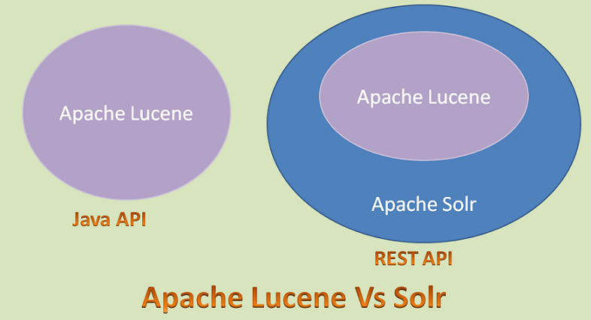
Implementation
Solr
Open source enterprise search server
No-SQL (non-traditional data store)
Based on Lucene Java search library
Wrapper: — HTTP request/response — XML API — caching / replication — web admin interface
Configuration: solr/server/solr/configsets/nutch/conf/solrconfig.xml
Run: solr/bin/solr start -Dsolr.ltr.enabled=true
Create a solr core before indexing from nutch!

Slide 15
Implementation
Solr LTR (Learning to Rank model)
In information retrieval systems, Learning to Rank is used to re-rank the top N retrieved documents using trained machine learning models.
The hope is that such sophisticated models can make more nuanced ranking decisions than standard ranking functions like TF-IDF or BM25.
public class LinearModel extends LTRScoringModel
A scoring model that computes scores using a dot product. Example models are RankSVM and Pranking.
Example configuration:
{
"class" : "org.apache.solr.ltr.model.LinearModel",
"name" : "myModelName",
"features" : [
{ "name" : "userTextTitleMatch" },
{ "name" : "originalScore" },
{ "name" : "isBook" }
],
"params" : {
"weights" : {
"userTextTitleMatch" : 1.0,
"originalScore" : 0.5,
"isBook" : 0.1
}
}
}

Slide 16
Implementation
Solr LTR : Original Score Feature
public class OriginalScoreFeature extends Feature
This feature returns the original score that the document had before performing the reranking.
Example configuration:
{
"name": "originalScore",
"class": “org.apache.solr.ltr.feature.OriginalScoreFeature",
"params": { }
}

Slide 17
Demonstration
Disease | Symptoms
Covid-19 | Shortness of breath, lack of taste, fever
Abetalipoproteinemia | 46 year old, female, ptosis, acanthocytosis, history of diarrhea, ataxia, paresthesia
Fibrodysplasia Ossificans Progressiva | Boy, normal birth, deformity of both big toes (missing joint), quick development of bone tumor near spine and osteogenesis at biopsy
Schizophrenia | Delusions, hallucinations, disorganized speech, lack of motivation or emotion
Conjunctivitis (Pink eye) | Pink or red color in the white of the eye
Notes:
We will search for a novel disease, a common disease and a rare disease.
The symptoms are entered to find out about the disease. Let us see a demo of it.
We are showing the top results in our search.
We also have google and wiki search in our page, so that if the user wants to know the meaning or if they don’t understand a term, they don’t have to leave the page.

Slide 18
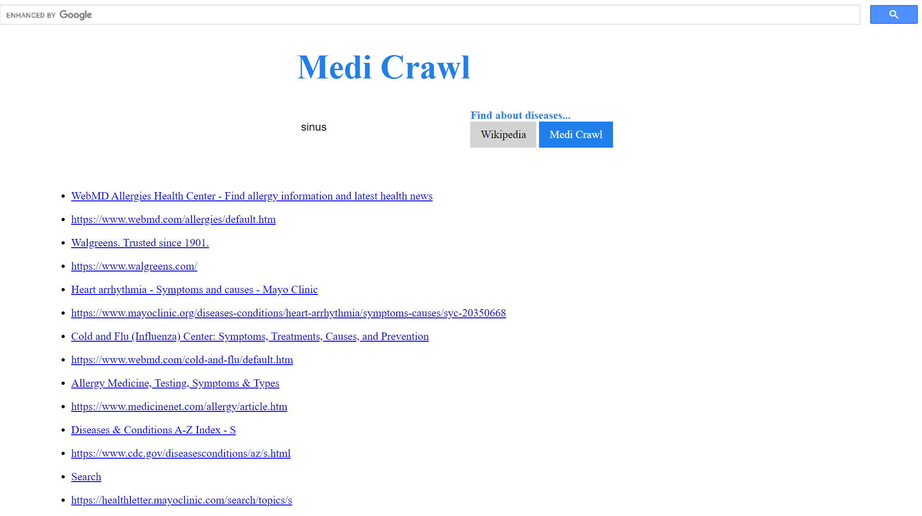
Demonstration
MediCrawl
Notes:
Results for sinus by medi crawl.

Slide 19
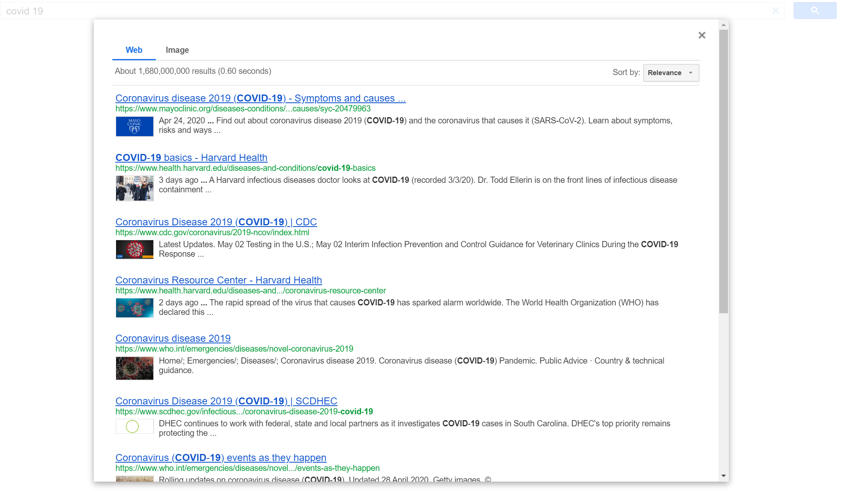
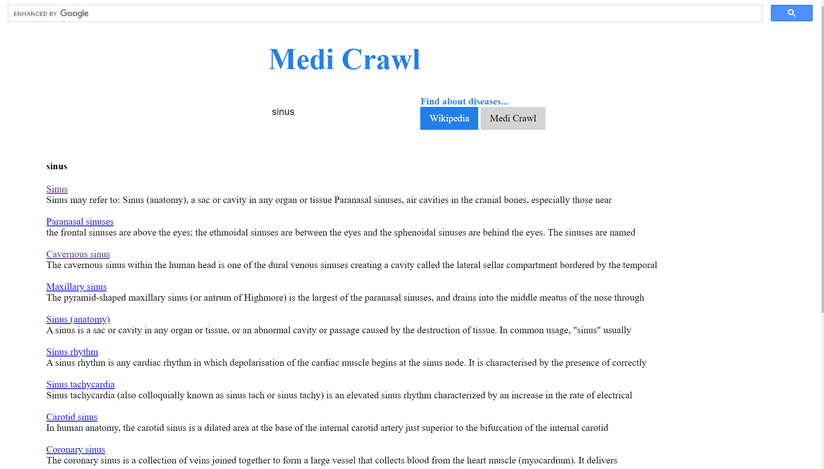
Demonstration
MediCrawl : Google & Wikipedia API
Notes:
Google & Wiki has the definitions for the search term.

Slide 20
Challenges
Retrieve relevant documents to a query
Retrieve from large set of documents efficiently
Ranking and Searching issues with Long tailed queries
Availability of dataset to test
Notes:
We faced several challenges firstly.
We need proper data i.e. verified data
Creating own database with large set of documents
We solved these challenges by using
1) SOLR – NoSql database which deals with large set of documents (partitions data & show json format)
2) Ranking & Searching – By default Nutch uses BM25 algorithm. On top we are using Linear ranking model for more accuracy.
3) Dataset for our website is obtained from FindZebra & Google – We got Rare Diseases from Find zebra & common diseases from Google… List of diseases, symptoms and their details are obtained from 20 websites.
As u saw earlier, results are compared with Mayo clinic & Find zebra

Slide 21
Results
Efficient - returns results in 300ms or less
State of the art of TF-IDF retrieval model
Document length normalization
Uses logarithmic TF instead of raw TF
Reduce time & space complexity
Better performance compared to TF-IDF
text / html | 3561
application / xhtml + xml | 84
application / pdf | 42
image / svg + xml | 18
application / xml | 3
application / rss + xml | 2
image / jpeg | 2
text / plain | 2
image / gif | 1
image / png | 1
 | 3716

Slide 22
Results
Ranking
Sample Linear model ranking:
"params":{ "q":"cold",
"fl":"title,url,[features]"}},
"response":{"numFound":520,"start":0,"docs":[
{
"title":"Common colds: Symptoms, causes, complications, and treatment",
"url":"https://www.medicalnewstoday.com/articles/166606",
"[features]":"originalScore=1.9142148,titleLength=7.0,contentLength=1560.0"},
{
"title":"Cold and Flu (Influenza) Center: Symptoms, Treatments, Causes, and Prevention",
"url":"https://www.webmd.com/cold-and-flu/default.htm",
"[features]":"originalScore=1.9114048,titleLength=10.0,contentLength=1048.0"},
{ .. ..

Slide 23
Conclusion
Conclusion & Future Work
We present an efficient web search engine for medical diagnosis
Works well for both common and rare diseases
Easy to implement and portable
Using open source / free software
Future work could be implementing a Deep learning model that takes symptoms as inputs and outputs probabilities of diseases and probable remedies
Source code available at https://github.com/devharsh/MediCrawl

Slide 24
Devharsh Trivedi (dtrived5@stevens.edu)
Vaishnavi Gopalakrishnan (vgopalak@stevens.edu)

