Slide 1

Bushel
We Are Here To Help

Slide 2




Team members
Allen Best
B.E in Software Engineering at Stevens Institute of Technology
Role: Website Developer
Jessica Basnet
M.S in Information System at Rider University
Role: Data Analyst
Devharsh Trivedi
PhD in Computer Science
at Stevens Institute of Technology
Role: Website Developer
Tan Dao
B.E in Chemical Engineering
at Stevens Institute of Technology
Role: Idea and Market Researcher

Slide 3

Problem
The pandemic has wiped out 41% of black-owned businesses.
Black-owned businesses are heavily concentrated in cities that have been hardest hit by the virus and they entered the pandemic with weaker financial conditions.
Only 20% of Paycheck Protection Program loans have gone to areas that had the highest concentration of Black-owned businesses.
A lot of people and organizations want to support black and brown-owned businesses but are not sure know how to start and where to donate.

Slide 4
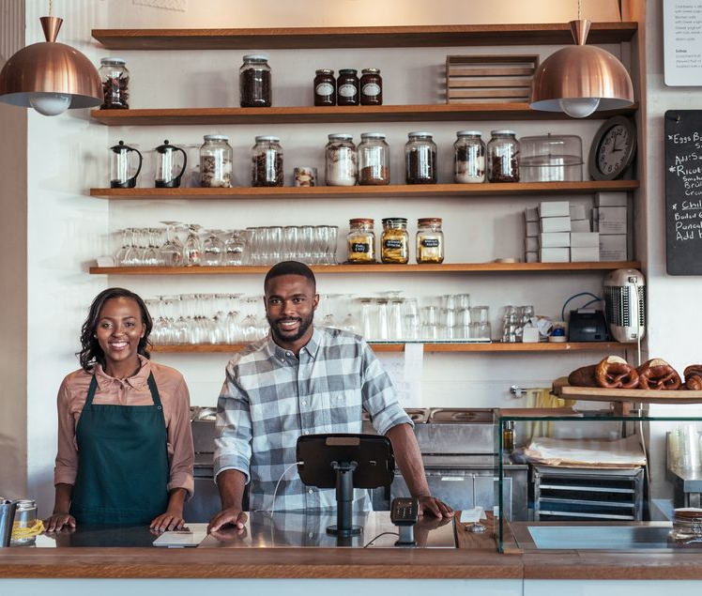
Our Solution
We create a platform that connects struggling businesses with people in their community. Our tool allows business owners to ask for resources they urgently need and makes sure that the right help can go to the right places at the right time.

Slide 5


Google Cloud
In this project, we use:
Google Maps API
Compute Engine
In the future, we intend to incorporate:
BigQuery
Firebase

Slide 6

Thank You!
Together We Make A Difference

