Slide 1
CCSC Eastern Conference 2026
Benchmarking State and Local Cybersecurity Readiness Through Automated Policy Analytics: Evidence from Maryland Local Governments
Devharsh Trivedi | Sage Despeignes | Titorian Huggins
Department of Computer Science, Bowie State University
Journal of Computing Sciences in Colleges 42(3) - Paper 129
Notes:
Thank the session chair. Joint work with my students Sage and Titorian at Bowie State. 20 minutes plus questions.

Slide 2
Outline
1
Background and prior work
5
Results: detection and agreement
2
Motivation and research questions
6
Ablation, errors, and stability
3
NIST CSF 2.0 and the Maryland corpus
7
Coverage findings and discussion
4
Methods, prompt, and ground truth
8
Recommendations and conclusion
Trivedi, Despeignes, Huggins | Bowie State University | CCSC Eastern 2026
2 / 22
Notes:
Twenty minutes: about seven on setup, seven on results, six on implications.

Slide 3
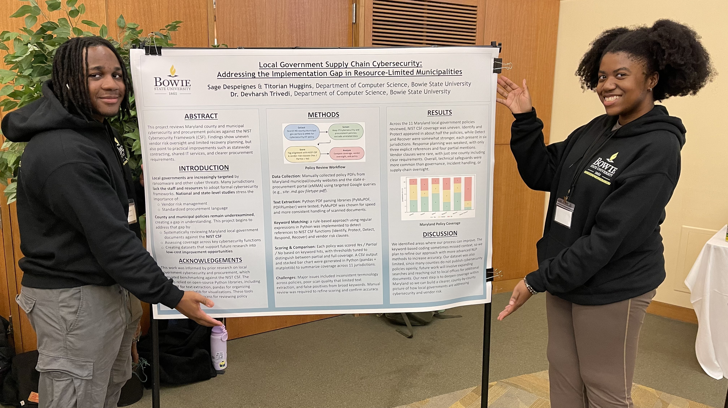
Background and prior work
Conducted as part of the SFS (Scholarship for Service) research component at Bowie State University
CCSC-E 2025: Sage and Titorian presented our poster mapping Maryland local policies to NIST CSF 1.1 - received an honorable mention
The poster identified uneven vendor-risk oversight and limited recovery planning across 11 jurisdictions, using keyword matching alone
This paper extends that work: CSF 1.1 to CSF 2.0 (adds the Govern function), an expanded 51-document corpus, an AI-assisted method, and a full quantitative evaluation
Titorian Huggins (L) and Sage Despeignes (R)
at the CCSC-E 2025 poster session
CSF 1.1 poster (2025) → CSF 2.0 paper (2026)
Sage Despeignes, Titorian Huggins, and Devharsh Trivedi. 2025. Local Government Supply Chain Cybersecurity: Addressing the Implementation Gap in Resource-Limited Municipalities. J. Comput. Sci. Coll. 41, 3 (October 2025), 36–37.
Trivedi, Despeignes, Huggins | Bowie State University | CCSC Eastern 2026
3 / 22
Notes:
Credit the students' poster and honorable mention. The Govern function added in CSF 2.0 is central to what we found missing.

Slide 4
Motivation
$18M
$17M
18,000
Baltimore ransomware, 2019
Atlanta ransomware, 2018
organizations, SolarWinds
estimated recovery cost
recovery expenditures
incl. state and local agencies
Limited budgets, aging infrastructure, and reliance on outside vendors and cloud services expand the local-government attack surface.
Federal guidance (EO 14028; CISA Cybersecurity Performance Goals) urges governance at all levels; municipal adoption remains uneven.
Alignment of state and local policies with NIST CSF 2.0 has not been systematically quantified.
Norris et al. 2021; Norris, Mateczun, and Forno 2022; CISA 2021
Trivedi, Despeignes, Huggins | Bowie State University | CCSC Eastern 2026
4 / 22
Notes:
Incidents everyone knows; the open question is what public policy documents actually say.

Slide 5
Research questions
1
To what extent do publicly available state and local policy documents address NIST CSF 2.0 functions?
2
How comprehensively do local governments address supply-chain cybersecurity risks?
3
How does AI-assisted classification compare to keyword-based analysis for policy assessment?
4
What improvements can resource-constrained municipalities prioritize?
Scope: coverage refers to what public documents state - a proxy for governance transparency, not a measure of implemented controls.
Trivedi, Despeignes, Huggins | Bowie State University | CCSC Eastern 2026
5 / 22
Notes:
RQ3 is the methodological core. The scope note matters for interpreting every later claim.

Slide 6
NIST Cybersecurity Framework 2.0
CSF 1.1 (2018): five functions
Identify
Protect
Detect
Respond
Recover
CSF 2.0 (February 2024): a sixth function, Govern
Govern
Identify
Protect
Detect
Respond
Recover
Govern covers organizational context, risk management strategy, roles and responsibilities, policies, and oversight - an explicit acknowledgment that technical controls alone are insufficient without executive accountability.
Supply chain risk management (GV.SC) moves under the governance umbrella, elevating third-party risk to a leadership concern.
NIST 2024; Barrett et al. 2018
Trivedi, Despeignes, Huggins | Bowie State University | CCSC Eastern 2026
6 / 22
Notes:
One minute of framework context for non-security audience members. Govern and GV.SC are what our findings hinge on.

Slide 7
Data: Maryland public document corpus
Targeted queries on md.gov: cybersecurity policy, disaster recovery plan, contractor cybersecurity, incident response plan, procurement policy
Plus six direct state agency downloads; MD5 deduplication leaves 51 unique PDFs
PyMuPDF extraction; first 12,000 characters per document classified
13.7%
only 7 of 51 documents are genuine cybersecurity policies
Trivedi, Despeignes, Huggins | Bowie State University | CCSC Eastern 2026
7 / 22
Notes:
Web-discoverable government documents are heterogeneous - exactly the condition that breaks keyword matching.

Slide 8
Methods: two NIST CSF 2.0 classifiers
Method 1: keyword baseline
Method 2: AI-assisted (LLM)
4-5 terms per function, e.g. Protect: access control, authentication, encryption, training, firewall
Case-insensitive regex counts, normalized 0-2
Document flagged if any function has 5+ raw hits
Claude Sonnet 4.6; single pass; identical auditor prompt for every document
Scores each function 0 / 1 / 2 with a stored rationale
Document flagged if any function scores 1 or higher
Govern
Identify
Protect
Detect
Respond
Recover
Rubric: 0 = absent 1 = partial (mentioned, no operational detail) 2 = present (substantive coverage)
Trivedi, Despeignes, Huggins | Bowie State University | CCSC Eastern 2026
8 / 22
Notes:
Same rubric and detection question for both methods.

Slide 9
Classification prompt and configuration
“You are a cybersecurity auditor. Classify the following policy according to NIST CSF 2.0: Govern / Identify / Protect / Detect / Respond / Recover. For each category provide: 0 = absent, 1 = partial, 2 = present. Explain your reasoning. [document text]”
Model identifier claude-sonnet-4-6; one pass per document; no system prompt beyond the text above; no per-document tuning; provider-default sampling (no temperature or seed control), quantified later by a three-run stability check
Input: first 12,000 characters (about 3,000 tokens, or 4-6 pages). Policy documents front-load purpose, scope, authority, and requirement statements, so the prefix captures primary intent; a fixed cut gives every document the same evidence budget and bounds inference cost
Truncation cost is visible only as one-point score variance on long manuals in the stability check; retrieval-augmented full-document processing is future work
The requested rationale is stored with every score, an auditable record; corpus, prompt, scores, labels, and code are public
github.com/devharsh/municipal-cyber-policy-analytics
Trivedi, Despeignes, Huggins | Bowie State University | CCSC Eastern 2026
9 / 22
Notes:
If asked why 12k characters: policies state their purpose and requirements up front; the cut is uniform across documents and methods, and the stability check bounds its effect.

Slide 10
Ground truth and label validation
Positive class: primary purpose is to define cybersecurity requirements
Independent second-rater validation
MD IT Security Manual v1.2 (2019)
MD DHMH IT Security Policy v4.0 (2014)
MD Judicial Information Security Policy (2026)
MD DOIT Cyber Risk Management Policy (2026)
MD DOIT Continuous Monitoring Policy (2026)
MD DOIT System & Network Security Policy (2026)
MSDE Acceptable Use Policy v2.0 (2024)
0.73 Cohen's kappa
92.2% raw agreement (47/51), substantial
All 7 positives independently confirmed
4 disagreements: two advisory reports, a data management plan, a workforce policy - all boundary documents
Labels retained under the primary-purpose rule
Trivedi, Despeignes, Huggins | Bowie State University | CCSC Eastern 2026
10 / 22
Notes:
The disagreement documents return later - they are the same ones the AI finds hard.

Slide 11
Results: detection performance
Method | TP | FP | FN | TN | Precision | Recall | F1 | Accuracy
Keyword (M1) | 6 | 21 | 1 | 23 | 0.222 | 0.857 | 0.353 | 56.9%
AI-assisted (M2) | 7 | 5 | 0 | 39 | 0.583 | 1.000 | 0.737 | 90.2%
-76%
p < 0.001
[0.20, 0.59]
false positives (21 to 5)
McNemar exact test: 18 errors corrected, 1 introduced
bootstrap 95% CI on the F1 difference
Recall of 1.00 refers to this corpus (7/7 positives). Tests: exact binomial McNemar on discordant pairs (b = 1, c = 18); percentile bootstrap over documents, 10,000 resamples.
Trivedi, Despeignes, Huggins | Bowie State University | CCSC Eastern 2026
11 / 22
Notes:
Significance testing added at reviewer request: discordant pairs 18 vs 1.

Slide 12
Agreement between methods by function
Function | r | rho | kappa_w
Govern | 0.789 | 0.667 | 0.779
Identify | 0.681 | 0.639 | 0.680
Protect | 0.151 | 0.144 | 0.076
Detect | 0.533 | 0.460 | 0.435
Respond | 0.542 | 0.498 | 0.541
Recover | 0.507 | 0.471 | 0.415
Ratings are ordinal, so Spearman rho and quadratic-weighted Cohen's kappa are reported alongside Pearson r; all three statistics tell the same story
Five of six functions agree strongly: r > 0.5 (p < 0.001), weighted kappa between 0.42 and 0.78
Protect is the sole exception (p = 0.291): keyword noise from 'training' erases the signal on exactly one function
Methods agree wherever documents use explicit governance, risk, or incident language
Trivedi, Despeignes, Huggins | Bowie State University | CCSC Eastern 2026
12 / 22
Notes:
Reviewers asked for ordinal statistics; kappa-w near zero for Protect versus 0.4-0.8 elsewhere is the cleanest summary of the failure.

Slide 13
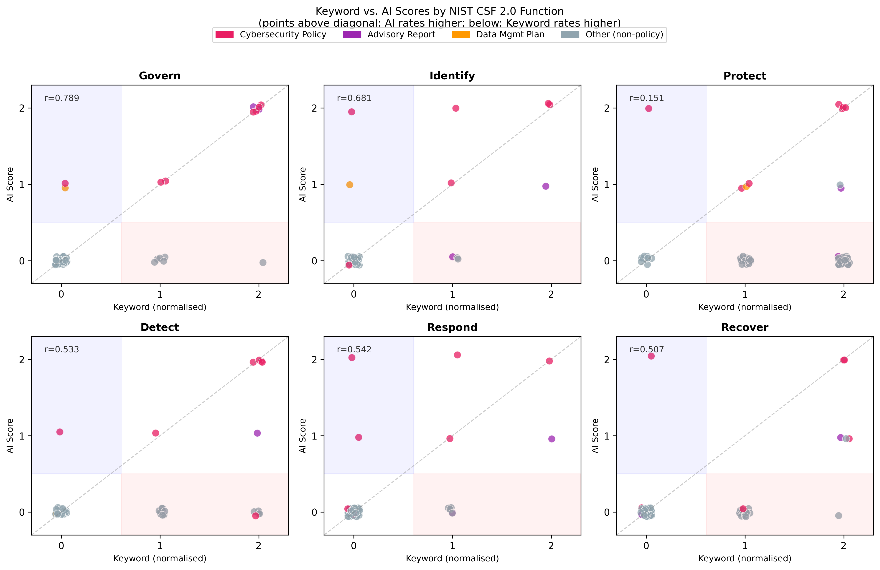
Keyword vs AI scores, function by function
Points on the diagonal are documents where the two methods agree exactly
In five panels, cybersecurity policies (pink) climb the diagonal and non-policy documents sit at the origin
The Protect panel is a structureless cloud: non-policy documents score high on keywords but zero with AI
Below-diagonal mass = keyword inflation; above-diagonal = AI credit for unmatched technical vocabulary
Each panel plots keyword (x) against AI (y) scores per document; panel labels report Pearson r (repository figure)
Trivedi, Despeignes, Huggins | Bowie State University | CCSC Eastern 2026
13 / 22
Notes:
Walk the audience to the Protect panel - the visual version of r = 0.151.

Slide 14
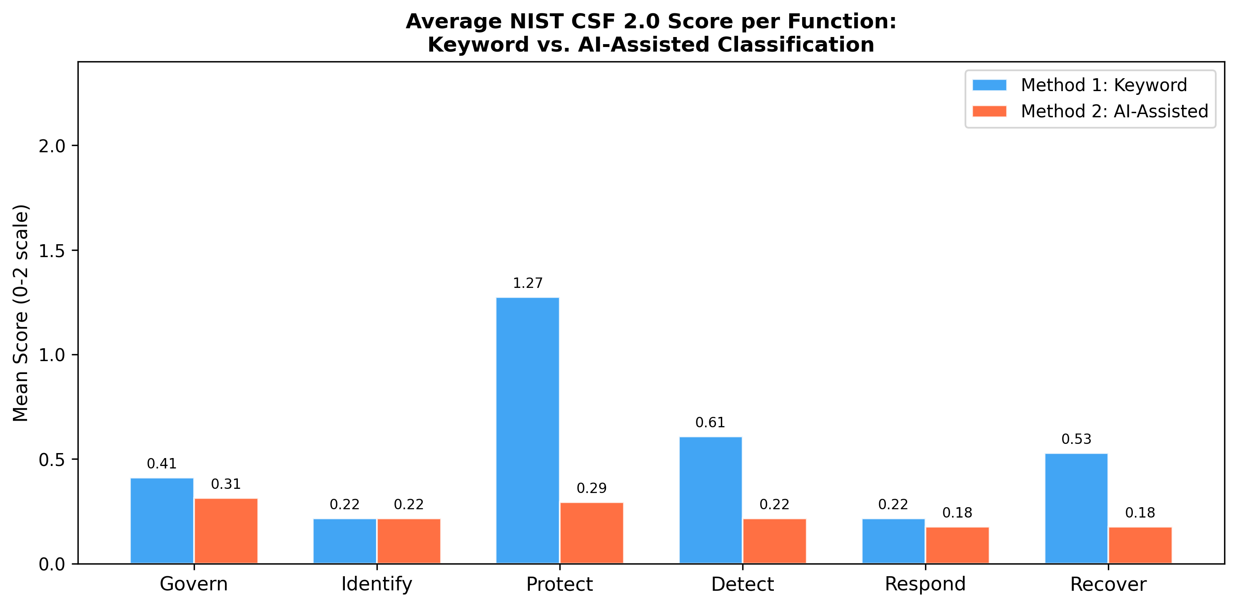
Failure analysis: the term 'training'
'training' appears hundreds of times in vocational and workforce documents: Protect mean raw score 18.0, four times any other function
A workforce WIOA annual report ranks 4th overall, above three genuine cybersecurity policies
The MD DOIT System & Network Security Policy scores 3: its technical vocabulary matches no keyword
Result: the noise wipes out Protect agreement while every other function stays significant
Mean normalized score per CSF function,
keyword vs AI-assisted (from the paper)
Trivedi, Despeignes, Huggins | Bowie State University | CCSC Eastern 2026
14 / 22
Notes:
The Protect bar towers for keywords while AI stays flat - that gap is noise, not coverage.

Slide 15
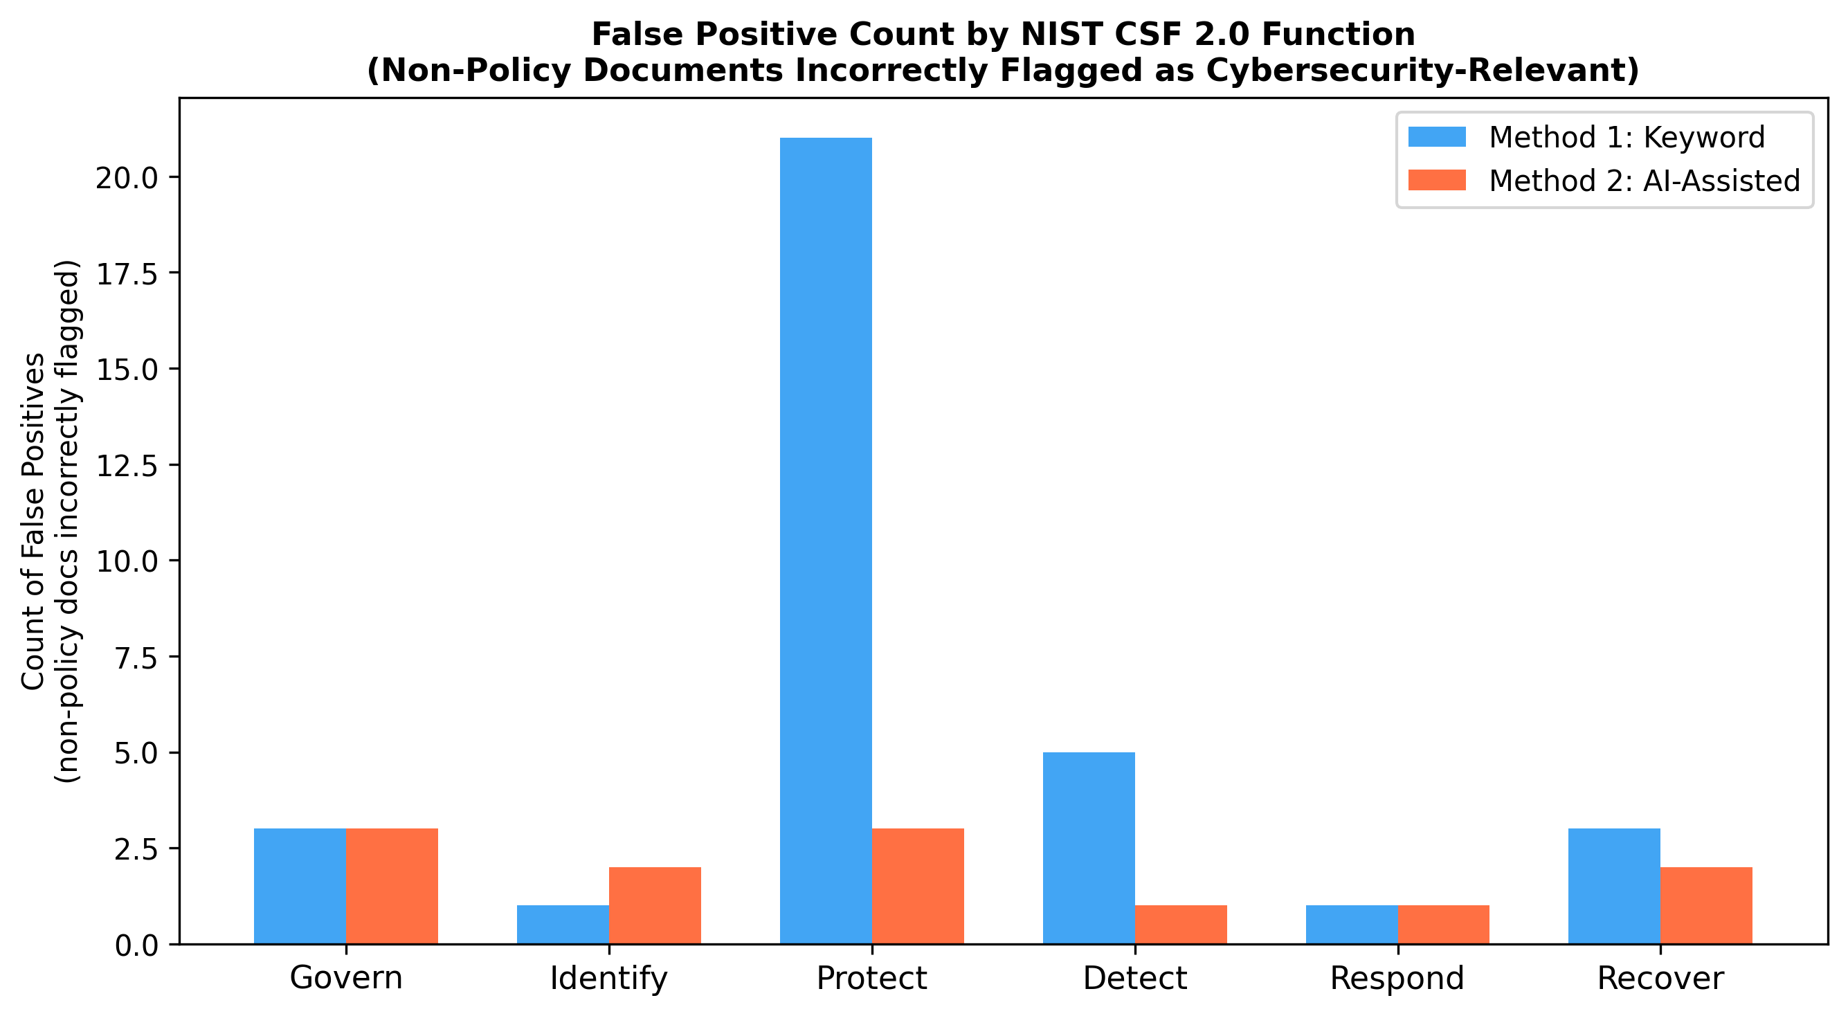
Where the false positives come from
Protect alone accounts for 21 of 27 keyword false-positive flags (78%)
Keyword false positives concentrate in business plans, workforce reports, and meeting agendas
AI function-level false positives total just 12 cells, spread across all six functions with no single driver
Both methods flag the two cybersecurity advisory reports - documents that discuss, but do not define, requirements
Function-level false-positive flags on non-policy documents (repository figure)
Trivedi, Despeignes, Huggins | Bowie State University | CCSC Eastern 2026
15 / 22
Notes:
This figure did not fit in the 15-page paper - the CSV behind it is in the public repository.

Slide 16
Ablation: keyword-list sensitivity
V0 original 4-5 term lists per function, bare 'training' included
V1 V0 minus the single ambiguous term 'training'
V2 'training' kept only with a security qualifier (e.g., security awareness training)
V3 V1 plus MFA, least privilege, segmentation, patch management, SIEM, threat intelligence, ... (engineered post hoc; approximates an upper bound)
AI one generic auditor prompt, no keyword lists
V1/V2: false positives 21 to 8; V3 additionally recovers the false negative (recall 1.00)
AI vs V3: not significant at n = 51 (McNemar p = 0.45), yet AI required no list engineering at all
Trivedi, Despeignes, Huggins | Bowie State University | CCSC Eastern 2026
16 / 22
Notes:
Honest framing: sensitivity to list specification, not 'AI beats keywords in general'. V3 approximates an upper bound.

Slide 17
Error analysis and stability
All five AI false positives
Three independent re-runs, 13 documents
UMGC Local Gov Cybersecurity Report - advisory
MD Cybersecurity Council Report - advisory
MD Procurement Manual - vendor security clauses
MD iMap Data Management Plan - data governance
QUEST grant - 'disaster recovery' meant economics
13/13
document-level relevance decisions identical in every run
70.5% of 78 function cells identical across all three runs
97.4% within one point; variance sits on the partial-vs-present boundary of long manuals
No non-cyber document ever scored above 0
Four of the five are the second rater's disagreements. Requiring a score of 2 keeps all 7 policies and leaves 2 false positives (F1 = 0.875).
Trivedi, Despeignes, Huggins | Bowie State University | CCSC Eastern 2026
17 / 22
Notes:
Both analyses added at reviewer request. Function means carry a one-point tolerance; binary detection is stable.

Slide 18
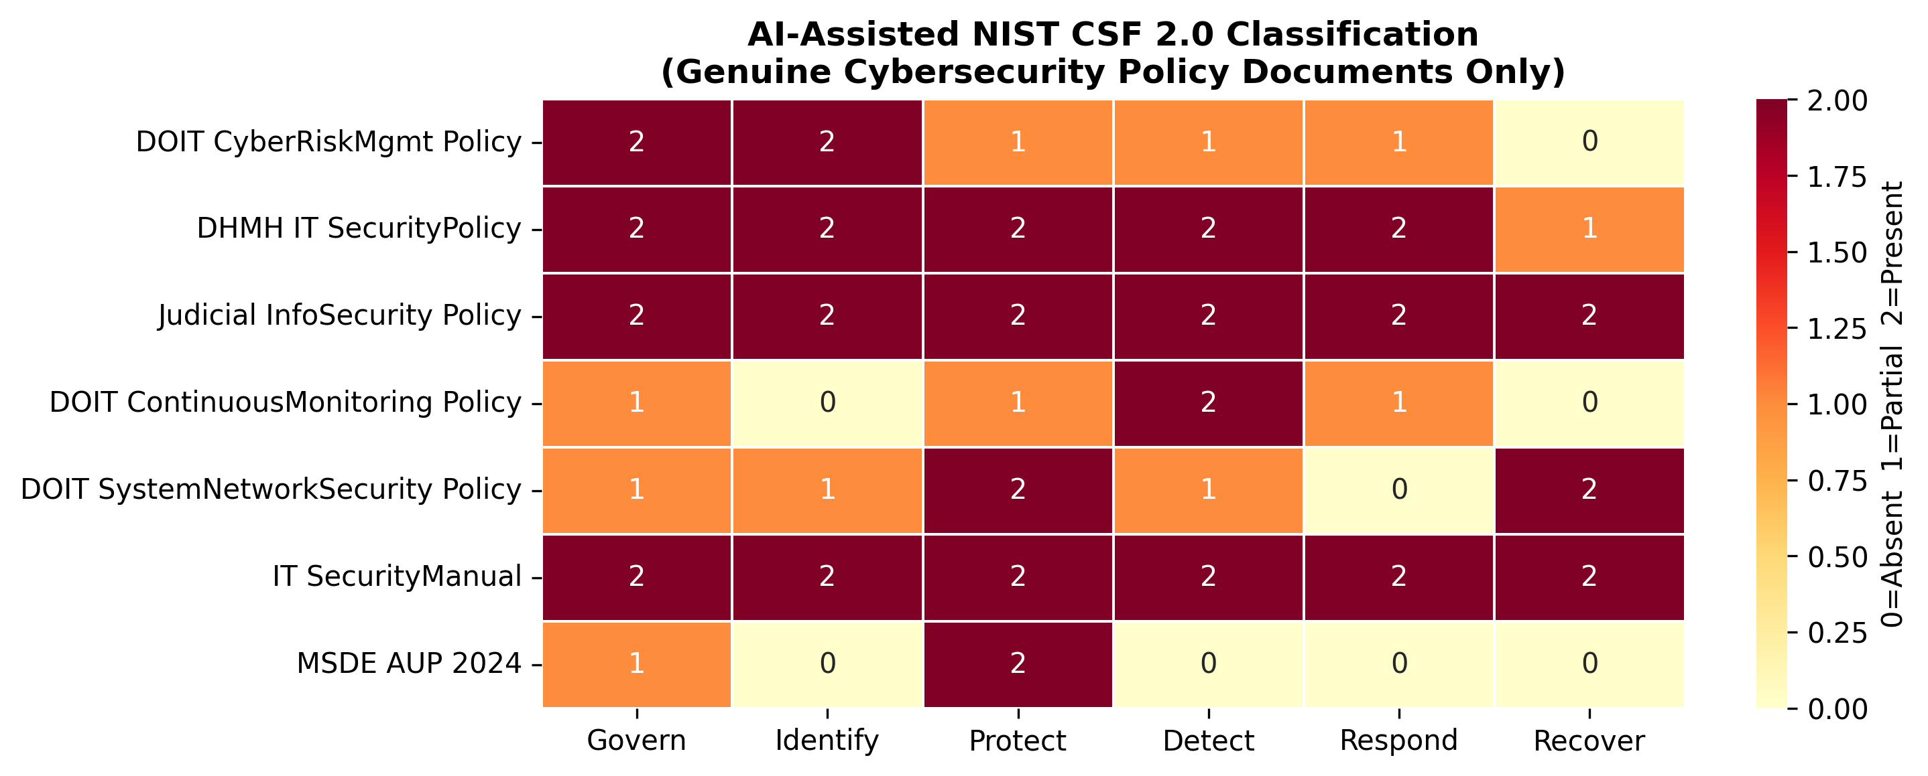
Coverage across the verified policies
Govern is consistently covered (mean 1.71/2); Detect (0.86) and Recover (1.14) lag across the seven verified policies
Supply chain terms appear in 34 of 51 documents, but substantive SCRM provisions in only 4 of 7 policies; eMMA procurement language names vendors without security obligations
Trivedi, Despeignes, Huggins | Bowie State University | CCSC Eastern 2026
18 / 22
Notes:
Repository figure that did not fit the page limit. Rows are the seven verified policies; note the cool Detect and Recover columns.

Slide 19
Discussion: coverage patterns
State level
Municipal level
Supply chain
Govern coverage is consistent across the seven verified policies (mean 1.71/2); Detect (0.86) and Recover (1.14) lag behind.
No standalone municipal cybersecurity policy was discoverable for any of the 23 counties or Baltimore City: absent or unpublished.
SCRM provisions in only 4 of 7 policies. Procurement language references vendors without imposing security obligations.
Public-facing municipal cybersecurity governance is largely absent or non-discoverable.
Trivedi, Despeignes, Huggins | Bowie State University | CCSC Eastern 2026
19 / 22
Notes:
Careful framing: absence of public documents, not proof of absent practice.

Slide 20
Recommendations
1
Adopt CSF 2.0 Govern provisions
2
Strengthen procurement templates
Document risk appetite and executive cybersecurity roles; minimal technical investment required.
Vendor certification, incident notification, and right-to-audit clauses as standard contract language.
3
Regionalize incident response
4
Publish governance policies
Partnerships pool detection and response capability across small jurisdictions.
Public documents create external accountability; Maryland DOIT's suite is a replicable template.
For researchers: prefer AI-assisted classification when policy corpora mix heterogeneous document types.
Trivedi, Despeignes, Huggins | Bowie State University | CCSC Eastern 2026
20 / 22
Notes:
Prioritized for thin budgets - governance and procurement language before technology purchases.

Slide 21
Conclusion and future work
AI-assisted classification significantly outperforms keyword matching on heterogeneous government corpora (F1 0.737 vs 0.353, p < 0.001) and still leads refined lists (0.636).
The pipeline is reproducible: public corpus, prompt, scores, rationales, dual-rater labels, and analysis code.
Maryland's public record shows consistent state-level governance and a municipal-level gap, especially for supply chain requirements.
Future work
Cross-state validation toward all 50 states
Open-source and fine-tuned LLM baselines
Retrieval-augmented full-document processing
Longitudinal re-collection over time
Release of the dual-rater labeled dataset
Trivedi, Despeignes, Huggins | Bowie State University | CCSC Eastern 2026
21 / 22
Notes:
Everything needed to replicate in another state is public.

Slide 22
Thank you
Questions?
dtrivedi@bowiestate.edu
github.com/devharsh/municipal-cyber-policy-analytics
linkedin.com/in/devharsh | researchgate.net/profile/Devharsh-Trivedi
Conducted as part of the SFS (Scholarship for Service) research component at Bowie State University.
Trivedi, Despeignes, Huggins | Bowie State University | CCSC Eastern 2026
22 / 22
Notes:
Point to the repo for corpus, code, and the labeled dataset. Open for questions and collaborations.

