Slide 1
FINAL YEAR CAPSTONE PROJECT · Intake 42nd · B.SC. IN CSE · BUBT
PRESENTED BY
Development of a Data-Driven Customer Segmentation Model to Enhance Marketing Strategies and Customer Satisfaction
S.M. Tahmidul Islam
21223203044
Hasan Al Mamun
21223203037
Mahbubul Alam Marin
21223203026
Mahbubur Raman Mahfuj
21223203036
Aminul Islam
21223203025
Supervised By
Ms. Sadah Anjum Shanto
Assistant Professor
Department of CSE, BUBT
Dhaka, Bangladesh
Spend the marketing budget on the customers who will actually respond—identified from behavior, not guesswork.
RFM Analysis · K-Means Clustering · Churn Prediction
FastAPI · React · Live Analytics Dashboard
Notes:
Good morning. Our project is Customer Segmentation for Targeted E-Commerce Marketing. In one line: we take a year of raw transaction data, group the customers by how they actually behave, and turn that into a live dashboard a marketing team can act on. I'll cover the problem, the method, the results, the system we built, and the limitations.

Slide 2
00 CONTENTS · SIX PARTS
What we will cover
01
The Problem
Why blanket marketing wastes money
02
Data & Method
RFM features, scaling, choosing K
03
Segmentation Results
Four clusters and what they mean
04
Churn Prediction
Who is about to leave—and the caveat
05
The System
Notebook → API → live dashboard
06
Evaluation & Limits
Honest assessment and future work
CUSTOMER SEGMENTATION FOR TARGETED E-COMMERCE MARKETING
02 / 28
Notes:
Here is the route. Six parts. I'll spend most of the time on parts three and four — the method and what the segments actually say — because that is where the contribution is.

Slide 3
01 THE PROBLEM · WHY BLANKET MARKETING FAILS
Everyone gets the same email
— One list, one message. The retailer holds thousands of customer records but no behavioural structure over them, so every campaign is sent to everyone.
— The customers are not alike. In this dataset the top 10% of customers account for 61% of all revenue. A single message cannot serve both ends of that distribution.
— Waste runs in both directions. Discounts are given to loyal customers who would have bought anyway, while budget is spent contacting customers who have already left.
— Churn is noticed too late. Without a recency signal, a lapsing customer is only identified once they have stopped buying — after the point where a win-back works.
THE COST OF ONE BLAST
4,339
customers contacted
£8,678
campaign cost at £2 / contact
56%
of that spend reaches customers
worth 11% of revenue
The data to fix this already exists — it is sitting unused in the transaction log.
CUSTOMER SEGMENTATION FOR TARGETED E-COMMERCE MARKETING
03 / 28
Notes:
The problem is simple to state. An online retailer has thousands of customers and treats them as one undifferentiated list. Every campaign goes to everybody. But the customers are not the same: in our data the top ten percent of customers generate sixty-one percent of the revenue. Sending the same twenty-percent-off coupon to a loyal high spender and to someone who bought once a year ago is wasteful in two directions — you discount revenue you would have earned anyway, and you spend on people who will not come back.

Slide 4
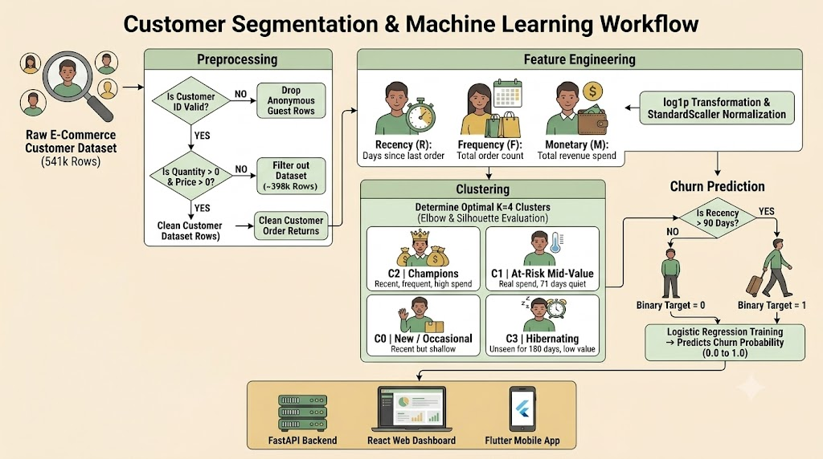
01 THE APPROACH · FROM RAW DATA TO DEPLOYED MODEL
The end-to-end workflow
CUSTOMER SEGMENTATION FOR TARGETED E-COMMERCE MARKETING
04 / 28
Notes:
This single slide is the whole project in one picture — worth pausing on, because everything that follows is a detail of one of these boxes.
Read it left to right. We start with the raw e-commerce dataset, 541,909 rows. Preprocessing is two decisions: drop rows with no customer ID, because a guest checkout cannot be attributed to a person, and filter out returns where quantity is not positive. That leaves roughly 398,000 clean transaction rows.
Feature engineering collapses those transactions into one row per customer with three numbers — Recency, Frequency, Monetary. Because monetary value is severely skewed we apply log1p and then StandardScaler before any modelling.
That feeds two branches. Downward, clustering: we use the elbow method and silhouette analysis to settle on K equals four, giving Champions, At-Risk Mid-Value, New or Occasional, and Hibernating. Rightward, churn prediction: we label a customer churned if recency exceeds ninety days and fit a logistic regression that outputs a churn probability between zero and one.
Both outputs land in the delivery layer at the bottom — the FastAPI backend, which serves the results as JSON, and the React dashboard that consumes them. Keep the spoken summary to those two; there is no need to walk through the mobile client unless someone asks about it directly.

Slide 5
01 OBJECTIVES · SCOPE OF THE PROJECT
What we set out to build
01
Turn transactions into customer behaviour
Collapse ~398k transaction lines into one interpretable row per customer using the RFM (Recency, Frequency, Monetary) framework.
02
Discover segments without labels
Apply unsupervised K-Means clustering to find natural groupings, selecting K with the elbow method and silhouette analysis rather than by assumption.
03
Attach a churn signal to every customer
Fit a logistic-regression model that scores each customer's probability of lapsing, so at-risk revenue can be quantified.
04
Translate segments into marketing actions
Give each cluster a business persona and a concrete recommended treatment — the output must be usable, not just descriptive.
05
Ship it as a usable product
Serve the pipeline through a FastAPI backend and a React dashboard so a non-technical user can explore the segments without touching code.
CUSTOMER SEGMENTATION FOR TARGETED E-COMMERCE MARKETING
05 / 28
Notes:
From that problem we set five objectives. Note the fifth one — we did not want this to end as a notebook full of plots. A marketing team cannot run Jupyter, so part of the objective was delivering it as a working web application.

Slide 6
02 THE DATASET · REAL TRANSACTIONS, ONE FULL YEAR
UCI Online Retail
541,909
4,339
3,665
37
RAW TRANSACTION ROWS
UNIQUE CUSTOMERS
DISTINCT PRODUCTS
COUNTRIES
— Source. UCI Machine Learning Repository — a genuine transaction log from a UK-based online gift retailer, not synthetic data.
— Grain. One row per line-item on an invoice: invoice number, product code and description, quantity, timestamp, unit price, customer ID and country.
— Window. 16 Jul 2025 – 24 Jul 2026. Roughly twelve months, which is long enough for recency and repeat-purchase behaviour to be meaningful.
— Note on dates. The original dataset covers Dec 2010 – Dec 2011. We shifted the window forward so the live demo reacts to present-day activity; intervals between purchases are untouched.
SCHEMA
InvoiceNo transaction id
StockCode product id
Description product name
Quantity units bought
InvoiceDate timestamp
UnitPrice price per unit
CustomerID customer id
Country billing country
CUSTOMER SEGMENTATION FOR TARGETED E-COMMERCE MARKETING
06 / 28
Notes:
We used the UCI Online Retail dataset — a real transaction log from a UK-based online gift retailer, about 542,000 rows covering roughly one year. It is a standard benchmark for this task, which means our results are comparable to published work. Note the dates shown here: we shifted the original 2010–2011 window forward so the live dashboard demo has recent activity to react to. The behaviour and the relative gaps between purchases are unchanged.

Slide 7
02 PREPROCESSING · 541,909 → 397,924 ROWS
Cleaning the transaction log
1
Drop null CustomerID
Guest checkouts with no customer identifier. Behaviour cannot be attributed to a person, so they cannot enter a per-customer model.
−135,080 ROWS
2
Remove returns & cancellations
Rows with Quantity ≤ 0 are refunds. They are not purchase behaviour and would distort both frequency and monetary value.
−10,624 ROWS
3
Parse InvoiceDate to datetime
Required before any recency arithmetic — without it, dates are strings and date differences are impossible.
TYPE FIX
4
Derive TotalPrice
TotalPrice = Quantity × UnitPrice. The line-level revenue figure that Monetary value is later summed from.
NEW FEATURE
Result: 397,924 clean transaction rows covering 4,339 identifiable customers — 73% of the original file retained.
CUSTOMER SEGMENTATION FOR TARGETED E-COMMERCE MARKETING
07 / 28
Notes:
Before any modelling, the data had to be cleaned. Two decisions matter and the examiner may push on both. First, we dropped 135,080 rows with no CustomerID — roughly a quarter of the file. These are guest checkouts; without an ID we cannot attribute behaviour to a person, and per-customer analysis is the entire point. Second, we removed rows with quantity less than or equal to zero — these are returns and cancellations. We keep them out because a return is not purchase behaviour. We acknowledge in our limitations that a returns-heavy customer is itself a useful signal we are discarding.

Slide 8
02 FEATURE ENGINEERING · 398K TRANSACTIONS → 4,339 CUSTOMERS
The RFM model
R
F
M
Recency
Frequency
Monetary
Days since the customer's last purchase, measured from a snapshot one day after the final transaction in the dataset.
The count of distinct invoices the customer placed across the whole period.
Total revenue from the customer: the sum of Quantity × UnitPrice across all their lines.
Lower is better — a recent buyer is an engaged buyer.
Higher is better — repeat purchase indicates loyalty.
Higher is better — this is the customer's realised value.
IMPLEMENTATION
— One customer = one row. A customer with 200 purchases still contributes a single row, described by three numbers.
— These three features are the entire input to every model that follows.
snapshot = df.InvoiceDate.max() + 1 day
rfm = df.groupby('CustomerID').agg(
Recency, Frequency, Monetary )
CUSTOMER SEGMENTATION FOR TARGETED E-COMMERCE MARKETING
08 / 28
Notes:
This is the heart of the feature engineering. RFM is a long-established marketing framework that describes a customer with three numbers. Recency: how many days since their last order — measured against a snapshot date one day after the last transaction in the data, so no customer has a recency of zero. Frequency: how many distinct invoices they placed. Monetary: total money spent. The key transformation is that 398,000 transaction rows collapse to 4,339 customer rows. We are no longer modelling purchases; we are modelling people.

Slide 9
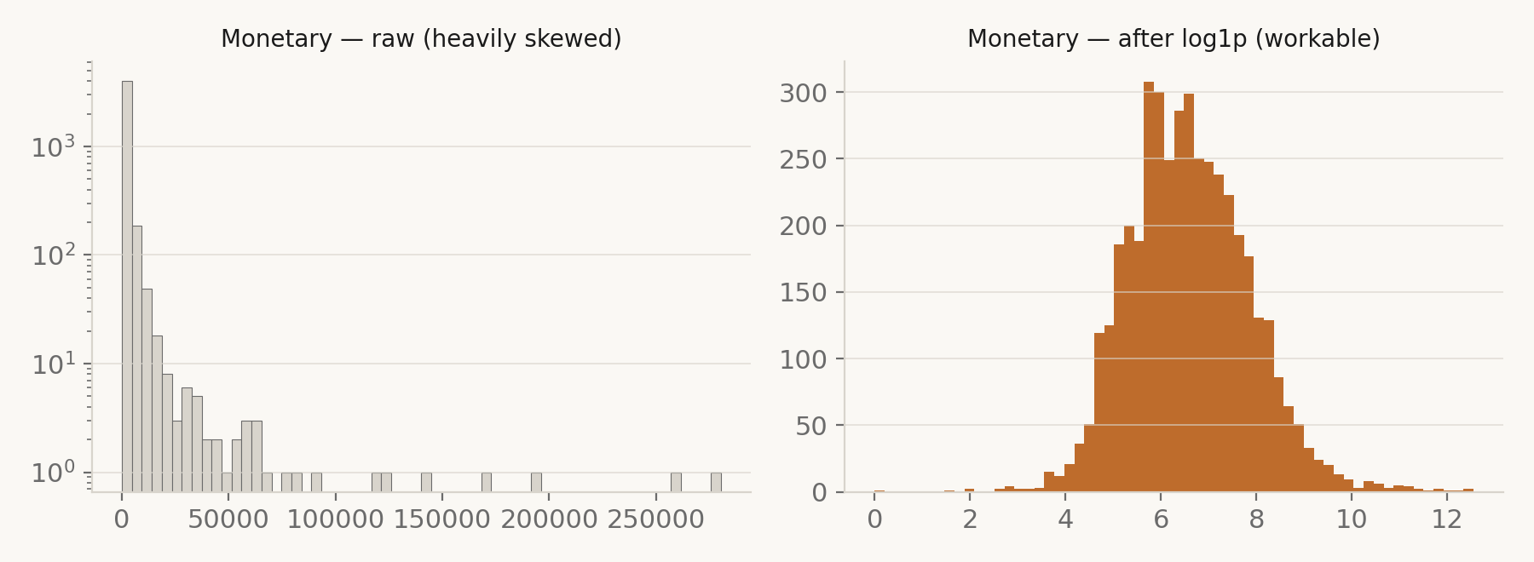
02 SCALING · LOG1P, THEN STANDARDSCALER
Taming the skew
— The problem. Monetary value is extremely right-skewed (skewness = 19.3); the largest customer spent £280,206 against a median of £674.
— Why it breaks K-Means. K-Means minimises Euclidean distance, so a handful of extreme spenders pull centroids toward themselves and consume clusters that should describe the majority.
— The fix. log1p compresses the tail without discarding anyone — skewness drops from 19.3 to 0.36. StandardScaler then puts all three features on a common scale.
— Our convention. Model on the scaled values; report and interpret in the original pounds and days. Scaled numbers mean nothing to a marketing manager.
Left: raw Monetary on a log-scaled count axis — nearly every customer is crushed into the first bin. Right: after log1p, the distribution is workable.
CUSTOMER SEGMENTATION FOR TARGETED E-COMMERCE MARKETING
09 / 28
Notes:
Scaling is where a lot of RFM projects go wrong, so we want to show our working. K-Means uses Euclidean distance, so a feature with a bigger numeric range dominates. Monetary ranges from a few pounds to two hundred and eighty thousand; recency ranges nought to about three seventy. Worse, monetary is extremely right-skewed — a skewness of over nineteen. If we only standardise, a handful of whales sit so far out that K-Means spends clusters isolating them. So we apply log1p first, which compresses the long tail and brings skewness down to zero point three six, and then StandardScaler. One convention we kept throughout: we model on the scaled data but always report and interpret using the original pounds and days.

Slide 10
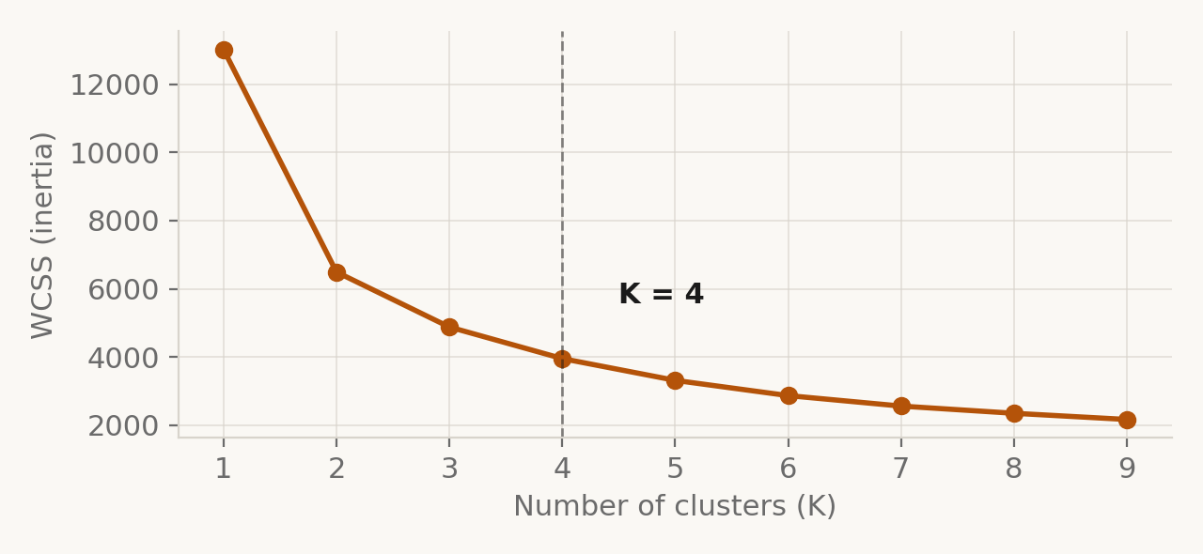
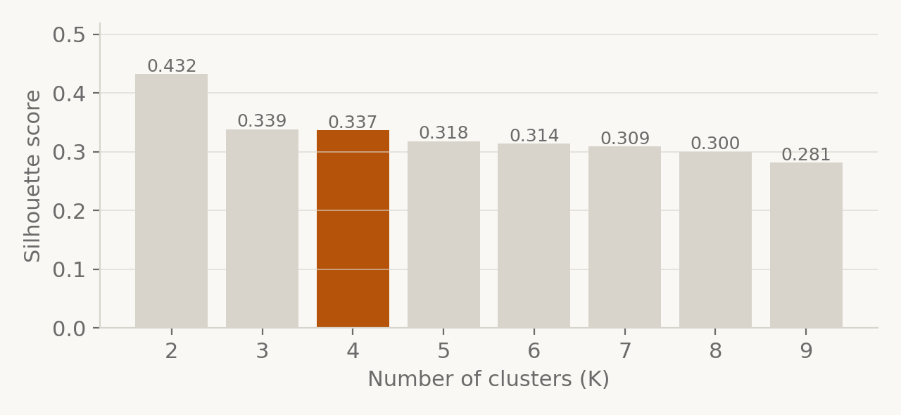
02 MODEL SELECTION · ELBOW, SILHOUETTE, AND A JUDGEMENT CALL
Why K = 4
THE HONEST ANSWER
— Silhouette actually peaks at K = 2 (0.432), not at K = 4 (0.337).
— It rewards few, well-separated blobs — but RFM behaviour is a continuum, so it will nearly always favour the smallest K.
— K = 2 only separates 'active' from 'inactive' — not something marketing can act on differently.
— K = 4 keeps a reasonable score and recovers the four standard RFM segments. Chosen for actionability, sanity-checked statistically.
CUSTOMER SEGMENTATION FOR TARGETED E-COMMERCE MARKETING
10 / 28
Notes:
Choosing K is the question an examiner is most likely to press on, so we will be direct about it. The elbow curve bends between three and five — it is a soft elbow, not a sharp one. Silhouette actually peaks at K equals two, with zero point four three. We did not take K equals two, and here is the defence. Silhouette rewards few, well-separated blobs, and RFM behaviour is a continuum, not naturally separated islands — so silhouette will almost always favour the smallest K. K equals two only tells us 'active versus inactive', which marketing already knows and cannot act on. K equals four still scores zero point three four, which indicates real structure, and it recovers the four segments the marketing literature recognises: champions, loyal, new, and hibernating. We chose K by actionability, with the statistics as a sanity check, and we are stating that openly rather than hiding it.

Slide 11
03
Four clusters, and what each one is worth
K-Means on scaled RFM · 4,339 customers assigned · interpreted in original units
CUSTOMER SEGMENTATION FOR TARGETED E-COMMERCE MARKETING
11 / 28
Notes:
That is the method. Now the results.

Slide 12
03 SEGMENTATION RESULTS · MEAN VALUES IN ORIGINAL UNITS
The four segments
SEGMENT
SIZE
% OF BASE
RECENCY
FREQUENCY
MONETARY
% OF REVENUE
Champions
715
16.5%
12 days
13.7 orders
£8,083
64.9%
At-Risk Mid-Value
1,175
27.1%
71 days
4.1 orders
£1,801
23.8%
New / Occasional
825
19.0%
18 days
2.2 orders
£558
5.2%
Hibernating
1,624
37.4%
180 days
1.3 orders
£342
6.2%
READ THE EXTREMES FIRST
— Champions (Cluster 2). 16% of customers, 65% of revenue. Bought 12 days ago, 14 orders each.
— Hibernating (Cluster 3). The largest group at 37% of the base, but only 6% of revenue and unseen for 180 days.
— At-Risk (Cluster 1). The segment that matters most: £1,801 average spend but 71 days since the last order — real value, actively cooling.
— New / Occasional (Cluster 0). Recent (18 days) but shallow — 2.2 orders. The growth opportunity.
CUSTOMER SEGMENTATION FOR TARGETED E-COMMERCE MARKETING
12 / 28
Notes:
Here are the four clusters in original units — days and pounds, not scaled numbers. Read the extremes first. Cluster 2 is 715 customers, bought 12 days ago on average, nearly 14 orders each, over eight thousand pounds apiece — these are the champions. Cluster 3 is the opposite: 1,624 customers, last seen 180 days ago, barely more than one order, about three hundred and forty pounds — dormant. Cluster 0 is recent but low-volume: new or occasional buyers. Cluster 1 sits in the middle and is the interesting one — decent spend, but seventy days since their last order. That is a segment actively cooling down, and it is the one where intervention pays.

Slide 13
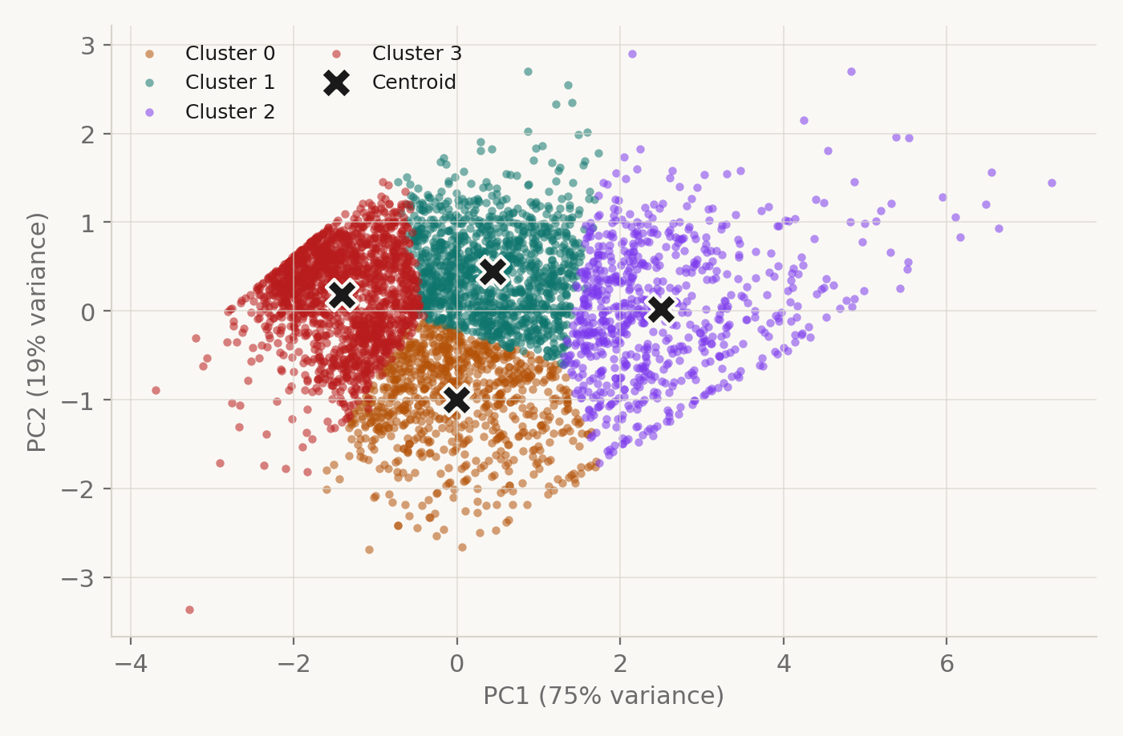
03 VISUALISATION · PCA PROJECTION, FOR VIEWING ONLY
The segments in two dimensions
— Why PCA. Scaled RFM is three-dimensional. PCA compresses it to two so the segmentation can be inspected visually.
— Faithful projection. PC1 retains 75% of the variance and PC2 a further 19% — 94% in total, so little structure is lost in the picture.
— Visualisation only. Clustering is performed in the full scaled RFM space. PCA is never fed back into the model.
— Overlap is expected. Customer behaviour is a continuum, not four islands. Perfectly separated circles would suggest artificial data — the centroids, marked X, are clearly distinct.
CUSTOMER SEGMENTATION FOR TARGETED E-COMMERCE MARKETING
13 / 28
Notes:
This is the visual check. We ran PCA to project the three-dimensional scaled RFM space down to two so it can be plotted; the first two components retain ninety-four percent of the variance, so this picture is a fair representation. Two things to say before anyone asks. First, PCA is used purely for visualisation — the clustering itself happens in the full three-dimensional scaled space, not on these coordinates. Second, the clusters touch at the boundaries. That is expected and correct: customer behaviour is a continuum, so perfectly separated circles would actually be a sign of something artificial. The centroids are clearly distinct and the gradient runs cleanly from dormant to champion.

Slide 14
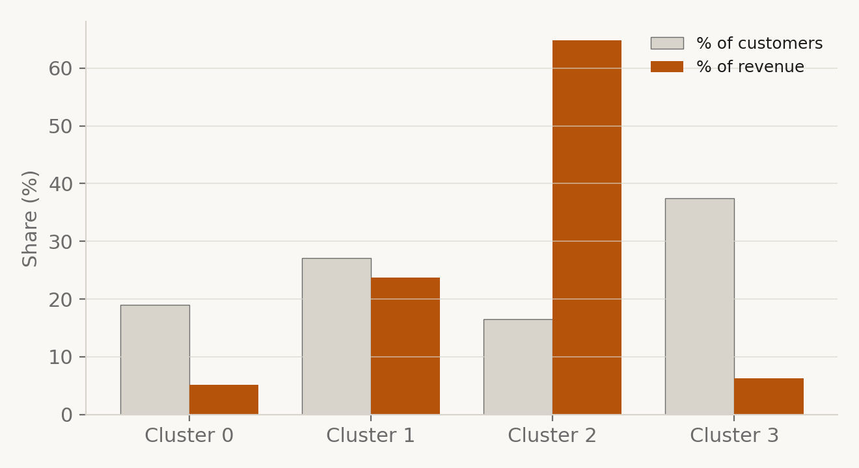
03 VALUE CONCENTRATION · WHERE THE REVENUE ACTUALLY SITS
Headcount is not value
THE MISMATCH
16%
of customers → 65% of revenue
CLUSTER 2 · CHAMPIONS
37%
of customers → 6% of revenue
CLUSTER 3 · HIBERNATING
Under blanket marketing these two groups get the same message and the same budget. That is the waste, stated in one number.
CUSTOMER SEGMENTATION FOR TARGETED E-COMMERCE MARKETING
14 / 28
Notes:
This is the single most important slide for the business argument, so I will pause on it. Look at the mismatch between the grey bars and the orange bars. Cluster 2 is sixteen percent of the customer base but sixty-five percent of the revenue. Cluster 3 is thirty-seven percent of the base — the biggest group — and six percent of the revenue. Under blanket marketing those two groups receive identical treatment and identical budget. That is precisely the waste we set out to remove. Segmentation makes the mismatch visible, and once it is visible it can be acted on.

Slide 15
03 ACTIVATION · WHAT MARKETING SHOULD ACTUALLY DO
From cluster to campaign
Champions
C2
Loyalty tier, early access, referral programme. Recognition — not discounts, which would only erode margin on revenue already secured.
Recent, frequent, high spend. The revenue engine.
At-Risk Mid-Value
C1
The priority for intervention. Personalised win-back offer, reminder of previously viewed items, time-limited incentive. Highest return per pound spent.
Real spend (£1,801) but 71 days quiet. Cooling.
New / Occasional
C0
Onboarding sequence and a second-purchase nudge. The objective is to convert them into Cluster 2 over time.
Recent but shallow — few orders, low spend.
Hibernating
C3
One low-cost reactivation attempt, then move to cheap channels. Do not spend premium acquisition budget re-chasing this group.
Unseen for 180 days, low value.
CUSTOMER SEGMENTATION FOR TARGETED E-COMMERCE MARKETING
15 / 28
Notes:
A cluster number is not a deliverable. This slide is the translation layer — for each segment, who they are and what marketing should actually do. Champions get recognition, not discounts; discounting them destroys margin on revenue you were going to receive anyway. At-risk customers get the win-back offer, because that is where a pound of spend changes an outcome. New buyers get a second-purchase nudge. And the hibernating group gets one cheap reactivation attempt, then goes to a low-cost channel — we deliberately do not recommend abandoning them, but we do not recommend spending premium budget on them either.

Slide 16
03 BUSINESS IMPACT · A WORKED EXAMPLE AT £2 PER CONTACT
What this saves
£8,678
£3,780
56%
89%
BLANKET CAMPAIGN · 4,339 CONTACTS
TARGETED CAMPAIGN · 1,890 CONTACTS
REDUCTION IN CAMPAIGN SPEND
OF REVENUE STILL ADDRESSED
HOW THE TARGET LIST IS BUILT
— Include Champions. 715 customers carrying 65% of revenue — retention here protects the base.
— Include At-Risk. 1,175 customers carrying 24% of revenue and visibly lapsing — this is where a pound of spend changes the outcome.
— Down-weight the rest. 2,449 customers move to low-cost channels rather than paid campaigns.
STATING THE CLAIM PRECISELY
This is a cost-efficiency figure derived from our actual segment sizes and revenue shares — it is not a measured lift in sales. Demonstrating uplift requires an A/B test against a randomised holdout group, which is the first item in our future work.
CUSTOMER SEGMENTATION FOR TARGETED E-COMMERCE MARKETING
16 / 28
Notes:
This is the money slide — the answer to 'so what?'. Take a campaign costing two pounds per contact. Blanket: 4,339 contacts, £8,678. Targeted at the two segments where spend actually changes behaviour — champions and at-risk — that is 1,890 contacts, £3,780. A fifty-six percent reduction in campaign cost, while still addressing the customers who account for eighty-nine percent of revenue. To be clear about what this claim is: it is a cost-efficiency argument computed from our real segment sizes, not a measured uplift. Proving uplift needs an A/B test against a holdout group, which is the first thing we would do next.

Slide 17
04 CHURN PREDICTION · LOGISTIC REGRESSION ON RFM
Who is about to leave
— The label. A customer is marked as churned if their Recency exceeds 90 days — a standard retail dormancy window, and one the dashboard lets you change (30 / 60 / 90 / 120 / 180).
— The model. Logistic regression on Recency, Frequency and Monetary, with an 80/20 stratified train-test split. Chosen for interpretability — coefficients can be explained to a marketing team.
— The output. A churn probability between 0 and 1 for every customer, which the dashboard buckets into High Risk (> 0.7), Medium Risk (0.4 – 0.7) and Low Risk / Loyal.
— Base rate. 33.0% of the customer base is churned under the 90-day definition — 1,432 customers.
CHURN RATE BY SEGMENT
Champions
0%
New / Occasional
0%
At-Risk Mid-Value
24%
Hibernating
71%
Risk tracks the segmentation cleanly — near zero among Champions, 71% among Hibernating. The two methods agree.
CUSTOMER SEGMENTATION FOR TARGETED E-COMMERCE MARKETING
17 / 28
Notes:
The second half of the project moves from description to prediction. Clustering tells us who a customer is today; we also wanted a forward-looking risk score. We defined churn as recency greater than ninety days, then trained a logistic regression on recency, frequency and monetary to output a churn probability per customer. Thirty-three percent of the base is flagged as churned under that definition. The really useful output is the breakdown by cluster on the right — churn risk is near zero in champions and seventy-one percent in the hibernating group, which independently confirms the segmentation is capturing something real.

Slide 18
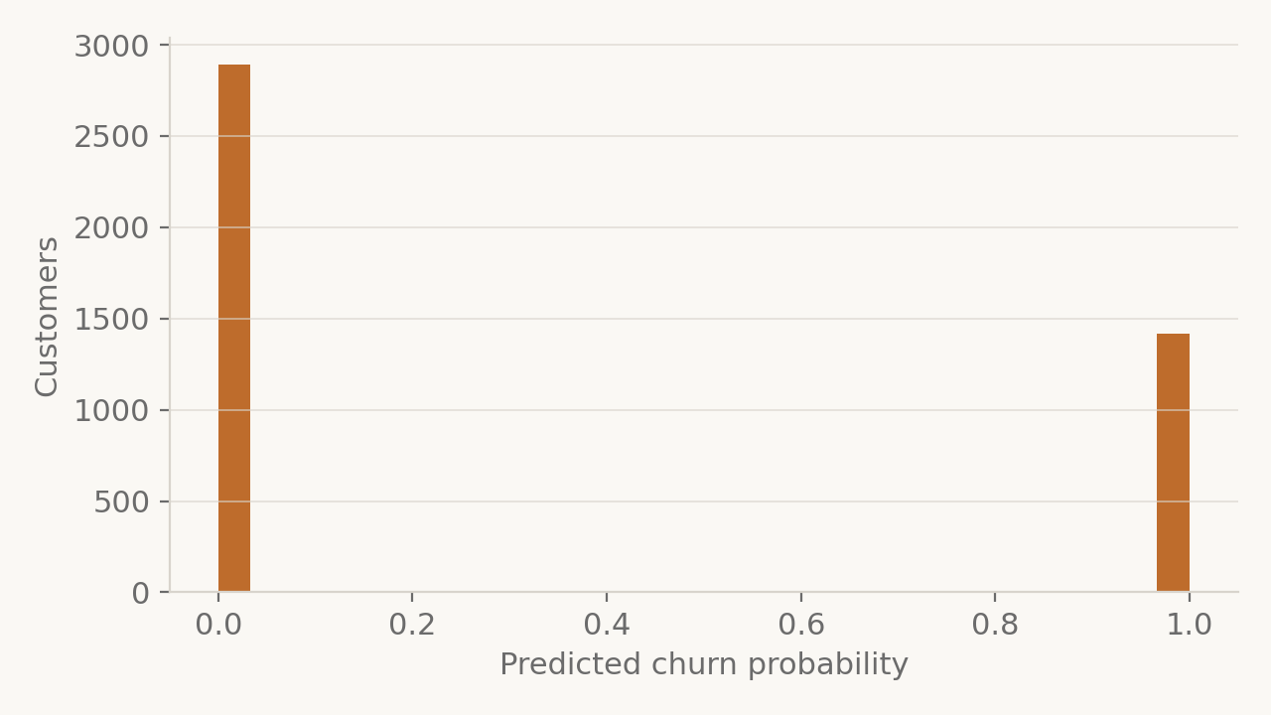
04 CHURN EVALUATION · READING OUR OWN RESULT HONESTLY
A perfect score is a red flag
100%
1.00
1.00
868
REPORTED ACCURACY
PRECISION · CHURN CLASS
RECALL · CHURN CLASS
TEST-SET CUSTOMERS
WHY — AND WE ARE RAISING THIS OURSELVES
— The label leaks. Churn is defined as Recency > 90, and Recency is also a model input — the classifier only learns a threshold on a feature it was handed.
— So the score is tautological. 100% measures label construction, not predictive ability.
— The correct fix. Define churn on a future window — did the customer buy in the next 90 days — and train without Recency as an input.
— What still holds. It remains a useful ranked dormancy indicator for prioritising outreach; it is simply not a forecast.
Probabilities collapse to 0 and 1 — no genuine uncertainty is expressed.
CUSTOMER SEGMENTATION FOR TARGETED E-COMMERCE MARKETING
18 / 28
Notes:
Now the slide we expect to be questioned on, so we are raising it ourselves. The classifier reports one hundred percent accuracy, precision and recall. That is not a good result — it is a warning sign, and we understand exactly why it happens. Our churn label is defined as recency greater than ninety, and recency is also one of the three inputs. The model only has to learn a threshold on a feature it has already been given. It is a tautology, not predictive power. The histogram shows the symptom: probabilities pile up at zero and one with nothing in between, because there is no genuine uncertainty to express. What would fix it: define churn on a future window — for example, did this customer buy in the next ninety days — and train only on features observed before that window, excluding recency. We did not have time to rebuild the pipeline for that, and we would rather state the flaw plainly than present a perfect score as a success.

Slide 19
05
From notebook to working product
A marketing team cannot run Jupyter. The same pipeline had to ship as an application.
CUSTOMER SEGMENTATION FOR TARGETED E-COMMERCE MARKETING
19 / 28
Notes:
So far this is analysis. The last part of the project was making it usable.

Slide 20
05 SYSTEM ARCHITECTURE · SAME PIPELINE, THREE SURFACES
How the three layers fit
PRESENTATION LAYER
React 19 + TypeScript
Recharts
TanStack Query
Frontend
Vite build, shadcn/ui components
PCA scatter, elbow, histograms
Data fetching and caching
APPLICATION LAYER
FastAPI + Uvicorn
pipeline.py
In-memory cache
Backend API
Typed Pydantic response models
The same code the notebook runs
Pipeline runs once at startup
DATA LAYER
data.csv
SQLite
scikit-learn models
Storage
541,909 raw transaction rows
Product catalogue + demo purchases
Fitted scaler, K-Means, PCA, LR
Key decision: the backend imports the notebook's own pipeline — dashboard and analysis can never disagree.
CUSTOMER SEGMENTATION FOR TARGETED E-COMMERCE MARKETING
20 / 28
Notes:
This is the system architecture. Three layers. The data layer is the raw CSV plus a SQLite database holding the product catalogue and any simulated purchases. The application layer is a FastAPI service in Python; critically it imports the exact same pipeline module the notebook uses, so there is no risk of the dashboard and the analysis disagreeing. It runs the pipeline once at startup, holds the results in memory, and serves cached JSON. The presentation layer is a React and TypeScript single-page app using Recharts, which fetches from those endpoints. The whole thing is deployed on Render.

Slide 21
05 BACKEND · FASTAPI · TYPED RESPONSES · CACHED AT STARTUP
The API surface
GET /summary
Total customers, revenue, churn rate, cluster count
GET /clusters
Per-cluster size, mean RFM and churn rate
GET /customers
Paginated directory — filter by cluster and churn band
GET /customers/{id}/transactions
Full invoice history for one customer
GET /charts/pca-scatter
De-duplicated 2-D projection points for plotting
GET /charts/churn-distribution
Pre-binned churn probability histogram
GET /charts/rfm-distribution
Pre-binned R, F and M histograms (99th-pct clipped)
GET /charts/elbow
WCSS per K — the elbow curve, served to the UI
POST /demo/purchase
Records a live purchase and re-segments that customer
Charts are binned server-side and cached, so the browser never handles 4,339 raw rows — the dashboard stays responsive.
CUSTOMER SEGMENTATION FOR TARGETED E-COMMERCE MARKETING
21 / 28
Notes:
Briefly, the API surface. Nine endpoints. Summary and clusters give the headline figures; customers is a paginated, filterable directory; the three chart endpoints return pre-binned data so the browser never has to process four thousand rows; and the demo endpoints drive the live re-segmentation I will show in a moment. Every response is a typed Pydantic model, so the frontend's TypeScript types match the backend contract exactly.

Slide 22
05 FRONTEND · SIX SECTIONS, READ TOP TO BOTTOM
The dashboard
01
Overview
Four headline indicators: total customers, total revenue, churn rate and cluster count — recomputed live for the selected threshold.
02
The Segments
The cluster table: size, mean recency, frequency, monetary value and churn rate for each of the four groups.
03
Distribution
PCA scatter of every customer coloured by cluster, beside the churn-probability density.
04
Directory
Paginated, filterable per-customer table — cluster, RFM, churn score and email. The list a campaign is actually built from.
05
Method
RFM distributions and the elbow plot, exposed in the product so the modelling choices are auditable rather than hidden.
06
Researchers
Project attribution.
Header control: the churn threshold (30 / 60 / 90 / 120 / 180 days) recomputes the whole dashboard — the definition of churn belongs to the user, not to us.
CUSTOMER SEGMENTATION FOR TARGETED E-COMMERCE MARKETING
22 / 28
Notes:
The dashboard is laid out as a report in six sections, so a manager reads it top to bottom rather than hunting through a menu. Overview gives the four headline numbers. The segments section is the cluster table. Distribution has the PCA scatter and the churn density. Directory is the searchable per-customer list — this is the part a marketer actually exports. Method exposes the elbow plot and RFM distributions so the analysis is auditable rather than a black box. One control worth pointing out: the churn threshold selector in the header recomputes the entire dashboard for 30, 60, 90, 120 or 180 days, so the definition of churn is the user's to set, not hard-coded by us.

Slide 23
05 LIVE DEMONSTRATION · REAL-TIME RE-SEGMENTATION
Watching a customer change segment
01
02
03
04
Log in
Buy a product
Backend recomputes
Segment updates live
A real customer authenticates against credentials stored per CustomerID; the backend issues a signed token.
The customer selects an item from the catalogue served out of SQLite and places an order.
Recency resets to 0, Frequency +1, Monetary increases. The fitted scaler and K-Means then re-predict this customer's cluster.
The panel shows before / after side by side and the dashboard figures move. /demo/reset restores the original state.
WHY THIS MATTERS
It proves the segmentation is a live system, not a one-off report. The fitted scaler, K-Means and logistic-regression models are held in memory and applied to new behaviour as it arrives — which is exactly how this would run in production.
CUSTOMER SEGMENTATION FOR TARGETED E-COMMERCE MARKETING
23 / 28
Notes:
This is what we would like to show live, because it demonstrates that the system is not a static report. A customer logs in with real credentials, buys a product, and the backend immediately recomputes that customer's recency to zero, increments frequency, adds to monetary value, re-runs the scaler and K-Means prediction, and reassigns them to a cluster. The panel shows the before and after side by side, so you can watch a customer move segment in real time. There is also a reset endpoint that restores the original state, so the demo can be run repeatedly.

Slide 24
06 LIMITATIONS · STATED UP FRONT
What this project does not do
01
The churn label leaks its own input
Churn is defined from Recency, which is also a feature, so the reported 100% accuracy measures label construction rather than predictive power.
02
A quarter of the data was discarded
135,080 rows had no CustomerID. That is real revenue excluded from the analysis simply because it cannot be attributed to a person.
03
K = 4 overrides the silhouette score
Silhouette prefers K = 2 (0.432 vs 0.337). We chose K = 4 for business interpretability — defensible, but a judgement call.
04
RFM ignores what customers buy
Only how recently, how often and how much. Two customers with identical RFM but completely different baskets are treated as identical.
05
The saving is modelled, not measured
The 56% figure is arithmetic over real segment sizes. Proving campaign uplift needs an A/B test against a randomized holdout group.
CUSTOMER SEGMENTATION FOR TARGETED E-COMMERCE MARKETING
24 / 28
Notes:
We would rather state the limitations than be caught by them. Five. One, the churn label leaks — already covered. Two, we discarded a quarter of the file with the null CustomerID rows; those are real revenue we cannot attribute. Three, the silhouette score genuinely prefers K equals two and we overrode it on business grounds — a defensible choice, but a choice. Four, RFM ignores what people buy, only how much and how often; product affinity would add a lot. Five, the cost saving is arithmetic from our segment sizes, not a measured uplift — that needs a controlled trial.

Slide 25
06 FUTURE WORK · IN PRIORITY ORDER
Where this goes next
HIGH
Rebuild churn as a real forecast
Define the label on a forward window — did the customer purchase in the next 90 days — and train only on features observed before it, with Recency excluded.
HIGH
Measure uplift with an A/B test
Run the targeted campaign against a randomised holdout to convert the modelled cost saving into an evidenced revenue result.
MEDIUM
Add product-affinity features
Extend RFM with category mix and basket composition so segments capture what people buy, not only how much and how often.
MEDIUM
Benchmark alternative clustering
Evaluate DBSCAN and hierarchical clustering against K-Means, with Davies–Bouldin and Calinski–Harabasz alongside silhouette.
MEDIUM
Model customer lifetime value
Move from historical spend to predicted future value so segments can be prioritised by what they will be worth.
LOW
Connect to a campaign platform
Push a selected segment straight into an email or ads tool so the dashboard becomes operational rather than analytical.
CUSTOMER SEGMENTATION FOR TARGETED E-COMMERCE MARKETING
25 / 28
Notes:
Future work maps directly onto those limitations, in priority order. Rebuild churn on a forward window so it becomes a genuine prediction. Run an A/B test to measure real uplift. Add product-affinity features so segments know what people buy, not just how much. Compare against alternative clustering — DBSCAN and hierarchical, which we imported but did not have time to evaluate properly. Add customer lifetime value so segments can be ranked by future worth. And wire the dashboard directly into an email platform so a segment becomes a campaign in one click.

Slide 26
06 CONCLUSION · SUMMARY OF CONTRIBUTION
What we delivered
541k
4
65%
56%
TRANSACTIONS PROCESSED
ACTIONABLE SEGMENTS
OF REVENUE IN ONE SEGMENT
MODELLED CUT IN CAMPAIGN SPEND
— Segmentation. 541,909 transactions reduced to four behavioural segments, each with a persona, a revenue share and a concrete marketing action.
— Prediction. A churn indicator on every customer, with the leakage in its construction identified and documented rather than glossed over.
— Delivery. A FastAPI backend and React dashboard sharing the notebook's exact pipeline — usable by a non-technical marketer.
THE HEADLINE FINDING
16% of customers generate 65% of revenue. Marketing to them as though they were the same as the other 84% is the single largest avoidable cost in the campaign budget.
CUSTOMER SEGMENTATION FOR TARGETED E-COMMERCE MARKETING
26 / 28
Notes:
To conclude. We took 542,000 raw transactions and turned them into four behavioural segments, each with a persona, a revenue share and a recommended marketing action. We attached a churn indicator to every customer. And we delivered it as a working web application rather than a notebook, so a marketing team can use it without writing code. The headline finding is the concentration: sixteen percent of customers carry sixty-five percent of revenue — and targeting on that basis cuts campaign cost by fifty-six percent while still addressing eighty-nine percent of revenue. Thank you. We are happy to take questions.

Slide 27
07 APPENDIX · PREPARATION NOTES — NOT FOR PRESENTATION
Anticipated questions
Why K-Means and not DBSCAN or hierarchical?
K-Means is efficient at this scale, produces centroids that are directly interpretable as segment profiles, and is the established choice for RFM. DBSCAN assumes density-separated groups, which RFM does not have — it would label most customers as noise.
Your silhouette is highest at K = 2. Why K = 4?
Silhouette favours few well-separated blobs and RFM is a continuum, so it biases toward small K. K = 2 gives only active/inactive, which is not actionable. K = 4 retains a reasonable score (0.337) and recovers the standard RFM segments.
Why is your churn accuracy 100%?
Because the label leaks. Churn = Recency > 90 and Recency is an input, so the model learns a threshold on a given feature. We identified this ourselves; the fix is a forward-window label with Recency excluded from the inputs.
Why drop 25% of the rows?
Those rows have no CustomerID — they are guest checkouts. Per-customer analysis is impossible without an identifier. We record it as a limitation, not a fix.
Why log-transform before scaling?
Monetary skew is 19.3; StandardScaler alone leaves extreme spenders far from the mass, and K-Means then wastes clusters isolating them. log1p brings skew to 0.36.
Is the 56% saving proven?
No — it is arithmetic over our real segment sizes and revenue shares. Proving uplift requires an A/B test against a holdout, which is our first future-work item.
CUSTOMER SEGMENTATION FOR TARGETED E-COMMERCE MARKETING
27 / 28
Notes:
APPENDIX — do not present this slide; it is your preparation crib. Keep it in the deck so you can jump to it if a question lands, or delete it before submitting.

Slide 28
Thank you
Questions welcome
CUSTOMER SEGMENTATION FOR TARGETED E-COMMERCE MARKETING
RFM · K-MEANS · CHURN PREDICTION · FASTAPI · REACT
S.M. Tahmidul Islam · Hasan Al Mamun · Mahbubul Alam Marin · Mahbubur Raman Mahfuj · Aminul Islam
Notes:
Thank you. We are ready for questions.

