Slide 1

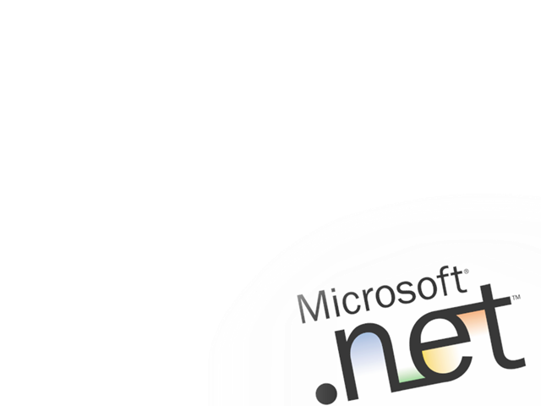
The Microsoft .NET Application Platform
Harry Pierson
HPierson@Microsoft.com
Senior Systems Engineer
Microsoft National Technology Team

Slide 2


Three Key Demands
Do more with less
“…one of the things that sort of sets us apart from our competitors is that we’re able to deliver solutions very
quickly. We deliver solutions in weeks and they are often
years. These are big solutions. And so the speed that we
can deliver them is very important.”
- Andy Neilson, Technical Architect, Webplan
Integration imperative
“Before, applications were just little islands of information
and getting stuff from island to island was a big event.”
- Scott Hanselman, Corillian Corporation
It just works
“Deployment and support of applications is a major issue.”
– Andrew K. Smith, Vice President, Credit Suisse First Boston
Notes:
When we talk with customers, they tell us that they’re facing three main challenges: integrating applications, delivering high quality on shrinking budgets, and ensuring that their data centers stay up and running reliability and securely.
Today, there’s relatively little “green field” development going on. This is because today most customers are finding it’s less expensive to buy an application and customize it or to integrate it with other applications than it is to build an application from scratch. As a result, most new application development consists of stitching together existing applications like R3, i2, and home-grown back ends with front end applications like Office. The problem is that these applications often weren’t designed to be integrated – or at least, not integrated easily. Consequently, an inordinate amount of time is spent sewing applications together to create new views on data.
At the same time this work is going on, companies are emerging from the heyday of the 90s and finding that their IT budgets have shrunk by between 20 and 80%. Of course, customer expectations have been set pretty high by IT departments that were once flush with cash. So we find that our customers are more than ever having to do more with less – fewer people, less money and less time. As a result, they’re looking for any and all tricks they can use to increase the productivity of their developers.
Finally, nobody likes to get a pager call at 2AM. Applications need to deliver rock-solid reliability, to be easy to install and maintain, and to deliver high performance.
These three challenges actually haven’t changed a lot over the last 20 years <click>

Slide 3















Technology Evolution
Shift Happens
Next Gen Clients
XML Web services
Client-Server
RAD
Components
PC GUI
LAN
XML Web Services
Internet Native Integration
Capabilities
PC CUI
Web
App Server
  Based on public standards
  Not wedded to any platform
  Loosely coupled programming
  Preserve and connect
  existing systems
  Broad industry support
Mainframe
Dumb terminal
Time
Notes:
If you look back 20 years or so, you’ll find that information technology has always been striving to meet those needs. In the 70s, the mainframe and dumb terminals delivered high reliability, but at a huge cost in terms of hardware, software, developer productivity, and little or no capability for integration.
The introduction of the PC and the PC network in the 80s introduced low-cost, very productive hardware and software platforms, but introduced a new set of challenges around integration with existing applications and a new management model.
The 90s saw the introduction of a host of new technologies. First came client/server, which leveraged the power of the rich client through technologies such as rapid application development and component-oriented application development. These made integration simpler and dramatically increased developer productivity, but some of the operational characteristics of this era made another technology – the Web – appear very attractive.
The Web introduced mainframe-like centralization to this model and provided a ubiquitous user interface paradigm. But as Web applications moved beyond static pages and needed to integrate into existing business systems, it became apparent that there were limits to the integration capabilities to this platform. In an effort to address this, the category of “application server” came into existence. Application servers – middleware that makes Unix systems better application development platforms – improved some aspects of Web application development, but at a price: high software costs and a lack of native integration capabilities.
As an aside, it’s interesting to note that Microsoft was at the forefront of the application server category with the Microsoft Transaction Server (MTS), which successfully combined components and transactions. With Windows 2000 Server, Microsoft actually created an operating system that had all the features of a much more expensive application server – transactions, Web application platform, message queuing, data access, and so on – but instead of making it an add-on product we chose to integrate it into the operating system. This choice enabled us to deliver the highest-performance, most productive application server on the market.
Today, a new technology – XML Web services – promises to combine the best characteristics of the client/server era with the Web era, providing a native integration infrastructure that works well with application development tools and provides great operational characteristics. XML Web services are a public-standards-based technology that brings together the loosely-coupled concepts of the Web to provide a reliable, scalable platform. Because they are operating system, programming language, and object-model agnostic, XML Web services enable existing applications to be easily integrated with new applications. This new technology is signaling a sea-change in the application platform space.

Slide 4
XML Web Services Explained
DCOM
RMI
LU 6.2
COM Object
Java Bean
Tx Program
User
Application
Business
Logic
Protocol
Client Platform
Server Platform
Windows 2000
Java VM
CICS OS/390
Every platform has an associated
programming paradigm and
distributed protocol.

Slide 5
XML Web Services Explained
???
DCOM
RMI
LU 6.2
COM Object
Java Bean
Tx Program
User
Application
User
Application
Business
Logic
Protocol
Client Platform
Client Platform
Server Platform
Windows 2000
Java VM
CICS OS/390
Every platform has an associated
programming paradigm and
distributed protocol.
When going cross-platform,
there is no common protocol.

Slide 6

XML Web Services Explained
Standard Web Protocols
COM Object
Java Bean
Tx Program
User
Application
User
Application
Business
Logic
Protocol
Client Platform
Client Platform
Server Platform
Windows 2000
Java VM
CICS OS/390
Standard web protocols makes
the platform specific business logic
an XML Web Service.
Every platform has an associated
programming paradigm and
distributed protocol.
When going cross-platform,
there is no common protocol.

Slide 7


XML Web Service Standards
Web Service
Standard
Web
Protocols
A programmable application component accessible via
standard web protocols
Directory of Web Services
on the Internet (or intranet)
UDDI
Universal Description,
Discovery, and Integration
WSDL
Web Services
Description Language
Describe a Web Service
SOAP
Simple Object
Access Protocol
Invoke a Web Service
Built with Web Standards
XML, XSD & HTTP

Slide 8
XML Web Services Today
Building XML Web Service based apps is possible with existing platforms
  Microsoft SOAP Toolkit 2.0
  IBM WebSphere Application Server 4.0
Bolt-on support for XML Web Services leaves developers doing the hard work
  No support for complex types
  Generate your own support files
  Manual handling of XML
  Translate between web service and native protocols
Better, integrated approach is needed

Slide 9


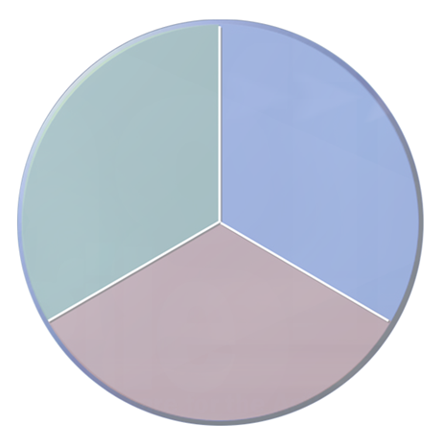






New Application Platform
Clients
Enable users to access and act on data and applications to easily reach a variety of devices, browsers, smart clients
Servers
Provide a set of product enhancements to the core server platform that enable users to quickly meet changing business needs
Tools
Services
Support XML Web services protocols and formats and provide a set of programmable services
Tools
Bring together application development paradigms for clients, servers, and services into a unified programming model and tool
Notes:
This new space is focused less on delivering a server-centric view of computing and more on providing a complete platform for application integration. To do this, the new application platform needs to deliver four things:
A set of client software that puts the right information in the hands of the user and is sensitive to the kind of device the user has; these client capabilities need to account for both online and offline scenarios as well as the fact that some devices have a huge amount of computing power while others don’t
A set of server software that extends the core XML Web services infrastructure to provide things like management and data storage
A next-generation component programming environment built on a set of reusable XML Web services that provide broad horizontal features
And, most important, unified programming model that spans clients, servers, and services as well as a rich set of application development tools that make developers productive and enable them to leverage the power in the underlying platform.

Slide 10
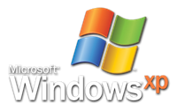
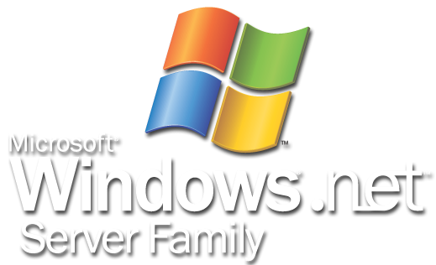

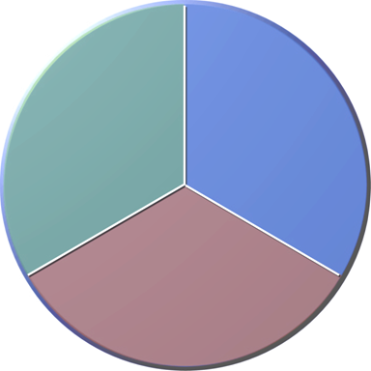










The Microsoft .NET Platform
xp
Notes:
Any time, any place, any device
Key point: Microsoft’s vision is about getting the information users need to them wherever they are in the best format for the device they’re using.
With the increasing proliferation of computing power to end users – everything from powerful desktop PCs to laptops to PDAs to mobile phones – Microosft’s vision of delivering the right information at the right time and the right place on the device you’re using has become increasingly important.
XML Web Services Fabric
Key point: the world is very heterogeneous, and you need a way to bring it together. XML and XML Web services represent that interconnectivity fabric.
The key to delivering information to is a set of open protocols and file formats based on XML and other Internet standards that make it easy to get the information anywhere in a common format, enabling greater interconnectivity than ever before.
Microsoft .NET
Key point: .NET is Microsoft’s platform for XML Web services
Microsoft’s implementation of this fabric is what we call Microsoft .NET – a platform designed from the ground up for the loosely coupled communication of XML Web services.
Servers, Services, and Clients
Key point: .NET spans clients, servers, and services (our competitors stop at servers). This makes us the only complete platform
Around that core lies a set of products and services that encompass all aspects of user experiences: server software such as the Windows operating system and .NET Enterprise Servers; services such as Passport, .NET Alerts and the .NET My Services; and powerful client software that leverages the capabilities of the computing devices users have such as Windows XP and Office XP.

Slide 11





The Microsoft .NET Platform
xp
Notes:
Any time, any place, any device
Key point: Microsoft’s vision is about getting the information users need to them wherever they are in the best format for the device they’re using.
With the increasing proliferation of computing power to end users – everything from powerful desktop PCs to laptops to PDAs to mobile phones – Microosft’s vision of delivering the right information at the right time and the right place on the device you’re using has become increasingly important.
XML Web Services Fabric
Key point: the world is very heterogeneous, and you need a way to bring it together. XML and XML Web services represent that interconnectivity fabric.
The key to delivering information to is a set of open protocols and file formats based on XML and other Internet standards that make it easy to get the information anywhere in a common format, enabling greater interconnectivity than ever before.
Microsoft .NET
Key point: .NET is Microsoft’s platform for XML Web services
Microsoft’s implementation of this fabric is what we call Microsoft .NET – a platform designed from the ground up for the loosely coupled communication of XML Web services.
Servers, Services, and Clients
Key point: .NET spans clients, servers, and services (our competitors stop at servers). This makes us the only complete platform
Around that core lies a set of products and services that encompass all aspects of user experiences: server software such as the Windows operating system and .NET Enterprise Servers; services such as Passport, .NET Alerts and the .NET My Services; and powerful client software that leverages the capabilities of the computing devices users have such as Windows XP and Office XP.

Slide 12
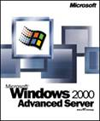
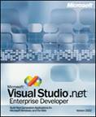

Core .NET Developer Platform
Windows
Visual Studio .NET
Provides complete, integrated application server
Delivers operational excellence with reliable, scalable, secure infrastructure
Harnesses power of Windows platform for
all developers
Unifies application and service development in one productive development environment
Key Features
  High-performance transactions
  Load balancing and clustering
  End-to-end security infrastructure
  Native XML Web services support
Key Features
  Graphical designers
  Templates and frameworks
  RAD for client and server
  XML Web services
Notes:
.NET is a set of technologies and a set of products. There’s a lot of confusion about what .NET really is. Let’s make .NET really concrete by focusing on one aspect of it: the core developer platform. There are two products in particular that define the core developer platform: Windows and Visual Studio .NET.
Windows is obviously our core operating system. With Windows 2000 Server, Microsoft delivered a best-in-class application server, complete with a transaction monitor, message queuing engine, directory server, clustering and failover, and many other features. Its performance on all major benchmarks such as TPC-C and TPC-W is unsurpassed. Our customers report it can deliver 99.999% uptime. Windows 2000 Server is running some of the most demanding businesses around. A new feature -- the .NET Framework – integrates into the operating system XML Web services capabilities. This is an important point: the .NET Framework bakes XML Web services into our core platform, enabling developers not only to build applications that expose XML Web services, but also enabling other operating system features to take advantage of them. So, not only can any developer using any tool expose and consume XML Web services using any programming language, operating system features can use XML Web services as well. With Windows .NET Server, we take full advantage of this integration by introducing capabilities such as the integration of COM+ components with XML Web services, and adding SOAP as a transport for MSMQ. We also bake in integration between Passport and Active Directory. That’s what you can do when XML Web services are in your platform.
Visual Studio .NET is our application development tool for taking advantage of the capabilities of Windows. It provides the most productive multi-language integrated development environment on the market, scaling from single developers up to the largest development teams. Features in VS such as templates and frameworks make developers immediately productive on our platofrm. We’ve taken the concept of rapid application devleopment (RAD) that we introduced for the client and applied it to server development as well.
The result of all this is that we’ve delivered what we think is the most productive, highest-performance XML Web services platform around.

Slide 13
Three Key Benefits
Do more with less
“With .NET, we can bring new solutions to market at least twice as fast with the same number of people, and at significantly higher initial quality levels.”
- Art Hyde, Development Manager, AON
Integration imperative
“Xerox has used XML Web services to integrate applications in ways that we could not do before.”
- Kirk Pothos, Software Development Manager, Xerox
It just works
“Based on the .NET platform, our infrastructure will save millions of dollars per year in application deployment costs.”
- Andrew K. Smith, Vice President, Credit Suisse First Boston
Notes:
Let’s go back to the three key demands we hear from customers -- integration, productivity, and operational excellence – and look at just how .NET delivers on them.

Slide 14
ASP .NET Web Forms
Rapid development of web applications
  Smart rendering for targeting multiple browsers and small footprint devices
  Intelligent State Management
  Automatic User Input Validation
  Built in security
  Compiled for maximum performance (2-4x J2EE perf)
  Integrated debugging and testing
  Visual designers for drag-and-drop development
  Componentized for extensibility
Same paradigm for programming Visual Basic Forms applications

Slide 15
Windows Forms
“Running your application in the browser is like having your office in the elevator”
Allen Cooper
Rich client development environment
Ease of VB, power of VC++
  Drag and drop development
  Object-Oriented features
Deploy and update rich clients via HTTP
DLL Hell eliminated
Code Access Security
Smart Device Extensions

Slide 16
Enterprise Services
Leverage the application server infrastructure of Windows Server
  Automatic transaction management
  Role-based security
  Just in time Activation and Object Pooling
  Object construction
  Queued Components
Same paradigm for programming business objects in Visual Basic
Expose business objects as web services

Slide 17
ASP .NET Web Services
Expose business logic to the world using
XML Web Services protocols
  Integrated support for SOAP protocol
  Dynamic generation of WSDL information
Leverage Services from client application
  Search for services in UDDI repository
  Generate proxy classes from WSDL information
Same paradigm as business logic
  Must be able to type “<WebMethod()>
Fully extensible
  Support for customer headers and extensions

Slide 18
Data Access
Most business logic accesses relational data
Existing access technologies (ADO, OLEDB, ODBC, JDBC) designed for connected client
ADO .NET designed for disconnected access
  Data Readers are for read only forward only access (populate a web page)
  Data Set is a cache of relational data that tracks all changes that are mage against it
  Data Adapters are used to move data back and forth between a Data Set and the relational database
  Works with a variety of back end databases (SQL Server, Oracle, IBM DB2, etc.)

Slide 19
Enterprise Architecture
VS .NET Enterprise Architect Edition
  Includes integrated load testing tools
  Includes UML and database modeling tools
    Reverse and forward engineering of code and tables
Enterprise Templates
  Enforce architectural decisions in the development tool
  Project templates that can be built by your architects
  Specify appropriate technologies via policy
Enterprise Framework
  Enterprise building blocks from Microsoft
  First round shipping this summer
    Authentication and management

Slide 20
Summary
ASP .NET features XML Web Services support
  Consume and Expose XML Web Services
ASP .NET makes it easy to build web apps
  “Visual Basic for the web”
ASP .NET provides services to the enterprise developer
  The power of COM+ with the ease of .NET
Visual Studio .NET is the integrated tool for all aspects of enterprise development
  Visual designers and integrated debuggers make developers more productive

Slide 21


