Slide 1
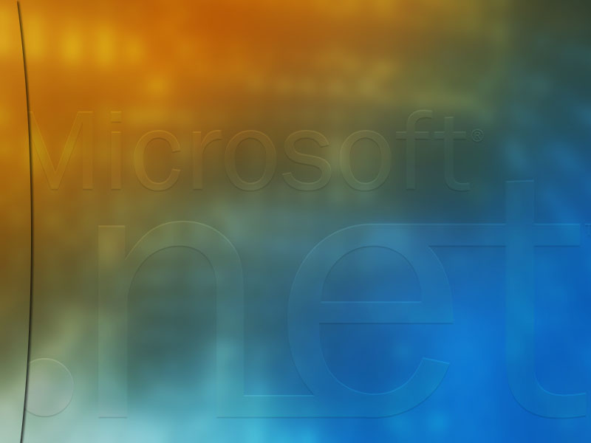
Microsoft .NET
Built on the Internet Foundation
Harry Pierson
HPierson@Microsoft.com
Senior Systems Engineer
Microsoft National Technology Team

Slide 2

Agenda
Microsoft’s Vision
Computing Boundaries
The Internet Foundation
.NET Platform
Summary

Slide 3
Microsoft’s Vision
A computer
on every desk
and in every home

Slide 4
Microsoft’s Vision
Empower people
through great software
any time, any place
and on any device

Slide 5
Executing On Our Vision
About $5 Billion in R&D this year
Commitment to open standards
  ECMA, W3C, IETF
Targeting the Evolving Internet
  High bandwidth global network
  Single use devices
  Mobile wireless access
.NET is the strategy to realize our vision

Slide 6
Computing Boundaries
Existing systems are built on multiple platforms and languages
Platform and language differences are boundaries to system integration
Non-technical boundaries also exist
  Trust, organizational, geographical
Additional boundaries to external entities
  Internet reliability, security, firewalls
Integration across these boundaries has become the norm, not the exception

Slide 7
Loosely Coupled Integration
Organizations can’t afford to reinvent the wheel when things change
System integration typically uses fragile “plumbing” code that is brittle and
can’t be reused
Loosely coupled integration enables different systems to be plugged-in with minimum additional effort
.NET is designed to be loosely integrated
and to integrate with other platforms.

Slide 8



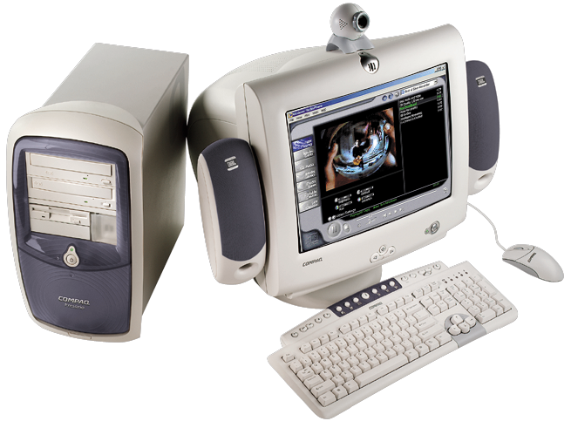
Real Life Scenario
Firewalls impede integration between external entities
Apps run on different platforms
Dept. of Health
Dept. of Education
WAN
Private Companies
Citizens
External Systems won’t conform to one platform
Federal Agencies
Schools &
Universities
Dept. of Public Safety
Relationship between apps is tightly coupled
App Integration must be rebuilt from scratch

Slide 9
The Internet Phenomenon
WWW popularity is due to ease of use
Cross-platform Internet standards are already in place
  Data Retrieval: HTTP
  Data Visualization: HTML
  Data Encoding: XML
Future distributed applications can utilize these web standards
  Enables cross-platform interoperability
We call this an “XML Web Service”

Slide 10
XML Web Services Explained
DCOM
RMI
LU 6.2
COM Object
Java Bean
Tx Program
User
Application
Business
Logic
Protocol
Client Platform
Server Platform
Windows 2000
Java VM
CICS OS/390
Every platform has an associated
programming paradigm and
distributed protocol.

Slide 11
XML Web Services Explained
???
DCOM
RMI
LU 6.2
COM Object
Java Bean
Tx Program
User
Application
User
Application
Business
Logic
Protocol
Client Platform
Client Platform
Server Platform
Windows 2000
Java VM
CICS OS/390
Every platform has an associated
programming paradigm and
distributed protocol.
When going cross-platform,
there is no common protocol.

Slide 12

XML Web Services Explained
Standard Web Protocols
COM Object
Java Bean
Tx Program
User
Application
User
Application
Business
Logic
Protocol
Client Platform
Client Platform
Server Platform
Windows 2000
Java VM
CICS OS/390
Standard web protocols makes
the platform specific business logic
an XML Web Service.
Every platform has an associated
programming paradigm and
distributed protocol.
When going cross-platform,
there is no common protocol.

Slide 13


XML Web Service Standards
Web Service
Standard
Web
Protocols
A programmable application component accessible via
standard web protocols
Directory of Web Services
on the Internet (or intranet)
UDDI
Universal Description,
Discovery, and Integration
WSDL
Web Services
Description Language
Describe a Web Service
SOAP
Simple Object
Access Protocol
Invoke a Web Service
Built with Web Standards
XML, XSD & HTTP

Slide 14
Real Life Scenario
Service available across platforms
Service available internally and externally via Web Protocols
Dept. of Health
Dept. of Education
Private Companies
Citizens
Federal Agencies
Schools &
Universities
Dept. of Public Safety
DPS publishes
XML Web Service
Only one service needed to handle many relationships

Slide 15














Technology Evolution
Shift Happens
Next Gen Clients
XML Web services
Client-Server
RAD
Components
PC GUI
LAN
.NET is software for building
XML Web Service applications
Capabilities
PC CUI
Web
App Server
Mainframe
Dumb terminal
Time
Notes:
If you look back 20 years or so, you’ll find that information technology has always been striving to meet those needs. In the 70s, the mainframe and dumb terminals delivered high reliability, but at a huge cost in terms of hardware, software, developer productivity, and little or no capability for integration.
The introduction of the PC and the PC network in the 80s introduced low-cost, very productive hardware and software platforms, but introduced a new set of challenges around integration with existing applications and a new management model.
The 90s saw the introduction of a host of new technologies. First came client/server, which leveraged the power of the rich client through technologies such as rapid application development and component-oriented application development. These made integration simpler and dramatically increased developer productivity, but some of the operational characteristics of this era made another technology – the Web – appear very attractive.
The Web introduced mainframe-like centralization to this model and provided a ubiquitous user interface paradigm. But as Web applications moved beyond static pages and needed to integrate into existing business systems, it became apparent that there were limits to the integration capabilities to this platform. In an effort to address this, the category of “application server” came into existence. Application servers – middleware that makes Unix systems better application development platforms – improved some aspects of Web application development, but at a price: high software costs and a lack of native integration capabilities.
As an aside, it’s interesting to note that Microsoft was at the forefront of the application server category with the Microsoft Transaction Server (MTS), which successfully combined components and transactions. With Windows 2000 Server, Microsoft actually created an operating system that had all the features of a much more expensive application server – transactions, Web application platform, message queuing, data access, and so on – but instead of making it an add-on product we chose to integrate it into the operating system. This choice enabled us to deliver the highest-performance, most productive application server on the market.
Today, a new technology – XML Web services – promises to combine the best characteristics of the client/server era with the Web era, providing a native integration infrastructure that works well with application development tools and provides great operational characteristics. XML Web services are a public-standards-based technology that brings together the loosely-coupled concepts of the Web to provide a reliable, scalable platform. Because they are operating system, programming language, and object-model agnostic, XML Web services enable existing applications to be easily integrated with new applications. This new technology is signaling a sea-change in the application platform space.

Slide 16
XML Web Services Today
Building XML Web Service based apps is possible with existing platforms
  Microsoft SOAP Toolkit 2.0
  IBM WebSphere Application Server 4.0
XML Web Services applications are more than just the SOAP protocol
Integrating XML Web Services deeply into the platform improves productivity
.NET is the best platform for building
XML Web Service Applications

Slide 17
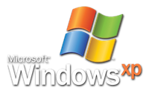
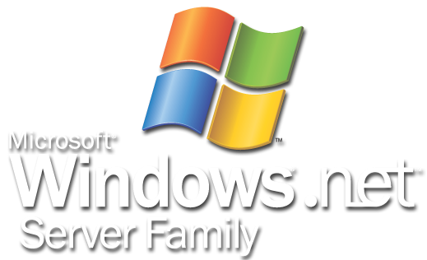

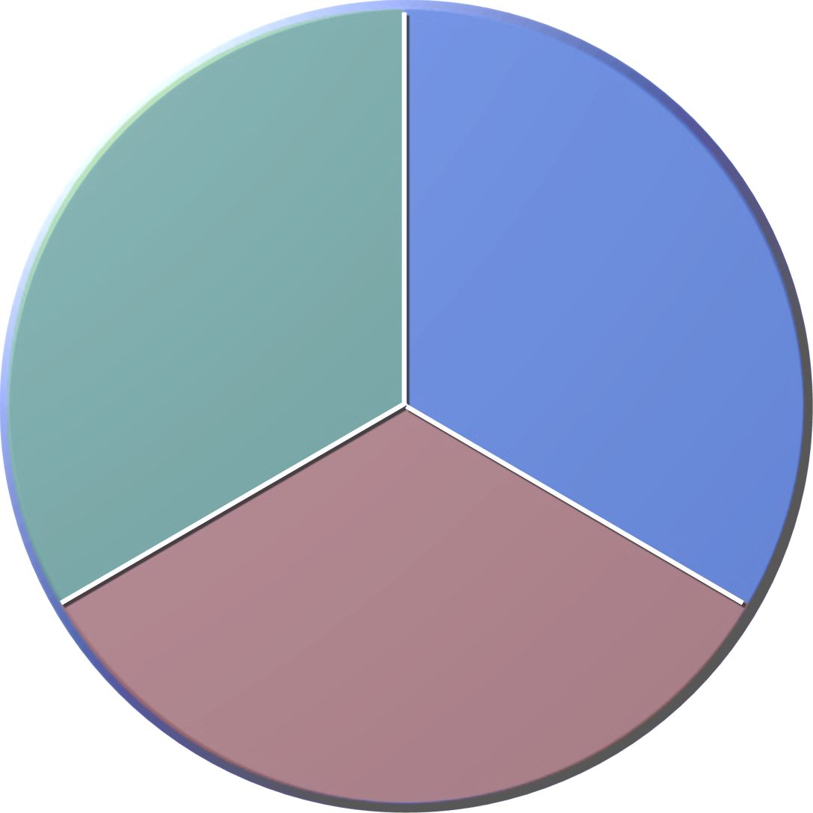



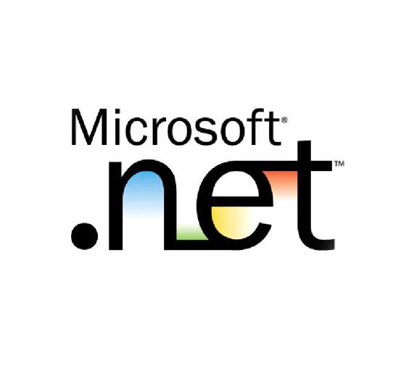









Putting The Pieces Together
xp
Notes:
Any time, any place, any device
Key point: Microsoft’s vision is about getting the information users need to them wherever they are in the best format for the device they’re using.
With the increasing proliferation of computing power to end users – everything from powerful desktop PCs to laptops to PDAs to mobile phones – Microosft’s vision of delivering the right information at the right time and the right place on the device you’re using has become increasingly important.
XML Web Services Fabric
Key point: the world is very heterogeneous, and you need a way to bring it together. XML and XML Web services represent that interconnectivity fabric.
The key to delivering information to is a set of open protocols and file formats based on XML and other Internet standards that make it easy to get the information anywhere in a common format, enabling greater interconnectivity than ever before.
Microsoft .NET
Key point: .NET is Microsoft’s platform for XML Web services
Microsoft’s implementation of this fabric is what we call Microsoft .NET – a platform designed from the ground up for the loosely coupled communication of XML Web services.
Servers, Services, and Clients
Key point: .NET spans clients, servers, and services (our competitors stop at servers). This makes us the only complete platform
Around that core lies a set of products and services that encompass all aspects of user experiences: server software such as the Windows operating system and .NET Enterprise Servers; services such as Passport, .NET Alerts and the .NET My Services; and powerful client software that leverages the capabilities of the computing devices users have such as Windows XP and Office XP.

Slide 18




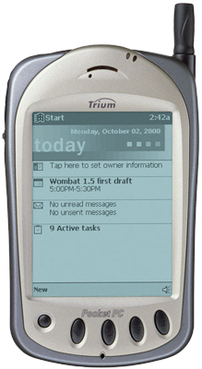

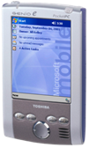
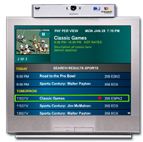
Clients
Users want rich client experience
  Mobile and Powerful
  Natural user interface
Windows and Office XP
  Task based interface designed
  around specific scenarios
Windows Powered Devices

Slide 19












Servers
Built on Windows Server family
  Best value in the industry
Web-enabled to the Core
  Deep support for Internet standards
Enterprise -Abilities
  Guaranteed 99.999% availability
  Software scale out on all tiers
Fastest time to market

Slide 20
Services
.NET Passport
  Single sign-on service for the Web
    Biggest authenticator on the web today
  Evolving to support Kerberos protocol
    Support for multi-platform and federation
.NET Alerts
  Notification delivery service
  Innovative mechanism for reaching users
  Intelligent routing of alerts to endpoints
.NET My Services
  Coming in 2003

Slide 21

Developer Foundation
Visual Studio .NET
  Combines the best of our current development products
  Support for multiple languages and tasks
  Native XML Web Services support
  Support for alternative devices
Developer Productivity is Job #1
  Automate many developer tasks
  Unify programming paradigm
  “I can do in a day what used to take a week”
Next generation applications

Slide 22
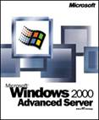
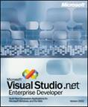

Core .NET Developer Platform
Windows Server
Visual Studio .NET
Provides complete, integrated application server
Delivers operational excellence with reliable, scalable, secure infrastructure
Harnesses power of Windows platform for all developers
Unifies application and service development in one productive development environment
Key Features
  High-performance transactions
  Load balancing and clustering
  End-to-end security infrastructure
  Native XML Web services support
Key Features
  Graphical designers
  Templates and frameworks
  RAD for client and server
  XML Web services
Notes:
.NET is a set of technologies and a set of products. There’s a lot of confusion about what .NET really is. Let’s make .NET really concrete by focusing on one aspect of it: the core developer platform. There are two products in particular that define the core developer platform: Windows and Visual Studio .NET.
Windows is obviously our core operating system. With Windows 2000 Server, Microsoft delivered a best-in-class application server, complete with a transaction monitor, message queuing engine, directory server, clustering and failover, and many other features. Its performance on all major benchmarks such as TPC-C and TPC-W is unsurpassed. Our customers report it can deliver 99.999% uptime. Windows 2000 Server is running some of the most demanding businesses around. A new feature -- the .NET Framework – integrates into the operating system XML Web services capabilities. This is an important point: the .NET Framework bakes XML Web services into our core platform, enabling developers not only to build applications that expose XML Web services, but also enabling other operating system features to take advantage of them. So, not only can any developer using any tool expose and consume XML Web services using any programming language, operating system features can use XML Web services as well. With Windows .NET Server, we take full advantage of this integration by introducing capabilities such as the integration of COM+ components with XML Web services, and adding SOAP as a transport for MSMQ. We also bake in integration between Passport and Active Directory. That’s what you can do when XML Web services are in your platform.
Visual Studio .NET is our application development tool for taking advantage of the capabilities of Windows. It provides the most productive multi-language integrated development environment on the market, scaling from single developers up to the largest development teams. Features in VS such as templates and frameworks make developers immediately productive on our platofrm. We’ve taken the concept of rapid application devleopment (RAD) that we introduced for the client and applied it to server development as well.
The result of all this is that we’ve delivered what we think is the most productive, highest-performance XML Web services platform around.

Slide 23
The .NET Advantage
High Performance
  .NET implementation of Doculabs “Nile Bookstore” benchmark application 2-4x faster than J2EE
  Faster application means less hardware costs
Productive developers
  .NET version of J2EE Pet Store “blueprint” application requires ¼ the code to implement
  Less code means more productive developers
Integrated Application Server
  Garner estimates $1 billion has been overspent on (J2EE) application server products
  .NET web and application services integrated directly into the server operating system
  Integration means no additional licensing costs

Slide 24
.NET Customer Experience
Xerox
  Development cost down 71%
  Development staffing requirements down 17%
  Time to market down 66%
Marks and Spencer
  Development costs down 66%
  Development time down 75%
  415% 1st year return on investment
Nationwide
  Lines of code down 96%
  Process change implementation time down 99%
Case studies on http://www.microsoft.com/net

Slide 25
Summary
.NET is designed for building
XML Web Service applications
Users will access data from a wide variety of rich applications and devices
.NET Enterprise servers support Internet standards and Enterprise abilities
.NET Services provide building blocks for next generation applications
Visual Studio .NET increases programmer productivity
The .NET advantage is business value

Slide 26
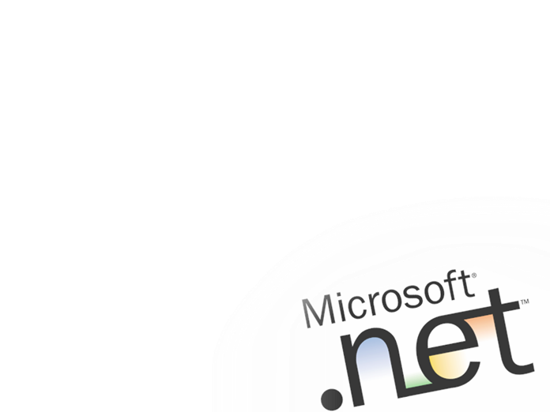

Slide 27
Appendix Slides
J2EE Competitive

Slide 28
.NET vs. Java
Smart clients + browsers
Bolt-on XML Support
Native XML Support
Browser
only
JSP Servlet EJB
.NET My Services
None
Single, integrated tool
Host of disparate tools
Complete: Client/server/service & tools
Native XML Web Service support
Any programming language
Unified programming model
Best developer experience
Server-centric
Single programming language
Multiple programming models
Poor performance
Vendor lock-in still a problem

Slide 29
Server Technology Timeline
EJB
JSP
MDB
JDBC
JAX
JMS
J2EE
WS DP
J2EE
1996
1997
1998
1999
2000
2001
Microsoft
Mar 1992
QC
ASP
MTS/COM+
SOAP TK
MSXML
VS .NET
MSMQ
ODBC
WinDNA
.NET

Slide 30
Implementing Petstore On .NET
.NET = 1/4th the code
17500
Lines of Code Required
14,273
15000
.NET Petshop
12500
Java Petstore
10000
7500
5,891
5,404
5000
3,484
1,881
2,566
2500
863
684
412
56
Total Lines of Code
User Interface
Middle Tier
Data Tier
Configuration
Notes:
Lines of code isn’t necessarily the best measure of developer productivity, but it’s one start. As you can see, it took about ¼ the lines of code to implement Petshop on .NET vs. what it took with Oracle’s application server. More information on this is available at http://www.gotdotnet.com/compare.

Slide 31
Nile App Server Benchmark
Created by Doculabs and has been used extensively by Ziff Davis
End-to-end ecommerce application
Application includes
  90% Data-driven pages
  Use of scripting and components
  Ad-hoc database searching and browsing
  Database transactions
  User authentication/login
  Realistic dataset
  Session state (shopping cart)
  Optionally can highlight dynamic page output caching

Slide 32
The Nile Tests
Implementations tested
  MS .NET implemented with C#/ASP.NET
  ASP using VB6 COM+ components
  ISAPI/ATL Server using VC++ 7.00
  WebSphere 4.0 and WebLogic 6.1 using JSPs
  WebSphere 4.0 and WebLogic 6.1 using EJBs
Tested in large-scale performance lab
All materials and source code published on Web
  .NET vs. WebSphere benchmark kit
  Customers can replicate/test for themselves
  http://www.gotdotnet.com/team/compare

Slide 33
The Nile J2EE Results: Peak Throughput
2 CPUs
Pages Served Per Second
1750
4 CPUs
8 CPUs
1500
1395
1362
1289
1280
1260
1250
957
930
1000
886
890
905
874
834
750
649
537
668
489
478
400
400
500
BEA 6.1 JSP/Linux 7.2/Oracle 8i
BEA 6.1 EJB/Linux 7.2/Oracle 8i
Websphere
4.0 JSP/
Linux 7.2/ Oracle 8i
Websphere
4.0 EJB/
Linux 7.2/ Oracle 8i
ASP/
W2K/SQL Server 2000
VB-COM+
W2K/SQL Server 2000
2-tier
3-tier
2-tier
3-tier
2-tier
3-tier

Slide 34
The Nile J2EE Results: Peak Throughput
Pages Served Per Second
2 CPUs
4500
4 CPUs
3999
4004
4000
8 CPUs
3500
3000
2713
2867
2500
2000
1633
1500
1260
1399
886
890
930
874
1000
649
668
478
500
400
BEA 6.1 EJB/Linux 7.2/Oracle 8i
Websphere
4.0 EJB/
Linux 7.2/ Oracle 8i
VB-COM+
W2K/SQL Server 2000
ASP.NET C#/
SQL Server 2000
C++ ATL Server
W2K/SQL Server 2000
3-tier
3-tier
3-tier
3-tier
3-tier

Slide 35
Impact on Hardware Requirements
For Nile: .NET requires just 1/3 of the servers to handle same load as J2EE and VB/COM+
Significantly reduces deployment cost
Significantly reduces ongoing manageability costs
Scale up with more processors, no config change
  Java requires significant configuration change and re-tuning of JVM as processors added
  JVM must be manually cloned, thread counts changed, tuning re-executed to find optimum settings

