Slide 1
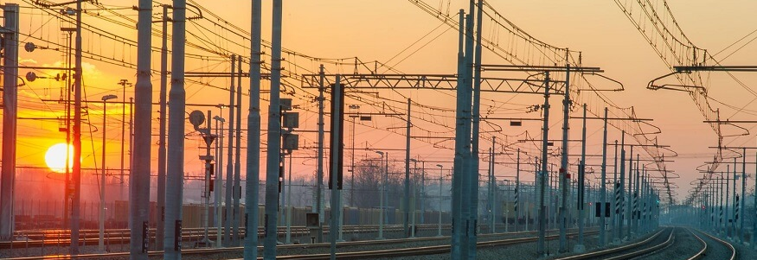
Railway Reservation System
Project prepared by Himal Tamang

Slide 2
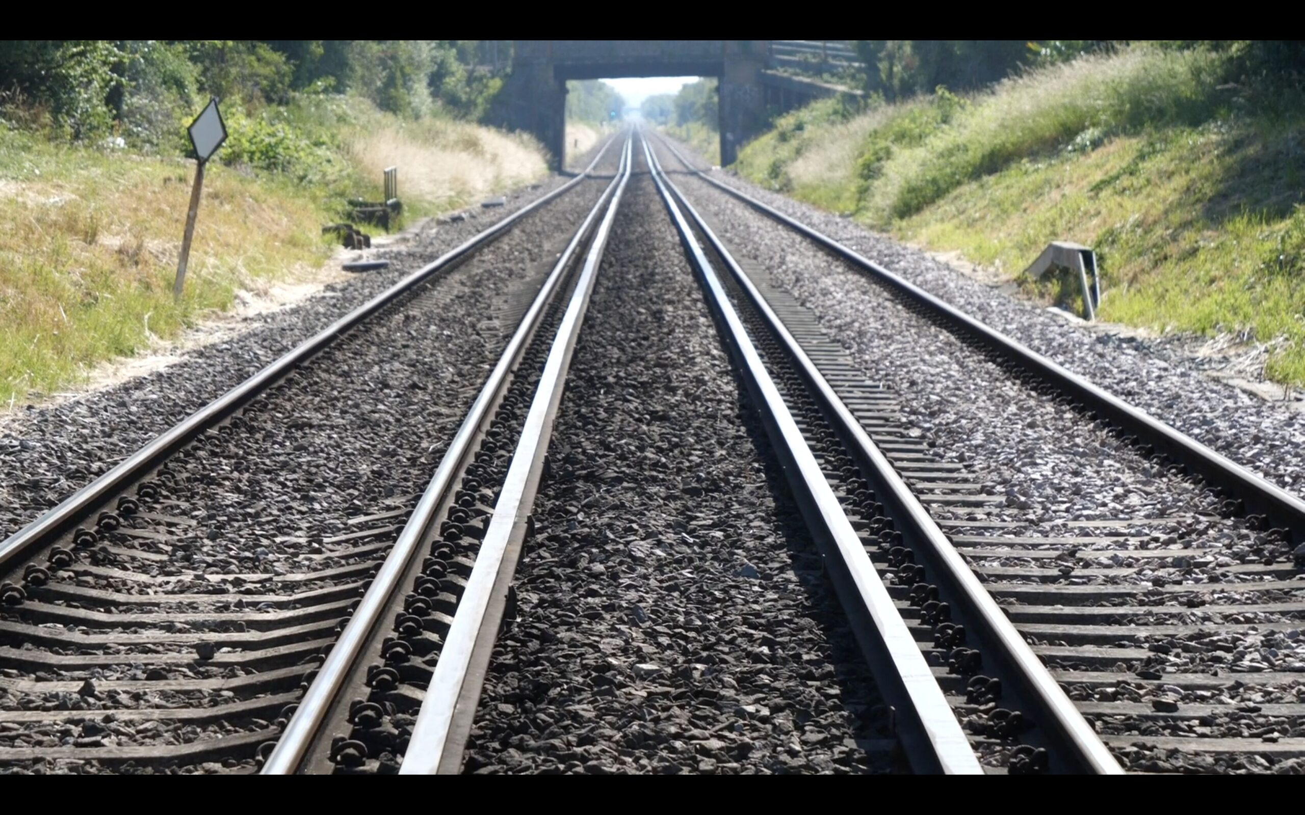
What is the project about?
Develop a robust railway reservation system.
Streamline booking process.
Efficiently manage reservations.
Provide seamless experience for passengers and administrators.

Slide 3
What is the project about?
Address inefficiencies of traditional systems.
Aim for efficiency and user-friendliness.

Slide 4

Discussion ( Expectations & Learnings )
My expectation
Build minimanilist railway reservation system
Can book multiple tickets at once.
Increased accuracy.
Improved system reliability.

Slide 5
Discussion ( Expectations & Learnings )
Learning:
Build an reservation system in c.
Learn to combine all the concepts that I have learned throughout the course
Learn about railway reservation system status in real time, technology advancement in railway system

Slide 6

Future Work
Upgrade the same concept in modern languages like Nextjs, Python, PHP, etc
Integrate the database to store the data of users in real time

Slide 7
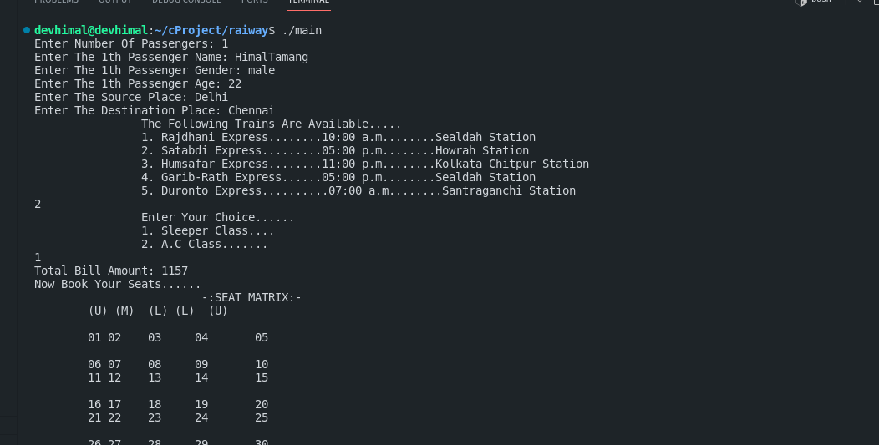
Demo

Slide 8

Accepting Question and Suggestion
Thank you

