Slide 1

Data Science Initiative at SOIS
C. S. Ramashesha
B. Dinesh Rao
M. Devi Prasad
Friday, 27-January-2017
Slide 1 of 18

Slide 2
The Presentation Plan
Our original goals 1 slide
Brief status summary 2 slides
Summary of our approach 7 slides
and the progress so far
Fund utilization status as on this day 1 slide
Plans for this year and the next 3 slides
A request 1 slide
Conclusion 1 slide
Slide 2 of 18

Slide 3
The Goals
To create data systems programs in collaboration with international universities
design a new Master’s program around data science
develop competency in data science
identify two international universities for collaboration
Slide 3 of 18

Slide 4
A Brief Status Summary
Developed a new Master’s program in data science
admitted two batches of students (18 + 8 students)
Created opportunities for faculty development within SOIS
used MOOCs and hosted hands-on workshops, …
collaborated with the Department of Statistics (of MU)
Identified one university for (potential) collaboration
Virginia Commonwealth University
February 6 - visit by VCU’s associate-dean of School of Business
Slide 4 of 18

Slide 5
A Brief Status Summary
Accepted an international student for internship
five month internship in data analytics and visualization
student from EFREI, France
Designed a software architecture for Big Data Analysis in MU
Manipal Data Architecture
ensures security and privacy of sensitive data
enables monetizable services for data sharing and analytics
Slide 5 of 18

Slide 6
Big Data and Data Analytics Program
A new ME (Master of Engineering) program
admitted two batches (18 + 8 students)
Great support from the faculty of the department of Statistics
Industry support by Philips Healthcare, Bangalore
Slide 6 of 18

Slide 7
Competency Development Efforts
Learning from popular MOOCs - Udacity courses
Active Learning
Interactive, hands-on workshops conducted by experts
Learning by Doing
hobby projects (personal) and term projects (with students)
Participatory Learning
term projects offered by Philips Healthcare
Slide 7 of 18

Slide 8
Workshops
We hosted three intensive, hands-on workshops
Two day workshop on data visualization
5 faculty, and 30 students of SOIS
21-22, October, 2016. Instructor - Nikhil Kabbin, Gramener, Bangalore
Three day workshop on virtualization for big data systems
7 faculty, and 30 students of SOIS
14-16, December, 2016. Instructor - Saurabh Bharjatiya, Rekall Software, Hyderabad
Four day Faculty development program on Big Data and Hadoop
6 faculty of MIT, Manipal. 5 faculty and 25 students of SOIS
11-14, January, 2017. Instructor - Animesh Yadav, Finland Labs, Delhi
Slide 8 of 18

Slide 9
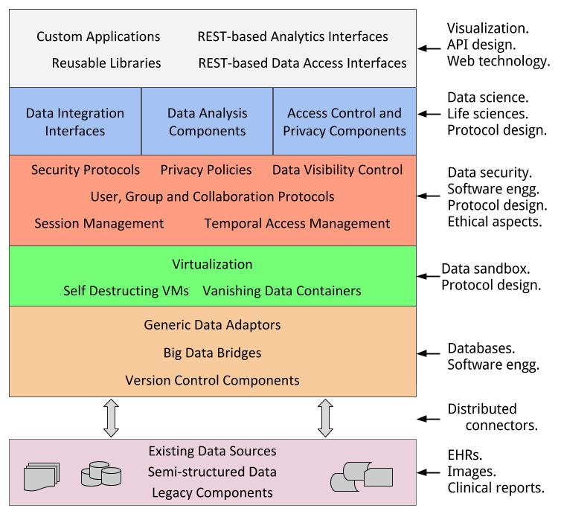
System Design Effort
Manipal Data Architecture
Offers opportunities for novel research collaborations
Service Oriented Architecture (SOA) enables monetizable data services
Slide 9 of 18

Slide 10
International Student Internship
Mr. Gevithan Shanmugathasan, student from EFREI, France, is pursuing five month internship at SOIS
Topic - Data Analytics and Visualization
Duration - October-2016 to February-2017
Slide 10 of 18

Slide 11
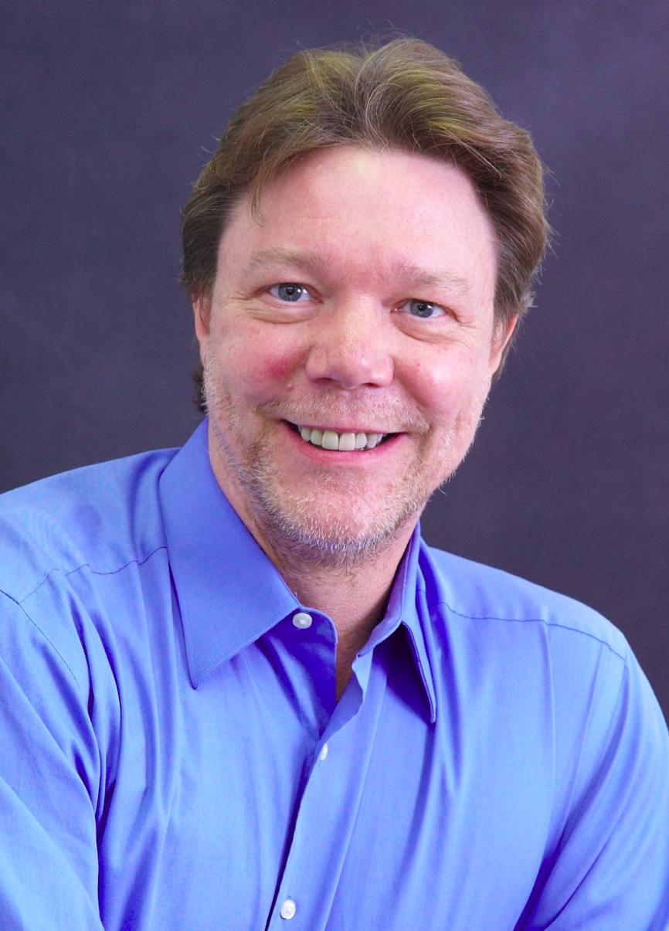
Visit by an International Expert
Dr. Peter Aiken
ACM Distinguished Speaker
Associate Professor of Information Systems
Virginia Commonwealth University (VCU)
addressed students and faculty of SOIS on 16-August-2016
Slide 11 of 18

Slide 12
Potential Collaboration with VCU
Prof. Jayaraman Vijayakumar, Associate Dean - Graduate Programs, VCU, will be visiting SOIS
next month, on 6-February
we intend to brainstorm and figure out a suitable pattern of collaboration
Slide 12 of 18

Slide 13
Intramural Fund Utilization Status
At present, we have utilized around 2.6 lakhs
workshops and faculty development programs
In our estimate, we will require about 5 lakhs to support planned activities for the next two months
national conference (in March)
a workshop (in February)
procuring reference books
Slide 13 of 18

Slide 14
Planned Activities - Next Two Months
Seventh National conference on Information Sciences
24 and 25, March, 2017
Workshop on Machine Learning
Azure platform group, Microsoft India.
Slide 14 of 18

Slide 15
The Plan for 2017-18
We will form an advisory board
furthering interdisciplinary research and development
taking more effective steps for international collaboration
We will collaborate with premier Indian institutes
helps in establishing long term research association
makes it possible to invite/host resident experts/scholars
creates avenues for external funded research
Slide 15 of 18

Slide 16
The Plan for 2017-18
We will host programs of international reach
(conference, winter/summer school, seminar)
data analytics and data visualization
data and information security and privacy
formal verification
We will identify one more reputed international university for collaboration in data science programs
Slide 16 of 18

Slide 17
Our Requests for 2017-2018
We sincerely request you to extend the grant period
extension of the existing funding support
We request you to expand the scope
data and information security
medical software systems
embedded systems design
software and hardware verification
Slide 17 of 18

Slide 18
Conclusion
Sincere thanks to each one of you, for your generous support, patience and time
we request your comments, advice and continued support
Slide 18 of 18

