Slide 1
Microservice

Slide 2
STAGE 1 : First Microservice and its Deployment
GOAL : Write First Microservice and Run inside a K8s cluster.
Step 1:
Create a REST Web API project – Platform Service.
Step 2:
Create Docker Image and Push it to Docker hub.
Step 3:
Create Deployment file to run microservice as Pods inside K8s environment.
Step 4:
Create NodePort Service for accessing Platform Service running inside Pod.

Slide 3
STAGE 1 : First Microservice and its Deployment
Step 1: Create a RESTFul WebApi for –
Platform Service
Scaffold a new webapi project with the dependencies
Add dependency packages
CMD:
dotnet add package X
X = Automapper.Extensions.Microsoft.DependencyInjection
Microsoft.EntityFrameworkCore
Microsoft.EntityFrameworkCore.Design
Microsoft.EntityFrameworkCore.Inmemory
Microsoft.EntityFrameworkCore.SQLServer
2) Create Models – Internal Representation of data.
DTO – External representation of data.
Decorate property with System.ComponentModel.DataAnnotation attributes.
EntityFrameworkCore uses these attributes for creating tables.
3) Create DBContext – for persisting Models to database.
Add the DBContext as a service to asp.net core.
Configure DBContext to work with Entity Framework’s InMemory Database.
Request/Response
DTO
Controller
DTO
Model
Irepo (Repository of Models)
Model
DBContext (Used to talk with configure
Data provider to persist model)
Model
DBContext configured to use InMemoryDb

Slide 4
STAGE 1 : First Microservice and its Deployment
4) Create IPlatformRepo
5) Implement PlatformRepo
Add PlatformRepo scoped service.
Builder.Services.AddScoped<IPlatformRepo, PlatformRepo>();
6. Prepare test data.
7. Create DTOs. Dtos represent the structure that is used to send and receive data from application and client.
8. Automapper to map Dto with Model data.
Create PlatformProfile class to define mapping between Platform model with CreatePlatformDto and ReadPlatformDto objects
9. Implement Controllers
Step 2: Create Docker Image and Test Container
Create a Docker File and build docker image.
Test the Docker image by running a container.
Use port mapping for accessing the container and test the api.

Slide 5
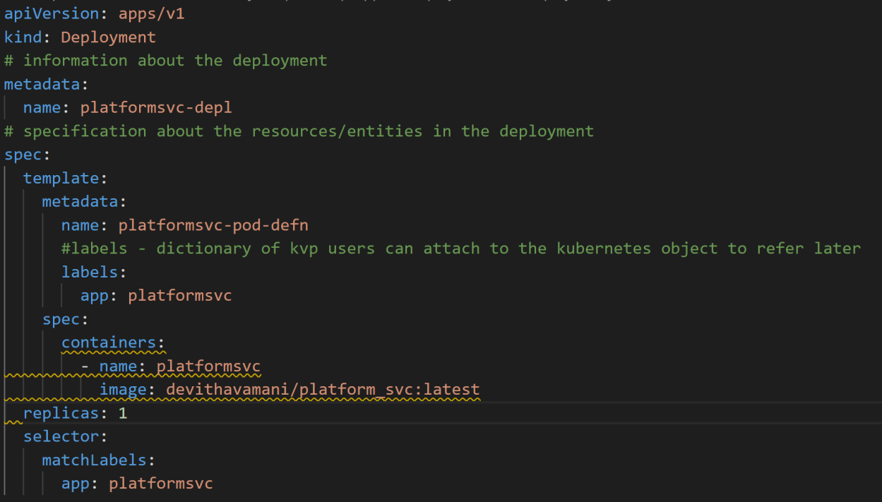
STAGE 1 : First Microservice and its Deployment
Step 3: Deploy the first microservice in K8s as Pods
1) Create first microservice Deployment in k8s cluster.

Slide 6
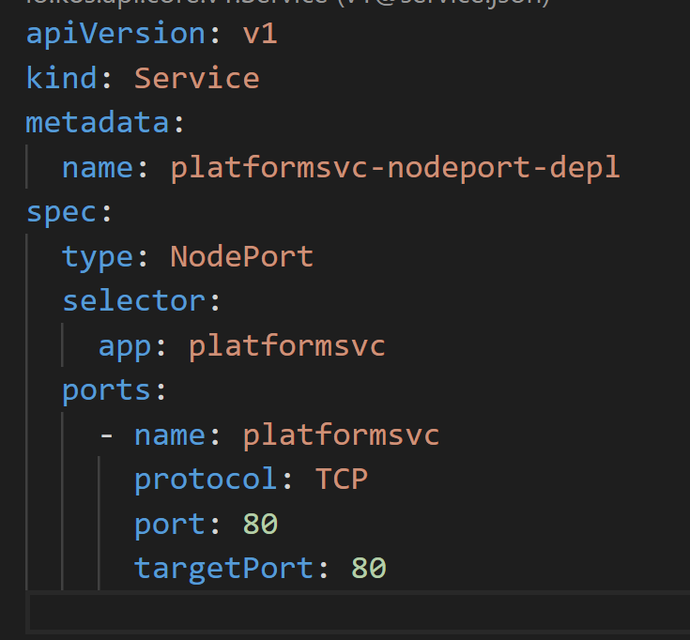
STAGE 1 : First Microservice and its Deployment
Step 4: Create NodePort Service to access Pods running inside the cluster
2) Create NodePort service to access pods running in platform service.

Slide 7
STAGE 2 : Second Microservice and its Deployment
GOAL : Write Second Microservice and Run inside a K8s cluster.
Step 1:
Create a REST Web API project – Command Service.
Step 2:
Create Docker Image and Push it to Docker hub.
Step 3:
Create Deployment file to run microservice as Pods inside K8s environment.

Slide 8
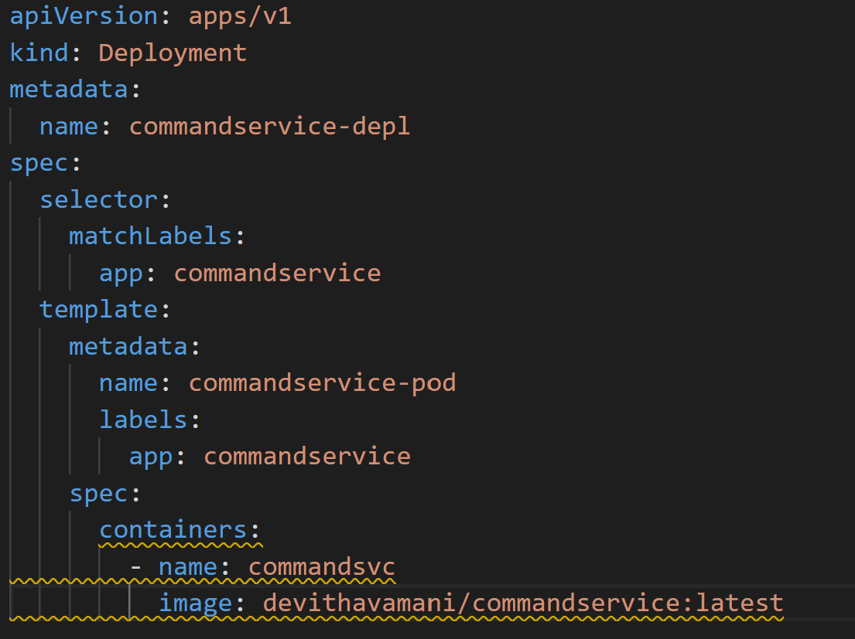
Command Service deployment File.

Slide 9
STAGE 3: Microservice-to-Microservice Synchronous Communication
GOAL: Create a ClusterIP service for Platform and Command microservice to allow both to communicate with each other within the cluster.
Step 1:
Create ClusterIP for both Platform and Command Service.
Step 2:
Update Platform service to make a HTTP POST request to Command service using IHTTPClientFactory. Use Command Service’s ClusterIP name as URI for making HTTP Post request.

Slide 10
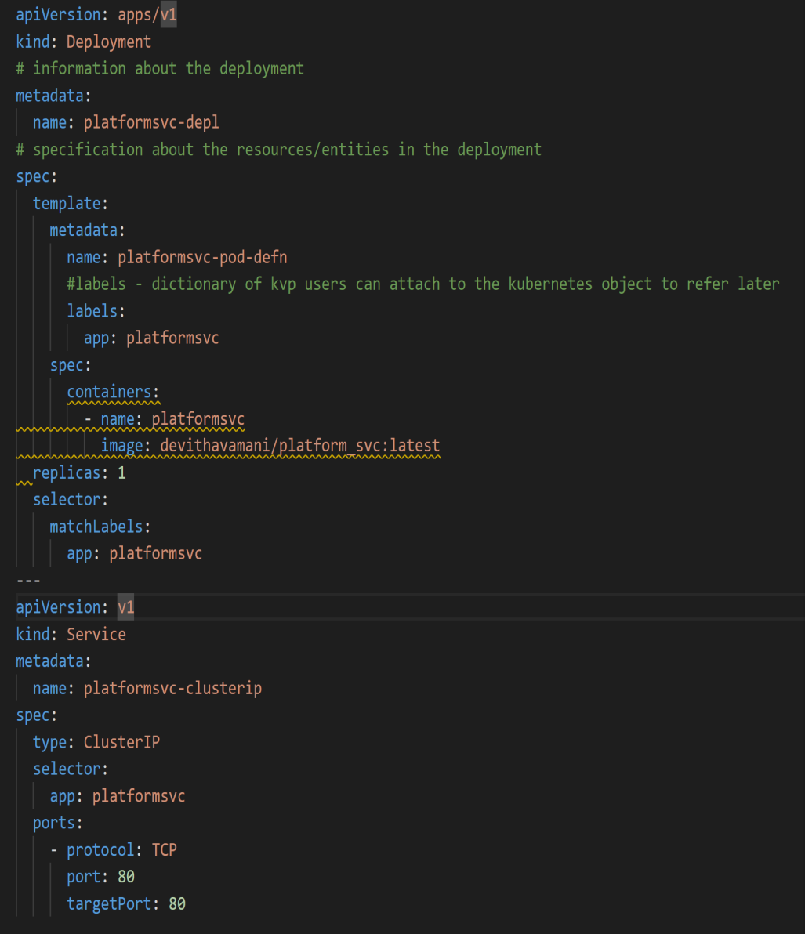
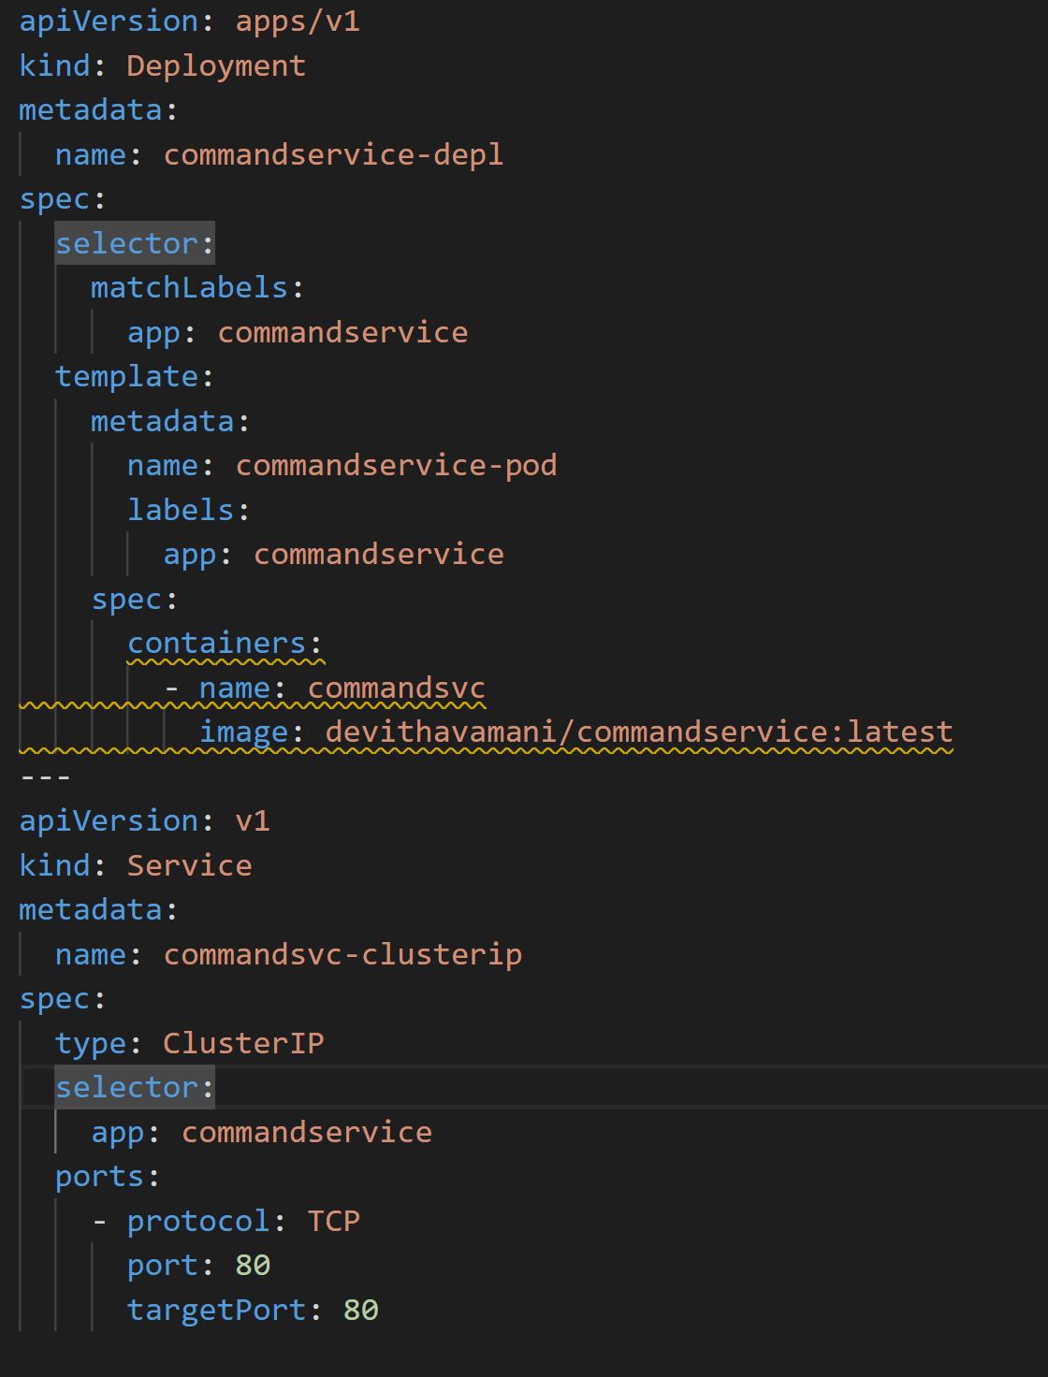
ClusterIP creation :
Platform Service Command Service

Slide 11
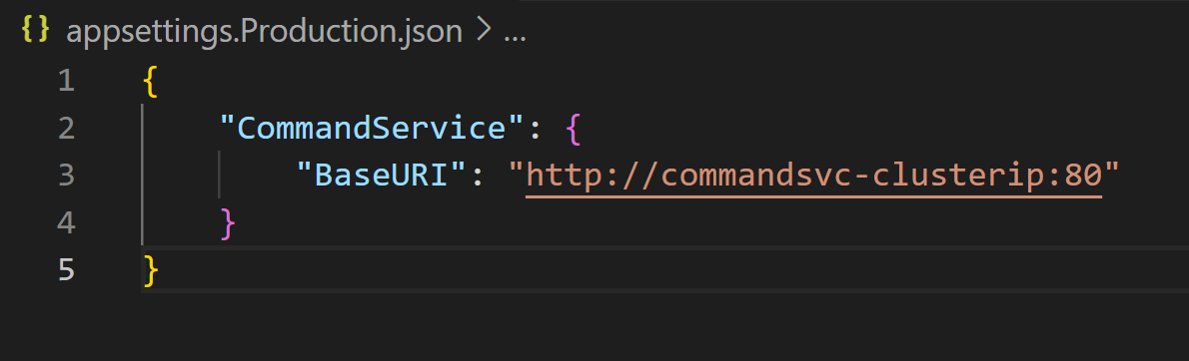
Configure Cluster IP in Platform Service for making HTTP Request:
Add command service clusterIP uri in platform service config file.
Use above config in making http request to command servuce. Options pattern is used to get the URI from configuration file.

Slide 12
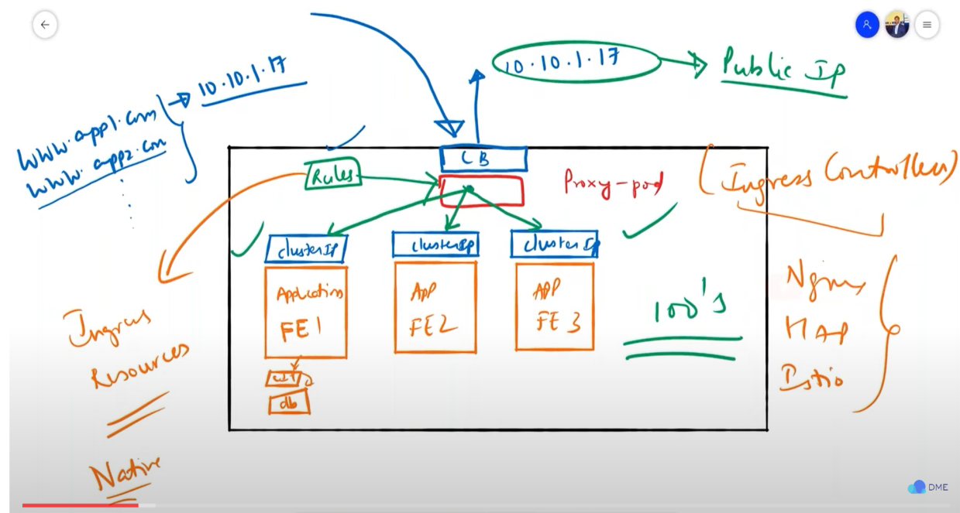
STAGE 4: Install nginx Ingress controller in kubernetes cluster
What is Ingress Controller – proxy pod to route the request to Pods based on received request. Helps to achieve a single Public IP for all the publicly exposed apps/services running in the cluster.
https://www.youtube.com/watch?v=-wHRGFRnboY

Slide 13
STAGE 4: Install nginx Ingress controller in kubernetes cluster
Kubernetes does not comes with ingress controller. But supports ingress controller from third party like nginx, istio and so on.
Ingress Resources: K8s allows user to create/write ingress resources. Ingress resources is a K8s object to write rules for routing to be used by installed ingress controller.

Slide 14
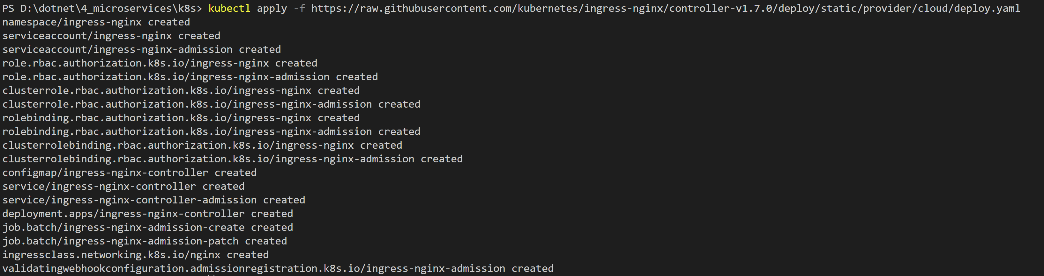
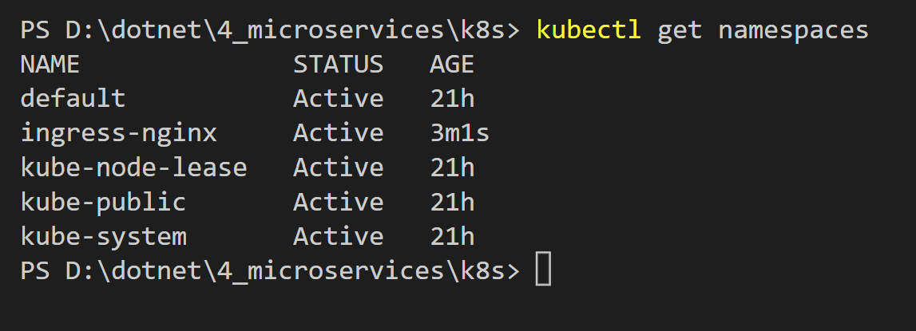
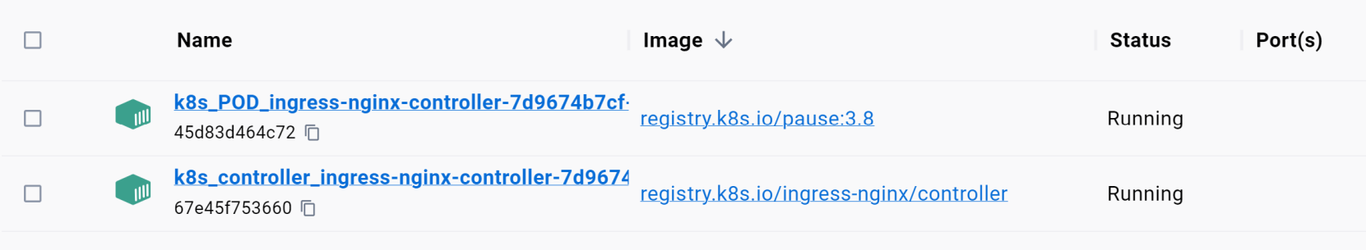
STAGE 4: Install nginx Ingress controller in kubernetes cluster
Install Ingress controller for kubernetes in Docker Desktop
kubectl apply -f https://raw.githubusercontent.com/kubernetes/ingress-nginx/controller-v1.7.0/deploy/static/provider/cloud/deploy.yaml
Notes:
Ingress Controller created in namespace – “ingress-nginx”. Application runs in namespace “default”

