Slide 1
Microservices
https://www.youtube.com/watch?v=DgVjEo3OGBI&t=381s

Slide 2
To Know About Microservices
What is microservices?
How to decide an app can be implemented using microservices?

Slide 3
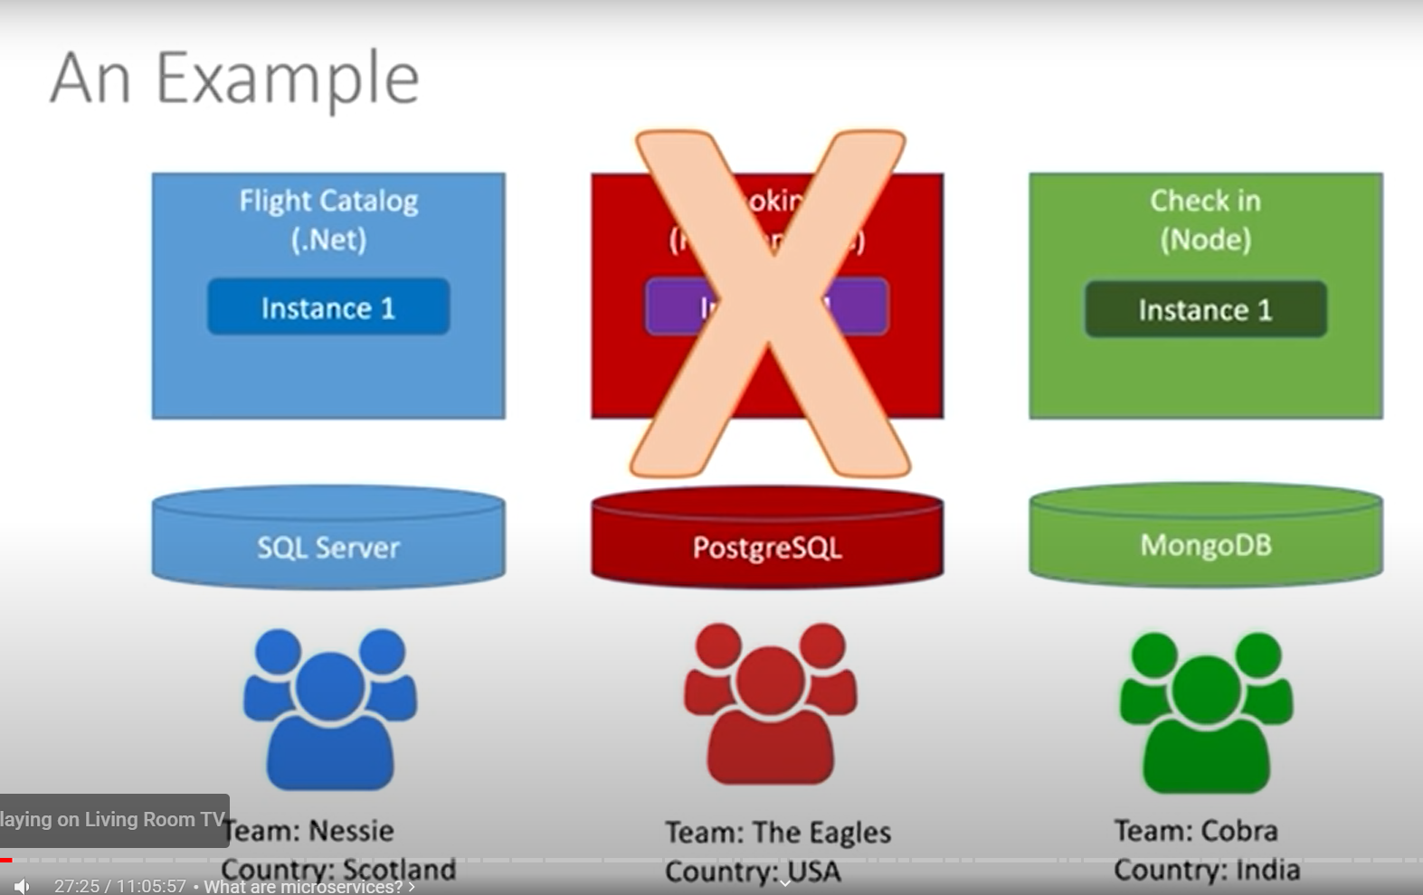












Microservices - Example
Ruby on rails

Slide 4
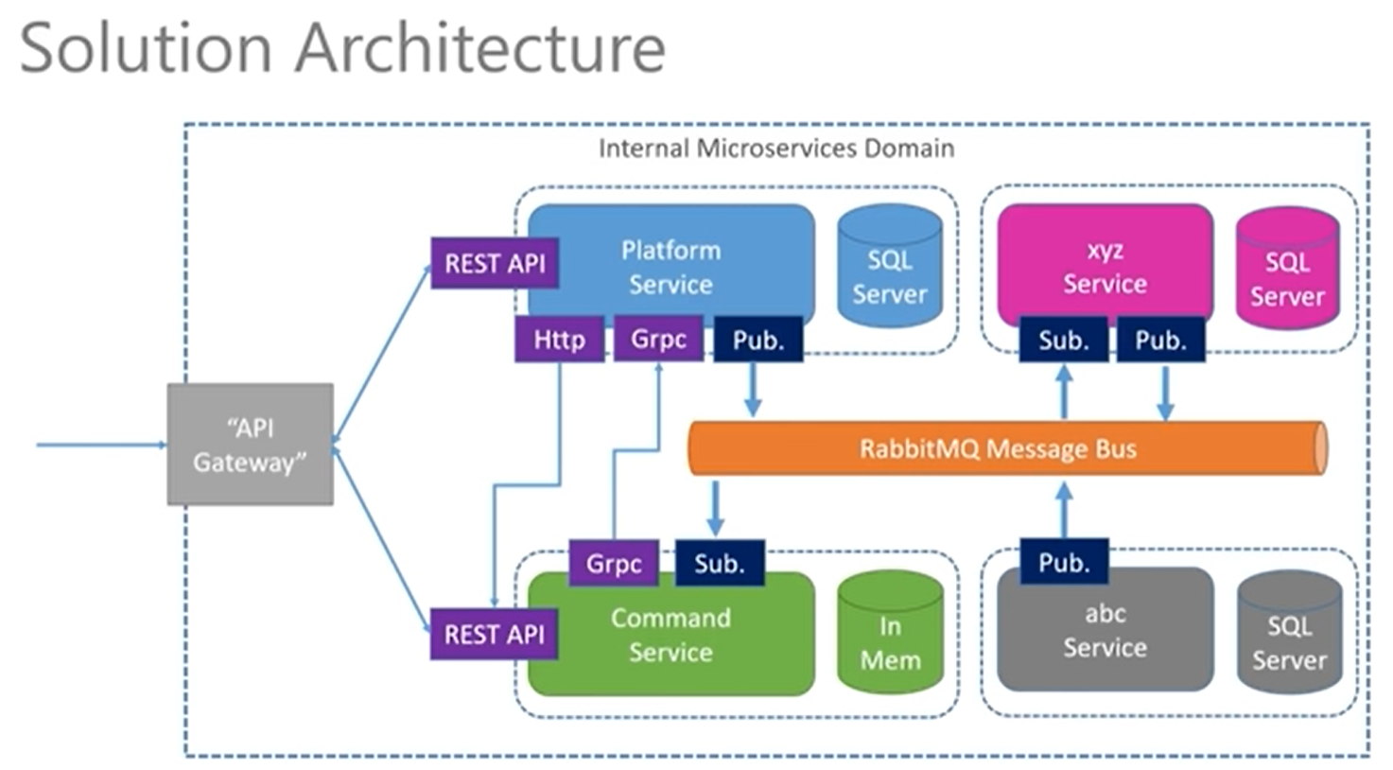
2 Services – Platform and Command and its Event Driven implementation using Message Bus
Why these 2?

Slide 5
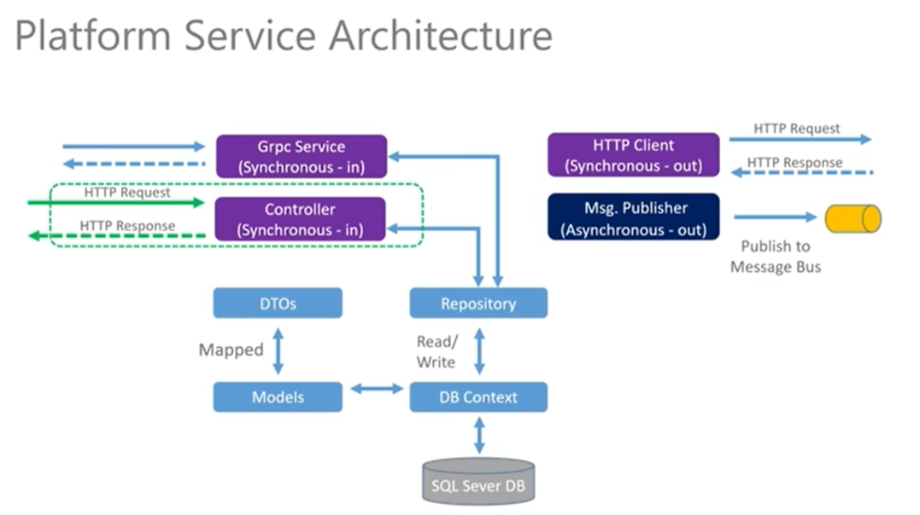
Module 1:
Notes:
Green – External i.e, outside microservice domain. From user request to platform service and response back to user.
Grpc – command service communication with platform service
httpClient – command and platform service coupled for data transfer
Msg publisher – asynchronous communication between platform and command service,

Slide 6
Module 1 :Platform Services
Step 1: Empty WebAPI project using .Net 5
Add Packages
Automapper – converts one object to type to another objectj
What are the objects that are converted?
https://code-maze.com/automapper-net-core/
Cmd: dotnet add package Automapper.Extensions.Microsoft.DependencyInjection
Entity Framework –
dotnet add package Microsoft.EntityFrameworkCore
dotnet add package Microsoft.EntityFrameworkCore.Design
dotnet add package Microsoft.EntityFrameworkCore.InMemory
dotnet add package Microsoft.EntityFrameworkCore.SqlServer
Step 2: Create Model - POCO for Internal Representation of Data. Create Platform poco class – data managed by this service.
(DTO – Representation of data that is going out of the app)
DataAnnotations play a role where it validates the data passed to the database.
https://www.entityframeworktutorial.net/code-first/dataannotation-in-code-first.aspx

Slide 7
Module 1 :Platform Services
Step 3: Create DBContext for establishing connection between Models – Platform data and Database. Register DBContext as service.
Use previously created (platform)model to create data in database – sqlServer. Code First Approach.
Configure DbContext to use InMem database for the services up and running.
What is a DbContext:
A DbContext instance represents a session with the database and can be used to query and save instances of your entities. DbContext is a combination of the Unit Of Work and Repository patterns. Entity Framework Core does not support multiple parallel operations being run on the same DbContext instance. This includes both parallel execution of async queries and any explicit concurrent use from multiple threads. Therefore, always await async calls immediately, or use separate DbContext instances for operations that execute in parallel. In Asp.Net Core, DBContext uses a scoped model
What is a Database Connection?
A database connection is a session of work, opened by the program to communicate with a specific database server, in order to execute SQL statements as a specific user.
Find:
Lazy Loading in EF
Scoped Dbcontext – single db context for a single request works when there are multiple users requesting to access data? Concurrency handled in EF?

Slide 8
Module 1 :Platform Services
Step 4:
Create Repository Interface for platform – GetAllPlatforms, GetPlatformById, CreatePlatform and SaveChanges.
Implement Repository interface and dependency inject DbContext via constructor. Interface method implementation using DBContext.
Register repository interface to give the concrete implementation.
Services.AddScoped<IPlatformFormRepo, PlatformRepo>();
Dotnet cmds:
Dotnet build
Dotnet run
Review:
Model – Platform POCO Created
Data – DBContext created - DBSet for Model Platform is created – Registered DBContext as Service
Repo – Platfrom Interface created – Concrete Platform Repo Implemented – Registered Repo as service

Slide 9
Module 1 :Platform Services
Step 5: Prepare DB -> seed data to DbContext.
Step 6: Prepare DTO – External Representation of Data.
PlatformCreateDTO – inputs taken from api
PlatformReadDTO – inputs passed to api
DataAnnotations plays a role where it validates the received inputs in api.
Step 7: Map Model to Dto’s using Automapper.
Register Automapper
Map Dto’s to model – Create a profile class

Slide 10
Module 1 :Platform Services
Step 8: Create controller for platform.
Controller:
Derive from Microsoft.AspNetCore.Mvc.ControllerBase
[ApiController] – decorate with this attr
[Route(“api/[controller]”) – define route, write route methods, and register the controller.
Build the sever and test the api’s:
Get all platforms – retrieves the seeded data
Get Platform by ID – returns 200, if platform available
- returns 404, if platform not found
Create Platform – creates platform and returns 201 status code,
with the location uri in response.
Controller dependency –
1. Requires repo to work on data
2. Requires mapping service to map between data and dto.
Controller receives Dto object out of api request
Controller
DTO
Model Data

Slide 11
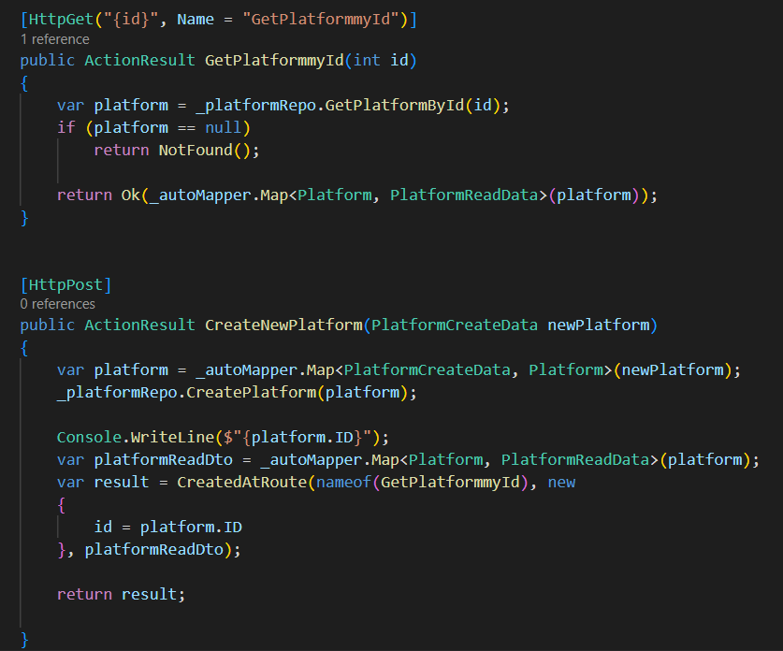
REST Status Code : 201
Returns a URI for the new inserted item.
CreatedAtRoute : Generates 201 route/uri as response to Post request.
Arguments: look for a method by name “GetPlatformmyId” function that receives 1 parameters, in this case 1 integer value.
Arg1 : name of method/route to redirect
Arg 2 : value to be passed to the method/route
Arg 3: Object to be added in response body

Slide 12
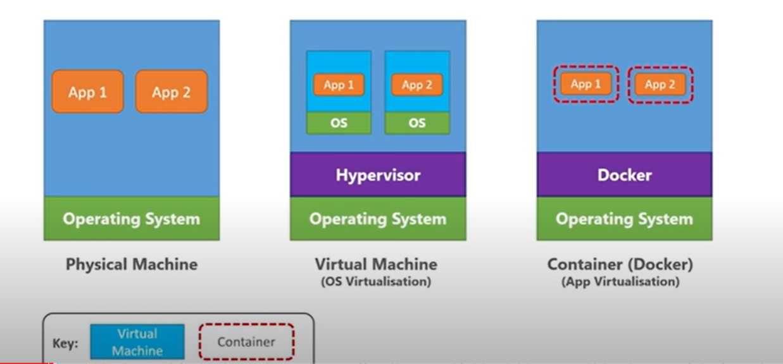
Module 2 – Dockerize ASP.Net Core

Slide 13
Module 2 – Dockerize ASP.Net Core
Docker File : Instruction to Docker Engine about the app to convert into Docker Image

Slide 14
References

Slide 15
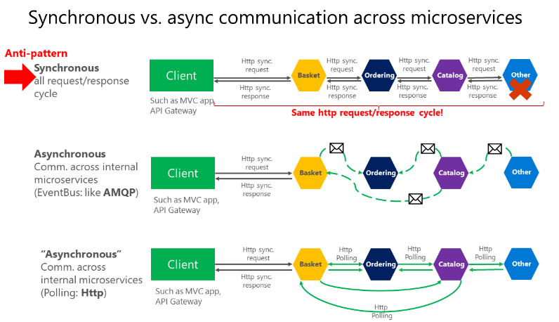
Communication in a microservice architecture
https://learn.microsoft.com/en-us/dotnet/architecture/microservices/architect-microservice-container-applications/communication-in-microservice-architecture

Slide 16
Resources:
Automapper
ASP.Net Core
https://code-maze.com/net-core-series/
Microservices architecture:
https://learn.microsoft.com/en-us/dotnet/architecture/microservices/

