Slide 1
PROJECT UBS ULTRASONIC BLIND STICK

Slide 2
Problem Statement
According to the WHO, about 285 million people are estimated to be visually impaired and 39 million are blind worldwide.
The blind stick , well known in the world as ‘White Cane’, specifically designed for assisting the visually impaired these are longer and thinner and allow the user to "feel" the path ahead, but for a really small range.
Is there any better alternative which can solve this trouble?

Slide 3
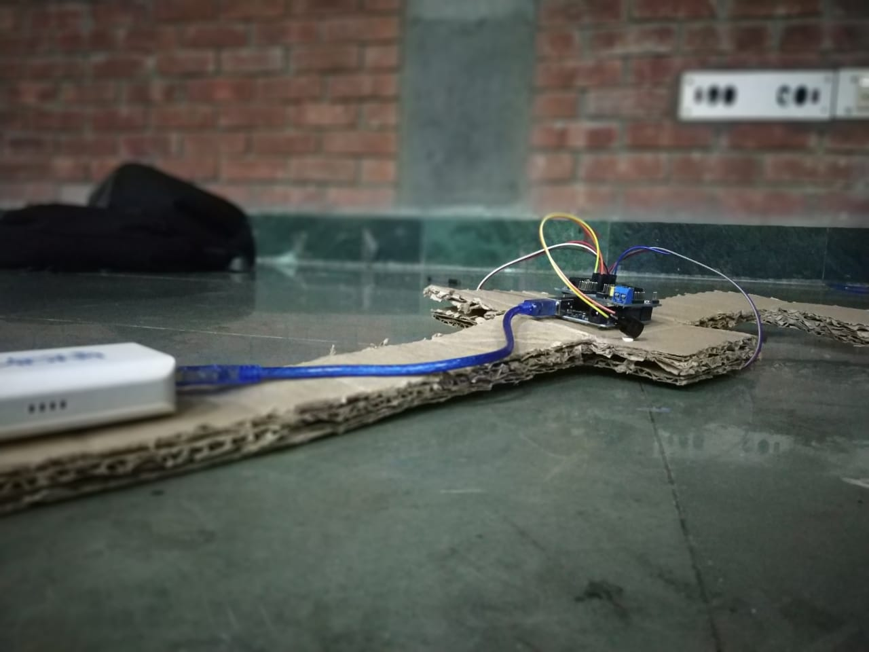
What is an Ultrasonic Blind Stick??
The UBS is an advanced design integrated with ultrasonic sensor along with buzzer and haptic sensing.
Our proposed project first uses ultrasonic sensors to detect obstacles ahead using ultrasonic waves and calculates distance .

Slide 4
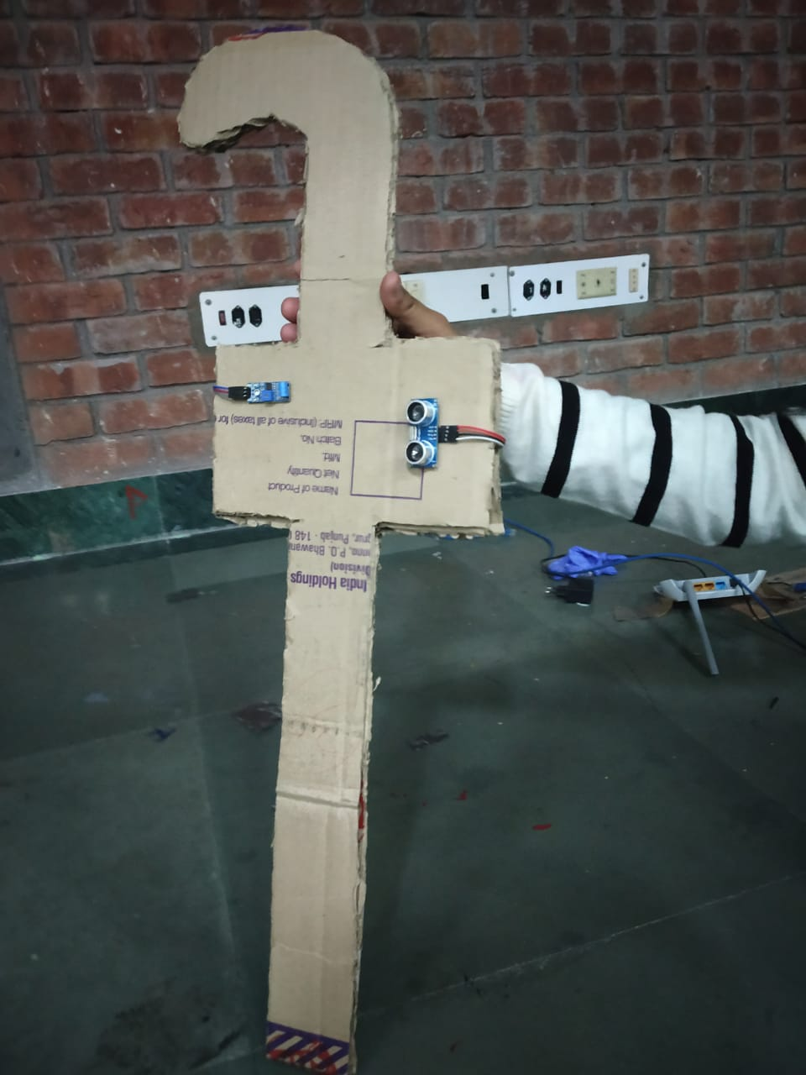
Objective of this Project
The main objective of this project is to help blind people to walk with ease and to be warned whenever their walking path is obstructed with other objects, people or other similar odds. As a warning signal, a buzzer is connected in the circuit, whose frequency of beep changes according to the distance of object.
The closer the distance of obstruction, the more will be the buzzer beep frequency. We can say that the beep frequency is inversely proportional to the distance.

Slide 5
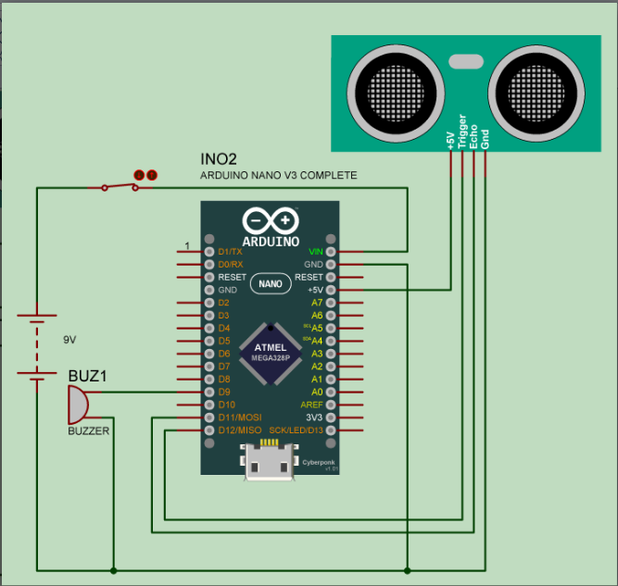

Slide 6
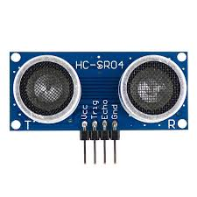
Ultrasonic Sensor
The main component used for this device is the ultrasonic sensor. The ultrasonic sensor transmits a high frequency sound pulse and then calculates the time to receive the signal of the sound echo to reflect back. The sensor has 2 tasks.
One of them acts as the transmitter and transmits the ultrasonic waves.
The other one acts as a receiver (mostly a small microphone) and receives the echoed sound signal.
The sensor is calibrated according to the speed of the sound in air. With this calibrated input, the time difference between the transmission and reception of sound pulse is determined to calculate the distance of the object.

Slide 7
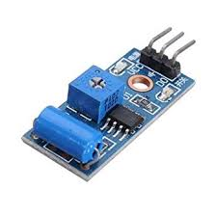
Haptic Sensor
The Vibration Sensor Detector is designed for the security practice.
Vibration sensors are sensors for measuring, displaying, and analyzing linear velocity, displacement and proximity, or acceleration.

Slide 8
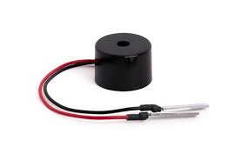
Piezo Buzzer
The piezo buzzer produces sound based on reverse of the piezoelectric effect.
The generation of pressure variation or strain by the application of electric potential across a piezoelectric material is the underlying principle.
These buzzers can be used alert a user of an event corresponding to a switching action, counter signal or sensor input. The buzzer produces a same noisy sound irrespective of the voltage variation applied to it.

Slide 9
Working
Our proposed project first uses ultrasonic sensors to detect obstacles ahead using ultrasonic waves.
On sensing obstacles the sensor passes this data to the arduino. The arduino then processes this data and calculates if the obstacle is close enough. If the obstacle is not that close the circuit does nothing.
If the obstacle is close it sends a signal to sound a buzzer.
When the distance reaches for a value greater than the benchmark value then the buzzers sounds with greater intensity.
When the distance reaches for a value less than the benchmark value then the buzzers sounds with lower intensity.
Demo Video: https://youtu.be/lkO0qN2vHMQ

Slide 10
Team Members
Devansh Kaushik
Bhawna Dey
Honey Gupta
Nandini Ahuja

