Slide 1
Limits to arbitrage in Indian equities
Stage I: theory, data and the futures-cash band
BS project, Stage I (EC 495) | November 2026
Prince Kumar (23B3032)
Guide: Prof. Aditi Chaubal, Department of Economics, IIT Bombay
Notes:
Stage I of the project: the model, the test plan, the data, the band within which futures and cash prices move, and whether the F&O ban binds on trading. What the limits do to prices is Stage II.

Slide 2
Agenda
Executive summary
The question and the approach
Why India, the F&O ban, the model and the frozen test plan
The data
Bans and the futures-cash basis, 2015 to 2026
The no-arbitrage band
How wide it is, and what sets it: costs and frictions
Does the ban bind on trading?
Trading in a ban, the 95% trigger and the 2025 rules
Conclusion and Stage II

Slide 3
Executive summary

Slide 4
Executive summary
Executive summary
Futures and cash prices of Indian stocks move in a wide band that costs shape only loosely; the F&O ban binds hard on trading.
A wide, asymmetric band. The basis moves between about -35 and +24 bp around each stock's median. Inside, it drifts; outside, it is pushed back. The lower side reaches further because the correcting trade needs a short sale.
Costs shape it loosely. A new cash-and-carry round trip costs 27 to 31 bp, in the outer tail. The upper tail rose after the 2024 and 2026 tax increases, as predicted, but by more than the cost changes and not unusually against placebo dates.
The ban binds hard on trading. Futures volume falls by about 87% in a ban. Once violations were checked on intraday positions (from March 2020), every futures trade in a ban closed positions.
The 2025 rules cut bans. Against the old rule applied to the same stocks, ban days fell by about three quarters in the first year.
Source: NSE archives, 2010 to 2026; author's analysis
Notes:
Four messages for Stage I: the band, its relation to costs, trading in a ban, and the 2025 rules.

Slide 5
Both primary tests of this stage hold as specified
Executive summary
Pre-specified tests of Stage I; primary tests Holm-corrected with the two of Stage II
Test | Prediction | Result | Verdict
H8 Trading in a ban (primary) | Futures volume falls; trades only close positions | -2.00 log points (s.e. 0.11) | Supported
H3 Costs and the band (primary) | Upper edge rises with each tax increase | +6.96 bp (s.e. 0.61); weak against placebo dates | Supported, weakly
H1 Frictions and the band | Wider bands where frictions are higher | +3.5 bp per s.d. (p = 0.002), across stocks | Supported
Density at the 95% trigger | Not signed by the model | No bunching (p = 0.86) | Descriptive
Every detail the plan left open was fixed in a dated log before the test that needed it.
Analyses added after a result (for example, the split by enforcement period) are labelled as such.
Both primary tests of Stage I hold; the cost result is weak once common shocks are allowed for
Source: NSE archives; author's analysis
Notes:
H3 and H8 are primary; H1 and the density test are secondary. H6 and H7, the other two primary hypotheses, are in Stage II.

Slide 6
The question and the approach

Slide 7
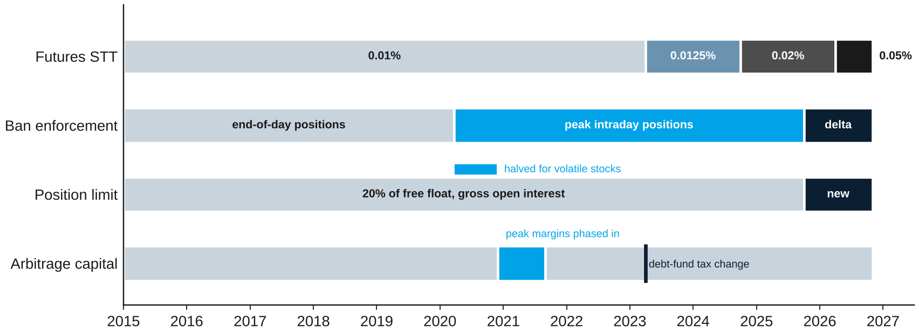
India changes almost every limit on a known date
The question and the approach
Futures STT, ban enforcement, the position-limit rule and arbitrage capital, 2015 to 2026
Dated rule changes let me measure each limit instead of assuming it
Source: SEBI circulars and press releases; NSE circulars; AMFI
Notes:
Dated rule changes are what make each limit measurable.

Slide 8
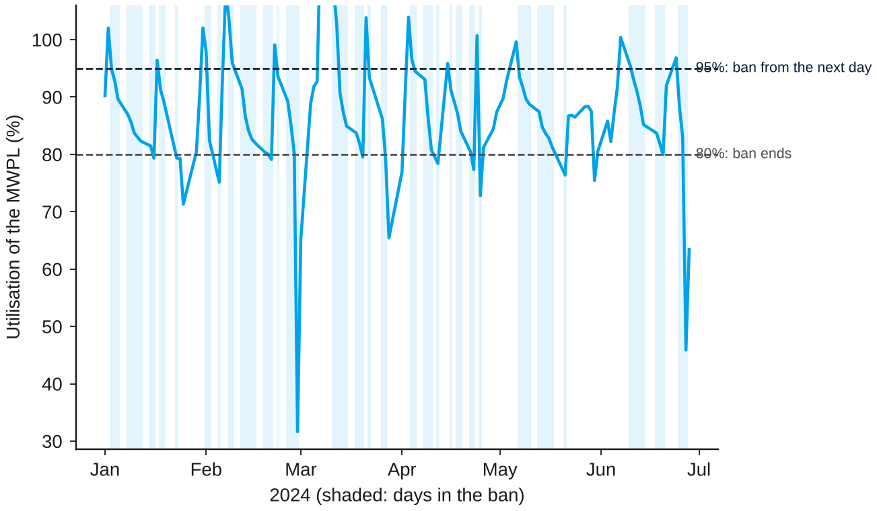
The F&O ban lets every trader only reduce positions
The question and the approach
Utilisation of the position limit for SAIL, the most-banned stock, January to June 2024
How the rule works
Enter the day after open interest exceeds 95% of the market-wide position limit
Leave after it falls to 80%
In between, everyone may only reduce positions, in all expiries
1,788 spells in 141 stocks, 2015 to October 2026
To my knowledge, no study had examined this rule
Source: NSE archives; author's analysis
Notes:
The ban binds everyone, not only arbitrageurs. That is what makes it different from a cap on one trader.

Slide 9
Stage I builds the foundation; Stage II asks about prices
The question and the approach
How strongly do limits to arbitrage bind, and how much mispricing do they explain?
Stage I (this presentation)
Stage II
A model with every Indian limit as a parameter
A frozen test plan and a data set from public NSE files
How wide is the band within which the futures-cash basis moves?
Do costs and frictions set its edges?
Does the ban bind on trading, as the rule intends?
What a ban does to prices: one-sided correction, the level of the basis at ban start
Position limits before a ban: anticipation; the 2025 formula; the 2020 halving
Arbitrage capital: do fund inflows narrow the band?
Short-sale constraints: F&O entry, anomalies, a constraint index for all stocks
Policy on position limits and their enforcement
Stage I answers three questions: where the band lies, what sets it, and whether bans bind
Source: NSE archives; author's analysis
Notes:
The project is split into two stages. This presentation covers Stage I.

Slide 10
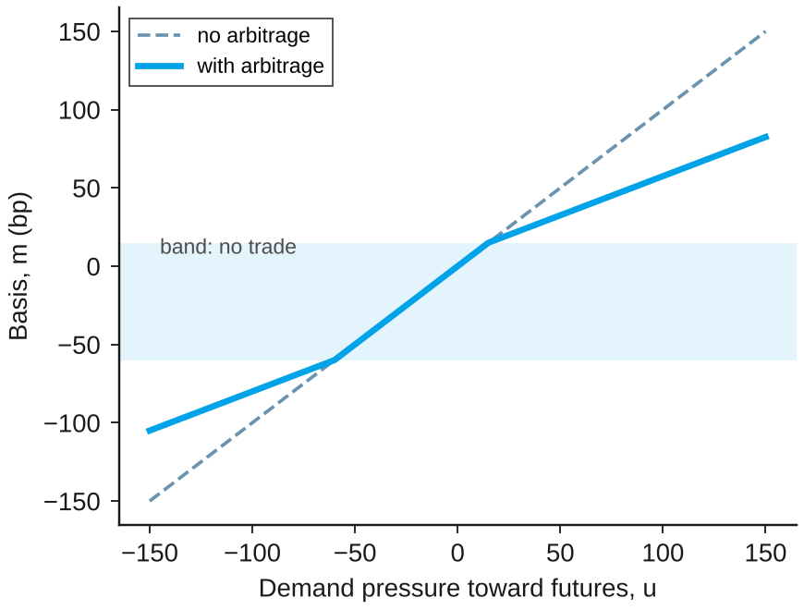
Model: costs set the band; a ban blocks two things
The question and the approach
Equilibrium basis against the demand pressure of outside traders, with illustrative costs
Band
Arbitrage pays only outside [-c-, c+]
Costs set the edges; capital and risk set how far the basis travels beyond them
Ban: arbitrage
Arbitrageurs may only reduce positions
Rich futures are no longer corrected
Ban: demand
New futures demand is blocked; part moves to the stock
This lowers the basis
Stage I tests the band and trading in a ban; the price predictions come in Stage II
Source: author's model; illustrative parameters, not estimates
Notes:
Inside the band the basis follows demand one for one. The ban removes new arbitrage and also blocks new futures demand.

Slide 11
I fixed the tests before looking at outcomes
The question and the approach
Five safeguards against fitting theory and data to each other
What I did
Why
1
Model
One model; every limit a parameter; each prediction with what would contradict it
Hypotheses are derived, not fitted
2
Frozen plan
Tests and signs fixed with a time stamp on 5 November 2026
No choosing specifications after seeing results
3
Data
Built from public NSE files and checked against the exchange's rules
Errors caught before testing
4
Estimator tests
Each estimator recovers known effects on simulated data
Methods checked before real data
5
Full reporting
Primary tests Holm-corrected; weak and failed results kept
Nothing is left out
Source: NSE archives; author's analysis
Notes:
Order of work: model, frozen plan, data, estimator tests, full reporting.

Slide 12
Each prediction states what would contradict it
The question and the approach
Predictions of the model and where they are tested
Prediction | Contradicted if | Plan label | Tested in
The basis moves in an asymmetric band, wider below zero | No band; a symmetric band | Band | Stage I
Tax increases raise the upper edge, more for larger ones | Edges unrelated to costs | H3 (primary) | Stage I
Bands are wider where frictions are higher | No relation | H1 | Stage I
In a ban futures volume falls and trades only close positions | Futures activity unchanged | H8 (primary) | Stage I
In a ban rich futures revert more slowly | No asymmetry, or the opposite | H7 (primary) | Stage II
The level effect follows the composition of trading | Sign unrelated to composition | Level effect | Stage II
Short-sale access speeds price adjustment | No change, or the opposite | H6 (primary) | Stage II
Source: pre-analysis plan, frozen 5 November 2026
Notes:
Primary hypotheses of the plan: H3, H6, H7, H8. H3 and H8 are in Stage I.

Slide 13
The data

Slide 14
The data come entirely from public NSE files
The data
Sources, coverage and the main checks
Bans and limits
Daily open interest, position limits and ban lists, February 2010 to October 2026
Next-day flags match the official ban list for 11,753 of 11,764 flags
1,788
ban spells
Prices and basis
Futures and cash bhavcopies 2015 to 2026; basis from volume-weighted prices
Settlement prices avoided: they are set at cost of carry on thin days
9,416
ban stock-days
Corporate events
Dividends subtracted at present value
Contracts with a dividend or other event in their life excluded
486,040
stock-days of basis
Lending, rates
Daily stock-lending trades, 2015 to 2026
Three-month interbank rate for the cost of carry
371
stocks with futures
Source: NSE archives; OECD via FRED; author's analysis
Notes:
Everything is rebuilt by scripts; a full rerun reproduces every number.

Slide 15
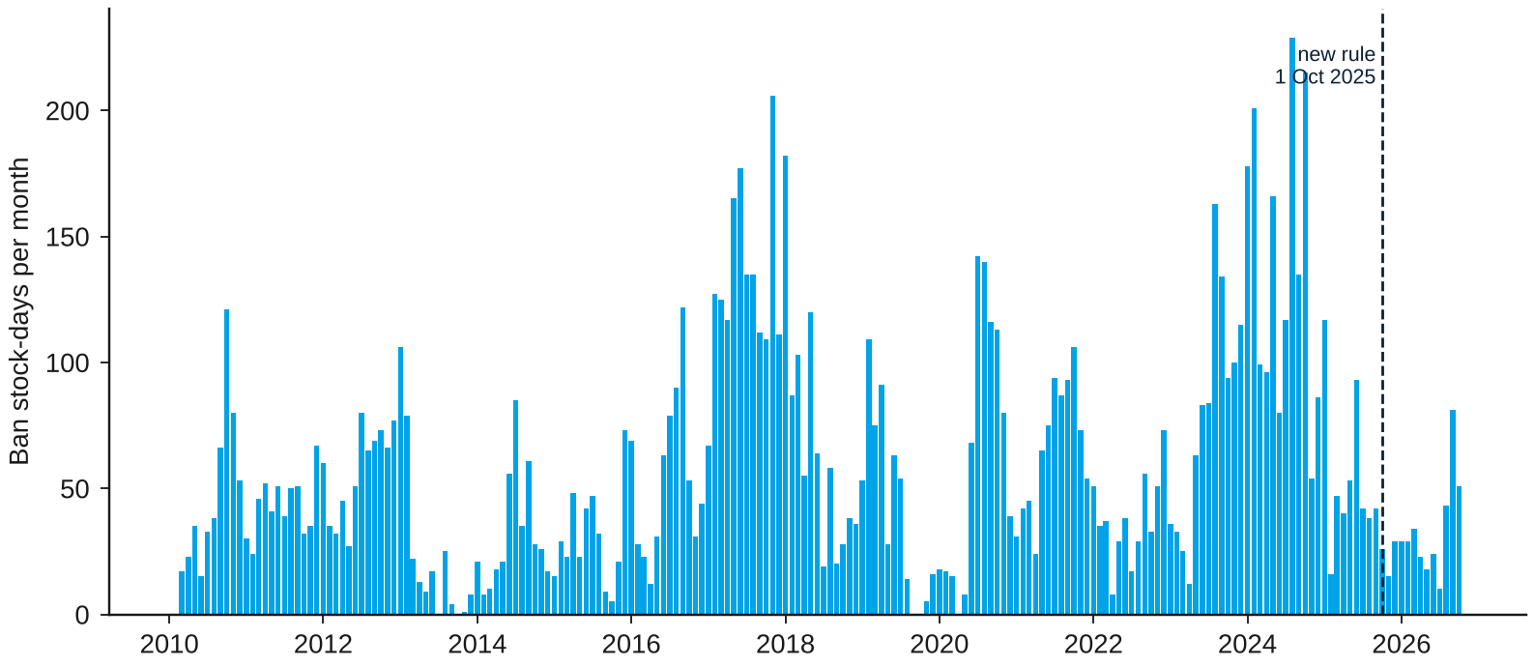
Bans come in waves and fell under the new rule
The data
Stock-days in the ban per month, February 2010 to October 2026
What the chart shows
1,788 spells in 141 stocks, 2015 to October 2026
Typical spell: 4 trading days before the reform, 9 after it
1 October 2025: every stock's limit cut, to a median of 73% of the old value
Bans are frequent enough to study, and concentrated in a few stocks
Source: NSE securities-in-ban lists; author's analysis
Notes:
Bans are concentrated in a few stocks; SAIL had 76 spells.

Slide 16
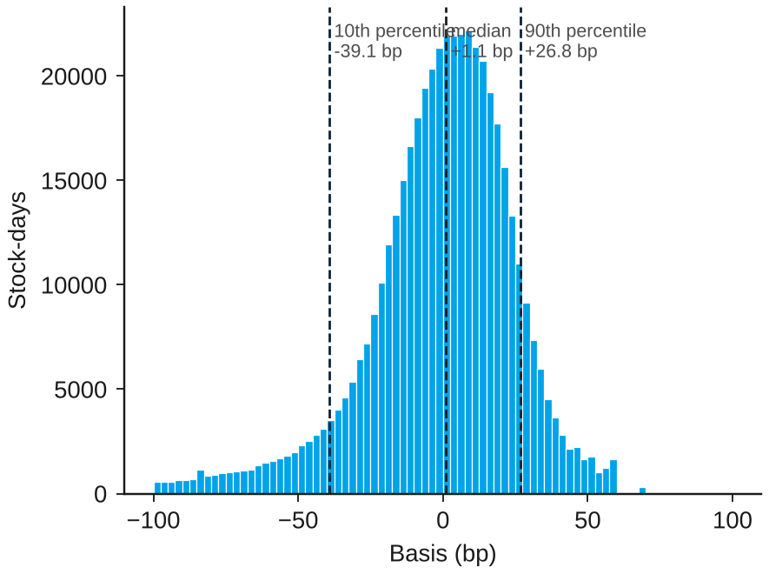
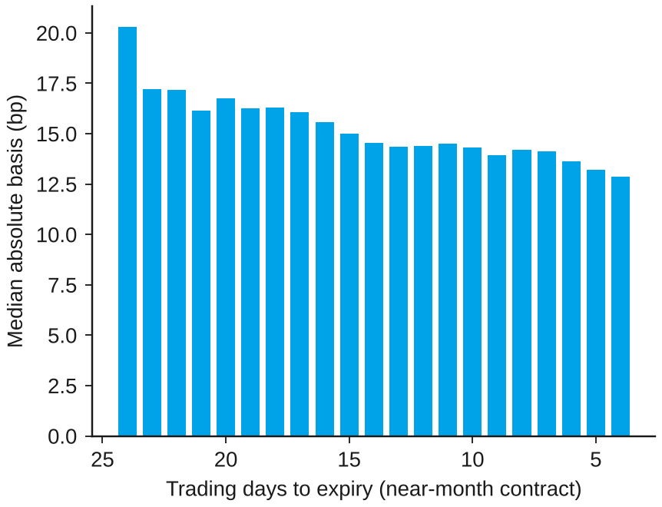
The basis is centred near zero with a long lower tail
The data
Futures-cash basis of the analysis sample, 2015 to 2026
Median +1.1 bp; cheap futures go further from zero
The basis narrows as expiry approaches
Cheap futures are further from zero, as expected when the correcting trade needs a short sale
Source: NSE archives; author's analysis
Notes:
Median +1.1 bp; 10th percentile -39.1; 90th +26.8. The basis narrows toward expiry as carrying costs shrink.

Slide 17
The no-arbitrage band

Slide 18
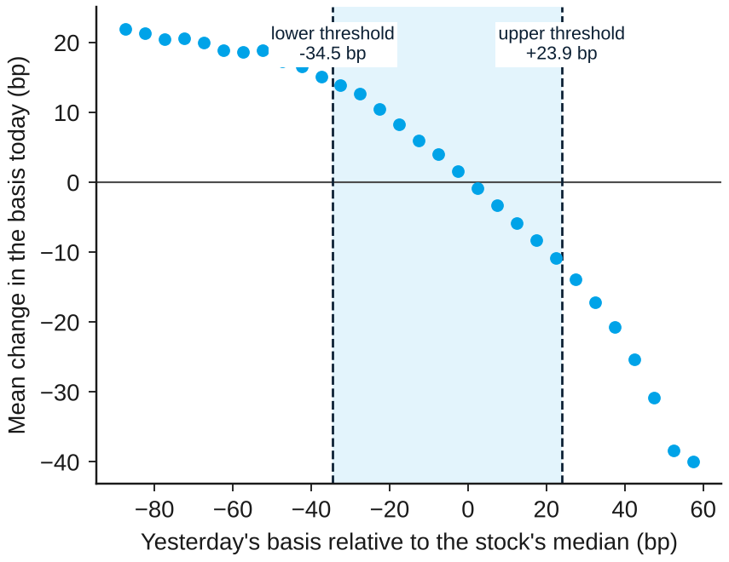
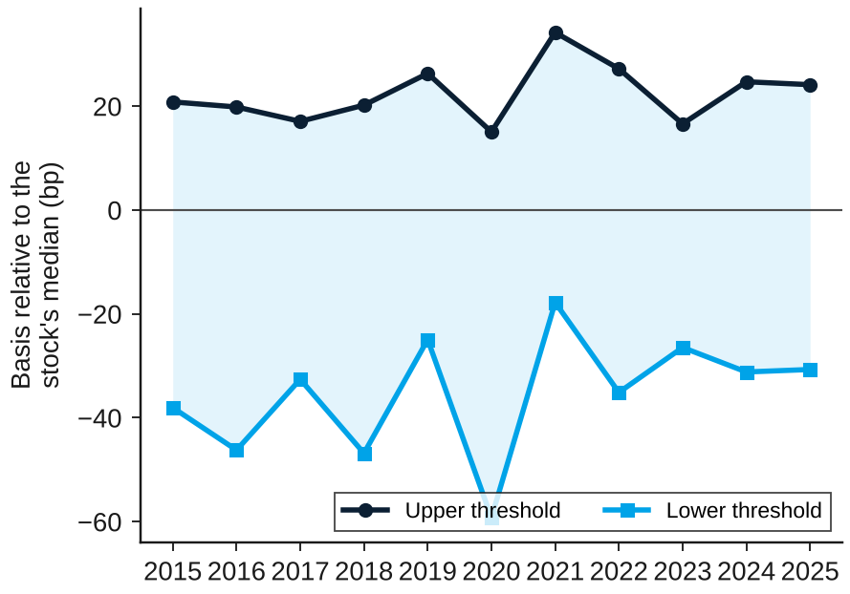
The basis moves in a wide, asymmetric band
The no-arbitrage band
Pooled threshold model, non-ban days, 2015 to 2026, 360 stocks
Pull back grows with the deviation; band -34.5 to +23.9 bp
Stable across years, apart from March 2020
The band is about 58 bp wide, far wider than intraday bands found in earlier Indian studies
Source: NSE archives; author's analysis
Notes:
Linearity rejected (sup-F 7,471 against a critical value of 31). The band is stable across years except 2020.

Slide 19
The band's location is robust; its speed is not
The no-arbitrage band
Reversion slopes by regime, before and after a correction for noise
 | Lower regime | Middle | Upper regime
Threshold (bp) | below -34.5 |  | above +23.9
Share of days | 12% | 76% | 12%
Slope, threshold model | -0.08 | -0.47 | -0.81
Slope, noise-corrected | -0.12 | -0.19 | -0.14
What this means
Daily volume-weighted prices contain noise that looks like fast reversion
Corrected, the three slopes are small and similar
Smooth-transition models fit almost as well; a symmetric one fits worse
Read the thresholds, not the speeds, as the main evidence on the band
Source: NSE archives; author's analysis
Notes:
Instrumenting yesterday's deviation with the deviation two days earlier removes the bias from measurement noise.

Slide 20
What sets the band

Slide 21
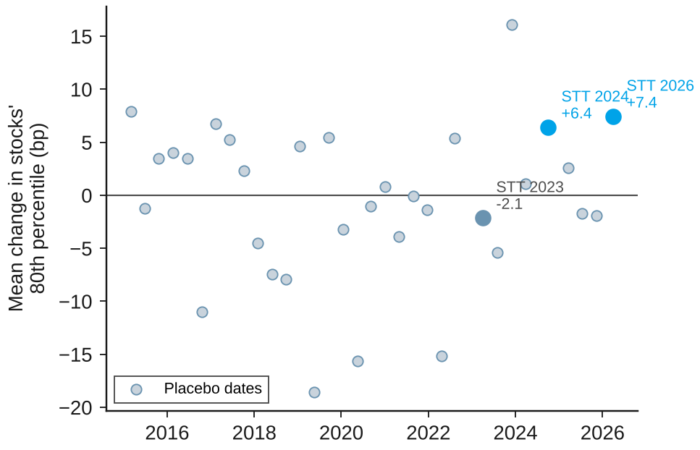
Tax rises lifted the upper tail, but not unusually
What sets the band
Change in stocks' 80th percentile at the STT dates and at 30 placebo dates (bp)
What the test shows
Predicted: the upper edge rises with each tax increase, more for larger ones
Found: +6.4 bp (2024) and +7.4 bp (2026); ordered as the cost changes
But: larger than the cost changes, the median moved too, and placebo dates move as much
Costs push the band the predicted way but do not set its edges tightly
Source: NSE archives; author's analysis
Notes:
Pre-specified H3: +6.96 bp pooled over 2024 and 2026 (s.e. 0.61). Placebo s.d. 7.4 bp; 10% and 7% of placebo dates show a rise as large.

Slide 22
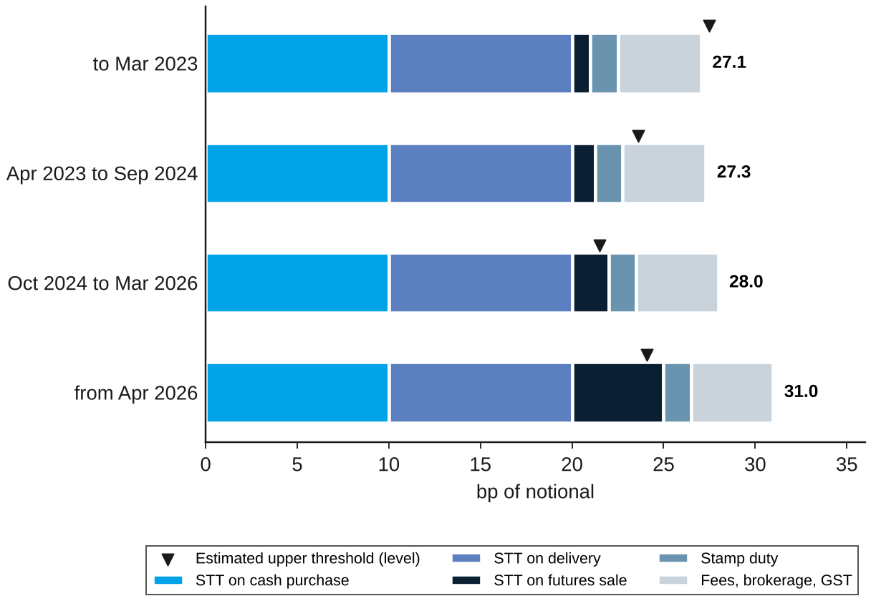
A new position costs more than the estimated edge
What sets the band
Round trip of an overnight cash-and-carry position, by STT period (bp)
What the chart shows
New position: 27 to 31 bp, between the 90th and 95th percentiles of the basis
Estimated upper edge: +22 to +28 bp
Rolling an existing position: only 4 to 8 bp
New capital enters only at large gaps; funds that roll lean against small ones
Source: NSE circulars on STT and transaction charges; author's analysis
Notes:
Brokerage 0.01% per leg; 25 to 38 bp for brokerage between 0.005% and 0.03%.

Slide 23
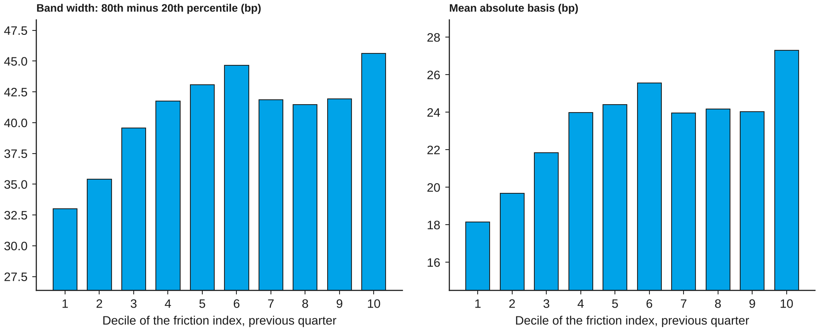
Bands are wider in stocks that are harder to trade
What sets the band
Band width and mean absolute basis by decile of a friction index (previous quarter)
The link holds across stocks, not within a stock over time
Source: NSE archives; author's analysis
Notes:
Index: spread, illiquidity, idiosyncratic volatility, utilisation, lack of stock lending. +3.5 bp per s.d. (s.e. 1.1, p = 0.002).

Slide 24
Does the ban bind on trading?

Slide 25
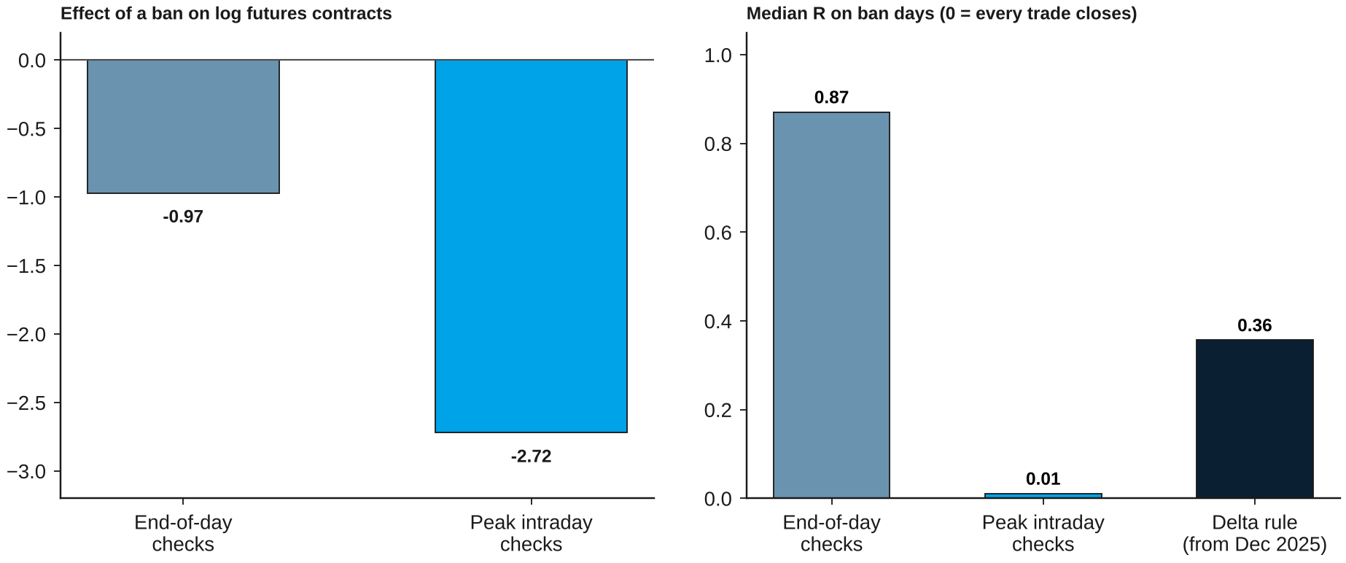
In a ban, futures trading collapses
Does the ban bind on trading?
Effect on log futures contracts, and median R on ban days, by enforcement regime
Futures volume falls by about 87% in a ban; cash trading rises and turns toward delivery
Source: NSE archives; author's analysis
Notes:
Pre-specified H8: -2.00 log points on futures volume, cash +7.5%, delivery share +4.1 points, against the same stock at 80 to 95% utilisation.

Slide 26
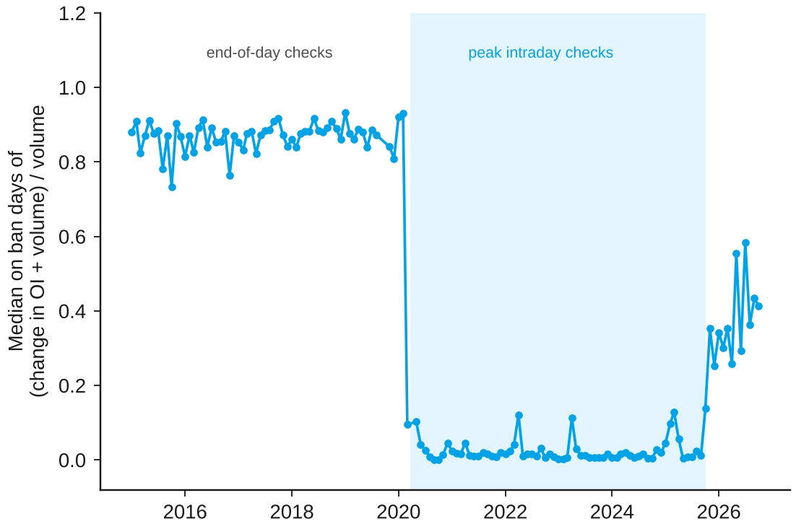
Intraday checks made the rule bind trade by trade
Does the ban bind on trading?
Monthly median on ban days of R = (change in open interest + volume) / volume
What the chart shows
To 22 March 2020 violations were judged on end-of-day positions: median R 0.87
From 23 March 2020 on peak intraday positions: median R 0.011
From October 2025 the delta rule allows offsetting trades: 0.19 to 0.36
The rule changes trading as designed only when positions are checked during the day
Source: NSE archives; author's analysis
Notes:
R = 0 when every trade closes a long and a short. The break in March 2020 matches SEBI press release 18/2020. The split by period was added after the pooled result.

Slide 27
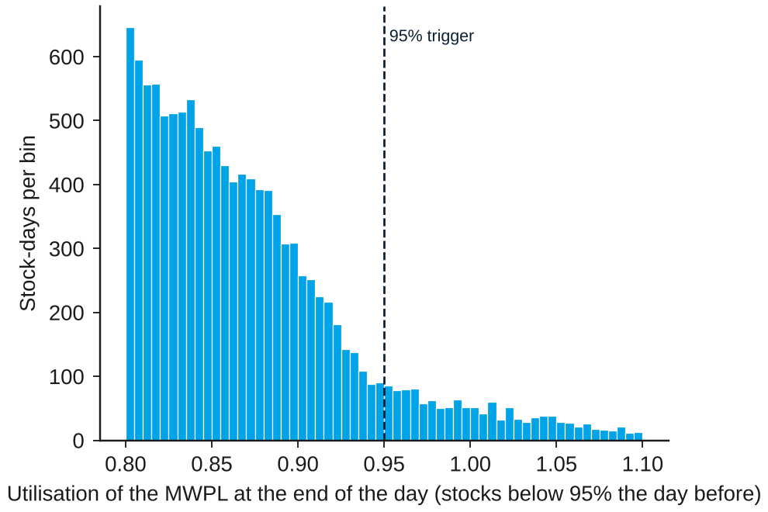
Traders do not hold back below the 95% trigger
Does the ban bind on trading?
End-of-day utilisation of stocks that were below 95% the day before, 2015 to September 2025
What the chart shows
No bunching just below 95% (p = 0.86)
Utilisation speeds up near the trigger rather than stalling
Chance of crossing next day: 7% at 85% utilisation, about half at 93 to 95%
There is no sign that traders hold back to avoid a ban
Source: NSE archives; author's analysis
Notes:
Density test (Cattaneo, Jansson and Ma) T = -0.18, p = 0.86. The population is stocks below 95% the day before, because above 95% a stock enters the ban.

Slide 28
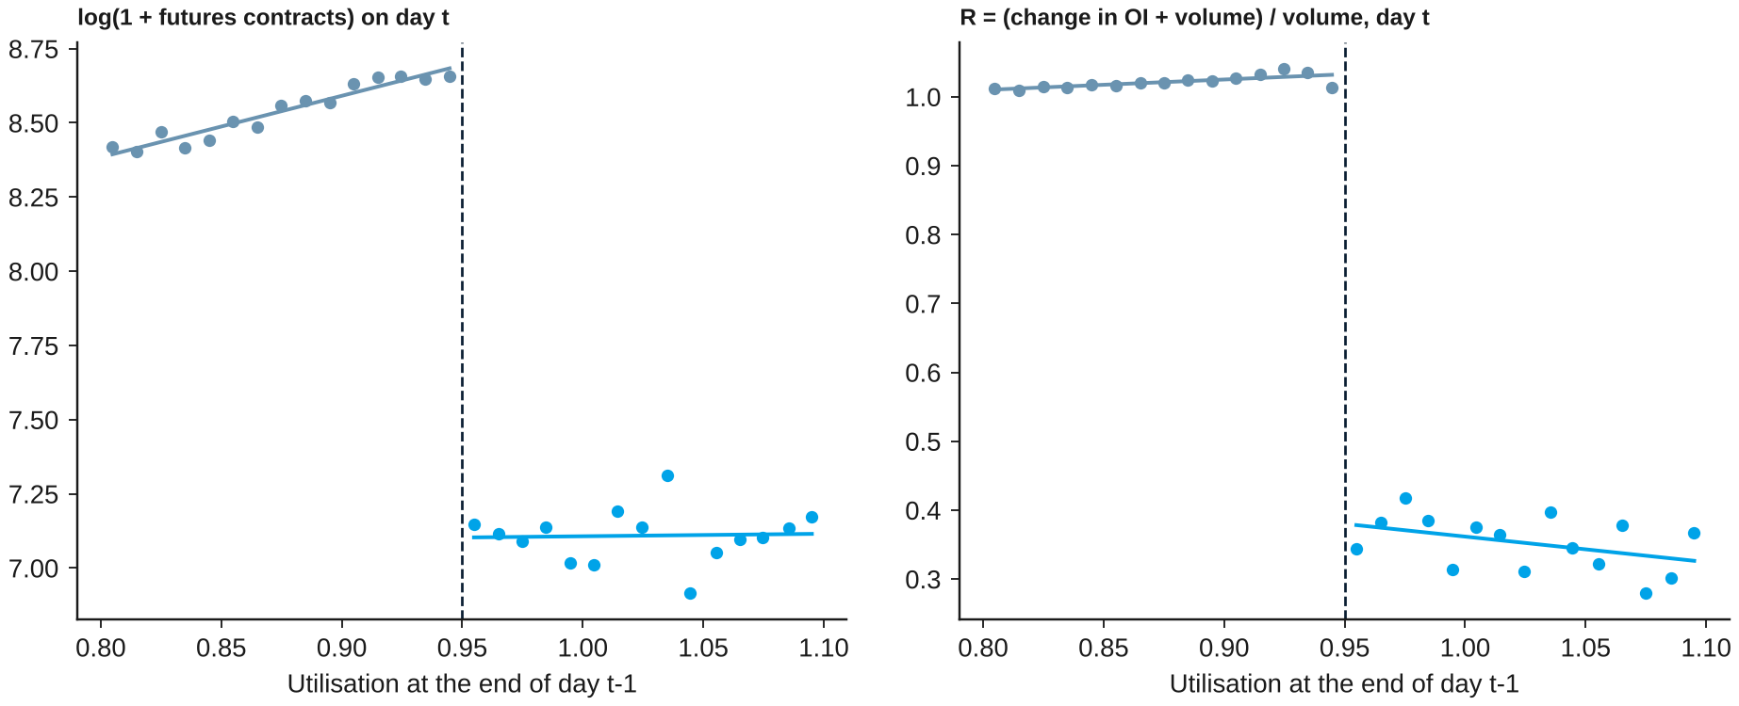
Trading breaks sharply at the 95% trigger
Does the ban bind on trading?
Binned means by utilisation at the end of the previous day, stocks not in a ban the day before
Crossing 95% puts a stock in the ban the next day in 99.7% of cases
Source: NSE archives; author's analysis
Notes:
Regression discontinuity: futures -1.53 log points, R -0.66, delivery share +5.1 points; cash volume does not jump.

Slide 29
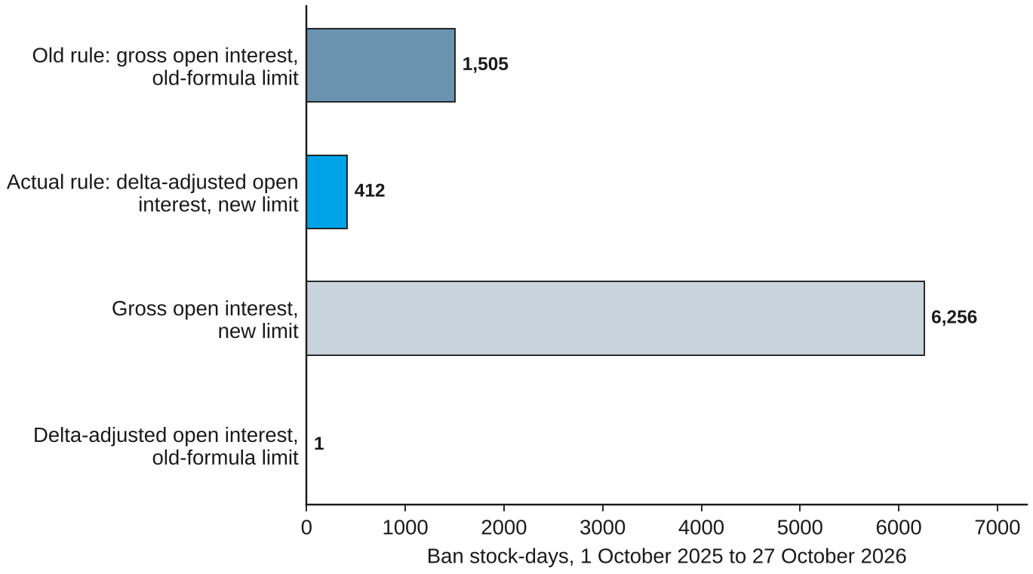
The 2025 rules cut ban days by about three quarters
Does the ban bind on trading?
Ban stock-days, 1 October 2025 to 27 October 2026, actual and counterfactual rules
What the reform did
Aim: SEBI set out to reduce 'spurious' bans
Before 2025 bans came from rising open interest; only 0.4% from a falling limit
Delta-adjusted open interest removes almost all bans; the lower limit alone would have quadrupled them
Net: 412 ban days against 1,505 under the old rule
The reform met its stated aim on the number of bans
Source: NSE archives; author's analysis
Notes:
The simulated ban rule reproduces the official lists exactly. The old-formula limit is an approximation.

Slide 30
Conclusion and Stage II

Slide 31
What Stage I shows
Conclusion
The three questions of this stage and their answers
Question | Answer | Main evidence
How wide is the band? | Wide and asymmetric | -35 to +24 bp around each stock's median; linearity rejected; stable over time
Do costs set its edges? | Loosely | Upper tail up after 2024 and 2026 tax rises, but not unusually; new position costs 27 to 31 bp
Do frictions widen it? | Across stocks | +3.5 bp per s.d. of a friction index; no effect within a stock
Does the ban bind on trading? | Yes, strongly | Futures volume -87%; every trade closes positions under intraday checks; 2025 rules cut bans by three quarters
Limits bind hard on trading; what they do to prices is the question of Stage II
Source: NSE archives; author's analysis
Notes:
Position limits bind hard on trading; costs shape the band loosely.

Slide 32
Four limitations of this stage
Conclusion
Limitation
What could go wrong
...and what I did
Daily data
Intraday arbitrage is out of scope, and noise inflates measured reversion
Noise-corrected estimates reported alongside
Positions unobserved
The arbitrage book in the model is not seen in public data
Edges tested through changes, not levels
Few cost events
Three tax increases, one on the same day as a fund tax change
Placebo dates calibrate the test
Short post-reform period
Only 44 ban spells since October 2025
Reform effect on prices left to Stage II
Intraday data and a longer post-reform sample would sharpen the tests
Source: NSE archives; author's analysis
Notes:
These shape the design of Stage II.

Slide 33
Stage II asks what the limits do to prices
Conclusion
The plan for the second stage
1
The ban and prices
One-sided correction in a ban (H7); the basis when a ban starts; placebo bans
2
Limits before a ban
Is the basis richer as utilisation nears 95%? The 2025 formula; the 2020 halving
3
Arbitrage capital
Do inflows into arbitrage funds narrow the band?
4
Short-sale access
F&O entry and exit (H6); anomalies; a constraint index for all stocks
5
Policy
Design and enforcement of position limits
Stage I's model, plan and data carry over unchanged
Source: NSE archives; author's analysis
Notes:
Two primary hypotheses (H6, H7) and the remaining secondary tests of the frozen plan, plus new work.

Slide 34
Limits to arbitrage in Indian equities
Thank you
BS project, Stage I (EC 495) | November 2026
Prince Kumar (23B3032)
Guide: Prof. Aditi Chaubal, Department of Economics, IIT Bombay

Slide 35
Appendix

Slide 36
The model's propositions behind each test
Appendix
Proposition | Statement | Tested by
1 Band | Arbitrage pays only outside [-c-, c+]; inside, the basis follows demand | Band estimation
2 What moves it | Costs set the edges; capital and risk set how far the basis goes beyond | H3 (Stage I); H4 (Stage II)
3 Existing book | The no-trade region moves with the existing position | Design of the cost test
4 One-sided | In a ban rich futures are not corrected; cheap ones are while positions last | H7 (Stage II)
5 Level effect | The ban's effect on the level has no fixed sign | Stage II
6 Trading | If the rule binds on every trade, each trade closes positions | H8 (Stage I)
Source: author's model; proofs in the Stage I report
Notes:
The propositions are theoretical derivations; the tests ask whether the data agree with them.

Slide 37
How the data were built and checked
Appendix
Bans
Next-day flags agree with the official list for 11,753 of 11,764 flags
95% entry and 80% exit rules hold for 99.4% and 99.7% of spells
Basis
Volume-weighted futures and cash prices, net of dividends and carry
Futures price inside the day's range for 99.8% of contracts
Sample
Near contract, next one in the last three trading days; at least five contracts
First 20 days after F&O entry excluded; winsorised at 1% and 99% within each year
Reproduction
One script sequence produces every estimate; a full rerun reproduced every number
Each estimator first recovered known effects on simulated data
Source: author's analysis; Stage I report, Section 5 and Appendix B
Notes:
Every data set is rebuilt from raw files by scripts with a report of counts and checks.

