Slide 1
Limits to arbitrage in Indian equities
BS project presentation (EC 495)
November 2026
Prince Kumar (23B3032)
Guide: Prof. Aditi Chaubal, Department of Economics, IIT Bombay
Notes:
Title. The project asks how strongly limits to arbitrage bind in Indian equities, using India's F&O ban as the sharpest lens.

Slide 2
Agenda
Executive summary
The question and our approach
Why India, how the F&O ban works, the model and the frozen test plan
The F&O ban
Trading, correction and the level of the basis when a ban starts
The band: costs, capital and position limits
How wide the band is and what moves it
Short-sale constraints
F&O entry and a constraint index for every listed stock
Conclusion and policy

Slide 3
Executive summary

Slide 4
Executive summary
Executive summary
Limits to arbitrage bind hard on trading in Indian equities. On prices they bind less, and differently, than the textbook channel predicts.
Bans bind on trading. In a ban, futures volume falls by about two log points. Once violations were judged on intraday positions (from March 2020), every futures trade in a ban closed positions.
Correction is not one-sided as predicted. Rich futures revert faster in a ban, mostly in its first days, and the basis falls about 6 bp when a ban starts before recovering within a week. Neither appears at false ban dates.
Costs shape a wide band; capital leaves weak traces. The basis moves in a band of about -35 to +24 bp; a new cash-and-carry round trip (27 to 31 bp) lies in its outer tail. Inflows to arbitrage funds go with a lower upper tail, weakly.
Short-sale access speeds price adjustment. After a stock enters the F&O segment its price delay falls by 0.11. A constraint index built from frictions predicts slower adjustment across all stocks, also after a size control.
The 2025 reform met its aim. Against the old rule applied to the same stocks, the October 2025 rules cut ban days by about three quarters.
Source: NSE archives, 2010 to 2026; author's analysis
Notes:
Five messages. Trading effects are large and clean; price effects are real but not the textbook one-sided channel.

Slide 5
Three of four primary tests hold as specified
Executive summary
The four pre-specified primary hypotheses, corrected jointly (Holm, 5%)
Hypothesis | Prediction | Result | Holm p | Verdict
H8 Trading in a ban | Futures volume falls; trades only close positions | -2.00 log points (s.e. 0.11) | 7e-41 | Supported
H3 Costs and the band | Upper edge rises with each tax increase | +6.96 bp (s.e. 0.61); weak against placebos | 6e-24 | Supported
H6 Short-sale access | F&O entry lowers delay and bad-news drift | Delay -0.109 (s.e. 0.023); drift the other way | 1e-5 | Supported (delay)
H7 One-sided correction | Rich futures revert more slowly in a ban | -0.089 (s.e. 0.037): faster, not slower | 1 | Rejected
Ten secondary tests were reported without adjustment and read as a pattern; three are below 0.05.
Every detail the plan left open was fixed in a dated log before the test that needed it.
The failed prediction is reported in full: rich futures revert faster in a ban
Source: NSE archives; author's analysis
Notes:
The primary family was fixed in advance. H7 failed with the opposite sign and is reported in full.

Slide 6
The question and our approach

Slide 7
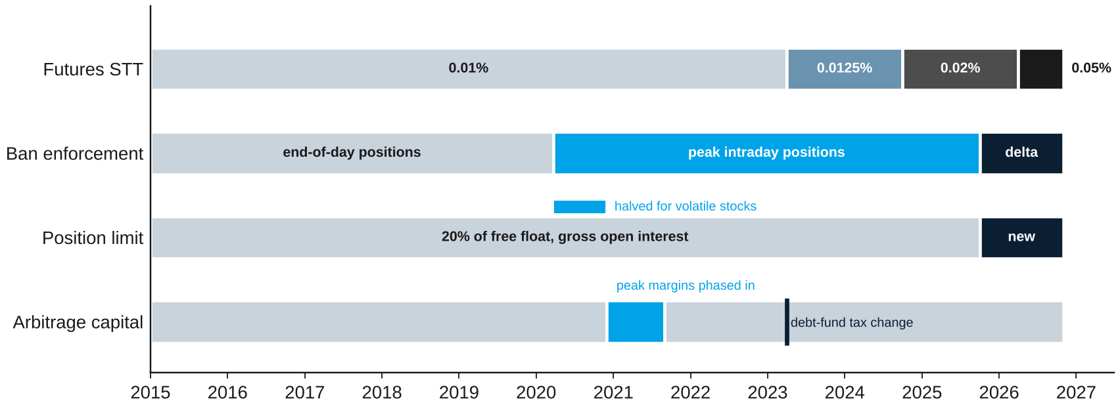
India changes almost every limit on a known date
The question and our approach
Futures STT, ban enforcement, the position-limit rule and arbitrage capital, 2015 to 2026
Dated rule changes let us measure each limit instead of assuming it
Source: SEBI circulars and press releases; NSE circulars; AMFI
Notes:
Dated rule changes are what make each limit measurable.

Slide 8
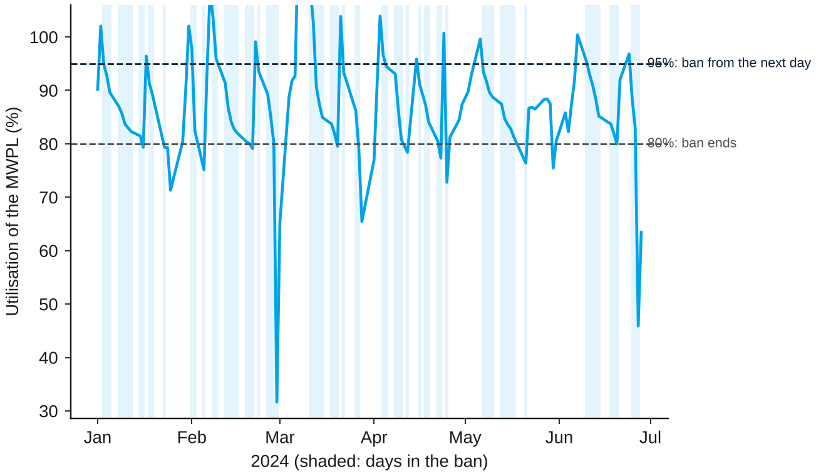
The F&O ban lets every trader only reduce positions
The question and our approach
Utilisation of the position limit for SAIL, the most-banned stock, January to June 2024
How the rule works
Enter the day after open interest exceeds 95% of the market-wide position limit
Leave after it falls to 80%
In between, everyone may only reduce positions, in all expiries
1,788 spells in 141 stocks, 2015 to October 2026
To my knowledge, no study had estimated what this rule does to prices
Source: NSE archives; author's analysis
Notes:
The ban binds everyone, not only arbitrageurs. That is what makes it different from a cap on one trader.

Slide 9
We fixed the tests before looking at outcomes
The question and our approach
The five safeguards of the project
What we did
Why
1
Model
One model; every limit a parameter; each prediction with what would contradict it
Hypotheses are derived, not fitted
2
Frozen plan
Tests and signs fixed with a git time stamp on 5 November 2026
No choosing specifications after seeing results
3
Blind data
Built from public NSE files; treatment and outcome code kept apart
No peeking while the data are built
4
Estimator tests
Each estimator recovers known effects on simulated data
Methods checked before real data
5
Full reporting
Primary family Holm-corrected; nulls and contradictions kept
The failed prediction stays in
Source: NSE archives; author's analysis
Notes:
Order of work: model, frozen plan, blind data, estimator tests, full reporting.

Slide 10
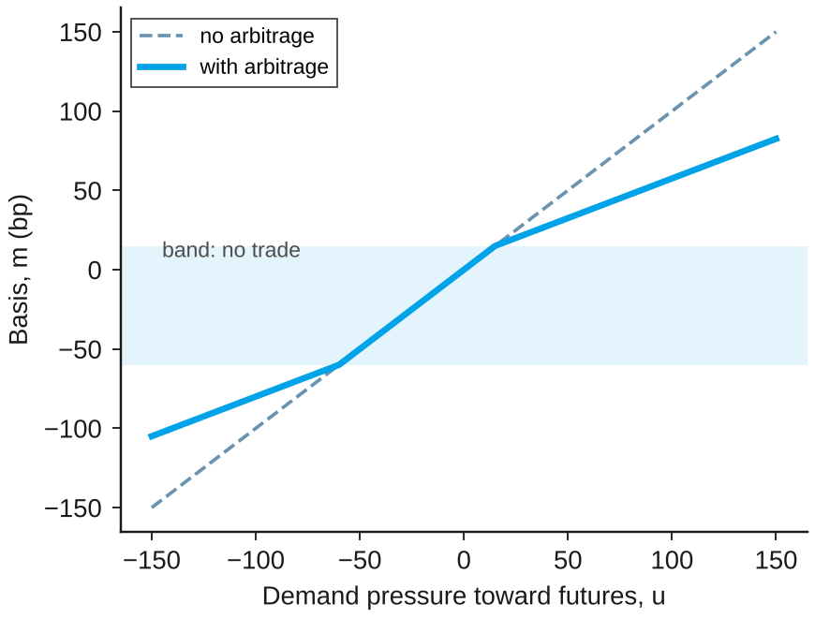
Costs set the band; a ban blocks two things
The question and our approach
Equilibrium basis against the demand pressure of outside traders, with illustrative costs
Band
Arbitrage starts only outside [-c-, c+]
Costs set the edges; capital and risk set how far the basis travels beyond them
Ban: arbitrage
Arbitrageurs may only reduce positions
Rich futures are no longer corrected
Ban: demand
New futures demand is blocked; part moves to the stock
This lowers the basis
So the ban's effect on the level has no fixed sign: it depends on what is blocked
Source: author's model (thesis, Chapter 4 and Appendix C); illustrative parameters, not estimates
Notes:
Inside the band the basis follows demand one for one. The ban removes new arbitrage and also blocks new futures demand.

Slide 11
Each hypothesis states what would contradict it
The question and our approach
Predictions derived from the model; the first four form the primary family
 | Prediction | Contradicted if
H8 | In a ban futures volume falls and every trade closes positions | Futures activity unchanged
H7 | In a ban rich futures revert more slowly, cheap ones as fast or faster | No asymmetry, or the opposite
H3 | Band edges move with the STT, more for larger increases | Edges unrelated to cost changes
H6 | F&O entry lowers price delay and bad-news drift; exit raises them | No change or the opposite
Level | The basis level at ban start follows the composition of open interest | Sign unrelated to composition
H9 | The upper tail grows smoothly as utilisation nears 95% | Jump only at 95%
H1, H4, H5 | Wider bands with frictions; scarcer capital widens; overpricing anomalies stronger where shorting is hard | No relation; symmetric effects
Source: frozen pre-analysis plan (git tag pap-v1, 5 November 2026)
Notes:
Primary family: H8, H7, H3, H6. Secondary tests are reported without adjustment.

Slide 12
The data come entirely from public NSE files
The question and our approach
Sources, coverage and the main checks
Bans and limits
Daily open interest, position limits and ban lists, February 2010 to October 2026
Next-day flags match the official ban list for 99.9% of stock-days
1,788
ban spells
Prices and basis
Futures and cash bhavcopies 2015 to 2026; basis from volume-weighted prices
Settlement prices avoided: they are set at cost of carry on thin days
486,040
stock-days of basis
Events
Results dated from the exchange's first dissemination time
239 entries into and 171 exits from the F&O segment
80,042
stock-quarters in the index
Capital, lending
AMFI arbitrage-fund flows and assets, April 2018 to September 2026
Daily securities-lending trades, 2015 to 2026
3,310
stocks in the cash market
Source: NSE archives; AMFI; OECD via FRED; author's analysis
Notes:
Everything is rebuilt by scripts; a full rerun reproduces every number.

Slide 13
The F&O ban

Slide 14
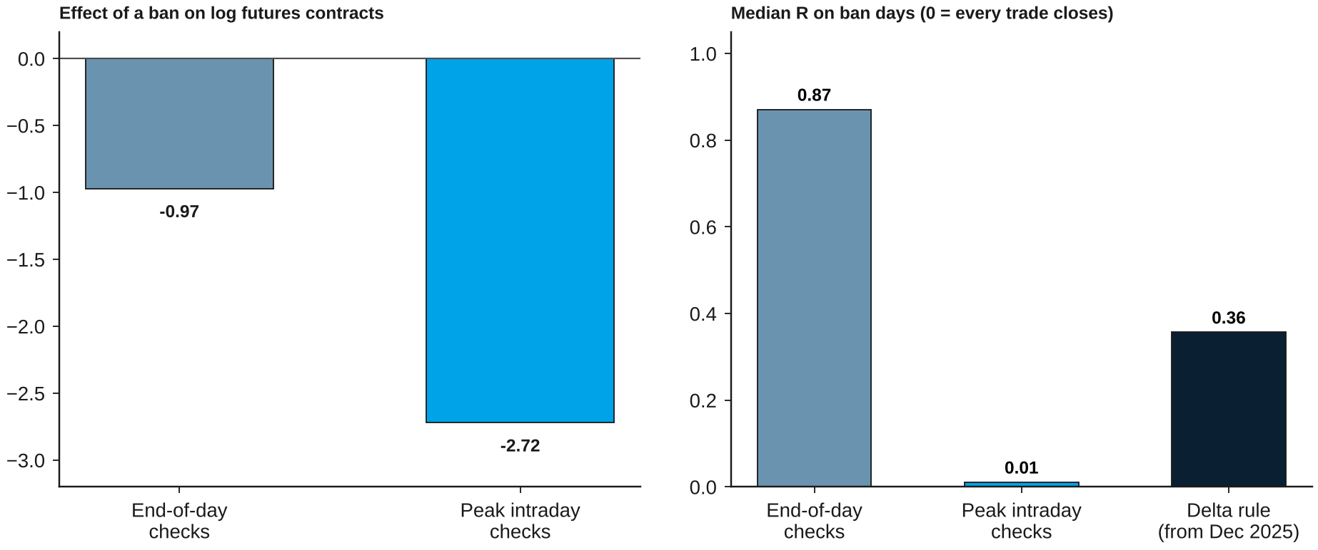
In a ban, futures trading collapses
The F&O ban
Effect of a ban on log futures contracts, and the median R on ban days, by enforcement regime
Futures volume falls by about 87% in a ban; cash trading rises and turns toward delivery
Source: NSE archives; author's analysis
Notes:
Pre-specified H8: -2.00 log points on futures volume, cash +7.5%, delivery share +4.1 points.

Slide 15
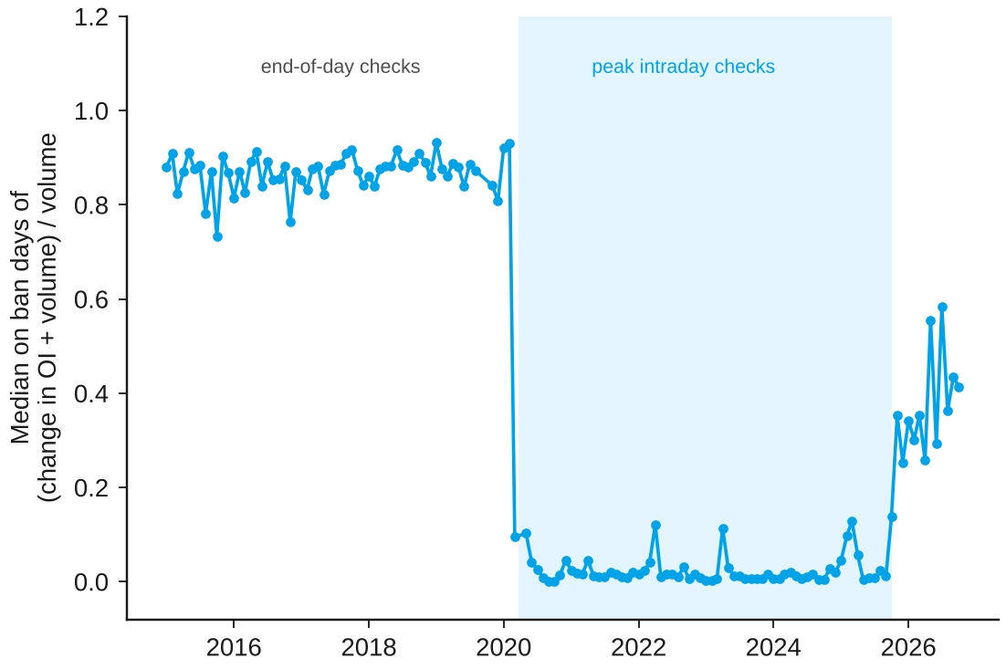
Intraday checks made the rule bind trade by trade
The F&O ban
Monthly median on ban days of R = (change in open interest + volume) / volume
What the chart shows
To 22 March 2020 violations were judged on end-of-day positions: median R 0.87
From 23 March 2020 on peak intraday positions: median R 0.011
From October 2025 the delta rule allows offsetting trades: 0.19 to 0.36
The rule changes trading as designed only when positions are checked during the day
Source: NSE archives; author's analysis
Notes:
R = 0 when every trade closes a long and a short. The break in March 2020 matches SEBI press release 18/2020.

Slide 16
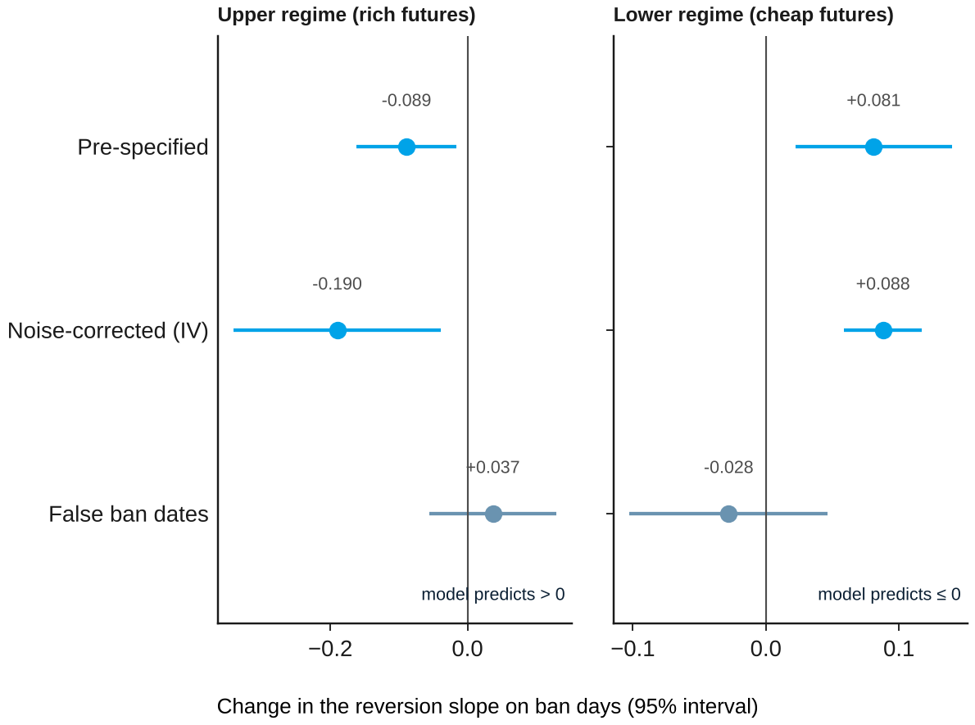
Correction is not one-sided: rich futures revert faster
The F&O ban
Change in the reversion slope on ban days, by regime, with 95% intervals
Why it matters
Predicted: slower reversion of rich futures (above 0)
Found: -0.089 (s.e. 0.037); cheap futures revert more slowly
Robust: -0.190 when instrumented; +0.037 at false ban dates
Timing: concentrated in the first five days of a spell
The pre-specified prediction failed, with the opposite sign
Source: NSE archives; author's analysis
Notes:
The prediction came from the reduce-only arbitrage channel alone. The opposite sign survives a noise correction.

Slide 17
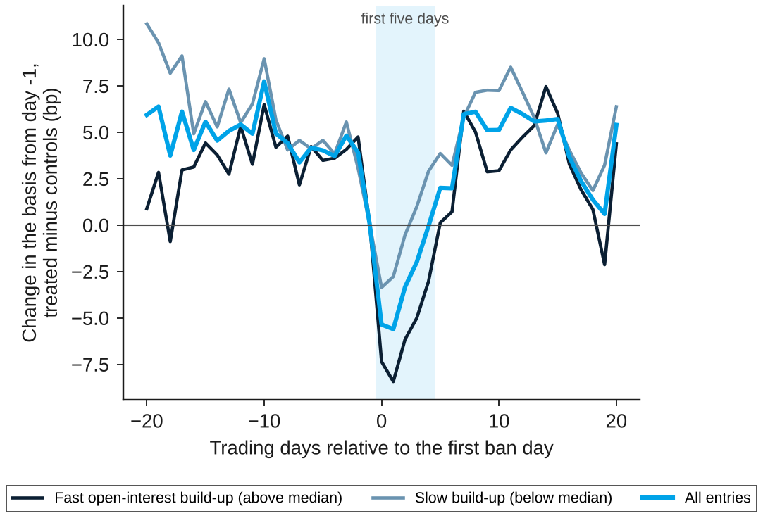
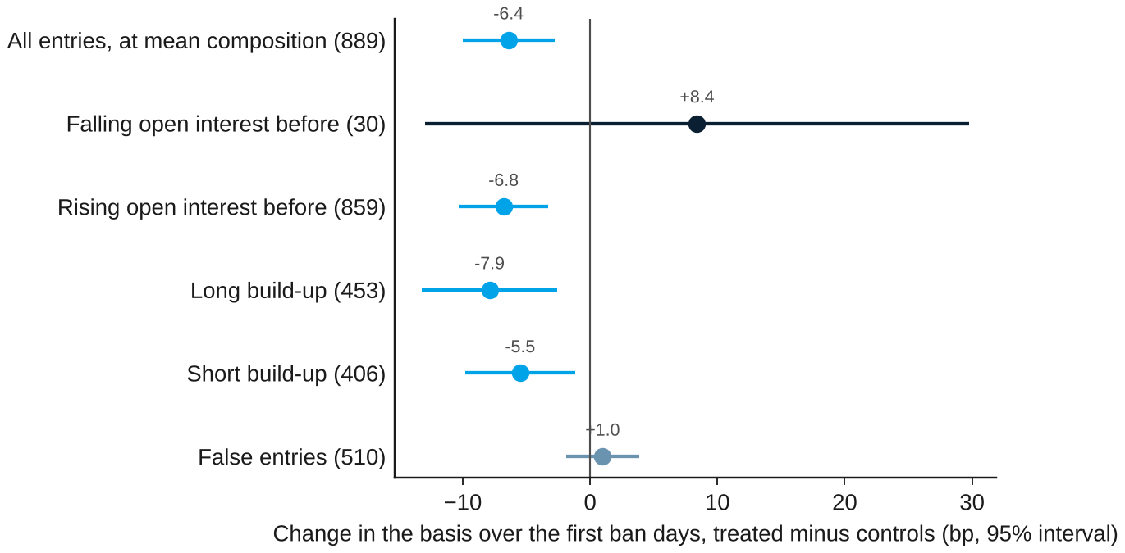
The basis falls when a ban starts, then recovers
The F&O ban
Change in the basis around ban entry, treated minus matched controls (bp)
About -6 bp in the first days, more after fast build-ups
Both long and short build-ups; nothing at false entries
Blocked new futures demand fits both facts, a reading formed after the results
Source: NSE archives; author's analysis
Notes:
889 matched entries, 2015 to September 2025. Controls: same week, 85 to 95% utilisation, matched on path and basis.

Slide 18
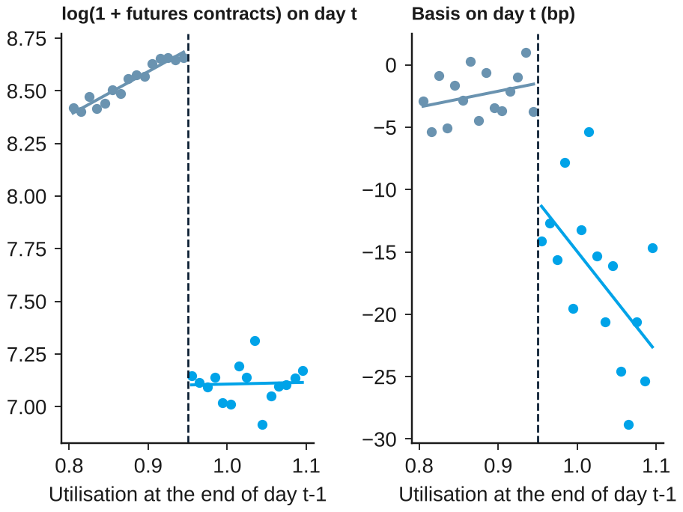
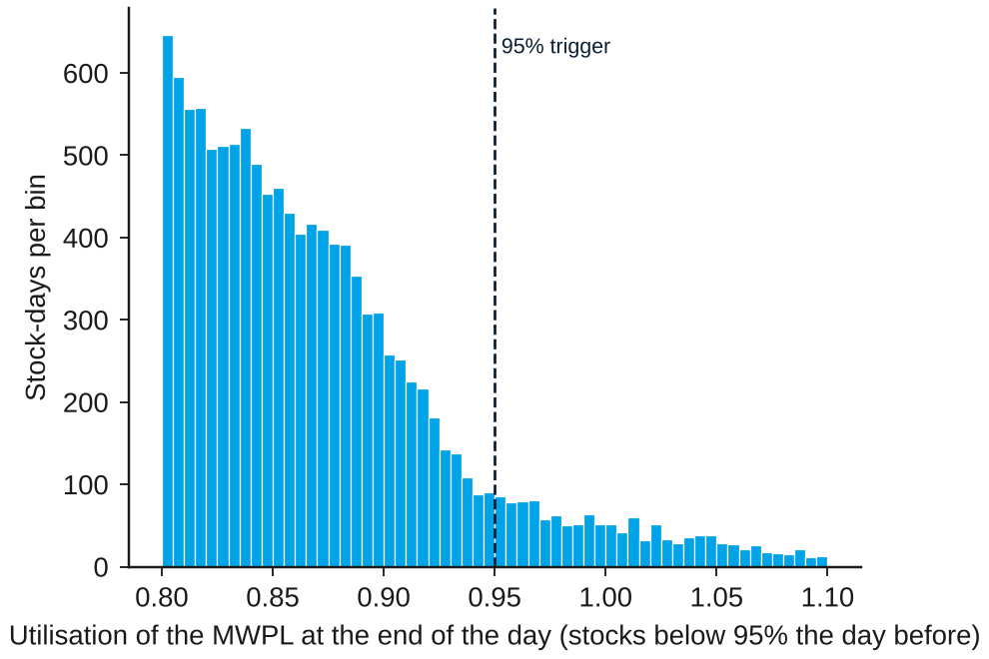
Traders do not hold back below the 95% trigger
The F&O ban
Utilisation around the trigger, and outcomes on either side of it
No bunching below 95% (density test p = 0.86)
Futures trading drops at 95%; the basis is lower above it
The trigger works mechanically; the basis gap is already there the day it is crossed
Source: NSE archives; author's analysis
Notes:
Density test p = 0.86. Regression discontinuity: futures -1.53 log points; basis -12.9 bp, but already -11.3 on the crossing day.

Slide 19
The band: costs, capital and position limits

Slide 20
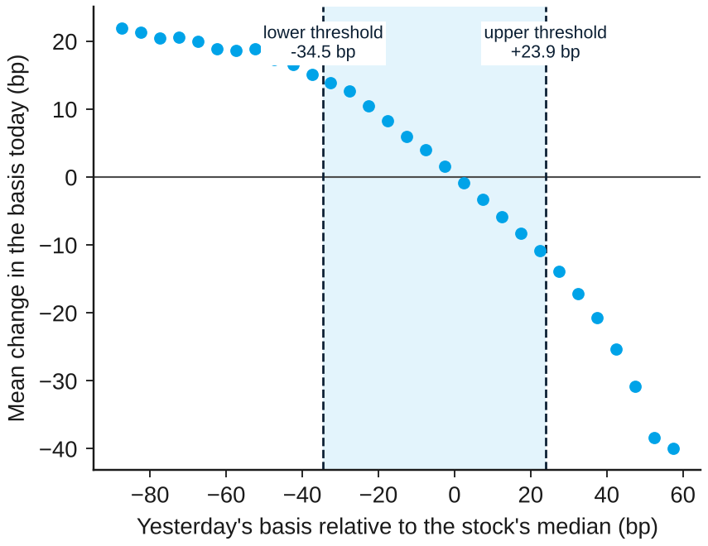
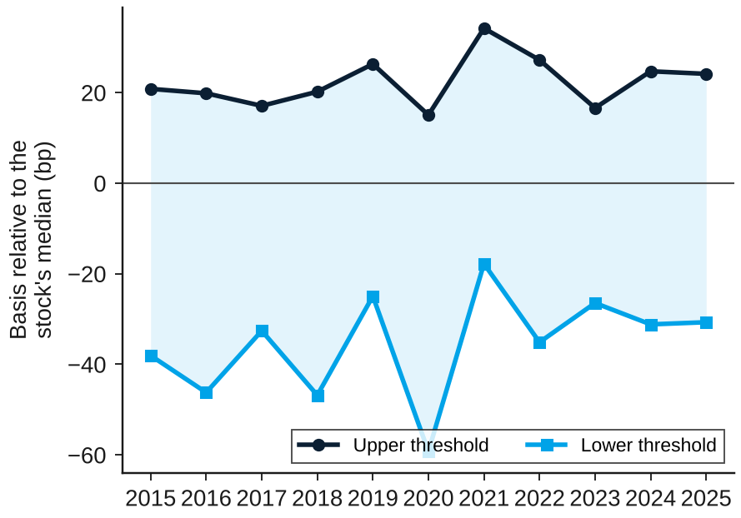
The basis moves in a wide, asymmetric band
The band
Pooled threshold model, non-ban days, 2015 to 2026 (473,110 observations, 360 stocks)
Reversion grows with the deviation; band -34.5 to +23.9 bp
Stable across years, apart from March 2020
Much daily reversion is price noise; where the band lies is the robust part
Source: NSE archives; author's analysis
Notes:
Linearity rejected (sup-F 7,471). Instrumenting with the deviation two days earlier shrinks all slopes: daily reversion is mostly noise.

Slide 21
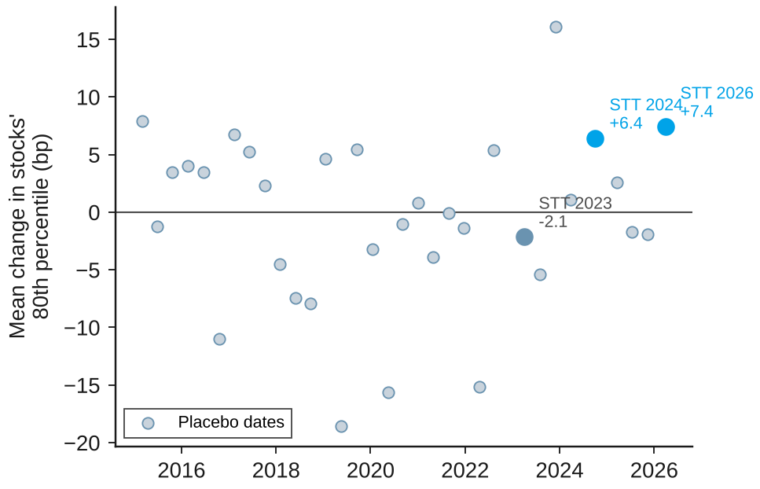
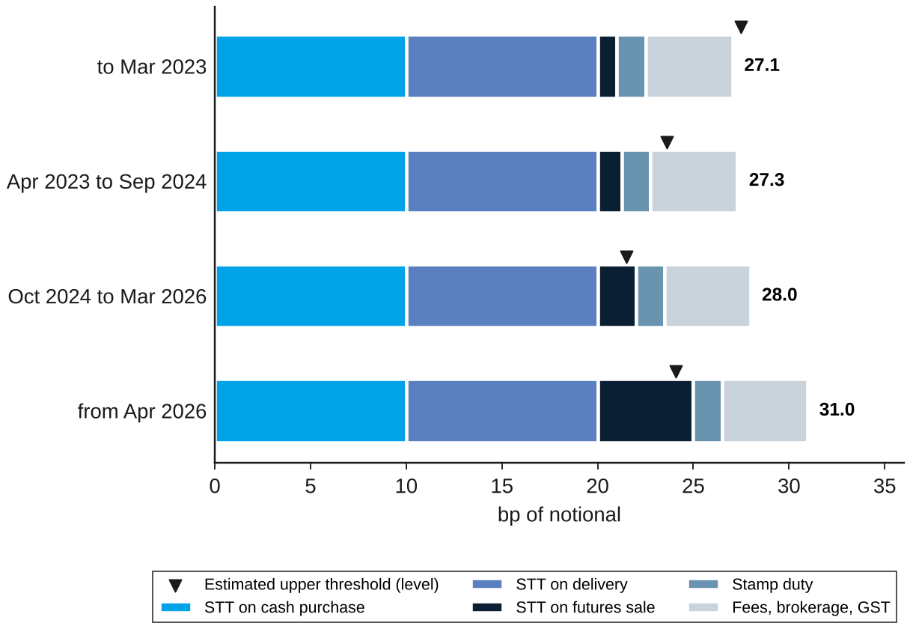
Tax rises lifted the whole distribution
The band
Change in stocks' 80th percentile at STT dates, and the bottom-up cost of a new position
Large changes, but within the range of placebo dates
A new round trip costs 27 to 31 bp, above the upper edge
New capital enters only at large gaps; funds that roll lean against small ones (4 to 8 bp)
Source: NSE archives; author's analysis
Notes:
Pre-specified H3: +6.96 bp pooled. Placebo standard deviation 7.4 bp; true changes rank at the 10th and 7th percentiles.

Slide 22
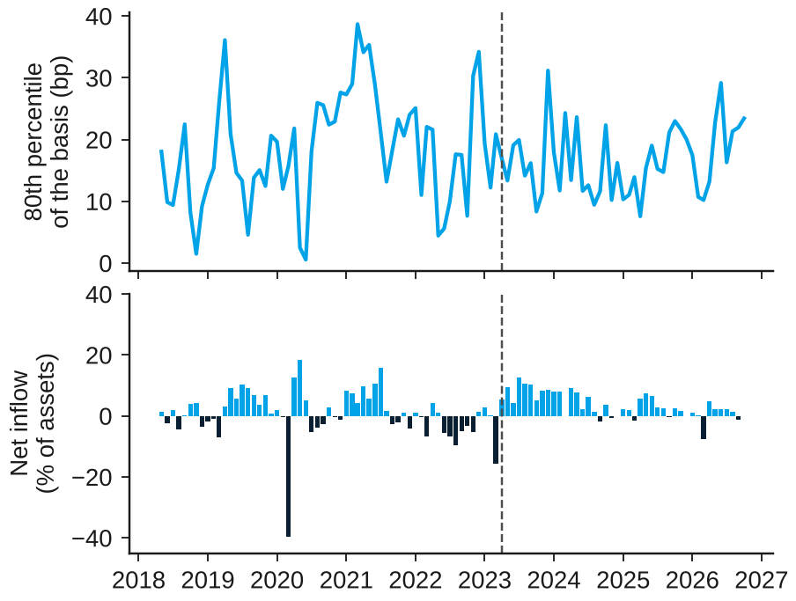
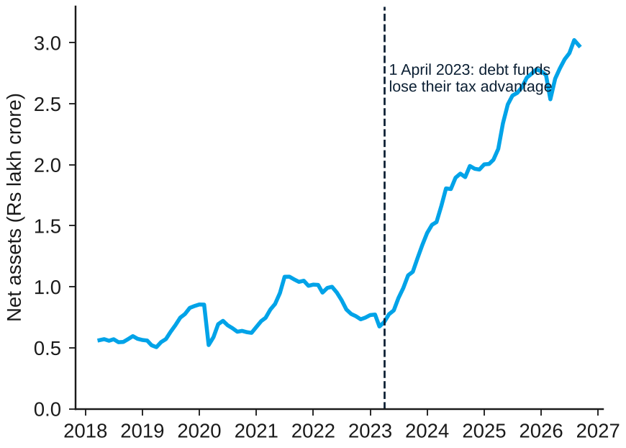
Arbitrage capital leaves weak traces
The band
Arbitrage-fund flows, assets and the upper tail of the basis, monthly
Inflows go with a lower upper tail next month (p = 0.11)
Fund assets quadrupled after debt funds lost their tax edge
The link is clearer month on month and before 2023, and invisible after
Source: AMFI monthly reports; NSE archives; author's analysis
Notes:
Pre-specified H4: -17.5 bp per unit of flow, p = 0.11. First differences -20.6 (s.e. 6.8).

Slide 23
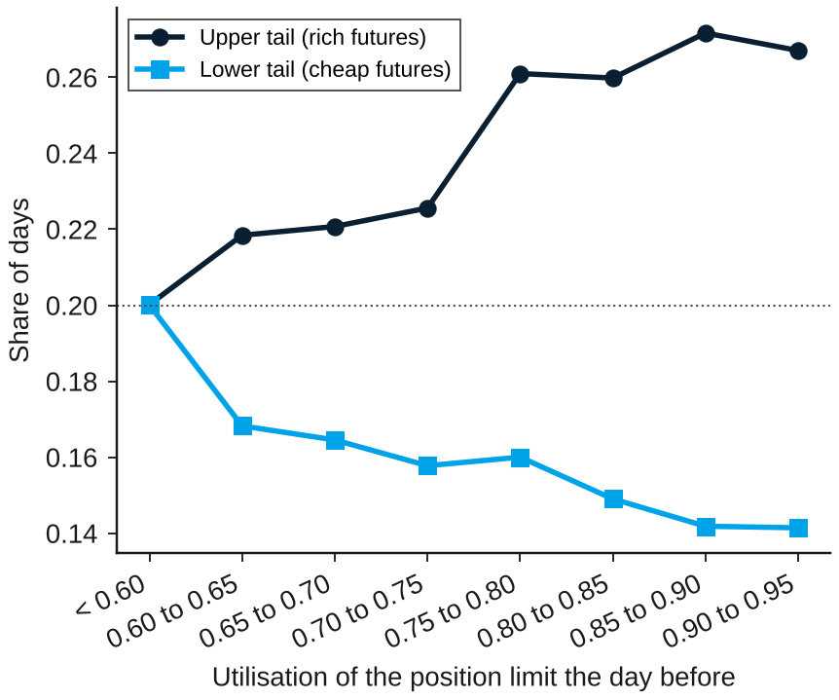
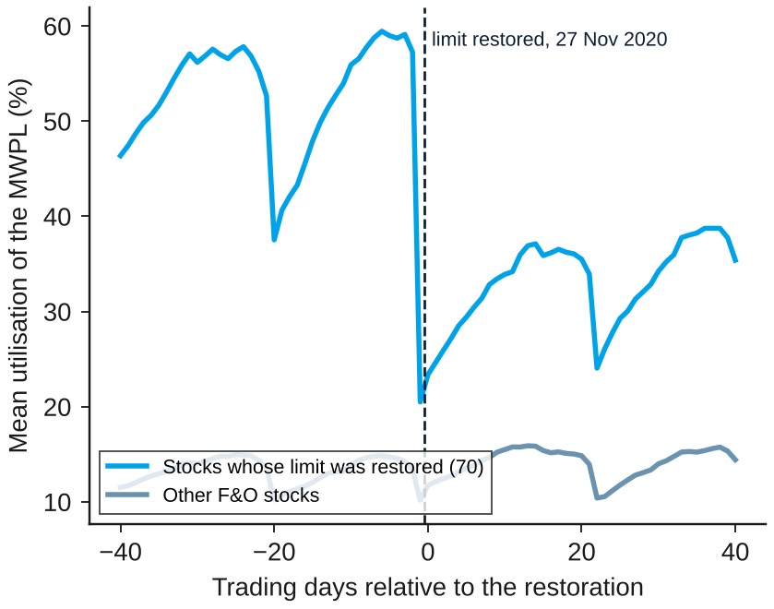
Rich futures become more common near the trigger
The band
Upper-tail share by utilisation, and the 2020 restoration of halved limits
The upper-tail share rises from 0.20 to 0.27 (p = 0.019)
Restoring halved limits cut utilisation at once
The level of the limit matters for prices even before a ban starts
Source: NSE archives; author's analysis
Notes:
H9 slope +0.079 (p = 0.019). Restoration on 27 November 2020: utilisation -0.21, ban days -4.6 points, upper tail -6.8 points.

Slide 24
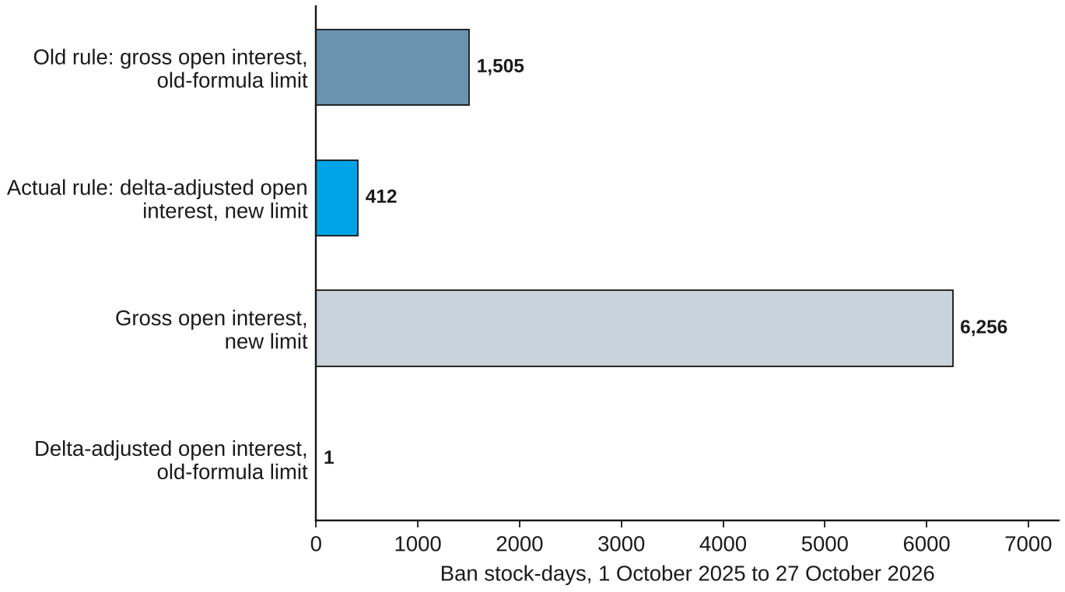
The 2025 rules cut ban days by about three quarters
The band
Ban stock-days, 1 October 2025 to 27 October 2026, actual and counterfactual rules
What the reform did
Aim: SEBI set out to reduce 'spurious' bans
Before 2025 bans came from rising open interest; only 0.4% from a falling limit
Delta-adjusted open interest removes almost all bans; the lower limit alone would have quadrupled them
Net: 412 ban days against 1,505 under the old rule
The reform met its stated aim
Source: NSE archives; author's analysis
Notes:
The simulated ban rule reproduces the official lists exactly. The old-formula limit is an approximation.

Slide 25
Short-sale constraints

Slide 26
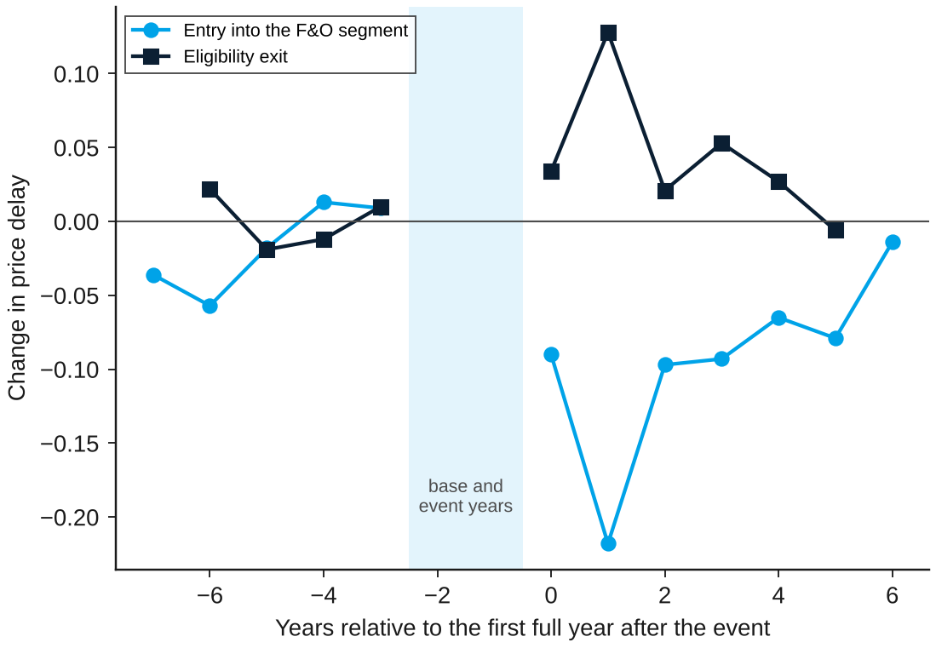
F&O entry speeds up how prices respond to news
Short-sale constraints
Change in price delay by year relative to the first full year after entry or exit
Component | Estimate | p
Entry: price delay | -0.109 | 1e-6
Entry: bad-news drift | -0.040 | 0.99
Exit: price delay | +0.053 | 0.09
Exit: bad-news drift | +0.014 | 0.77
Prediction: entry lowers delay and drift; exit raises them
Delay falls by 0.11 after entry (median 0.24 before); drift after bad news does not weaken
Source: NSE archives; author's analysis
Notes:
Callaway and Sant'Anna estimator; Sun and Abraham gives -0.063. Drift after bad news becomes stronger after entry, not weaker.

Slide 27
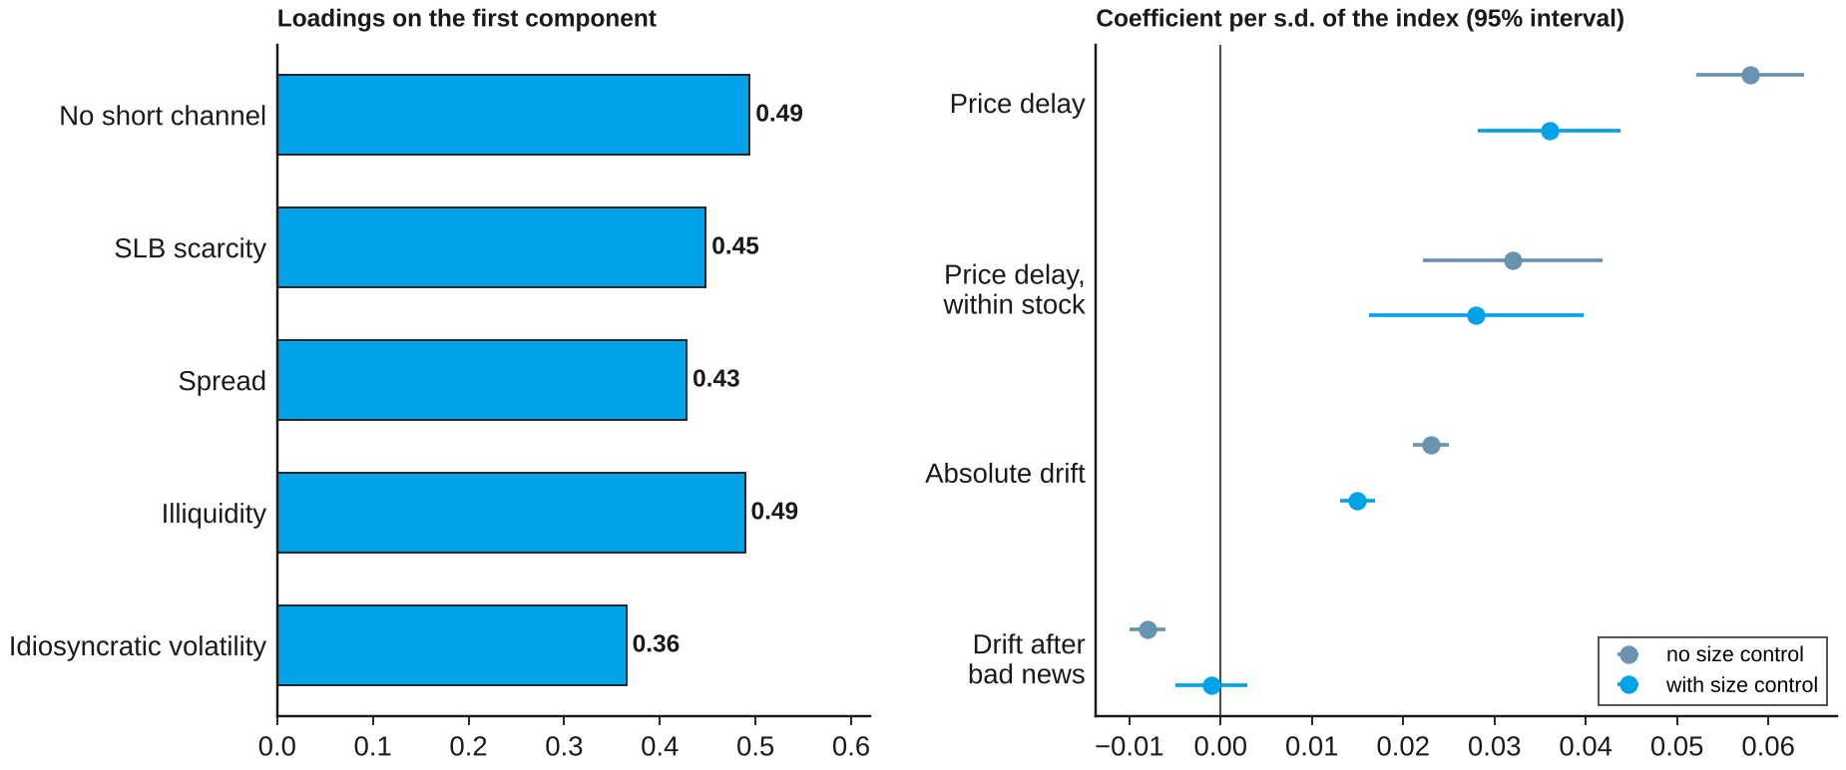
Constrained stocks adjust more slowly, market-wide
Short-sale constraints
A quarterly index from five frictions for all NSE stocks: loadings and validation
The link with price delay survives a size control; the bad-news link is a size effect
Source: NSE bhavcopies and SLB files; AMFI market capitalisation; author's analysis
Notes:
80,042 stock-quarters, 3,310 stocks. Associations, not causal effects.

Slide 28
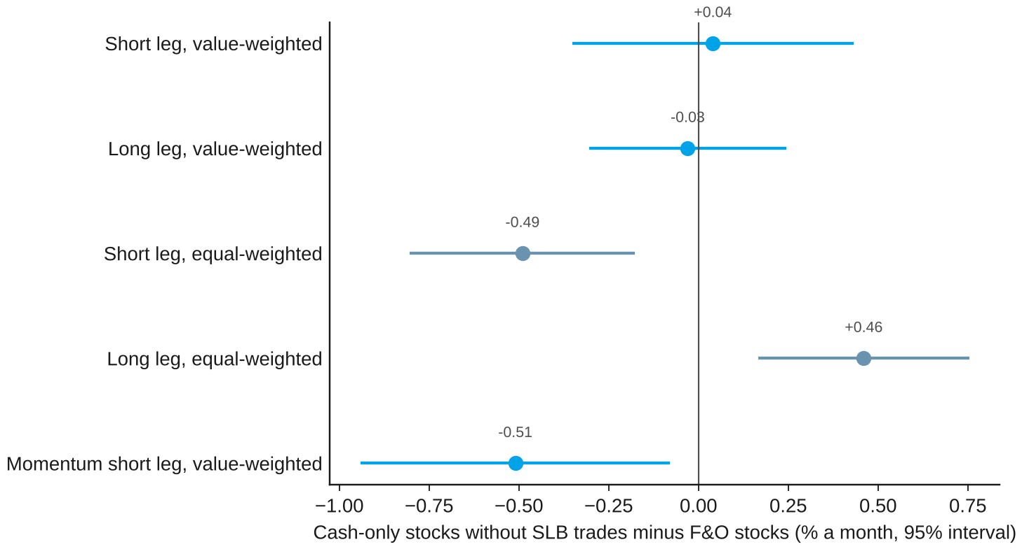
Anomalies are not one-sided where shorting is hard
Short-sale constraints
Cash-only stocks without lending minus F&O stocks, % a month
What the chart shows
Value-weighted, the overpriced side does no worse where shorting is hardest
Equal-weighted, anomalies are stronger among small cash-only stocks, on both sides
Momentum alone fits the prediction (-0.51%)
Groups differ greatly in size, which limits what this comparison can show
Source: NSE archives; author's analysis
Notes:
Pre-specified H5: short-leg difference +0.04% (s.e. 0.20), p = 0.57.

Slide 29
Conclusion and policy

Slide 30
Limits bind hard on trading, less cleanly on prices
Conclusion
What each limit does, and how strong the evidence is
Limit | On trading | On prices | Main evidence
Position limits | Strong | Real, not one-sided | Volume -2 log points; basis -6 bp at ban start; 2025 rules cut bans by three quarters
Short-sale constraints | Not tested | Speed of adjustment | Delay -0.11 after F&O entry; no effect on bad-news drift or overpricing
Trading costs | Not tested | Set the band | Band -35 to +24 bp; new round trip in the outer tail; edges not one-for-one with the tax
Arbitrage capital | Not tested | Weak | Inflows go with a lower upper tail (p = 0.11); clearer in differences
Position limits matter most; costs shape the band; capital is a weak force
Source: NSE archives; author's analysis
Notes:
Position limits matter most; costs set the band; capital is a weak force; short-sale access matters for speed.

Slide 31
Bans restrain demand at the cost of arbitrage
Conclusion
What the evidence shows, and what it implies for the rules
What the evidence shows
What it implies
A ban cuts futures volume by almost 90%
Its price effect appears at the start of a ban and fades within a week
The rule bites as designed only under intraday checks
The 2025 rules cut ban days by about three quarters
A ban blocks the speculative demand it targets, and the arbitrage that keeps prices together
Enforcement matters as much as the threshold
Measuring open interest in delta terms removes avoidable bans
F&O access has a measurable benefit: faster price adjustment
-87%
~1 week
-73%
93%
futures volume in a ban
for the price effect to fade
ban days, 2025 rules against old
of individual F&O traders lost money, FY22 to FY24
Limits restrain a large speculative demand, and arbitrage pays part of the price
Source: author's analysis; SEBI press release 22/2024; SEBI circulars 2024/132 and 2025/79
Notes:
SEBI's study: 93% of over one crore individual F&O traders lost money in FY22 to FY24, more than Rs 1.8 lakh crore in total.

Slide 32
Four limitations we know about
Conclusion
Limitation
What could go wrong
...and what I did
Daily data
Intraday arbitrage is out of scope, and noise inflates measured reversion
Noise-corrected estimates reported alongside
Inventory unobserved
The model's arbitrage book is not seen in public data
Composition of open interest used as a proxy
Short post-reform sample
Only 44 ban spells since October 2025
Post-reform results labelled low-powered
Size confounds
Constrained stocks are much smaller
Size controls; F&O entry as a within-stock design
Intraday data and a longer post-reform sample would sharpen the ban tests
Source: NSE archives; author's analysis
Notes:
Next steps: intraday data, a longer post-reform sample, and the three papers that could not be read in full.

Slide 33
Limits to arbitrage in Indian equities
Thank you
November 2026
Prince Kumar (23B3032)
Guide: Prof. Aditi Chaubal, Department of Economics, IIT Bombay

Slide 34
Appendix

Slide 35
All pre-specified tests
Appendix
Primary family (Holm) and secondary tests (unadjusted)
Test | Result | Comment
H8 trading | Supported (p < 1e-10) | Identity holds under intraday enforcement
H3 costs | Supported (p < 1e-10) | Weak against placebos; mostly a common shift
H6 short-sale access | Supported (p = 5e-6) | Through price delay; drift goes the other way
H7 one-sided correction | Rejected, opposite sign | Survives a noise correction
Level effect | p = 0.083 | Signs as predicted; median split p = 0.025
Density, RD at 95% | p = 0.86; -12.9 bp | No bunching; gap present before the ban
Hysteresis | +0.4 bp, p = 0.64 | No extra level shift
H9 anticipation, reform | p = 0.019; p = 0.11 | Upper tail grows toward 95%; reform right sign
H2, H1, H4, H5 | p = 0.59, 0.002, 0.11, 0.57 | No power; across stocks only; weak; not supported
Source: author's analysis; thesis, Table 9.1
Notes:
Secondary tests read as a pattern; one or two values below 0.05 would be expected by chance.

Slide 36
How the data were built and checked
Appendix
Bans
Next-day flags agree with the official list for 11,753 of 11,764 flags
95% entry and 80% exit rules hold for 99.4% and 99.7% of spells
Basis
Volume-weighted futures and cash prices, net of dividends and carry
Contracts with dividends or corporate events in their life excluded
Results dates
Earliest of the exchange's announcement and the filing; board meetings fill gaps
Covers 98% to 100% of F&O stock-quarters
Reproduction
One script sequence produces every estimate; a full rerun reproduced every number
Each estimator first recovered known effects on simulated data
Source: author's analysis; thesis, Chapter 5 and Appendix B
Notes:
Every data set is rebuilt from raw files by scripts with a report of counts and checks.

Slide 37
The model's eleven results map onto the tests
Appendix
Result | Statement | Tested by
1-2 Band | Arbitrage only outside [-c-, c+]; costs set the edges, capital the passthrough | H3, H4, band chapter
3 Inventory | The no-trade region moves with the existing book | Estimator tests
4 One-sided | In a ban rich futures are not corrected; cheap ones are while inventory lasts | H7
5-6 Demand, level | Blocked new demand reverses its effect; the level effect has no fixed sign | Level effect
7 Trading | Contract-by-contract enforcement makes every trade close positions | H8
8-9 Anticipation | The upper edge rises toward 95%; the limit is not an instrument for bans | H9, density, RD
10-11 Short sales | Bad news slower without a short channel; Miller overpricing | H2, H5, H6
Source: author's model (thesis, Appendix C)
Notes:
All closed forms were checked numerically against a brute-force solver.

