Slide 1
Hyper Text Markup Language
A markup language is a set of markup tags
HTML documents are described by HTML tags
Each HTML tag describes different document content

Slide 2
Brief History
Wats New In HTML5
HTML5 Features
Understand DOCTYPE

Slide 3
HTML Evolution
1990 – HTML 1.0
HTML 2.0
HTML3.0
2000 – HTML 4.0
2010 – HTML 5

Slide 4
History
Two groups working on it
WHATWG - Web HyperText Application Technology Working Group
W3C - World Wide Web Consortium

Slide 5
Multiple Front End Technologies
> Flash
>Silver Light
> Flex etc…
Plugin Dependencies , Security Threats … etc

Slide 6
What is HTML5????
HTML5 = MARKUP + API

Slide 7
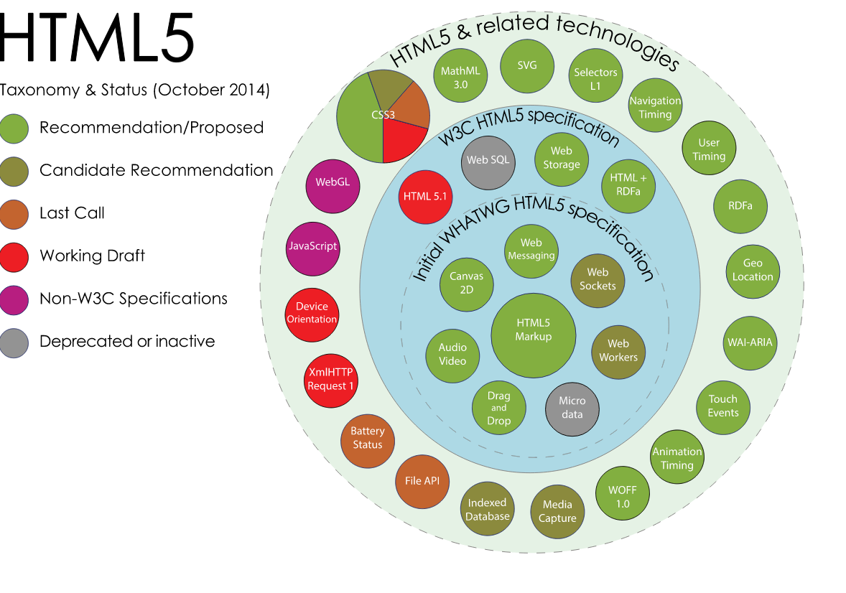

Slide 8
<!DOCTYPE root-element PUBLIC "FPI" ["URI"] [ <!-- internal subset declarations --> ]>
<!DOCTYPE HTML PUBLIC "-//W3C//DTD HTML 4.01//EN" "http://www.w3.org/TR/html4/strict.dtd">
Formal Public Identifier (FPI) is a short piece of specially formatted text that may be used to uniquely identify a product, specification or document

Slide 9
A document type declaration, or DOCTYPE, is an instruction that associates a particular webpage with a document type definition (DTD)
XHTML's DTDs are also Strict, Transitional and Frameset.

Slide 10
XHTML Strict DTD. No deprecated tags are supported and the code must be written correctly.
XHTML Transitional DTD is like the XHTML Strict DTD, but deprecated tags are allowed.
XHTML Frameset DTD is the only XHTML DTD that supports Frameset. The DTD is below.

Slide 11
HTML5 uses a DOCTYPE declaration which is very short, due to its lack of references to a DTD in the form of a URL or FPI. All it contains is the tag name of the root element of the document, HTML
<!DOCTYPE html>, case-insensitively.

Slide 12
Character encoding
computers deal in bits and bytes
Every piece of text you've ever seen on a computer screen is actually stored in a particular character encoding
Prev HTML versions
<meta http-equiv="Content-Type" content="text/html; charset=UTF-8">
HTML5
<meta charset="character_set">
Character set : Specifies the character encoding for the HTML document.

Slide 13
MarkUp
<!DOCTYPE html> <html> <head> <meta charset="UTF-8"> <title>Title of the document</title> </head> <body> Content of the document...... </body> </html>

Slide 14



Slide 15
New Elements
The most interesting new elements are:
New semantic elements like <header>, <footer>, <article>, and <section>.
New form controls like number, date, time, calendar, and range.
New graphic elements: <svg> and <canvas>.
New multimedia elements: <audio> and <video>.

Slide 16
New HTML5 API's
HTML Geolocation
HTML Drag and Drop
HTML Local Storage
HTML Application Cache
HTML Web Workers

Slide 17
Structural Elements
HTML5 = More Meaningful Markup ...not just DIVs and SPAN
multiple divs clubbed together to form website for instance

Slide 18
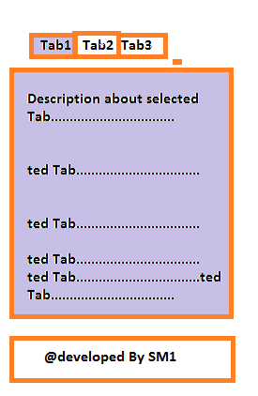

Slide 20
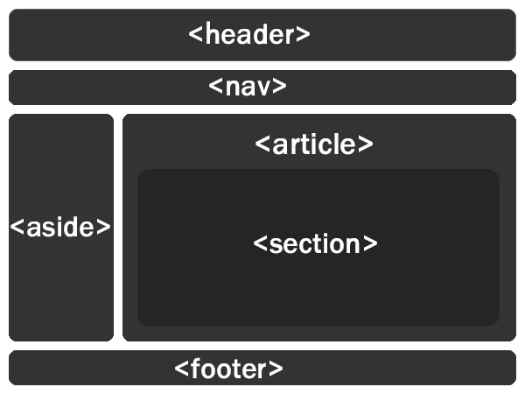

Slide 21
Aside : section of a page that consists of content that is tangentially related to the content around the aside element, and which could be considered separate from that content
Section : represents a generic document or application section. A section, in this context, helps to break content of page into different areas, categories or sections
Article : represents a component of a page that consists of a self-contained composition in a document, page, application, or site and that is intended to be independently distributable or reusable, e.g. in syndication
Footer :represents a footer for its nearest ancestor sectioning content or sectioning root element
Sections can contain Article & vice versa

Slide 23
<figure> and <figcaption> Elements
Captions with images
<figure> <img src="pic_mountain.jpg" width="304" height="228"> <figcaption>Fig1. - The Pulpit Rock, Norway.</figcaption> </figure>

Slide 24

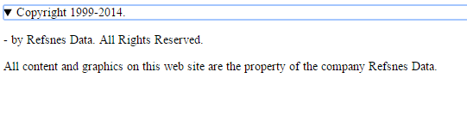
Summary & Details Tag
The <summary> tag defines a visible heading for the <details> element. The heading can be clicked to view/hide the details.

Slide 25
<details> <summary>Copyright 1999-2014.</summary> <p> - by Refsnes Data. All Rights Reserved.</p> <p>All content and graphics on this web site are the property of the company Refsnes Data.</p> </details>

Slide 27
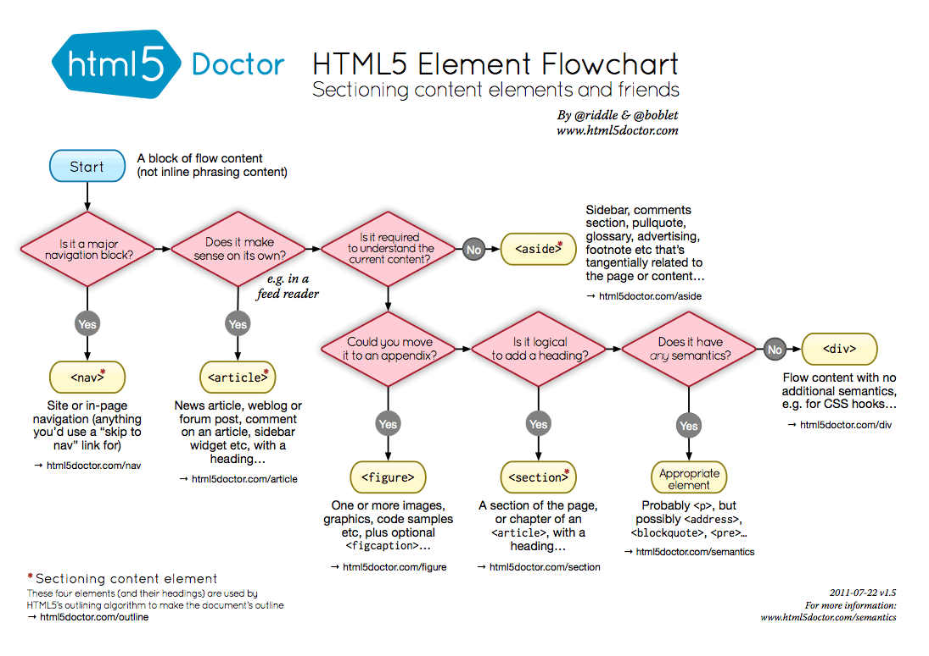

Slide 28

Browser support:
Caniuse.com

Slide 29
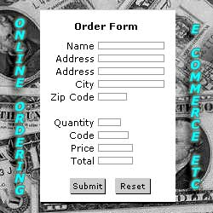
Form

Slide 30
HTML Form Attributes
<form> form elements </form>
action attribute defines the action to be performed when the form is submitted.
<form action="action_page.php">
<form action="action_page.php" method="GET">

Slide 31
Action
Method
Target
accept-charset
Autocomplete : Specifies if the browser should autocomplete the form (default: on)
NoValidate
<form action="action_page.php" method="GET" target="_blank" accept-charset="UTF-8" enctype="application/x-www-form-urlencoded" autocomplete="off" novalidate>

Slide 32
Input Text
<input type="text">
defines a one-line input field for text input:
<form> First name:<br> <input type="text" name="firstname"> <br> Last name:<br> <input type="text" name="lastname"> </form>

Slide 33
Radio Input
<form> <input type="radio" name="sex" value="male" checked>Male <br> <input type="radio" name="sex" value="female">Female </form>

Slide 34
Submit Input
<form action="action_page.php"> First name:<br> <input type="text" name="firstname" value="Mickey"> <input type="submit" value="Submit"> </form>

Slide 35
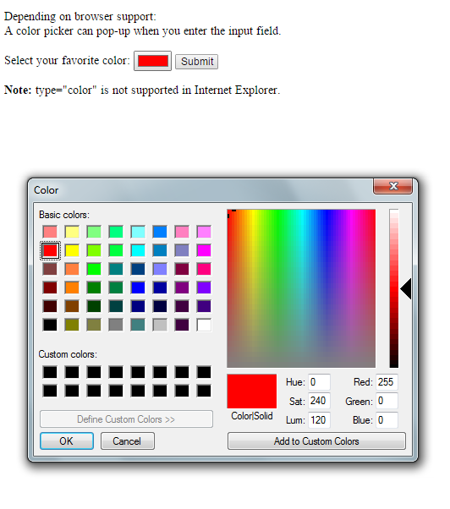
color

Slide 36
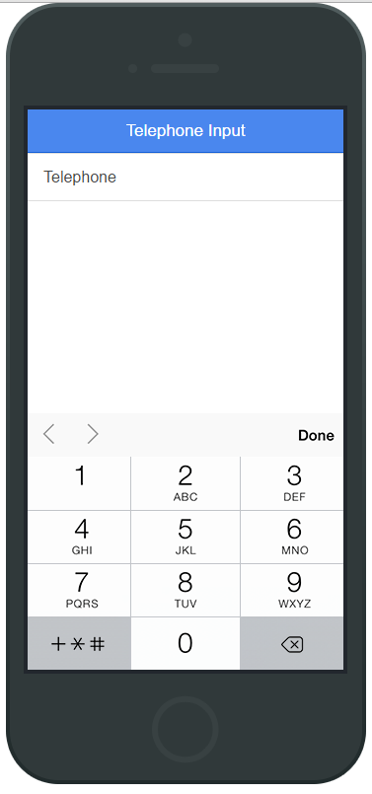
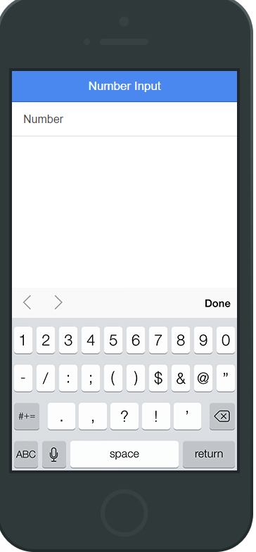
number
tel

Slide 37
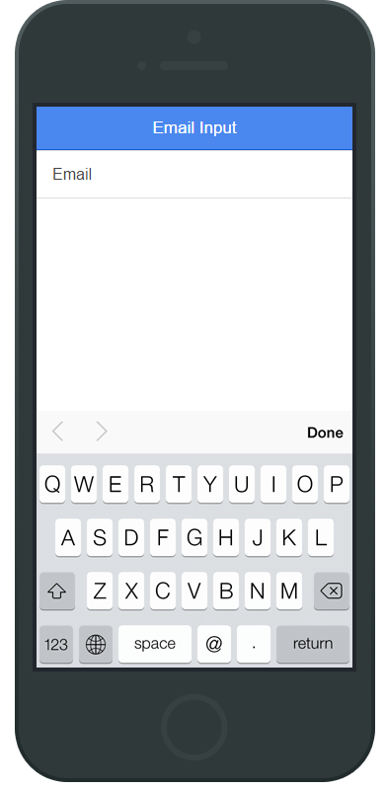
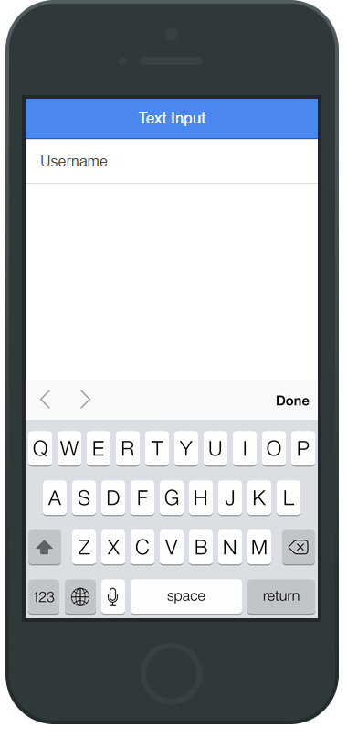
email
text

Slide 38
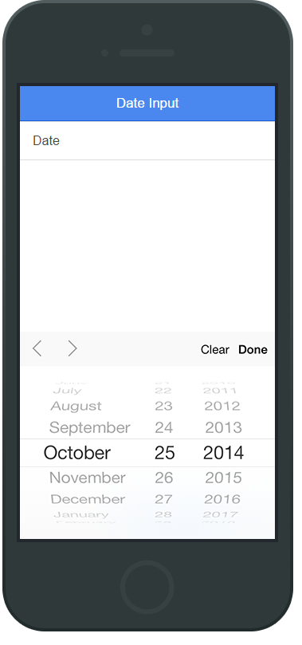
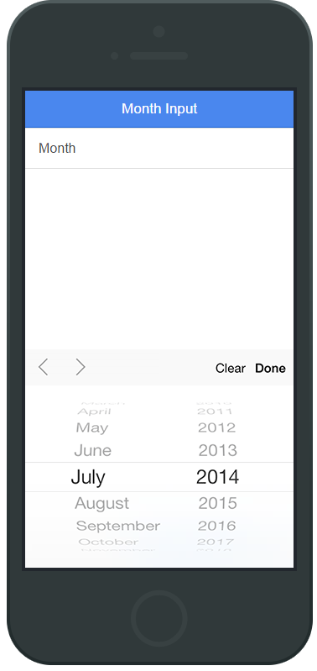
date
month

Slide 39
Input Restrictions
max | Specifies the maximum value for an input field
min | Specifies the minimum value for an input field
pattern | Specifies a regular expression to check the input value against
required | Specifies that an input field is required (must be filled out)

Slide 40
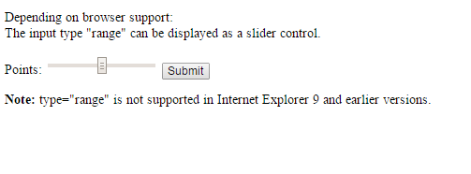
range

