Slide 1
Game AI
Project 1: simple strategies for turn-based games
Alina Arunova
Phil Matyash
Marina Mircheska
Aditya Kela
Sattar Rahimbeyli
Notes:
1

Slide 2
Task 1.2 Simple Strategies for Tic Tac Toe
Getting started
Random moves are random
Random moves != random chances
Random vs Random will result almost the same way
Notes:
2

Slide 3
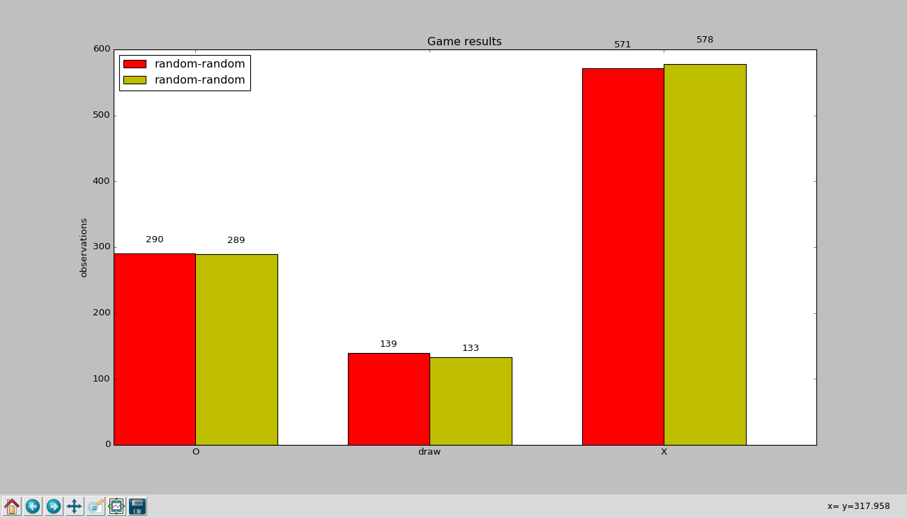
Task 1.2 Simple Strategies for Tic Tac Toe
Getting started
Notes:
3

Slide 4
Task 1.2 Simple Strategies for Tic Tac Toe
Probabilistic strategy
The idea:
play a statistically sufficient number of games
rank points on a tic-tac-toe 3x3 board according to their win participation
use ranks in decision-making going from top ranked down
The approach:
weights = {} for point in points: weights[point] = sum([1/len(winStates) for winState in winStates if point in winState])
Notes:
4

Slide 5
Task 1.2 Simple Strategies for Tic Tac Toe
Probabilistic strategy
The results (odds):
47% | 39% | 45%
37% | 61% | 38%
48% | 37% | 50.5%
Notes:
5

Slide 6
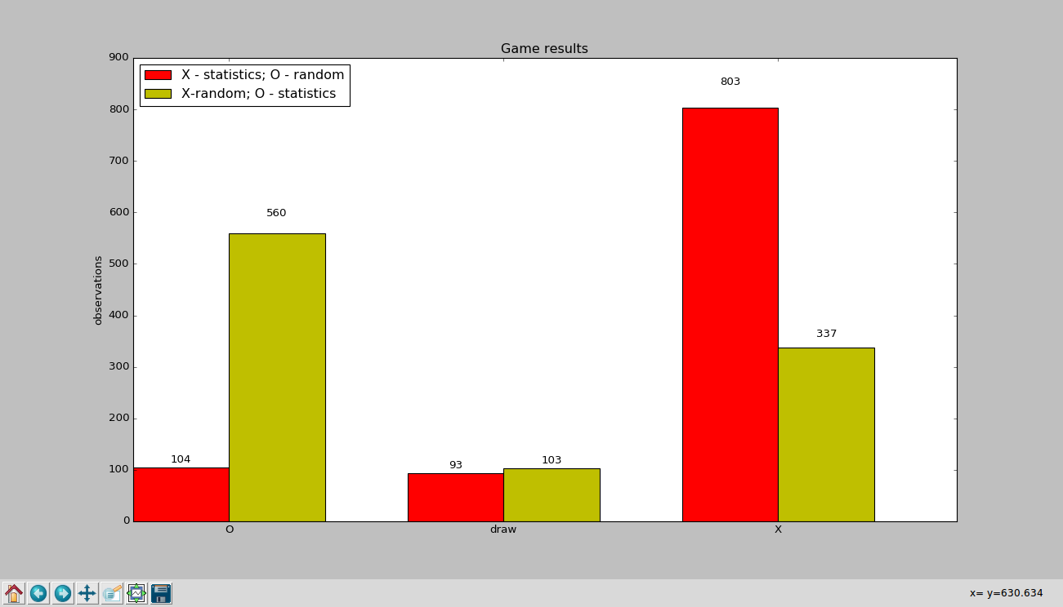
Task 1.2 Simple Strategies for Tic Tac Toe
Probabilistic strategy
Notes:
6

Slide 7
Task 1.2 Simple Strategies for Tic Tac Toe
Heuristic strategy
The idea:
evaluation (utility) function + depth-one-search combo-wombo
benefits:
low complexity and therefore fast calculations
drawbacks:
lower chances to win comparing to full-tree-search
Approach:
function eval(S,p): return n_winning_states(S, p) - n_winning_states(S, -1*p)
depth-one-search algorithm is here to make sure a player p will not lose in the next step. (e.g. to move accordingly if there is a threat of loosing)
Notes:
7

Slide 8
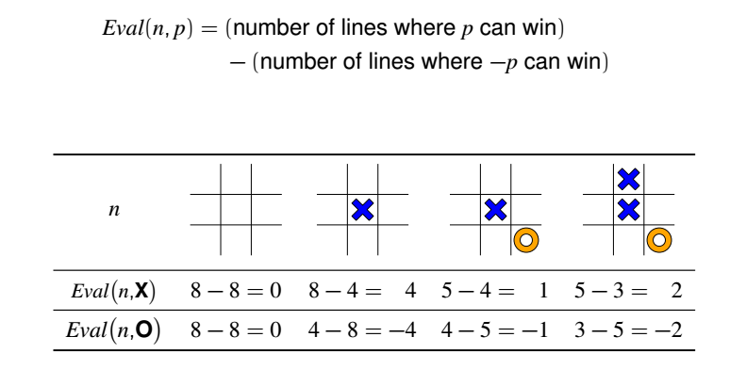
Task 1.2 Simple Strategies for Tic Tac Toe
Lecture recap
The key point– is to move in a way to have more potential winning states than the opponent
Notes:
8

Slide 9
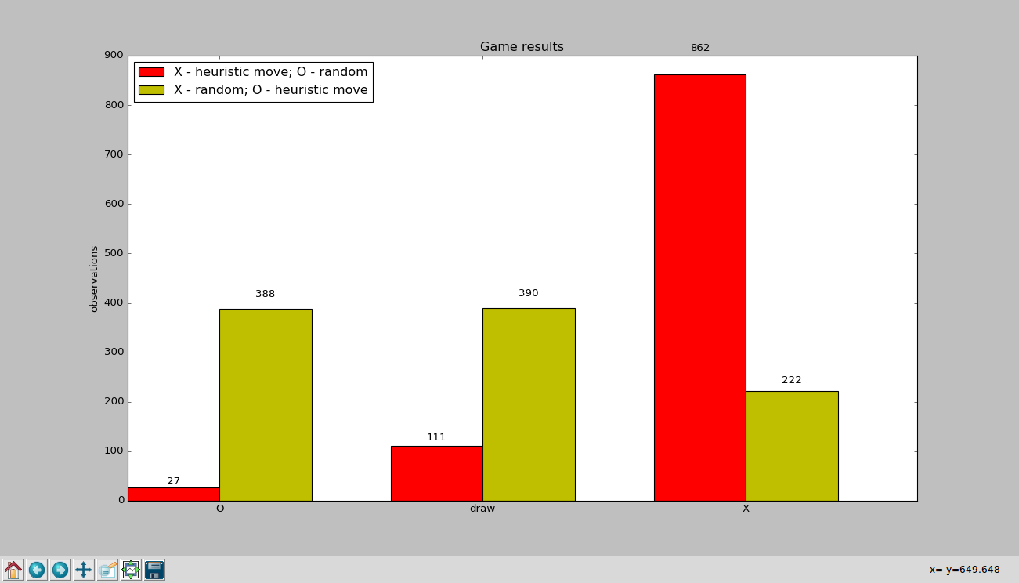
Task 1.2 Simple Strategies for Tic Tac Toe
Heuristic strategy
Notes:
9

Slide 10
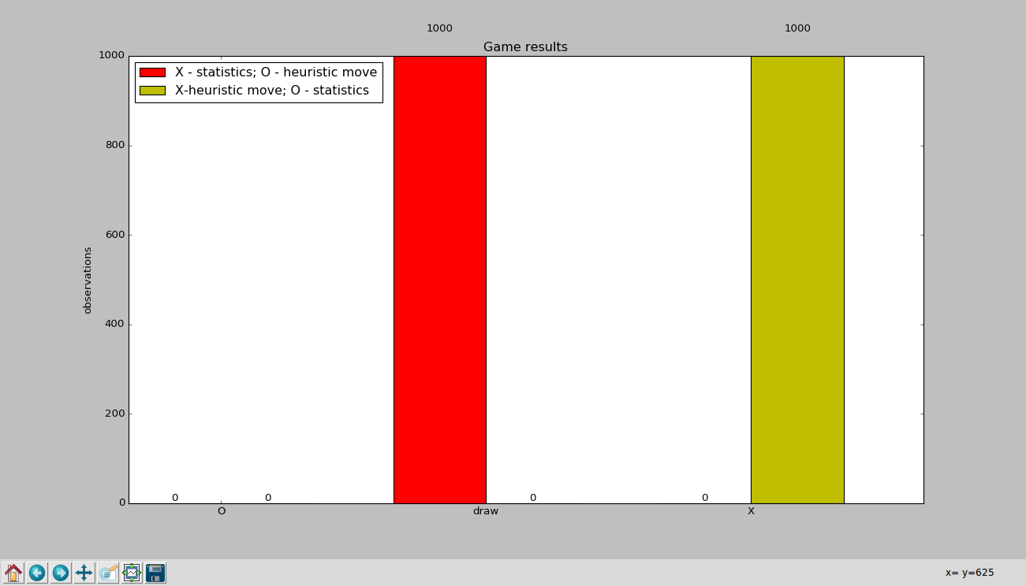
Task 1.2 Simple Strategies for Tic Tac Toe
Heuristic vs Statistic
Notes:
10

Slide 11
Task 1.3 Connect Four
Game implementation description
Structure:
neighbor-checking functions
def checkUpandDown(grid,line,column,player)
def checkRightandLeft(grid,lin,column,player)
def checkDiagonalLeftUpRightDown(grid,line,column,player)
def checkDiagonalRightUpLeftDown(grid,line,column,player)
“smart-advice” function def nextMove(a,player)
hints the user of a potential danger or victory
Notes:
11

Slide 12
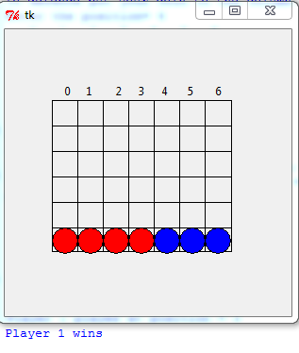
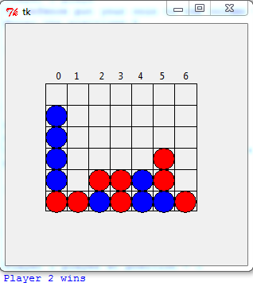
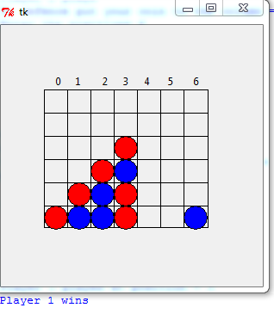
Task 1.3 Connect Four
Game demonstration
Notes:
12

Slide 13
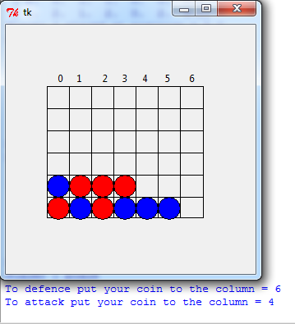
Task 1.3 Connect Four
Game demonstration – “smart-advice” strategy
Warn when three connected checkers of same color detected
Ideally:
warn when two or three connected checkers of same color detected
problem:
brute force too expensive
“smarter” would be to eliminate two or three connected checkers that can’t turn into longer chain
left for further work…
Notes:
13

Slide 14
Task 1.3 Connect Four
Statistics of winning fields – random strategy
Runs: 100
Wins of player 1: 51
Loses of player 2: 49
Draws: 0
Runs: 1000
Wins of player 1: 537
Loses of player 2: 460
Draws: 3
18 | 33 | 24 | 35 | 28 | 26 | 21
22 | 20 | 28 | 27 | 19 | 20 | 19
10 | 16 | 21 | 15 | 10 | 11 | 16
11 | 14 | 15 | 10 | 8 | 10 | 9
4 | 7 | 5 | 6 | 2 | 4 | 6
2 | 3 | 5 | 6 | 1 | 3 | 3
265 | 292 | 289 | 338 | 274 | 253 | 258
172 | 221 | 210 | 240 | 219 | 193 | 190
145 | 161 | 170 | 164 | 143 | 144 | 137
116 | 121 | 105 | 16 | 119 | 98 | 119
49 | 57 | 40 | 61 | 55 | 43 | 40
29 | 22 | 17 | 28 | 27 | 23 | 25
Notes:
14

Slide 15
Task 1.3 Connect Four
Statistics of winning fields – “smart-advice" strategy
Runs: 100
Wins of player 1: 53
Loses of player 2: 46
Draws: 1
Runs: 1000
Wins of player 1: 494
Loses of player 2: 478
Draws: 28
23 | 26 | 30 | 30 | 27 | 31 | 30
15 | 26 | 19 | 29 | 24 | 23 | 21
15 | 22 | 27 | 26 | 22 | 27 | 11
13 | 8 | 16 | 19 | 13 | 15 | 21
8 | 11 | 10 | 11 | 7 | 10 | 6
4 | 5 | 6 | 6 | 6 | 10 | 6
239 | 230 | 255 | 254 | 270 | 247 | 238
186 | 207 | 251 | 277 | 222 | 216 | 168
122 | 189 | 219 | 246 | 225 | 169 | 136
138 | 126 | 137 | 167 | 161 | 135 | 110
63 | 71 | 72 | 86 | 76 | 86 | 54
37 | 44 | 34 | 37 | 43 | 36 | 55
Notes:
15

Slide 16
Thank you for your attention!
Notes:
16

