Slide 1
Game AI
Project 2: Game Trees and Path Planning
Alina Arunova
Phil Matyash
Marina Mircheska
Aditya Kela
Sattar Rahimbeyli
Notes:
‹#›

Slide 2
Outline
Tic Tac Toe tree calucaltion
Minmax computations
Minmax search for connect four
Breakout predictor
Path planning
Notes:
‹#›

Slide 3

Task 2.1: Tic Tac Toe tree calculation
Task: Build a full tic tac toe tree. Calculate wins by X player, branching factor.
Solution:
1) to generate a tree like structure, the best way is to operate “node” objects with generic methods like setChild, getChild, hasChild, getParent, setParent and application specific setState, getState
2) recursively build the tree
3) recursively navigating by tree - calculate the properties
Notes:
‹#›

Slide 4
Task 2.1: Tic Tac Toe tree calculation
The results:
Upper bound of nodes = 9! (362880)
Total node count :269173
Total win X player win count :55872
Total draw count :95166
Total parent node count :155758
Average branching factor: 1.728149
Notes:
‹#›

Slide 5
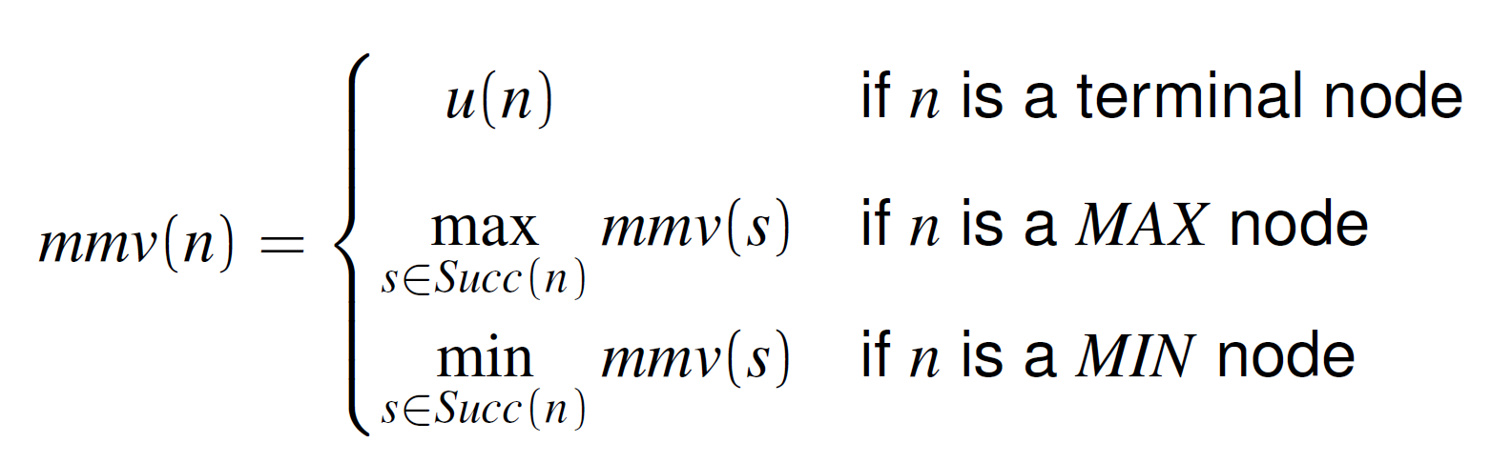
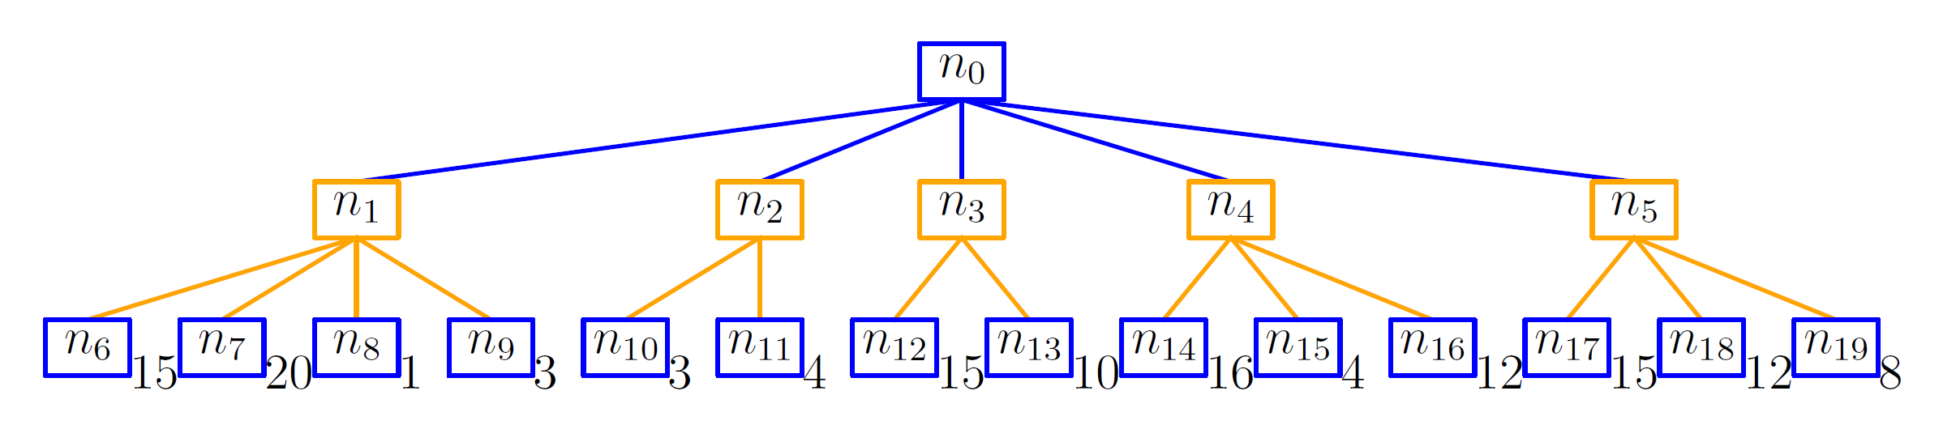
Task 2.2: Minmax computations
Task 2a: implement the minmax algorithm and test it on an example tree
Minmax algorithm consists of recursive computations:
Notes:
‹#›

Slide 6
Task 2.2: Minmax computations
Task: implement the minmax algorithm and test it on an example tree
Minmax algorithm consists of recursive computations:
1
3
10
4
8
Notes:
‹#›

Slide 7
Task 2.2: Minmax computations
Task: implement the minmax algorithm and test it on an example tree
Minmax algorithm consists of recursive computations:
10
1
3
10
4
8
Notes:
‹#›

Slide 8
Task 2.2: Minmax computations
Our implementation:
class TreeNode()
TreeNode(nodeId, utility)
nodeId: int
parent: int
successors: list
mmv: int
maxutil: int
insertChildren(node, nodeList)
maxStep(node)
minStep(node)
bestMaxStrategy(node)
printTree(node)
Notes:
‹#›

Slide 9
Task 2.2: Minmax computations
Our implementation:
class TreeNode()
building a tree from an example done manually ☹
root = TreeNode(0, None) node1 = TreeNode(1, None) node2 = TreeNode(2, None) node3 = TreeNode(3, None) node4 = TreeNode(4, None) node5 = TreeNode(5, None) node6 = TreeNode(6, 15) node7 = TreeNode(7, 20) node8 = TreeNode(8, 1) node9 = TreeNode(9, 3) node10 = TreeNode(10, 3) node11 = TreeNode(11, 4) node12 = TreeNode(12, 15) node13 = TreeNode(13, 10) node14 = TreeNode(14, 16) node15 = TreeNode(15, 4) node16 = TreeNode(16, 12) node17 = TreeNode(17, 15) node18 = TreeNode(18, 12) node19 = TreeNode(19, 8) root.insertChildren(root, [node1, node2, node3, node4, node5]) node1.insertChildren(node1, [node6, node7, node8, node9]) node2.insertChildren(node2, [node10, node11]) node3.insertChildren(node3, [node12, node13]) node4.insertChildren(node4, [node14, node15, node16]) node5.insertChildren(node5, [node17, node18, node19])
TreeNode(nodeId, utility)
nodeId: int
parent: int
successors: list
mmv: int
maxutil: int
insertChildren(node, nodeList)
maxStep(node)
minStep(node)
bestMaxStrategy(node)
printTree(node)
Notes:
‹#›

Slide 10
Task 2.2: Minmax computations
current node 0
node has children, exploring children...
|nodeId: 1 |parent: 0 |utility: None |mmv: 1 |maxutil: 20
node has children, exploring children...
|nodeId: 6 |parent: 1 |utility: 15 |mmv: 15 |maxutil: -inf
node is a leaf
|nodeId: 7 |parent: 1 |utility: 20 |mmv: 20 |maxutil: -inf
node is a leaf
...............
|nodeId: 5 |parent: 0 |utility: None |mmv: 8 |maxutil: 15
node has children, exploring children...
|nodeId: 17 |parent: 5 |utility: 15 |mmv: 15 |maxutil: -inf
node is a leaf
|nodeId: 18 |parent: 5 |utility: 12 |mmv: 12 |maxutil: -inf
node is a leaf
|nodeId: 19 |parent: 5 |utility: 8 |mmv: 8 |maxutil: -inf
node is a leaf
mmv for n0: 10
Our implementation:
class TreeNode()
building a tree from an example done manually ☹
verbose visualization •
TreeNode(nodeId, utility)
nodeId: int
parent: int
successors: list
mmv: int
maxutil: int
insertChildren(node, nodeList)
maxStep(node)
minStep(node)
bestMaxStrategy(node)
printTree(node)
10
1
3
10
4
8
Notes:
‹#›

Slide 11
Task 2.2: Minmax computations
current node 0
node has children, exploring children...
|nodeId: 1 |parent: 0 |utility: None |mmv: 1 |maxutil: 20
node has children, exploring children...
|nodeId: 6 |parent: 1 |utility: 15 |mmv: 15 |maxutil: -inf
node is a leaf
|nodeId: 7 |parent: 1 |utility: 20 |mmv: 20 |maxutil: -inf
node is a leaf
...............
|nodeId: 5 |parent: 0 |utility: None |mmv: 8 |maxutil: 15
node has children, exploring children...
|nodeId: 17 |parent: 5 |utility: 15 |mmv: 15 |maxutil: -inf
node is a leaf
|nodeId: 18 |parent: 5 |utility: 12 |mmv: 12 |maxutil: -inf
node is a leaf
|nodeId: 19 |parent: 5 |utility: 8 |mmv: 8 |maxutil: -inf
node is a leaf
mmv for n0: 10
Our implementation:
class TreeNode()
building a tree from an example done manually ☹
verbose visualization •
but tree traversals and minmax recursion working great! ☺
TreeNode(nodeId, utility)
nodeId: int
parent: int
successors: list
mmv: int
maxutil: int
insertChildren(node, nodeList)
maxStep(node)
minStep(node)
bestMaxStrategy(node)
printTree(node)
10
1
3
10
4
8
Notes:
‹#›

Slide 12
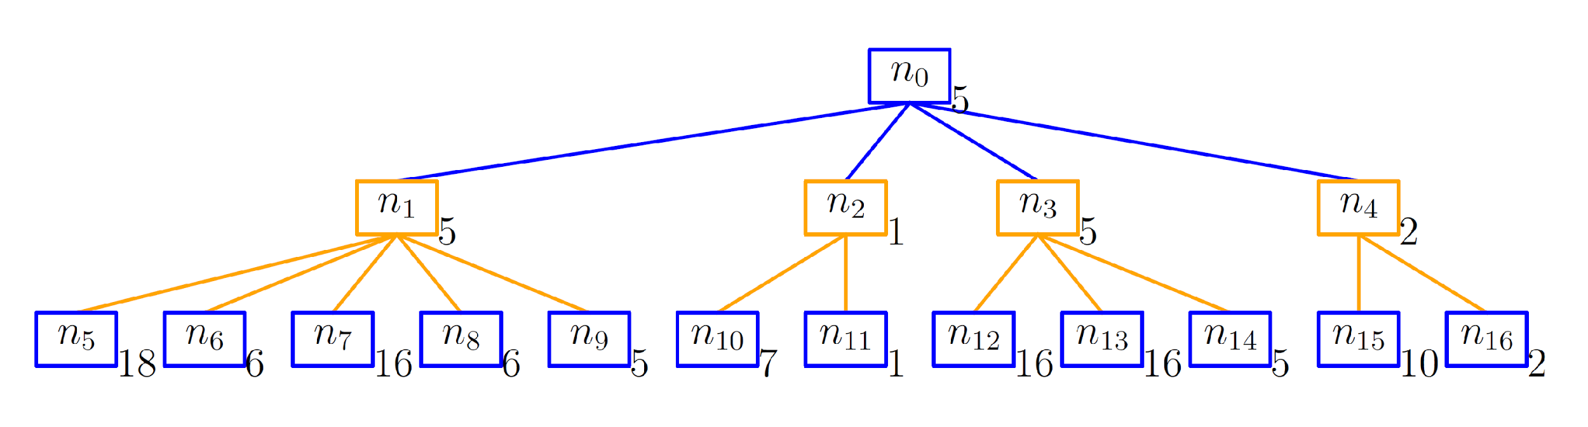
Task 2.2: Minmax computations
Task 2b: given a tree with precomputed minmax values, discuss ties
Q1: how to track “better alternatives” in case of ties?
Notes:
‹#›

Slide 13
Task 2.2: Minmax computations
Task 2b: given a tree with precomputed minmax values, discuss ties
Q1: how to track “better alternatives” in case of ties?
Q2: does it matter which choice?
Notes:
‹#›

Slide 14
Task 2.2: Minmax computations
Task 2b: given a tree with precomputed minmax values, discuss ties
Q1: how to track “better alternatives” in case of ties?
add an additional field (maxutil) for each node
while traversing the tree to compute mmv, also compute the “best” alternative and store it in each non-leaf node
Q2: does it matter which choice?
TreeNode(nodeId, utility)
nodeId: int
parent: int
successors: list
mmv: int
maxutil: int
insertChildren(node, nodeList)
maxStep(node)
minStep(node)
bestMaxStrategy(node)
printTree(node)
Notes:
‹#›

Slide 15
Task 2.2: Minmax computations
Task 2b: given a tree with precomputed minmax values, discuss ties
Q1: how to track “better alternatives” in case of ties?
add an additional field (maxutil) for each node
while traversing the tree to compute mmv, also compute the “best” alternative and store it in each non-leaf node
when looking for the best path, compare by maxutil when ties for mmv
Q2: does it matter which choice?
Notes:
‹#›

Slide 16
Task 2.2: Minmax computations
Task 2b: given a tree with precomputed minmax values, discuss ties
Q1: how to track “better alternatives” in case of ties?
add an additional field (maxutil) for each node
while traversing the tree to compute mmv, also compute the “best” alternative and store it in each non-leaf node
when looking for the best path, compare by maxutil when ties for mmv
Q2: does it matter which choice?
No! assuming MIN is smart, he will always choose the smallest payoff out of all
unless MIN is not so smart
Notes:
‹#›

Slide 17
Task 2.3:Minmax search for connect four
Implement the depth-restricted search to find the best move
Modify depth-parameter to find the best case
Implement an appropriate evaluation function
check every row,column and diagonals for possibility to put four in together and gather achieved result
check every row,column and diagonals for possibility of the opponent to put four in together and gather achieved result
return yourValue - opponentValue and compare with all other values to make a move

Slide 18
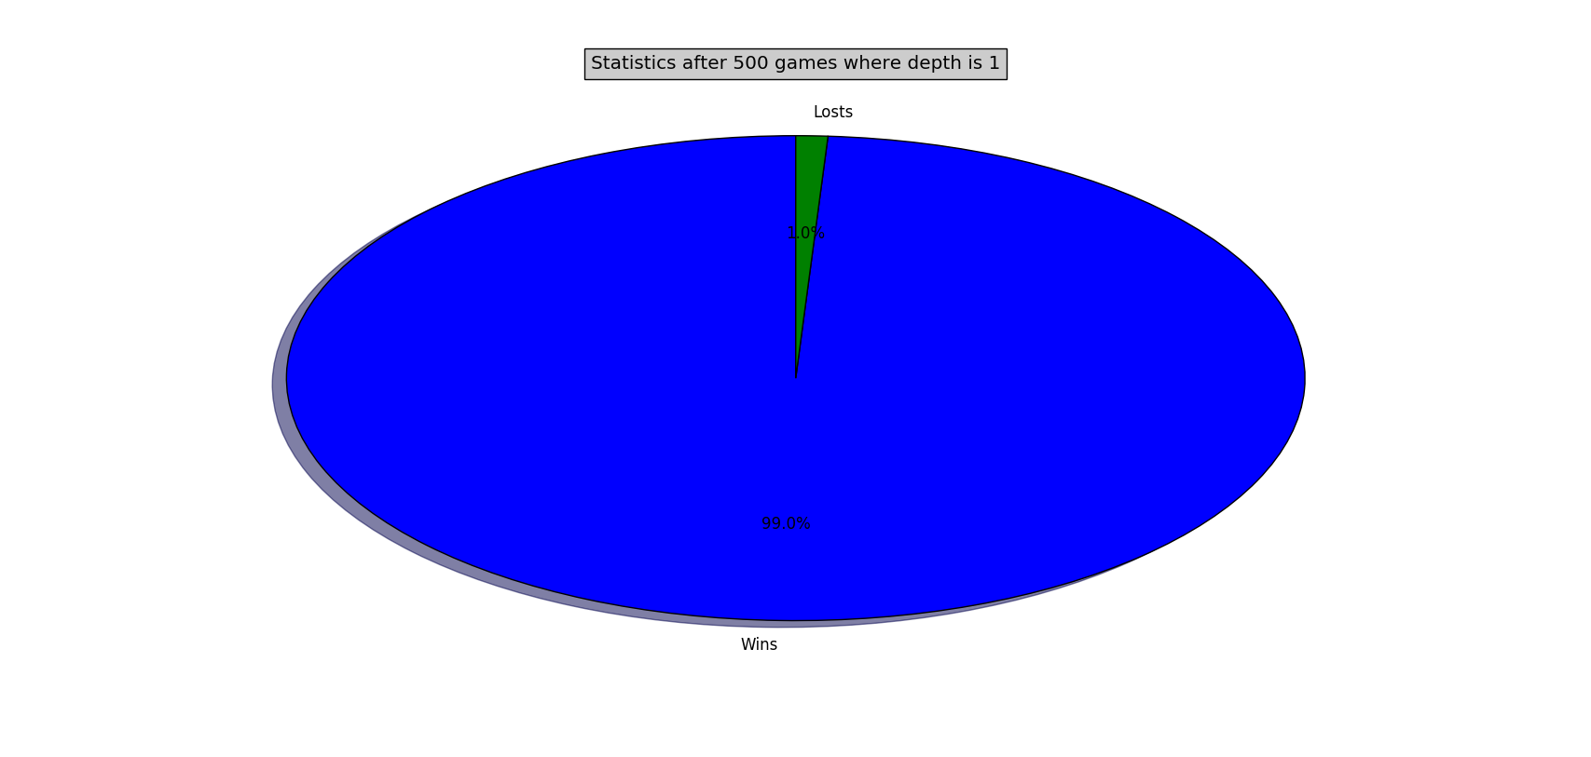

Task 2.3:Statistics (depth 1)

Slide 19
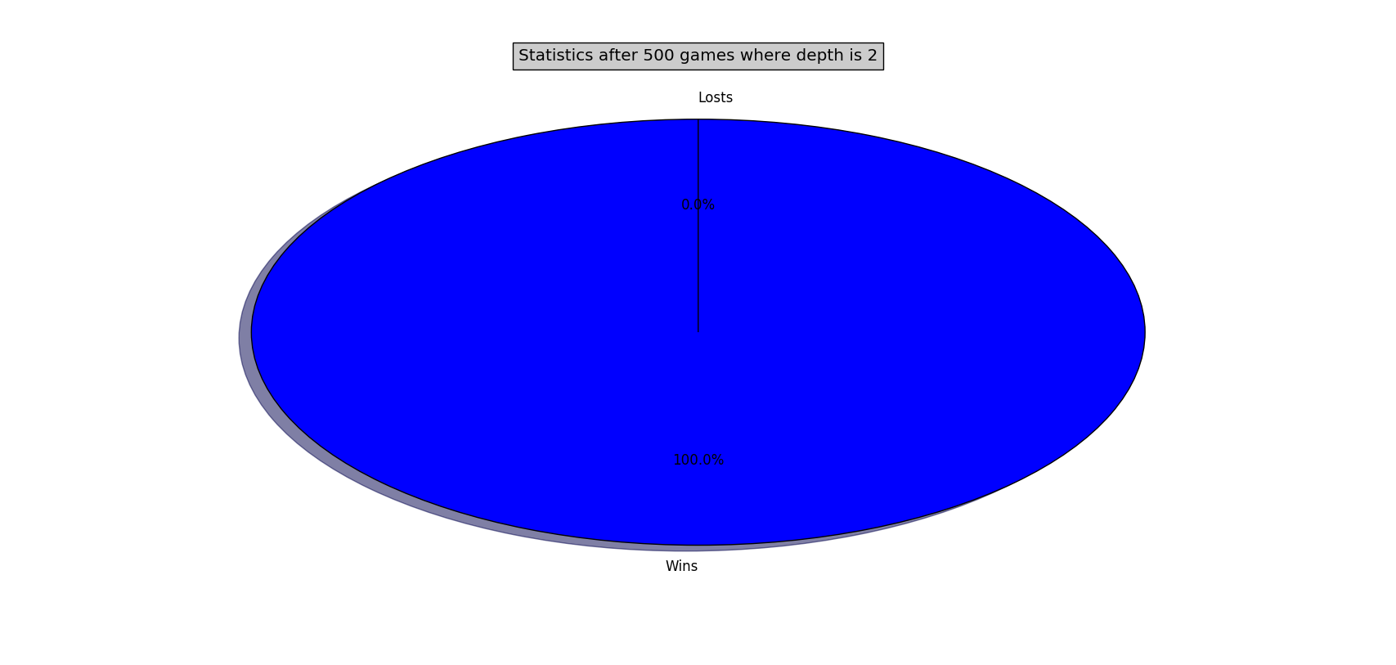

Task 2.3:Statistics (depth 2)

Slide 20


Task 2.3:Statistics (depth 3)

Slide 21
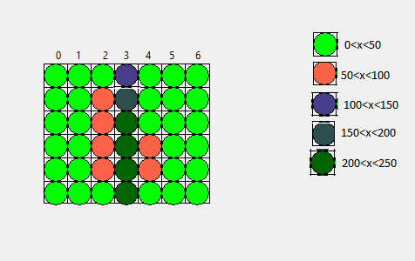
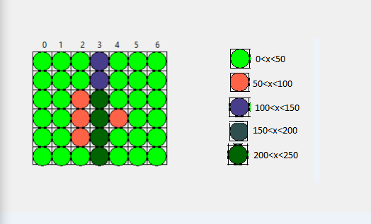
Task 2.3:Statistics (Used layers)

Slide 22
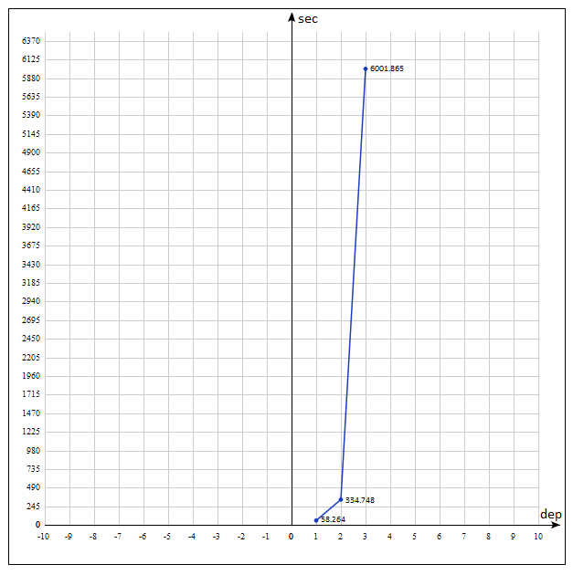
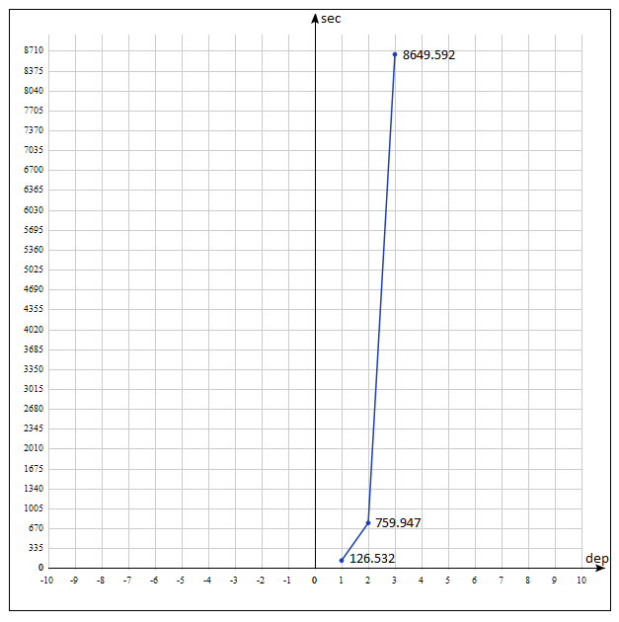
Task 2.3:Statistics (Time statistics)

Slide 23
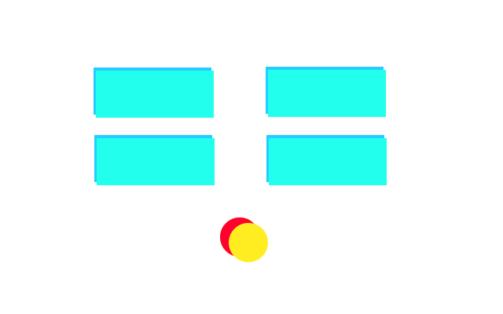
Task 2.4: Breakout Predictor
Create Copy of Ball + Bricks
Copy of ball: “predictor”
Notes:
‹#›

Slide 24
Task 2.4: Breakout Predictor
The predictor starts with same vel_x and vel_y as ball
Predictor moves faster than ball
= move_predictor and collision_predictor function called 300 times per frame
Predictor velocity not increased by increasing velocity
Paddle follows predictor
Notes:
‹#›

Slide 25
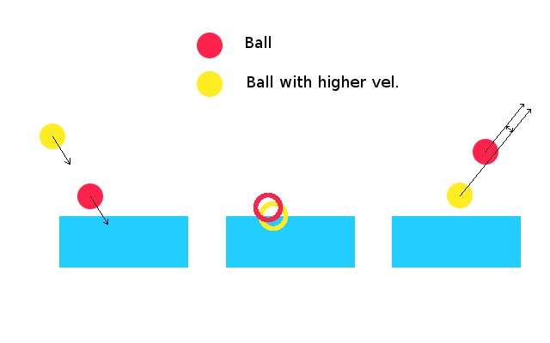
Task 2.4: Breakout Predictor
Notes:
‹#›

Slide 26
Task 2.4: Breakout Predictor
Ball Velocity increase over time:
Predictor initialized every frame with same ball_vel each frame
Paddle follows ball similarly
Advantage: Works even for collisions causing random velocty changes
Overkill
Notes:
‹#›

Slide 27
Task 2.5: Path Planning
Task: Given the input map, build a route from start to stop using 2 algorithms (Dijkstra and A*)
Solution:
1) Use networkx graph as data type and also visualization capabilities
2) Straight forward algo implementation
Test values: start = (1,1), stop = (33,20)
Notes:
‹#›

Slide 28
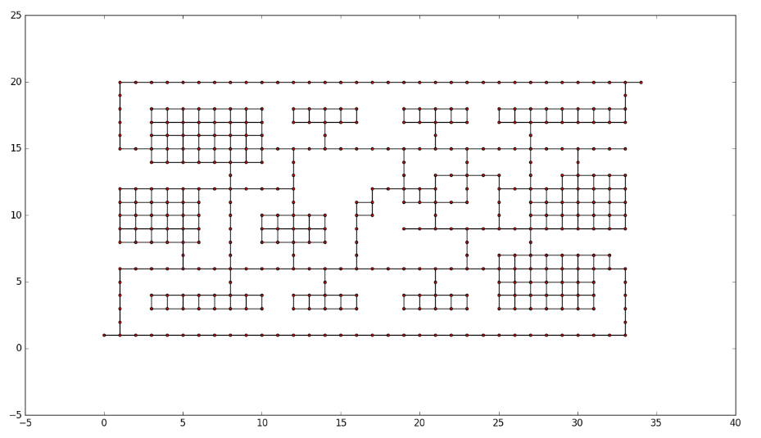
Task 2.5: Path Planning
The input

Slide 29
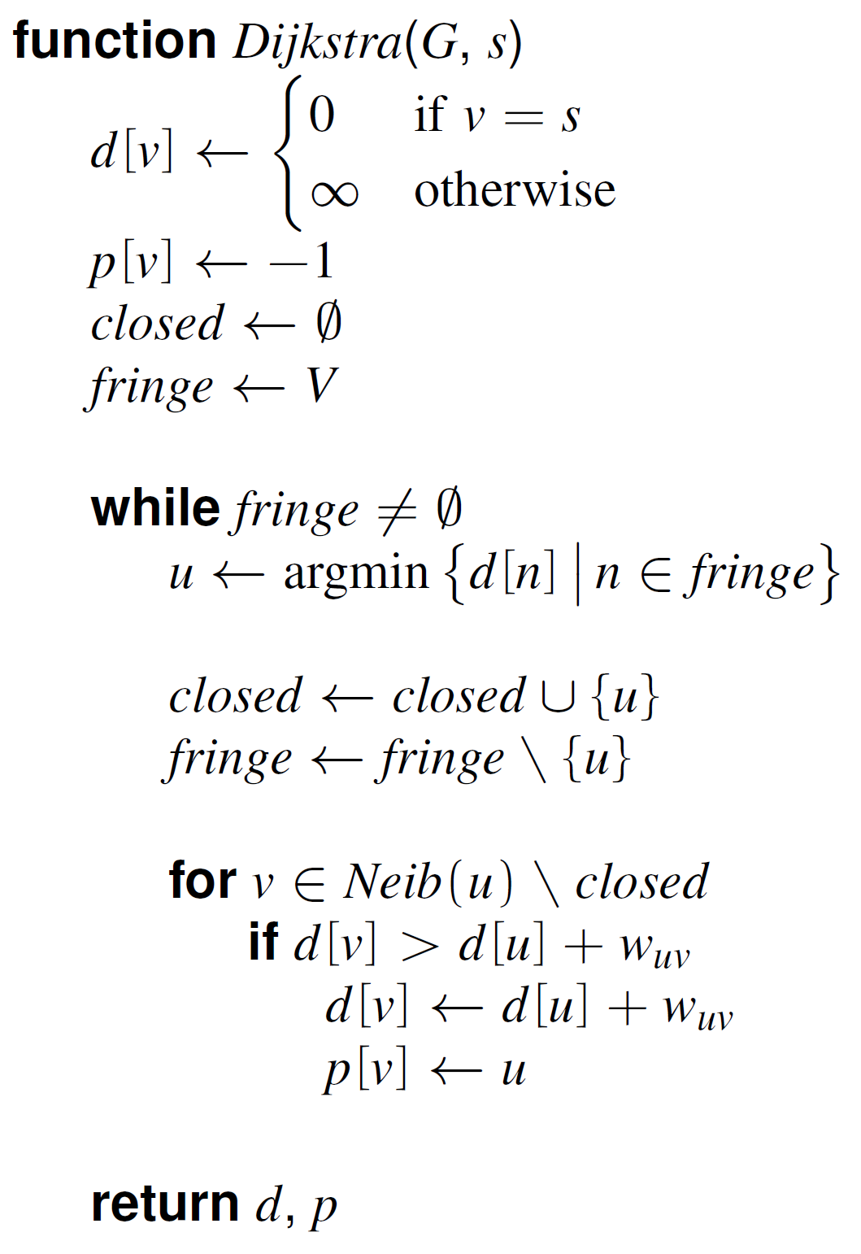
Task 2.5: Path Planning
Dijkstra
RECAP (from the lecture):
Notes:
‹#›

Slide 30
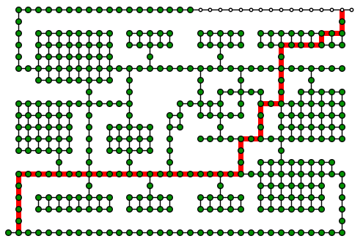
Task 2.5: Path Planning
Dijkstra output

Slide 31
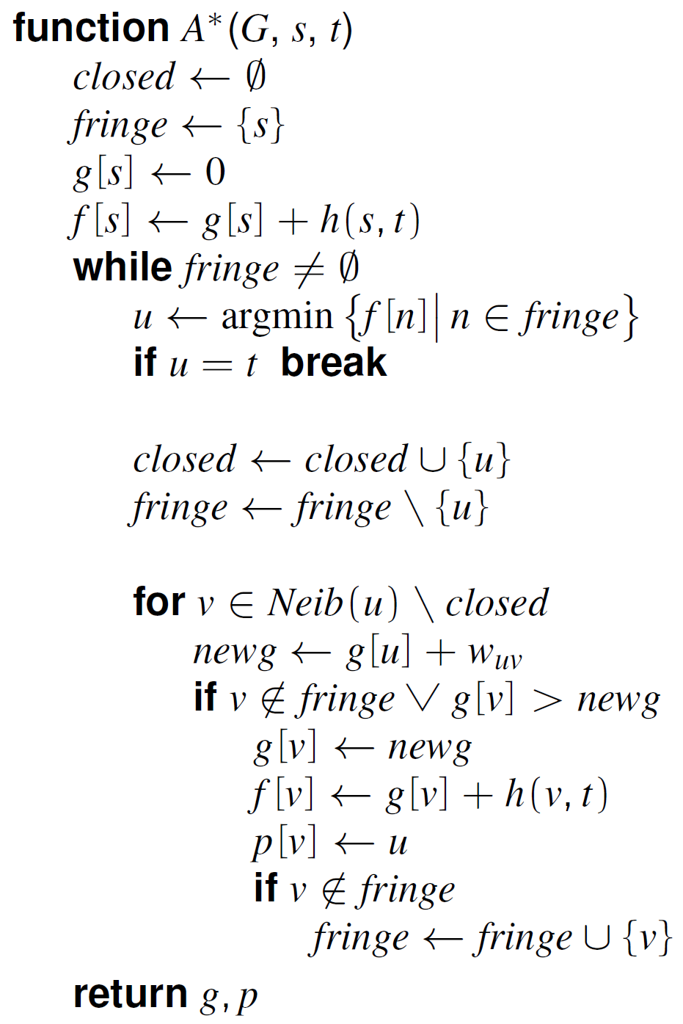
Task 2.5: Path Planning
A* algorithm
RECAP (from the lecture):
Notes:
‹#›

Slide 32
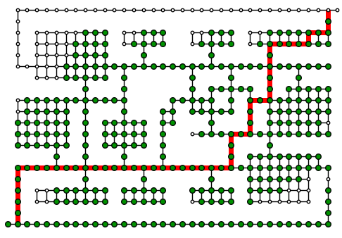
Task 2.5: Path Planning
A* output

Slide 33
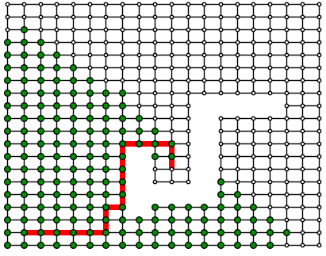
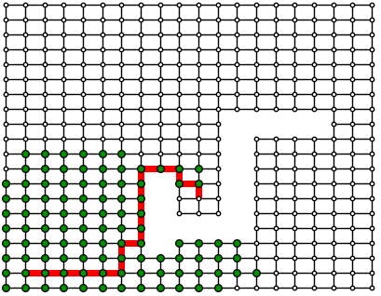
Task 2.5: Path Planning
Extra comparison
Dijkstra A*

Slide 34
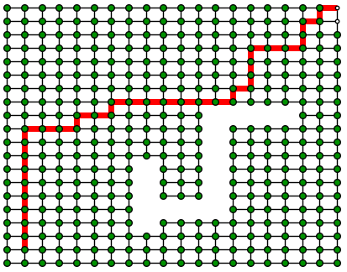
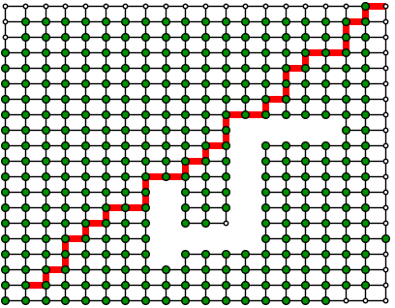
Task 2.5: Path Planning
Extra comparison
Dijkstra A*

