Slide 1
Game AI
Project 3: Behavior Programming
Alina Arunova
Phil Matyash
Marina Mircheska
Aditya Kela
Sattar Rahimbeyli
Notes:
‹#›

Slide 2
Outline
Connect four for large board
Fuzzy-controller for breakout
Self organizing maps
Bayesian imitation learning
Notes:
‹#›

Slide 3
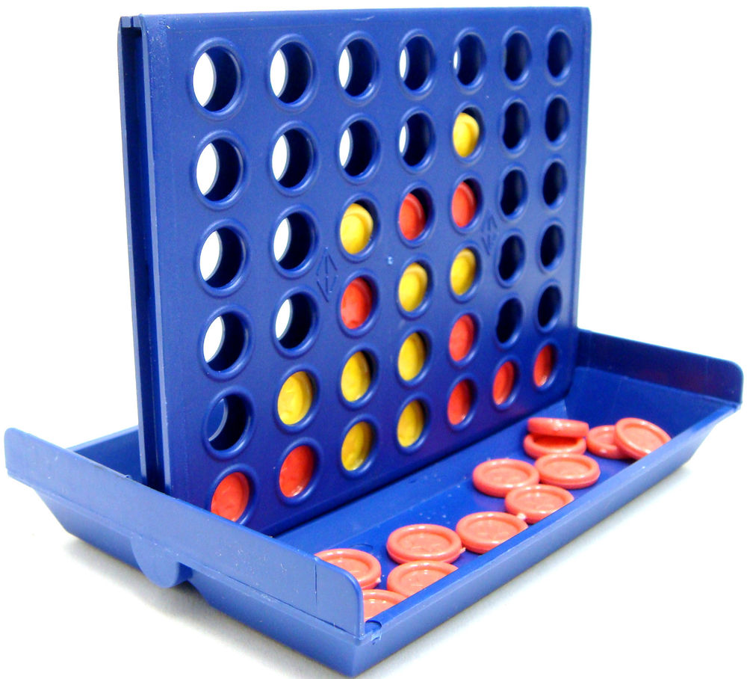

Slide 4
Task 3.1: Minmax search for connect four 19X19
Implement the depth-restricted search to find the best move
Modify the depth-parameter to find the best case
Gather statistics with resized board (19x19)
Win/Loss statistics
Time statistics
The number of filled layers
Depth-parameter statistics
Notes:
‹#›

Slide 5
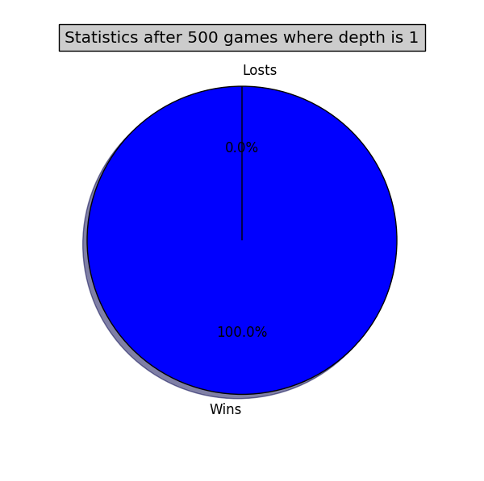

Task 3.1:Win/Loss statistics
Notes:
‹#›

Slide 6


Task 3.1:Win/Loss statistics
Notes:
‹#›

Slide 7
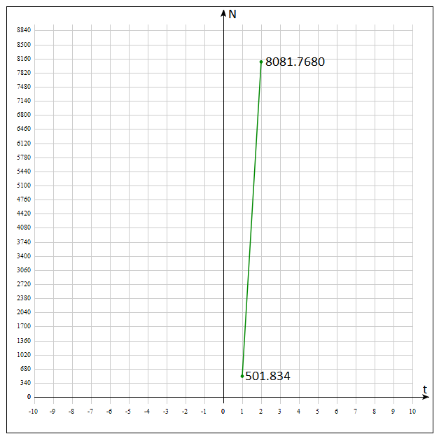
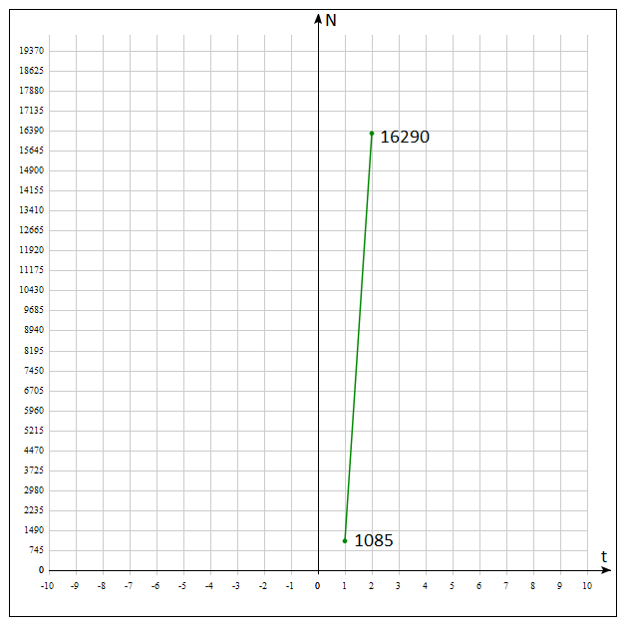
Task 3.1:Time statistics
500 samples
1000 samples
Notes:
‹#›

Slide 8
Task 3.1:The number of filled layers
500 Samples depth 1
1000 Samples depth 1
 | 0 | 1 | 2 | 3
...
13 |  | 1 | 1
14 |  | 5 | 1
15 | 416 | 19 | 3
16 | 444 | 21 | 3
17 | 466 | 22 | 4 | 2
18 | 500 | 80 | 71 | 62
 | 0 | 1 | 2 | 3
...
13 |  | 1
14 |  | 12 | 1
15 | 839 | 37 | 10
16 | 898 | 40 | 14
17 | 949 | 49 | 16 | 5
18 | 1000 | 148 | 134 | 112
Notes:
‹#›

Slide 9
Task 3.1:The number of filled layers
500 Samples depth 2
1000 Samples depth 2
 | 0 | 1 | 2 | 3
...
13 |  | 3 | 1
14 |  | 8 | 1
15 | 432 | 17 | 2
16 | 450 | 15 | 2
17 | 473 | 17 | 1
18 | 500 | 62 | 57 | 52
 | 0 | 1 | 2 | 3
...
13
14 |  | 7
15 | 856 | 30 | 5
16 | 900 | 30 | 7
17 | 949 | 34 | 12 | 7
18 | 1000 | 140 | 126 | 104
Notes:
‹#›

Slide 10
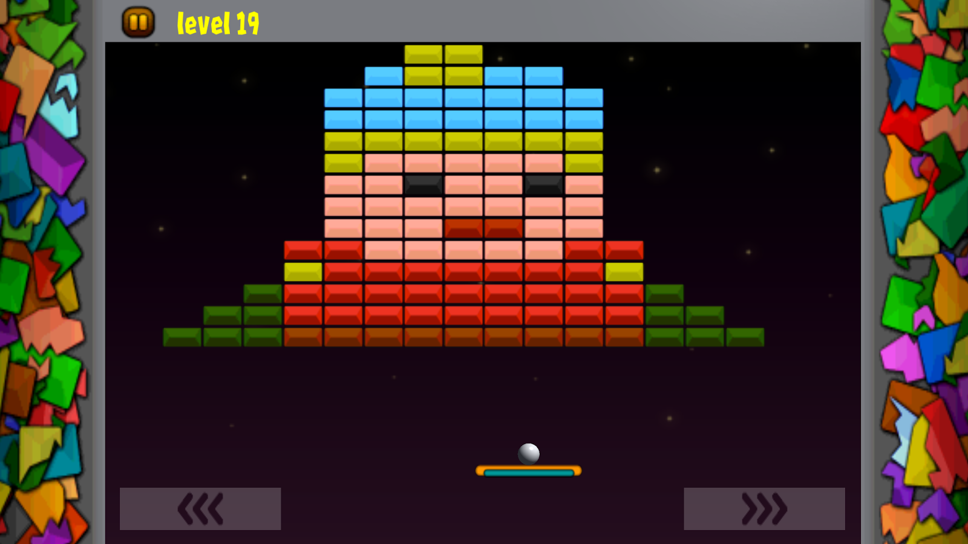

Slide 11
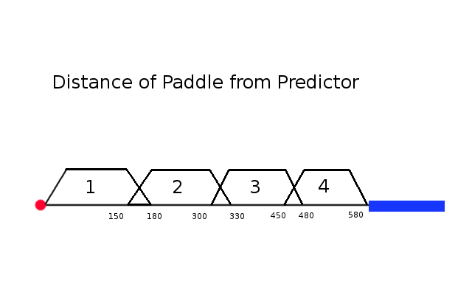
Task 3.2: Fuzzy Controller for Breakout
The maximum distance (= 580 units) between the
Paddle and the Predictor ball is divided into 4 rules
Notes:
‹#›

Slide 12
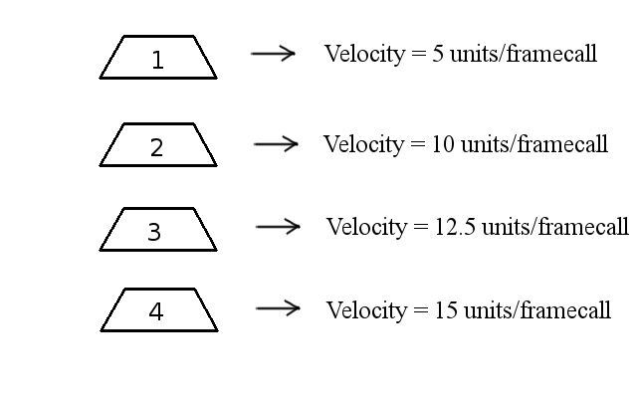
Task 3.2: Fuzzy Controller for Breakout
The rule set for the
divided distance is:
Notes:
‹#›

Slide 13
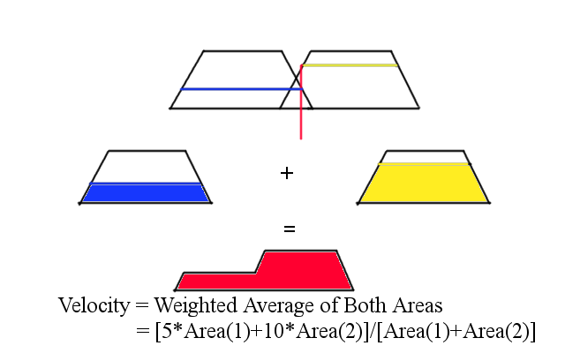
Task 3.2: Fuzzy Controller for Breakout
If the distance between
the predictor ball and the paddle leads to two rules
firing, then the velocity function is the weighted average:
Notes:
‹#›

Slide 14
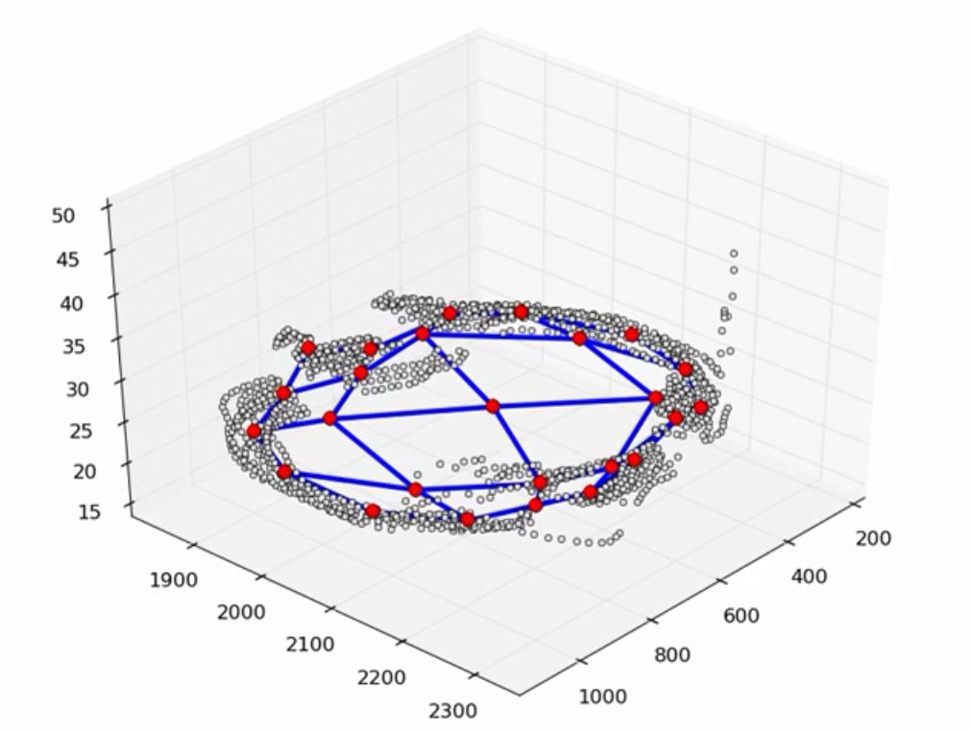

Slide 15
Task 3.3: Self organizing maps
Fit self organizing maps to the datasets
Self organizing map algorithm
Assign random values to neurons (centers)
Choose random pattern from dataset
Find the closest neuron to that pattern(custom metric)
distance[winner] = distance(neuron,pattern)
Update neurons(centers)
nrn[i] += lr(t)*e^(dist(nrn[i],pat)/2*sig(t))*(pat - nrn[i])
lr(t) = 1 - (t/T)
sig(t) = e^[-(t/T)]
Notes:
‹#›

Slide 16
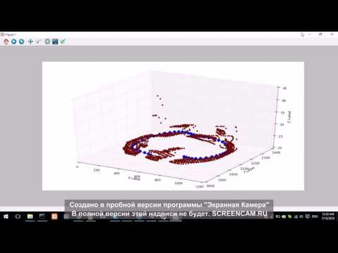
Task 3.3: Self organizing maps (circle figure)
Notes:
‹#›

Slide 17
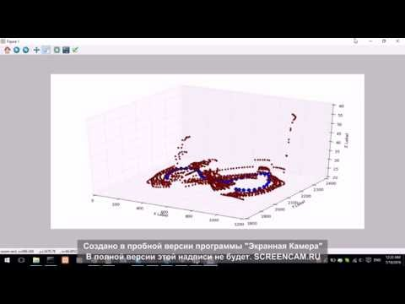
Task 3.3: Self organizing maps (figure 8)
Notes:
‹#›

Slide 18
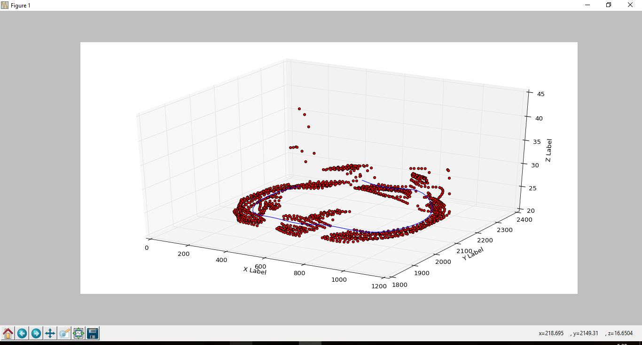
Task 3.4: Bayesian imitation learning
Notes:
‹#›

Slide 19
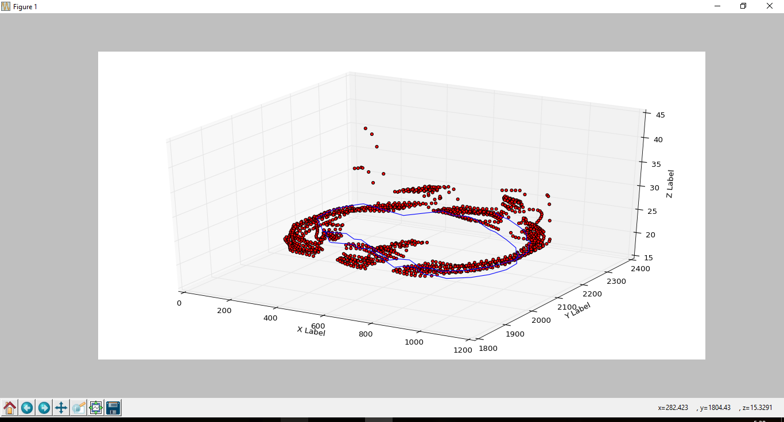
Task 3.4: Bayesian imitation learning
Notes:
‹#›

Slide 20
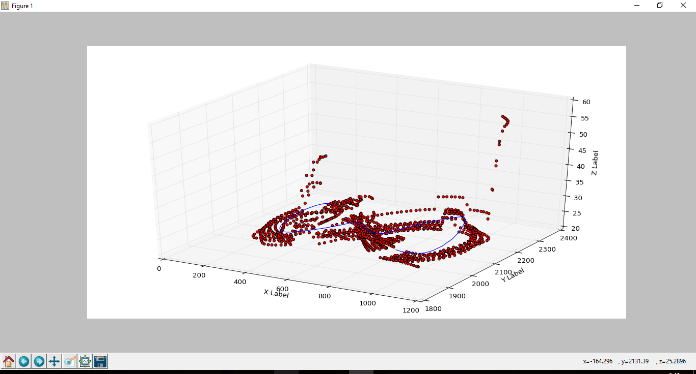
Task 3.4: Bayesian imitation learning
Notes:
‹#›

Slide 21
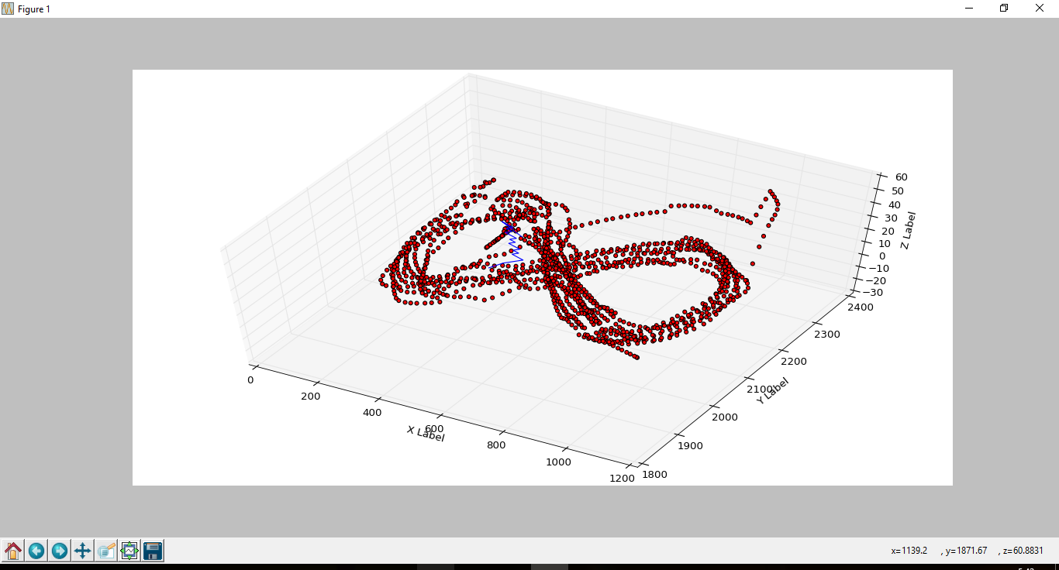
Task 3.4: Bayesian imitation learning
Notes:
‹#›

Slide 22
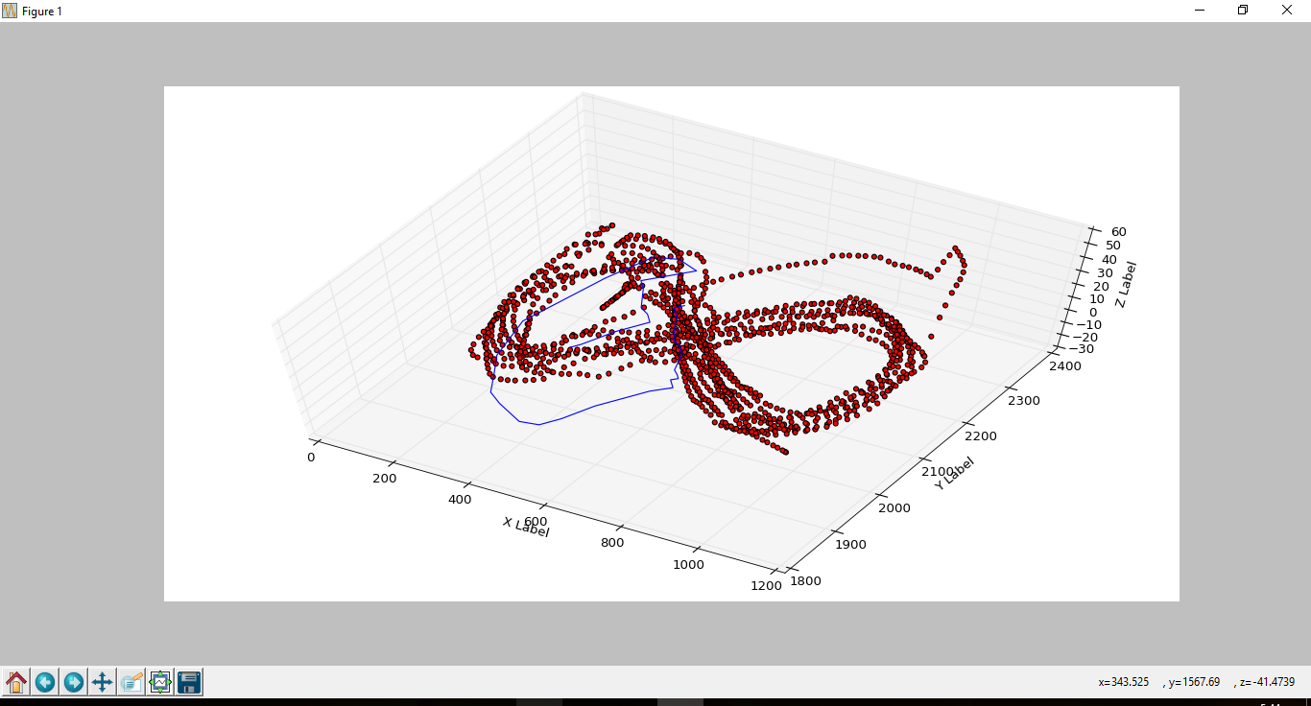
Task 3.4: Bayesian imitation learning
Notes:
‹#›

Slide 23
Thank you for attention

