Slide 1



practical learning redefined
One point solution for all your placement needs
terv.pro

Slide 2
C Programming Session 1.2

Slide 3

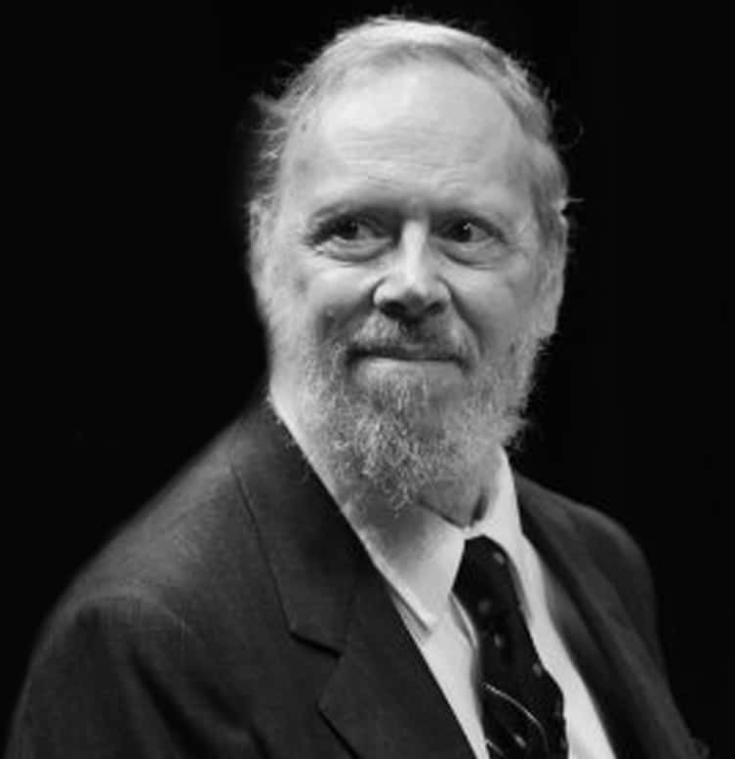
C
Language
Notes:
Documentation section:
The documentation section consists of a set of comment lines giving the name of the program, the author and other details, which the programmer would like to use later.
Link section: The link section provides instructions to the compiler to link functions from the system library such as using the #include directive.
Definition section: The definition section defines all symbolic constants such using the #define directive.
Global declaration section: There are some variables that are used in more than one function. Such variables are called global variables and are declared in the global declaration section that is outside of all the functions. This section also declares all the user-defined functions.
main () function section: Every C program must have one main function section. This section contains two parts; declaration part and executable part
Declaration part: The declaration part declares all the variables used in the executable part.
Executable part: There is at least one statement in the executable part. These two parts must appear between the opening and closing braces. The program executionbegins at the opening brace and ends at the closing brace. The closing brace of the main function is the logical end of the program. All statements in the declaration and executable part end with a semicolon.
Subprogram section: If the program is a multi-function program then the subprogram section contains all the user-defined functions that are called in the main () function. User-defined functions are generally placed immediately after the main () function, although they may appear in any order.
All section, except the main () function section may be absent when they are not required.

Slide 4
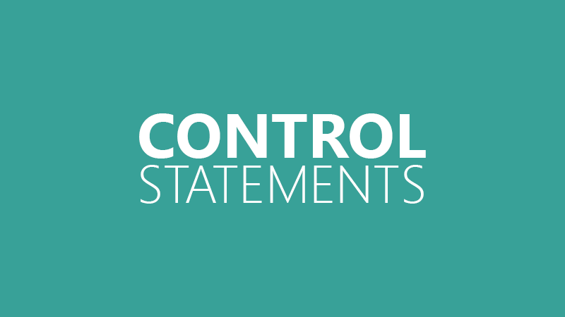

Slide 5
Flow Control
Branching
- Decides what actions to take
Looping
Decides how many times to
take a certain action.
Notes:
Decision making in C
Decision making is about deciding the order of execution of statements based on certain conditions or repeat a group of statements until certain specified conditions are met. C language handles decision-making by supporting the following statements,
if statement
switch statement
conditional operator statement (? : operator)
goto statement

Slide 6
Branching
- if statement
- if...else statement
- if...elseif....else statement
- switch statement
Looping
- for loop
- while loop
- do...while loop
Notes:
C programming language assumes any non-zero and non-null values as true, and if it is either zero or null, then it is assumed as false value.

Slide 7
- if statement
- if...else statement
- if...elseif....else statement
- switch statement
- for loop
- while loop
- do...while loop
Notes:
C programming language assumes any non-zero and non-null values as true, and if it is either zero or null, then it is assumed as false value.

Slide 8
#include <stdio.h>
int main () {
int a = 10;
if ( a < 20 )
{
printf("a is less than 20\n" );
}
printf("value of a is : %d\n", a);
return 0;
}
if( 10 < 20 )
if ( true )
Output:
a is less than 20
value of a is: 10
Notes:
An if statement consists of a Boolean expression followed by one or more statements.
Syntax
The syntax of an 'if' statement in C programming language is −
if(boolean_expression)
{
/* statement(s) will execute if the boolean expression is true */
}
If the Boolean expression evaluates to true, then the block of code inside the 'if' statement will be executed. If the Boolean expression evaluates to false, then the first set of code after the end of the 'if' statement (after the closing curly brace) will be executed.
C programming language assumes any non-zero and non-null values as true and if it is either zero or null, then it is assumed as false value.

Slide 9
- if statement
- if...else statement
- if...elseif....else statement
- switch statement
- for loop
- while loop
- do...while loop
Notes:
C programming language assumes any non-zero and non-null values as true, and if it is either zero or null, then it is assumed as false value.

Slide 10
Largest among 2 numbers
if (x < y)
{
printf(“x is less than y \n”);
}
else
{
printf(“x is greater than y \n”);
}
Let x =10 and y =20
And we get,
x is less than y

Slide 11

Largest among 2 numbers
if (x < y)
{
printf(“x is less than y \n”);
}
else
{
printf(“x is greater than y \n”);
}
Let x =10 and y =10
And here we get,
x is greater than y

Slide 12
- if statement
- if...else statement
- if...elseif....else statement
- switch statement
- for loop
- while loop
- do...while loop
Notes:
C programming language assumes any non-zero and non-null values as true, and if it is either zero or null, then it is assumed as false value.

Slide 13
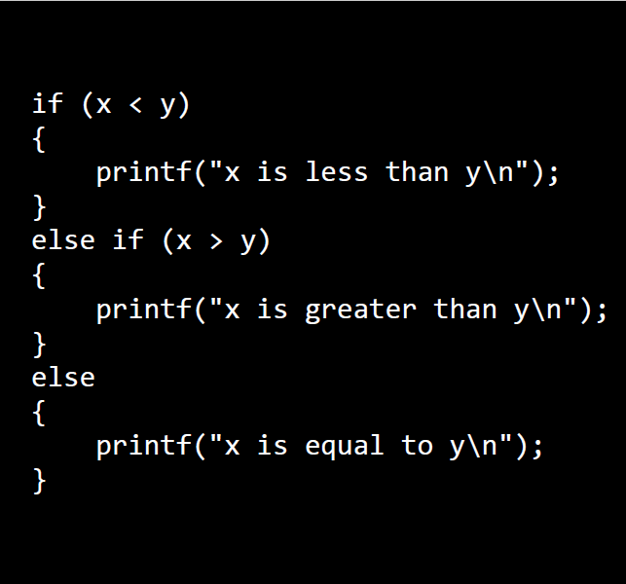
Largest among 2 numbers

Slide 14
Largest among 3 numbers
#include<stdio.h>
void main()
{
int a, b, c;
scanf("%d %d %d", &a, &b, &c);
if ((a > b) && (a > c))
printf("\n a is greatest");
if ((b > c) && (b > a))
printf("\n b is greatest");
if ((c > a) && (c > b))
printf("\n c is greatest");
}
&& - Logical AND Operator
Input 1 | Input 2 | Output
True | True | True
True | False | False
False | True | False
False | False | False
Notes:
A=b=c

Slide 15
- if statement
- if...else statement
- if...elseif....else statement
- switch statement
- for loop
- while loop
- do...while loop
Notes:
C programming language assumes any non-zero and non-null values as true, and if it is either zero or null, then it is assumed as false value.

Slide 16
#include <stdio.h>
int main () {
char grade = 'B';
switch (grade)
{
case 'A' :
printf("Excellent!\n" );
break;
case 'B' :
printf("Well done\n" );
break;
default :
printf("Invalid grade\n" );
}
printf("Your grade is %c\n", grade );
return 0;
}
Notes:
A switch statement allows a variable to be tested for equality against a list of values. Each value is called a case, and the variable being switched on is checked for each switch case.
The following rules apply to a switch statement −
The expression used in a switch statement must have an integral or enumerated type, or be of a class type in which the class has a single conversion function to an integral or enumerated type.
You can have any number of case statements within a switch. Each case is followed by the value to be compared to and a colon.
The constant-expression for a case must be the same data type as the variable in the switch, and it must be a constant or a literal.
When the variable being switched on is equal to a case, the statements following that case will execute until a break statement is reached.
When a break statement is reached, the switch terminates, and the flow of control jumps to the next line following the switch statement.
Not every case needs to contain a break. If no break appears, the flow of control will fall through to subsequent cases until a break is reached.
A switch statement can have an optional default case, which must appear at the end of the switch. The default case can be used for performing a task when none of the cases is true. No break is needed in the default case.

Slide 17
#include <stdio.h>
int main () {
char grade = 'B';
switch (grade)
{
case 'A' :
printf("Excellent!\n" );
break;
case 'B' :
printf("Well done\n" );
break;
default :
printf("Invalid grade\n" );
}
printf("Your grade is %c\n", grade );
return 0;
}
switch ( 'B' )
Output:
Well done
Your grade is B
Notes:
A switch statement allows a variable to be tested for equality against a list of values. Each value is called a case, and the variable being switched on is checked for each switch case.
The following rules apply to a switch statement −
The expression used in a switch statement must have an integral or enumerated type, or be of a class type in which the class has a single conversion function to an integral or enumerated type.
You can have any number of case statements within a switch. Each case is followed by the value to be compared to and a colon.
The constant-expression for a case must be the same data type as the variable in the switch, and it must be a constant or a literal.
When the variable being switched on is equal to a case, the statements following that case will execute until a break statement is reached.
When a break statement is reached, the switch terminates, and the flow of control jumps to the next line following the switch statement.
Not every case needs to contain a break. If no break appears, the flow of control will fall through to subsequent cases until a break is reached.
A switch statement can have an optional default case, which must appear at the end of the switch. The default case can be used for performing a task when none of the cases is true. No break is needed in the default case.

Slide 18
#include <stdio.h>
int main ()
{
char grade = 'B';
switch (grade)
{
case 'A' :
printf("Excellent!\n" );
break;
case 'B' :
printf("Well done\n" );
default :
printf("Invalid grade\n" );
}
printf("Your grade is %c\n", grade );
return 0;
}
- No break statement
- Executes until it reaches the end of switch block
Output:
Well done
Invalid grade
Your grade is B
Notes:
A switch statement allows a variable to be tested for equality against a list of values. Each value is called a case, and the variable being switched on is checked for each switch case.
The following rules apply to a switch statement −
The expression used in a switch statement must have an integral or enumerated type, or be of a class type in which the class has a single conversion function to an integral or enumerated type.
You can have any number of case statements within a switch. Each case is followed by the value to be compared to and a colon.
The constant-expression for a case must be the same data type as the variable in the switch, and it must be a constant or a literal.
When the variable being switched on is equal to a case, the statements following that case will execute until a break statement is reached.
When a break statement is reached, the switch terminates, and the flow of control jumps to the next line following the switch statement.
Not every case needs to contain a break. If no break appears, the flow of control will fall through to subsequent cases until a break is reached.
A switch statement can have an optional default case, which must appear at the end of the switch. The default case can be used for performing a task when none of the cases is true. No break is needed in the default case.

Slide 19
- if statement
- if...else statement
- if...elseif....else statement
- switch statement
- for loop
- while loop
- do...while loop
Notes:
C programming language assumes any non-zero and non-null values as true, and if it is either zero or null, then it is assumed as false value.

Slide 20
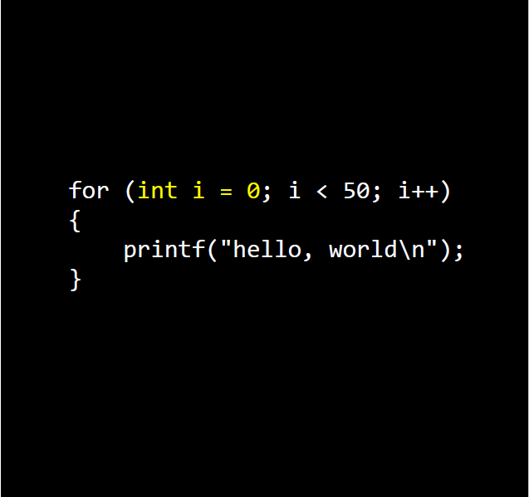
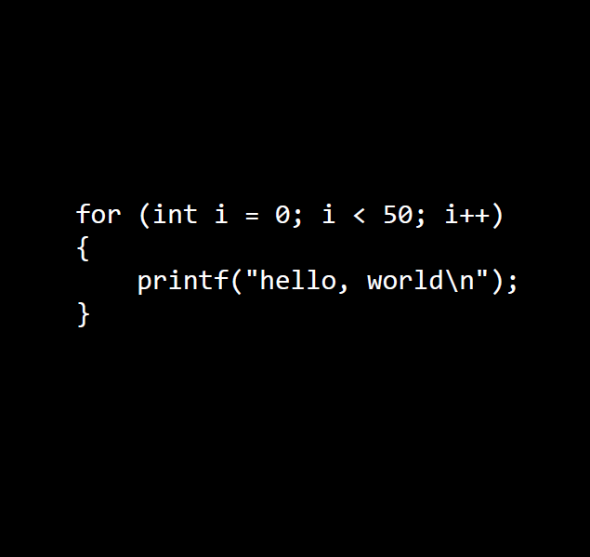
For loop:
A repetition control structure
Notes:
You may encounter situations, when a block of code needs to be executed several number of times. In general, statements are executed sequentially: The first statement in a function is executed first, followed by the second, and so on.

Slide 21
int i = 0;
Initialization – executed only once

Slide 22
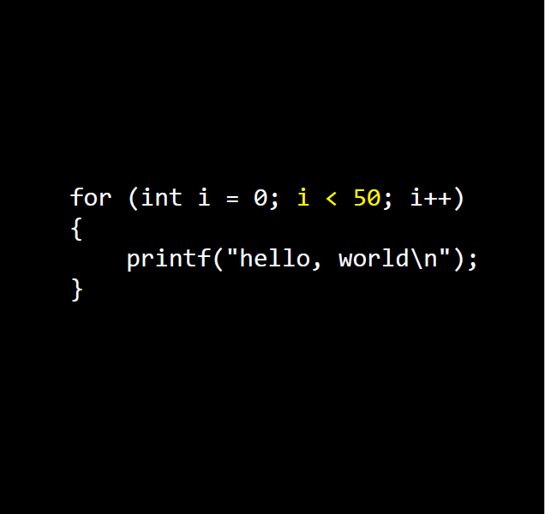
i < 50
Condition –
If true – enters the loop
If false – comes out of the for loop

Slide 23
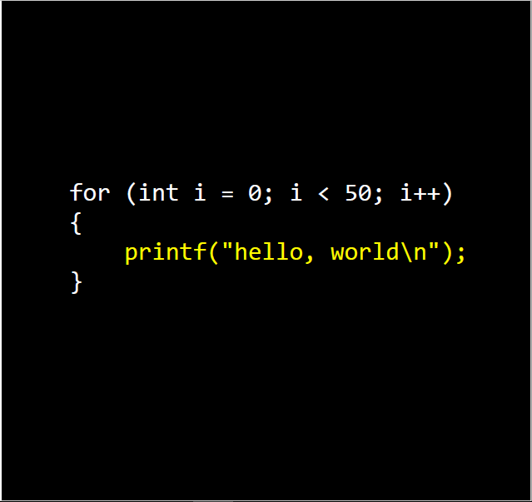
Since condition is true – it enters the loop

Slide 24
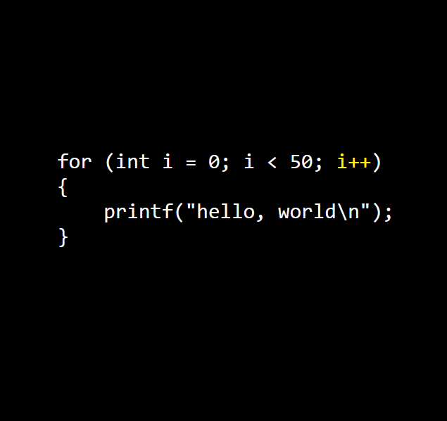
Each time after the execution of loop, it increments the value.

Slide 25
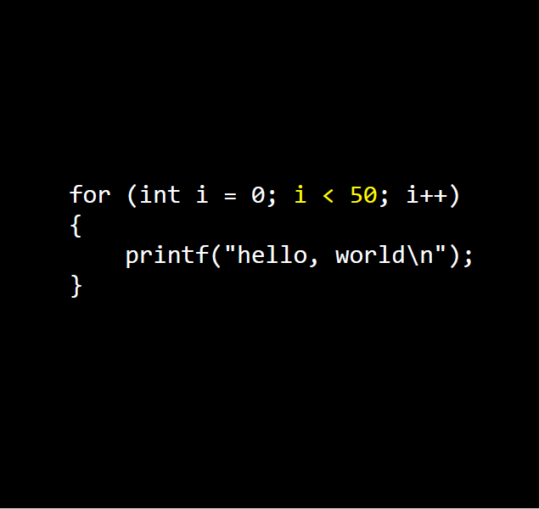
After incrementing the value, again it checks the condition before entering the loop.

Slide 26
If condition is true, it enters the loop

Slide 27
And, the process repeats until the condition becomes false

Slide 29
Output:
hello, world
hello, world
hello, world
.
.
.
hello, world
(50 times will be printed)

Slide 30
- if statement
- if...else statement
- if...elseif....else statement
- switch statement
- for loop
- while loop
- do...while loop
Notes:
C programming language assumes any non-zero and non-null values as true, and if it is either zero or null, then it is assumed as false value.

Slide 31
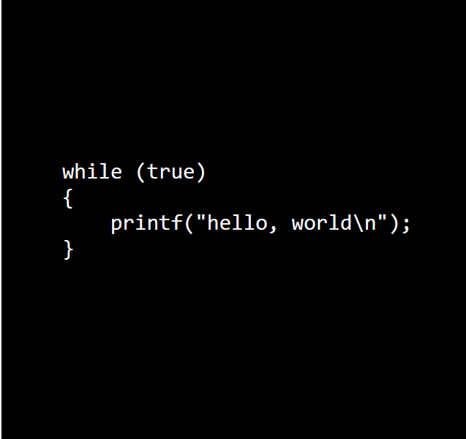
If condition is true, it enters the loop
Notes:
A while loop in C programming repeatedly executes a target statement as long as a given condition is true.
Syntax
The syntax of a while loop in C programming language is −
while(condition)
{
statement(s);
}
Here, statement(s) may be a single statement or a block of statements. The condition may be any expression, and true is any nonzero value. The loop iterates while the condition is true.
When the condition becomes false, the program control passes to the line immediately following the loop.

Slide 32
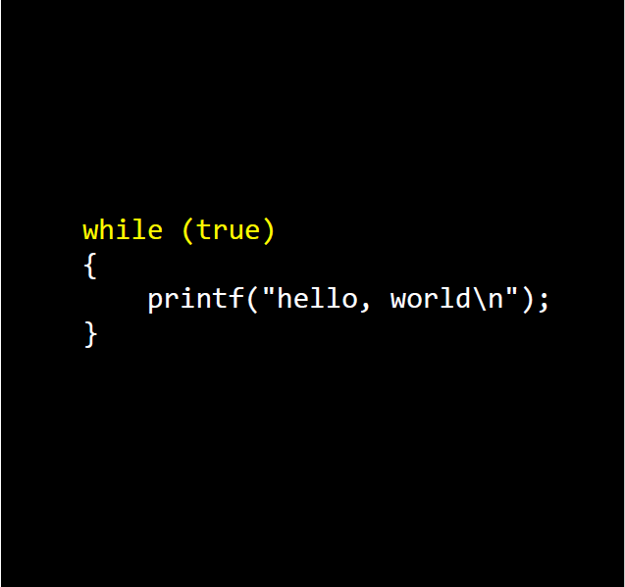

Slide 33
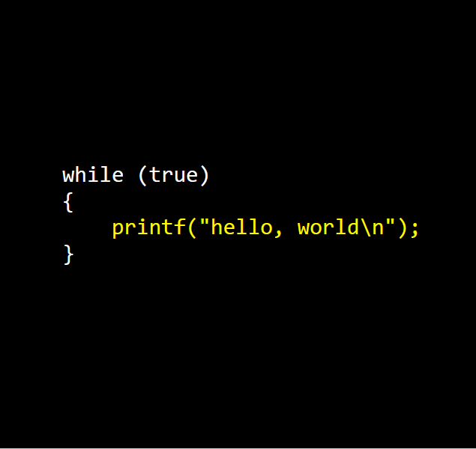

Slide 34
The loop will be executed until the condition becomes false

Slide 35
- if statement
- if...else statement
- if...elseif....else statement
- switch statement
- for loop
- while loop
- do...while loop
Notes:
C programming language assumes any non-zero and non-null values as true, and if it is either zero or null, then it is assumed as false value.

Slide 36
#include <stdio.h>
int main ()
{
int a = 1;
do
{
printf(“Value of a: %d\n", a);
a = a + 1;
} while( a < 4 );
return 0;
}
Output:
Value of a: 1
Value of a: 2
Value of a: 3
Notes:
Unlike for and while loops, which test the loop condition at the top of the loop, the do...while loop in C programming checks its condition at the bottom of the loop.
A do...while loop is similar to a while loop, except the fact that it is guaranteed to execute at least one time.
Syntax
The syntax of a do...while loop in C programming language is −
do
{
statement(s);
} while( condition );
Notice that the conditional expression appears at the end of the loop, so the statement(s) in the loop executes once before the condition is tested.
If the condition is true, the flow of control jumps back up to do, and the statement(s) in the loop executes again. This process repeats until the given condition becomes false.

Slide 37
#include <stdio.h>
int main () {
int a = 1;
do
{
printf("Value of a: %d\n", a);
a = a + 1;
} while( a < 1 );
return 0;
}
#include <stdio.h>
int main () {
int a = 1;
while( a < 1 )
{
printf("Value of a: %d\n", a);
a = a + 1;
}
return 0;
}
Output:
Value of a: 1
Output:
---
Notes:
Unlike for and while loops, which test the loop condition at the top of the loop, the do...while loop in C programming checks its condition at the bottom of the loop.
A do...while loop is similar to a while loop, except the fact that it is guaranteed to execute at least one time.
Syntax
The syntax of a do...while loop in C programming language is −
do
{
statement(s);
} while( condition );
Notice that the conditional expression appears at the end of the loop, so the statement(s) in the loop executes once before the condition is tested.
If the condition is true, the flow of control jumps back up to do, and the statement(s) in the loop executes again. This process repeats until the given condition becomes false.

Slide 38
while loop
do...while loop
Condition is checked first, then loop body will be executed
If condition is false, loop body will not be executed
Entry controlled loop
Loop body will be executed first, then condition is checked
If condition is false, loop body will be executed at least once
Exit controlled loop

Slide 39
PROGRAMS

Slide 40
PROGRAMS

Slide 41
Write a C program print “Hello World” without using any header file.
int printf(const char *format, ...);
int main()
{
printf( "Hello World" );
return 0;
}
Notes:
Stdio.h Header fie contains only the declaration of all the input and output functions.
Here in program, we have to use printf, so the programmer can directly give the prinf function’s declaration part.

Slide 42
1. Write a C program to find the area of a circle.
The input diameter will be given only as an integer and the output area of a circle should be a floating point variable with 2 point precision. (Assume PI = 3.14)
Input: 10
Output: 78.50
Input: 2
Output: 3.14

Slide 43
#include<stdio.h>
int main()
{
int diameter;
scanf("%d", &diameter);
float radius = (diameter)/2;
float pi =3.14;
float area = (pi) * (radius * radius);
printf("%0.2f", area);
return 0;
}
Input: 10
Output: 78.50
Input: 2
Output:
3.14
Notes:
float radius = (diameter)/2;
When input =10, output will be 78.50
But when input is 7, then output what is the output we get from the given program????
Ask the students like why the output will be different..????
Interact with them... give time.. then discuss..!!
%0.2f is to print the answer with 2 values after decimal point.

Slide 44
#include<stdio.h>
int main()
{
int diameter;
scanf("%d", &diameter);
float radius = (diameter)/2;
float pi =3.14;
float area = (pi) * (radius * radius);
printf("%0.2f", area);
return 0;
}
Hidden test cases...!
Try this...!
Input: 3
Output:
3.14
Actually answer is 7.07
Notes:
float radius = (diameter)/2;
When input =10, output will be 78.50
Give them different inputs (even number integers)for which they will get correct output.
Then, later give them odd numbers as an input, for which their program might fail to give the correct output, here teach them about hidden test case,
Ask the students like why the output will be different..????
Interact with them... give time.. then discuss..!!
%0.2f is to print the answer with 2 values after decimal point.

Slide 45
#include<stdio.h>
int main()
{
int diameter;
scanf("%d", &diameter);
float radius = (diameter)/2;
float pi =3.14;
float area = (pi) * (radius * radius);
printf("%0.2f", area);
return 0;
}
float radius = diameter / 2
= 7 / 2
= int / int = int
= 3 (not 3.5)
radius = 3.000000
Notes:
int / int is int
So, 7/2 is 3 (not 3.5)
float radius = (3 will be stored as float type)
So when the input is even, radius will not be a problem.
When the input is odd, radius will be a problem. So we should do type casting. (explicit type-casting)
float radius - (float) diameter /2; --> Here diameter is taken as float (type-casted). float/ int = float

Slide 46
#include<stdio.h>
int main()
{
int diameter;
scanf("%d", &diameter);
float radius = (float)diameter/2;
float pi =3.14;
float area = (pi) * (radius * radius);
printf("%0.2f", area);
return 0;
}
float radius = (float)diameter / 2
= float / int = float
= 7.000000 / 2
radius = 3.500000
Notes:
int / int is int
So, 7/2 is 3 (not 3.5)
float radius = (3 will be stored as float type)
So when the input is even, radius will not be a problem.
When the input is odd, radius will be a problem. So we should do type casting. (explicit type-casting)
float radius - (float) diameter /2; --> Here diameter is taken as float (type-casted). float/ int = float

Slide 47
#include<stdio.h>
int main()
{
int diameter;
scanf("%d", &diameter);
float radius = (float)diameter/2;
float pi =3.14;
float area = (pi) * (radius * radius);
printf("%0.2f", area);
return 0;
}
Input: 20
Output: 314.00
Input: 3
Output: 7.07
Notes:
Works for both even input and odd output.

Slide 48
2. Write a C program to check alphabet or not.
Get any character as an input from the user and check whether the given character is an alphabet or not.
Input: A
Output: ALPHABET
Input: a
Output: ALPHABET
Input: ?
Output: NOT AN ALPHABET

Slide 49
#include <stdio.h>
int main()
{
char c;
scanf("%c",&c);
if( (c>='a' && c<='z') || (c>='A' && c<='Z'))
printf("ALPHABET");
else
printf("NOT AN ALPHABET");
return 0;
}
Input: A
Output: ALPHABET
Input: a
Output: ALPHABET
Input: ?
Output: NOT AN ALPHABET

Slide 50
3. Write a C program to check Vowel or Consonant.
Get any character as an input from the user and check whether the given character is Vowel or Consonant.
Input: A
Output: Vowel
Input: a
Output: Vowel
Input: R
Output: Consonant

Slide 51
#include <stdio.h>
int main() {
char c; int Low, Upp;
scanf("%c",&c);
Low = (c == 'a' || c == 'e' || c == 'i' || c == 'o' || c == 'u');
Upp = (c == 'A' || c == 'E' || c == 'I' || c == 'O' || c == 'U');
if (Low || Upp)
printf("Vowel");
else
printf("Consonant");
return 0; }
Input: A
Output: Vowel
Input: a
Output: Vowel
Input: R
Output: Consonant

Slide 52
4. Write a C program to check Leap year.
Get any integer (yyyy) as an input from the user and check whether the given year is a leap year or not.
Input: 1600
Output: Leap year
Input: 2011
Output: Not a leap year

Slide 53
#include <stdio.h>
int main() {
int year;
scanf("%d",&year);
if( year%100 == 0)
{ if( year%400 == 0) { printf("Leap year"); }
else { printf("Not a Leap year"); }
}
else if(year%4 == 0) { printf("Leap year"); }
else { printf("Not a Leap year"); }
return 0;
}
Input: 1600
Output: Leap year
Input: 2011
Output: Not a leap year

Slide 54
5. Write a C program to swap two numbers without third variable.
Get two integers as an input from the user and check swap the two integers without using third variable
Input: 10 20
Output: 20 10
Input: 15 22 Output: 22 15
Notes:
Here the program is just to check whether the given number is a prime or not..!!
Task is..!! If its a prime number what has to print... else..??
Ask the students to look at the sample input and output to understand what has to be printed if its a prime..!!
Here, if its a prime number, we should print the square of the given number. And if it's not a prime then half of the given number has to be printed.
(If not a prime number and odd) --> then print half the number with 2 presicion values
(If not a prime and even number) --> then half the number in integer form

Slide 55
#include <stdio.h>
int main()
{
int A, B;
scanf("%d %d",&A, &B);
A = A - B;
B = A + B;
A = B - A;
printf("%d %d", A, B);
return 0;
}
Input: 10 20
Output: 20 10
Input: 15 22
Output: 22 15

Slide 56
6. Write a C program to find the factorial of a given number.
Factorial of a non-negative integer n, denoted by n!, is the product of all positive integers less than or equal to n. For example, The value of 5! is 5*4*3*2*1 = 120 (n<20)
Input: 5
Output: 120
Input: 10
Output: 3628800

Slide 57
#include<stdio.h>
int main()
{
int num, i,
long int fact=1;
scanf(“%d”, &num);
for(i=1;i<=num;i++)
fact = fact * i;
printf("%ld",fact);
return 0;
}
Input: 5
Output: 120
Input: 10
Output: 3628800

Slide 58
7. Write a C program to power of a number.
The program takes two integers from the user (a base number and an exponent) and calculates the power. For example: In case of 2, 3 the first input 2 is the base number and second input 3 is the exponent. And, the power is equal to 2*2*2
Input: 2 3
Output: 8
Input: 3 4
Output: 81

Slide 59
#include <stdio.h>
int main() {
int base, exponent;
long long result = 1;
scanf("%d %d", &base, &exponent);
while (exponent != 0)
{
result *= base; --exponent;
}
printf("%lld", result);
return 0;
}
Input: 2 3
Output: 8
Input: 3 4
Output: 81
Notes:
long long is int type only, %lld is theformat specifier used.

Slide 60
8. Write a C program to print the factors of a positive integer.
The program takes a positive integer from the user and displays all the positive factors of that number. Example: If 6 is the input, then output should be 1 2 3 6.
Input: 15
Output: 1 3 5 15
Input: 12
Output: 1 2 3 4 6 12

Slide 61
#include <stdio.h>
int main()
{
int number, i;
scanf("%d",&number);
for(i=1; i <= number; ++i)
{
if (number%i == 0)
printf("%d ",i);
}
return 0;
}
Input: 15
Output: 1 3 5 15
Input: 12
Output: 1 2 3 4 6 12

Slide 62
9. Write a C program to count number of digits in an integer.
The program takes an integer from the user and calculates the number of digits. For example: If the user enters 2319, the output of the program will be 4.
Input: 23456
Output: 5
Input: 12
Output: 2

Slide 63
#include <stdio.h>
int main() {
long long n;
int count = 0;
scanf("%lld", &n);
while(n != 0)
{
n /= 10;
++count;
}
printf("%d", count);
return 0;
}
Input: 23456
Output: 5
Input: 12
Output: 2
Notes:
long long is int type only, %lld is theformat specifier used.

Slide 64
10. Write a C program to sum of digits of a number.
The program takes one positive integer as an input, find the sum of individual digits of a given positive integer. Example: 456 as 4+5+6 = 15
Input: 1236
Output: 12
Input: 12
Output: 3

Slide 65
#include <stdio.h>
int main() {
int n, t, sum = 0, rem;
scanf("%d", &n);
while (n != 0)
{
rem = n % 10;
sum = sum + rem;
n = n / 10;
}
printf(" %d ",sum);
return 0;
}
Input: 1236
Output: 12
Input: 12
Output: 3
Notes:
long long is int type only, %lld is theformat specifier used.

Slide 66
11. Write a C program to reverse an integer.
This program takes an integer input from the user. For example: if input 215 , then after reversing the integer, should print 512 as an output.
Input: 234
Output: 432
Input: 12
Output: 21

Slide 67
#include <stdio.h>
int main() {
int rev =0, rem, n;
scanf("%d", &n);
while(n != 0)
{
rem = n%10;
rev = rev *10 + rem;
n /= 10;
}
printf("%d", rev);
return 0; }
Input: 234
Output: 432
Input: 12
Output: 21

Slide 68
12. Write a C program to check palindrome.
An integer(n<1000) is a palindrome if the reverse of that number is equal to the original number. For example: If the input is 515, then after reversing we get 515 which is as same as the original number, Palindrome
Input: 234
Output: Not a Palindrome
Input: 121
Output: Palindrome

Slide 69
#include <stdio.h>
int main()
{
int rev =0, rem, n, copy;
scanf("%d", &n);
copy = n;
while(n != 0)
{
rem = n%10;
rev = rev *10 + rem;
n /= 10;
}
if (copy == rev)
{
printf(“Palindrome”);
}
else
{
printf(“Not a Palindrome”);
}
return 0;
}

Slide 70
13. Write a C program to sum all the prime numbers within a range.
The first input, N1 which is a positive integer, will contain the lower bound of the range. The second input N2, which is also a positive integer will contain the upper bound of the range. The program should consider all the prime numbers within the range, excluding the upper bound and lower bound.
Input: 5 13
Output: 18
Input: 7 24
Output: 83

Slide 71
for(i=N1+1; i<N2; i++)
{
for(j=2; j<=sqrt(i); j++)
{
count=0;
if(i%j == 0)
{
count++;
break;
}
}
if(count == 0)
sum = sum + i;
}
#include<stdio.h>
#include<math.h>
int main() {
int N1, N2,i, j, count, sum=0;
scanf("%d %d", &N1, &N2);
printf("%d",sum);
return 0;
}

Slide 72
14. Write a C program to find GCD of 2 numbers.
The HCF or GCD of two integers is the largest integer that can exactly divide both numbers (without a remainder).
Input: 2 7
Output: 1
Input: 5 15
Output: 5

Slide 73
#include<stdio.h>
int main() {
int a,b,small,i;
scanf("%d %d", &a, &b);
small=a>b?b:a;
for(i=small;i>=1;i--)
{
if((a%i==0)&&(b%i==0))
{
printf("%d",i); break;
}
}
return 0; }
Input: 2 7
Output: 1
Input: 5 15
Output: 5

Slide 74
Wipro: 02
15. Write a C program to find LCM of 2 numbers using GCD.
The HCF or GCD of two integers is the largest integer that can exactly divide both numbers (without a remainder).
Input: 5 7
Output: 35
Input: 5 15
Output: 15

Slide 75
#include<stdio.h>
int main() {
int a, b, small, i, GCD, LCM;
scanf("%d %d", &a, &b);
small=a>b?b:a;
for(i=small;i>=1;i--)
{
if((a%i==0)&&(b%i==0))
{
GCD = i; break;
}
}
LCM = (a*b)/GCD
printf("%d", LCM);
return 0;
}
Input: 5 7
Output: 35
Input: 5 15
Output: 15

Slide 76
Assignment Programs

Slide 77
Assignment Programs

Slide 78
1. Program to check whether the integer is a perfect square.
2. Program to print the fibonacci series upto n number of terms.
3. Program to find hypotenuse of a triangle.
(Given opposite and adjacent side)
4. Program to print the multiplication table.
5. Program to display the ATM transaction.
Problem Description:
1) Balance checking, 2) Cash withdrawal and 3) Cash deposition.

Slide 79


Notes:
Doubts???

Slide 80
Thank you!

Slide 81
Thank you!

