Slide 1



practical learning redefined
One point solution for all your placement needs
terv.pro

Slide 2
C Programming Session 2.1

Slide 3

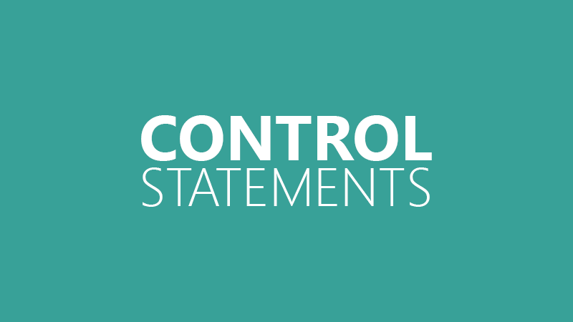

Slide 4

Challenge: 26
#include <stdio.h>
int main() {
int i = 3;
switch (i)
{
case 0+1: printf(“TERV");
break;
case 1+2: printf(“TERV PRO");
break;
default: printf(“TERV TERV");
}
return 0;
}
What is the output of the above program?
(A) TERV
(B) TERV PRO
(C) TERV TERV
(D) Compile-time error

Slide 5
Challenge: 27
#include <stdio.h>
int main()
{
int x = 1;
switch (x)
{
case 2: printf("Choice is 1");
break;
case 1+1: printf("Choice is 2");
break;
}
return 0;
}
What is the output of the above program?
(A) Choice is 1
(B) Choice is 2
(C) Run-time error
(D) Compile-time error
Notes:
Compiler Error: duplicate case value
Two case labels cannot have same value

Slide 6
Challenge: 28
# include <stdio.h>
int main() {
int i = 0;
for (i=0; i<20; i++) {
switch(i) {
case 0:
i += 5;
case 1:
i += 2;
default:
i += 4;
break; }
printf("%d ", i);
} return 0; }
What is the output of the above program?
(A) 5 10 15 20
(B) 7 12 17 22
(C) 11 16 21
(D) Compiler Error

Slide 7
Challenge: 29
#include <stdio.h>
int main() {
int x = 1;
switch (x) {
x = x + 1;
case 1: printf("Choice is 1");
break;
case 2: printf("Choice is 2");
break;
default: printf("Invalid choice");
break;
}
return 0;
}
What is the output of the above program?
(A) Choice is 1
(B) Choice is 2
(C) Invalid choice
(D) Compile-time error
Notes:
x = x+1 inside switch statement will not be executed.

Slide 8
Challenge: 30
#include <stdio.h>
int main()
{
float x = 1.1;
switch (x)
{
case 1.1: printf("Choice is 1");
break;
default: printf("Invalid choice");
break;
}
return 0;
}
What is the output of the above program?
(A) Choice is 1
(B) Choice is 2
(C) Invalid choice
(D) Compile-time error
Notes:
Compiler Error: switch quantity not an integer
The expression used in switch must be integral type ( int, char and enum). Any other type of expression is not allowed.

Slide 9
Challenge: 31
#include <stdio.h>
int main()
{
int i;
if (printf("0"))
i = 3;
else
i = 5;
printf("%d", i);
return 0;
}
What is the output of the above program?
(A) 3
(B) 03
(C) 05
(D) 5
Notes:
The control first goes to the if statement where 0 is printed. The printf("0") returns the number of characters being printed i.e. 1. The block under if statement gets executed and i is initialized with 3.

Slide 10
Challenge: 32
What is the output of the above program?
(A) 3 1 -1 -3
(B) Infinite loop
(C) 2 1 0
(D) Error
#include<stdio.h>
int main()
{
int n;
for (n = 3; n!=0; n--)
printf("\n n = %d", n--);
return 0;
}
Notes:
n = 3
n = 1
n = -1
n = -3
n = -5
n = -7
n = -9
n = -11
n = -13 etc.... infinite loop

Slide 11
Challenge: 33
#include <stdio.h>
int main()
{
int i = 0;
switch (i)
{
case '0': printf(“TERV");
break;
case '1': printf(“TERV PRO");
break;
default: printf("Technical");
}
return 0;
}
What is the output of the above program?
(A) TERV
(B) TERV PRO
(C) Technical
(D) Error

Slide 12
Challenge: 34
How many times the value i will be printed?
(A) Error
(B) 9
(C) 10
(D) 1
#include<stdio.h>
void main()
{
int i;
for(i=0;i<10;i++);
printf("%d ",i);
}
Notes:
1. For loop with ending semicolon is called Body less for loop
2. This type of for loop is only used for incrementing subscript variable (here i)
3. This for loop will run 10 times and finally updates value

Slide 13
Challenge: 35
How many times the value i will be printed?
(A) Error
(B) 9
(C) 10
(D) 1
#include<stdio.h>
void main()
{
int i;
for(i=0;i<10;i++)
printf("%d ",i);
}
Notes:
Here printf belongs to for loop.

Slide 14
Challenge: 36
#include<stdio.h>
int main()
{
int x, y;
for(x=5;x>=1;x--)
{
for(y=1;y<=x;y++)
printf("%d\n",y);
}
}
How many times the below loop will be executed?
(A) 15
(B) 10
(C) 5
(D) 16
Notes:
Here printf belongs to for loop.

Slide 15
Challenge: 37
#include<stdio.h>
int main()
{
int x=1;
for( ; ; )
{
printf("%d\n",x);
}
}
How many times the for loop will be executed?
(A) 1
(B) 0
(C) Infinite times
(D) Compile time error
Notes:
Here printf belongs to for loop.

Slide 16
Challenge: 38
#include<stdio.h>
void main()
{
int i, j;
for(i=0,j=0; i<10,j<20; i++,j++)
{
printf("i=%d %t j=%d", i, j);
}
}
What will be the value of i and j after execution of following program?
(A) 10 10
(B) 20 20
(C) 10 20
(D) Run time error
Notes:
comma operator is executed from left to right so until j<20 for loop statement is true, so both i and j are incremented.
So, i = 20 and j = 20.

Slide 17
Challenge: 39
#include<stdio.h>
void main()
{
int i = -10;
for( ; i ; printf("%d ", i++));
}
What will be the output given program?
(A) -10 to -1
(B) -10 to infinite
(C) -10 to 0
(D) Compiler error
Notes:
for loop can be initialized outside of the loop. Since until -1 value of i remain a non-zero value and hence the condition is true up to -1. But when i is further increases its value becomes 0 and condition becomes false and loop stops there.
Note: In C any non-zero value(positive or negative) evaluates to true and only zero value is evaluates to false.

Slide 18
Challenge: 40
#include<stdio.h>
void main()
{
int a=11,b=5;
if(a=5)
b = 6;
printf("%d %d", a, b);
}
What will be the output given program?
(A) 11 6
(B) 11 5
(C) 5 6
(D) Compiler error
Notes:
if(a=5) -- condition is always true.

Slide 19
Challenge: 41
#include<stdio.h>
void main()
{
int a=11,b=5;
if(a=0)
b = 6;
printf("%d %d", a, b);
}
What will be the output given program?
(A) 11 6
(B) 0 6
(C) 0 5
(D) Compiler error
Notes:
if(a=0) here condition is false.

Slide 20
Challenge: 42
#include<stdio.h>
void main()
{
int value=0;
if(value)
{
printf("Well done ");
}
printf("Excellent");
}
What will be the output given program?
(A) Well done Excellent
(B) Well done
(C) Excellent
(D) Compiler error
Notes:
if(value) -- if(0) -- here condition is false. so it will not enter the if part.

Slide 21
Challenge: 43
#include<stdio.h>
void main()
{
int value=1;
if(value)
{
printf("Well done ");
}
printf("Excellent");
}
What will be the output given program?
(A) Well done Excellent
(B) Well done
(C) Excellent
(D) Compiler dependent
Notes:
if(value) -- if(1) -- here condition is True. so it will enter if part.

Slide 22
Challenge: 44
#include <stdio.h>
int main() {
char a[5] = "FACE“; int i;
for(i=0; i<3; i++)
{ switch (a[i]) {
case 'F': printf("Choice is 1\n");
break;
case 'A':
printf("choice is 2\n");
break;
default: printf("Invalid choice");
break;
} }
return 0;
}
What will be the output given program?
Choice is 1
Choice is 2
Invalid Choice
(B) Choice is 1
(C) Invalid Choice
(D) Compiler Error
Notes:
if(value) -- if(1) -- here condition is True. so it will enter if part.

Slide 23
Challenge: 45
#include<stdio.h>
int main() {
char a[5] = “TERV";
switch (a)
{
case “PRO":
printf("Choice is 1\n");
break;
case “TERV":
printf("choice is 2\n");
break;
}
return 0;
}
What will be the output given program?
Choice is 1
Choice is 2
(B) Choice is 1
(C) Invalid Choice
(D) Compiler Error
Notes:
if(value) -- if(1) -- here condition is True. so it will enter if part.

Slide 24


Slide 25


Slide 26
An operator is a symbol that tells the compiler to perform certain mathematical or logical manipulations.
Operators are used in program to manipulate data and variables.
C Operators are classified into 7 categories:.

Slide 27
Arithmetic Operators
C Operators are classified into
7 categories:.
RelationalOperators
Assignment Operators
Logical Operators
Bitwise Operators
Increment and decrement Operators
Special Operators

Slide 28
Arithmetic Operators
7 categories:.
Relational Operators
Relational Operators
Assignment Operators
Assignment Operators
Logical Operators
Logical Operators
Bitwise Operators
Bitwise Operators
Increment and decrement Operators
Increment and decrement Operators
Special Operators
Special Operators

Slide 29
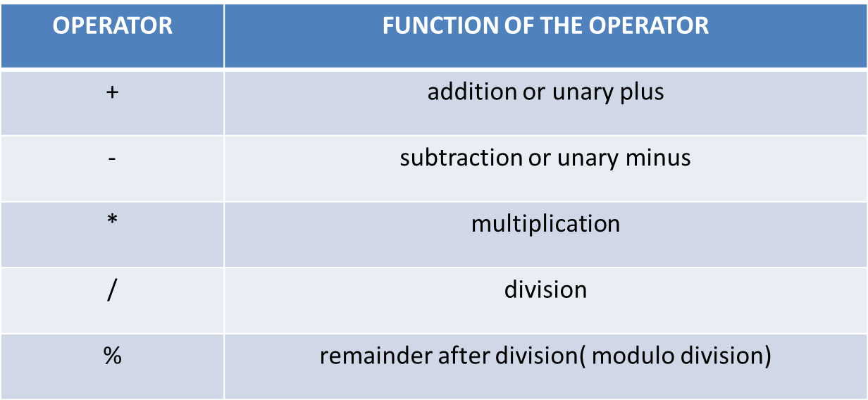
An arithmetic operator performs mathematical operations such as addition, subtraction and multiplication on numerical values (constants and variables).
Arithmetic Operators

Slide 30
Arithmetic Operators
7 categories:.
Relational Operators
Relational Operators
Assignment Operators
Assignment Operators
Logical Operators
Logical Operators
Bitwise Operators
Bitwise Operators
Increment and decrement Operators
Increment and decrement Operators
Special Operators
Special Operators

Slide 31
A relational operator checks the relationship between two operands. If the relation is true, it returns 1; if the relation is false, it returns value 0.
Relational operators are used in decision making and loops.
Relational Operators

Slide 32
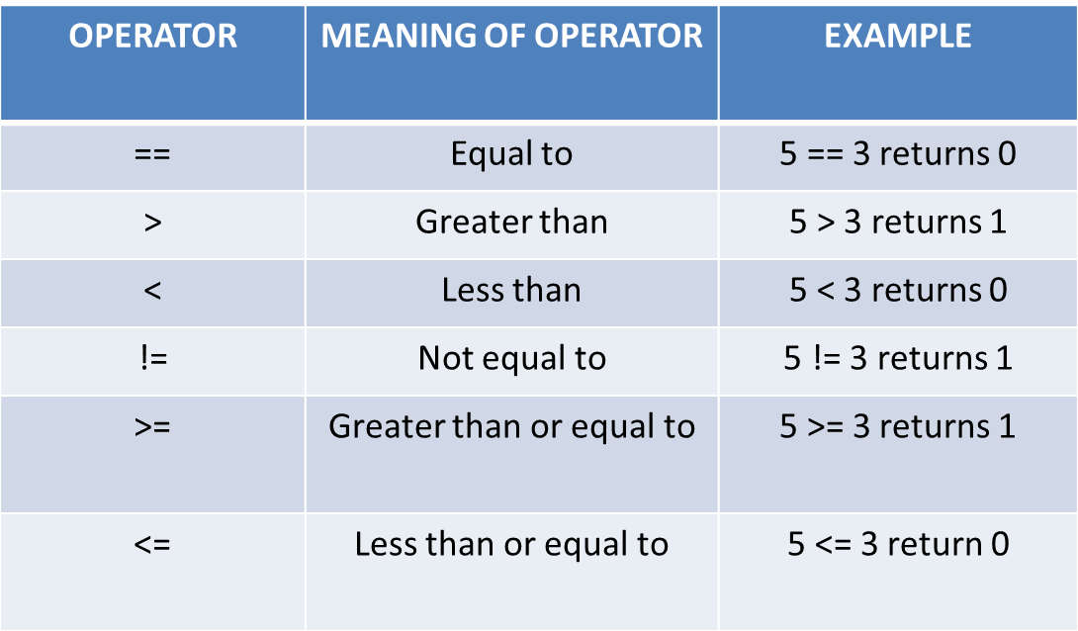
Relational Operators

Slide 33
Arithmetic Operators
7 categories:.
Relational Operators
Relational Operators
Assignment Operators
Assignment Operators
Logical Operators
Logical Operators
Bitwise Operators
Bitwise Operators
Increment and decrement Operators
Increment and decrement Operators
Special Operators
Special Operators

Slide 34
Operator | Example | Meaning
= | a = b | a = b
+= | a += b | a = a+b
-= | a -= b | a = a-b
*= | a *= b | a = a*b
/= | a /= b | a = a/b
%= | a %= b | a = a%b
Assignment operators are used in C programming.
Assignment Operators
Notes:
Geetha kka

Slide 35
Arithmetic Operators
7 categories:.
Relational Operators
Relational Operators
Assignment Operators
Assignment Operators
Logical Operators
Logical Operators
Bitwise Operators
Bitwise Operators
Increment and decrement Operators
Increment and decrement Operators
Special Operators
Special Operators

Slide 36
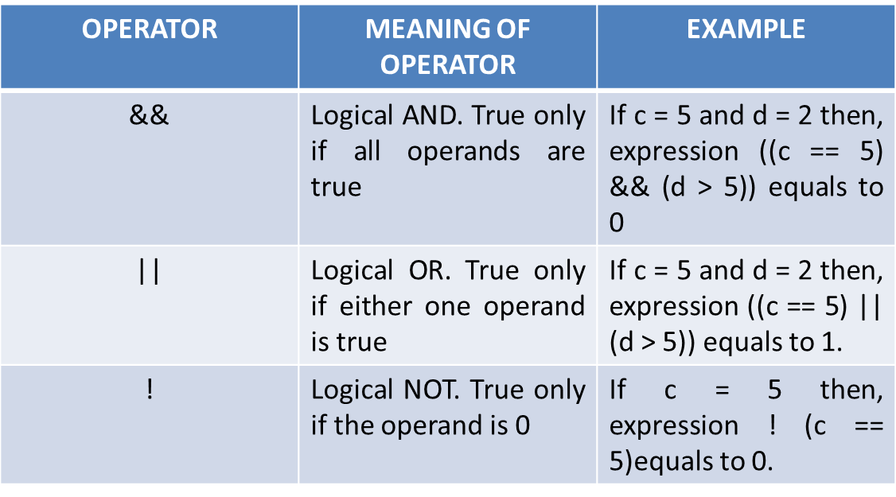
An expression containing logical operator returns either 0 or 1 depending upon whether expression results true or false.
Logical operators are commonly used in decision making in C programming.
Logical Operators

Slide 37
Logical Operators
#include <stdio.h>
int main()
{
int a = 5, b = 5, c = 10, result;
result = (a == b) && (c > b);
printf("(a == b) && (c > b) =%d \n", result);
result = (a == b) && (c < b);
printf("(a == b) && (c < b) =%d \n", result);
result = (a == b) || (c < b);
printf("(a == b) || (c < b) =%d \n", result);
result = (a != b) || (c < b);
printf("(a != b) || (c < b) =%d \n", result);
result = !(a != b);
printf("!(a == b) =%d \n", result);
result = !(a == b);
printf("!(a == b) =%d \n", result);
}
(a == b) && (c > b) =1
(a == b) && (c < b) =0
(a == b) || (c < b) =1
(a != b) || (c < b) =0
!(a != b) =1
!(a == b) =0
Output
Notes:
Fill the output

Slide 38
Arithmetic Operators
7 categories:.
Relational Operators
Relational Operators
Assignment Operators
Assignment Operators
Logical Operators
Logical Operators
Bitwise Operators
Bitwise Operators
Increment and decrement Operators
Increment and decrement Operators
Special Operators
Special Operators

Slide 39
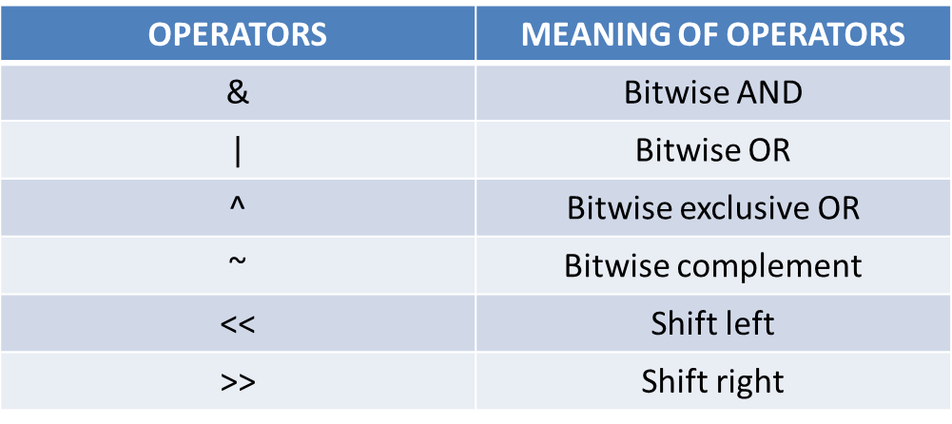
Bitwise operators are used in C programming to perform bit-level operations.
During computation, mathematical operations like: addition, subtraction, multiplication and division are converted to bit-level which makes processing faster and saves power.
Binary conversion is important here.
Bitwise Operators

Slide 40
a | b | a & b | a | b | a ^ b
0 | 0 | 0 | 0 | 0
0 | 1 | 0 | 1 | 1
1 | 0 | 0 | 1 | 1
1 | 1 | 1 | 1 | 0
Notes:
Fill the output
Change the true or false comment lines to fade in one by one later.
#include <stdio.h>
int main()
{
int a = 5, b = 5, c = 10;
printf("%d == %d = %d \n", a, b, a == b); // true 5==5 = 1
printf("%d == %d = %d \n", a, c, a == c); // false 5==10 = 0
printf("%d > %d = %d \n", a, b, a > b); //false 5>5 = 0
printf("%d < %d = %d \n", a, c, a < c); //true 5<10 = 1
printf("%d != %d = %d \n", a, b, a != b); //false 5!=5 = 0
printf("%d != %d = %d \n", a, c, a != c); //true 5!=10 =0
printf("%d >= %d = %d \n", a, b, a >= b); //true 5>=5 = 1
printf("%d >= %d = %d \n", a, c, a >= c); //false 5>=10 = 0
return 0;
}

Slide 41
int x = 11;
int y = 7;
int a = 8, b = 2;
printf("%d", x | y );
printf("%d“, x & y);
printf("%d“, x ^ y);
printf("%d", a << 2);
printf("%d", a >> 2);
Output:
15
3
12
32
2
Notes:
Fill the output
Change the true or false comment lines to fade in one by one later.
#include <stdio.h>
int main()
{
int a = 5, b = 5, c = 10;
printf("%d == %d = %d \n", a, b, a == b); // true 5==5 = 1
printf("%d == %d = %d \n", a, c, a == c); // false 5==10 = 0
printf("%d > %d = %d \n", a, b, a > b); //false 5>5 = 0
printf("%d < %d = %d \n", a, c, a < c); //true 5<10 = 1
printf("%d != %d = %d \n", a, b, a != b); //false 5!=5 = 0
printf("%d != %d = %d \n", a, c, a != c); //true 5!=10 =0
printf("%d >= %d = %d \n", a, b, a >= b); //true 5>=5 = 1
printf("%d >= %d = %d \n", a, c, a >= c); //false 5>=10 = 0
return 0;
}

Slide 42
x = 1 0 1 1
y = 0 1 1 1
int x = 11;
int y = 7;
int a = 8, b = 2;
printf("%d", x | y );
printf("%d", x & y);
printf("%d", x ^ y);
printf("%d", a << 2);
printf("%d", a >> 2);
x | y = 1 1 1 1
11 | 7
Output:
15
3
12
32
2
Notes:
Fill the output
Change the true or false comment lines to fade in one by one later.
#include <stdio.h>
int main()
{
int a = 5, b = 5, c = 10;
printf("%d == %d = %d \n", a, b, a == b); // true 5==5 = 1
printf("%d == %d = %d \n", a, c, a == c); // false 5==10 = 0
printf("%d > %d = %d \n", a, b, a > b); //false 5>5 = 0
printf("%d < %d = %d \n", a, c, a < c); //true 5<10 = 1
printf("%d != %d = %d \n", a, b, a != b); //false 5!=5 = 0
printf("%d != %d = %d \n", a, c, a != c); //true 5!=10 =0
printf("%d >= %d = %d \n", a, b, a >= b); //true 5>=5 = 1
printf("%d >= %d = %d \n", a, c, a >= c); //false 5>=10 = 0
return 0;
}

Slide 43
x = 1 0 1 1
y = 0 1 1 1
int x = 11;
int y = 7;
int a = 8, b = 2;
printf("%d", x | y );
printf("%d", x & y);
printf("%d", x ^ y);
printf("%d", a << 2);
printf("%d", a >> 2);
x & y = 0 0 1 1
Output:
15
3
12
32
2
11 & 7
Notes:
Fill the output
Change the true or false comment lines to fade in one by one later.
#include <stdio.h>
int main()
{
int a = 5, b = 5, c = 10;
printf("%d == %d = %d \n", a, b, a == b); // true 5==5 = 1
printf("%d == %d = %d \n", a, c, a == c); // false 5==10 = 0
printf("%d > %d = %d \n", a, b, a > b); //false 5>5 = 0
printf("%d < %d = %d \n", a, c, a < c); //true 5<10 = 1
printf("%d != %d = %d \n", a, b, a != b); //false 5!=5 = 0
printf("%d != %d = %d \n", a, c, a != c); //true 5!=10 =0
printf("%d >= %d = %d \n", a, b, a >= b); //true 5>=5 = 1
printf("%d >= %d = %d \n", a, c, a >= c); //false 5>=10 = 0
return 0;
}

Slide 44
x = 1 0 1 1
y = 0 1 1 1
int x = 11;
int y = 7;
int a = 8, b = 2;
printf("%d", x | y );
printf("%d", x & y);
printf("%d", x ^ y);
printf("%d", a << 2);
printf("%d", a >> 2);
x ^ y = 1 1 0 0
Output:
15
3
12
32
2
11 ^ 7
Notes:
Fill the output
Change the true or false comment lines to fade in one by one later.
#include <stdio.h>
int main()
{
int a = 5, b = 5, c = 10;
printf("%d == %d = %d \n", a, b, a == b); // true 5==5 = 1
printf("%d == %d = %d \n", a, c, a == c); // false 5==10 = 0
printf("%d > %d = %d \n", a, b, a > b); //false 5>5 = 0
printf("%d < %d = %d \n", a, c, a < c); //true 5<10 = 1
printf("%d != %d = %d \n", a, b, a != b); //false 5!=5 = 0
printf("%d != %d = %d \n", a, c, a != c); //true 5!=10 =0
printf("%d >= %d = %d \n", a, b, a >= b); //true 5>=5 = 1
printf("%d >= %d = %d \n", a, c, a >= c); //false 5>=10 = 0
return 0;
}

Slide 45
int x = 11;
int y = 7;
int a = 8, b = 2;
printf("%d", x | y );
printf("%d", x & y);
printf("%d", x ^ y);
printf("%d", a << 2);
printf("%d", a >> 2);
a = 0 0 0 0 1 0 0 0
0
0
0 0 1 0 0 0
Output:
15
3
12
32
2
8 << 2 – Left shift
Notes:
Fill the output
Change the true or false comment lines to fade in one by one later.
#include <stdio.h>
int main()
{
int a = 5, b = 5, c = 10;
printf("%d == %d = %d \n", a, b, a == b); // true 5==5 = 1
printf("%d == %d = %d \n", a, c, a == c); // false 5==10 = 0
printf("%d > %d = %d \n", a, b, a > b); //false 5>5 = 0
printf("%d < %d = %d \n", a, c, a < c); //true 5<10 = 1
printf("%d != %d = %d \n", a, b, a != b); //false 5!=5 = 0
printf("%d != %d = %d \n", a, c, a != c); //true 5!=10 =0
printf("%d >= %d = %d \n", a, b, a >= b); //true 5>=5 = 1
printf("%d >= %d = %d \n", a, c, a >= c); //false 5>=10 = 0
return 0;
}

Slide 46
int x = 11;
int y = 7;
int a = 8, b = 2;
printf("%d", x | y );
printf("%d", x & y);
printf("%d", x ^ y);
printf("%d", a << 2);
printf("%d", a >> 2);
a = 0 0 0 0 1 0 0 0
0 0 1 0 0 0
0
0
Output:
15
3
12
32
2
8 << 2 – Left shift
Notes:
Fill the output
Change the true or false comment lines to fade in one by one later.
#include <stdio.h>
int main()
{
int a = 5, b = 5, c = 10;
printf("%d == %d = %d \n", a, b, a == b); // true 5==5 = 1
printf("%d == %d = %d \n", a, c, a == c); // false 5==10 = 0
printf("%d > %d = %d \n", a, b, a > b); //false 5>5 = 0
printf("%d < %d = %d \n", a, c, a < c); //true 5<10 = 1
printf("%d != %d = %d \n", a, b, a != b); //false 5!=5 = 0
printf("%d != %d = %d \n", a, c, a != c); //true 5!=10 =0
printf("%d >= %d = %d \n", a, b, a >= b); //true 5>=5 = 1
printf("%d >= %d = %d \n", a, c, a >= c); //false 5>=10 = 0
return 0;
}

Slide 47
int x = 11;
int y = 7;
int a = 8, b = 2;
printf("%d", x | y );
printf("%d", x & y);
printf("%d", x ^ y);
printf("%d", a << 2);
printf("%d", a >> 2);
a = 0 0 0 0 1 0 0 0
0 0 0 0 1 0
0
0
Output:
15
3
12
32
2
8 >> 2 – Right shift
Notes:
Fill the output
Change the true or false comment lines to fade in one by one later.
#include <stdio.h>
int main()
{
int a = 5, b = 5, c = 10;
printf("%d == %d = %d \n", a, b, a == b); // true 5==5 = 1
printf("%d == %d = %d \n", a, c, a == c); // false 5==10 = 0
printf("%d > %d = %d \n", a, b, a > b); //false 5>5 = 0
printf("%d < %d = %d \n", a, c, a < c); //true 5<10 = 1
printf("%d != %d = %d \n", a, b, a != b); //false 5!=5 = 0
printf("%d != %d = %d \n", a, c, a != c); //true 5!=10 =0
printf("%d >= %d = %d \n", a, b, a >= b); //true 5>=5 = 1
printf("%d >= %d = %d \n", a, c, a >= c); //false 5>=10 = 0
return 0;
}

Slide 48
int x = 11;
int y = 7;
int a = 8, b = 2;
printf("%d", x | y );
printf("%d", x & y);
printf("%d", x ^ y);
printf("%d", a << 2);
printf("%d", a >> 2);
a = 0 0 0 0 1 0 0 0
0
0
0 0 0 0 1 0
Output:
15
3
12
32
2
8 >> 2 – Right shift
Notes:
Fill the output
Change the true or false comment lines to fade in one by one later.
#include <stdio.h>
int main()
{
int a = 5, b = 5, c = 10;
printf("%d == %d = %d \n", a, b, a == b); // true 5==5 = 1
printf("%d == %d = %d \n", a, c, a == c); // false 5==10 = 0
printf("%d > %d = %d \n", a, b, a > b); //false 5>5 = 0
printf("%d < %d = %d \n", a, c, a < c); //true 5<10 = 1
printf("%d != %d = %d \n", a, b, a != b); //false 5!=5 = 0
printf("%d != %d = %d \n", a, c, a != c); //true 5!=10 =0
printf("%d >= %d = %d \n", a, b, a >= b); //true 5>=5 = 1
printf("%d >= %d = %d \n", a, c, a >= c); //false 5>=10 = 0
return 0;
}

Slide 49
Arithmetic Operators
7 categories:.
Relational Operators
Relational Operators
Assignment Operators
Assignment Operators
Logical Operators
Logical Operators
Bitwise Operators
Bitwise Operators
Increment and decrement Operators
Increment and decrement Operators
Special Operators
Special Operators

Slide 50
Increment ++ and Decrement -- are to change the value by 1.
++ Increment the value by 1.
-- Decrement the value by 1.
Increment and decrement Operators
Pre-Increment
Post-Increment
Notes:
Increment ++ and Decrement -- are to change the value by 1.

Slide 51

Pre-Increment
Post-Increment
++a.
First increment by 1
then, it returns the value.
a++.
First return the original value
then, it is incremented by 1.
Notes:
More simple examples to be given to make the concept clear.

Slide 52
a++ Initially a = 10. so 10 is displayed
then, a is increased to 11.
++b Initially b = 10.It is increased to 11
then, it is displayed.
Example
#include <stdio.h>
int main()
{
int a=10,b=10;
printf("%d\n",a++);
printf("%d",++b);
return 0;
}
Output:
10
11

Slide 53
Arithmetic Operators
7 categories:.
Relational Operators
Relational Operators
Assignment Operators
Assignment Operators
Logical Operators
Logical Operators
Bitwise Operators
Bitwise Operators
Increment and decrement Operators
Increment and decrement Operators
Special Operators
Special Operators

Slide 54
Mainly 3 type of special operators are used in C programming.
Comma Operator
The sizeof operator
Ternary Operator (?:)
Special Operators

Slide 55
Special Operators
Comma Operator - used to link related expressions together.
Notes:
Example to separate variables while declaring.

Slide 56
Special Operators
The sizeof operator:
The sizeof is an unary operator will returns the number of memory bytes allocated for the data (constant, variables, array, structure etc).

Slide 57
Special Operators
Output
Size of int: 2 bytes
Size of float: 4 bytes
Size of double: 8 bytes
#include <stdio.h>
void main() {
int integerType; float floatType; double doubleType;
printf("Size of int: %d bytes\n",sizeof(integerType));
printf("Size of float: %d bytes\n",sizeof(floatType));
printf("Size of double: %d bytes\n",sizeof(doubleType));
}
Notes:
char charType;
printf("Size of char: %ld byte\n",sizeof(charType));

Slide 58
Special Operators
Ternary Operator ( ? : )
A conditional operator is a ternary operator, that is, it works on 3 operands.
condition ? statement1 : statement2
10 < 20 ? printf(" True ") : printf(" False ");
Output: True
Notes:
Using ?: reduce the number of line codes and improve the performance of application
If the condition is true, then statement 1 will be executed and if the condition is false, statement2 will be executed
a<b ? printf("a is less") : printf("a is greater");

Slide 59
Challenge: 46
#include<stdio.h>
void main()
{
int i=0, j=1, k=2, m;
m = i++ || j++ || k++;
printf("%d %d %d %d",i, j, k, m);
}
What will be the output given program?
(A) 1 1 3 1
(B) 0 1 3 1
(C) 1 2 2 1
(D) 1 1 2 2
Notes:
Here, i++ is post increment,
m = i++ || j++ || k++
m = 0 (but i value is 1) || 1 (but j value will be 2) || ---> terminated (will not proceed further)
So, i =1, j =2, k=2, m=1

Slide 60
Scope of Variables
Lifetime of a variable (where it can be used)
Three types:
Local variables
Global variables
Formal parameters
Notes:
C Identifiers:
Identifier refers to name given to entities such as variables, functions, structures etc.
Identifier must be unique. They are created to give unique name to a entity to identify it during the execution of the program. For example:
int money; double account_Balance;
Here, money and account_Balance are identifiers.
Also remember, identifier names must be different from keywords. You cannot use int as an identifier because int is a keyword.

Slide 61
#include <stdio.h>
void fun()
{
int x = 4;
printf("%d\n", x);
}
int main()
{
int x = 10;
{
int x = 5;
printf("%d\n", x);
}
printf("%d\n", x);
fun();
}
Local Variables
Local Variables are declared inside a function or a block
Notes:
Local Variables:
Variables that are declared inside a function or a block are called local variables and are said to have local scope. These local variables can only be used within the function or block in which these are declared. We can use (or access) a local variable only in the block or function in which it is declared. It is invalid outside it.
Local variables are created when the control reaches the block or function containg the local variables and then they get destroyed after that.

Slide 62
#include <stdio.h>
void fun()
{
int x = 4;
printf("%d\n", x);
}
int main()
{
{
printf("%d\n", x);
}
printf("%d\n", x);
fun();
}
Local Variables
Local Variables are declared inside a function or a block
local variable of function fun
local variable of function main
local variable of the block { }
int x = 10;
int x = 5;

Slide 63
#include <stdio.h>
void fun()
{
int x = 4;
printf("%d\n", x);
}
int main()
{
{
printf("%d\n", x);
}
printf("%d\n", x);
fun();
}
Local Variables
- Execution always starts from main()
int x = 10;
int x = 5;
Notes:
Execution always starts from main().

Slide 64

#include <stdio.h>
void fun()
{
int x = 4;
printf("%d\n", x);
}
int main()
{
{
printf("%d\n", x);
}
printf("%d\n", x);
fun();
}
Local Variables
Stack Memory
int x = 10;
x = 10
int x = 5;
Scope - main block
Notes:
Local variables are stored in stack area.
Stack - Last in first out.
scope of x=10, is there till end of the main block. You can see the open and close brace of main block is yellow in colour(highlighted) which tells the scope of a variable.. explain this to studets...!

Slide 65
#include <stdio.h>
void fun()
{
int x = 4;
printf("%d\n", x);
}
int main()
{
{
printf("%d\n", x);
}
printf("%d\n", x);
fun();
}
Local Variables
Stack Memory
int x = 10;
int x = 5;
x = 5
Scope - local block
x = 10
Scope - main block
Notes:
Local variables are stored in stack area.
Stack - Last in first out.
x=5, is alive till the end of the local block. (Highlighted)

Slide 66
#include <stdio.h>
void fun()
{
int x = 4;
printf("%d\n", x);
}
int main()
{
{
printf("%d\n", x);
}
printf("%d\n", x);
fun();
}
Local Variables
Stack Memory
int x = 10;
int x = 5;
x = 5
Scope - local block
Output:
5
x = 10
Scope - main block
Notes:
Local variables are stored in stack area.
Stack - Last in first out.
Highlighted printf statement --> refers to the local variable first (x=5);

Slide 67
#include <stdio.h>
void fun()
{
int x = 4;
printf("%d\n", x);
}
int main()
{
{
printf("%d\n", x);
}
printf("%d\n", x);
fun();
}
Local Variables
Stack Memory- LIFO
int x = 10;
int x = 5;
x = 5
Scope - local block
End of the local block
x = 10
Scope - main block
Notes:
Local variables are stored in stack area.
Stack - Last in first out.
Contol reaches the end of the block, so the variable loses its scope (i.e., variable is destroyed, removed from stack area.

Slide 68
#include <stdio.h>
void fun()
{
int x = 4;
printf("%d\n", x);
}
int main()
{
{
printf("%d\n", x);
}
printf("%d\n", x);
fun();
}
Local Variables
Stack Memory- LIFO
int x = 10;
int x = 5;
Output:
5
10
x = 10
Scope - main block
Notes:
Local variables are stored in stack area.
Stack - Last in first out.
Contol reaches the end of the block, so the variable loses its scope (i.e., variable is destroyed) removed from stack area.

Slide 69
#include <stdio.h>
void fun()
{
int x = 4;
printf("%d\n", x);
}
int main()
{
{
printf("%d\n", x);
}
printf("%d\n", x);
fun();
}
Local Variables
x = 4
Stack Memory- LIFO
int x = 10;
int x = 5;
Scope - fun block
Output:
5
10
x = 10
Scope - main block
Notes:
Local variables are stored in stack area.
Stack - Last in first out.
function call;
x=4, is local the fun block

Slide 70
#include <stdio.h>
void fun()
{
int x = 4;
printf("%d\n", x);
}
int main()
{
{
printf("%d\n", x);
}
printf("%d\n", x);
fun();
}
Local Variables
Stack Memory- LIFO
int x = 10;
int x = 5;
x = 4
Scope - fun block
Output:
5
10
4
x = 10
Scope - main block
Notes:
Local variables are stored in stack area.
Stack - Last in first out.
Contol reaches the end of the block, so the variable loses its scope (i.e., variable is destroyed) removed from stack area.

Slide 71
#include <stdio.h>
void fun()
{
int x = 4;
printf("%d\n", x);
}
int main()
{
{
printf("%d\n", x);
}
printf("%d\n", x);
fun();
}
Local Variables
Stack Memory- LIFO
End of the fun block
int x = 10;
int x = 5;
x = 4
Scope - fun block
Output:
5
10
4
x = 10
Scope - main block
Notes:
Local variables are stored in stack area.
Stack - Last in first out.
Contol reaches the end of the block, so the variable loses its scope (i.e., variable is destroyed) removed from stack area.

Slide 72
#include <stdio.h>
void fun()
{
int x = 4;
printf("%d\n", x);
}
int main()
{
{
printf("%d\n", x);
}
printf("%d\n", x);
fun();
}
Local Variables
Stack Memory- LIFO
int x = 10;
int x = 5;
Output:
5
10
4
x = 10
Scope - main block
End of the main block
Notes:
Local variables are stored in stack area.
Stack - Last in first out.
Contol reaches the end of the block, so the variable loses its scope (i.e., variable is destroyed) removed from stack area.

Slide 73
#include <stdio.h>
void fun()
{
int x = 4;
printf("%d\n", x);
}
int main()
{
int x = 10;
{
printf("%d\n", x);
}
printf("%d\n", x);
fun();
}
Local Variables
// x=10 is valid till the end of a main function.
Output:
10
10
4

Slide 74
Local Variables
#include <stdio.h>
void fun()
{
printf("%d\n", x);
}
int main()
{
int x = 10;
{
printf("%d\n", x);
}
printf("%d\n", x);
fun();
}
// x=10 is valid till the end of a main function.
// fun function is a different block which cannot access 'x' variable
Error:
'x' undeclared

Slide 75

#include <stdio.h>
void fun()
{
printf("%d\n", x);
}
int main()
{
int x = 10;
{
printf("%d\n", x);
}
printf("%d\n", x);
fun();
}
Local Variables
Can only be used within the function or block in which these are declared.
It is invalid outside the local blocks.
Error:
'x' undeclared

Slide 76
Global Variables
#include <stdio.h>
int x = 10;
void fun()
{
int x = 5;
printf("%d\n", x);
}
int main()
{
printf("%d\n", x);
fun();
}
Variables that are defined outside of all the functions.
Notes:
Global Variables:
Variables that are defined outside of all the functions and are accessible throughout the program are global variables and are said to have global scope. Once declared, these can be accessed and modified by any function in the program. We can have the same name for a local and a global variable but the local variable gets priority inside a function.

Slide 77
Global Variables
#include <stdio.h>
int x = 10;
void fun()
{
int x = 5;
printf("%d\n", x);
}
int main()
{
printf("%d\n", x);
fun();
}
Variables that are defined outside of all the functions.
Global variables are accessible throughout the program.
Output:
10

Slide 78
Global Variables
#include <stdio.h>
int x = 10;
void fun()
{
int x = 5;
printf("%d\n", x);
}
int main()
{
printf("%d\n", x);
fun();
}
Can have the same name for a local and a global variable
But the local variable gets priority inside a function.
Output:
10
5
Notes:
You can see that the value of the local variable ‘x’ was given priority inside the function ‘fun1’ over the global variable have the same name ‘x’.

Slide 79
Global Variables
#include <stdio.h>
int x = 10;
void fun()
{
printf("%d\n", x);
}
int main()
{
printf("%d\n", x);
fun();
}
No local variable to refer, so it accesses the global variable.
Output:
10
10

Slide 80
Formal Parameters
#include <stdio.h>
int x = 10;
void fun(int x)
{
printf("%d\n", x );
}
int main()
{
printf("%d\n", x);
fun(5);
}
The parameters which are used inside the body of a function.
Formal parameters are treated as local variables in that function.
Formal parameters gets the priority over the global variables.
Output:
10
5
Notes:
Formal Parameters:
Formal Parameters are the parameters which are used inside the body of a function. Formal parameters are treated as local variables in that function and get a priority over the global variables.

Slide 81
Challenge: 47
What is the output of the above program?
(A) if block is executed.
(B) else block is executed.
(C) It is unpredictable as i is not initialized.
(D) Error
#include <stdio.h>
int i;
int main()
{
if (i);
else
printf("Else");
return 0;
}
Notes:
Since i is defined globally, it is initialized with default value 0. The Else block is executed as the expression within if evaluates to FALSE. Please note that the empty block is equivalent to a semi-colon(;). So the statements if (i); and if (i) {} are equivalent.

Slide 82


Slide 84
- A group of statements that together perform a task. - You can divide up your code into separate functions. - But logically the division is such that each function performs a specific task.
Notes:
A function is a block of statements that performs a specific task. Suppose you are building an application in C language and in one of your program, you need to perform a same task more than once. In such case you have two options –
a) Use the same set of statements every time you want to perform the task b) Create a function to perform that task, and just call it every time you need to perform that task.
Using option (b) is a good practice and a good programmer always uses functions while writing codes in C.

Slide 85
Syntax of a function
return_type function_name (argument list)
{
Set of statements – Block of code
}

Slide 86
#include <stdio.h>
int addition (int num1, int num2)
{
int sum = num1+num2;
return sum;
}
int main()
{
int var1 = 10, var2 = 20;
int res = addition (var1, var2);
printf ("Output: %d", res);
return 0;
}

Slide 87
#include <stdio.h>
int addition (int num1, int num2)
{
int sum = num1+num2;
return sum;
}
int main()
{
int var1 = 10, var2 = 20;
int res = addition (var1, var2);
printf ("Output: %d", res);
return 0;
}
Function Declaration
- Body of the function
int - return type
addition - Function name
(int num1, int num2) – arguments
{ } - Block of statements
Notes:
Introduce the word arguments here without fail...!

Slide 88
#include <stdio.h>
int addition
{
int sum = num1+num2;
return sum;
}
int main()
{
int var1 = 10, var2 = 20;
int res = addition
printf ("Output: %d", res);
return 0;
}
( 10 , 20 )
(int num1, int num2)
- Function Call
10, 20 - Actual parameters
num1, num2 - Formal parameters
(var1, var2);
( 10 , 20 );
Notes:
For Trainers:
Explain that program execution always starts from main function only. And then trainers can explain about function call.
Arguments - two names.. formal and actual parameters.

Slide 89
#include <stdio.h>
int addition
{
int sum = num1+num2;
return sum;
}
int main()
{
int var1 = 10, var2 = 20;
int res =
printf ("Output: %d", res);
return 0;
}
( num1=10 , num2=20 )
(int num1, int num2)
(sum = 10+20 =30)
return 30;
30;
addition (10,20);
Output: 30

Slide 90
#include<stdio.h>
int addition (int num1, int num2);
int main()
{
int var1 = 10, var2 = 20;
int res = addition (var1, var2);
printf(“%d”, res);
return 0;
}
int addition(int num1, int num2)
{
int sum;
return sum = num1+ num2;
}

Slide 91
#include<stdio.h>
int addition (int num1, int num2);
int main()
{
int var1 = 10, var2 = 20;
int res = addition (var1, var2);
printf(“%d”, res);
return 0;
}
int addition(int num1, int num2)
{
int sum;
return sum = num1+ num2;
}
Function declaration
- A function declaration tells the compiler about a function name and how to call the function.
The actual body of the function can be defined separately.

Slide 92
#include<stdio.h>
int addition (int num1, int num2);
int main()
{
int var1 = 10, var2 = 20;
int res = addition (var1, var2);
printf(“%d”, res);
return 0;
}
int addition(int num1, int num2)
{
int sum;
return sum = num1+ num2;
}
Function declaration
Function call
- Pass the required parameters along with the function name, and if the function returns a value, then you can store the returned value.

Slide 93
#include<stdio.h>
int addition (int num1, int num2);
int main()
{
int var1 = 10, var2 = 20;
int res = addition (var1, var2);
printf(“%d”, res);
return 0;
}
int addition(int num1, int num2)
{
int sum;
return sum = num1+ num2;
}
Function declaration
Function call
Function Definition
- The function body contains a collection of statements that define what the function does.

Slide 94
#include<stdio.h>
int addition (int num1, int num2);
int main()
{
int var1 = 10, var2 = 20;
int res = addition (var1, var2);
printf(“%d”, res);
return 0;
}
int addition(int num1, int num2)
{
int sum;
return sum = num1+ num2;
}
Function declaration
Function call
Function Definition
Output: 30

Slide 95
Write a program to find the sum of n natural numbers using recursion.
Input: 10
Output: 55
Input: 5
Output: 15

Slide 96
#include <stdio.h>
int sum(int n);
int main()
{
int Number, result;
scanf("%d", &Number);
result = sum(Number);
printf("sum=%d", result);
}
int sum(int n)
{
if (n != 0)
return n + sum(n-1);
else
return n;
}
Number = 3

Slide 97
#include <stdio.h>
int sum(int n);
int main()
{
int Number, result;
scanf("%d", &Number);
result = sum(3);
printf("sum=%d", result);
}
int sum(int n)
{
if (n != 0)
return n + sum(n-1);
else
return n;
}
Number = 3

Slide 98
#include <stdio.h>
int sum(int n);
int main()
{
int Number, result;
scanf("%d", &Number);
result = sum(3);
printf("sum=%d", result);
}
n = 3
int sum(int n)
{
if (n != 0)
return n + sum(n-1);
else
return n;
}
Number = 3

Slide 99
n = 3
int sum(int n)
{
if (3 != 0)
return 3 + sum(3-1);
else
return n;
}
int sum( n = 2)
{
if (2 != 0)
return 2 + sum(2 -1);
else
return n;
}
int sum( n = 0)
{
if (0 != 0)
return n + sum(n-1);
else
return 0;
}
int sum( n = 1)
{
if (1 != 0)
return 1 + sum(1-1);
else
return n;
}
False

Slide 100
int sum(3)
{
if (3 != 0)
return 3 + sum(2);
else
return n;
}
int sum(2)
{
if (2 != 0)
return 2 + sum(1);
else
return n;
}
int sum(0)
{
if (0 != 0)
return n + sum(n-1);
else
return 0;
}
int sum(1)
{
if (1 != 0)
return 1 + sum(0);
else
return n;
}
False

Slide 101
int sum(3)
{
if (3 != 0)
return 3 + sum(2);
else
return n;
}
int sum(2)
{
if (2 != 0)
return 2 + sum(1);
else
return n;
}
int sum(0)
{
if (0 != 0)
return n + sum(n-1);
else
return 0;
}
int sum(1)
{
if (1 != 0)
return 1 + sum(0);
else
return n;
}
False
sum(0) returns 0

Slide 102
int sum(3)
{
if (3 != 0)
return 3 + sum(2);
else
return n;
}
int sum(2)
{
if (2 != 0)
return 2 + sum(1);
else
return n;
}
int sum(1)
{
if (1 != 0)
return 1 + 0;
else
return n;
}

Slide 103
int sum(3)
{
if (3 != 0)
return 3 + sum(2);
else
return n;
}
int sum(2)
{
if (2 != 0)
return 2 + sum(1);
else
return n;
}
int sum(1)
{
if (1 != 0)
return 1;
else
return n;
}
sum(1) returns 1

Slide 104
int sum(3)
{
if (3 != 0)
else
return n;
}
return 3 + sum(2);
return 3 + 3;
int sum(2)
{
if (2 != 0)
else
return n;
}
sum(2) returns 3
return 2 + sum(1);
return 2 + 1;
return 3;
sum(1) returns 1

Slide 105
#include <stdio.h>
int sum(int n);
int main()
{
int Number, result;
scanf("%d", &Number);
result = sum(3);
printf("sum=%d", result);
}
int sum(3)
{
if (3 != 0)
else
return n;
}
return 6;

Slide 106
#include <stdio.h>
int sum(int n);
int main()
{
int Number, result;
scanf("%d", &Number);
result = 6;
printf("sum=%d", result);
}
int sum(3)
{
if (3 != 0)
return 6;
else
return n;
}
Input: 3
Output: 6

Slide 107
if (5 != 0)
return 5 + sum(5-1);
if (4 != 0)
return 4 + sum(4 -1);
if (3 != 0)
return 3 + sum(3-1);
n = 5
int sum(int n)
{
if (n != 0)
return n + sum(n-1);
else
return n;
}
if (2 != 0)
return 2 + sum(2-1);
if (1 != 0)
return 1 + sum(1-1);
if (0 != 0) → False
return 0;

Slide 108
if (5 != 0)
return 5 + sum(4);
if (4 != 0)
return 4 + sum(3);
if (3 != 0)
return 3 + sum(2);
int sum(5)
{
if (n != 0)
return n + sum(n-1);
else
return n;
}
if (2 != 0)
return 2 + sum(1);
if (1 != 0)
return 1 + sum(0);
if (0 != 0) → False
return 0;

Slide 109
if (5 != 0)
return 5 + sum(4);
if (4 != 0)
return 4 + sum(3);
if (3 != 0)
return 3 + sum(2);
int sum(5)
{
if (n != 0)
return n + sum(n-1);
else
return n;
}
if (2 != 0)
return 2 + sum(1);
if (1 != 0)
return 1 + sum(0);
sum(0) – returns 0
if (0 != 0) → False
return 0;

Slide 110
if (5 != 0)
return 5 + sum(4);
if (4 != 0)
return 4 + sum(3);
if (3 != 0)
return 3 + sum(2);
int sum(5)
{
if (n != 0)
return n + sum(n-1);
else
return n;
}
if (2 != 0)
return 3 ;
return 2 + 1 ;
return 2 + sum(1);
sum(1) – returns 1
if (1 != 0)
return 1 + 0;
return 1;
sum(0) – returns 0

Slide 111
if (5 != 0)
return 5 + sum(4);
if (4 != 0)
return 4 + sum(3);
if (3 != 0)
sum(3) – returns 6
return 3 + 3;
return 6;
return 3 + sum(2);
int sum(5)
{
if (n != 0)
return n + sum(n-1);
else
return n;
}
if (2 != 0)
sum(2) – returns 3
return 3 ;

Slide 112
if (5 != 0)
return 5 + sum(4);
if (4 != 0)
return 4 + 6;
return 10;
return 4 + sum(3);
sum(3) – returns 6
int sum(5)
{
if (n != 0)
return n + sum(n-1);
else
return n;
}

Slide 113
if (5 != 0)
return 5 + sum(4);
return 5 + 10;
return 15;
if (4 != 0)
sum(4) – returns 10
return 10;
int sum(5)
{
if (n != 0)
return n + sum(n-1);
else
return n;
}

Slide 114
#include <stdio.h>
int sum(int n);
int main()
{
int Number, result;
scanf("%d", &Number);
result =
printf("sum=%d", result);
}
int sum( 5 )
{
if (5 != 0)
return 15;
else
return n;
}
sum(5);
15;
Input: 5
Output: 15

Slide 115
Functions
With arguments
Without arguments
call by value
call by reference

Slide 116
#include<stdio.h>
int addition (int num1, int num2);
int main()
{
int var1 = 10, var2 = 20;
int res = addition (var1, var2);
printf(“%d”, res);
return 0;
}
int addition(int num1, int num2)
{
int sum;
return sum = num1+ num2;
}
Function with arguments...!
(Call by value)
Output: 30
Notes:
Function call by passing only values.

Slide 117
Swap two numbers using Function...!!

Slide 118
Swapping two numbers

Slide 119
#include <stdio.h>
void swap( int var1, int var2 )
{
int temp ;
temp = var1 ;
var1 = var2 ;
var2 = temp ;
}
void main( ) {
int num1 = 35, num2 = 45 ;
printf("Before swapping: %d, %d", num1,num2);
swap(num1, num2);
printf("\nAfter swapping: %d, %d", num1,num2);
}
Function with arguments...!
(Call by value)
Notes:
Function call by passing only values.

Slide 120
#include <stdio.h>
void swap( int var1, int var2 )
{
int temp ;
temp = var1 ;
var1 = var2 ;
var2 = temp ;
}
void main( ) {
int num1 = 35, num2 = 45 ;
printf("Before swapping: %d, %d", num1,num2);
swap(num1, num2);
printf("\nAfter swapping: %d, %d", num1,num2);
}
35
45
num1
num2
Notes:
Function call by passing only values.

Slide 121
#include <stdio.h>
void swap( int var1, int var2 )
{
int temp ;
temp = var1 ;
var1 = var2 ;
var2 = temp ;
}
void main( ) {
int num1 = 35, num2 = 45 ;
printf("Before swapping: %d, %d", num1,num2);
swap(num1, num2);
printf("\nAfter swapping: %d, %d", num1,num2);
}
35
45
num1
num2
Output:
Before swapping: 35, 45
Notes:
Function call by passing only values.

Slide 122
#include <stdio.h>
void swap( int var1, int var2 )
{
int temp ;
temp = var1 ;
var1 = var2 ;
var2 = temp ;
}
void main( ) {
int num1 = 35, num2 = 45 ;
printf("Before swapping: %d, %d", num1,num2);
swap(num1, num2);
printf("\nAfter swapping: %d, %d", num1,num2);
}
35
45
num1
num2
swap( 35, 45 );
Function call (by passing values)
Output:
Before swapping: 35, 45
Notes:
Function call by passing only values.

Slide 123
#include <stdio.h>
void swap( int var1, int var2 )
{
int temp ;
temp = var1 ;
var1 = var2 ;
var2 = temp ;
}
void main( ) {
int num1 = 35, num2 = 45 ;
printf("Before swapping: %d, %d", num1,num2);
swap(num1, num2);
printf("\nAfter swapping: %d, %d", num1,num2);
}
35
45
num1
num2
swap( 35, 45 );
Function call (by passing values)
Output:
Before swapping: 35, 45
Notes:
Function call by passing only values.

Slide 124
#include <stdio.h>
void swap( var1 = 35, var2 = 45 )
{
int temp ;
temp = var1 ;
var1 = var2 ;
var2 = temp ;
}
void main( ) {
int num1 = 35, num2 = 45 ;
printf("Before swapping: %d, %d", num1,num2);
swap(num1, num2);
printf("\nAfter swapping: %d, %d", num1,num2);
}
35
45
num1
num2
swap( 35, 45 );
Function call (by passing values)
35
45
var1
var2
Output:
Before swapping: 35, 45
Notes:
Function call by passing only values.

Slide 125
#include <stdio.h>
void swap ( int var1, int var2 )
{
int temp ;
temp = var1 ;
var1 = var2 ;
var2 = temp ;
}
void main( ) {
int num1 = 35, num2 = 45 ;
printf("Before swapping: %d, %d", num1,num2);
swap(num1, num2);
printf("\nAfter swapping: %d, %d", num1,num2);
}
35
45
num1
num2
35
45
var1
var2
temp
Output:
Before swapping: 35, 45
Notes:
Function call by passing only values.

Slide 126
#include <stdio.h>
void swap ( int var1, int var2 )
{
int temp ;
temp = var1 ;
var1 = var2 ;
var2 = temp ;
}
void main( ) {
int num1 = 35, num2 = 45 ;
printf("Before swapping: %d, %d", num1,num2);
swap(num1, num2);
printf("\nAfter swapping: %d, %d", num1,num2);
}
35
45
num1
num2
35
35
45
var1
var2
temp
Output:
Before swapping: 35, 45
Notes:
Function call by passing only values.

Slide 127
#include <stdio.h>
void swap ( int var1, int var2 )
{
int temp ;
temp = var1 ;
var1 = var2 ;
var2 = temp ;
}
void main( ) {
int num1 = 35, num2 = 45 ;
printf("Before swapping: %d, %d", num1,num2);
swap(num1, num2);
printf("\nAfter swapping: %d, %d", num1,num2);
}
35
45
num1
num2
35
45
35
45
var1
var2
temp
Output:
Before swapping: 35, 45
Notes:
Function call by passing only values.

Slide 128
#include <stdio.h>
void swap ( int var1, int var2 )
{
int temp ;
temp = var1 ;
var1 = var2 ;
var2 = temp ;
}
void main( ) {
int num1 = 35, num2 = 45 ;
printf("Before swapping: %d, %d", num1,num2);
swap(num1, num2);
printf("\nAfter swapping: %d, %d", num1,num2);
}
35
45
num1
num2
35
45
45
35
var1
var2
temp
Output:
Before swapping: 35, 45
Notes:
Function call by passing only values.

Slide 129
#include <stdio.h>
void swap ( int var1, int var2 )
{
int temp ;
temp = var1 ;
var1 = var2 ;
var2 = temp ;
}
void main( ) {
int num1 = 35, num2 = 45 ;
printf("Before swapping: %d, %d", num1,num2);
swap(num1, num2);
printf("\nAfter swapping: %d, %d", num1,num2);
}
35
45
num1
num2
45
35
35
End of the function block
var1
var2
temp
Output:
Before swapping: 35, 45
Notes:
Swap function - end of the function block
Local variable will be destroyed once we reach the end of the block.

Slide 130
#include <stdio.h>
void swap ( int var1, int var2 )
{
int temp ;
temp = var1 ;
var1 = var2 ;
var2 = temp ;
}
void main( ) {
int num1 = 35, num2 = 45 ;
printf("Before swapping: %d, %d", num1,num2);
swap(num1, num2);
printf("\nAfter swapping: %d, %d", num1,num2);
}
35
45
num1
num2
Output:
Before swapping: 35, 45
After swapping: 35, 45

Slide 131
#include <stdio.h>
void swap( int *var1, int *var2 )
{
int temp ;
temp = *var1 ;
*var1 = *var2 ;
*var2 = temp ;
}
int main( ) {
int num1 = 35, num2 = 45 ;
printf("Before swapping: %d, %d", num1, num2);
swap(&num1, &num2);
printf("\nAfter swapping: %d, %d", num1, num2);
}
Function with arguments...!
(Call by Reference)
Notes:
Function call by reference

Slide 132
#include <stdio.h>
void swap( int *var1, int *var2 )
{
int temp ;
temp = *var1 ;
*var1 = *var2 ;
*var2 = temp ;
}
int main( ) {
int num1 = 35, num2 = 45 ;
printf("Before swapping: %d, %d", num1, num2);
swap(&num1, &num2);
printf("\nAfter swapping: %d, %d", num1, num2);
}
num1
num2
35
45
100
200

Slide 133
#include <stdio.h>
void swap( int *var1, int *var2 )
{
int temp ;
temp = *var1 ;
*var1 = *var2 ;
*var2 = temp ;
}
int main( ) {
int num1 = 35, num2 = 45 ;
printf("Before swapping: %d, %d", num1, num2);
swap(&num1, &num2);
printf("\nAfter swapping: %d, %d", num1, num2);
}
num1
num2
35
45
100
200
Output:
Before swapping: 35, 45

Slide 134
#include <stdio.h>
void swap( int *var1, int *var2 )
{
int temp ;
temp = *var1 ;
*var1 = *var2 ;
*var2 = temp ;
}
int main( ) {
int num1 = 35, num2 = 45 ;
printf("Before swapping: %d, %d", num1, num2);
swap(&num1, &num2);
printf("\nAfter swapping: %d, %d", num1, num2);
}
num1
num2
35
45
100
200
swap (100, 200);
& - address of num1 and
num2 is passed
Output:
Before swapping: 35, 45

Slide 135
#include <stdio.h>
void swap( int *var1, int *var2 )
{
int temp ;
temp = *var1 ;
*var1 = *var2 ;
*var2 = temp ;
}
int main( ) {
int num1 = 35, num2 = 45 ;
printf("Before swapping: %d, %d", num1, num2);
swap(&num1, &num2);
printf("\nAfter swapping: %d, %d", num1, num2);
}
num1
num2
35
45
100
200
swap (100, 200);
* pointer variable (holds
address value)
Output:
Before swapping: 35, 45
Notes:
We are passing address in the function call, so we need to receive the address value using pointer variable.
Pointer variable can hold only address vale ( pointing to the location)

Slide 136
#include <stdio.h>
void swap( int *var1, int *var2 )
{
int temp ;
temp = *var1 ;
*var1 = *var2 ;
*var2 = temp ;
}
int main( ) {
int num1 = 35, num2 = 45 ;
printf("Before swapping: %d, %d", num1, num2);
swap(&num1, &num2);
printf("\nAfter swapping: %d, %d", num1, num2);
}
num1
num2
35
45
100
200
100
200
var1
var2
temp
Output:
Before swapping: 35, 45
Notes:
We are passing address in the function call, so we need to receive the address value using pointer variable.
Pointer variable can hold only address vale ( pointing to the location)

Slide 137
#include <stdio.h>
void swap( int *var1, int *var2 )
{
int temp ;
temp = *var1 ;
*var1 = *var2 ;
*var2 = temp ;
}
int main( ) {
int num1 = 35, num2 = 45 ;
printf("Before swapping: %d, %d", num1, num2);
swap(&num1, &num2);
printf("\nAfter swapping: %d, %d", num1, num2);
}
num1
num2
35
35
45
100
200
var1 = 100
*var1= 35
100
200
var1
var2
temp
Output:
Before swapping: 35, 45
Notes:
var1 = 100
*var1= refers the value at 100th address (35)

Slide 138
#include <stdio.h>
void swap( int *var1, int *var2 )
{
int temp ;
temp = *var1 ;
*var1 = *var2 ;
*var2 = temp ;
}
int main( ) {
int num1 = 35, num2 = 45 ;
printf("Before swapping: %d, %d", num1, num2);
swap(&num1, &num2);
printf("\nAfter swapping: %d, %d", num1, num2);
}
num1
num2
35
45
45
var1 = 100 var2= 200
*var1= 35
*var2 = 45
100
200
100
200
35
var1
var2
temp
Output:
Before swapping: 35, 45

Slide 139
#include <stdio.h>
void swap( int *var1, int *var2 )
{
int temp ;
temp = *var1 ;
*var1 = *var2 ;
*var2 = temp ;
}
int main( ) {
int num1 = 35, num2 = 45 ;
printf("Before swapping: %d, %d", num1, num2);
swap(&num1, &num2);
printf("\nAfter swapping: %d, %d", num1, num2);
}
num1
num2
45
45
100
200
35
100
200
35
var1
var2
temp
Output:
Before swapping: 35, 45

Slide 140
#include <stdio.h>
void swap( int *var1, int *var2 )
{
int temp ;
temp = *var1 ;
*var1 = *var2 ;
*var2 = temp ;
}
int main( ) {
int num1 = 35, num2 = 45 ;
printf("Before swapping: %d, %d", num1, num2);
swap(&num1, &num2);
printf("\nAfter swapping: %d, %d", num1, num2);
}
num1
num2
45
35
100
200
100
200
35
End of the function block
var1
var2
temp
Output:
Before swapping: 35, 45

Slide 141
#include <stdio.h>
void swap( int *var1, int *var2 )
{
int temp ;
temp = *var1 ;
*var1 = *var2 ;
*var2 = temp ;
}
int main( ) {
int num1 = 35, num2 = 45 ;
printf("Before swapping: %d, %d", num1, num2);
swap(&num1, &num2);
printf("\nAfter swapping: %d, %d", num1, num2);
}
num1
num2
45
35
100
200
Output:
Before swapping: 35, 45
After swapping: 45, 35

Slide 142
#include<stdio.h>
int addition ( );
int main()
{
int res = addition ( );
printf(“%d”, res);
return 0;
}
int addition( )
{
int var1 = 10, var2 = 20, sum;
return sum = var1+ var2;
}
Function without arguments...!
Output: 30

Slide 143


Every C program has at least one function.
i.e., Main function
Notes:
Every C program has atleast one function...!
Ask students about this satement, whether true or false.

Slide 144

Every C program has at least one function.
Can we pass arguments to the main function...?
How do we pass arguments to the main function...?
- Command line
Need of passing arguments to the main function...?
- Inputs can be passed as arguments
Notes:
Already they have an idea that functions can be written with arguments or even without arguments. Now, ask them if that is the case, then will main function takes arguments....? If so, how to pass arguments to the main function...?

Slide 145
Write a program to add two numbers using command line arguments.
Input: 10 20
Output: 30

Slide 146
#include <stdio.h>
int main()
{
int num1, num2, sum;
scanf(" %d %d", &num1, &num2);
sum = num1 + num2;
printf(" sum is : %d ", sum);
return 0;
}
Command line arguments...?

Slide 147
int main ( int argc, char *argv[ ] )
- main() function of a C program accepts arguments from command line or from other shell scripts.
argc – Number of arguments in the command line including program name.
argv[ ] – This is carrying all the arguments including program name.
sum.c 10 20
Arguments:
sum.c - file name
10 - first input
20 - second input
Notes:
Passing inputs as arguments to the main using command line.
In command line, we actually run our program by giving the command i.e., file name. Here let’s say the file name of our program be sum.c, while we give command to run the program, we also pass inputs at the same time in the same command line,
sum.c 10 20. each input should be given after one space.
Now whatever we pass in the command line, will be taken as arguments and passed to main function.

Slide 148
#include<stdio.h>
int main(int num, char *argv[])
{
printf("num = %d\n", num);
printf("argv[0] = %s ", argv[0]);
printf("argv[1] = %s ", argv[1]);
printf("argv[2] = %s ", argv[2]);
return 0;
}
Command line - sum.c 10 20
Output:
num = 3
argv[0] = sum.c
argv[1] = 10
argv[2] = 20
Notes:
printf("argv[0] = %s ", argv[0]); sum.c will be printed
printf("argv[1] = %s ", argv[1]); 10 (is integer, but stored as char type in arguments) so %s is used to print it
printf("argv[2] = %s ", argv[2]); 20 (is an integer, but stored as char type)

Slide 149
int main ( int argc, char *argv[ ] )
sum.c 10 20
Arguments:
sum.c - file name
10 - first input
20 - second input
argc – 3
argv[ ]
(No. of arguments including file name)
argv[0] = sum.c
argv[1] = 10
argv[2] = 20
Notes:
Passing inputs as arguments to the main using command line.
In command line, we actually run our program by giving the command i.e., file name. Here let’s say the file name of our program be sum.c, while we give command to run the program, we also pass inputs at the same time in the same command line,
sum.c 10 20. each input should be given after one space.
Now whatever we pass in the command line, will be taken as arguments and passed to main function.

Slide 150
#include <stdio.h>
int main()
{
int num1, num2, sum;
scanf(" %d %d", &num1, &num2);
sum = num1 + num2;
printf(" sum is : %d ", sum);
return 0;
}
#include <stdio.h>
int main(int argc, char*argv[])
{
int sum;
sum = argv[1] + argv[2];
printf(" sum is : %d ", sum);
return 0;
}

Slide 151
#include <stdio.h>
int main()
{
int num1, num2, sum;
scanf(" %d %d", &num1, &num2);
sum = num1 + num2;
printf(" sum is : %d ", sum);
return 0;
}
#include <stdio.h>
int main(int argc, char*argv[])
{
int sum;
sum = argv[1] + argv[2];
printf(" sum is : %d ", sum);
return 0;
}
Error:
argv[1] and argv[2] -- char* type

Slide 152
#include <stdio.h>
int main()
{
int num1, num2, sum;
scanf(" %d %d ", &num1, &num2);
sum = num1 + num2;
printf(" sum is : %d ", sum);
return 0;
}
#include <stdio.h>
int main(int argc, char*argv[])
{
int sum, num1, num2;
num1 = atoi (argv[1]);
num2 = atoi (argv[2]);
sum = num1 + num2;
printf(" sum is : %d ", sum);
return 0;
}
atoi() - Ascii TO Integer
atoi() - converts string into an
integer numerical representation
Notes:
atoi - stands for Ascii to Integer
atoi -used to convert a string into an integer numerical representation.

Slide 153
Write a program to find factorial of a number using recursion.
Input will be passed as the command line parameter.
Input: 4
Output: 24
Input: 6
Output: 720

Slide 154
if n =4,
fact(4)
return 4* fact(3)
return 3 * fact(2)
return 2 * fact(1)
return 1

Slide 155
if n =4,
fact(4)
return 4 *
return 3 *
24
returns 24
6
fact(3)
2
returns 6
fact(2)
return 2 *
fact(1)
returns 2
1
return 1

Slide 156
#include <stdio.h>
long int fact(int n);
int main() {
int num;
scanf("%d", &num);
printf("%ld", fact(num));
return 0;
}
long int fact(int n) {
if (n >= 1)
return n*fact(n-1);
else
return 1;
}
Input: 6
Output: 720

Slide 157
Thank you!

Slide 158
Thank you!

