Slide 1
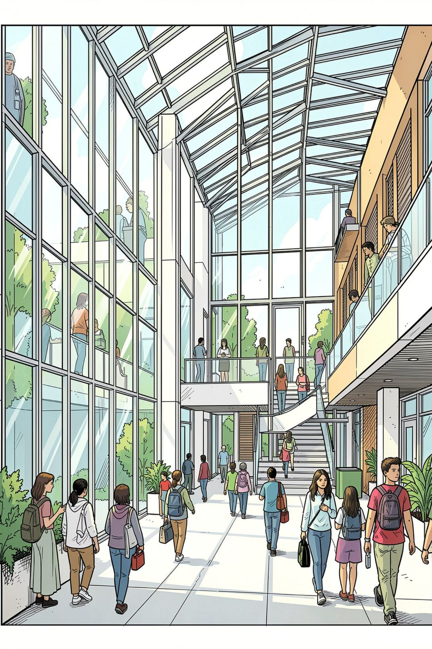
AI-Based Campus Navigation & Indoor Location Assistance
An intelligent, real-time navigation system for academic buildings and laboratories — bridging the gap between GPS limitations and the complex indoor environments of modern educational campuses.
ACADEMIC PROJECT PRESENTATION
AI · INDOOR POSITIONING · SMART CAMPUS
GARIKIPATI DEEPAK
323129512063

Slide 2
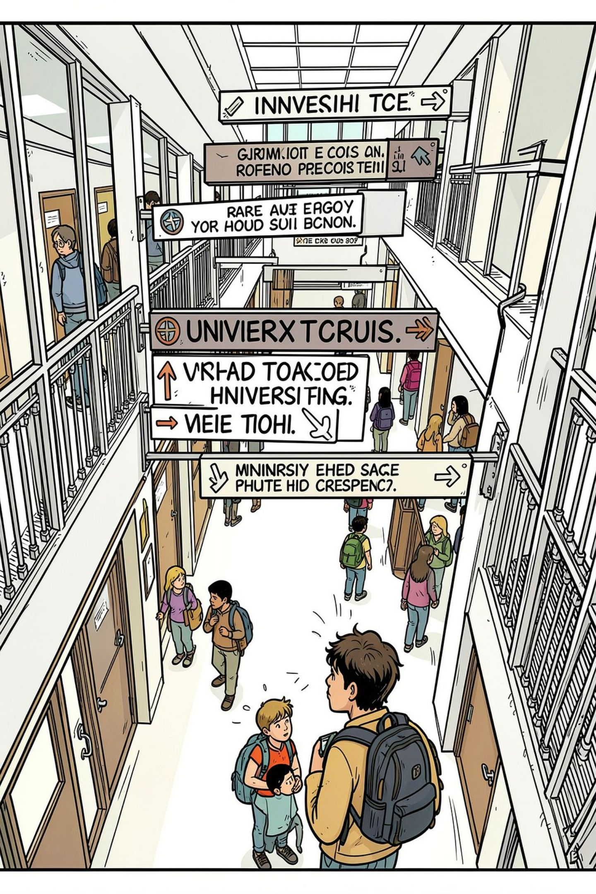
The Problem: Lost in Large Academic Buildings
Conventional GPS fails indoors. Students, faculty, and visitors struggle to locate classrooms, labs, and offices in multi-storey buildings — wasting time, causing stress, and reducing campus productivity.
GPS Blind Spots
Complex Layouts
Standard GPS signals cannot penetrate building interiors, leaving users without any positional guidance once inside.
Multi-storey academic buildings with hundreds of rooms create a maze that static maps cannot resolve in real time.
Accessibility Gaps
Differently-abled users lack specialized navigation support, making campus navigation inequitable and exclusionary.

Slide 3
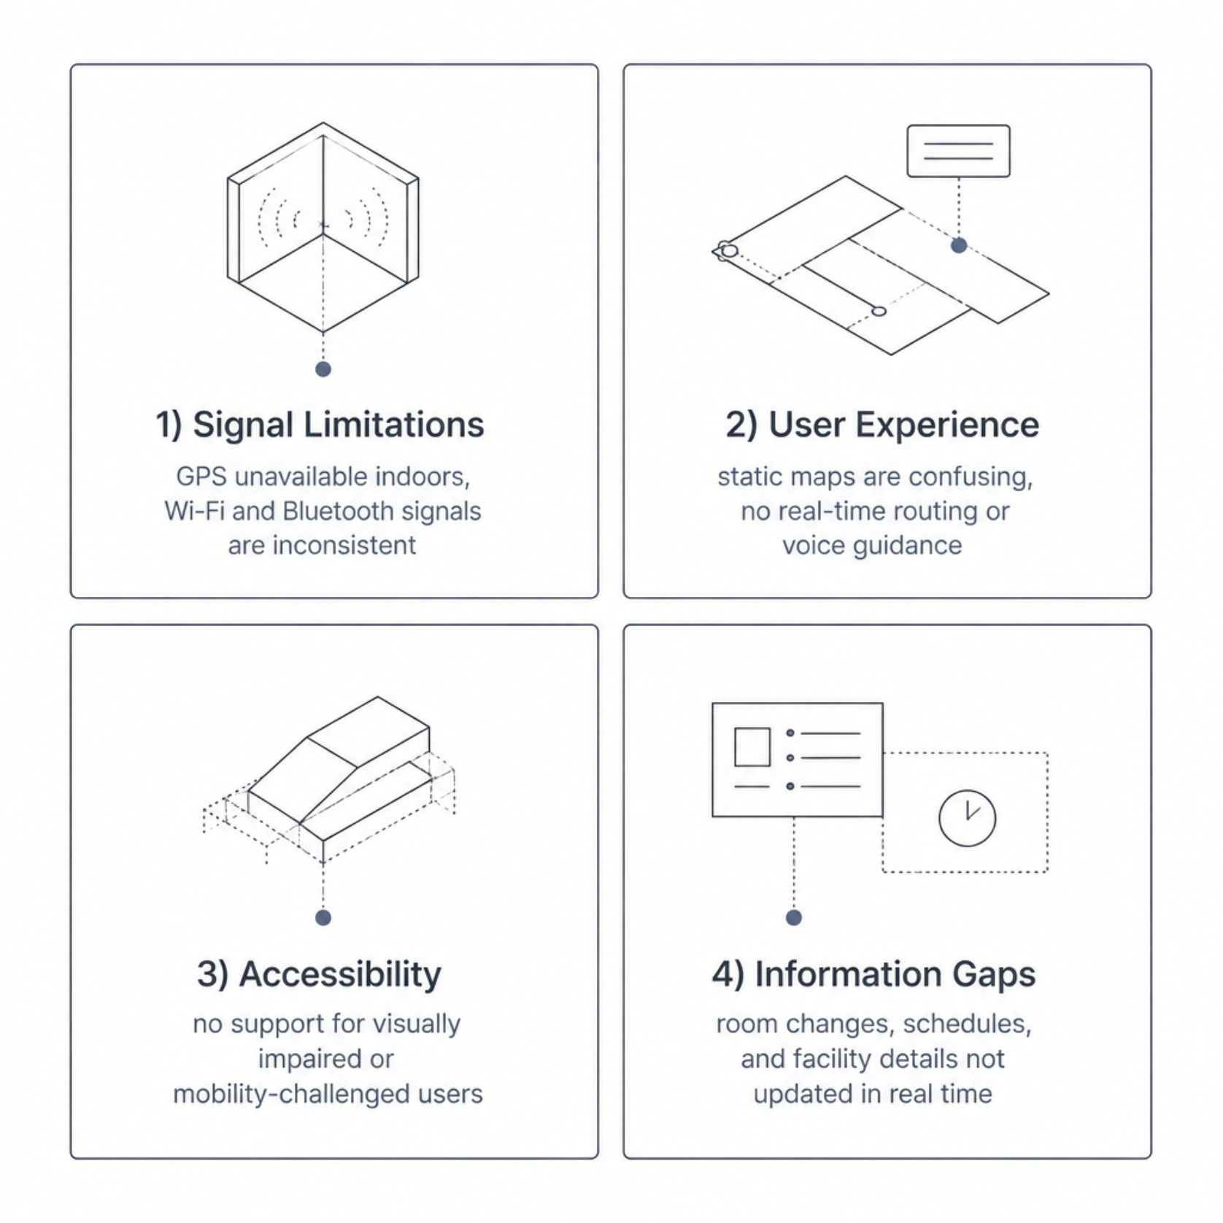

Existing Challenges in Indoor Navigation
Why Current Solutions Fall Short
Most campuses rely on printed maps, basic directory boards, or generic smartphone apps that offer no real-time indoor positioning. These tools cannot adapt to dynamic changes like room reassignments or schedule updates, leaving users without reliable, actionable guidance.
A 2023 study found that first-year students spend an average of 18 minutes searching for their first classroom in an unfamiliar building.

Slide 4
Project Objectives
Accurate Indoor Positioning
1
Determine user location within buildings using QR codes, Bluetooth beacons, Wi-Fi fingerprinting, and computer vision.
Real-Time Route Optimization
2
Compute and display the shortest, most efficient path to any campus destination dynamically.
Voice-Guided Navigation
3
Provide hands-free, turn-by-turn audio guidance for an intuitive, eyes-free navigation experience.
Accessibility & Inclusivity
4
Support differently-abled users with wheelchair-accessible routing, screen reader compatibility, and visual aids.
Live Notifications
5
Push real-time alerts for room changes, schedule updates, and facility availability directly to users.

Slide 5
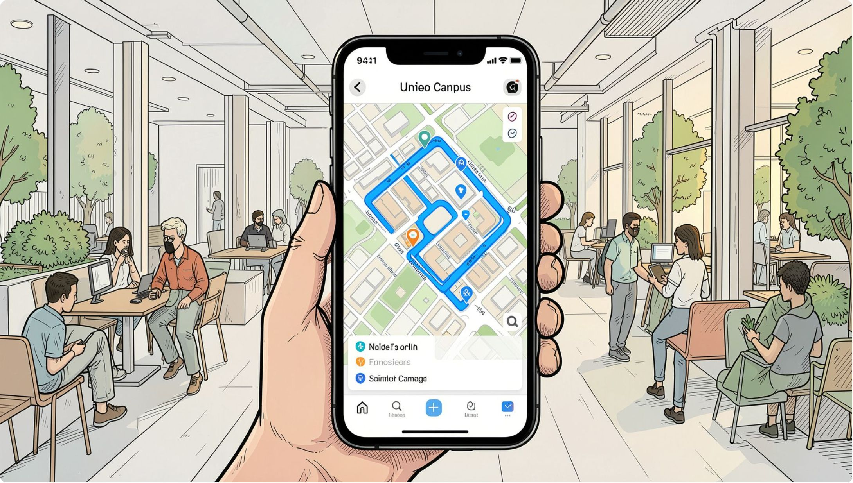
Proposed Solution at a Glance
A Unified Smart Navigation Platform
The system combines AI-powered localization with a digital campus map to deliver seamless indoor-outdoor navigation. Users simply open the app, select a destination, and receive real-time, step-by-step guidance — whether they are crossing campus or navigating a five-storey laboratory building.
Hybrid indoor positioning using multiple sensor modalities
AI-driven shortest-path routing with live updates
Multi-language, voice-enabled, accessibility-first design

Slide 6

System Architecture
Data & Infra
Map DB, beacons, Wi‑Fi, cloud servers
AI Engine
Positioning, route optimization, NLP
Core UI
Mobile app, web portal, voice assistant
The architecture is organized into four interconnected layers, enabling seamless data flow from physical sensors through AI processing to the end-user interface — ensuring low latency, high accuracy, and system scalability across the entire campus.

Slide 7
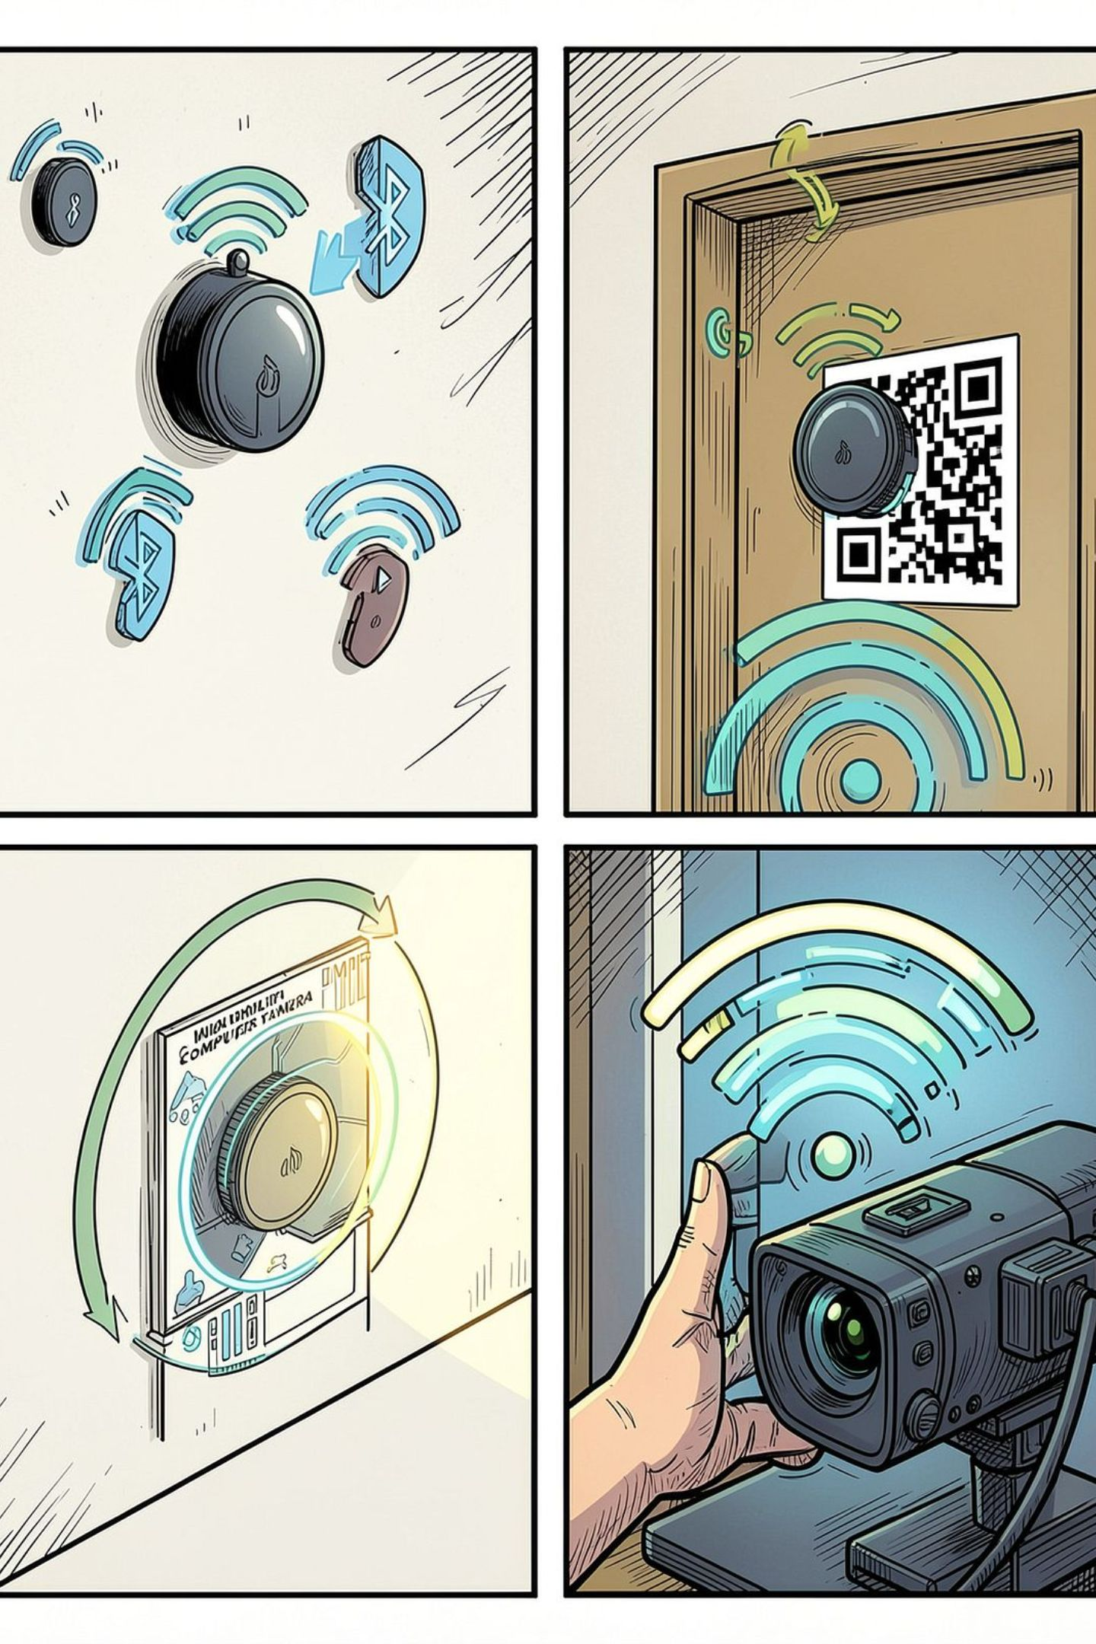
Indoor Positioning Technologies
QR Code Markers
Strategically placed at corridors and entrances. Users scan to anchor their precise location within the building map.
Bluetooth Beacons
Low-energy BLE beacons broadcast signals that the app uses for proximity-based triangulation with sub-meter accuracy.
Wi-Fi Fingerprinting
ML models match real-time Wi-Fi signal strength patterns against a pre-surveyed fingerprint database for room-level precision.
Computer Vision
Camera-based visual localization identifies architectural features and signage to determine position without any hardware installation.

Slide 8
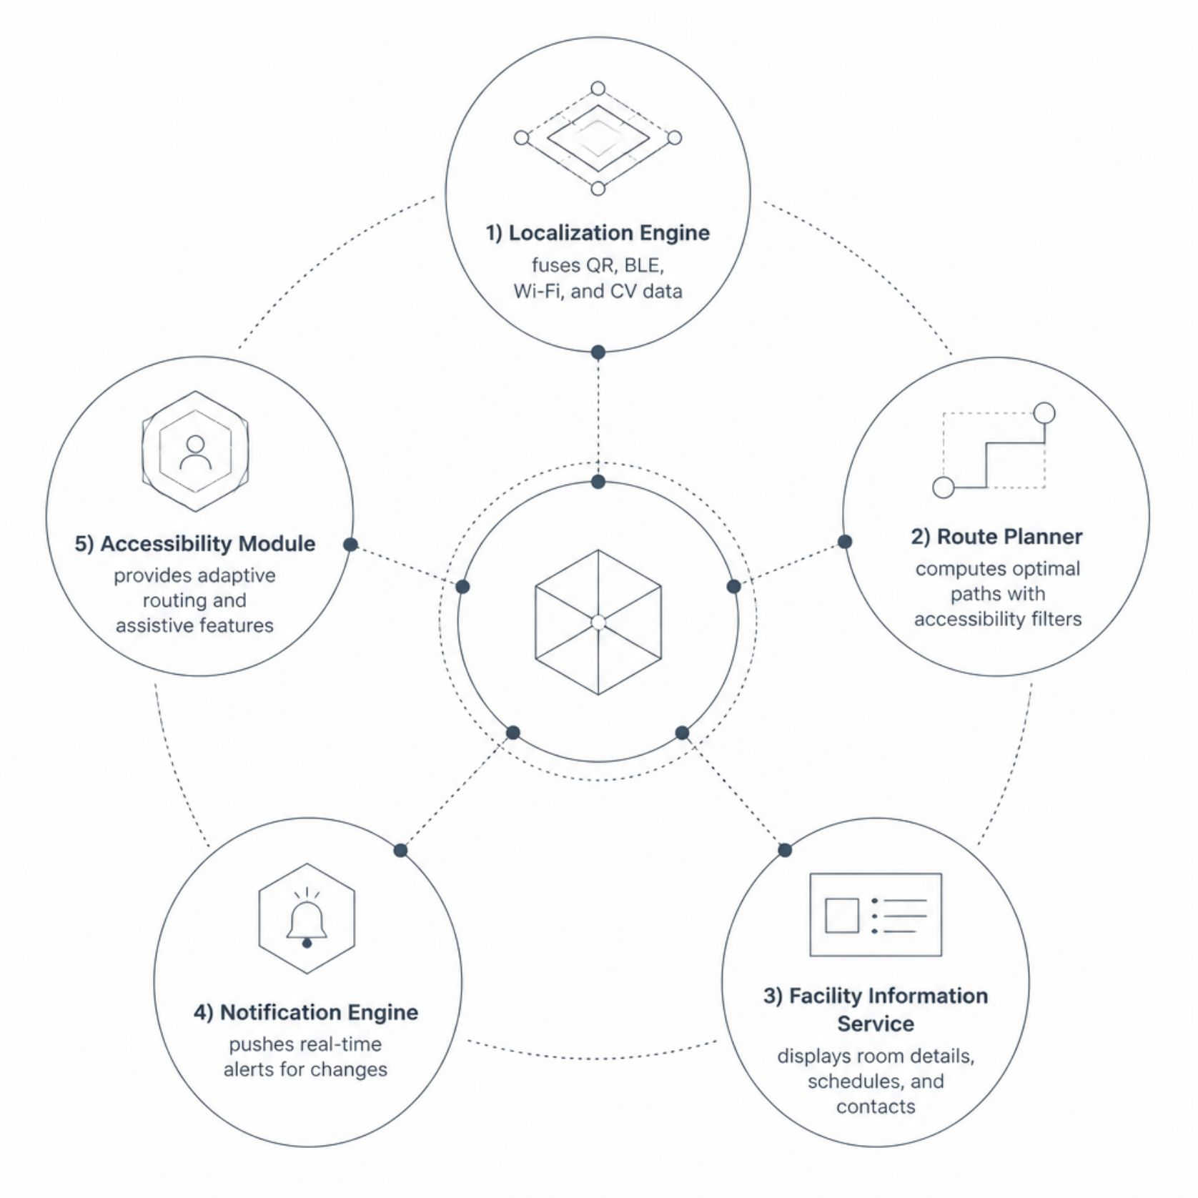
AI Technologies & Core Modules
AI Stack
Deep Learning (CNN / RNN)
Natural Language Processing
Wi-Fi fingerprint classification and visual scene recognition for precise localization.
Voice command understanding and text-to-speech for guided navigation.
Graph Neural Networks
Federated Learning
Dynamic pathfinding that adapts to real-time congestion and accessibility constraints.
Privacy-preserving model updates from user data without centralizing sensitive location information.

Slide 9

Workflow & User Journey
Compute Route
Detect Position
Open App
Choose Destination
AI optimizes for accessibility and real‑time constraints
Begin Navigation
Grant location permissions
QR, BLE beacon, or Wi‑Fi fingerprint
Select from searchable campus directory
Voice turn‑by‑turn with live notifications
From first launch to arrival, the system delivers a frictionless experience — combining automatic positioning, intelligent routing, and accessible guidance to ensure every user reaches their destination confidently and efficiently.

Slide 10


Expected Outcomes & Impact
~60%
Time Saved
Estimated reduction in time spent locating destinations within unfamiliar buildings.
5+
Positioning Methods
Hybrid techniques ensure reliability across diverse building environments.
100%
Accessibility Coverage
Full support for differently-abled users with adaptive routing and assistive features.
24/7
Real-Time Availability
Continuous live updates for schedules, room changes, and facility status.
This system lays the foundation for a smart, technology-enabled campus — improving accessibility, reducing navigation friction, and enhancing overall institutional productivity.

