Slide 1
Food Delivery App with AI-Powered Recommendations
Batch Details:
Harini – Reg No: 231FA04853
Geethika – Reg No: 231FA04C67
Deepika – Reg No: 231FA04866
Poojitha – Reg No: 231FA04844

Slide 2
🖥️ Introduction
Aim: To develop an intelligent food delivery application with voice input and AI-based dish recommendations.
Key Features:
- Audio-to-text input using Whisper AI
- Personalized dish suggestions
- Smooth ordering and payment experience

Slide 3
🌐 Tech Stack
Frontend: React
Backend: FastAPI
Database: SQL
Voice Recognition: Whisper AI

Slide 4
🔒 Login Page
Secure user login with username and password
JWT tokens for session management
User-friendly UI built in React

Slide 5
🎙️ Audio Input
After login, app prompts for voice input
Whisper AI converts audio to text
Text is analyzed to understand user preferences

Slide 6
🤖 AI-Powered Recommendations
System analyzes input text
Suggests dishes using:
- NLP techniques
- Keyword-based matching
- Recommendation algorithm based on past data
Users get top dish recommendations

Slide 7
🍽️ Dish Selection
User selects one or more dishes
Cart shows selected items with quantity and price
Option to edit or remove items

Slide 8
💳 Payment Gateway
Supports online payment (credit/debit/UPI)
After successful payment:
- Confirmation message displayed
- Order saved in database

Slide 9
✅ Order Confirmation
Displays message: "Order Placed Successfully!"
Estimated delivery time shown
Option to view order history

Slide 10
📊 Database Structure
Users Table
Orders Table
Dishes Table
Recommendation Logs

Slide 11
🛠️ Backend Functionality
FastAPI endpoints:
- /login
- /recommend
- /order
Whisper integration for audio
SQL queries for order management and recommendations

Slide 12
🎨 Frontend Features
Clean and responsive React UI
Audio recording feature
Dynamic dish display
Payment and order confirmation screens

Slide 13
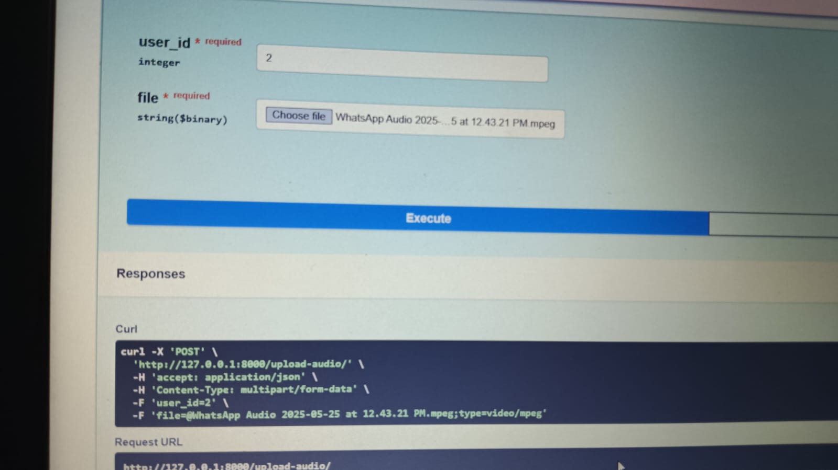
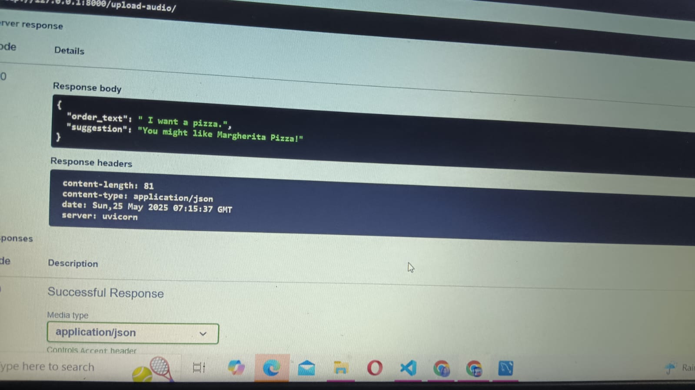

Slide 15
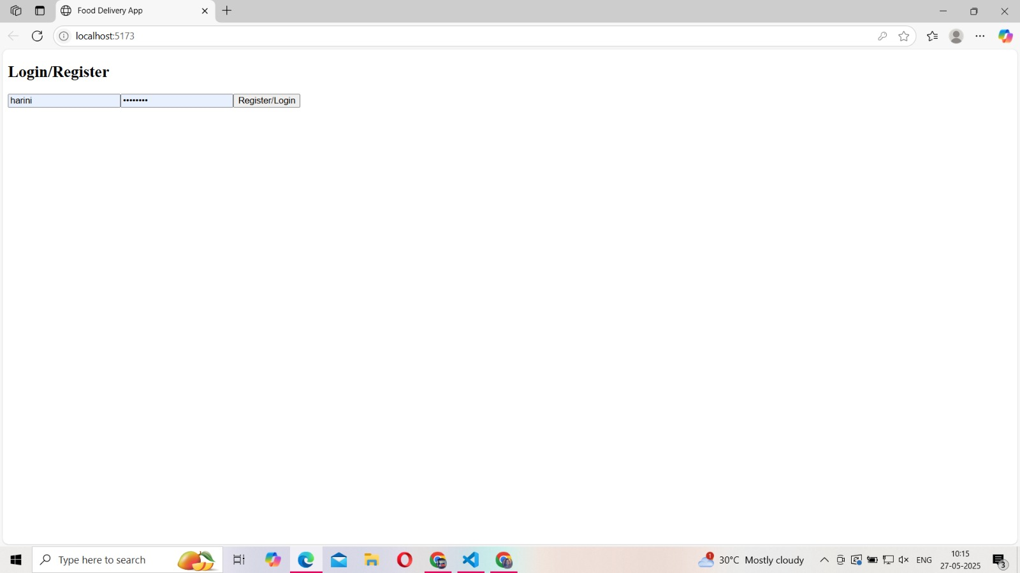
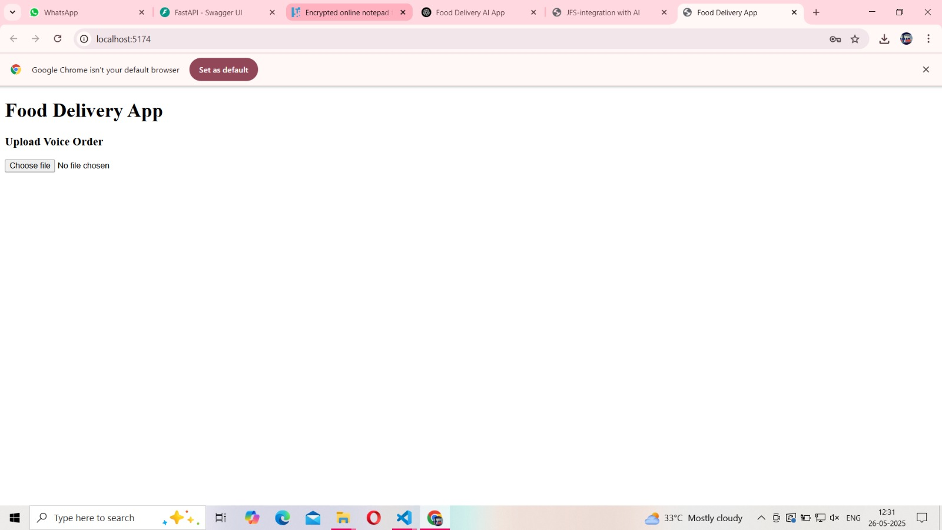

Slide 16
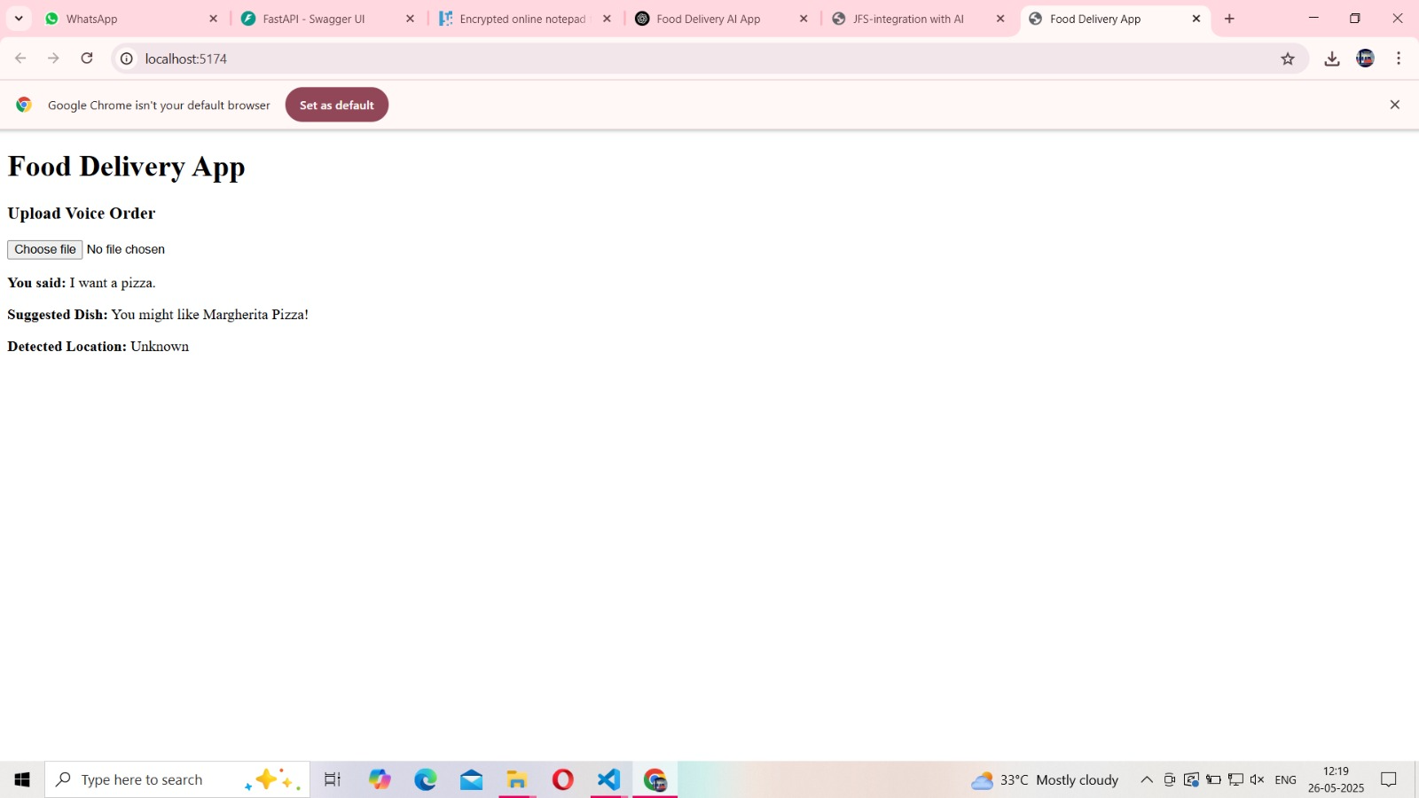

Slide 17
🏁 Conclusion
Innovative voice-driven food ordering
Seamless AI integration
Scalable backend
Real-world usability

