Slide 1
DEVI NUR PURNAMA SARI 15.01.53.0057 A2

Slide 2
Graph Theory and Network Analysis (with Python codes)

Slide 3
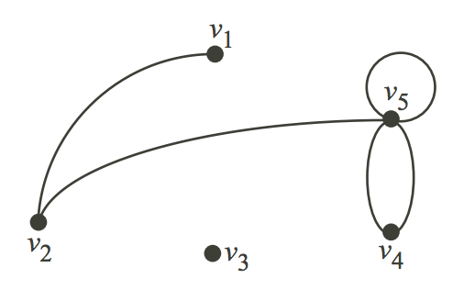
Graphs and Their Applications

Slide 4
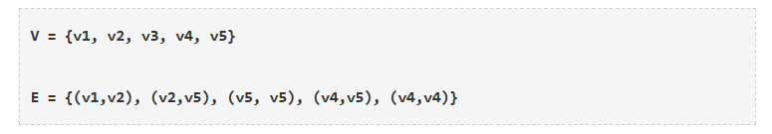
Consider that this graph represents the places in a city that people generally visit, and the path that was followed by a visitor of that city. Let us consider V as the places and E as the path to travel from one place to another. The edge (u,v) is the same as the edge (v,u)They are unordered pairs. Concretely – Graphs are mathematical structures used to study pairwise relationships between objects and entities. It is a branch of Discrete Mathematics and has found multiple applications in Computer Science, Chemistry, Linguistics, Operations Research, Sociology etc. The Data Science and Analytics field has also used Graphs to model various structures and problems. As a Data Scientist, you should be able to solve problems in an efficient manner and Graphs provide a mechanism to do that in cases where the data is arranged in a specific way.

Slide 5
Formally,
A Graph is a pair of sets. G = (V,E). V is the set of vertices. E is a set of edges. E is made up of pairs of elements from V (unordered pair)
A DiGraph is also a pair of sets. D = (V,A). V is the set of vertices. A is the set of arcs. A is made up of pairs of elements from V (ordered pair) In the case of digraphs, there is a distinction between `(u,v)` and `(v,u)`. Usually the edges are called arcs in such cases to indicate a notion of direction. There are packagesthat exist in R and Python to analyze data using Graph theory concepts. In this article we will be briefly looking at some of the concepts and analyze a dataset using Networkx Python package.

Slide 6
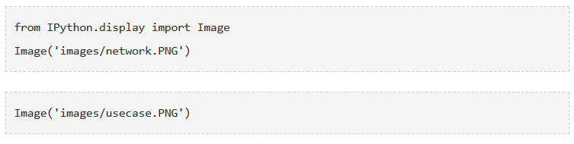
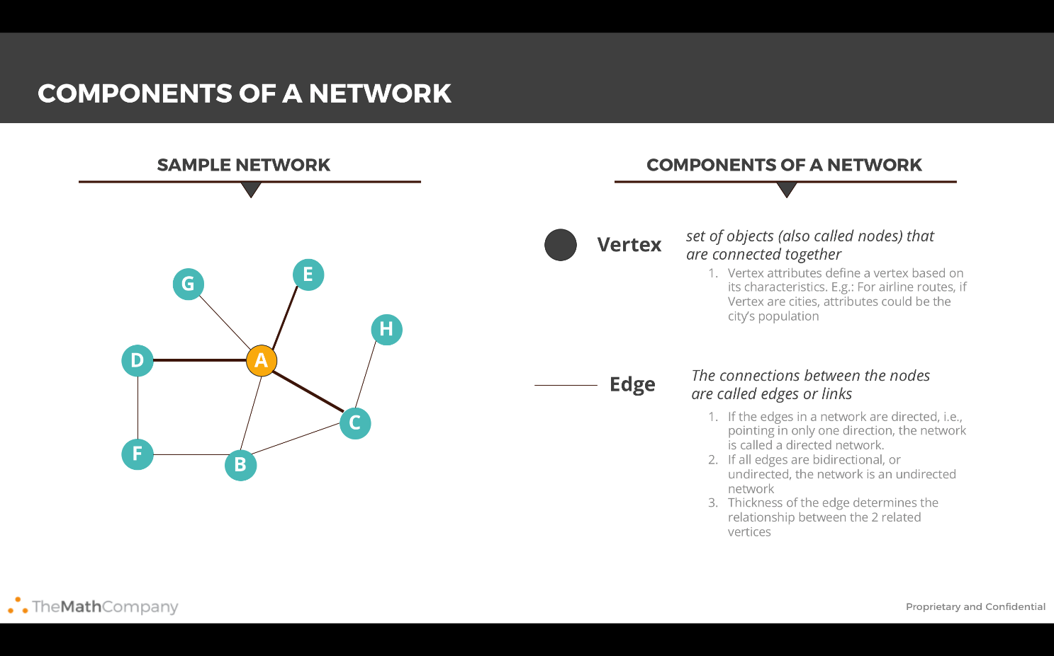

Slide 7
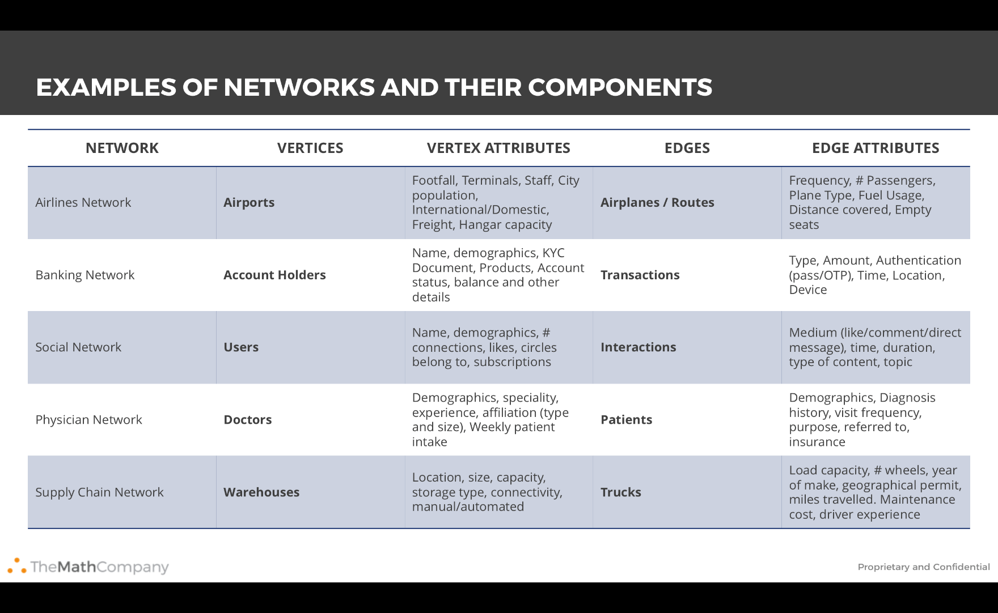

Slide 8
History and why graphs? The origin of the theory can be traced back to the Konigsberg bridge problem (circa 1730s). The problem asks if the seven bridges in the city of Konigsberg can be traversed under the following constraints. - no doubling back - you end at the same place you started This is the same as asking if the multigraph of 4 nodes and 7 edges has an Eulerian cycle (An Eulerian cycle is an Eulerian path that starts and ends on the same Vertex. And an Eulerian path is a path in a Graph that traverses each edge exactly once. More Terminology is given below). This problem led to the concept of Eulerian Graph. In the case of the Konigsberg bridge problem the answer is no and it was first answered by (you guessed it) Euler.

Slide 9
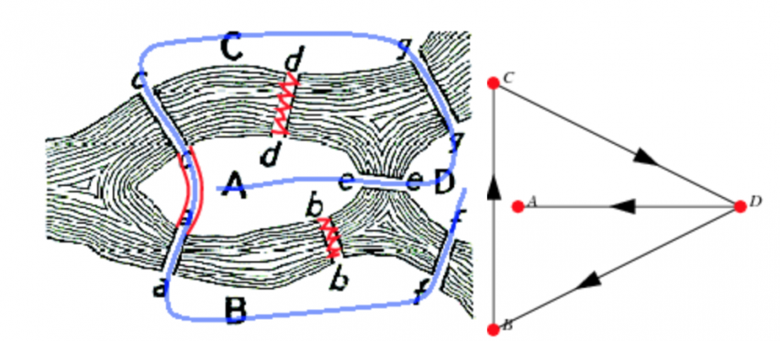
Why Graphs?

Slide 10
Graphs provide a better way of dealing with abstract concepts like relationships and interactions. They also offer an intuitively visual way of thinking about these concepts. Graphs also form a natural basis for analyzing relationships in a Social context
Graph Databases have become common computational tools and alternatives to SQL and NoSQL databases
Graphs are used to model analytics workflows in the form of DAGs (Directed acyclic graphs)
Some Neural Network Frameworks also use DAGs to model the various operations in different layers
Graph Theory concepts are used to study and model Social Networks, Fraud patterns, Power consumption patterns, Virality and Influence in Social Media. Social Network Analysis (SNA) is probably the best known application of Graph Theory for Data Science
It is used in Clustering algorithms – Specifically K-Means
System Dynamics also uses some Graph Theory concepts – Specifically loops
Path Optimization is a subset of the Optimization problem that also uses Graph concepts
From a Computer Science perspective – Graphs offer computational efficiency. The Big O complexity for some algorithms is better for data arranged in the form of Graphs (compared to tabular data)

Slide 11
Terminologies you need to know
The vertices u and v are called the end vertices of the edge (u,v)
If two edges have the same end vertices they are Parallel
An edge of the form (v,v) is a loop
A Graph is simple if it has no parallel edges and loops
A Graph is said to be Empty if it has no edges. Meaning E is empty
A Graph is a Null Graph if it has no vertices. Meaning V and E is empty
A Graph with only 1 Vertex is a Trivial graph
Edges are Adjacent if they have a common vertex. Vertices are Adjacent if they have a common edge
The degree of the vertex v, written as d(v), is the number of edges with v as an end vertex. By convention, we count a loop twice and parallel edges contribute separately
Isolated Vertices are vertices with degree 1. d(1) vertices are isolated
A Graph is Complete if its edge set contains every possible edge between ALL of the vertices
A Walk in a Graph G = (V,E) is a finite, alternating sequence of the form ViEiViEi consisting of vertices and edges of the graph G
A Walk is Open if the initial and final vertices are different. A Walk is Closed if the initial and final vertices are the same
A Walk is a Trail if ANY edge is traversed atmost once
A Trail is a Path if ANY vertex is traversed atmost once (Except for a closed walk)
A Closed Path is a Circuit – Analogous to electrical circuits

Slide 12
Graph Theory Concepts
- Average Path Length
The average of the shortest path lengths for all possible node pairs. Gives a measure of ‘tightness’ of the Graph and can be used to understand how quickly/easily something flows in this Network.
- BFS and DFS
Breadth first search and Depth first search are two different algorithms used to search for Nodes in a Graph. They are typically used to figure out if we can reach a Node from a given Node. This is also known as Graph Traversal
The aim of the BFS is to traverse the Graph as close as possible to the root Node, while the DFS algorithm aims to move as far as possible away from the root node.
- Centrality
One of the most widely used and important conceptual tools for analysing networks. Centrality aims to find the most important nodes in a network. There may be different notions of “important” and hence there are many centrality measures. Centrality measures themselves have a form of classification (or Types of centrality measures). There are measures that are characterized by flow along the edges and those that are characterized by Walk Structure.

Slide 13
Some of the most commonly used ones are:
Degree Centrality – The first and conceptually the simplest Centrality definition. This is the number of edges connected to a node. In the case of a directed graph, we can have 2 degree centrality measures. Inflow and Outflow Centrality
Closeness Centrality – Of a node is the average length of the shortest path from the node to all other nodes
Betweenness Centrality – Number of times a node is present in the shortest path between 2 other nodes
These centrality measures have variants and the definitions can be implemented using various algorithms. All in all, this means a large number of definitions and algorithms.
- Network Density
A measure of how many edges a Graph has. The actual definition will vary depending on type of Graph and the context in which the question is asked. For a complete undirected Graph the Density is 1, while it is 0 for an empty Graph. Graph Density can be greater than 1 in some situations (involving loops).
- Graph Randomizations
While the definitions of some Graph metrics maybe easy to calculate, it is not easy to understand their relative importance. We use Network/Graph Randomizations in such cases. We calculate the metric for the Graph at hand and for another similar Graph that is randomly generated. This similarity can for example be the same number of density and nodes. Typically we generate a 1000 similar random graphs and calculate the Graph metric for each of them and then compare it with the same metric for the Graph at hand to arrive at some notion of a benchmark.
In Data Science when trying to make a claim about a Graph it helps if it is contrasted with some randomly generated Graphs.

Slide 14
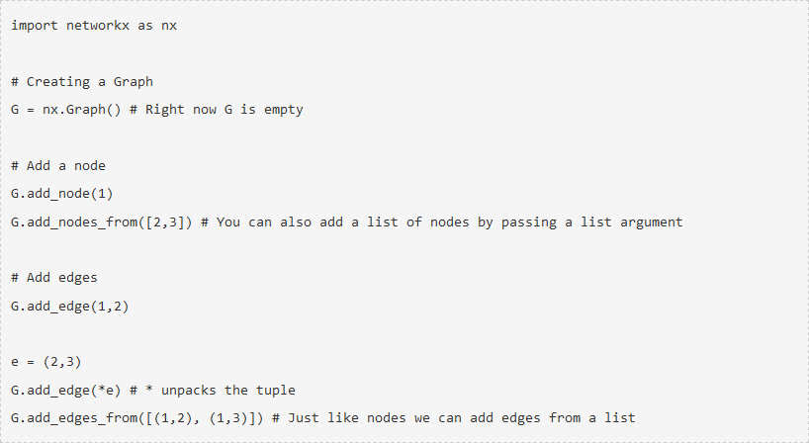
Getting familiar with Graphs in python

Slide 15
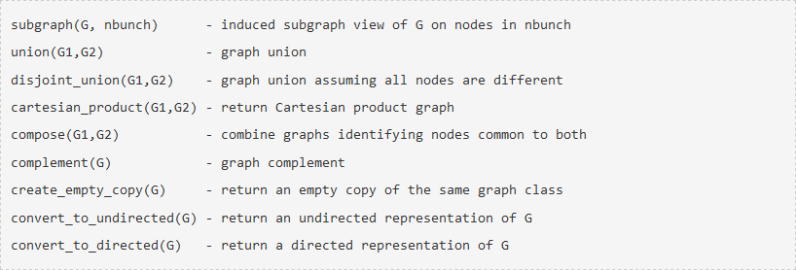

Slide 16
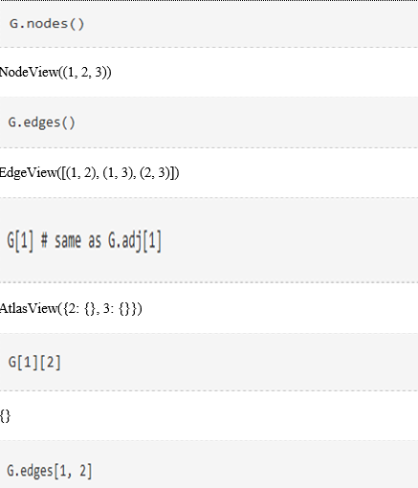

Slide 17
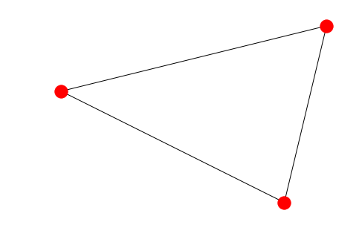
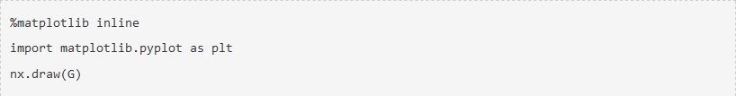
Graph Visualization
Networkx provides basic functionality for visualizing graphs, but its main goal is to enable graph analysis rather than perform graph visualization. Graph visualization is hard and we will have to use specific tools dedicated for this task. Matplotlib offers some convenience functions. But GraphViz is probably the best tool for us as it offers a Python interface in the form of PyGraphViz (link to documentation below).

Slide 18
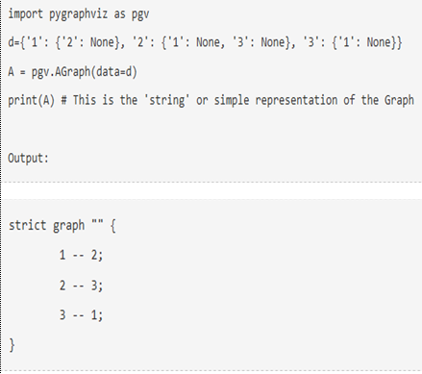

Slide 19
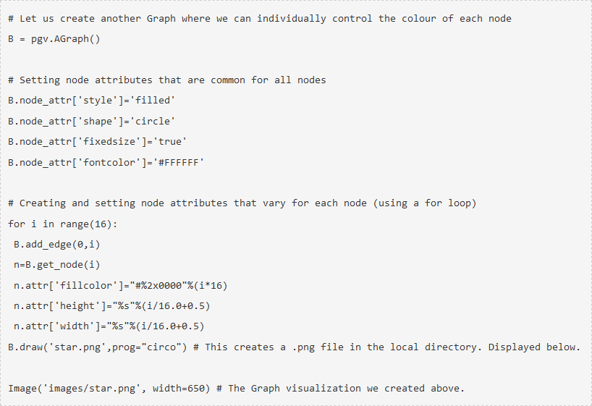

Slide 20
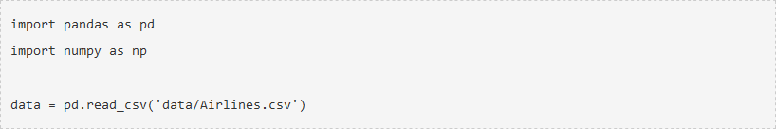
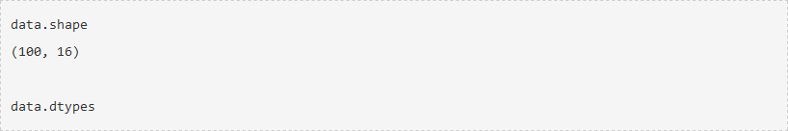
Analysis on a dataset
We will be looking to take a generic dataset (not one that is specifically intended to be used for Graphs) and do some manipulation (in pandas) so that it can be ingested into a Graph in the form of a edgelist. And edgelist is a list of tuples that contain the vertices defining every edge.
The dataset we will be looking at comes from the Airlines Industry. It has some basic information on the Airline routes. There is a Source of a journey and a destination. There are also a few columns indicating arrival and departure times for each journey. As you can imagine this dataset lends itself beautifully to be analysed as a Graph. Imagine a few cities (nodes) connected by airline routes (edges). If you are an airline carrier, you can then proceed to ask a few questions like :
What is the shortest way to get from A to B? In terms of distance and in terms of time
Is there a way to go from C to D?
Which airports have the heaviest traffic?
Which airport in “in between” most other airports? So that it can be converted into a local hub

Slide 21
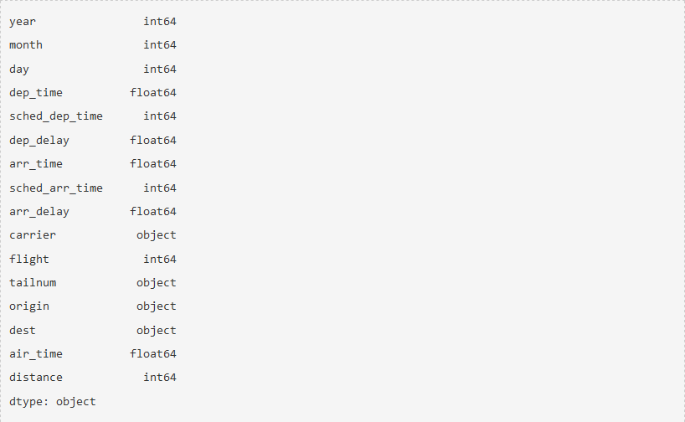

Slide 22
We notice that origin and destination look like good choices for Nodes. Everything can then be imagined as either node or edge attributes. A single edge can be thought of as a journey. And such a journey will have various times, a flight number, an airplane tail number etc associated with it
We notice that the year, month, day and time information is spread over many columns. We want to create one datetime column containing all of this information. We also need to keep scheduled and actual time of arrival and departure separate. So we should finally have 4 datetime columns (Scheduled and actual times of arrival and departure)
Additionally, the time columns are not in a proper format. 4:30 pm is represented as 1630 instead of 16:30. There is no delimiter to split that column. One approach is to use pandas string methods and regular expressions
We should also note that sched_dep_time and sched_arr_time are int64 dtype and dep_time and arr_time are float64 dtype
An additional complication is NaN values

Slide 23
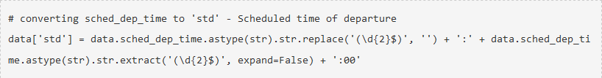
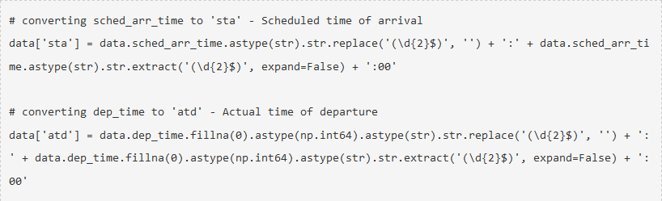
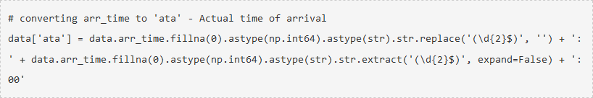

Slide 24
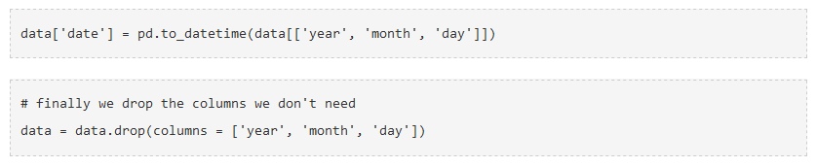
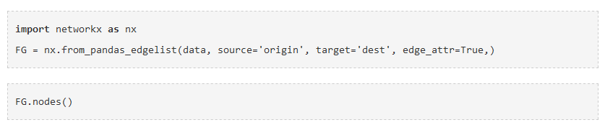

Slide 25
OUTPUT

Slide 26
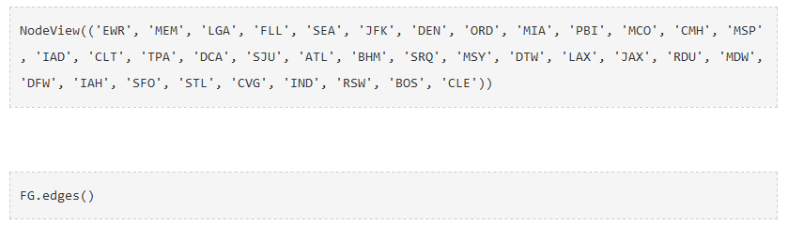

Slide 27
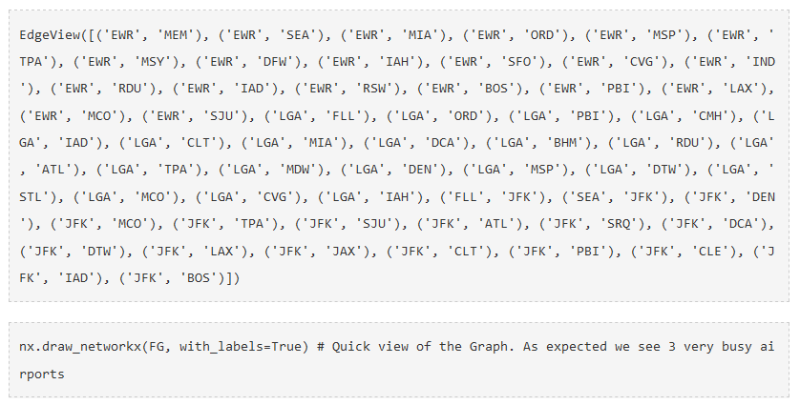

Slide 28
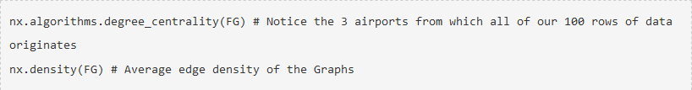
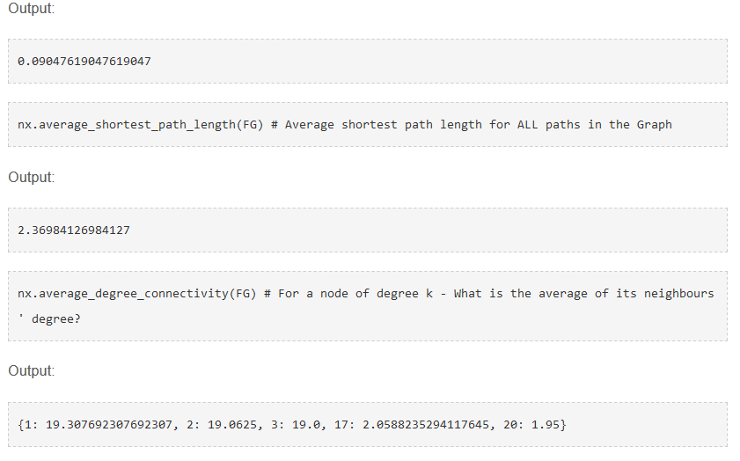

Slide 30
As is obvious from looking at the Graph visualization (way above) – There are multiple paths from some airports to others. Let us say we want to calculate the shortest possible route between 2 such airports. Right off the bat we can think of a couple of ways of doing it: - There is the shortest path by distance - There is the shortest path by flight time What we can do is to calculate the shortest path algorithm by weighing the paths with either the distance or airtime. Please note that this is an approximate solution – The actual problem to solve is to calculate the shortest path factoring in the availability of a flight when you reach your transfer airport + wait time for the transfer. This is a more complete approach and this is how humans normally plan their travel. For the purposes of this article we will just assume that is flight is readily available when you reach an airport and calculate the shortest path using the airtime as the weight

Slide 31
CONCLUSION
This article has at best only managed a superficial introduction to the very interesting field of Graph Theory and Network analysis. Knowledge of the theory and the Python packages will add a valuable toolset to any Data Scientist’s arsenal. For the dataset used above, a series of other questions can be asked like:
Find the shortest path between two airports given Cost, Airtime and Availability?
You are an airline carrier and you have a fleet of airplanes. You have an idea of the demand available for your flights. Given that you have permission to operate 2 more airplanes (or add 2 airplanes to your fleet) which routes will you operate them on to maximize profitability?
Can you rearrange the flights and schedules to optimize a certain parameter (like Timeliness or Profitability etc)

