Slide 1
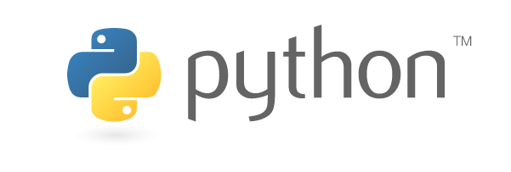

Introduction to Python
Premier Embedded Training centre in the country

Slide 2
Software Language Levels
Machine Language (Binary)
Assembly Language
Assembler converts Assembly into machine
High Level Languages (C, Java, Python)
Compiled : C
Interpreted : Python, Perl, Shell
Premier Embedded Training centre in the country

Slide 3
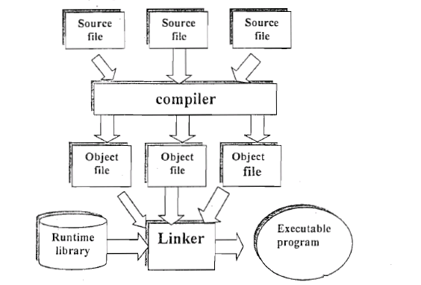
Complier Interpreter
Source File
Interpreter (Intermediate Code)
Executable Program
Premier Embedded Training centre in the country

Slide 4
PYTHON
High Level Scripting Language
Processed at runtime by interpreter
Object Oriented
Provides high-level dynamic data
Open Source with cross platform
Premier Embedded Training centre in the country
Notes:
Dynamic Data---collection of data in memory that has the flexibility to grow or shrink in size, enabling a programmer to control exactly how much memory is utilized.

Slide 5
History
Conceived in the late 1980’s
Developed 1990 by Guido van Rossum, Netherlands
Derived from ABC, Modula-3, C, C++
Open sourced from the beginning
Used by Google from the beginning
Premier Embedded Training centre in the country

Slide 6
Releases
Created in 1989 by Guido Van Rossum
Python 1.0 released in 1994
Python 2.0 released in 2000
Python 3.0 released in 2008
Python 2.7 is the recommended version
3.0 adoption will take a few years
Premier Embedded Training centre in the country

Slide 7
Python Features
Designed to be easy to learn and master
Clean, clear syntax
Very few keywords
Highly portable
Runs almost anywhere - high end servers, workstations, Linux and Mac OSX
Inbuilt Variables
GUI Programming
Easily integrated with C, C++, Java
Premier Embedded Training centre in the country

Slide 8
Python Features
no compiling or linking | mixed language systems
no type declarations | fast development
automatic memory management | run-time program construction
high-level data types and operations | interactive, dynamic nature
object-oriented programming | fewer restrictions and rules
embedding and extending in C | wide portability
classes, modules, exceptions | system Files, GUIs, databases, etc.
Reusability | simpler, shorter, more flexible
Premier Embedded Training centre in the country

Slide 9
Who uses Python?
1. Google
2. NASA
3. Library of congress- research library of US
4. The ONION- American digital media compay
….and the list goes on….
Premier Embedded Training centre in the country

Slide 10
Environmental Setup
Pre-installed on most Unix systems, including Linux and MAC OS X
Download from http://python.org/download/
Latest version - Python 3.6.1
Comes with a large library of standard modules
Premier Embedded Training centre in the country

Slide 11
Running Python
Interactive Interpreter
Script from command-line
Integrated Development environment(IDE)
Premier Embedded Training centre in the country

Slide 12
Integrated Development environment(IDE)
1. PyDev with Eclipse
2. Komodo
3. Emacs
4. Vim
5. pycharm
6. Gedit
7. Idle
8. PIDA (Linux)(VIM Based)
9. NotePad++ (Windows)
10.BlueFish (Linux)
Premier Embedded Training centre in the country

Slide 13
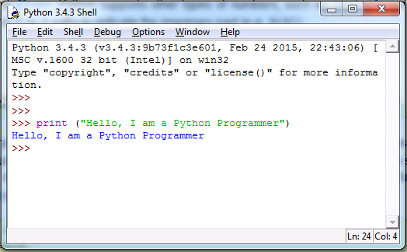
Interactive Interpreter
Python prompts with ‘>>>’
To exit python CTRL-D
Premier Embedded Training centre in the country

Slide 14
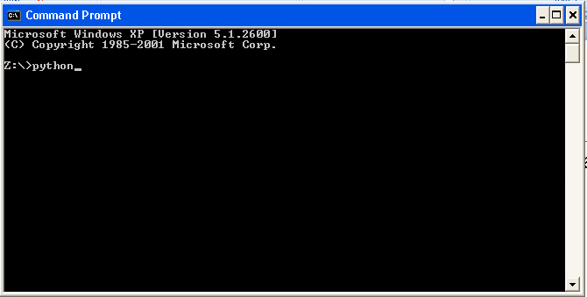
Script from command line
To make the file executable → filename.py
Then run → Python filename.py
Premier Embedded Training centre in the country

Slide 15
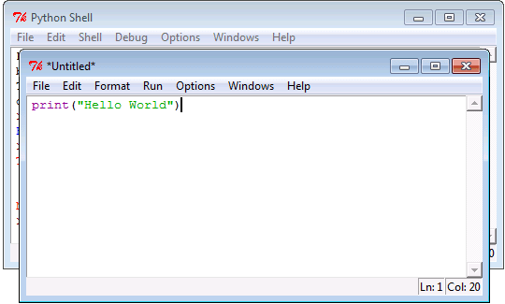
Integrated Development Environment
Runs Python from IDE
Premier Embedded Training centre in the country

Slide 16
Interactive programming mode
>>> 3 + 7
10
>>> 3 < 15
True
>>> ‘Hello..!‘
Hello
>>>'print me‘
Print me
>>> print (‘Hello..! ‘)
Hello..!
The interpreter provides an interactive environment to play with the language
Results of expressions are printed on the screen
Premier Embedded Training centre in the country

Slide 17
Interactive mode programming
Examples:
>>>Name=“Python”
>>>print (Name)
Python
>>> print (1+2+3+4)
10
>>> print (15/2)
7
>>> print (15.0/2)
7.5
>>> print (50/2)
25
>>>round(2.333)
2
>>> x = 3 + 2j
>>> y = -1j
>>> x + y
(3+1j)
Premier Embedded Training centre in the country

Slide 18
Script mode Programming
num1 = 10
num2 = 20
sum = num1+num2
print “Sum of 2 Num is:”,sum
Save in .py extension (filename.py)
Run the program
Premier Embedded Training centre in the country

