Slide 1
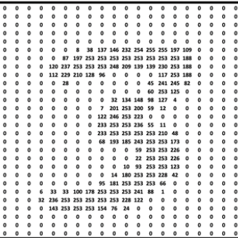
BAYESIAN INFERENCE
ON MNIST DATASET
BY
DEVIKA BYLAPUDI

Slide 2
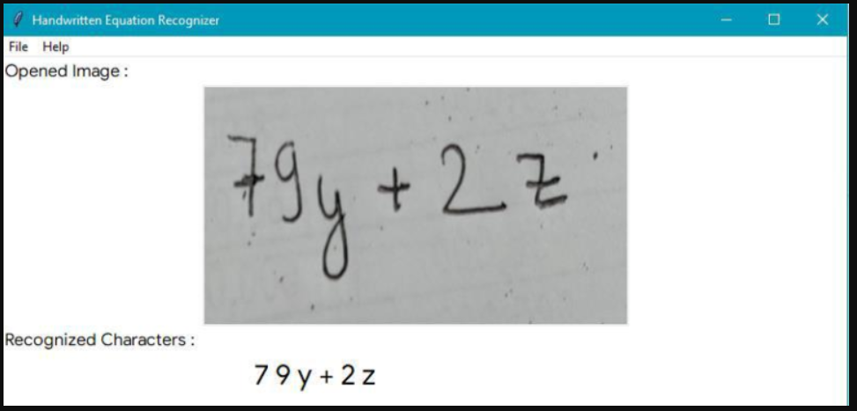
BUSINESS USECASE
REAL TIME FEEDBACK IN ACADEMICS:
Real-time feedback in education, especially when integrated with handwriting recognition technology, can transform the learning experience for students.
As students write their answers, the system can instantly analyze their handwriting and content, providing immediate corrections or suggestions.
Instead of waiting for a teacher to grade assignments, students receive continuous assessment throughout their work.
Teachers can access real-time data on student performance, identifying common errors or misconceptions across the class.
Allows them to tailor instruction and address specific needs in subsequent lessons.

Slide 3
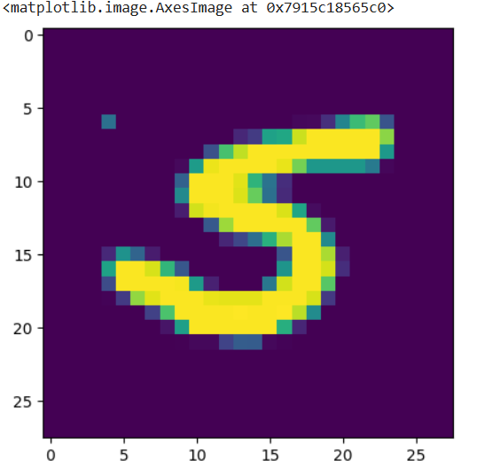
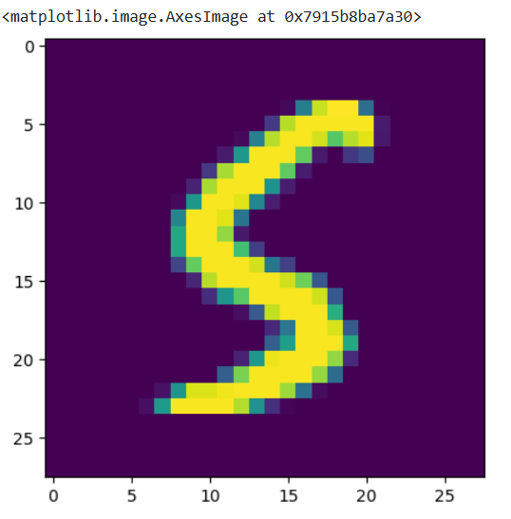
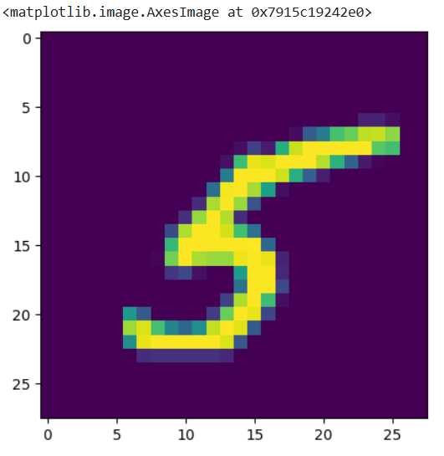
Representation of handwritten information captured as pixels written as a matrix

Slide 4

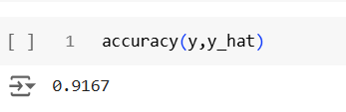
Naïve Bayes Classifier:
Probabilistic classification algorithm based on Bayes' theorem. It's a simple yet effective technique often used for text classification, spam filtering.
In Training Phase, the algorithm calculates the probability of each class (prior probability).
For each class, it calculates the probability of each feature given that class (conditional probability).
When a new data point is presented, the algorithm calculates the probability of each class given the features of the data point.
The class with the highest probability is assigned to the new data point.
Accuracy of Training Data
Accuracy of Testing Data

Slide 5
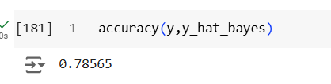
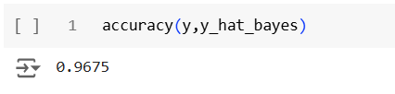
Non Naïve Bayes Classifier:
Non-Naive Bayes classifier does not assume that features are independent of each other.
Considers the relationships and dependencies between different features when making predictions.
Accounts for feature dependencies by utilizing the full covariance matrix, offering a more thorough approach than the Naive Bayes classifier.
Non-naive Bayes classifiers tend to be more computationally intensive than Naive Bayes because they have to model dependencies, requiring additional data and computational resources.
Accuracy of Training Data
Accuracy of Testing Data

Slide 6
SUMMARY:
To provide the instance feedback for the students to offer instant feedback, supporting self-paced learning and skill reinforcement.
Applied Models are Naïve Bayes and Non Naïve Bayes Classifier.
Libraries used in the model : Pandas , NumPy , Matplotlib, SciPy.
Feed the model with the training dataset, allowing it to learn by adjusting internal parameters based on the data.
Use the model to make predictions on the test set and compare predictions to the actual labels to calculate metrics accuracy.

Slide 7

Q&A
THANK YOU

