Slide 1
Do Harsher DUI Penalties Reduce Recidivism?
A Regression Discontinuity Analysis at the BAC 0.08 Threshold
Boomie Tran, Devika Desai, Loan Tran, Megha Chauhan, Rupal Gupta, Yasmeen Rajkotwala
Overview
Examine whether crossing the legal BAC cutoff changes future recidivism
Use a Regression Discontinuity Design (RDD)
Focus on drivers just below and just above the legal limit

Slide 2
Data and RD Setup
Dataset
RD Setup
214,558 observations
Running variable: Centered BAC = min(BAC1, BAC2) − 0.08
Time period: 1999–2007
Treatment indicator: 1 if min BAC ≥ 0.08, 0 otherwise
Outcome variable: Recidivism
Cutoff: 0
Minimum of two BAC readings used to match the legal rule
Data Quality Checks
No missing values
Why minimum BAC?
BAC1 and BAC2 highly correlated (r = 0.995)
Washington State law uses the minimum of the two breathalyzer readings to determine whether the driver crosses the 0.08 threshold and receives stricter penalties.

Slide 3
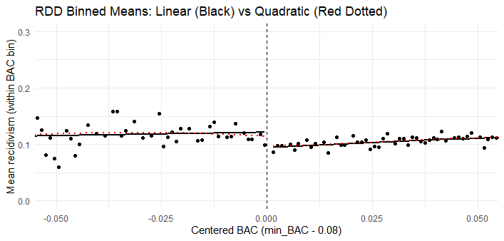
Visual Inspection Around the Cutoff
What we did:
Created binned means plot of recidivism against centered BAC
Compared linear and quadratic fitted lines around the cutoff
What we found:
Visual pattern suggests a downward jump in recidivism at the threshold
Linear and quadratic fits are similar near the cutoff
Supports using a local RD approach around BAC = 0.08

Slide 4
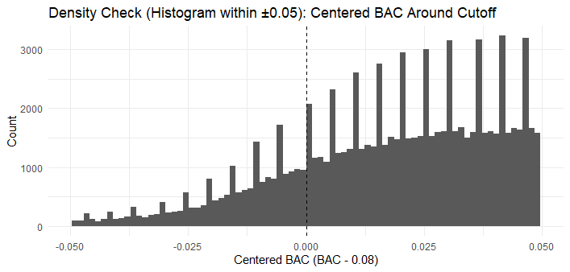
RDD Assumption Checks
Placebo Tests — Predetermined Covariates
We ran RD regressions using covariates as the outcome instead of recidivism. These should NOT jump at the cutoff.
Male | White | Age | Accident | Year
Manipulation Test (rddensity)
Checks whether drivers can precisely sort themselves just below the 0.08 cutoff.
Test statistic
1.2007
p-value
0.2298
Fail to reject null hypothesis of density continuity at the cutoff (p > 0.05).
These checks support the key RD assumption that individuals just below and above the cutoff are comparable.

Slide 5
Main Specification: Linear RD with Triangular Kernel
Final Model
Supporting Robustness Results
Linear RD with triangular kernel weights
Specification
Effect
Bandwidth: |X| < 0.05
Base model (no controls)
−0.0189
Triangular kernel gives more weight to observations closer to the cutoff
With controls + year FE
−0.0192
Triangular kernel (final)
−0.0154
Estimated Treatment Effect
rdrobust (manual bw=0.05)
−0.015
−0.0154
Effect remains negative across all bandwidth choices.
Statistically significant | Crossing the BAC threshold reduces
recidivism by about approx. 1.5 percentage points

Slide 6
Conclusion
Why We Selected the Triangular Kernel Model
Final Conclusion
Standard approach in RD analysis
Harsher DUI penalties at the 0.08 BAC cutoff reduce repeat offending
Gives more weight to observations closest to the cutoff
Evidence suggests a small but meaningful deterrence effect
Results are stable across alternative bandwidths
Quadratic terms were not jointly significant
Key Numbers
Treatment effect:
−0.0154
Wald test for quadratic terms: p = 0.281
Baseline recidivism:
~11.2%
Relative reduction:
~16.6%
p-value:
< 0.05
Stricter penalties at the BAC threshold appear to reduce repeat DUI offenses.

