Slide 1

Unlocking Revenue Drivers:
Tokyo Airbnb Market Analysis
Data-Driven Insights for Strategic Platform Growth
Role: Airbnb Data Analyst | City: Tokyo, Japan
MKTG 5355 — Marketing Analytics

Slide 2
Business Problem
Tokyo is one of Asia's most competitive short-term rental markets. As Airbnb's Data Analyst, we analyzed 27,945 listings to identify what truly drives revenue.
Core Business Question:
Which factors most significantly influence estimated annual revenue for Tokyo Airbnb listings?
Four Key Investigation Areas:
Business Goal:
Identify the key revenue levers that enable Airbnb to strategically plan short term actions (immediate host and listing improvements) and long-term platform investments (sustainable revenue growth across Tokyo)
Hypothesis:
H₀: Listing attributes, host characteristics, neighborhood and review signals have no significant impact on estimated annual revenue
H₁: At least one factor significantly influences estimated annual revenue
Areas | Questions
🏠 Listing Attributes | Does property type, bedroom count, amenities and guest capacity drive higher revenue?
👤 Host Characteristics | Do super-host status, response time and host tenure impact revenue performance?
📍Neighborhood Factors | Which Tokyo neighborhoods command the strongest revenue premiums?
⭐ Guest Review Signals | How do review volume and review scores rating influence revenue generation?

Slide 3
Data Preprocessing
27,945 listings → 21,287 active listings, with 57 variables plus engineered features
RAW DATA
DATA CLEANING
MISSING VALUES
OUTLIER TREATMENT
FEATURE ENGINEERING
📊
🔧
🔍
✂️
⚙️
27,945 listings
79 variables
String types
Missing values
Outliers present
Skewed revenue
Price: string → numeric
(removed $ signs)
Boolean t/f → 1/0
(superhost, bookable)
Amenities list →counted list item →
count_amenities
Price → dropped
Superhost → filled 0
Response time → mode
Rates → median
Bedrooms/beds →
KNN Imputer (k=5)
8 ghost rows dropped
Capped at 99th %ile:
Accommodates
Bedrooms | Beds
Bathrooms | Price
Removes extremes erroneous values e.g.
price = ¥9,999,998
host_tenure_days
days_since_last_review
property_bucket (5 grp)
neighbourhood_bucket
(5 Tokyo regions)
estimated_annual_revenue: price * estimated_occupany_365d, primarydependent variable
log → estimated annual revenue
27,945 → 21,287
3,930 listings
Resolved
Capped 99th percentile
Log Transformed
Final Listings Dataset
Zero Revenue Excluded
Missing Values
Outliers
Distributions

Slide 4
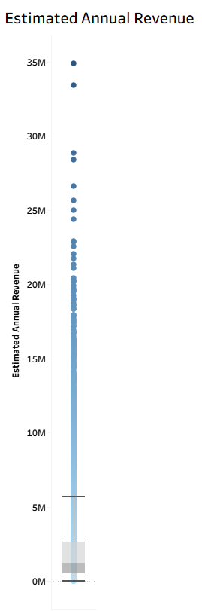
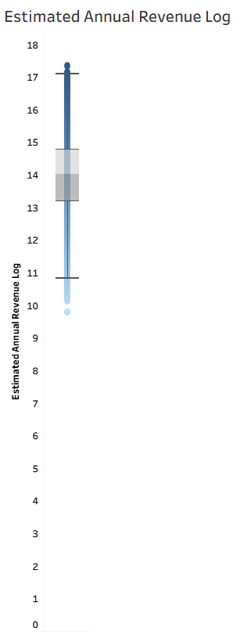
Univariate Analysis
Y-Variable: Estimated Annual Revenue (log)
Log transformation distribution is approximately normal confirming transformation was effective.
Mild left skew: mean (¥1.18M) slightly below median (¥1.23M)
Key Statistics
Median annual revenue = ¥1,234,370 (~¥1.23M per year)
Mean slightly lower at ¥1,118,237 due to mild left skew from lower revenue listings
IQR spans ¥537,208 to ¥2,604,449 (~¥537K - ~¥2.6M per year)
Right tail extends to ¥34.8M premium luxury listings
Left tail minimum ¥17,628 very low activity listings
Note: Raw revenue was right skewed → log transformation applied

Slide 5
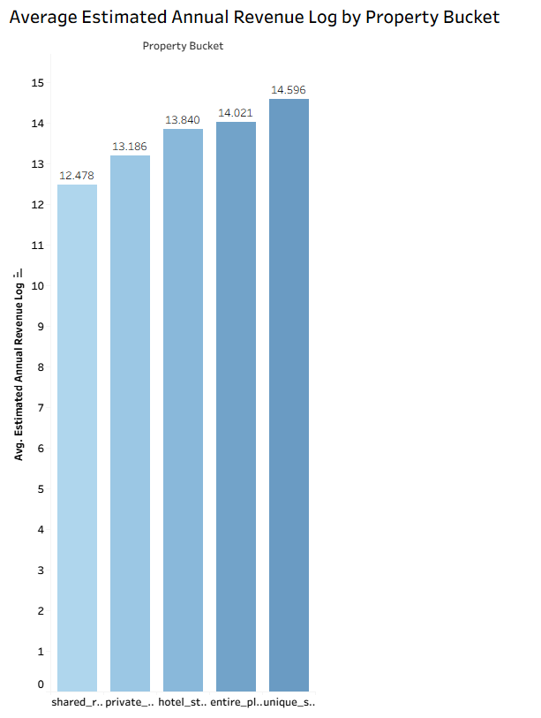
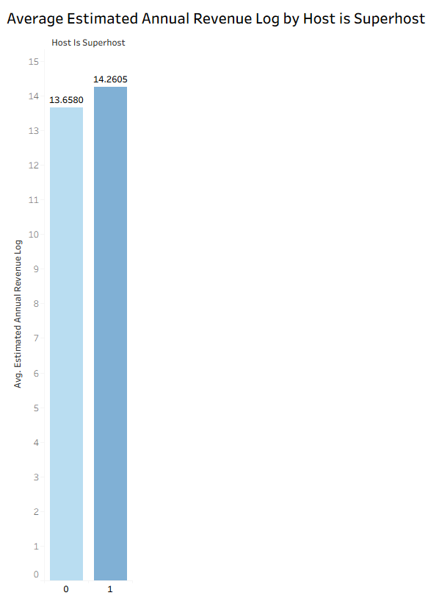
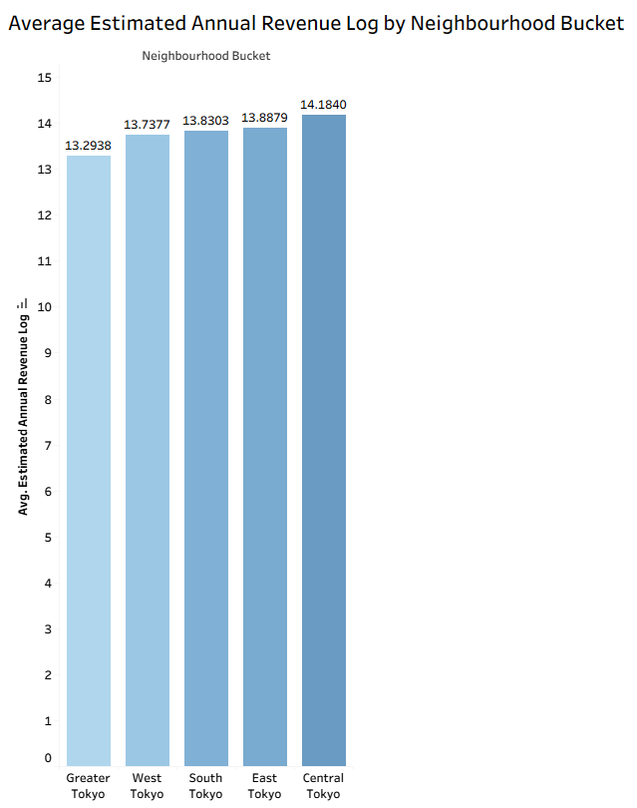


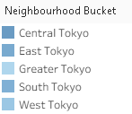
Bivariate Analysis- Categorical Variables
With F = 307.84, p < .0001 property bucket is statistically significant and explains about 5.45% of the variation in revenue.
Entire place dominates in volume with strong revenue of ¥1.22M
With F-1453.04,p<.0001 hosts_is_ superhost is statistically significant and explain about 6.39% variation in the revenue.
Superhots generate about ¥702,873 more per year nearly 1.82 x more revenue than non-superhost.
With F-147.73, p <.0001 neighborhood bucket is statistically significant and explains about 2.7% variation in estimated annual revenue by neighborhood bucket.
Central Tokyo generates the highest average revenue (¥1.45M)

Slide 6
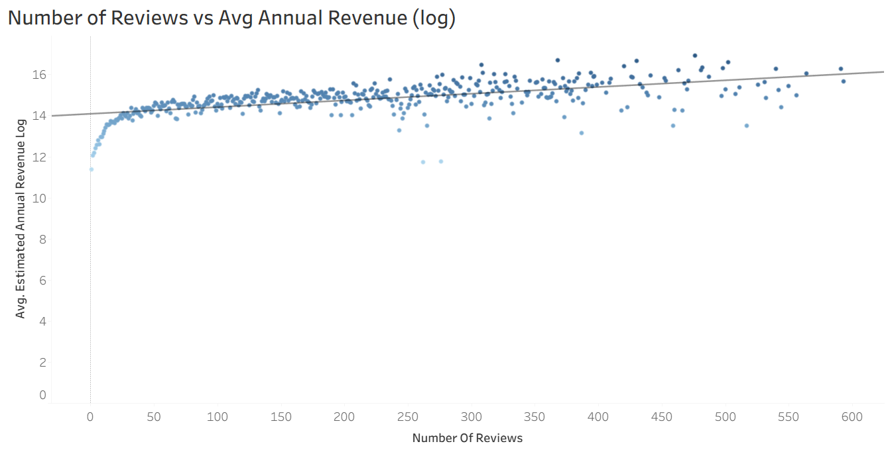
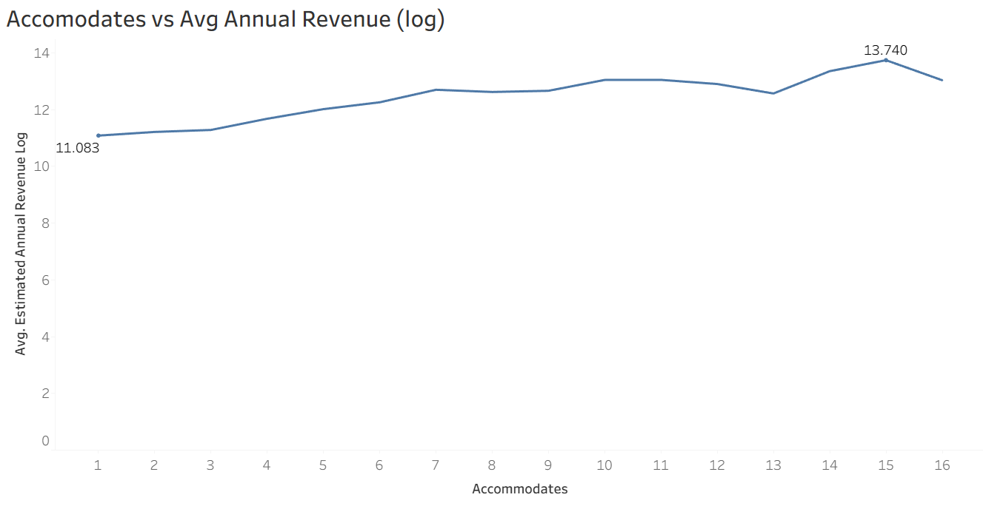
Bivariate Analysis- Continuous Variables
Number of reviews: strongest continuous predictor
r = 0.33 | With p < .0001, r² ~ 0.1314, number of reviews is statistically significant, and explains approximately 13.1% of the variation in estimated annual revenue log
New listings with fewer than 10 reviews earn approximately ¥162,754 annually while listings with 500+ reviews earn ¥8,886,110 a remarkable 54x revenue gap
Listings with 500+ reviews earn ~16x more revenue than new listings early reviews drive the steepest gain.
Accommodates:
r = 0.36 | With p < .0001, r² ~ 0.1299, accommodates is statistically significant, and explains approximately 13.% of the variation in estimated annual revenue log
Revenue rises from ¥64,706 (1 guest capacity) to ¥924,132 (15 guest capacity) a 14x revenue difference between the smallest and largest capacity listings
Listings accommodating more guests earn higher revenue , each additional guest adds +0.40%, with sharpest gains in the 1–7 guest range.

Slide 7
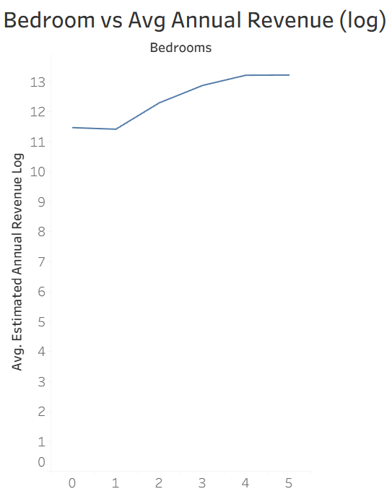
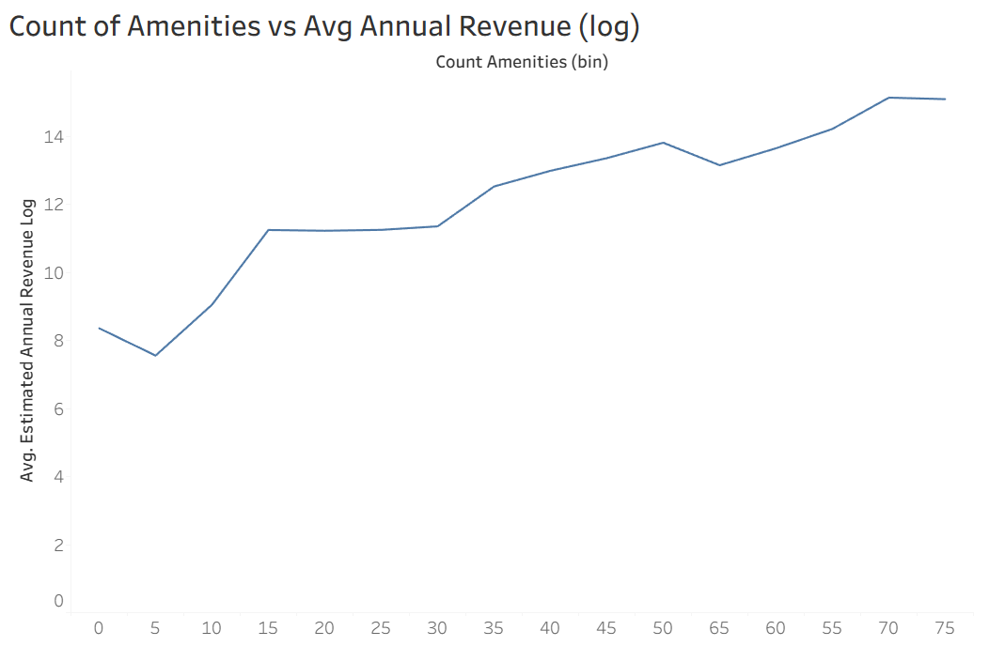
Bivariate Analysis- Continuous Variables
Bedrooms :
r = 0.31 | With p<0.001, r² ~ 0.3119, count of amenities is statistically significant and explains approximately 9.73%of the variation in estimated annual revenue.
Revenue rises from ~¥98,715 (studio) to ~¥594,776 (4+ bedrooms) a 6x revenue gap between the smallest and largest listings
Each additional bedroom lifts revenue by +0.33% larger listings capture stronger booking demand.
Count of amenities:
r = 0.32 | With p<0.001, r² ~ 0.105, count of amenities is statistically significant and explains approximately 10.5% of the variation in estimated annual revenue.
Revenue rises dramatically from ~¥2,439 (5 amenities) to ~¥977,008 (50 amenities) a 400x revenue difference between poorly and well-equipped listings
Revenue rises steadily up to 50 amenities then plateaus each amenity adds +0.29% to revenue.

Slide 8
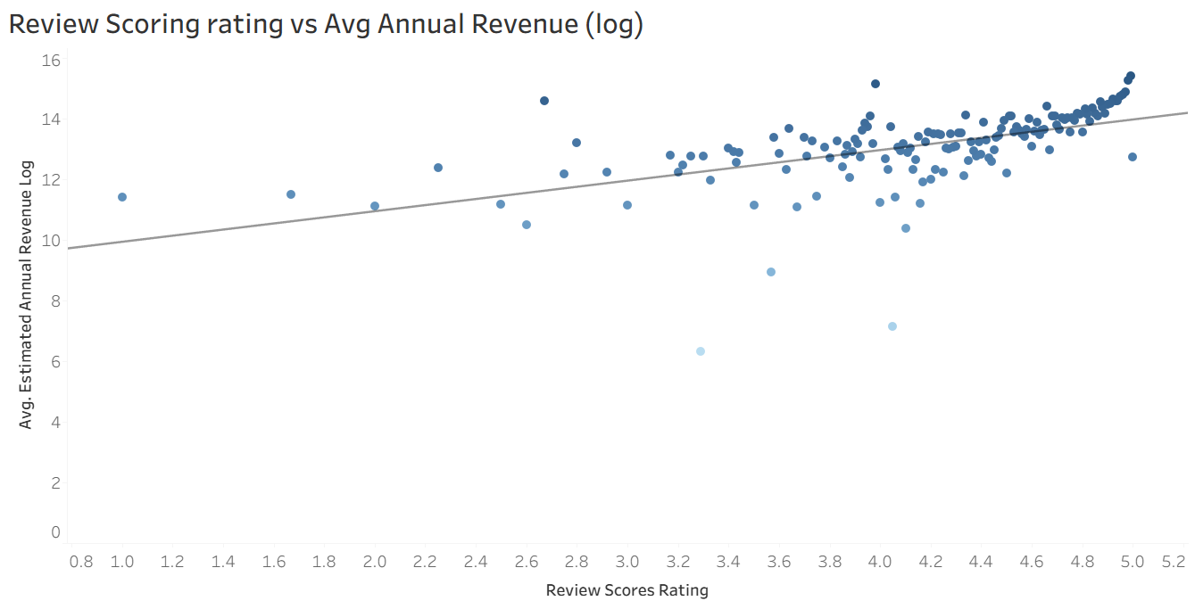
Bivariate Analysis- Continuous Variables
Review scores - Weakest Continuous Predictor
r = 0.19 | With p<0.001, r² ~0.0379, count of amenities is statistically significant and explains approximately 3.8%of the variation in estimated annual revenue
Rating of 1.0 earn approximately ¥22,026 annually while listings with a rating of 5.0 earn approximately ¥1,202,604 a 54x revenue difference driven purely by rating improvement

Slide 9
Regression Analysis
Linear
Semi-Log
Log-Log

Slide 10



Model Overview
8 predictors, N = 21,287
Nominal: property_bucket (ref: entire_place) | neighbourhood_bucket (ref: Greater Tokyo) | host_is_superhost (ref: 0)
Continuous: accommodates, bedrooms, review_scores_rating, number_of_reviews, count_amenities
Different functional forms were tested to ensure robustness of results
Adj R-Square Comparison
Metric | Linear | Semi-log | Log-log ✓
Adj R² | 37.1% | 37.2% | 57.4%
Central Tokyo vs Greater Tokyo (Largest overall impact) | +¥1.5M | +125% | +114%
Superhost vs Non-Superhost | +¥602K | +37% | +25%
Private room vs Entire Place | –¥469K | –41% | –41%
Shared room vs Entire Place | –¥700K | –65% | –65%
Review score | +¥361K | +33.5% | +0.80%
Accommodates | +¥197K | +8.3% | +0.40%
Bedroom | +¥389K | +11.2% | +0.33%
Amenities | +¥34K | +1.75% | +0.29%
Review Score | +¥360K | +33.5% | +0.80%
Number of Reviews | +¥9.5K | +0.53% | +0.47%
Linear
Semi-log
Log-Log
Number of reviews = highest F ratio across all 3 models most consistent and reliable predictor of revenue

Slide 11
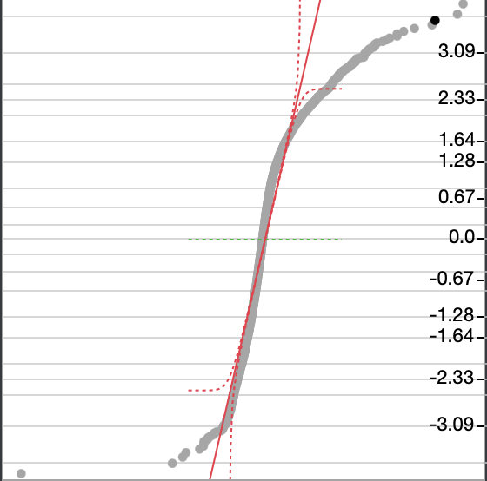
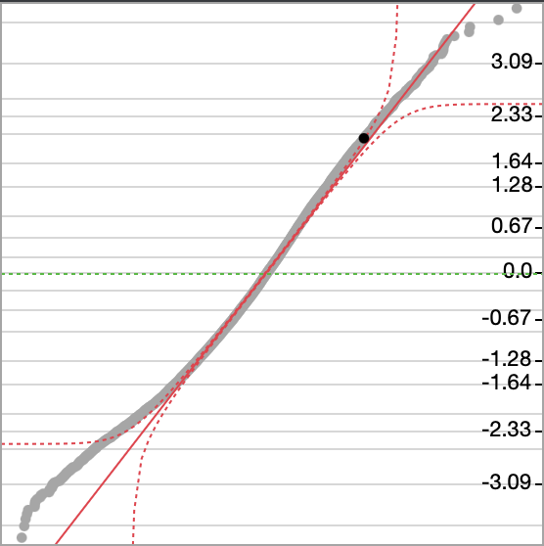
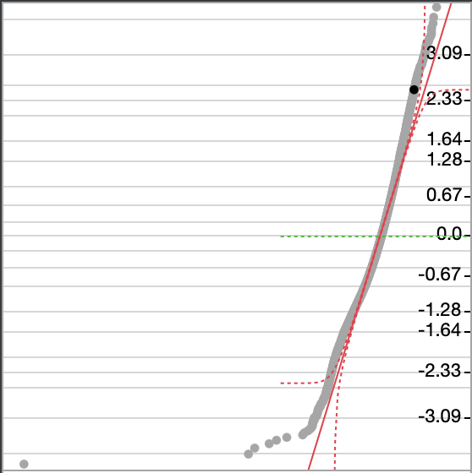
Residual Diagnostics Test
Residual Fit: Linear Regression
Residual Fit :Semi-Log Regression
Residual Fit: Log-Log Regression
QQ Plot:
Strong deviation from normality (tails)
Wide residual spread (–33 to +27)
Poor fit
QQ Plot:
Improvement in spread (–18.6 to +3.0)
Still skewed (left tail issue)
Moderate improvement
QQ Plot:
Tightest residual range (–3.57 to +3.72)
More symmetric distribution
Best overall fit
Anderson-Darling Goodness of Fit Test for all the 3 models :
p < .0001 → reject null hypothesis, residuals are statistically not normally distributed
With large sample size (N = 21K), the test is overly sensitive visual improvement is more meaningful.
While all models violate strict normality, the log-log model significantly improves residual behavior and provides the most reliable fit

Slide 12
Log-Log Regression – Best Model
Log(Revenue) = 8.98 + 0.799·log(Rating) + 0.466·log(Reviews) + 0.336·log(Bedrooms+1) + 0.402·log(Accommodates) + 0.288·log(Amenities+1) + [Dummies] + ε
Coefficients represent elasticity: % change in revenue for a 1% change in input
⭐ Demand Signals:
Review Score → +0.80% (strongest elasticity)
Reviews → +0.47% (most statistically reliable driver)
Trust signals increase demand and pricing power
👥 Capacity Drivers:
Accommodates → +0.40%
Bedrooms → +0.33%
Larger listings scale revenue through higher booking potential
🛎️ Guest Experience Drivers:
Amenities → +0.29%
Amenities improve perceived value but have smaller marginal impact
📍 Location (BIGGEST EFFECT)
Central Tokyo → +114%
East/South → ~+52%
West → +44%
Location drives the largest step-change in revenue
🏠 Property Type
Shared → –65%
Private → –41%
Hotel → –17%
Unique → Not significant
Guests strongly prefer privacy and full-property access
🏅 Host Quality
Superhost → +24.6%
Superhost status signals trust and increases willingness to pay
Location drives the largest revenue jump, while reviews and ratings drive consistent, scalable growth

Slide 13
⭐ Improve Review Scores (Highest Impact):
Ratings have the strongest elasticity (+0.80%)
Focus on host coaching, guest feedback, post-stay engagement
🏅 Grow Superhost Base
Superhosts earn +24.6% more revenue
Invest in retention, incentives, and onboarding programs
🏠 Promote Entire Place Listings
Private: –41% | Shared: –65% vs entire place
Incentivize full-property listings & conversions
📍 Expand High-Potential Locations
Central Tokyo: +114% (largest impact)
East/South/West: +45%–58%
Target host acquisition + marketing in these areas
🛠️ Drive Capacity & Amenity Upgrades
Amenities, bedrooms, capacity → positive revenue impact
Encourage feature upgrades & listing optimization
Creates compounding growth (more bookings → more reviews → more revenue.
Recommendations

Slide 14
Moderate Model Fit:
Log-log model explains 57.4% of revenue variation → ~42.6% remains unexplained
Missing Key Drivers: Important factors not included
listing photos quality, host response rate
seasonality (calendar data not used)
neighbourhood demand signals (review data not used)
proximity to tourist attractions
🔬 Future Research:
Interaction Effects:
Explore combined effects (e.g., Superhost × Central Tokyo)
Incorporate Calendar Data:
Capture seasonality, pricing trends, and occupancy pattern
Feature Expansion:
Include host behavior, listing quality, and location granularity
Data Limitations

Slide 15
Appendix
Notes:
Thank you

Slide 16
Regression Equations
Linear Model : -3,832,422 + 47096.438(hotel_style) – 469601 (private_room) - 700104.5 (shared_room) + 571595.57 (unique_stay) + 1512359 (Central Tokyo) + 723431.12 (East Tokyo) + 803756.53 (South Tokyo) – 549935.39 (West Tokyo) + 602644.04 (Superhost) + 197,711.03 (Accomodates) + 389, 245.91 (Bedrooms) + 360, 826.53 (Review Score Rating) + 9,520.92 (Number of Reviews) + 34,973.55 (Amenities) + ε
Semi-Log Model: 10.62647 − 0.15741 (hotel_style) − 0.532578 (private_room) − 1.147226(shared_room) + 0.102892(unique_stay) + 0.8124835(Central Tokyo) + 0.4546729(East Tokyo) + 0.4599184(South Tokyo) + 0.3759864(West Tokyo) + 0.2889199(Review Score) + 0.0052688(Number of Reviews) + 0.1063913(Bedrooms) + 0.0797315(Accommodates) + 0.3159109(Superhost) + 0.0174491(Amenities) + ε
Log-Log Model : log(Estimated Annual Revenue)= 8.9808305 + 0.2875812 log(Amenities+1) + 0.7992211 log(Review Score) + 0.4656384 log(Number of Reviews) + 0.3338908log(Bedrooms+1) + 0.4024934 log(Accommodates) − 0.192305 (hotel_style) − 0.524523(private_room) − 1.062015 (shared_room) −0.008846 (unique_stay) + 0.7591168(Central Tokyo) + 0.4220898(East Tokyo) + 0.4226478(South Tokyo) + 0.3640181(West Tokyo) + 0.2197603(Superhost) + ε

