Slide 1
Bio-medical Image Processing
Dr. R. Devika Rubi

Slide 2
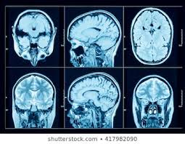
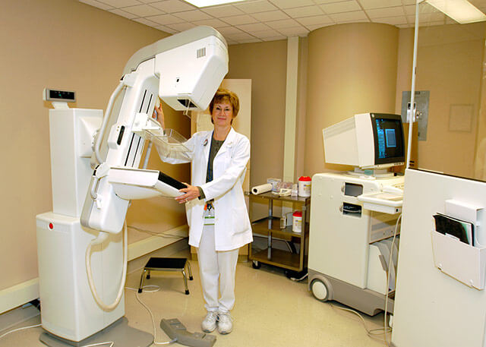
Medical Images
X-Ray
Uses invisible electromagnetic energy beams to produce images on a photographic film
Produce images of internal tissues, bones and organs for many reasons including diagnosing tumors or bone injuries
The Light or rays are absorbed by different parts of body in different quantity
For eg. Bones observe more radiation(white), soft tissue permit more of the rays to pass through them, producing gray shades
Mammogram (analog) images are, a kind of x-ray used for the examination of breast cancer
Digital mammography allowing the radiologist to capture and manipulate the images, so that abnormalities can been seen
For eg. By manipulating the contrast, making the images lighter or darker, malignant masses within the tissue can be identified
Digital Mammography
(John Hopkins Breast Center)

Slide 3
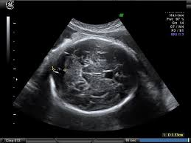
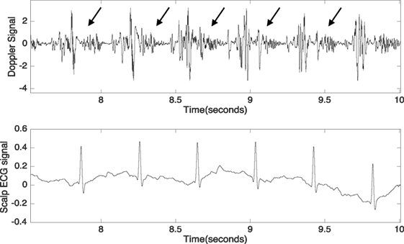
Medical Images…
Ultra Sound Fetal brain
Ultra-Sound Imaging
Uses sound as a physical phenomenon
Sound Is transferred as vibrations passing through an object or body
Sound passes only through matter and not through vacuum
Frequency or pitch is most important
Frequency is the sound characteristic, defined as the rate at which the object vibrate
Color Doppler Imaging
Digitized array of color as visual effect of the speed and direction of blood flow through blood vessels
Color Doppler ultrasound can be used to listen to the fetal heartbeat, examine the fetal heart for defects, and estimate placental blood flow
During this special type of ultrasound, distinct colors show the different rates of blood flow

Slide 4
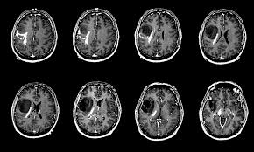
MRI (Magnetic Resonance Imaging)
Used for screening the breast and brain (internal injury to the brain)
Uses the magnetic properties of hydrogen nuclei (protons)
A small fraction of protons brought into alignment with a strong magnetic field within the MRI scanner
Nuclei are exposed to pulse of radiofrequency energy, displaces nuclei (in breast/brain tissue)
After the relaxation of nuclei, system releases an amount of energy which is electronically processed to construct image
Glioma (Brain Tumor)

Slide 5
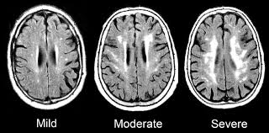
Computed Tomography (CT)
Makes use of computer-processed combinations of many X-ray measurements taken from different angles to produce cross-sectional (tomographic) images (virtual "slices") of specific areas of a scanned object
Allowing the user to see inside the object without cutting
Digital geometry processing is used to further generate a three-dimensional volume of the inside of the object from a small series of two-dimensional radiographic images taken around a single axis of rotation
Brain Hemorrhage – CT Image

Slide 6
Other Medical imaging modalities…
Radiography
Digital Radiography
Echocardiogram
Electrocardiogram (ECG/EKG)
Computer Tomography Angiography (CTA)
Positron Emission Tomography (PET)

Slide 7

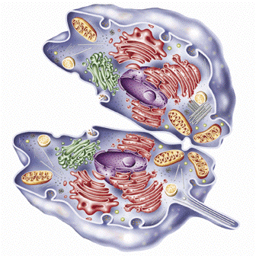
DNA - Introduction
A chromosome is a deoxyribonucleic acid (DNA) molecule with part or all of the genetic material (genome) of an organism
Genetic material is located in nucleus
The genetic information is stored in Deoxyribonucleic acid, DNA
DNA contains the information needed to build an individual

Slide 8
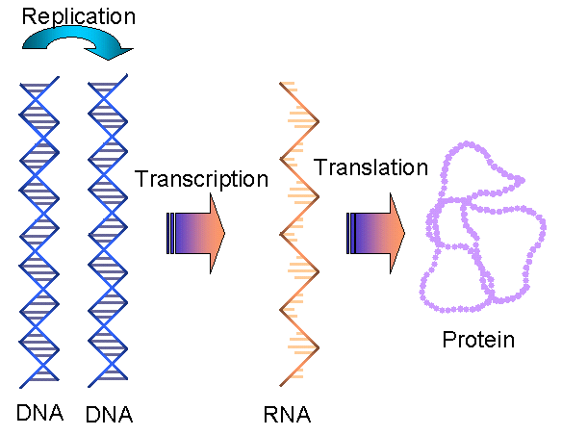
What is DNA needed for?
Genetic information is transferred from DNA and converted to protein
RNA molecules work as messengers
Proteins are the biological workers
Information of the DNA is copied to a RNA molecule in transcription
RNA directs the protein synthesis in a translation
Protein’s 3D structure determines it’s function
Information transfer only in one direction

Slide 9
The Genetic Code
Describes how nucleotide sequence is converted to protein sequence
Unit of three nucleotides = a codon
A codon codes for a specific amino acid (structural component of protein)
A gene: DNA sequence that is needed to encode amino acid sequence of a protein
Composed of exons, introns and different control elements
Exon – protein coding sequence
Intron – intervening sequence

Slide 10
Inverse table for the standard genetic code (Dr.Dayhoff )
Dr. Dayhoff, American Physical Chemist - “Mother and Father of bioinformatics".
Amino acid | DNA codons | Compressed |  | Amino acid | DNA codons | Compressed
Ala / A | GCT, GCC, GCA, GCG | GCN |  | Leu / L | TTA, TTG, CTT, CTC, CTA, CTG | YTR, CTN
Arg / R | CGT, CGC, CGA, CGG, AGA, AGG | CGN, AGR |  | Lys / K | AAA, AAG | AAR
Asn / N | AAT, AAC | AAY |  | Met / M | ATG
Asp / D | GAT, GAC | GAY |  | Phe / F | TTT, TTC | TTY
Cys / C | TGT, TGC | TGY |  | Pro / P | CCT, CCC, CCA, CCG | CCN
Gln / Q | CAA, CAG | CAR |  | Ser / S | TCT, TCC, TCA, TCG, AGT, AGC | TCN, AGY
Glu / E | GAA, GAG | GAR |  | Thr / T | ACT, ACC, ACA, ACG | ACN
Gly / G | GGT, GGC, GGA, GGG | GGN |  | Trp / W | TGG
His / H | CAT, CAC | CAY |  | Tyr / Y | TAT, TAC | TAY
Ile / I | ATT, ATC, ATA | ATH |  | Val / V | GTT, GTC, GTA, GTG | GTN
START | ATG |  |  | STOP | TAA, TGA, TAG | TRA, TAG

Slide 11
DNA to Protein Conversion
Part of the sequence from psoriasis associated gene HCR
atgtttccac cttcaggttc cactgggctg attcccccct cccactttca agctcggccc
ctttcaactc tgccaagaat ggctcccacc tggctctcag acattcccct ggtccaaccc
Three different reading frames can be used, but only one is the right one
Translate tools are found from the internet
Met F P P S G S T G L I P P S H F Q A R P L S T L P R Met A P T W L S D I P L V Q

Slide 12
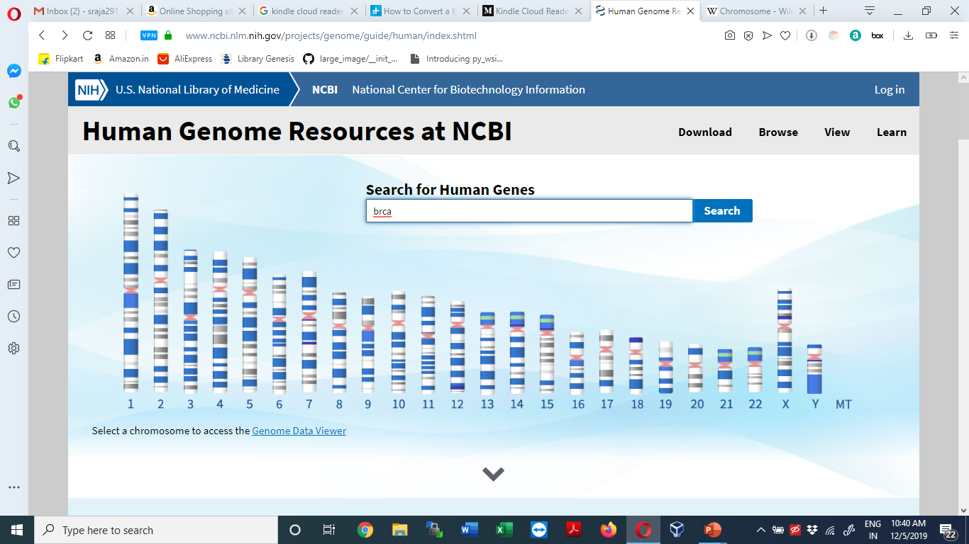

Slide 13
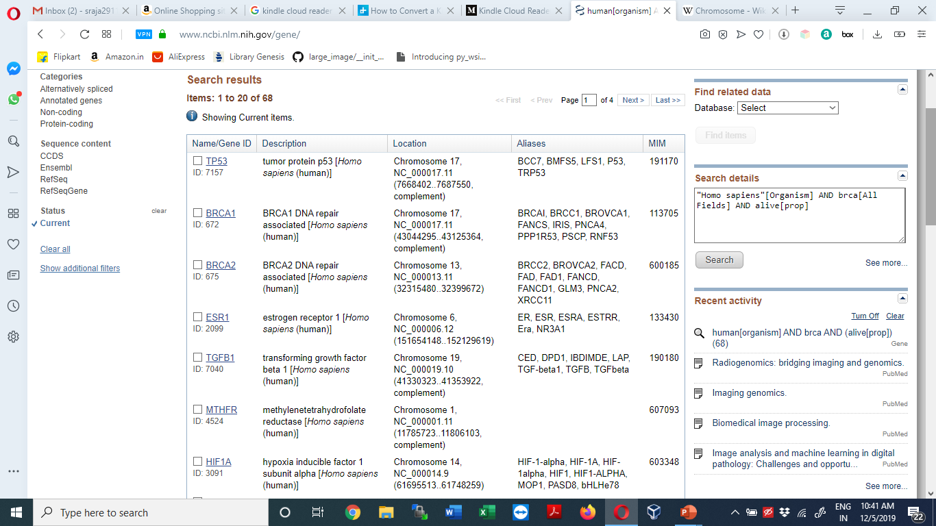

Slide 14
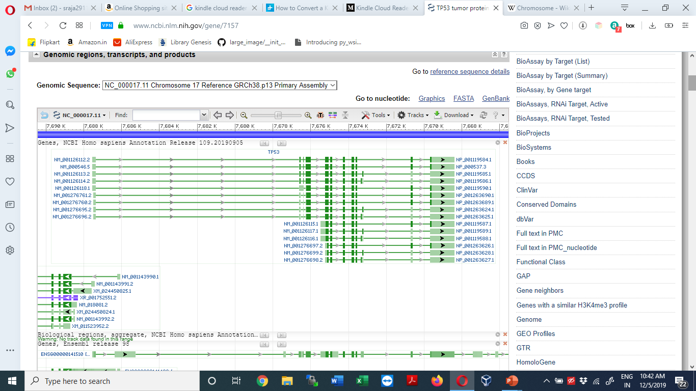

Slide 15
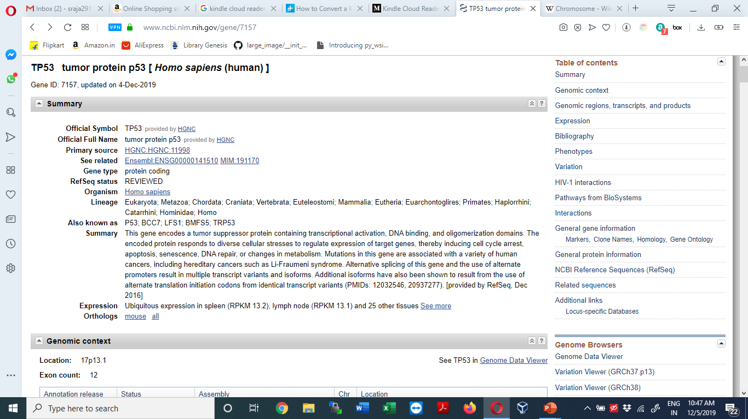

Slide 16
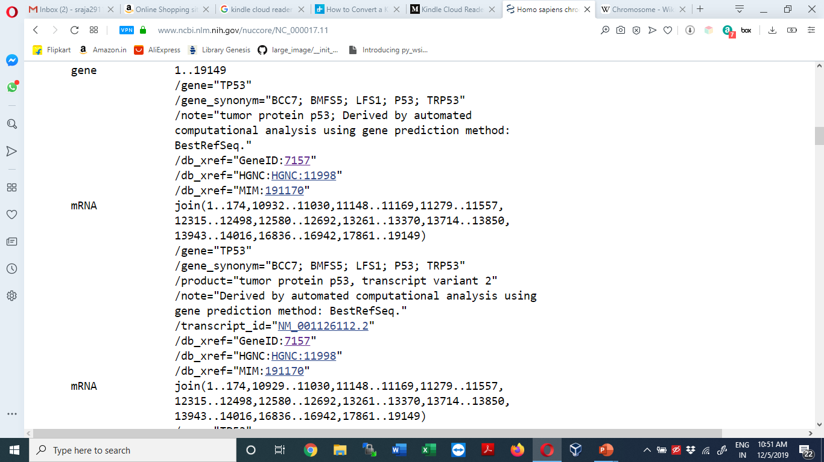

Slide 17
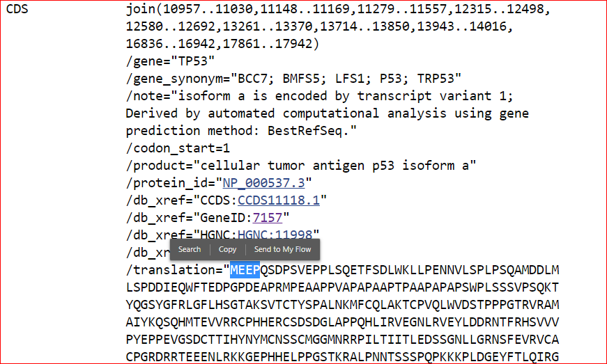

Slide 18
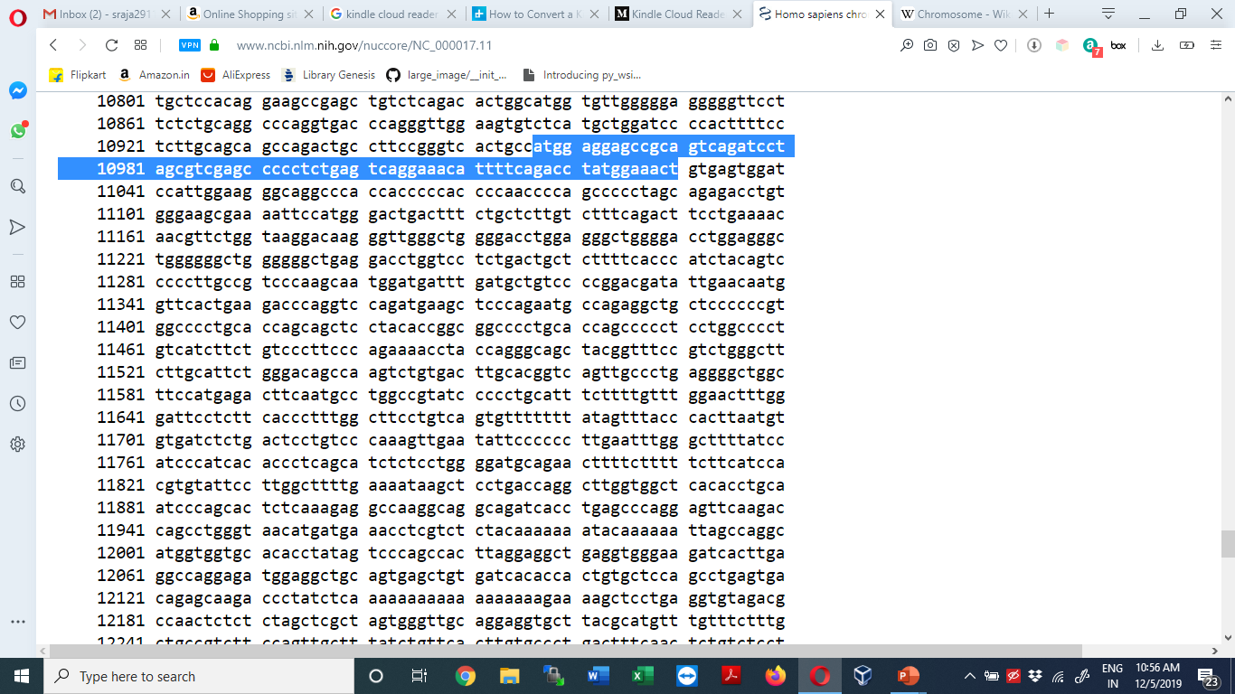

Slide 19
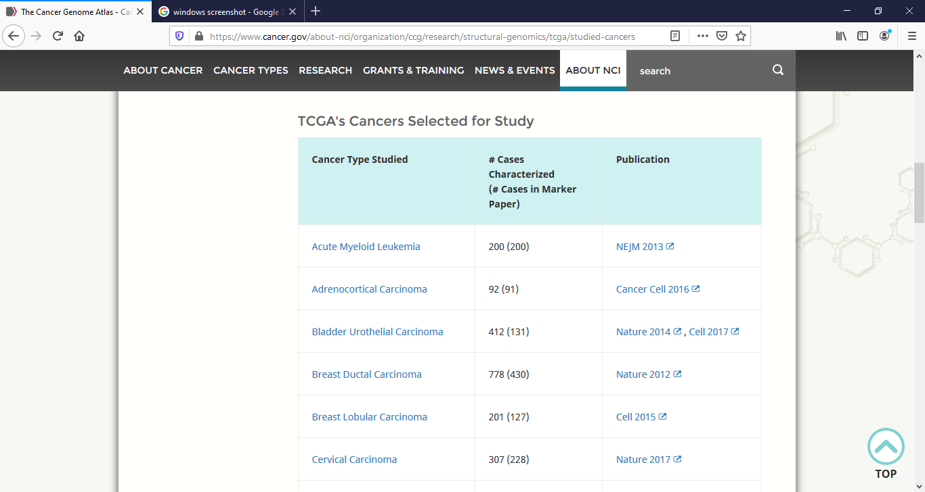
Medical repositories - TCGA
The Cancer Genome Atlas (TCGA), a landmark cancer genomics program, molecularly characterized over 20,000 primary cancer and matched normal samples spanning 33 cancer types, started in 2006
Over the next dozen years, TCGA generated over 2.5 petabytes of genomic, epigenomic, transcriptomic, and proteomic data

Slide 20
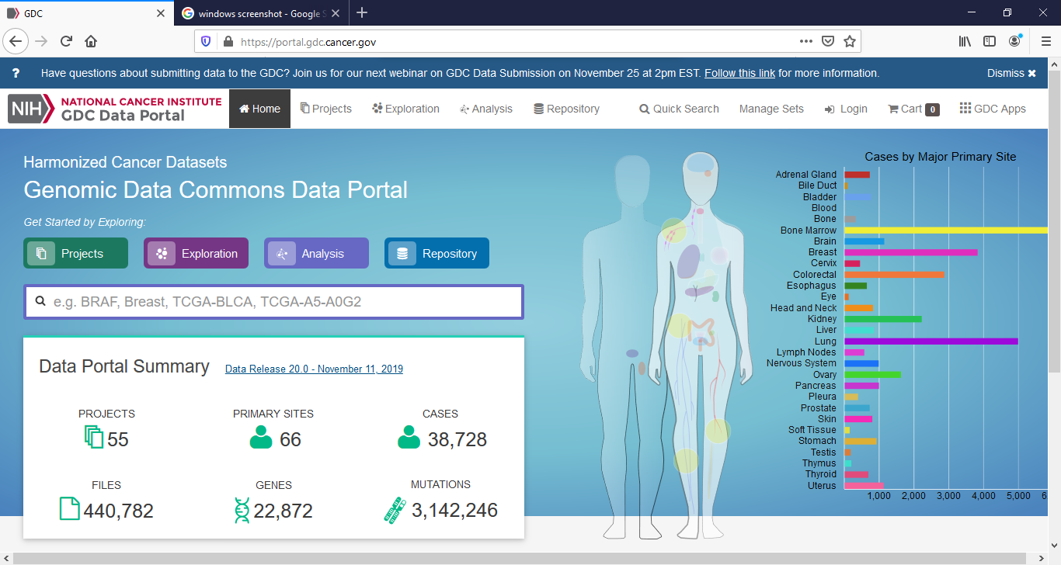
TCGA – GDC (Genomic Data Commons) Data Portal

Slide 21
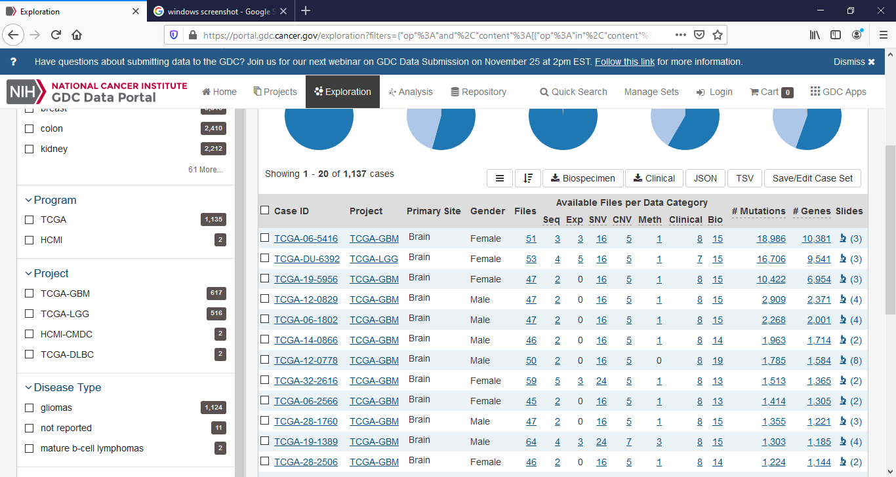

Slide 22
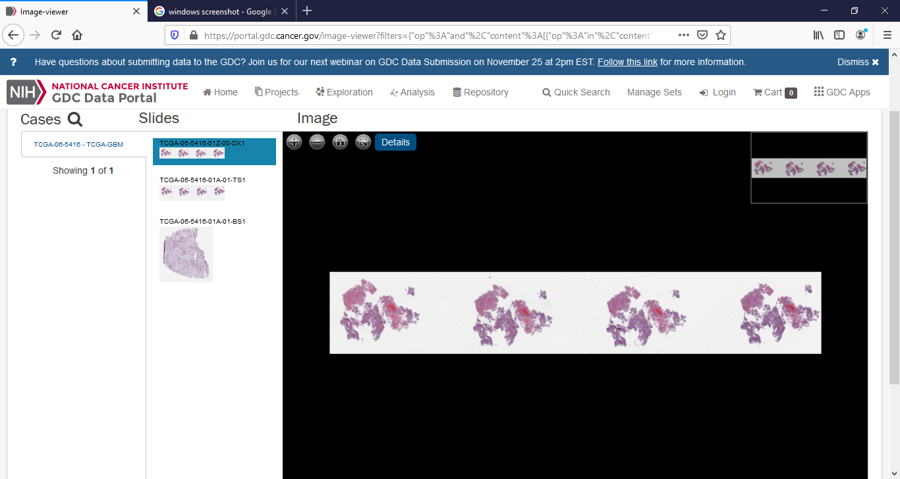
TCGA – WSI Images

Slide 23
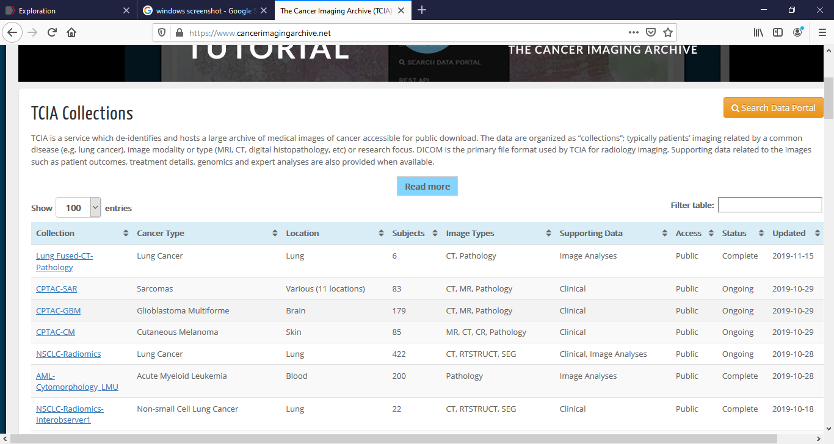
The Cancer Imaging Archive (TCIA)

Slide 24
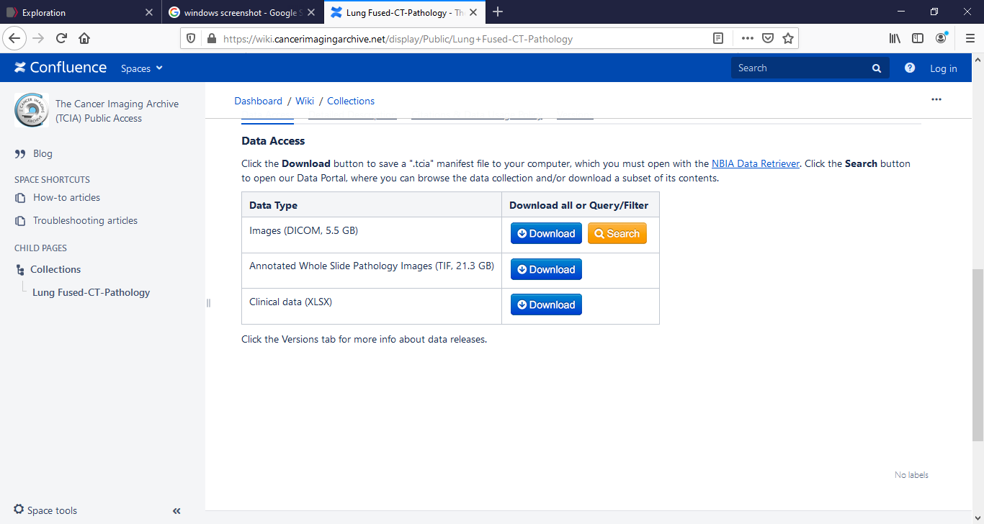
The Cancer Imaging Archive (TCIA)

Slide 25
cBioPortal (MSKCC)
The cBioPortal for Cancer Genomics provides visualization, analysis, and download of large-scale cancer genomics data sets
The cBio Cancer Genomics Portal (http://cbioportal.org) is an open-access resource for interactive exploration of multidimensional cancer genomics data sets, currently providing access to data from more than 5,000 tumor samples from 20 cancer studies (Eg. TCGA, Genie…)
Non-synonymous mutations, DNA copy-number data (putative, discrete values per gene, e.g. "deeply deleted" or "amplified", as well as log2 or linear copy number data), mRNA and microRNA expression data, protein-level and phosphoprotein level data (RPPA or mass spectrometry based), DNA methylation data, and de-identified clinical data

Slide 26
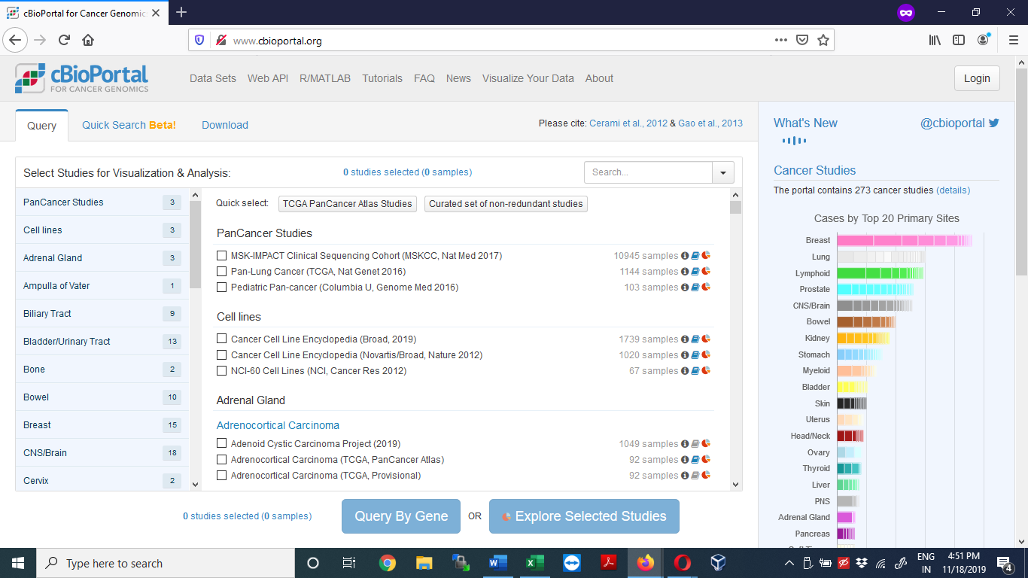
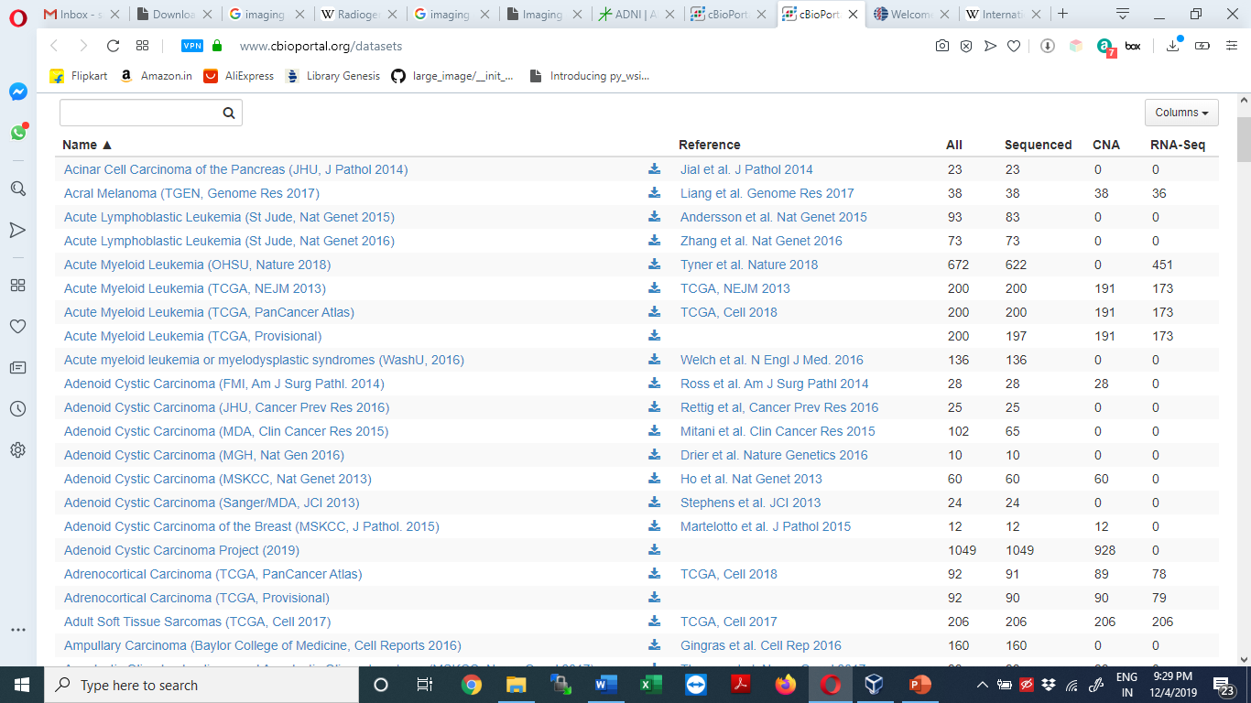
cBioPortal

Slide 27
Other Medical repositories
Alzheimer's Disease Neuroimaging Initiative (ADNI) is a multisite study that aims to improve clinical trials for the prevention and treatment of Alzheimer’s disease (AD) - http://adni.loni.usc.edu
The Lung Image Database Consortium image collection (LIDC-IDRI) consists of diagnostic and lung cancer screening thoracic computed tomography (CT) scans with marked-up annotated lesion - https://wiki.cancerimagingarchive.net/display/Public/LIDC-IDRI
The International Cancer Genome Consortium (ICGC) - Systematic studies of more than 25,000 cancer genomes at the genomic, epigenomic and transcriptomic levels ; The ICGC incorporates data from The Cancer Genome Atlas (TCGA) and the Sanger Cancer Genome Project.
American Association for Cancer Research (AACR) Project GENIE
The Open Access Series of Imaging Studies (OASIS) is a project aimed at making neuroimaging data sets of the brain freely available to the scientific community - http://www.oasis-brains.org
The Federal Interagency Traumatic Brain Injury Research (FITBIR) informatics system was developed to share data across the entire TBI research field and to facilitate collaboration between laboratories, as well as interconnectivity with other informatics platforms
BrainWeb: Simulated Brain Database - https://brainweb.bic.mni.mcgill.ca/brainweb/
Japanese Society of Radiological Technology - The aim of the Japanese Society of Radiological Technology (JSRT) is to contribute to the development and improvement of radiological science and technology in terms of research activity, intellectual exchange, and scientific communication with other related parties - https://www.jsrt.or.jp/data/english/jsrt/
The ENIGMA (Enhancing Neuro Imaging Genetics through Meta Analysis) Network brings together researchers in imaging genomics to understand brain structure, function, and disease, based on brain imaging and genetic data

