Slide 1
Bio-medical Image Processing
Dr. R. Devika Rubi

Slide 2
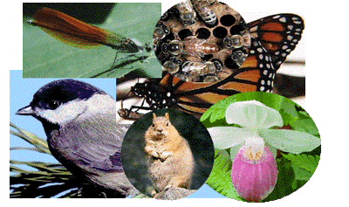
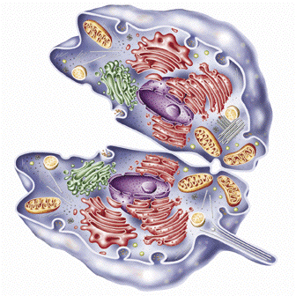
DNA - Introduction
A chromosome is a deoxyribonucleic acid (DNA) molecule with part or all of the genetic material (genome) of an organism
Genetic material is located in nucleus
The genetic information is stored in Deoxyribonucleic acid, DNA
DNA contains the information needed to build an individual

Slide 3
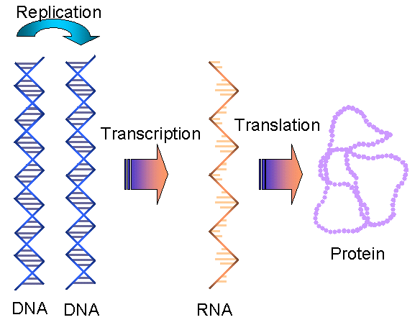
What is DNA needed for?
Genetic information is transferred from DNA and converted to protein
RNA molecules work as messengers
Proteins are the biological workers
Information of the DNA is copied to a RNA molecule in transcription
RNA directs the protein synthesis in a translation
Protein’s 3D structure determines it’s function
Information transfer only in one direction

Slide 4
The Genetic Code
Describes how nucleotide sequence is converted to protein sequence
Unit of three nucleotides = a codon
A codon codes for a specific amino acid (structural component of protein)
A gene: DNA sequence that is needed to encode amino acid sequence of a protein
Composed of exons, introns and different control elements
Exon – protein coding sequence
Intron – intervening sequence

Slide 5
Inverse table for the standard genetic code (Dr.Dayhoff )
Dr. Dayhoff, American Physical Chemist - “Mother and Father of bioinformatics".
Amino acid | DNA codons | Compressed |  | Amino acid | DNA codons | Compressed
Ala / A | GCT, GCC, GCA, GCG | GCN |  | Leu / L | TTA, TTG, CTT, CTC, CTA, CTG | YTR, CTN
Arg / R | CGT, CGC, CGA, CGG, AGA, AGG | CGN, AGR |  | Lys / K | AAA, AAG | AAR
Asn / N | AAT, AAC | AAY |  | Met / M | ATG
Asp / D | GAT, GAC | GAY |  | Phe / F | TTT, TTC | TTY
Cys / C | TGT, TGC | TGY |  | Pro / P | CCT, CCC, CCA, CCG | CCN
Gln / Q | CAA, CAG | CAR |  | Ser / S | TCT, TCC, TCA, TCG, AGT, AGC | TCN, AGY
Glu / E | GAA, GAG | GAR |  | Thr / T | ACT, ACC, ACA, ACG | ACN
Gly / G | GGT, GGC, GGA, GGG | GGN |  | Trp / W | TGG
His / H | CAT, CAC | CAY |  | Tyr / Y | TAT, TAC | TAY
Ile / I | ATT, ATC, ATA | ATH |  | Val / V | GTT, GTC, GTA, GTG | GTN
START | ATG |  |  | STOP | TAA, TGA, TAG | TRA, TAG

Slide 6
DNA to Protein Conversion
Part of the sequence from psoriasis associated gene HCR
atgtttccac cttcaggttc cactgggctg attcccccct cccactttca agctcggccc
ctttcaactc tgccaagaat ggctcccacc tggctctcag acattcccct ggtccaaccc
Three different reading frames can be used, but only one is the right one
Translate tools are found from the internet
Met F P P S G S T G L I P P S H F Q A R P L S T L P R Met A P T W L S D I P L V Q

Slide 7
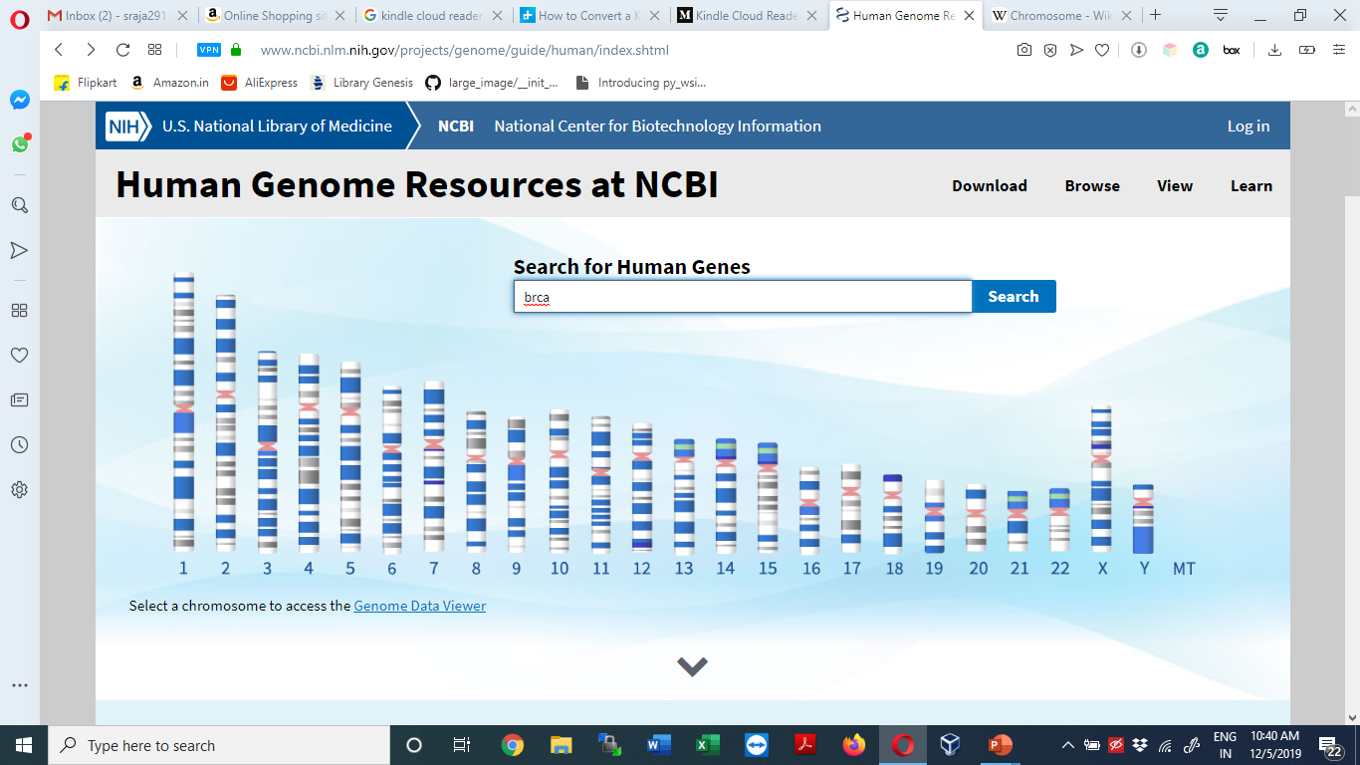

Slide 8
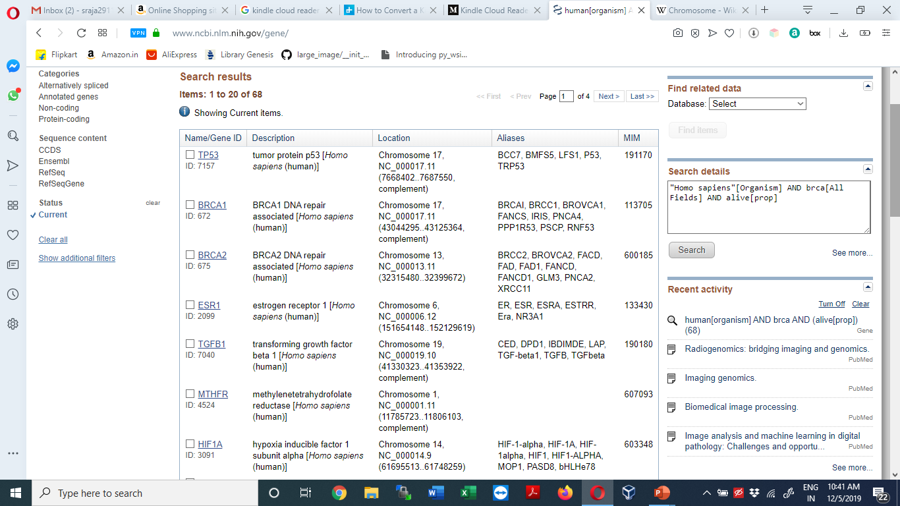

Slide 9
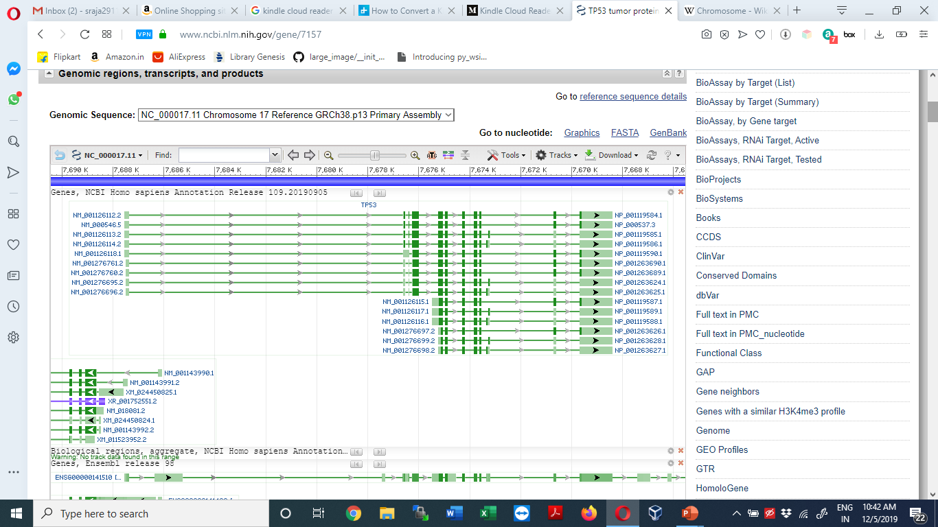

Slide 10
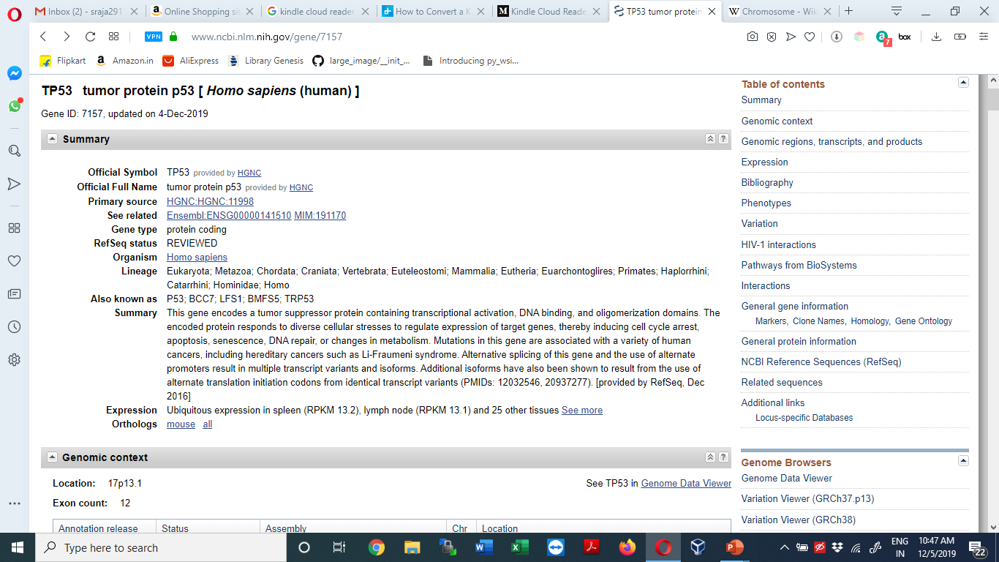

Slide 11
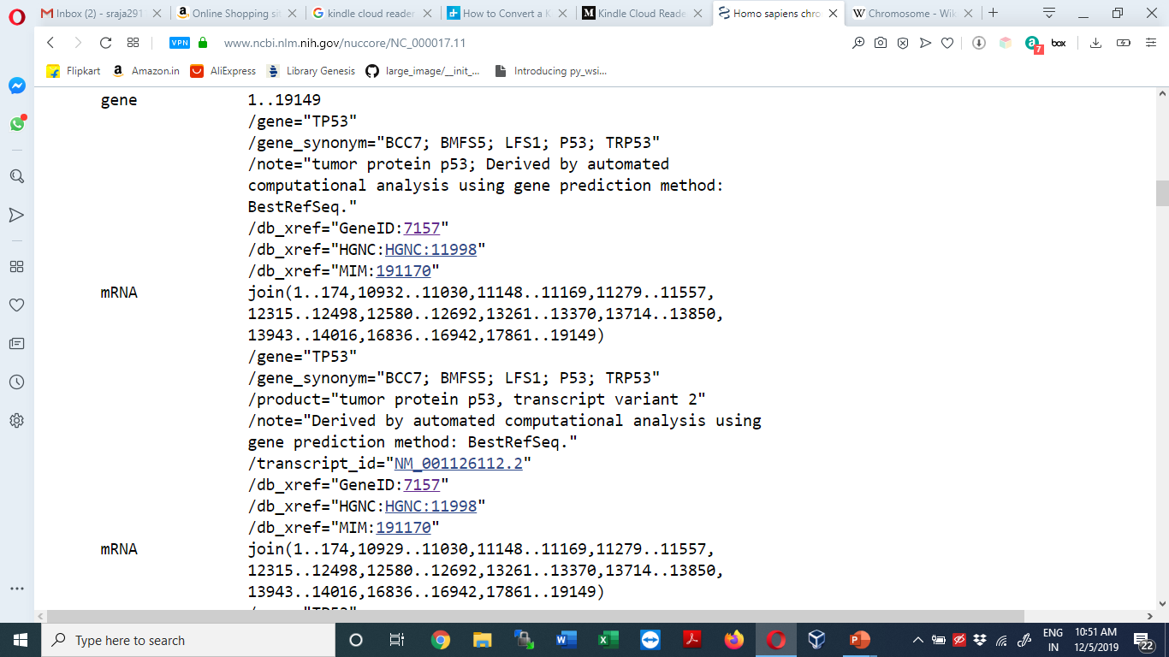

Slide 12
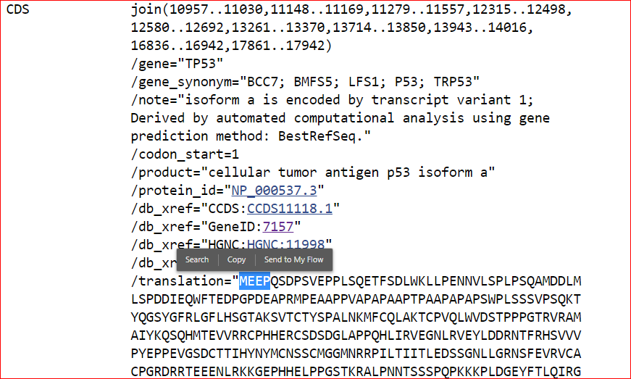

Slide 13
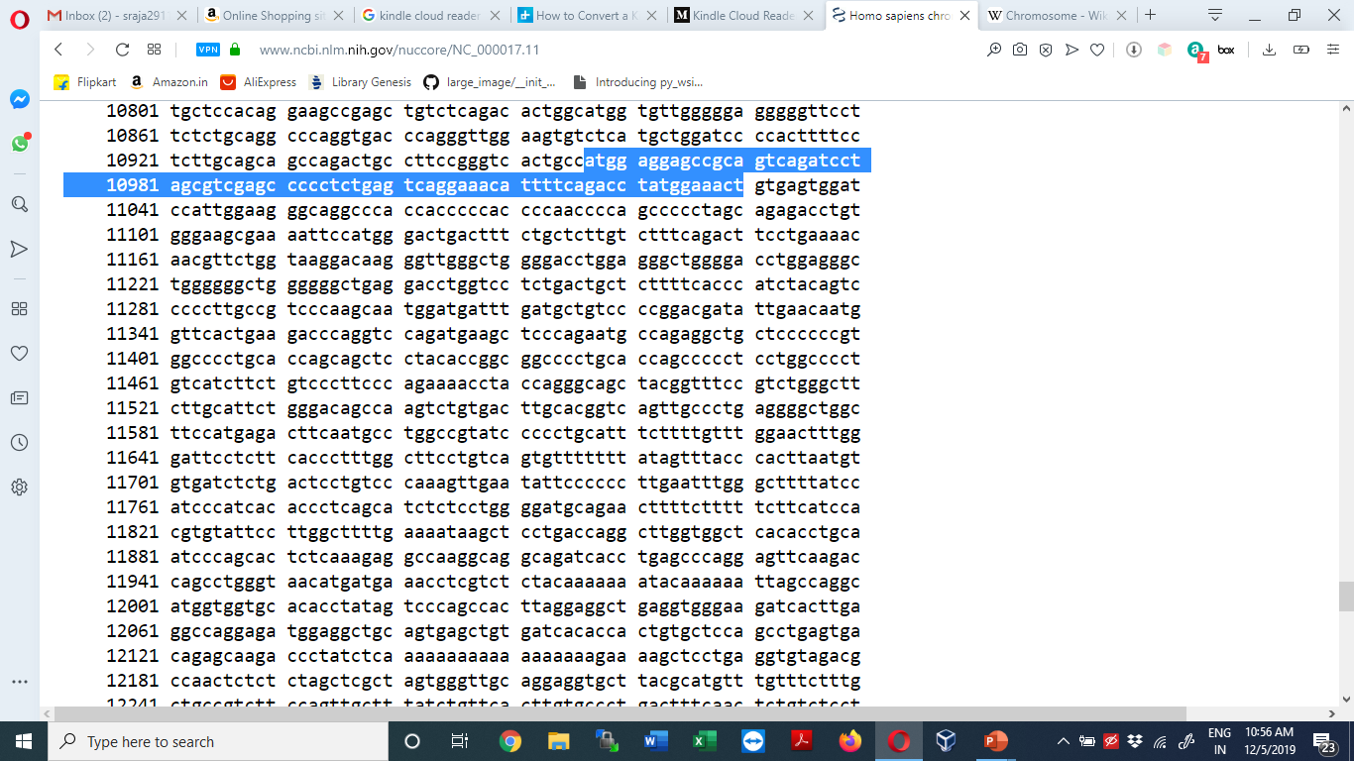

Slide 14
Histopathology
Histopathology (compound of three Greek words: histos "tissue", pathos "suffering", and -logia "study of") refers to the microscopic examination of tissue in order to study the manifestations of disease
Histopathology is the diagnosis and study of diseases of the tissues, and involves examining tissues and/or cells under a microscope
Histopathologists are doctors who work closely with other clinical specialties. They can reach a diagnosis by examining a small piece of tissue from the skin, liver, kidney or other organ. This is called a biopsy
They examine the tissue carefully under a microscope, looking for changes in cells that might explain what is causing a patient’s illness. Around 20 million histopathology slides are examined in the UK each year

Slide 15
WSI (Whole Slide Imaging) Imaging
Histopathologists provide a diagnostic service for cancer; they handle the cells and tissues removed from suspicious ‘lumps and bumps’, identify the nature of the abnormality and, if malignant, provide information to the clinician about the type of cancer, its grade and, for some cancers, its responsiveness to certain treatments
Whole slide imaging (WSI), which refers to scanning of conventional glass slides in order to produce digital slides, is the most recent imaging modality being employed by pathology departments worldwide. WSI continues to gain traction among pathologists for diagnostic, educational, and research purposes
Whole slide imaging, also known as virtual microscopy, refers to scanning a complete microscope slide and creating a single high-resolution digital file. This is commonly achieved by capturing many small high-resolution image tiles or strips and then montaging them to create a full image of a histological section

Slide 16
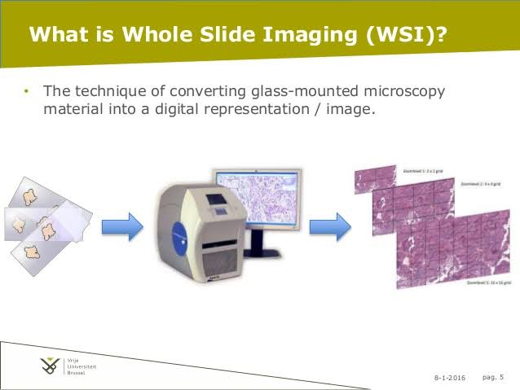
WSI Imaging
The DICOM Standard now provides support for WSI digital slides, by incorporating a way to handle tiled large images as multi-frame images and multiple images at varying resolutions

Slide 17
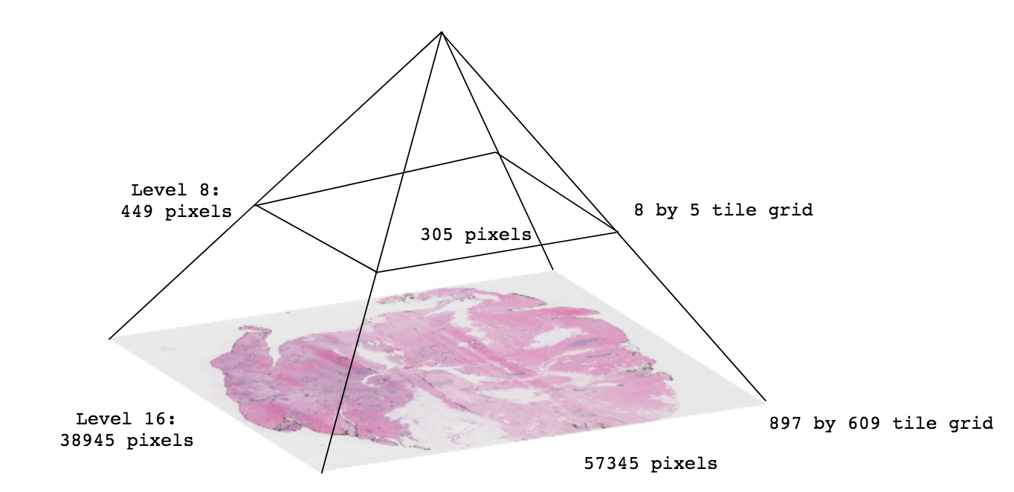
A .svs file (WSI Image) – Pyramid image
Most .svs images have between 15-20 levels, depending on the magnification of the image (typically 20x-40x) and the whole slide scanner (HistomicsTK worksheet)

Slide 18
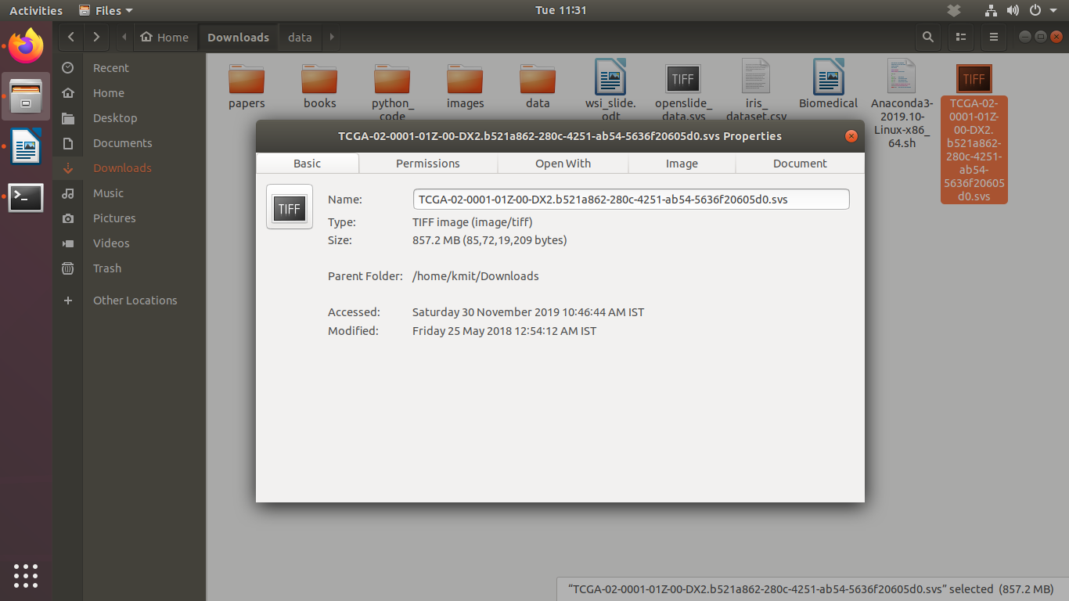
Reading Whole-slide Images using Large-image
[1]:
import large_image
INFO:girder:Created LRU Cache for 'tilesource' with 167 maximum size
[2]:
wsi_url = 'https://data.kitware.com/api/v1/file/5899dd6d8d777f07219fcb23/download'
wsi_path = 'TCGA-02-0010-01Z-00-DX4.07de2e55-a8fe-40ee-9e98-bcb78050b9f7.svs'
if not os.path.isfile(wsi_path):
!curl -OJ "$wsi_url"

Slide 19
Loading a whole-slide image
[4]:
ts = large_image.getTileSource(wsi_path)
INFO:girder:Using memcached for large_image caching
Using memcached for large_image caching
[5]:
ts.getMetadata()
[5]:
{'levels': 9,
'magnification': 20.0,
'mm_x': 0.0005015,
'mm_y': 0.0005015,
'sizeX': 32001,
'sizeY': 38474,
'tileHeight': 240,
'tileWidth': 240}

Slide 20
getMagnificationForLevel()
The getMagnificationForLevel() function of the TileSource class returns a python dict containing the magnification and physical size of a pixel for a specified level in the image pyramid.
[7]:
# Get the magnification associated with Level 0
ts.getMagnificationForLevel(level=0)
[7]:
{'level': 0,
'magnification': 0.078125,
'mm_x': 0.128384,
'mm_y': 0.128384,
'scale': 256.0}

Slide 21
[8]:
# Get the magnification associated with all levels of the image pyramid
for i in range(ts.levels):
print('Level-{} : {}'.format(
i, ts.getMagnificationForLevel(level=i)))
Level-0 : {'magnification': 0.078125, 'scale': 256.0, 'level': 0, 'mm_y': 0.128384, 'mm_x': 0.128384}
Level-1 : {'magnification': 0.15625, 'scale': 128.0, 'level': 1, 'mm_y': 0.064192, 'mm_x': 0.064192}
Level-2 : {'magnification': 0.3125, 'scale': 64.0, 'level': 2, 'mm_y': 0.032096, 'mm_x': 0.032096}
Level-3 : {'magnification': 0.625, 'scale': 32.0, 'level': 3, 'mm_y': 0.016048, 'mm_x': 0.016048}
Level-4 : {'magnification': 1.25, 'scale': 16.0, 'level': 4, 'mm_y': 0.008024, 'mm_x': 0.008024}
Level-5 : {'magnification': 2.5, 'scale': 8.0, 'level': 5, 'mm_y': 0.004012, 'mm_x': 0.004012}
Level-6 : {'magnification': 5.0, 'scale': 4.0, 'level': 6, 'mm_y': 0.002006, 'mm_x': 0.002006}
Level-7 : {'magnification': 10.0, 'scale': 2.0, 'level': 7, 'mm_y': 0.001003, 'mm_x': 0.001003}
Level-8 : {'magnification': 20.0, 'level': 8, 'scale': 1.0, 'mm_y': 0.0005015, 'mm_x': 0.00050

Slide 22
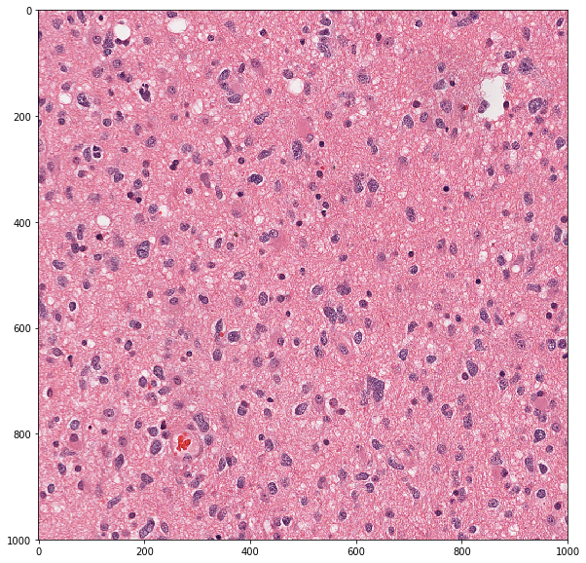
[12]:
pos = 1000
tile_info = ts.getSingleTile(
tile_size=dict(width=1000, height=1000),
scale=dict(magnification=20),
tile_position=pos
)
plt.imshow(tile_info['tile'])

